Slide 1
Early and Latter Rain
It is Coming!

Slide 2
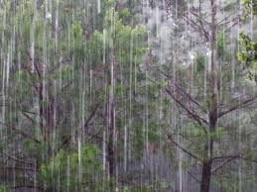
Predicted
“Be glad then, ye children of Zion, and rejoice in the LORD your God: for he hath given you the former rain moderately, and he will cause to come down for you the rain, the former rain, and the latter rain in the first month.” Joel 2:23

Slide 3
It Fell!
“And when the day of Pentecost was fully come, they were all with one accord in one place. And suddenly there came a sound from heaven as of a rushing mighty wind, and it filled all the house where they were sitting. And there appeared unto them cloven tongues like as of fire, and it sat upon each of them. And they were all filled with the Holy Ghost, and began to speak with other tongues, as the Spirit gave them utterance. And there were dwelling at Jerusalem Jews, devout men, out of every nation under heaven. Now when this was noised abroad, the multitude came together, and were confounded, because that every man heard them speak in his own language. And they were all amazed and marvelled, saying one to another, Behold, are not all these which speak Galilaeans? And how hear we every man in our own tongue, wherein we were born? Parthians, and Medes, and Elamites, and the dwellers in Mesopotamia, and in Judaea, and Cappadocia, in Pontus, and Asia, Phrygia, and Pamphylia, in Egypt, and in the parts of Libya about Cyrene, and strangers of Rome, Jews and proselytes, Cretes and Arabians, we do hear them speak in our tongues the wonderful works of God.” Acts. 2:1-11

Slide 4
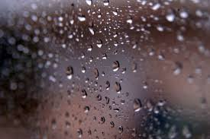
“It is true that in the time of the end, when God's work in the earth is closing, the earnest efforts put forth by consecrated believers under the guidance of the Holy Spirit are to be accompanied by special tokens of divine favor. Under the figure of the early and the latter rain, that falls in Eastern lands at seedtime and harvest, the Hebrew prophets foretold the bestowal of spiritual grace in extraordinary measure upon God's church. The outpouring of the Spirit in the days of the apostles was the beginning of the early, or former, rain, and glorious was the result. To the end of time the presence of the Spirit is to abide with the true church.” Acts of the Apostles, pgs. 54,55

Slide 5
The Purpose of the Early Rain Today!
“I was shown that if God's people make no efforts on their part, but wait for the refreshing to come upon them and remove their wrongs and correct their errors; if they depend upon that to cleanse them from filthiness of the flesh and spirit, and fit them to engage in the loud cry of the third angel, they will be found wanting. The refreshing or power of God comes only on those who have prepared themselves for it by doing the work which God bids them, namely, cleansing themselves from all filthiness of the flesh and spirit, perfecting holiness in the fear of God.” (1T 619)

Slide 6
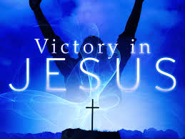
Victory, Overcoming Sin, NOW!
“Seeing ye have purified your souls in obeying the truth through the Spirit unto unfeigned love of the brethren, see that ye love one another with a pure heart fervently:” 1 Peter 1:23
“In all who submit to His power the Spirit of God will consume sin. But if men cling to sin, they become identified with it.” DA, pg. 107

Slide 7
Cleansed!
“Many have in a great measure failed to receive the former rain. They have not obtained all the benefits that God has thus provided for them. They expect that the lack will be supplied by the latter rain. When the richest abundance of grace shall be bestowed, they intend to open their hearts to receive it. They are making a terrible mistake. The work that God has begun in the human heart in giving his light and knowledge, must be continually going forward. Every individual must realize his own necessity. The heart must be emptied of every defilement, and cleansed for the indwelling of the Spirit. It was by the confession and forsaking of sin, by earnest prayer and consecration of themselves to God, that the early disciples prepared for the outpouring of the Holy Spirit on the day of Pentecost. The same work, only in greater degree, must be done now. Then the human agent had only to ask for the blessing, and wait for the Lord to perfect the work concerning him. It is God who began the work, and he will finish his work, making man complete in Jesus Christ. But there must be no neglect of the grace represented by the former rain. Only those who are living up to the light they have, will receive greater light. Unless we are daily advancing in the exemplification of the active Christian virtues, we shall not recognize the manifestations of the Holy Spirit in the latter rain.” RH, March 2, 1897

Slide 8
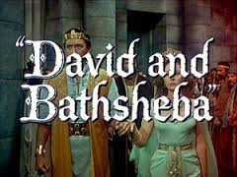
That Doctrine is as Bad as…….
An Elder years ago in an affluent Adventist church in Northern California visited our church one Sabbath in 1991…………….

Slide 9
Purposes of the Early Rain
1. cleansing themselves from all filthiness of the flesh and spirit, perfecting holiness in the fear of God.
2. confessing and forsaking of sin.
3. The heart must be emptied of every defilement, and cleansed for the indwelling of the Spirit.
These are the purposes of the Early Rain, without which no one will receive the Latter Rain.

Slide 10
I’ll Get Ready Later!
I’ll get ready at the time of the Sunday Law. The Lord will purify me at that time. A few secret sins do not matter. The Lord can miraculously change me at that time!

Slide 11
Get Ready, Get Ready!
“The Latter Rain is coming on those that are pure… None receive the latter rain but those who do all they can. Christ will help us. All could be overcomers by the grace of God through the blood of Jesus. All heaven is interested in this work. Angels are interested. God can make them a host against their enemies. Ye give up too quick. The arm of God is mighty. Satan works in different ways to steal the mind off from God. Victory! Victory! We must have it over every wrong. A solemn sinking into God. Get Ready. Set thine house in order.” GC Bulletin, 1893, pg. 179

Slide 12
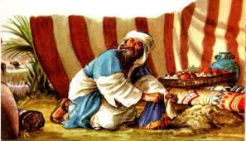
He Did Not Prepare!
He saw the soldiers come back defeated and some of the dead. He watched Joshua and the elders laying flat in the dirt for much of the day. He saw the depressed condition of the people of God. He saw SDAdventism in a frightful condition; a sitting duck before its enemies. Then he heard the call………………

Slide 13
Sin in the Camp
“Up, sanctify the people, and say, Sanctify yourselves against to morrow: for thus saith the LORD God of Israel, There is an accursed thing in the midst of thee, O Israel: thou canst not stand before thine enemies, until ye take away the accursed thing from among you.” Joshua 7:13
The call to confess and put away sin was given. He heard the dreadful news that some cursed thing was in the midst of the church. He knew that that meant him. What would he do about it?

Slide 14
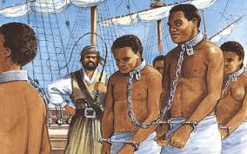
The Opportunity Beckoned
Someone has pornographic dvd’s in their home and is coveting them! Someone is holding on to pots of gold and silver while the work of God suffers! Someone is coveting things that Heaven doesn’t approve! The call to forsake these sins was heard! The message rang through the encampment!
He would not budge! ‘Let not sin reign in your mortal bodies, in the lusts thereof…’ Romans 6:12

Slide 15
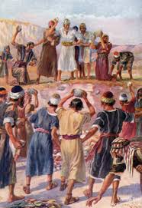
Time for Reflection
Sin is destroying you today. It is destroying your family, and one day your family will die because of your sins. Will you submit it to Christ today? The consequences are the same today as they were in the days of Achan!

Slide 16
Lips Sealed!
“Achan acknowledged his guilt, but when it was too late for the confession to benefit himself. He had seen the armies of Israel return from Ai defeated and disheartened; yet he did not come forward and confess his sin. He had seen Joshua and the elders of Israel bowed to the earth in grief too great for words. Had he then made confession, he would have given some proof of true penitence; but he still kept silence. He had listened to the proclamation that a great crime had been committed, and had even heard its character definitely stated. But his lips were sealed.” PP, pg. 497, 498

Slide 17
He is Doomed!
“So Joshua rose up early in the morning, and brought Israel by their tribes; and the tribe of Judah was taken: And he brought the family of Judah; and he took the family of the Zarhites: and he brought the family of the Zarhites man by man; and Zabdi was taken: And he brought his household man by man; and Achan, the son of Carmi, the son of Zabdi, the son of Zerah, of the tribe of Judah, was taken. And Joshua said unto Achan, My son, give, I pray thee, glory to the LORD God of Israel, and make confession unto him; and tell me now what thou hast done; hide it not from me. And Achan answered Joshua, and said, Indeed I have sinned against the LORD God of Israel, and thus and thus have I done: When I saw among the spoils a goodly Babylonish garment, and two hundred shekels of silver, and a wedge of gold of fifty shekels weight, then I coveted them, and took them; and, behold, they are hid in the earth in the midst of my tent, and the silver under it. So Joshua sent messengers, and they ran unto the tent; and, behold, it was hid in his tent, and the silver under it.” Joshua 7:16-22

Slide 18
The Great Test!
“The Lord has shown me clearly that the image of the beast will be formed before probation closes; for it is to be the great test for the people of God, by which their eternal destiny will be decided…(Rev. 13:11-17 quoted)
“This is the test that the people of God must have before they are sealed. All who prove their loyalty to God by observing His law, and refusing to accept a spurious sabbath, will rank under the banner of the Lord God Jehovah, and will receive the seal of the living God. Those who yield the truth of heavenly origin and accept the Sunday sabbath, will receive the mark of the beast.” (Letter 11, 1890) quoted in 7A Bible Commentary, pg. 976

Slide 19
Sunday Law Judgment
In quick succession the judgments of God will follow one another--fire and flood and earthquake, with war and bloodshed.
Oh, that the people might know the time of their visitation! There are many who have not yet heard the testing truth for this time. There are many with whom the Spirit of God is striving. The time of God's destructive judgments is the time of mercy for those who have had no opportunity to learn what is truth. Tenderly will the Lord look upon them. His heart of mercy is touched; His hand is still stretched out to save, while the door is closed to those who would not enter.” 9 Testimonies, pg. 97

Slide 20
Judgments On Adventism First!
1. Judgment on Adventism at the Sunday Law.
2. Those Adventists , who are sealed, are given the Latter Rain and give the Loud Cry.
3. Those Adventists, who are holding on to sin, will get the mark of the beast and will violently oppose the people of God!
4. As the Sunday Law draws near, it is high time that we awaken out of sleep before it is too late!

Slide 21
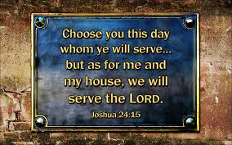
Choose Ye This Day!
“And if it seem evil unto you to serve the Lord, choose you this day whom ye will serve; whether the gods which your fathers served that were on the other side of the flood, or the gods of the Amorites, in whose land ye dwell: but as for me and my house, we will serve the Lord.”

