Slide 1
Everyone Knows…
Yet Somehow Forgotten…

Slide 2
A Quick Review….
The Papacy is the Antichrist because:
1. Came out of Rome (Dan. 7:7, 19-20, 23-24)
2. Persecuted saints [burned Reformers, torture] (Dan. 7:21, 25; 8:10; Rev. 13:7)
3. Has kingly temporal power [crusades] (Dan. 7:24)
4. Different than other temporal kings of the Roman Empire [claims spiritual authority](Dan. 7:24; 2:43)
5. Subdues three kings/kingdoms [Ostrogoths, Vandals, Heruli] (Dan. 7:24)
6. Speaks great words against God [blasphemies, claiming to be God abolishing sins] (Dan. 7:25)
7. Changes God’s Laws and Times [Sabbath-Sunday, Catechism Commandments remove 2nd and shorten] (Dan. 7:25)
8. Time of complete reign = 1260 days/3-1/2 years/42 months (Dan. 7:25, 12:7; Rev. 11:2, 11:3, 12:6, 12:14, 13:5)
9. Became exceedingly great/magnifies himself [greater than Alexander, Greece or Persia] (Dan. 8:9, 11; 2 Thess. 2:4)
10. Sanctuary in heaven is cast down [instead of looking to a heavenly ministration, there is a “new” worldly one] (Dan. 8:11)

Slide 3
11. Cast down truth [holds tradition and Popes as higher authority than Scripture] (Dan. 8:12)
12. Practiced falsehoods and prospered still [paganism integration] (Dan. 8:12)
13. Revelation 13 beast described similar to terrible beast of Daniel 7 [attributes of all former beasts of Daniel] (Rev. 13:1)
14. Has power, seat, and great authority [ex cathedra] (Rev. 13:2)
15. Wounded to death, but healed [1798] (Rev. 13:3)
16. World wonders after this beast [adoration, interest] (Rev. 13:3)
17. Blasphemes God’s name, tabernacle, and dwellers of heaven (Rev. 13:6)
18. Comes out of highly populated area or “sea” (Rev. 13:1, 17:15)
19. Rose to power when the church “fell away” from truth (2 Thess. 2:3)
20. Sits in the Temple of God [Church] showing himself that he is God (2 Thess. 2:4)
21. Rules until the Lord destroys him with the brightness of His coming (2 Thess. 2:8; Dan. 7:26)

Slide 4
21. Description of a harlot [false/unfaithful church], which rides/controls the beast (Rev. 17:1, 3)
22. Kings and Merchants are in league with this power (Rev. 17:2; 18:3, 9, 11)
[because of this there must be a conspiracy and therefore widespread deception]
23. Merchants made rich by her [Rothschilds] (Rev. 18:15)
24. Blood of all slain upon the earth (Rev. 18:24)
25. Controls the world from obscure vantage point/wilderness [Illuminati, Freemasons, Knights of Malta, Rothschilds, Eastern Star] (Rev. 17:3)
26. Arrayed in purple and scarlet [cardinals/bishops or sin/royalty-no virtue] (Rev. 17:4)
27. Mother church of all false churches (Rev. 17:5)
28. Sits on seven mountains [Rome sits on 7 hills] (Rev. 17:9)
29. Extremely ecumenical (Rev. 17:12-13)
30. The “woman” is also a city [Rome] (Rev. 17:18)

Slide 5
Starting at home…
Throughout Christendom, Protestantism was menaced by formidable foes. The first triumphs of the Reformation past, Rome summoned new forces, hoping to accomplish its destruction. At this time the order of the Jesuits was created, the most cruel, unscrupulous, and powerful of all the champions of popery. Cut off from earthly ties and human interests, dead to the claims of natural affection, reason and conscience wholly silenced, they knew no rule, no tie, but that of their order, and no duty but to extend its power.The gospel of Christ had enabled its adherents to meet danger and endure suffering, undismayed by cold, hunger, toil, and poverty, to uphold the banner of truth in face of the rack, the dungeon, and the stake. To combat these forces, Jesuitism inspired its followers with a fanaticism that enabled them to endure like dangers, and to oppose to the power of truth all the weapons of deception. There was no crime too great for them to commit, no deception too base for them to practice, no disguise too difficult for them to assume. Vowed to perpetual poverty and humility, it was their studied aim to secure wealth and power, to be devoted to the overthrow of Protestantism, and the re-establishment of the papal supremacy.

Slide 6
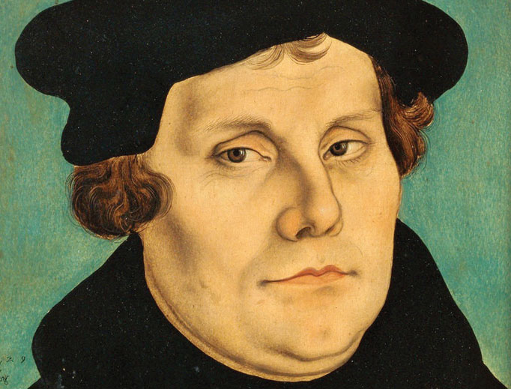
The Religionists and Theologians
The Lutheran Belief:
"nothing else than the kingdom of Babylon and of very Antichrist. For who is the man of sin and the son of perdition, but he who by his teaching and his ordinances increases the sin and perdition of souls in the church; while he yet sits in the church as if he were God? All these conditions have now for many ages been fulfilled by the papal tyranny." (Martin Luther, First Principles, pp. 196-197)
Martin Luther (1483-1546)

Slide 7
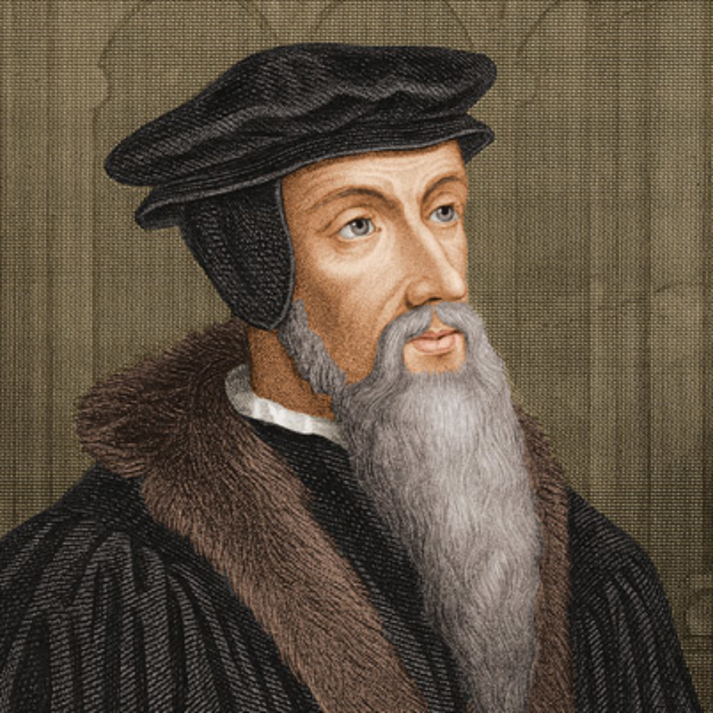
The Calvinists
But to conclude this point in a few words: I deny that See to be Apostolical, wherein nought is seen but a shocking apostacy — I deny him to be the vicar of Christ, who, in furiously persecuting the gospel, demonstrates by his conduct that he is Antichrist — I deny him to be the successor of Peter, who is doing his utmost to demolish every edifice that Peter built — and I deny him to be the head of the Church, who by his tyranny lacerates and dismembers the Church, after dissevering her from Christ, her true and only Head.—Calvin, “Tracts and Letters” vol 1, 219-220.
John Calvin (1509-1564)

Slide 8
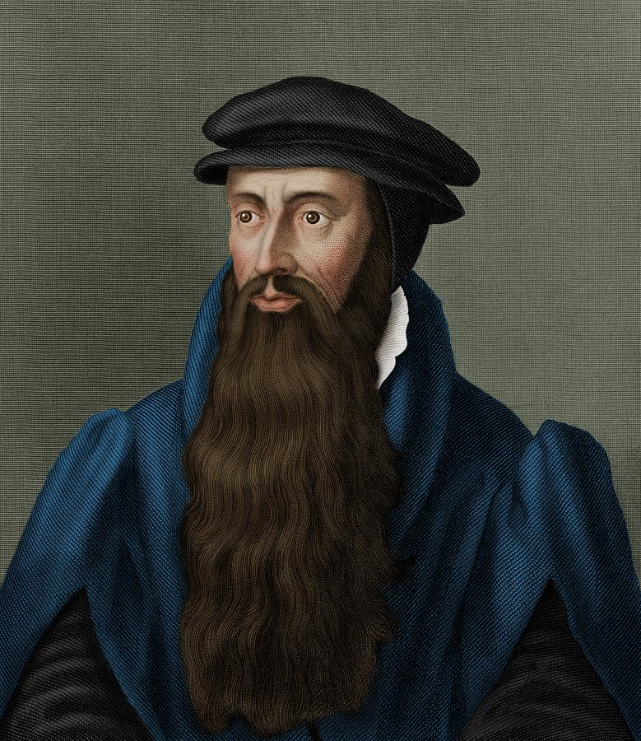
The Presbyterians
Yea, to speak it in plain words; lest that we submit ourselves to Satan, thinking that we submit ourselves to Jesus Christ, for, as for your Roman kirk, as it is now corrupted, and the authority thereof, whereon stands the hope of your victory, I no more doubt but that it is the synagogue of Satan, and the head thereof, called the pope, to be that man of sin, of whom the apostle speaks." (John Knox, The History of the Reformation of Religion in Scotland, p.65)
John Knox (1505-1572

Slide 9
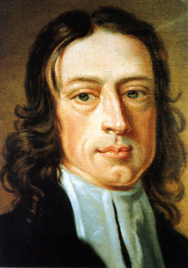
The Methodists
The man of sin, the son of perdition– …in many respects, the Pope has an indisputable claim to those titles. He is, in an emphatical sense, the man of sin, as he increases all manner of sin above measure. And he is, too, properly styled, the son of perdition, as he has caused the death of numberless multitudes, both of his opposers and followers, destroyed innumerable souls, and will himself perish everlastingly. He it is that opposes himself to the emperor, once his rightful sovereign; and that exalts himself above all that is called God, or that is worshipped, commanding angels, and putting kings under his feet, both of whom are called gods in scripture; claiming the highest power, the highest honor; suffering himself, not once only, to be styled God or vice-god. Indeed no less is implied in his ordinary title, “Most Holy Lord,” or, “Most Holy Father.” So that he sits enthroned in the temple of God – Mentioned Rev. 11:1. Declaring himself that he is God, claiming the prerogatives which belong to God alone.—Explanatory Notes Upon the New Testament, p. 216)
John Wesley (1703-1791)

Slide 10
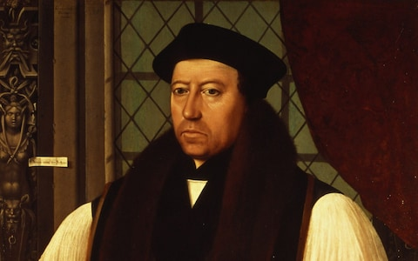
Anglicans
"Whereof it followeth Rome to be the seat of Antichrist, and the pope to be very antichrist himself. I could prove the same by many other scriptures, old writers, and strong reasons." (Works by Cranmer, vol.1, pp.6-7)
Thomas Cranmer (1489-1556)

Slide 11
Baptists
“Popery is contrary to Christ’s Gospel, and is the Antichrist, and we ought to pray against it. It should be the daily prayer of every believer that Antichrist might be hurled like a millstone into the flood and for Christ, because it wounds Christ, because it robs Christ of His glory, because it puts sacramental efficacy in the place of His atonement, and lifts a piece of bread into the place of the Saviour, and a few drops of water into the place of the Holy Ghost, and puts a mere fallible man like ourselves up as the vicar of Christ on earth; if we pray against it, because it is against Him, we shall love the persons though we hate their errors: we shall love their souls though we loath and detest their dogmas”—Spurgeon, quoted in “All Roads Lead to Rome”, 1991, p. 205.
Charles Spurgeon (1834-1892)

Slide 12
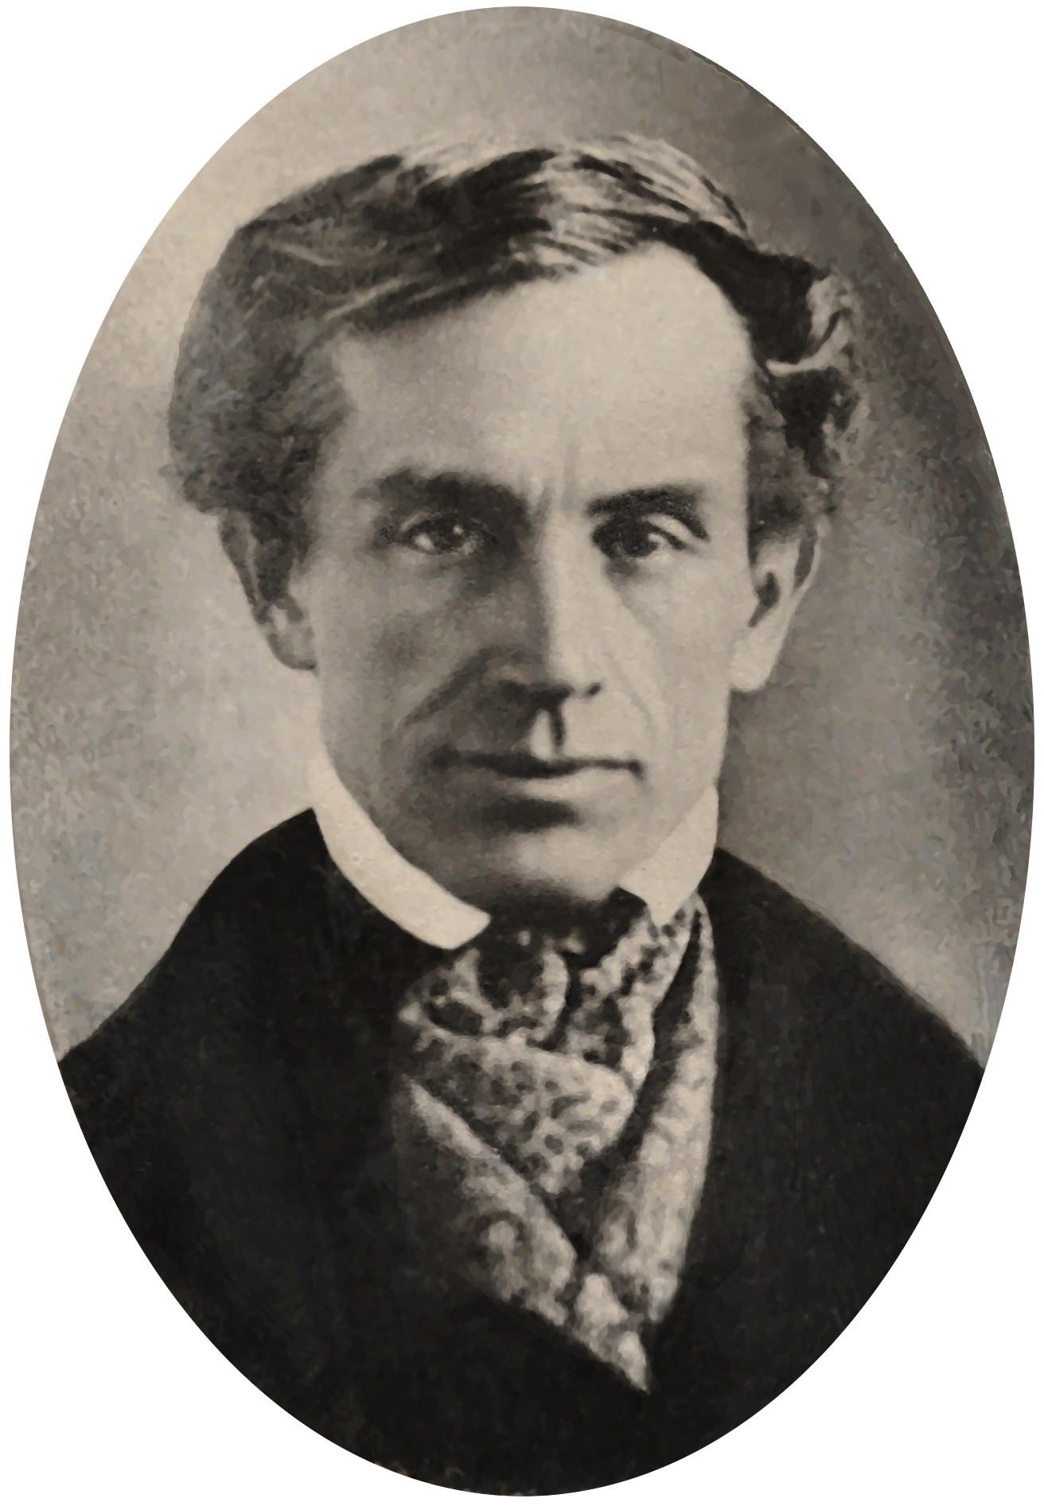
The Scholars…
“But when he proclaims to the world that all power, temporal as well as spiritual, exists the Pope, (denying, of course, the fundamental doctrine of republicanism;) that liberty of conscience is a ‘raving’ and ‘most pestilential error;’ that ‘he execrates and detests the liberty of the press;’ when his intolerant creed asserts that faith is to be kept with heretics (all being heretics, in the creed of a Catholic, who are not Catholics,) and many other palpable anti-republican, as well as immoral doctrines, he has then blended with his creed political tenets that vitally affect the very existence of our government”—Morse, 1841, “Foreign Conspiriacy Against the Liberties of the United States, p. 80
Samuel Morse (1791-1872)

Slide 13
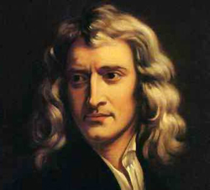
Isaac Newton
By its eyes it was a Seer; and by its mouth speaking great things and changing times and laws, it was a Prophet as well as a King. And such a Seer, a Prophet and a King, is the Church of Rome. . . With his mouth he gives laws to kings and nations as an Oracle; and pretends to Infallibility, and that his dictates are binding to the whole world—Newton, “Observations on the Prophecies of Daniel and the Apocalypse of St. John”, p. 49
Sir Isaac Newton 1643-1727

Slide 14
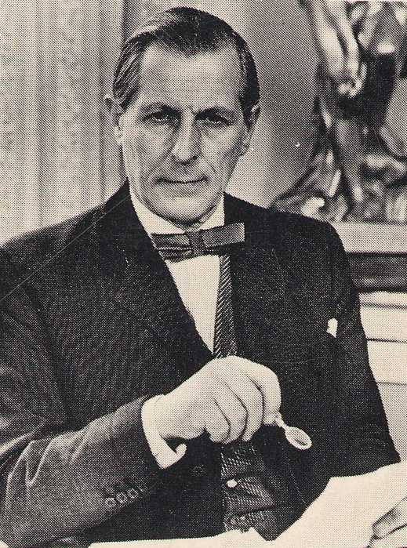
THE VATICAN'S HOLOCAUST is not a misnomer, an accusation, and even less a speculation. It is an historical fact. Rabid nationalism and religious dogmatism were its two main ingredients. During the existence of Croatia as an independent Catholic State, over 700,000 men, women and children perished. Many were executed, tortured, died of starvation, buried alive, or were burned to death. Hundreds were forced to become Catholic. Catholic padres ran concentration camps; Catholic priests were officers of the military corps which committed such atrocities.—The Vatican’s Holocaust, 1987, p. vii

Slide 15
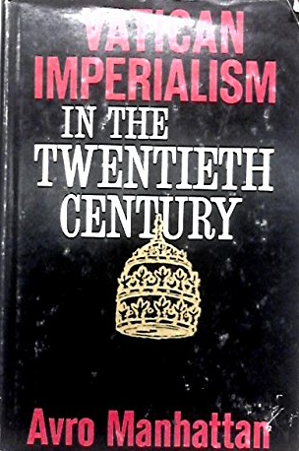
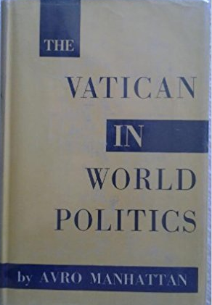
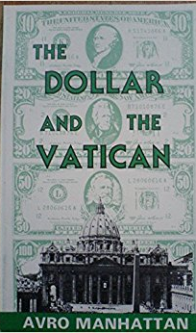
Avro Manhattan

Slide 16
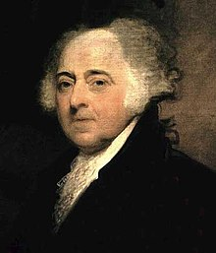
Leaders…
John Adams: “My history of the Jesuits is not eloquently written, but it is supported by unquestionable authorities, [and] is very particular and very horrible. Their [the Jesuit Order’s] restoration [in 1814 by Pope Pius VII] is indeed a step toward darkness, cruelty, despotism, [and] death. … I do not like the appearance of the Jesuits. If ever there was a body of men who merited eternal damnation on earth and in hell, it is this Society of Loyola.“—John Adams To Thomas Jefferson, “An Inquiry Into the Assassination of Abraham Lincoln,” November 4, 1816
John Adams, 2nd President of the United States from 1789-1797

Slide 17
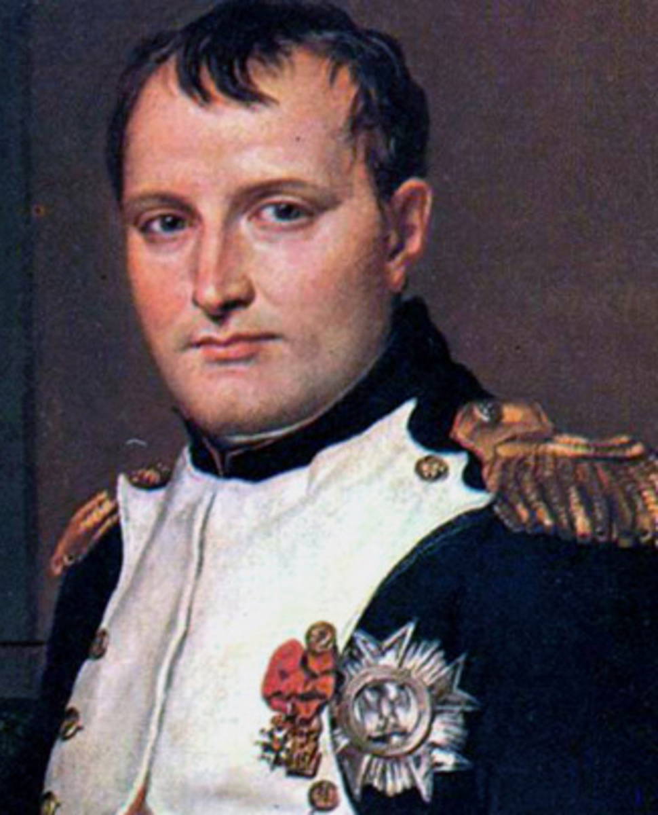
Napoleon Got It!!
The Jesuits are a military organization, not a religious order. Their chief is a general of an army, not the mere father abbot of a monastery. And the aim of this organization is: POWER. Power in its most despotic exercise. Absolute power, universal power, power to control the world by the volition of a single man. Jesuitism is the most absolute of despotisms; and at the same time the greatest and most enormous of abuses…. The general of the Jesuits insists on being master, sovereign, over the sovereign. Wherever the Jesuits are admitted they will be masters, cost what it may. Their society is by nature dictatorial, and therefore it is the irreconcilable enemy of all constituted authority. Every act, every crime, however atrocious, is a meritorious work, if committed for the interest of the Society of Jesuits, or by the order of the general. — General Montholon, Memorial of the Captivity of Napoleon at St. Helena, pp. 62, 174

Slide 18
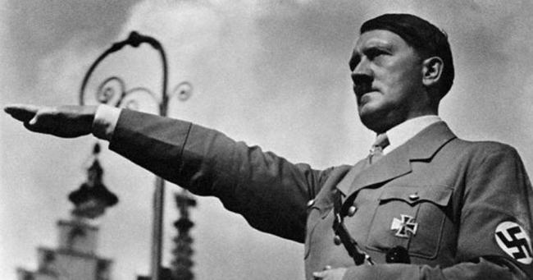
Hitler
Above all I have learned from the Jesuits. And so did Lenin too, far as I recall. The world has never known anything quite so splendid as the hierarchical structure of the Catholic Church. There were quite a few things I simply appropriated from the Jesuits for the use of the Party.—Barthel, “The Jesuits: History and Legend of the Society of Jesus”, 1984, p. 266

Slide 19
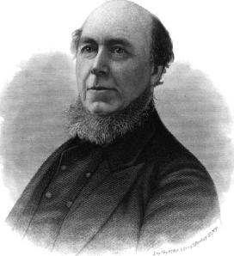
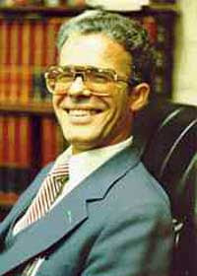
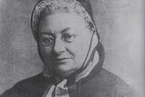
The Cloud of First Hand Witnesses….
Ex-Jesuit Priest Alberto Rivera
Ex-Catholic Priest Charles Chiniquy
Ex-Jesuit Boyd Barret
Ex-Nun M.F. Cusak
Ex-Priest Jeremiah Crowley

Slide 20
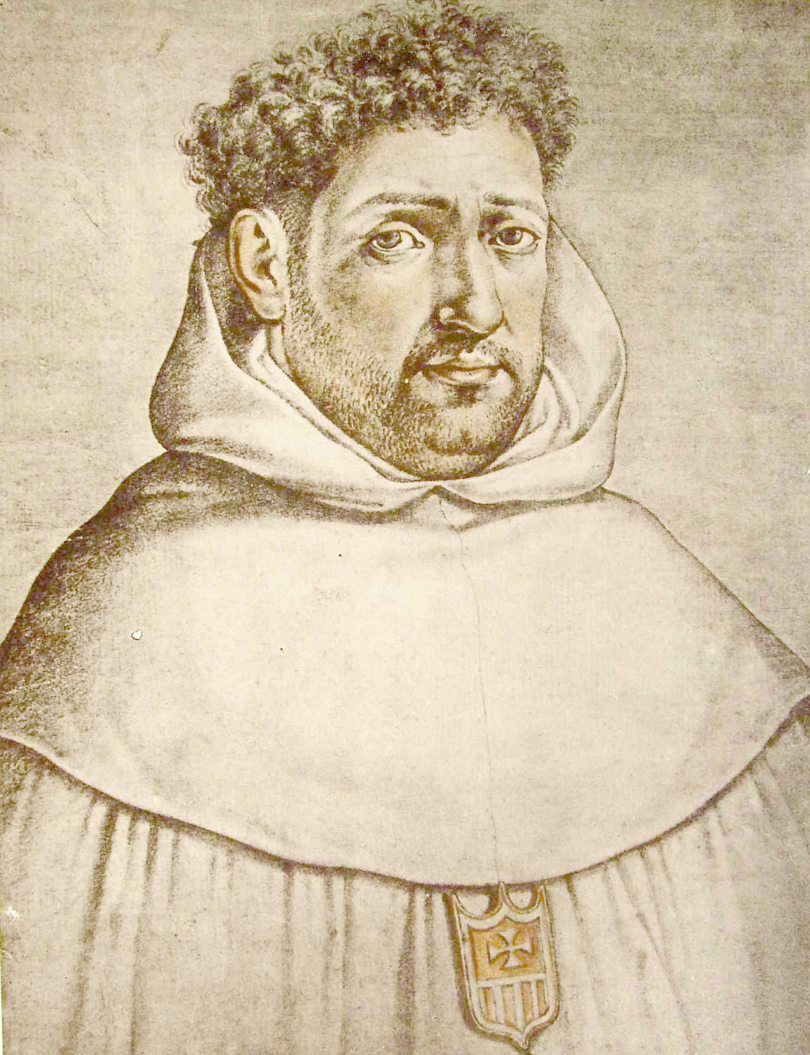
What Happened???
Francisco Ribera (1537-1591), a Jesuit priest and doctor of theology from Spain, studied diligently the prophecies concerning the Antichrist. In response to Luther and other Reformers claims that the Papacy was the Antichrist, Ribera instead reinterpreted the prophecies to look for a future figure at the end of times as the true Antichrist and one that would originate from outside the church.
(George Eldon Ladd, The Blessed Hope. A Biblical Study of the Second Advent and Rapture (Grand Rapids, Michigan: Eerdmans, 1956): 37-38.)

Slide 21
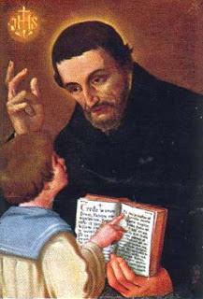
Another Option….
Luis de Alcasar (1554-1613) was a Jesuit scholar who also studied and reinterpreted the historical prophecies of Daniel and Revelation, putting them in the past prior to the decline of the Roman Empire. In this scenario, “Nero” was the Antichrist and the Catholic Church was the triumphant “New Jerusalem” which vanquished both spiritual and temporal enemies. This has been expanded to include Antiochus IV Epiphanes
(Vestigatio arcani sensus in Apocalypsi (1614))

Slide 22
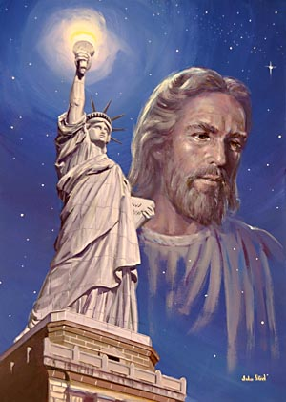
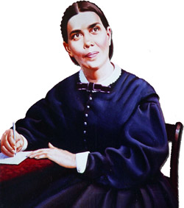
Someone Knew This Would Happen
Romanism is now regarded by Protestants with far greater favor than in former years. In those countries where Catholicism is not in the ascendancy, and the papists are taking a conciliatory course in order to gain influence, there is an increasing indifference concerning the doctrines that separate the reformed churches from the papal hierarchy, GC p. 563

