Slide 1
Tithing, pt.5 ‘Bible Giants’

Slide 2
Spirit of Prophecy is Very Clear!
The Spirit of Prophecy is full of examples of people who bypassed denominational-regular lines and supported self supporting ministries. Foremost among these individuals was Ellen White. Beginning in 1868 with the Hannah More debacle, Ellen White determined to use tithe/offerings to support those who were not working in regular lines. Not only did she use her monies this way, but she used the means of others that were given to her.
With the work in the South and the letter to Colorado Conference President G. F. Watson, Ellen White made it very clear that her son Edson; Sutherland and Magan at Madison, and other black and white ministers, who were not receiving support from the denomination, were worthy of tithes/offerings and that it was right to bypass the denominational lines to support them!!!!

Slide 3
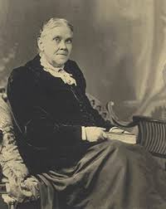
Was She A Rebel?
The fact that Ellen White bypassed the church to support self-supporting workers for much of her adult life forces a question: was she a rebel or did she see from other sources that this was indeed right and good? Are there any examples in the Bible of individuals that had to work outside the regular lines of Judaism to do the work of God that was not being done in the church at that time?

Slide 4
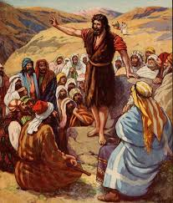
There Were Others
“In the natural order of things, the son of Zacharias would have been educated for the priesthood. But the training of the rabbinical schools would have unfitted him for his work. God did not send him to the teachers of theology to learn how to interpret the Scriptures. He called him to the desert, that he might learn of nature and nature's God. It was a lonely region where he found his home, in the midst of barren hills, wild ravines, and rocky caves. But it was his choice to forgo the enjoyments and luxuries of life for the stern discipline of the wilderness. Here his surroundings were favorable to habits of simplicity and self-denial. Uninterrupted by the clamor of the world, he could here study the lessons of nature, of revelation, and of Providence.” DA, pg. 101

Slide 5
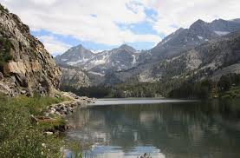
No Choice!!!
What choice did John the Baptist have? Sure, his dad, was a denominational employee and he could have been trained for the priesthood, but that would have made him unfit for the work God gave him to do.
Was that why Ellen White pushed Sutherland and Magan to start their own self supporting school because denominational work was so corrupted? The answer is as clear as a pane of glass!

Slide 6
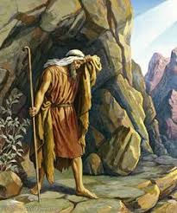
So, the Elijah who was raised up to prepare the world for Jesus’ first coming was outside of the organization and Elijah number 3, Ellen White, encouraged people to work outside of the confines of the church because of apostasy and kingly power and control. Well, what about the first Elijah, the Tishbite from Gilead? Was he part of the organization in his day or was he self supporting?

Slide 7
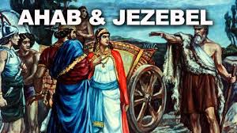
He Did Not Eat at Headquarters
“And Elijah the Tishbite, who was of the inhabitants of Gilead, said unto Ahab, As the LORD God of Israel liveth, before whom I stand, there shall not be dew nor rain these years, but according to my word.” 1 Kings 17:1
“Now therefore send, and gather to me all Israel unto mount Carmel, and the prophets of Baal four hundred and fifty, and the prophets of the groves four hundred, which eat at Jezebel's table.” 1 Kings 18:19

Slide 8
God Called Him!
“Far removed from any city of renown, and occupying no high station in life, Elijah the Tishbite nevertheless entered upon his mission confident in God's purpose to prepare the way before him and to give him abundant success…Unbelief was fast separating the chosen nation from the Source of their strength. Viewing this apostasy from his mountain retreat, Elijah was overwhelmed with sorrow…” PK, pgs. 119,120
Elijah was far, far away from the center of ancient Adventism. He held no position in the church. Jezebel was paying the pastors and officials that bowed to her whims. God trained and led in Elijah’s pursuit of truth and his willingness to stand for it.

Slide 9
Schools of the Prophets
“Fathers and mothers in Israel became indifferent to their obligation to God, indifferent to their obligation to their children. Through unfaithfulness in the home, and idolatrous influences without, many of the Hebrew youth received an education differing widely from that which God had planned for them. They learned the ways of the heathen. To meet this growing evil, God provided other agencies as an aid to parents in the work of education. From the earliest times, prophets had been recognized as teachers divinely appointed. In the highest sense the prophet was one who spoke by direct inspiration, communicating to the people the messages he had received from God. But the name was given also to those who, though not so directly inspired, were divinely called to instruct the people in the works and ways of God. For the training of such a class of teachers, Samuel, by the Lord's direction, established the schools of the prophets.” Education, pgs. 46,47

Slide 10
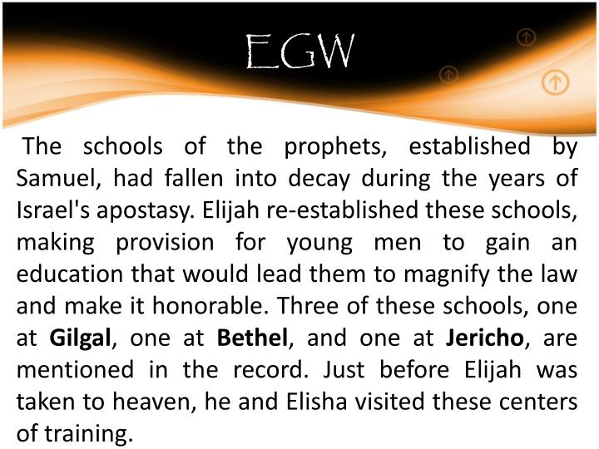
“So David fled, and escaped, and came to Samuel to Ramah, and told him all that Saul had done to him. And he and Samuel went and dwelt in Naioth. And it was told Saul, saying, Behold, David is at Naioth in Ramah. And Saul sent messengers to take David: and when they saw the company of the prophets prophesying, and Samuel standing as appointed over them, the Spirit of God was upon the messengers of Saul, and they also prophesied. And when it was told Saul, he sent other messengers, and they prophesied likewise. And Saul sent messengers again the third time, and they prophesied also.”
1 Samuel 19:18-21

Slide 11
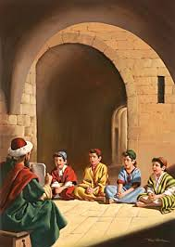
In ancient Israel, the children were educated at home. However, thru interaction with the heathen, the Israelites became corrupted and parents were fast losing their grasp on properly educating their children. In order to develop a solid educational program in Israel, the Lord had Samuel create a school whereby young men could be trained in proper education and could then establish schools throughout Israel. This would be a blessing to the parents and would provide a safeguard for the children to be trained in the ways of God.

Slide 12
Schools of the Prophets
“These schools were intended to serve as a barrier against the wide-spreading corruption, to provide for the mental and spiritual welfare of the youth, and to promote the prosperity of the nation by furnishing it with men qualified to act in the fear of God as leaders and counselors. To this end, Samuel gathered companies of young men who were pious, intelligent, and studious. These were called the sons of the prophets. As they studied the word and the works of God, His life-giving power quickened the energies of mind and soul, and the students received wisdom from above. The instructors were not only versed in divine truth, but had themselves enjoyed communion with God, and had received the special endowment of His Spirit. They had the respect and confidence of the people, both for learning and for piety. In Samuel's day there were two of these schools—one at Ramah, the home of the prophet, and the other at Kirjath-jearim. In later times others were established.” Education, pg. 47

Slide 13
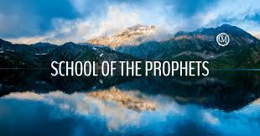
“The pupils of these schools sustained themselves by their own labor in tilling the soil or in some mechanical employment. In Israel this was not thought strange or degrading; indeed, it was regarded as a sin to allow children to grow up in ignorance of useful labor. Every youth, whether his parents were rich or poor, was taught some trade. Even though he was to be educated for holy office, a knowledge of practical life was regarded as essential to the greatest usefulness. Many, also, of the teachers supported themselves by manual labor.” Education , pg. 48

Slide 14
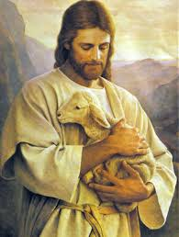
The Greatest Example of All
Did most of His preaching outside the synagogue. (Matthew 5:1,2)
Had a treasurer that held donations to His ministry. (John 12:6)
Jesus did not understand the storehouse to be the denomination either!

Slide 15
Bypassed Denominational Schools
“From the earliest times the faithful in Israel had given much care to the education of the youth.” DA, pg. 69
“In the days of Christ the town or city that did not provide for the religious instruction of the young was regarded as under the curse of God. Yet the teaching had become formal. Tradition had in a great degree supplanted the Scriptures. True education would lead the youth to “seek the Lord, if haply they might feel after Him, and find Him.” Acts 17:27. But the Jewish teachers gave their attention to matters of ceremony. The mind was crowded with material that was worthless to the learner, and that would not be recognized in the higher school of the courts above. The experience which is obtained through a personal acceptance of God's word had no place in the educational system. Absorbed in the round of externals, the students found no quiet hours to spend with God. They did not hear His voice speaking to the heart. In their search after knowledge, they turned away from the Source of wisdom. The great essentials of the service of God were neglected. The principles of the law were obscured. That which was regarded as superior education was the greatest hindrance to real development. Under the training of the rabbis the powers of the youth were repressed. Their minds became cramped and narrow. The child Jesus did not receive instruction in the synagogue schools.” DA, pgs. 69,70

Slide 16
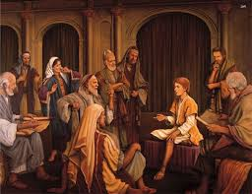
At The Passover-12 Years Old
“The rabbis knew that Jesus had not been instructed in their schools; yet His understanding of the prophecies far exceeded theirs. In this thoughtful Galilean boy they discerned great promise. They desired to gain Him as a student, that He might become a teacher in Israel. They wanted to have charge of His education, feeling that a mind so original must be brought under their molding.” DA, pg. 80

Slide 17
Days of Conflict
“From its earliest years the Jewish child was surrounded with the requirements of the rabbis. Rigid rules were prescribed for every act, down to the smallest details of life. Under the synagogue teachers the youth were instructed in the countless regulations which as orthodox Israelites they were expected to observe. But Jesus did not interest Himself in these matters. From childhood He acted independently of the rabbinical laws. The Scriptures of the Old Testament were His constant study, and the words, “Thus saith the Lord,” were ever upon His lips. As the condition of the people began to open to His mind, He saw that the requirements of society and the requirements of God were in constant collision. Men were departing from the word of God, and exalting theories of their own invention. They were observing traditional rites that possessed no virtue. Their service was a mere round of ceremonies; the sacred truths it was designed to teach were hidden from the worshipers. He saw that in their faithless services they found no peace. They did not know the freedom of spirit that would come to them by serving God in truth. Jesus had come to teach the meaning of the worship of God, and He could not sanction the mingling of human requirements with the divine precepts. He did not attack the precepts or practices of the learned teachers; but when reproved for His own simple habits, He presented the word of God in justification of His conduct. In every gentle and submissive way, Jesus tried to please those with whom He came in contact. Because He was so gentle and unobtrusive, the scribes and elders supposed that He would be easily influenced by their teaching. They urged Him to receive the maxims and traditions that had been handed down from the ancient rabbis, but He asked for their authority in Holy Writ.” DA, pgs. 84,85

Slide 18
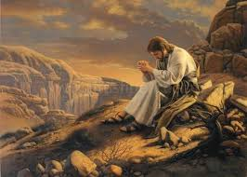
He Walked Alone
Jesus bypassed the denominational schools. He rejected the denominational authorities in spiritual things. When He began His ministry, would He be a leader in the church? He had never mingled the truth with error and He would not do it now. He had a self supporting ministry, outside denominational lines. He accepted tithes/offerings from those who felt so moved to support Him and had a treasurer who held the funds. Because of all this, “The kingdom He had come to establish was the opposite of that which the Jews desired. He who was the foundation of the ritual and economy of Israel would be looked upon as its enemy and destroyer.” DA, pg. 111

Slide 19
What Other Evidence is Needed?
The Savior of the world had a self supporting ministry. The denomination of His day would never employ Him/pay Him UNLESS He recognized their authority and obeyed their dictates. This was the issue all through His ministry and was crystallized toward the end of His ministry. “And when he was come into the temple, the chief priests and the elders of the people came unto him as he was teaching, and said, By what authority doest thou these things? and who gave thee this authority? And Jesus answered and said unto them, I also will ask you one thing, which if ye tell me, I in like wise will tell you by what authority I do these things. The baptism of John, whence was it? from heaven, or of men? And they reasoned with themselves, saying, If we shall say, From heaven; he will say unto us, Why did ye not then believe him? But if we shall say, Of men; we fear the people; for all hold John as a prophet. And they answered Jesus, and said, We cannot tell. And he said unto them, Neither tell I you by what authority I do these things.” Matthew 21:23-27

Slide 20
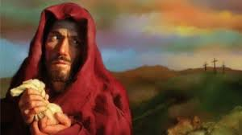
John 12 records, “Then took Mary a pound of ointment of spikenard, very costly, and anointed the feet of Jesus, and wiped his feet with her hair: and the house was filled with the odour of the ointment. Then saith one of his disciples, Judas Iscariot, Simon's son, which should betray him, Why was not this ointment sold for three hundred pence, and given to the poor? This he said, not that he cared for the poor; but because he was a thief, and had the bag, and bare what was put therein.” (verses 3-6) Clearly, Jesus had a treasurer, Judas, and he held the tithes/offerings given to the ministry. These bypassed the denominational coffers! The STOREHOUSE??????

