Slide 1
The Day of Atonement
The Day of Judgment

Slide 2
One of the Jewish Feasts
The fourth of five Jewish feasts was the Day of Atonement. It was coupled between the feast of trumpets and the feast of tabernacles. These three feasts made up the autumn feasts in the Jewish religious year.
The first of the three autumn feasts was the feast of trumpets. This one fell each year on the 7th month and the first day of the month.
“And the LORD spake unto Moses, saying, Speak unto the children of Israel, saying, In the seventh month, in the first day of the month, shall ye have a sabbath, a memorial of blowing of trumpets, a holy convocation. Ye shall do no servile work therein: but ye shall offer an offering made by fire unto the LORD.” Leviticus 23:23-25

Slide 3
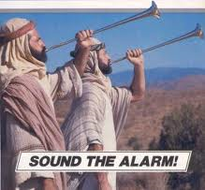
The purpose of the Feast of Trumpets
This feast took place 10 days before the Day of Atonement.
The Jewish people call this feast Rosh Hashanah, which literally means "Head of the Year," and it is observed as the start of the civil year (in contrast with the religious year which starts with Passover) on the Jewish calendar.
The Feast of Trumpets is so important in Jewish thinking that it stands alongside Yom Kippur ("Day of Atonement") to comprise what Judaism calls "the high holy days" on the Jewish religious calendar. It begins the "ten days of awe" before the Day of Atonement.
It was a warning blast to prepare for the Day of Atonement.

Slide 4
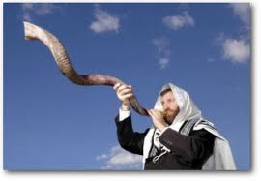
Distinct Horn
The trumpet referred to here was the shofar, a ram's horn. It was distinctive from the silver trumpets blown on the other new moons. Silver trumpets were sounded at the daily burnt offering and at the beginning of each new month (Numbers 10:10), but the shofar specifically was blown on the beginning of the month Tishri. It had a special sound to get ready for the Day of Atonement!!

Slide 5
Ten Days Before
The Feast of Trumpets was 10 days before the Day of Atonement. Due to the fact that this feast had end-time ramifications, like all the other feasts, this corresponds with the blowing trumpet of William Miller and others, calling the world to judgment in 1844. This feast of trumpets would correspond to the mid 1830’s and the warning message ‘to prepare to meet thy God.’

Slide 6
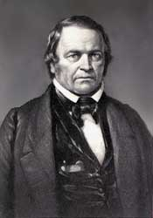
Prepare, Prepare,………….
“An upright, honest-hearted farmer, who had been led to doubt the divine authority of the Scriptures, yet who sincerely desired to know the truth, was the man specially chosen of God to lead out in the proclamation of Christ's second coming. Like many other reformers, William Miller had in early life battled with poverty and had thus learned the great lessons of energy and self-denial.” GC, pg. 317

Slide 7
The Day
“And the LORD spake unto Moses, saying, ‘Also on the tenth day of this seventh month there shall be a day of atonement; it shall be a holy convocation unto you; and ye shall afflict your souls, and offer an offering made by fire unto the LORD. And ye shall do no work in that same day: for it is a day of atonement, to make an atonement for you before the LORD your God. For whatsoever soul it be that shall not be afflicted in that same day, he shall be cut off from among his people. And whatsoever soul it be that doeth any work in that same day, the same soul will I destroy from among his people. Ye shall do no manner of work: it shall be a statute for ever throughout your generations in all your dwellings. It shall be unto you a sabbath of rest, and ye shall afflict your souls: in the ninth day of the month at even, from even unto even, shall ye celebrate your sabbath.” Leviticus 23:26-32

Slide 8
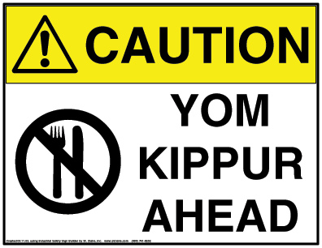
Yom Kippur
Yom Kippur , also known as the Day of Atonement, is the holiest day of the year for religious Jews. Its central themes are atonement and repentance. According to Jewish tradition, God inscribes each person's fate for the coming year into a book, the Book of Life, on Rosh Hashanah, and waits until Yom Kippur to "seal" the verdict. During the Days of Awe, a Jew tries to amend his or her behavior and seek forgiveness for wrongs done against God and against other human beings.

Slide 9
Day of Atonement=Day of Judgment
“For whatsoever soul it be that shall not be afflicted in that same day, he shall be cut off from among his people. And whatsoever soul it be that doeth any work in that same day, the same soul will I destroy from among his people.” Leviticus 23:29,30
Today, the ten days between Rosh Hashanah and Yom Kippur are days of repentance, when Jews express remorse for their sins through prayer and fasting. Yom Kippur is the final day of judgment, when each person's fate is sealed by God for the upcoming year.

Slide 10
Some Add ons!
Every Feast had a ceremonial sabbath connected to it. However, the ceremonial sabbath connected to the day of atonement was known as the ‘Sabbath of sabbaths.’
It calls it the Sabbath of Sabbaths and a day upon which one must afflict one's soul.
Leviticus 23:27 decrees that Yom Kippur is a strict day of rest.
Five additional prohibitions are traditionally observed, as detailed in the Jewish oral tradition:
No eating and drinking
No wearing of leather shoes
No bathing or washing
No anointing oneself with perfumes or lotions
No marital relations
Extremes

Slide 11
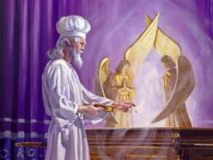
The Uniqueness of ‘The Day’
1. The only day the high priest went into the Most Holy Place.
2. The only day the high priest only wore his linen clothes instead of his daily attire/regalia.
3. The only that mediation was for cleansing and not for forgiveness.
4. The only day that sin was removed and not placed in the sanctuary.

Slide 12
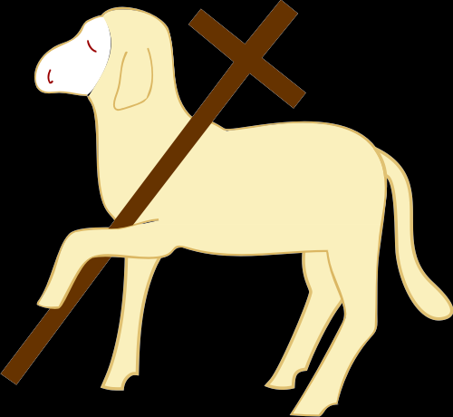
Why a Day of Atonement?
In the daily service, a person received forgiveness for their sins. Their sin was transferred to the sanctuary. They were forgiven; God’s entire government is built on this fact. When anyone comes to God thru the merits of Christ and asks for forgiveness, God’s character of justice must forgive. Why was it necessary for a Day of Atonement? Why was it necessary for a future day of Atonement/Judgment if a person had already been forgiven. The answer to this unlocks one of the most beautiful aspects of the entire salvation process/story!

Slide 13
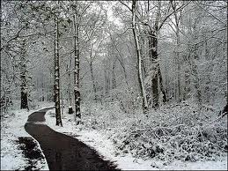
Some Wrong Answers
1. Legal forgiveness is all that matters.
2. Once you accept Christ, you are saved no matter what you may do.
3. Some are destined to be saved and others to be lost. If you are in the elect, don’t worry.
4. Because of Christ’s death, all mankind is saved.

Slide 14
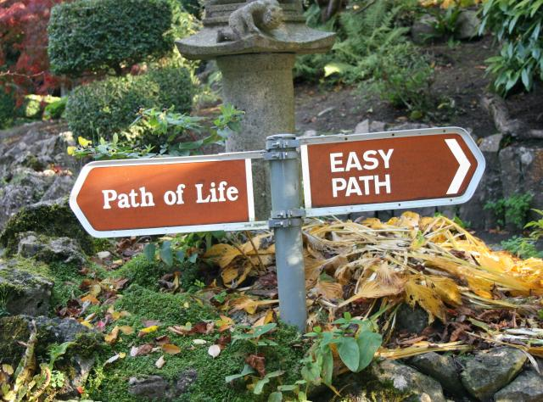
God Doesn’t Take away the power of Choice
Once we accept Christ’s forgiveness and are legally forgiven by God, we do not stop making choices. We do not become robots. We can choose to step away from the forgiveness of Christ and we can choose our own way. The Day of Atonement answers a simple question; is the person, who once embraced the forgiveness and love of God, still choosing to follow Christ when the Day of Atonement comes or at the end of his life? Am I still claiming Christ in my life when my name comes up in the judgment?

Slide 15
An Attorney Speaks
“But is that gift of life irrevocable, or is it contingent? To put it another way, by believing in Jesus does one thereby lose the freedom to change one’s mind? Evidently not; a great number of backsliders makes that point all too evident. The gift of life is bestowed with the condition of accepting Christ-with all that implies, including accepting Him as part of one’s own life. The relationship is more than a one-time contact; it is an ongoing connection, and to lose it brings tragic consequences…While belief in Christ calls into being the legal right to live forever, that gift cannot be granted irrevocably until there is no possibility that a person will change his mind and return to sin…God is confronted by persons stating a request that He cannot deny-eternal life in the name of Jesus. But He is also dealing with human beings, whose freedom of choice gives them the ability to change their minds.” Walton, Decision at the Jordan, pg. 67

Slide 16
Let The Day Begin!
“And the LORD said unto Moses, Speak unto Aaron thy brother, that he come not at all times into the holy place within the vail before the mercy seat, which is upon the ark; that he die not: for I will appear in the cloud upon the mercy seat. Thus shall Aaron come into the holy place: with a young bullock for a sin offering, and a ram for a burnt offering.” Leviticus 16:1,2

Slide 17
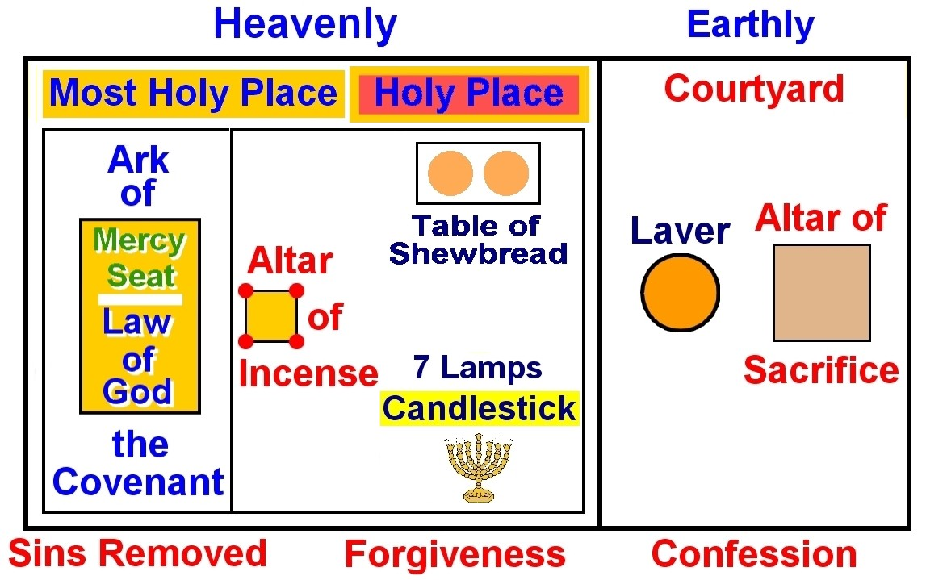
Thru the Blood!
Leviticus 16:1,2 tells us that Aaron, as the High Priest, was only to enter into the most holy place once each year and this was on the Day of Atonement. These verses call it the holy place, but the mercy seat is only found in the Most Holy Place. Aaron was never to enter there without blood, representing the blood of Christ. Only the blood of Jesus can mediate for sinful man before the holy God! He only entered there the 7th month and the 10th day of the month.

Slide 18
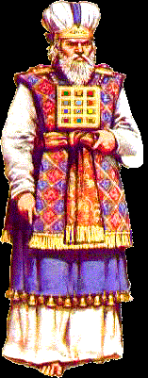
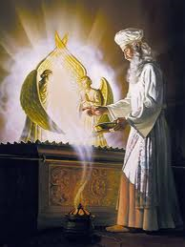
The High Priest Changes Clothes!

Slide 19
Clean!
Only on the Day of Atonement would the High Priest wear the white garments: tunic, belt, turban and pants. This signifies that the High Priest came before God within the Most Holy Place humbly and simply. He did not come in the outward splendor of gold and rich colors, but in pure white. Furthermore, white is the color of righteousness and cleansing, and righteousness/cleansing is what the High Priest is seeking for himself and all Israel as he came before the Ark.
“He shall put on the holy linen coat, and he shall have the linen breeches upon his flesh, and shall be girded with a linen girdle, and with the linen mitre shall he be attired: these are holy garments; therefore shall he wash his flesh in water, and so put them on.” (verse 4)
The high priest washed himself on this day at least twice to typify purity and cleanliness before God!

Slide 20
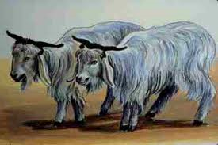
The Mysterious Goats

