Slide 1
When Two Forces Meet
Revelation 18

Slide 2
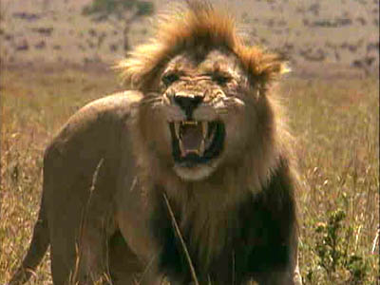
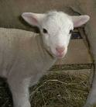
The Lion and the Lamb

Slide 3
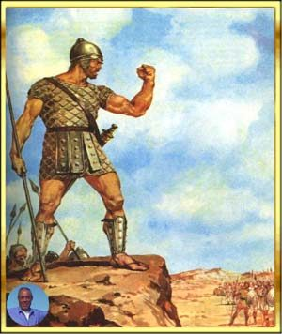
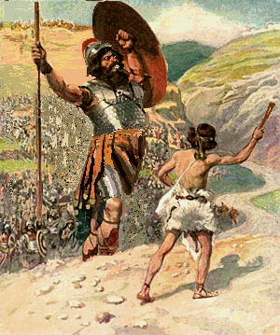
The Giant vs. The Kid

Slide 4
A Collision of Sorts
“And after these things I saw another angel come down from heaven, having great power; and the earth was lightened with his glory. And he cried mightily with a strong voice, saying, Babylon the great is fallen, is fallen, and is become the habitation of devils, and the hold of every foul spirit, and a cage of every unclean and hateful bird.” Revelation 18:1,2

Slide 5
The Mightiest Force in the Universe
“I saw the latter rain is coming suddenly, as the midnight cry and with ten times the power.” Ellen White letter, Spalding-Megan Collection, pages 3,4
How powerful was the midnight cry?
“In the parable of Matthew 25 the time of waiting and slumber is followed by the coming of the bridegroom. This was in accordance with the arguments just presented, both from prophecy and from the types. They carried strong conviction of their truthfulness; and the "midnight cry" was heralded by thousands of believers.
Like a tidal wave the movement swept over the land. From city to city, from village to village, and into remote country places it went, until the waiting people of God were fully aroused.

Slide 6
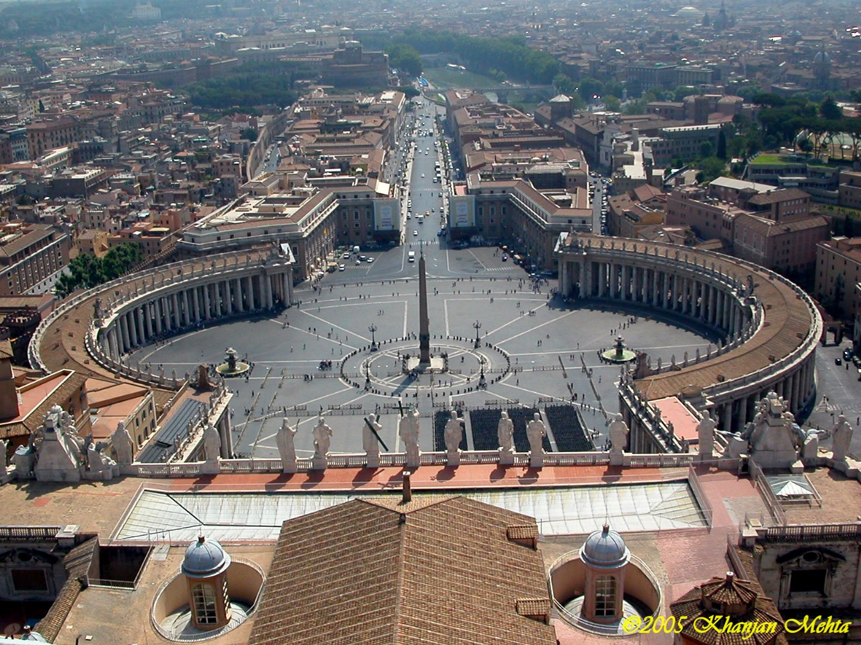
Collides with Babylon the Great
Controller of:
1. the kings of the earth.
2. the wealthy of the earth.
3. the churches of the earth.
4. the military might of the earth.

Slide 7
A Message Shakes the Earth
"I saw another angel come down from Heaven, having great power; and the earth was lightened with his glory. And he cried mightily with a strong voice, saying, Babylon the great is fallen, is fallen, and is become the habitation of devils, and the hold of every foul spirit, and a cage of every unclean and hateful bird." "And I heard another voice from Heaven, saying, Come out of her, my people, that ye be not partakers of her sins, and that ye receive not of her plagues." [REV. 18:1, 2, 4.] In this scripture the announcement of the fall of Babylon, as made by the second angel, [REV. 14:8.] is repeated, with the additional mention of the corruptions which have been entering the churches since 1844. A terrible condition of the religious world is here described. With every rejection of truth, the minds of the people have become darker, their hearts more stubborn, until they are entrenched in an infidel hardihood. In defiance of the warnings which God has given, they continue to trample upon one of the precepts of the Decalogue, and they persecute those who hold it sacred. Christ is set at naught in the contempt placed upon his word and his people.
As the teachings of Spiritualism are accepted by the churches, no real restraint is imposed upon the carnal heart, and the profession of religion becomes a cloak to conceal the basest iniquity. A belief in spiritual manifestations opens the door to seducing spirits and doctrines of devils. The influence of evil angels is felt in the churches throughout the land. {4SP 421.2} Of Babylon at this time it is declared, "Her sins have reached unto heaven, and God hath remembered her iniquities." [REV. 18:5.] She has filled up the measure of her guilt, and destruction is about to fall upon her. But God still has a people in Babylon; and before the visitation of his judgments, these faithful ones must be called out, that they "partake not of her sins, and receive not of her plagues." Hence the movement symbolized by the angel coming down from Heaven, lightening the earth with his glory, and crying mightily with a strong voice, announcing the sins of Babylon. In connection with his message the call is heard, "Come out of her, my people." As these warnings join the third angel's message, it swells to a loud cry. {4SP 422.1}

Slide 8
Continued
“Fearful is the issue to which the world is to be brought. The powers of earth, uniting to war against the commandments of God, will decree that no man may buy or sell, save he that has the mark of the beast, and, finally, that whoever refuses to receive the mark shall be put to death. [REV. 13:15, 17.] The word of God declares: "If any man worship the beast and his image, and receive his mark in his forehead, or in his hand, the same shall drink of the wine of the wrath of God, which is poured out without mixture into the cup of his indignation." [REV. 14:9, 10.] But not one is made to feel the wrath of God until the truth has been brought in contact with his mind and conscience, and has been rejected. There are many in the churches of our country who have never, even in this land of light and knowledge, had an opportunity to hear the special truths for this time. The obligation of the fourth commandment has never been set before them in its true light. Jesus reads every heart, and tries every motive. The decree is not to be urged upon the people blindly. Every one is to have sufficient light to make his decision intelligently. The Sabbath will be the great test of loyalty; for it is the point of truth especially controverted.
Heretofore those who presented the truths of the third message have often been regarded as mere alarmists. The prediction that Church and State would unite to persecute those who keep the commandments of God has been pronounced groundless and absurd. It has been confidently declared that this land could never become other than what it has been, the defender of religious freedom. But as the question of enforcing Sunday observance is widely agitated, the event so long doubted and disbelieved is seen to be approaching, and the third message produces an effect which it could not have had before.” {4SP 423.2}

Slide 9
Righteousness Found in Christ Alone
“Many had lost sight of Jesus. They needed to have their eyes directed to His divine person, His merits, and His changeless love for the human family. All power is given into His hands, that He may dispense rich gifts unto men, imparting the priceless gift of His own righteousness to the helpless human agent. This is the message that God commanded to be given to the world. It is the third angel's message, which is to be proclaimed with a loud voice, and attended with the outpouring of His Spirit in a large measure.”--TM 91, 92
“The message of Christ's righteousness is to sound from one end of the earth to the other to prepare the way of the Lord. This is the glory of God, which closes the work of the third angel.”--6T 19

Slide 10
Glorious Results
Truth Soon to Triumph.--The end is near, stealing upon us stealthily, imperceptibly, like the noiseless approach of a thief in the night. May the Lord grant that we shall no longer sleep as do others, but that we shall watch and be sober. The truth is soon to triumph gloriously, and all who now choose to be laborers together with God, will triumph with it. The time is short; the night soon cometh when no man can work.--Testimonies, vol. 9, p. 135. (1909)
Conversion as at Pentecost.--The time is coming when there will be as many converted in a day as there were on the day of Pentecost, after the disciples had received the Holy Spirit.--Review and Herald, June 29, 1905.
Thousands Yet to Step Into Light.--Many have let the gospel invitation go unheeded; they have been tested and tried; but mountainous obstacles have seemed to loom up before their faces, blocking their onward march. Through faith, perseverance, and courage, many will surmount these obstructions and walk out into the glorious light.
Almost unconsciously barriers have been erected in the strait and narrow way; stones of stumbling have been placed in the path; these will be rolled away. The safeguards which false shepherds have thrown around their flocks will become as nought; thousands will step out into the light, and work to spread the light.
God will soon do great things for us, if we lie humble and believing at His feet. . . .More than one thousand will soon be converted in one day, most of whom will trace their first convictions to the reading of our publications.-- Review and Herald, Nov. 10, 1885. {Ev 693.3}

Slide 11
Come Out of Her
“For all nations have drunk of the wine of the wrath of her fornication, and the kings of the earth have committed fornication with her, and the merchants of the earth are waxed rich through the abundance of her delicacies. And I heard another voice from heaven, saying, Come out of her, my people, that ye be not partakers of her sins, and that ye receive not of her plagues. For her sins have reached unto heaven, and God hath remembered her iniquities.
Reward her even as she rewarded you, and double unto her double according to her works: in the cup which she hath filled fill to her double.” Revelation 18:3-6
“The whole chapter shows that Babylon that has fallen are the churches who will not receive the messages of warning the Lord has given in the first, second, and third angel's messages. They refused the truth and accepted a lie. They refused the messages of truth. See 2 Thessalonians 2:11, 12. The message in the 18th of Revelation is plain and clearly defined. Verse 3: "For all nations have drunk of the wine of the wrath of her fornication, and the kings of the earth have committed fornication with her, and the merchants of the earth are waxed rich through the abundance of her delicacies." Anyone who reads this chapter need not be deceived.” 1MR 302

Slide 12
What do we have?
1. The collision occurs in many forms.
2. The messages of Christ’s righteousness, the Sabbath, Babylon’s fall are all given.
3. The churches are utterly corrupted because of their rejection of the three angel’s messages.
4. Before the seven last plagues/judgments from heaven fall, the honest in the fallen churches are called out of those fallen churches.
5.Those who come out will receive the seal of God and the latter rain, and will be prepared to stand through the time of Jacob’s trouble.
6. Those SDA’s who haven’t walked in the light will have the mark of the beast and will oppose the final warning messages.

Slide 13
Arrogance Brings her Down
“How much she hath glorified herself, and lived deliciously, so much torment and sorrow give her: for she saith in her heart, I sit a queen, and am no widow, and shall see no sorrow. Therefore shall her plagues come in one day, death, and mourning, and famine; and she shall be utterly burned with fire: for strong is the Lord God who judgeth her.” Revelation 18:7,8

Slide 14
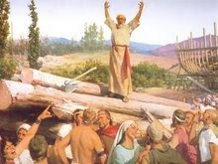
As it was in the days of Noah
As Noah preached the fall of the antediluvian world and was considered crazy, so to anyone proclaiming the fall of modern Babylon/the Papacy faces similar taunts. Regardless, the papacy and her minions are coming down—SOON!

Slide 15
The Kings/Rulers of the Earth
“And the kings of the earth, who have committed fornication and lived deliciously with her, shall bewail her, and lament for her, when they shall see the smoke of her burning,
Standing afar off for the fear of her torment, saying, Alas, alas, that great city Babylon, that mighty city! for in one hour is thy judgment come.”
Revelation 18:9,10
The leaders of the earth weep over the papacy’s collapse because they see their collapse in her fall.
An international conspiracy, linking the leaders of our world with Rome, unravels as the papacy falls.
“And every one that heareth these sayings of mine, and doeth them not, shall be likened unto a foolish man, which built his house upon the sand:” Matthew 7:26

Slide 16
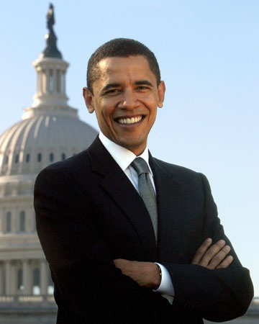
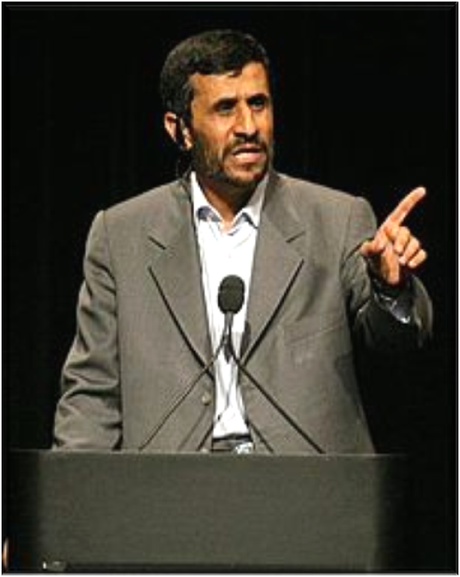
Kings Doing the pope’s Bidding

Slide 17
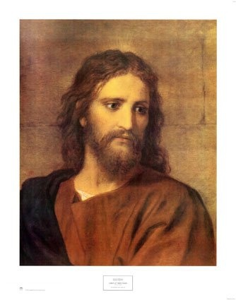
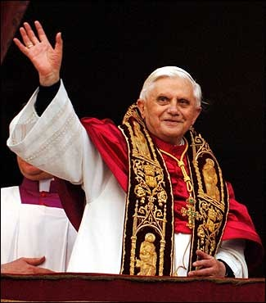
Only One Sure Foundation: Which will we choose?

Slide 18
Blending of kings and merchants
LONDON (AFP) “Prime Minister Gordon Brown said Monday the financial crisis must not be an excuse to retreat into protectionism and instead be viewed as the "difficult birth-pangs of a new global order".
In a speech, he will urge countries to avoid "muddling through as pessimists" and "make the necessary adjustment to a better future and setting the new rules for this new global order", according to his office.
Official data confirmed Friday that Britain is in recession. Days earlier, the government unveiled a new package of measures to help the flow of credit in the economy, but Brown has argued global action is needed for a quick recovery.
He will warn Monday that the crisis has given the world a choice: "We could allow this crisis to start a retreat from globalisation.
"As some want, we could close our markets -- for capital, financial services, trade and for labour -- and therefore reduce the risks of globalisation.
"But that would reduce global growth, deny us the benefits of global trade and confine millions to global poverty.
"Or we could view the threats and challenges we face today as the difficult birth-pangs of a new global order –”

Slide 19
The World’s Rich
“And the merchants of the earth shall weep and mourn over her; for no man buyeth their merchandise any more: The merchandise of gold, and silver, and precious stones, and of pearls, and fine linen, and purple, and silk, and scarlet, and all thyine wood, and all manner vessels of ivory, and all manner vessels of most precious wood, and of brass, and iron, and marble, And cinnamon, and odours, and ointments, and frankincense, and wine, and oil, and fine flour, and wheat, and beasts, and sheep, and horses, and chariots, and slaves, and souls of men. And the fruits that thy soul lusted after are departed from thee, and all things which were dainty and goodly are departed from thee, and thou shalt find them no more at all. The merchants of these things, which were made rich by her, shall stand afar off for the fear of her torment, weeping and wailing, And saying, Alas, alas, that great city, that was clothed in fine linen, and purple, and scarlet, and decked with gold, and precious stones, and pearls! For in one hour so great riches is come to nought.” Revelation 18:11-17

Slide 20
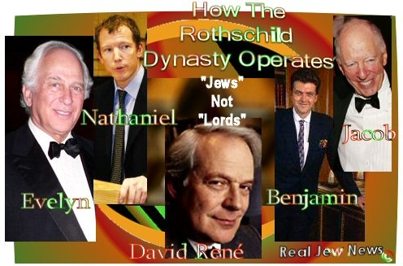
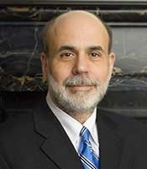
Sold Out To Rome

Slide 21
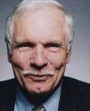
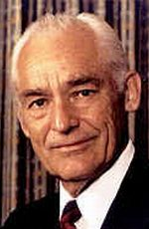
Some of the Players

Slide 22
The Wealthy Weep
“And cried when they saw the smoke of her burning, saying, What city is like unto this great city! And they cast dust on their heads, and cried, weeping and wailing, saying, Alas, alas, that great city, wherein were made rich all that had ships in the sea by reason of her costliness! for in one hour is she made desolate. Rejoice over her, thou heaven, and ye holy apostles and prophets; for God hath avenged you on her.” Revelation 18:18-20
Why do the wealthy weep when they see Rome falling? For the same reason that the rulers weep. Their success is so intertwined in the papacy’s success that when Rome falls, the world’s wealthy will see their fall.
In their insane efforts to bring chaos so as to destroy liberty and bring in a Sunday Law, Rome is destroying the economic fabric of the planet. We are in that process right now. Rome stops at nothing; murder, war, blood, destruction; all for the sake of getting control. When she gets it, the Bible says, she and her followers will be destroyed. This is insanity!

Slide 23
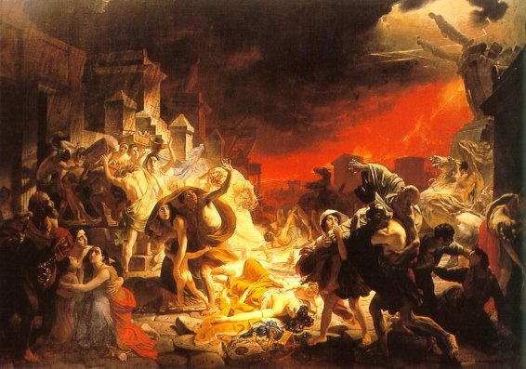
The Papacy Destroys Herself
“And a mighty angel took up a stone like a great millstone, and cast it into the sea, saying, Thus with violence shall that great city Babylon be thrown down, and shall be found no more at all. And the voice of harpers, and musicians, and of pipers, and trumpeters, shall be heard no more at all in thee; and no craftsman, of whatsoever craft he be, shall be found any more in thee; and the sound of a millstone shall be heard no more at all in thee; And the light of a candle shall shine no more at all in thee; and the voice of the bridegroom and of the bride shall be heard no more at all in thee: for thy merchants were the great men of the earth; for by thy sorceries were all nations deceived.” Revelation 18:21-23

Slide 24
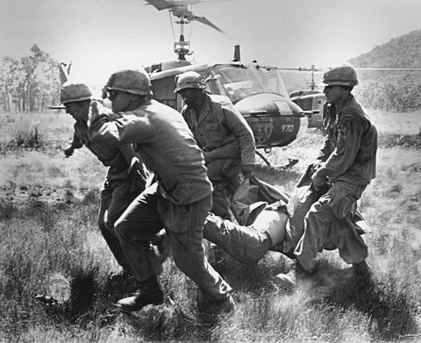
Papacy Runs Bloody
“And in her was found the blood of prophets, and of saints, and of all that were slain upon the earth. “ Revelation 18:24 The papacy will allow nothing to stand in her way. They kill anyone who doesn’t go along with her. They are responsible for the mass murder machines of many centuries; war, terror attacks……..

Slide 25
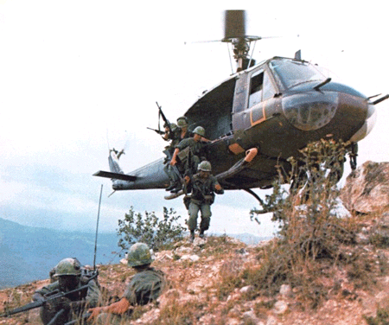
Wars and Rumors of Wars
According to this passage, the papacy is responsible for conflicts that leave mass amounts of people dead. This makes Rome responsible for Vietnam, WW 1 and 2, and the current war on terror. Rome will stop at nothing to get her way.

Slide 26
Cheney/CFR/Jesuits
In an interview with Politico.com the former Vice President was rattling the sabers of terror again. CBS summarized the interview as follows: “Cheney warned that there is a ‘high probability’ that terrorists will attempt a catastrophic nuclear or biological attack in coming years, and said he fears the Obama administration’s policies will make it more likely the attempt will succeed…

Slide 27
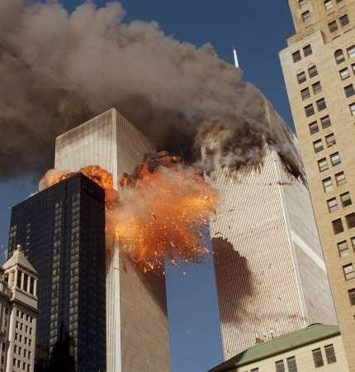
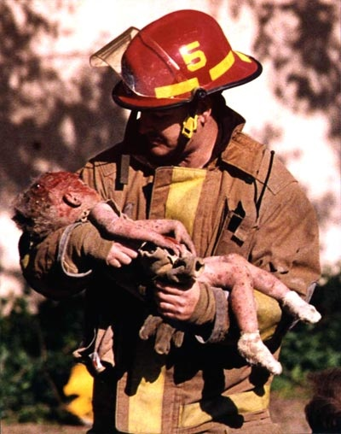
How Far we could go

Slide 28
Again!
Pakistani Taliban chief Baitullah Mehsud, for whom the United States has posted a five-million-dollar reward, said there would be more attacks after Monday’s raid on the Lahore police training school which left 12 people dead.
“We claim responsibility for the attack,” Mehsud, blamed for the 2007 assassination of former Prime Minister Benazir Bhutto, told AFP by telephone from an undisclosed location.
“This was in retaliation for the ongoing drone attacks in the tribal areas. There will be more such attacks.”
“Very soon we will take revenge from America, not in Afghanistan but in Washington, which will amaze the entire world,” Mehsud warned.
The U.S. recently announced a $5 million bounty on Mehsud’s head. Asked about it, he stated he would be happy to “embrace martyrdom.”

Slide 29
God Keeps His Children
“Christ will never abandon those for whom He has died. We may leave Him and be overwhelmed with temptation, but Christ can never turn from one for whom He has paid the ransom of His own life. Could our spiritual vision be quickened, we should see souls bowed under oppression and burdened with grief, pressed as a cart beneath sheaves, and ready to die in discouragement. We should see angels flying quickly to the aid of these tempted ones, forcing back the hosts of evil that encompass them, and placing their feet on the sure foundation. The battles waging between the two armies are as real as those fought by the armies of this world, and on the issue of the spiritual conflict eternal destinies depend. In the vision of the prophet Ezekiel there was the appearance of a hand beneath the wings of the cherubim. This is to teach God's servants that it is divine power that gives success. Those whom God employs as His messengers are not to feel that His work is dependent on them. Finite beings are not left to carry this burden of responsibility. He who slumbers not, who is continually at work for the accomplishment of His designs, will carry forward His work. He will thwart the purposes of wicked men and will bring to confusion the counsels of those who plot mischief against His people. He who is the King, the Lord of hosts, sitteth between the cherubim, and amidst the strife and tumult of nations. He guards His children still. When the strongholds of kings shall be overthrown, when the arrows of wrath shall strike through the hearts of His enemies, His people will be safe in His hands.” PK, pg. 176

Slide 30
Power is on Its Way
“I saw the latter rain is coming suddenly, as the midnight cry and with ten times the power.” Ellen White letter, Spalding-Megan Collection, pages 3,4
How powerful was the midnight cry?
“In the parable of Matthew 25 the time of waiting and slumber is followed by the coming of the bridegroom. This was in accordance with the arguments just presented, both from prophecy and from the types. They carried strong conviction of their truthfulness; and the "midnight cry" was heralded by thousands of believers.
Like a tidal wave the movement swept over the land. From city to city, from village to village, and into remote country places it went, until the waiting people of God were fully aroused.

Slide 31
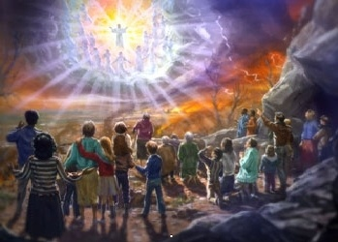
Mankind’s Only Hope

