Slide 1
Lincoln: A Man For All Time
The Battle that Was, and Is

Slide 2
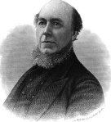
The Priest
Charles Chiniquy was a Catholic priest for at least 25 years. He was well known for his stand against the use of alcohol among his parishioners and his fellow priests. He became a marked man by the priests of Rome. This Catholic priest was accused of a crime by the priests of Chicago that he did not commit. He was put on trial in 1856. Few would defend him from this Catholic onslaught.

Slide 3
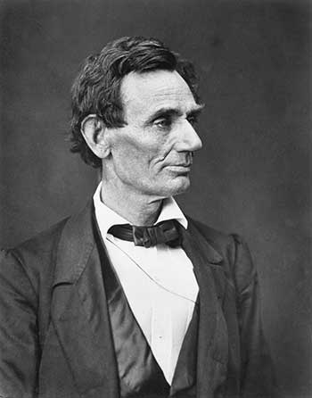
One Man Did
Abraham Lincoln did all he could to defend this innocent priest. The night before the trial was to close, things appeared hopeless. By morning, a miracle had occurred. Chiniquy was set free. Lincoln, for his part, had incurred the undying wrath of the papacy.

Slide 4
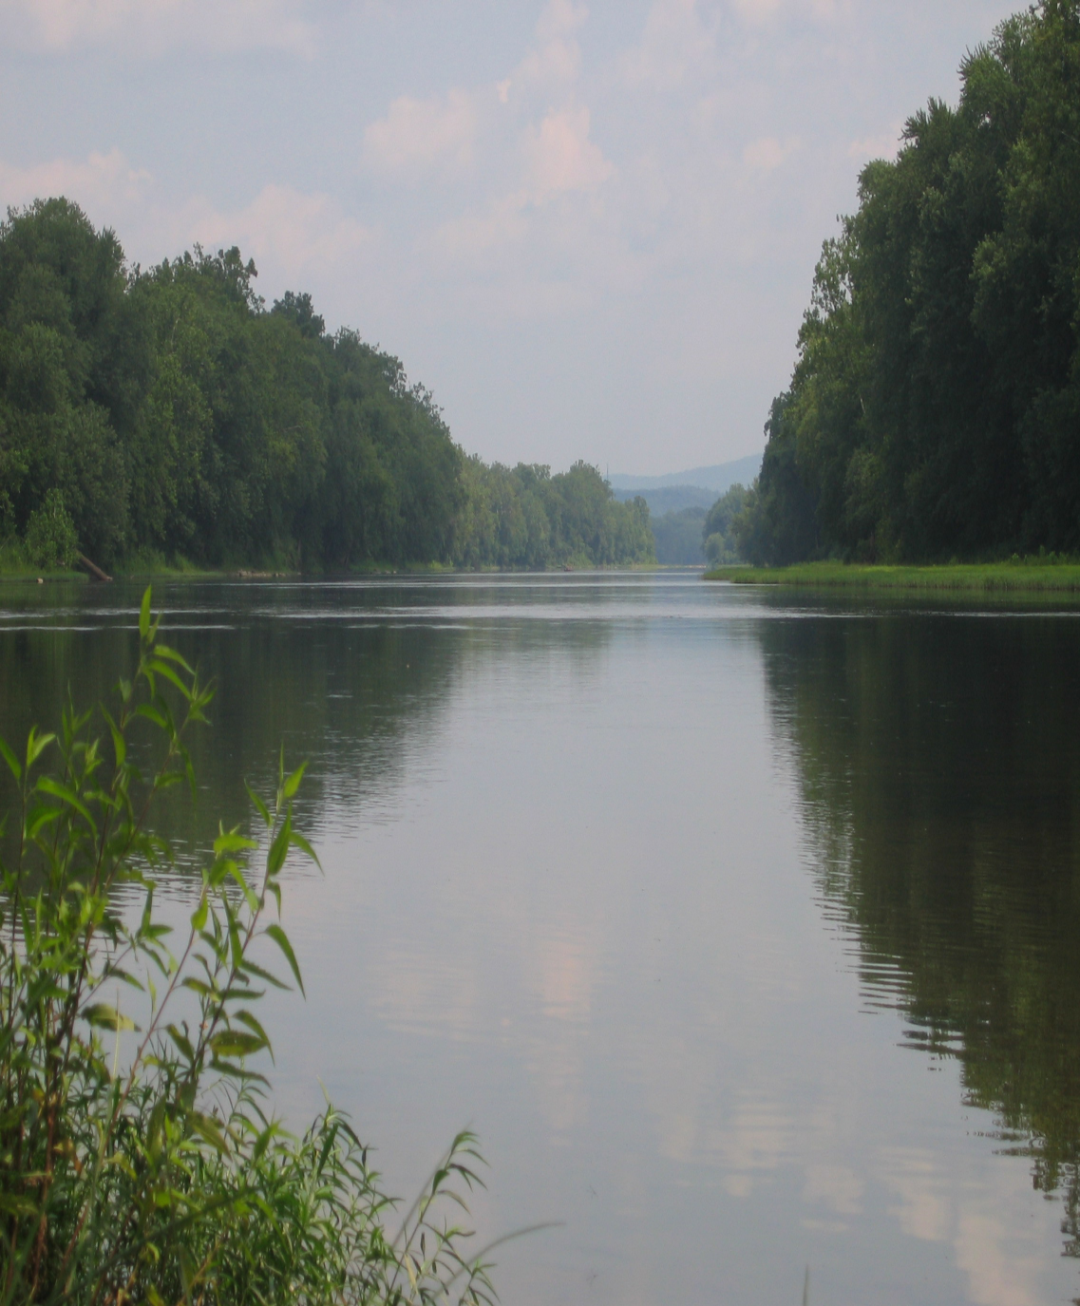
Chiniquy’s warning
“Father Chiniquy, what are you crying for? “Dear Mr. Lincoln,” I answered, “allow me to tell you that the joy I should naturally feel for such a victory is destroyed in my mind by the fear of what it may cost you. There were in the court not less than ten or twelve Jesuits from Chicago and St. Louis, who came to hear my sentence of condemnation to the penitentiary……What troubles my soul just now and draws my tears, is that it seems to me that I have read your sentence of death in their fiendish eyes. How many other noble victims have already fallen at their feet!” — Charles Chiniquy, Fifty Years in the Church of Rome, p. 280, 281.

Slide 5
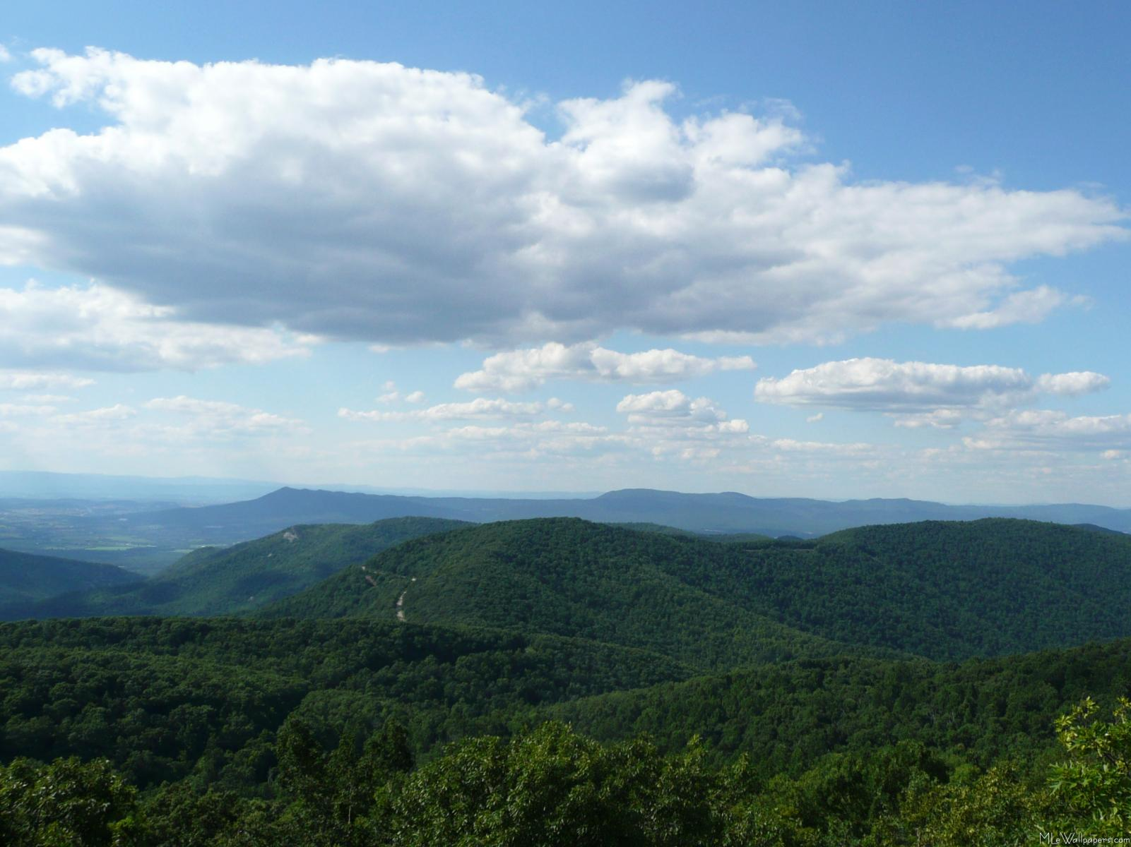
Lincoln’s Trip to Washington
“Twenty men had been hired in Baltimore to assassinate the President elect on his way to Washington. The leader of this band was an Italian refugee, a barber well known in Baltimore. Their plan was as follows: when Mr. Lincoln arrived in that city, the assassins were to mix with the crowd, and get as near his person as possible, and shoot at him with their pistols. If he was in a carriage, hand grenades had
been prepared, filled with detonating powder, such as Orsini used in attempting to assassinate Louis Napoleon. These were to be thrown into the carriage, and to make the work of death doubly sure, pistols were to be discharged into the vehicle at the same moment. The assassins had a vessel lying ready to receive them in the harbour. From thence they would be carried to Mobile, in the seceded state of Alabama.”
— John Smith Dye, The Adder’s Den, p. 113.
“An Italian barber well known in Baltimore, a Romanist, was to have stabbed him while seated in his carriage, when he started from the depot.” Burke McCarty, The Suppressed Truth About the Assassination of Abraham Lincoln, Arya Varta Publishing, p. 66.

Slide 6

Failed Attempts
Fortunately, the first plot of the Jesuits to kill Lincoln failed, as they sought to take Lincoln’s life before he ever reached the White House! “ While riding on a train John Wilkes Booth dropped a letter written to him by Charles Selby. Shortly after, the letter was found and delivered to President Lincoln, who after having read it wrote the word “Assassination” across it, and filed it in his office where it was found after his death and was placed in evidence as a court exhibit.
Here is an excerpt from the letter: Abe must die, and now. You can choose your weapons, the cup, the knife, the bullet. The cup failed us once and might again…. You know where to find your friends. Your disguises are so perfect and complete….. Strike for your home; strike for your country; bide your time, but strike sure.” Burke McCarty, Suppressed Truth About the Assassination of Lincoln, pages 131,132

Slide 7
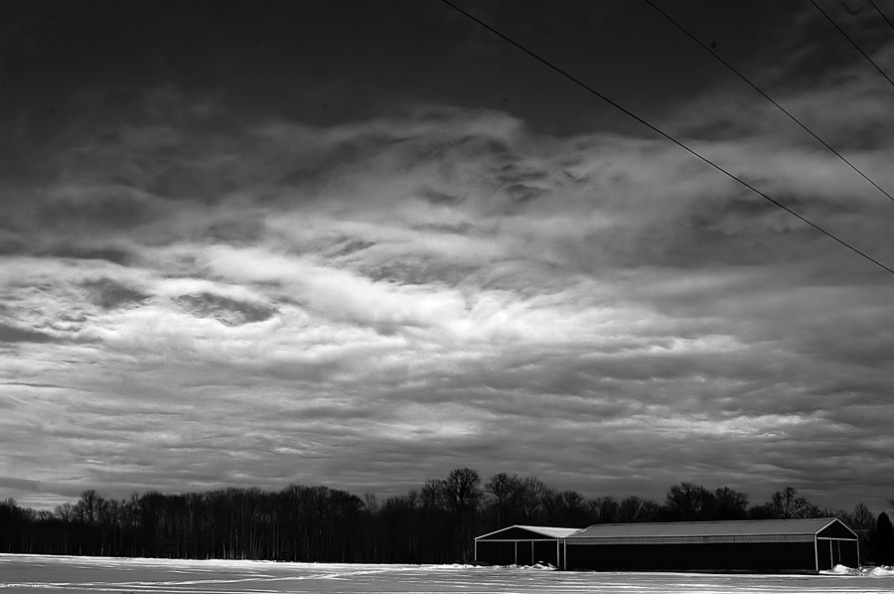
Lincoln’s Inaugural
“It was a dark day in our country’s history when an armed guard had to surround the hotel (Willard’s) where the Chief Magistrate had taken temporary lodging to prevent his assassination. And on the day, (March 4, 1861), of his Inauguration, he was escorted up Pennsylvania Avenue in a hollow square of cavalry, and the utmost vigilance was exercised by Gen. Scott to prevent his being publicly assassinated on the way to the Capitol to deliver his Inaugural Address from the east portico. These were terrible times.” John Smith Dye, The Adder’s Den, p. 135.

Slide 8

Rome Wanted Lincoln Dead and America Split in Half
“Rome saw at once that the very existence of the United States was a formidable menace to her own life. From the very beginning she perfidiously sowed the germs of division and hatred between the two great sections of this country and succeeded in dividing South from North on the burning question of slavery. That division was her golden opportunity to crush one by the other, and reign over the bloody ruins of both, a favored, long-standing policy.” Charles Chiniquy, Fifty Years in the Church of Rome, Chick Publications, p. 291, emphasis supplied.

Slide 9
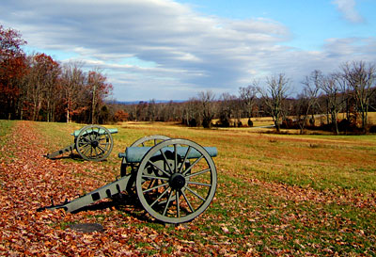
Division
“ According to German Chancellor, Otto von Bismarck, all this was carefully planned. “The division of the United States in federations of equal force was decided long before the Civil War by the high financial powers of Europe. These bankers were afraid that the United States, if they remained in one block and as one nation, would attain economic and financial independence, which would upset their financial domination over Europe and the world. Of course, in the 'inner circle' of Finance, the voice of the Rothschild’s prevailed. They saw an opportunity for prodigious booty if they could substitute two feeble democracies, burdened with debt to the financiers,...in place of a vigorous Republic sufficient unto herself. Therefore, they sent their emissaries into the field to exploit the question of slavery and to drive a wedge between the two parts of the Union...The rupture between the North and the South became inevitable; the masters of European finance employed all their forces to bring it about and to turn it their advantage.”
[Quoted in] G. Edward Griffin, The Creature from Jekyll Island, American Opinion, 374

Slide 10
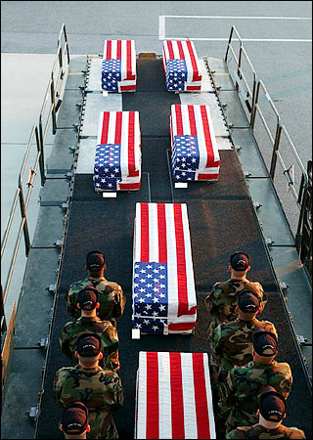
Rothschild’s and the Jesuits: One Big Happy Family
“Aware that the Rothschilds are an important Jewish family, I looked them up in Encyclopedia Judaica and discovered that they bear the title 'Guardians of the Vatican Treasury.'... The appointment of Rothschild gave the black papacy absolute financial privacy and secrecy. Who would ever search a family of orthodox Jews for the key to the wealth of the Roman Catholic Church?” F. Tupper Saussy, Rulers of Evil, Harper-Collins, pp. 160,161.

Slide 11
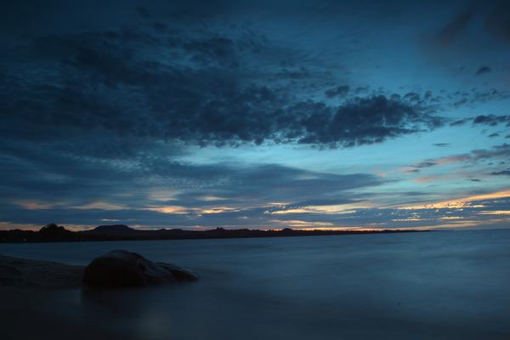
Lincoln Understood
“Unfortunately, I feel more and more every day that it is not against the Americans of the South, alone, I am fighting, it is more against the pope of Rome, his perfidious Jesuits and their blind and bloodthirsty slaves. As long as they hope to conquer the North, they will spare me; but the day we route their armies, take their cities and force them to submit, then, it is my impression that the Jesuits, who are the principal rulers of the South, will do what they have almost invariably done in the past. The dagger or the pistol will do what the strong hands of the warriors could not achieve. This civil war seems to be nothing but a political affair to those who do not see, as I do, the secret springs of that terrible drama. But it is more a religious than a civil war.” Fifty Years, pg. 294,295

Slide 12
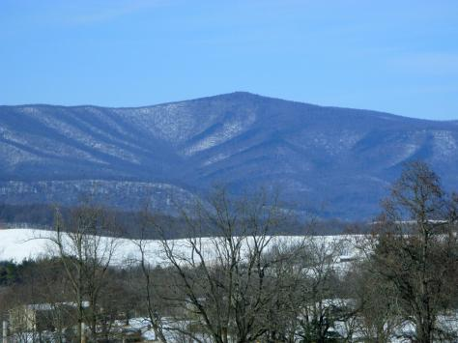
So Did Thomas Harris
Major General Thomas Harris served on the military commission that tried those involved in the murder of Abraham Lincoln and the attempts on others lives as well. His famous book ‘Rome’s Responsibility for the Assassination of Abraham Lincoln’ is a classic. We will now quote from him.

Slide 13
Pope Pius IX Writes to Jeff Davis
“It was the Pope of Rome, and his faithful lieutenant, Louis Napoleon, who, taking advantage of our civil war, undertook to establish a Roman Catholic empire in Mexico, and for this purpose sent Maximilian, a Roman Catholic prince, under the protection of a French army, to usurp dominion, and take possession of the country. All of this was done in the hope that the Union cause would be lost; and that through the strife that she had fomented, two Roman Catholic empires would be established on the American continent, viz. that of Mexico under Maximilian and that of the Confederacy under Jefferson Davis; thus making it possible to make a conquest of the entire continent. This letter of the Pope to Jefferson Davis, couched in such courteous and loving terms, and showing so clearly that his sympathy was with the Southern cause, was well understood by his loyal and faithful subjects all over the North. Roman Catholic officers began to resign and the rank and file began to desert, from the time of the publication of that letter in 1863 to the close of the war. In reply to the boast so freely made by Roman Catholic editors and orators that the Irish fought the battles of the civil war and saved the nation, the following document, received from the Pension department at Washington, is here given:

Slide 14
Desertions
Whole number of troop . . . . . . . . . . . 2,128,200
Natives of the United States . . . . . . . .1,627,267
Germans . . . . . . . . . . . . . . . . . . . . . . . 189,817
Irishmen . . . . . . . . . . . . . . . . . . . . . . . 144,221
British (other than Irish) . . . . . . . . . . . . 90,040
Other foreigners and missions . . . . . . . 87,855
The "Desertions" were as follows:
Natives of the United States . . . . . . . . 5 percent
Germans . . . . . . . . . . . . . . . . . . . . . 10 percent
Irish Catholics . . . . . . . . . . . . . . . . . 72 percent
British (Other than Irish) . . . . . . . . . . . 7 percent
Other foreigners . . . . . . . . . . . . . . . . . 7 percent
In other words: of the 144,000 Irishmen that enlisted. 104,000 deserted. And it is reliably stated that most of these desertions occurred after the recognition of the Confederacy by the Pope. It is also a fact that of the five percent of native Americans rated as deserters, 45 percent of the 5 percent were Catholics.”
Harris’ book, pgs. 12,13

Slide 15

The Riots in New York- 1863
“Not only by desertions and resignations was Roman Catholic disloyalty made apparent, but more conspicuously by the draft riots that followed, the rioters being made up, almost entirely, of Irish Roman Catholics. Arch-bishop Hughes posed as a Union man; and was so far trusted by President Lincoln, that he solicited his good offices at Rome, to prevent the Pope from giving recognition to the Confederate government; he being well aware of the consequences that would follow such recognition. The Archbishop proved a traitor to his trust; and the Pope's letter to Jefferson Davis followed closely on the heels of his visit to Rome, and resignations and desertions commenced. Then followed the terrible riots in New York City, when a draft became necessary to fill up our depleted ranks. For three fearful days and nights the city was terrorized by the violence of an Irish Catholic mob, right under the shadow of the Archbishop's palace. The Archbishop kept secluded in his palace, and as mute as a mouse, until notified by Mr. Lincoln that he would be held personally responsible for its continuance. He then came forth; and by a few kind words to the rioters, whom he addressed as his friends, the mob immediately dispersed, and order was restored. It only took a few words from him to accomplish what could not have been accomplished without much bloodshed, and perhaps the destruction of the city, by a military arm of our government; but mark those words were not spoken until it became necessary to the personal safety of the Arch-bishop. The traitor was here revealed. And now we come to the last desperate conspiracy to overthrow our government, and make the rebellion a success by a resort to the favorite policy of the Jesuits, that of assassination.” ibid. pg. 14

Slide 16

Not Just Lincoln
“It is my purpose now to review the facts connected with the assassination of President Lincoln, and the attempted assassination of Mr. Seward, and the purpose to assassinate Vice-president Johnson, Secretary Stanton and General Grant. The object of this scheme of wholesale assassinations of the civil and military heads of the government, was to throw the country into a state of chaos, and thus retrieve the fast failing fortunes of the Confederacy. These facts, as developed on the trial of the conspirators before a military commission, and on the trial of John H. Surratt two years later, before a civil court, together with evidence secured by Father Chiniquy, and given to the world in his book, ''Fifty Years In The Church Of Rome," show conclusively the hand of Rome in this stab at our nations life.” ibid. pg. 15

Slide 17
The Plot/Plotters Thicken
“Now for the facts. And we will take, as our starting point, the fact well established, that the headquarters of the conspiracy in Washington City, was the house of a Roman Catholic family, of which Mrs. Mary E. Surratt was the head; and all of its inmates, including a number of boarders, were devoted members of the Roman Catholic Church. This house was the meeting place, the council chamber, of Booth and his co-conspirators, including Mrs. Mary E. Surratt, and her son, John H. Surratt, who, next to Booth, were the most active members of the conspiracy in preparation for the execution of the plot. Booth, the ringleader, was born and reared a Protestant. He was only a nominal Protestant, however. He was man of the world; a drunkard and a libertine, and utterly indifferent to matters of religion. That under the influence of his associations in the conspiracy plot, he had become a pervert to Catholicism, was shown, however by the fact that, on examination of his person after his death, it was found that he was wearing a Catholic medal under his vest, and over his heart. The wily Jesuit, sympathizing with him in his political views, and in hope of destroying our government, and establishing the Confederacy, which had already received the Pope's recognition, and expressions of good will and sympathy conferred upon it, had been able to pervert him to Catholicism, and to deceive him into the belief that his medal would conduce to his personal safety, and to the success of his enterprise. He had, no doubt, been baptized into the Catholic Church. This medal at once marked and identified him as a pervert to Catholicism.” ibid. pgs. 15-17

Slide 18

Continued
“Now we have Mary E. Surratt, John H. Surratt, J. Wilkes Booth, Dr. Samuel Mudd, and Michael O'Laughlin, five of the leading active spirits in the execution of the plot to assassinate, belonging to the Roman Catholic Church. My impression is that Herold and Spangler were also members or adherents to that church. Be this as it may, they, together with Atzertot and Payne, were the mere tools, and hired agents of Booth and Surratt, and so stood ready to serve their purpose; and so it boots not to inquire into their faith or want of faith. Our inquiry then, thus far, has established the fact that five of the conspirators were members of the Roman Catholic Church and that these five were its leaders, to whom the execution of the plot had been confided..” ibid. pgs. 15-17

Slide 19
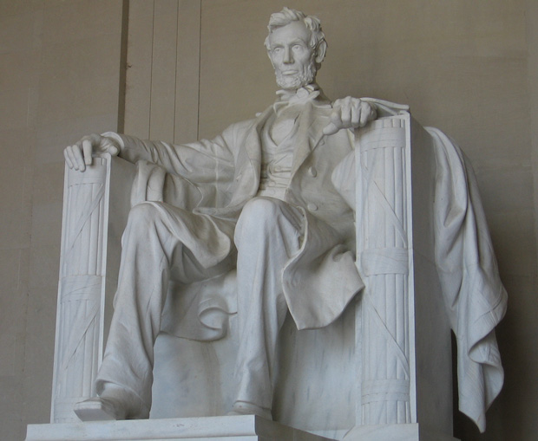
Lincoln Murdered
“Three or four hours before Lincoln was murdered in Washington, the 14th of April, 1865, that murder was not only known by someone, but it was circulated and talked of in the streets and in the houses of the priestly and Romish town of St. Joseph, Minnesota. The fact is undeniable; the testimonies are unchallengeable, and there were no railroad nor any telegraph communications nearer than forty or eighty miles from St. Joseph…. Mr. Linneman, who is a Roman Catholic, tells us that though he heard this from many in his store, and in the streets, he does not remember the name of a single one who told him that.... But if the memory of Mr. Linneman is so deficient on that subject, we can help him and tell him what was said with mathematical accuracy…The priests of Saint Joseph were often visiting Washington and boarding, probably, at Mrs. Surratt’s…. Those priests of Washington were in daily communication with their co-rebel priests of St. Joseph; they were their intimate friends. There was no secret among them…. The details of the murder, as the day selected for its commission, were as well known among the priests of St. Joseph as they were among those of Washington….The priests of Rome knew and circulated the death of Lincoln four hours before its occurrence in their Roman Catholic town of St. Joseph, Minnesota.” Fifty Years, pp. 316, 317.

Slide 20
Seward Almost Killed
“Lewis Payne, known as the Florida boy, an athletic young giant, who some months before had joined the conspiracy, rode up to the front of the residence of the Secretary of State, William Seward. He had been ill for three weeks, suffering from a fractured jaw, the result of the running away of his team and was under the constant care of male nurses. Payne rang the doorbell and it was answered by the colored butler. He told the latter that he had been sent with some medicine which he must take to the sick room. The butler refused to allow him to enter, saying that he had orders to allow no one to Mr. Seward’s room. The stranger [Lewis Payne], after a short struggle, knocked him down, and went bounding up the stairs. He rushed into the sick chamber, after felling each of the two sons of the Secretary….. He [Lewis Payne] then sprang upon the sick man and seriously stabbed him three times. By a super human effort, the latter struggled out of the bed with his assailant who left him in a heap on the floor, bleeding from the wounds he had inflicted. After his murderous assault on Seward, the ruffian rushed down the stairs, yelling at the top of his voice, “I am mad! I am mad,” and he very probably was. He was entirely under the control of the hypnotic influences of the wicked people in whose power he had allowed himself to be….

Slide 21
Kill The Leaders
….It was part of the plan that Michael O’Laughlin one of the conspirators from Baltimore, was to have murdered General Grant that night. This was not possible, owing to the change in the General’s plans. To Atzerodt, it fell to assassinate Vice President Johnson, but he became frightened and spent the day riding into the country on a horse.… ...he was found several days after with relatives of his below Washington. He made a written confession before he was executed which confirmed the presence of Surratt in Washington that fatal day a fact, which nine reputable witnesses had sworn to. “ McCarty, Suppressed Truth, pgs 121,122

Slide 22

Surratt’s Escape and Capture
John Surratt made his escape after Lincoln’s murder. He was housed by a priest in Montreal, taken on a ship, The Peruvian, to England, and then brought to Rome. When arrested, he was in the pope’s private army!

Slide 23
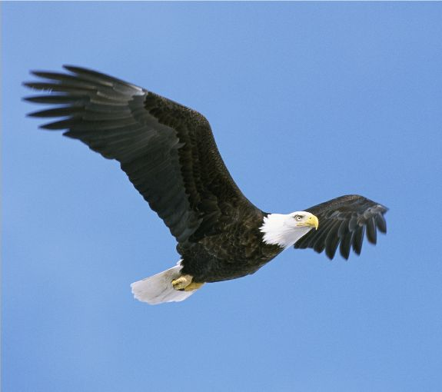
Rome is Responsible for Lincoln’s Murder
Lincoln was slain in April of 1865, but his memory and what he stood for will never die. His love for liberty and his desire to see that liberty be given to all men will never die!

