Slide 1
What is the Difference Between Mormons, Jehovah’s Witnesses, and Seventh-day Adventists? pt 17

Slide 2
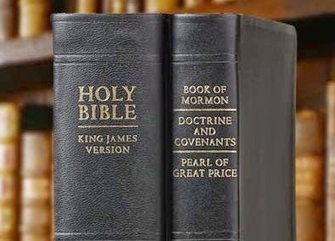
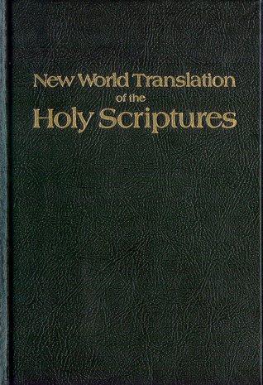
What We Will Study….
Origins of the Religion
Their Authorities and/or Authoritative Texts
Their Doctrinal Differences
Their Message to the World

Slide 3
Trust in the Organization?
The baptismal questions from the Aug. 1, 1966 Watchtower (p. 465) were:
(1) Have you recognized yourself before Jehovah God as a sinner who needs salvation, and have you acknowledged to him that this salvation proceeds from him, the Father, through his Son Jesus Christ?
(2) On the basis of this faith in God and in his provision for salvation, have you dedicated yourself unreservedly to God to do his will henceforth as he reveals it to you through Jesus Christ and through the Bible under the enlightening power of the holy spirit?
The newest baptismal vows were set forth in the June 1, 1985 (p. 30) Watchtower:
(1) On the basis of the sacrifice of Jesus Christ, have you repented of your sins and dedicated yourself to Jehovah to do his will?
(2) Do you understand that your dedication and baptism identify you as one of Jehovah's Witnesses in association with God's spirit-directed organization?

Slide 4
The Governing Body as Defined By JW.org
“The Governing Body is a small group of mature Christians who provide direction for Jehovah’s Witnesses worldwide. Their work is twofold: They oversee the preparation of Bible-based instruction through the publications, meetings, and schools of Jehovah’s Witnesses.​—Luke 12:42. They supervise the worldwide work of Jehovah’s Witnesses by directing our public ministry and overseeing the use of donated assets. The Governing Body follows the pattern set by “the apostles and elders in Jerusalem” in the first century, who made important decisions on behalf of the entire Christian congregation. (Acts 15:2) Like those faithful men, the members of the Governing Body are not the leaders of our organization. They look to the Bible for guidance, acknowledging that Jehovah God has appointed Jesus Christ as the Head of the congregation.​—1 Corinthians 11:3; Ephesians 5:​23.” JW.org, What Is the Governing Body of Jehovah’s Witnesses?, https://www.jw.org/en/jehovahs-witnesses/faq/governing-body-jw-helpers/

Slide 5
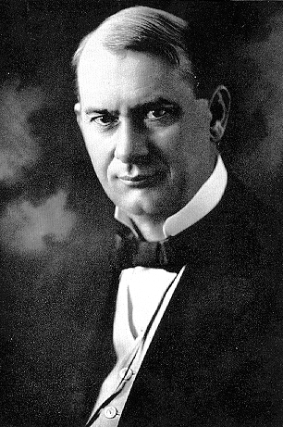
Historical Background of the Governing Body
“Since its incorporation in 1884, the Watch Tower Bible and Tract Society of Pennsylvania has been directed by a president and board of directors. Until January 1976, the president exercised complete control of doctrines, publications and activities of the Watch Tower Society and the religious denominations with which it was connected—the Bible Students and Jehovah's Witnesses. When the Society's second president, J. F. Rutherford, encountered opposition from directors in 1917, he dismissed them. In 1925, he overruled the Watch Tower Society's editorial committee when it opposed publication of an article about disputed doctrines regarding the year 1914. In 1931, the editorial committee was dissolved.” Wikipedia, Governing Body of Jehovah’s Witnesses

Slide 6
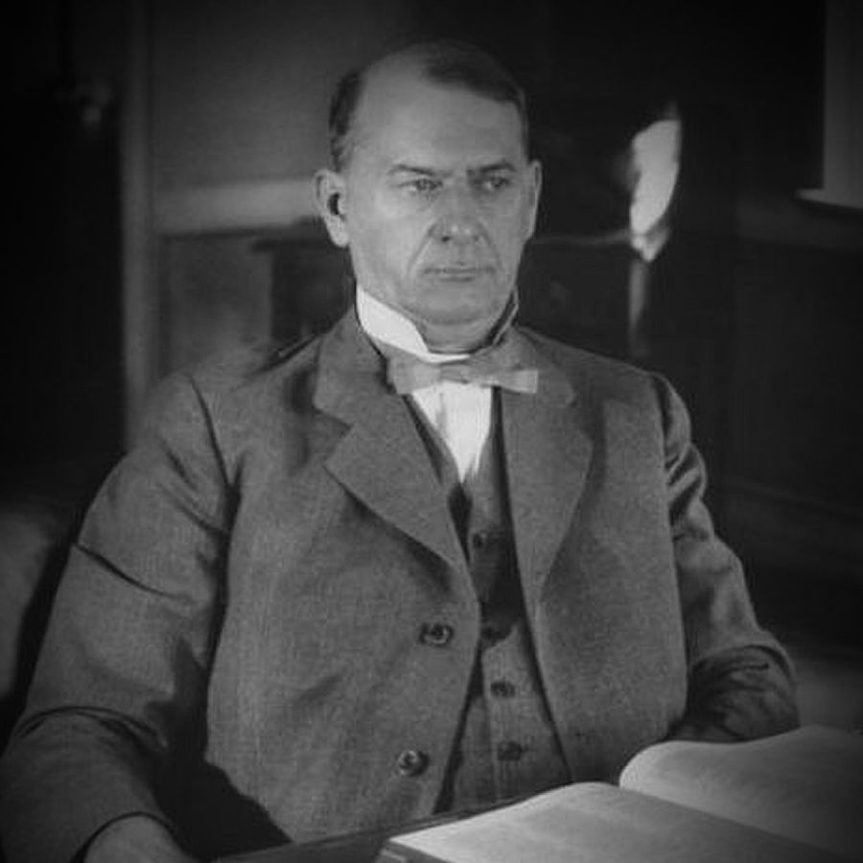
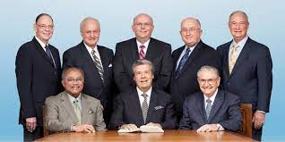
History Continued…
“In 1943, The Watchtower described the Watch Tower Bible and Tract Society as the "legal governing body" of anointed Jehovah's Witnesses. A year later, in an article opposing the democratic election of congregation elders, the magazine said the appointment of such ones was the duty of "a visible governing body under Jehovah God and his Christ". For several years, the role and specific identity of the governing body remained otherwise undefined. A 1955 organizational handbook stated that "the visible governing body has been closely identified with the board of directors of this corporation.“ Referring to events related to their 1957 convention, a 1959 publication said "the spiritual governing body of Jehovah's witnesses watched the developments [then] the president of the Watch Tower Bible & Tract Society [acted]." The 1970 Yearbook of Jehovah's Witnesses noted that the Watch Tower Bible and Tract
Society of Pennsylvania was the organization used to plan the activity of
Jehovah's Witnesses and provide them with "spiritual food", then
declared: "So really the governing body of Jehovah's Witnesses is the
board of directors of the Watch Tower Bible and Tract Society of
Pennsylvania.“ Wikipedia, Governing Body of Jehovah’s Witnesses

Slide 7
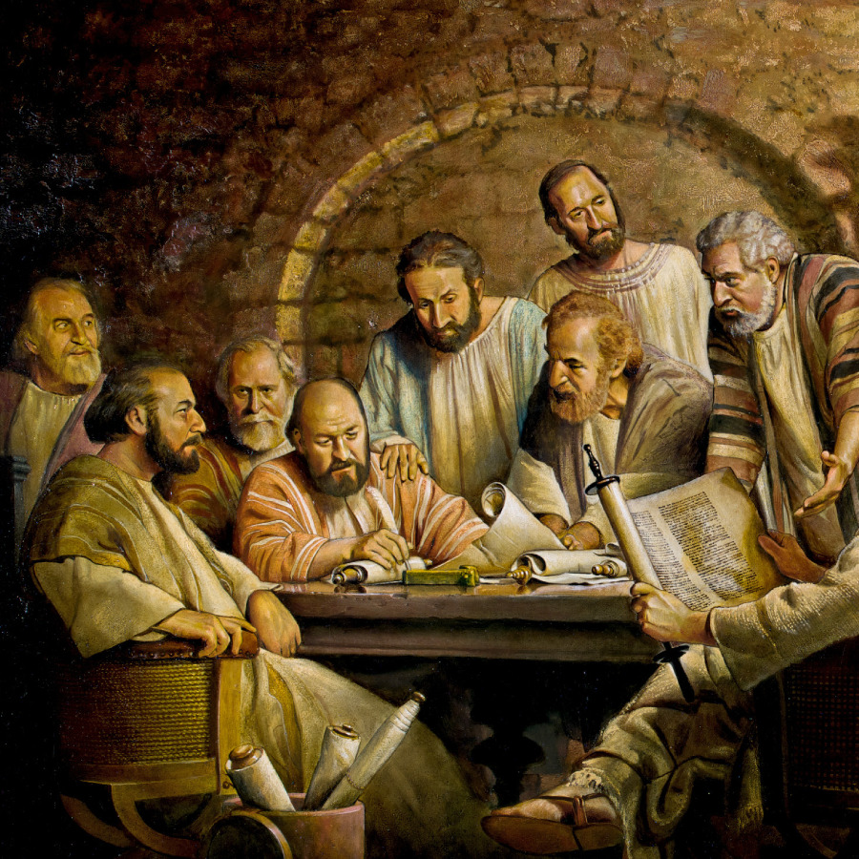
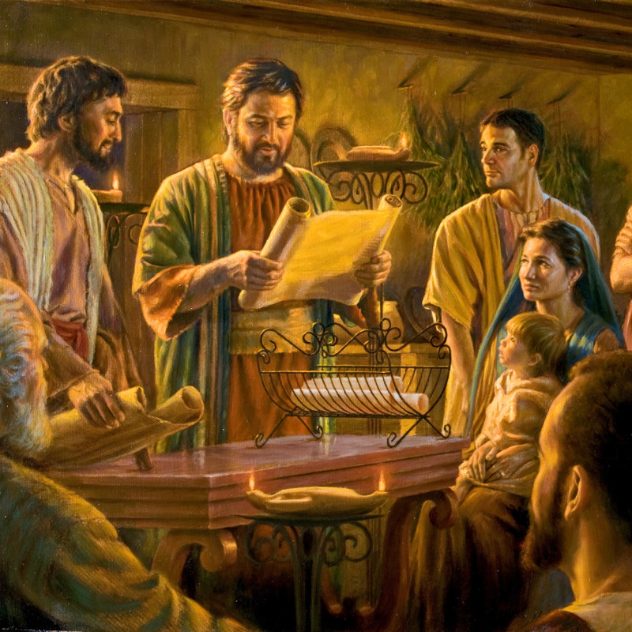
Propaganda Machine
JW.org, Lesson 20, How Does the Governing Body function today?

Slide 8
Governing Body is the “Voice of God”

Slide 9
Repeat of Rome?
JWs vs Catholicism
Arises Slowly to Primacy 1. Arises Slowly to Primacy
Claims to be the “Voice of God” 2. Claims to be the “Voice of God”
Must Submit conscience 3. Must Submit Conscience
Claims to speak for Christ 4. Vicar of Christ
Spiritual authority hierarchical structure 5. Church hierarchy
Only use their publications 6. Only use their publications
Watchtower guide to Bible 7. Catechism
No salvation outside church 8. No salvation outside church
NWT 9. Douay-Rheims, Good News, etc.
Excommunication/shunning 10. Excommunication
Works based Salvation 11. Works based Salvation
Coercive Conversion 12. Coercive Conversion
Don’t Look at other sources 13. Forbidden Books
Only Trust Us 14. Only Trust Us

Slide 10
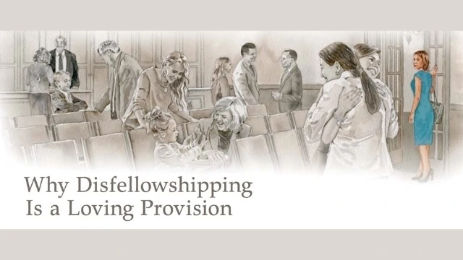
Overseers--Authority
“The offices of elder and ministerial servant were restored to Witness congregations in 1972, with appointments made from headquarters (and later by branch committees too). It was announced that, as of September 2014, appointments would be made by traveling overseers. In a major organizational overhaul in 1976, the power of the Watch Tower Society president was diminished, with authority for doctrinal and organizational decisions passed to the Governing Body” Wikipedia, Jehovah’s Witnesses

Slide 11
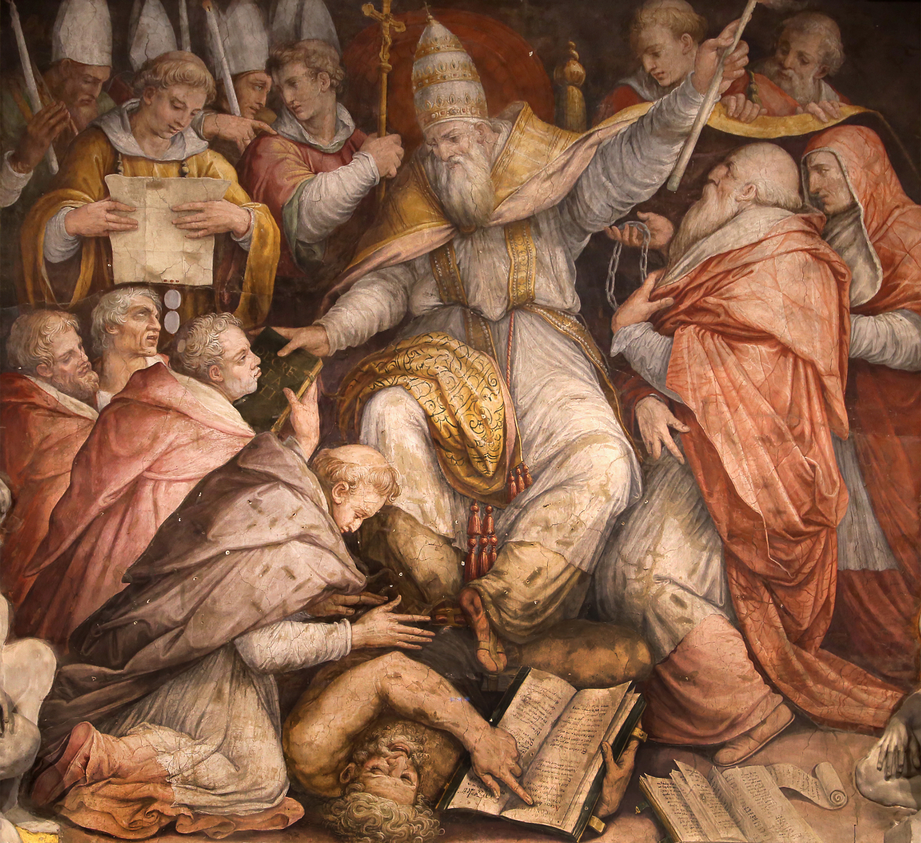
How Shunning Takes Place
“On June 7, 2022, the first degree decision unfavorable to the Jehovah’s Witnesses was overturned by the Court of Appeal of Ghent, which concluded that shunning can be freely taught and practiced in Belgium. . . . The elders’ manual “Shepherd the Flock of God” lists 18 types of offence which are potential grounds for disfellowshipping. The most common is sexual immorality, but the sanction also applies to celebrating other religious festivals, spreading false teachings, drunkenness, fraud, and theft. The elders appoint a committee of three men, who will listen to the witnesses and the offender, and then decide the outcome. . . . Members may not associate with the disfellowshipped or disassociated individual. It is also worth noting that reinstatement is possible, and indeed encouraged: the elders will attempt to visit the disfellowshipped member at least once a year to offer counsel and to determine whether the ex-member might be persuaded to return. One hears stories about a disfellowshipped Jehovah’s Witness being ordered out of the family home, with only a few belongings such an old van and no money for petrol, and having to sleep under a bridge as a consequence. It is hard to adjudicate on the veracity of individual stories, but it is certainly unlikely that this would be the norm in a Kingdom Hall today.” bitterwinter.org, disfellowshipping, shunning, and the Ghent Ruling, George Chryssides, https://bitterwinter.org/jehovahs-witnesses-disfellowshipping-shunning-and-the-ghent-ruling/

Slide 12
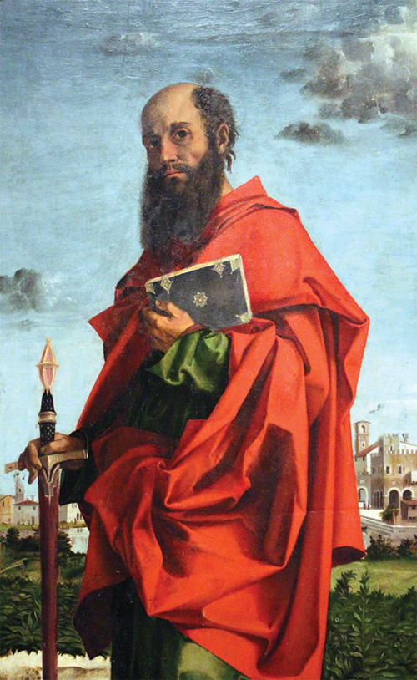
JW References on Shunning
2 John 9-11 “Whosoever transgresseth, and abideth not in the doctrine of Christ, hath not God. He that abideth in the doctrine of Christ, he hath both the Father and the Son. If there come any unto you, and bring not this doctrine, receive him not into your house, neither bid him God speed: For he that biddeth him God speed is partaker of his evil deeds.”
1 Cor. 15:31-34 “ I protest by your rejoicing which I have in Christ Jesus our Lord, I die daily. If after the manner of men I have fought with beasts at Ephesus, what advantageth it me, if the dead rise not? let us eat and drink; for to morrow we die. Be not deceived: evil communications corrupt good manners. Awake to righteousness, and sin not; for some have not the knowledge of God: I speak this to your shame.

Slide 13
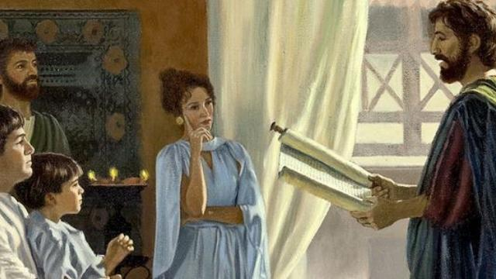
1 Corinthian 5 Shunning
1 Cor. 5:11-12 “But now I have written unto you not to keep company, if any man that is called a brother be a fornicator, or covetous, or an idolator, or a railer, or a drunkard, or an extortioner; with such an one no not to eat. For what have I to do to judge them also that are without? do not ye judge them that are within?”

Slide 14
Shunning in Practice
YouTube.com, “How Jehovah’s Witnesses Destroy Families”, Examining Religious Claims

Slide 15
Child Molestation Controversy
“The new Oxygen series “The Witnesses” is based on a five-year investigation by Trey Bundy of Reveal from The Center for Investigative Reporting into the coverup of child sexual abuse by Jehovah’s Witnesses leaders. Bundy has been uncovering how the Jehovah’s Witnesses hide child sexual abuse in their congregations – in fact, it’s official policy. The religion’s leaders have been going to extreme lengths to keep the details from public view.” revealnews.org/article/the-witnesses/, Feb. 5, 2020

Slide 16
Protecting Child Predators
Four Corners, ABC News (Australia), Jehovah's Witnesses set to defend child sexual abuse allegations in court, 2021

Slide 17
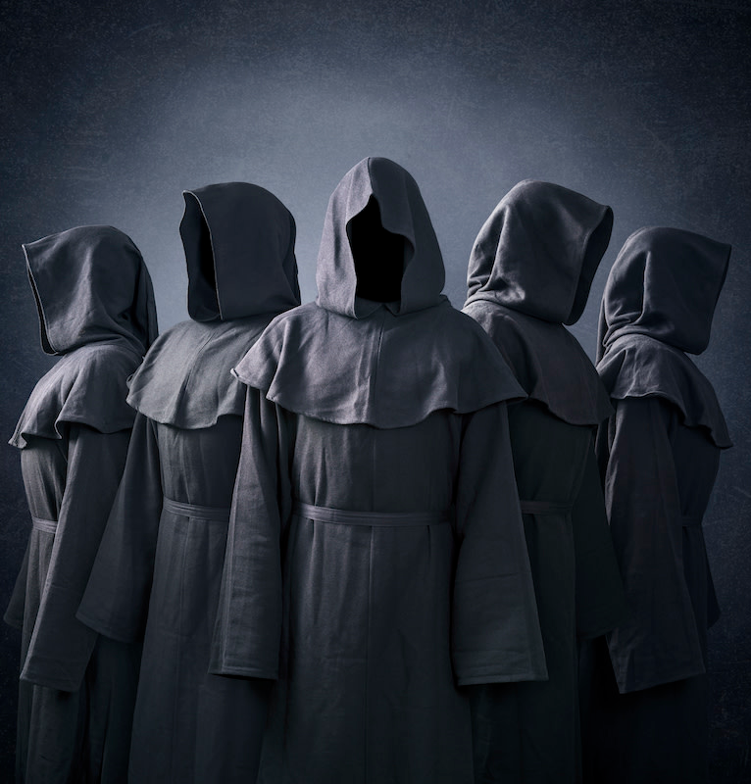
The Governing Body—Final Analysis
Evidence that the Governing Body is not the “voice of God”:
It asserts its own power in a similar way that the papacy rose to supremacy
Forces full submission of liberty of conscience to the “slave” just like Rome has done
Breaks up and shuns families who do not go in lockstep with their program, yet share that they do the opposite on media forums
False doctrines harbored- time-setting, blood transfusions, 1874, no 1914 as spiritual return of Christ, NWT, clearly not guided by God
Their Roman Catholic policy on child predatory behaviors

