Slide 1
Ezekiel, pt. 3
The Warning

Slide 2
Confirmation
Jeremiah has warned apostate Judah repeatedly to surrender to Nebuchadnezzar. He has repeatedly called them to repentance. He has repeatedly told them their captivity would be for 70 years. . All of his counsel, entreaties, and warnings have been in vain. When the truth of God has been rejected, lies become the order of the day and the devil had plenty ready!

Slide 3
A false prophet
“ And it came to pass the same year, in the beginning of the reign of Zedekiah king of Judah, in the fourth year, and in the fifth month that Hananiah the son of Azur the prophet, which was of Gibeon, spake unto me in the house of the LORD, in the presence of the priests and of all the people, saying, Thus speaketh the LORD of hosts, the God of Israel, saying, I have broken the yoke of the king of Babylon. Within two full years will I bring again into this place all the vessels of the LORD'S house, that Nebuchadnezzar king of Babylon took away from this place, and carried them to Babylon: And I will bring again to this place Jeconiah the son of Jehoiakim king of Judah, with all the captives of Judah, that went into Babylon, saith the LORD: for I will break the yoke of the king of Babylon. Then the prophet Jeremiah said unto the prophet Hananiah in the presence of the priests, and in the presence of all the people that stood in the house of the LORD,” Jeremiah 28:1-5

Slide 4
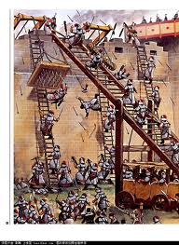
Ezekiel Affirms Jeremiah
“ Thou also, son of man, take thee a tile, and lay it before thee, and pourtray upon it the city, even Jerusalem: And lay siege against it, and build a fort against it, and cast a mount against it; set the camp also against it, and set battering rams against it round about. Moreover take thou unto thee an iron pan, and set it for a wall of iron between thee and the city: and set thy face against it, and it shall be besieged, and thou shalt lay siege against it. This shall be a sign to the house of Israel.” Ezekiel 4:1-3

Slide 5
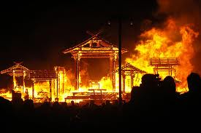
Keep in Mind
Nebuchadnezzar has already attacked the city of Jerusalem twice; once in 605 BC, and once in 597 BC. Ezekiel begins his ministry in 592 BC. Prophets in Judah are telling the people that they will be free from Babylonian captivity in a few years. Jeremiah and Ezekiel declare trouble for apostate Judah!

Slide 6
Strange Command
“ Lie thou also upon thy left side, and lay the iniquity of the house of Israel upon it: according to the number of the days that thou shalt lie upon it thou shalt bear their iniquity. For I have laid upon thee the years of their iniquity, according to the number of the days, three hundred and ninety days: so shalt thou bear the iniquity of the house of Israel.
And when thou hast accomplished them, lie again on thy right side, and thou shalt bear the iniquity of the house of Judah forty days: I have appointed thee each day for a year.” Ezekiel 4:4-6

Slide 7
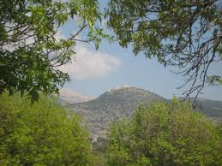
Day for a Year
The two time periods represent Israel’s falling from 975 BC, with the rise of Jeroboam till their utter collapse in 585 BC. The 40 years for Judah are from 625 to 585 BC.
The year day principle is outlined in these passages. Ezekiel was given super natural strength to fulfill this request!

Slide 8
No Prosperity Gospel Here!!!
“Therefore thou shalt set thy face toward the siege of Jerusalem, and thine arm shall be uncovered, and thou shalt prophesy against it. And, behold, I will lay bands upon thee, and thou shalt not turn thee from one side to another, till thou hast ended the days of thy siege. Take thou also unto thee wheat, and barley, and beans, and lentiles, and millet, and fitches, and put them in one vessel, and make thee bread thereof, according to the number of the days that thou shalt lie upon thy side, three hundred and ninety days shalt thou eat thereof. And thy meat which thou shalt eat shall be by weight, twenty shekels a day: from time to time shalt thou eat it. Thou shalt drink also water by measure, the sixth part of an hin: from time to time shalt thou drink. And thou shalt eat it as barley cakes, and thou shalt bake it with dung that cometh out of man, in their sight. And the LORD said, Even thus shall the children of Israel eat their defiled bread among the Gentiles, whither I will drive them. …

Slide 9
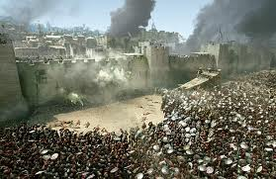
Seige is COMING
Then said I, Ah Lord GOD! behold, my soul hath not been polluted: for from my youth up even till now have I not eaten of that which dieth of itself, or is torn in pieces; neither came there abominable flesh into my mouth. Then he said unto me, Lo, I have given thee cow's dung for man's dung, and thou shalt prepare thy bread therewith. Moreover he said unto me, Son of man, behold, I will break the staff of bread in Jerusalem: and they shall eat bread by weight, and with care; and they shall drink water by measure, and with astonishment:: That they may want bread and water, and be astonied one with another, and consume away for their iniquity.” Ezekiel 4:8-17

Slide 10
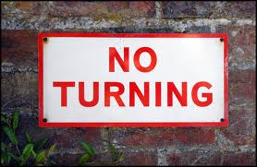
No Turning Back
The foolish prophets/teachers in Israel/Judah were telling the people lies. ‘All will be well within a few years’. Judgment, sure, swift, and powerful was on its way. The Jews are forged their own fetters; nothing could turn back the forth coming judgments; except a repentant heart!!

Slide 11
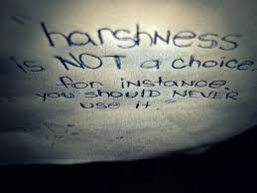
Too Harsh!
I like Jesus, but I don’t like God in the Old Testament. He was too harsh. The Godhead labored for a few thousand years to win Israel’s heart. They continuously and stubbornly refused His messages. The despised His commandments and the results are always the same!

Slide 12
God Can’t Protect Them
“ And thou, son of man, take thee a sharp knife, take thee a barber's razor, and cause it to pass upon thine head and upon thy beard: then take thee balances to weigh, and divide the hair. Thou shalt burn with fire a third part in the midst of the city, when the days of the siege are fulfilled: and thou shalt take a third part, and smite about it with a knife: and a third part thou shalt scatter in the wind; and I will draw out a sword after them. Thou shalt also take thereof a few in number, and bind them in thy skirts. Then take of them again, and cast them into the midst of the fire, and burn them in the fire; for thereof shall a fire come forth into all the house of Israel. Thus saith the Lord GOD; This is Jerusalem: I have set it in the midst of the nations and countries that are round about her. And she hath changed my judgments into wickedness more than the nations, and my statutes more than the countries that are round about her: for they have refused my judgments and my statutes, they have not walked in them…

Slide 13
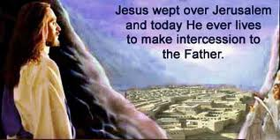
No Choice
“ Therefore thus saith the Lord GOD; Because ye multiplied more than the nations that are round about you, and have not walked in my statutes, neither have kept my judgments, neither have done according to the judgments of the nations that are round about you; Therefore thus saith the Lord GOD; Behold, I, even I, am against thee, and will execute judgments in the midst of thee in the sight of the nations.” Ezekiel 5:1-8

Slide 14
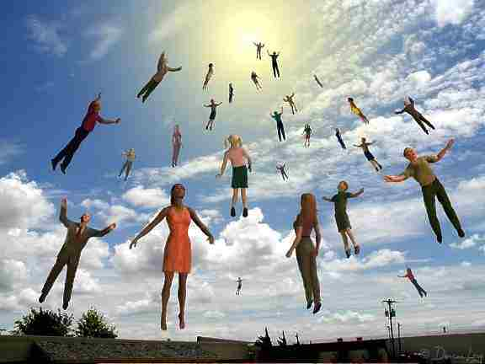
Raptured Away?????
Oh, but we are protected from that. That could never happen now. AS IT WAS IN THE DAYS OF EZEKIEL, SO IT WILL BE NOW! We are going to be raptured away!!! NO WE ARE NOT! SIN WILL BE PUNISHED!

Slide 15
Ezekiel 5:9-13
“And I will do in thee that which I have not done, and whereunto I will not do any more the like, because of all thine abominations. Therefore the fathers shall eat the sons in the midst of thee, and the sons shall eat their fathers; and I will execute judgments in thee, and the whole remnant of thee will I scatter into all the winds. Wherefore, as I live, saith the Lord GOD; Surely, because thou hast defiled my sanctuary with all thy detestable things, and with all thine abominations, therefore will I also diminish thee; neither shall mine eye spare, neither will I have any pity. A third part of thee shall die with the pestilence, and with famine shall they be consumed in the midst of thee: and a third part shall fall by the sword round about thee; and I will scatter a third part into all the winds, and I will draw out a sword after them. Thus shall mine anger be accomplished, and I will cause my fury to rest upon them, and I will be comforted: and they shall know that I the LORD have spoken it in my zeal, when I have accomplished my fury in them.” Ezekiel 5:9-13

Slide 16
His Strange Work
“Often they had heard Him declare that He came not to condemn the world, but that the world through Him might be saved. They remembered His words, "The Son of man is not come to destroy men's lives, but to save them." Luke 9:56. His wonderful works had been done to restore, never to destroy. The disciples had known Him only as the Restorer, the Healer. This act stood alone. What was its purpose? they questioned.
God "delighteth in mercy." "As I live, saith the Lord God, I have no pleasure in the death of the wicked." Micah 7:18; Ezek. 33:11. To Him the work of destruction and the denunciation of judgment is a "strange work." Isa. 28:21. But it is in mercy and love that He lifts the veil from the future, and reveals to men the results of a course of sin.” DA, pg. 582

Slide 17
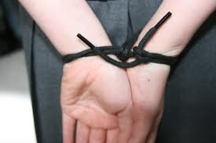
Tied Hands
“ Moreover I will make thee waste, and a reproach among the nations that are round about thee, in the sight of all that pass by. So it shall be a reproach and a taunt, an instruction and an astonishment unto the nations that are round about thee, when I shall execute judgments in thee in anger and in fury and in furious rebukes. I the LORD have spoken it. When I shall send upon them the evil arrows of famine, which shall be for their destruction, and which I will send to destroy you: and I will increase the famine upon you, and will break your staff of bread: So will I send upon you famine and evil beasts, and they shall bereave thee; and pestilence and blood shall pass through thee; and I will bring the sword upon thee. I the LORD have spoken it.” Ezekiel 5:14-17

Slide 18
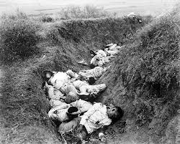
Casualties of War
When the mercies of God are despised; when the pleadings of God are so trampled upon that He can do no more, judgment comes and there are casualties. It is the inevitable consequence of war. “They shall come all for violence: their faces shall sup up as the east wind, and they shall gather the captivity as the sand.” Habb. 1:9

