Slide 1
Judges, pt. 11 Why Dan Failed

Slide 2
Dan, You're Missing!
“And I heard the number of them which were sealed: and there were sealed an hundred and forty and four thousand of all the tribes of the children of Israel. Of the tribe of Juda were sealed twelve thousand. Of the tribe of Reuben were sealed twelve thousand. Of the tribe of Gad were sealed twelve thousand. Of the tribe of Aser were sealed twelve thousand. Of the tribe of Naphtali were sealed twelve thousand. Of the tribe of Manasses were sealed twelve thousand. Of the tribe of Simeon were sealed twelve thousand. Of the tribe of Levi were sealed twelve thousand. Of the tribe of Issachar were sealed twelve thousand. Of the tribe of Zebulun were sealed twelve thousand. Of the tribe of Joseph were sealed twelve thousand. Of the tribe of Benjamin were sealed twelve thousand.” Rev. 7:4-8

Slide 3
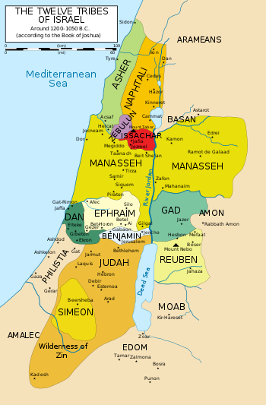
Dan and the 144,000
Dan is the one full tribe that was not recorded in the 144,000 list of the tribes of the children of Israel. Why is he not there? Could it be because he was a backbiter, (Gen. 49:17) or because he was only concerned with his prosperity and not that of his brethren? (Judges 5:17) Or, maybe sexual sins, like those of the most famous Danite, Samson, left him out of the illustrious 144,000? Backbiting, selfishness, and immorality can all keep someone out of heaven, but God can forgive these things too. I think what occurred in Judges 18 was Dan’s downfall!

Slide 4
The Backdrop
“In those days there was no king in Israel: and in those days the tribe of the Danites sought them an inheritance to dwell in; for unto that day all their inheritance had not fallen unto them among the tribes of Israel. And the children of Dan sent of their family five men from their coasts, men of valour, from Zorah, and from Eshtaol, to spy out the land, and to search it; and they said unto them, Go, search the land: who when they came to mount Ephraim, to the house of Micah, they lodged there. When they were by the house of Micah, they knew the voice of the young man the Levite: and they turned in thither, and said unto him, Who brought thee hither? and what makest thou in this place? and what hast thou here? And he said unto them, Thus and thus dealeth Micah with me, and hath hired me, and I am his priest. And they said unto him, Ask counsel, we pray thee, of God, that we may know whether our way which we go shall be prosperous. And the priest said unto them, Go in peace: before the LORD is your way wherein ye go.” Judges 18:1-6

Slide 5
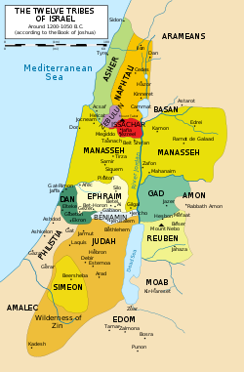
Checking Things Out!
The tribe of Dan, in close proximity to the tribe of Ephraim, decided to send out some men on a scouting mission. The five Danite men lodged in Micah’s house, checked out his wealth, and saw that he had his own, private priest. The Danites took note of all his goods and then departed.

Slide 6
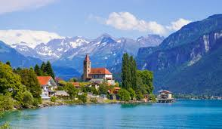
Returned With a Good Report
“And they came unto their brethren to Zorah and Eshtaol: and their brethren said unto them, What say ye? And they said, Arise, that we may go up against them: for we have seen the land, and, behold, it is very good: and are ye still? be not slothful to go, and to enter to possess the land. When ye go, ye shall come unto a people secure, and to a large land: for God hath given it into your hands; a place where there is no want of any thing that is in the earth.” Judges 18:8-10

Slide 7
Web is being Woven around Dan!
“And there went from thence of the family of the Danites, out of Zorah and out of Eshtaol, six hundred men appointed with weapons of war. And they went up, and pitched in Kirjathjearim, in Judah: wherefore they called that place Mahanehdan unto this day: behold, it is behind Kirjathjearim. And they passed thence unto mount Ephraim, and came unto the house of Micah. Then answered the five men that went to spy out the country of Laish, and said unto their brethren, Do ye know that there is in these houses an ephod, and teraphim, and a graven image, and a molten image? now therefore consider what ye have to do. And they turned thitherward, and came to the house of the young man the Levite, even unto the house of Micah, and saluted him.” Judges 18:11-15

Slide 8
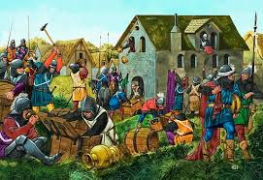
Took Everything!
The Danite men of war came to the house of Micah with every intention of robbing him blind! They knew of his possessions and knew that that would be a nice haul for one day’s work!! The priest was there, but Micah was out on an appointment. So, guess what the Danites did?

Slide 9
“And the five men that went to spy out the land went up, and came in thither, and took the graven image, and the ephod, and the teraphim, and the molten image: and the priest stood in the entering of the gate with the six hundred men that were appointed with weapons of war. And these went into Micah's house, and fetched the carved image, the ephod, and the teraphim, and the molten image. Then said the priest unto them, What do ye? And they said unto him, Hold thy peace, lay thine hand upon thy mouth,” Judges 18:17-19

Slide 10
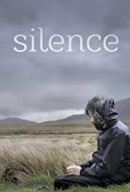
Silence!
When the tribe of Dan did wrong, as they were doing to Micah, no one was to say anything against them or their actions. They were untouchables!! This is not a good plan for success in this life and this is suicide in relation to the life to come. If we are not willing to acknowledge our sins, be sorry for them, and ask God to empower us to overcome them; then, we will never see the inside of the New Jerusalem. The tribe of Dan would not allow anyone to say anything negative about their actions! Bad.

Slide 11
End Time Church’s Deadly Disease
“And unto the angel of the church of the Laodiceans write; These things saith the Amen, the faithful and true witness, the beginning of the creation of God; I know thy works, that thou art neither cold nor hot: I would thou wert cold or hot. So then because thou art lukewarm, and neither cold nor hot, I will spue thee out of my mouth. Because thou sayest, I am rich, and increased with goods, and have need of nothing; and knowest not that thou art wretched, and miserable, and poor, and blind, and naked: I counsel thee to buy of me gold tried in the fire, that thou mayest be rich; and white raiment, that thou mayest be clothed, and that the shame of thy nakedness do not appear; and anoint thine eyes with eyesalve, that thou mayest see. As many as I love, I rebuke and chasten: be zealous therefore, and repent.” Revelation 3:14-19

Slide 12
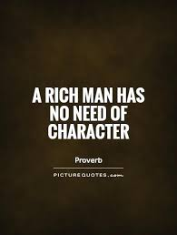
No Need!
“What greater deception can come upon human minds than a confidence that they are right when they are all wrong! The message of the True Witness finds the people of God in a sad deception, yet honest in that deception. They know not that their condition is deplorable in the sight of God. While those addressed are flattering themselves that they are in an exalted spiritual condition, the message of the True Witness breaks their security by the startling denunciation of their true condition of spiritual blindness, poverty, and wretchedness. The testimony, so cutting and severe, cannot be a mistake, for it is the True Witness who speaks, and His testimony must be correct.” 3T, pg. 252

Slide 13
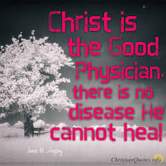
Dan Was in a Worse Position
The picture says Christ can heal every malady! Wrong! Christ can only heal those who recognize they are sick. He can not heal someone who is healthy or thinks they are healthy, like Laodicea or like Dan! “And when the scribes and Pharisees saw him eat with publicans and sinners, they said unto his disciples, How is it that he eateth and drinketh with publicans and sinners? When Jesus heard it, he saith unto them, They that are whole have no need of the physician, but they that are sick: I came not to call the righteous, but sinners to repentance.” Mark 2:16,17

Slide 14
Balm and Physician are there, but no healing!
“When Moses presented before the Lord the sad difficulties of the children of Israel, He did not present some new remedy, but called their attention to that which was at hand; for there was a bush or shrub which He had created that was to be cast into the water to make the fountain sweet and pure. When this was done, the suffering people could drink of the water with safety and pleasure. God has provided a balm for every wound. There is a balm in Gilead, there is a physician there.” (Letter 65a, 1894).
“Is there no balm in Gilead; is there no physician there? why then is not the health of the daughter of my people recovered?” Jeremiah 8:22

Slide 15
Micah Pursues Dan!
“And when they were a good way from the house of Micah, the men that were in the houses near to Micah's house were gathered together, and overtook the children of Dan. And they cried unto the children of Dan. And they turned their faces, and said unto Micah, What aileth thee, that thou comest with such a company? And he said, Ye have taken away my gods which I made, and the priest, and ye are gone away: and what have I more? and what is this that ye say unto me, What aileth thee?” Judges 18:22-24

Slide 16
Micah Demands Answers!
I treated you well. I allowed you into my home, and this is how you treat me. You steal my priest and my goods! Is this how you reward me? Daniel, again, shows his true colors. When confronted by their crime, Dan threw it back into Micah’s face, and demanded, “What is YOUR problem, Micah?” Micah was the one with the problem, not Dan! Right was wrong and wrong was right! This is the unpardonable sin, calling right wrong and wrong right! This was what kept Dan out of the 144,000!

Slide 17
Unpardonable Sin!
“But when the Pharisees heard it, they said, This fellow doth not cast out devils, but by Beelzebub the prince of the devils. And Jesus knew their thoughts, and said unto them, Every kingdom divided against itself is brought to desolation; and every city or house divided against itself shall not stand: And if Satan cast out Satan, he is divided against himself; how shall then his kingdom stand? And if I by Beelzebub cast out devils, by whom do your children cast them out? therefore they shall be your judges. But if I cast out devils by the Spirit of God, then the kingdom of God is come unto you. Or else how can one enter into a strong man's house, and spoil his goods, except he first bind the strong man? and then he will spoil his house. He that is not with me is against me; and he that gathereth not with me scattereth abroad. Wherefore I say unto you, All manner of sin and blasphemy shall be forgiven unto men: but the blasphemy against the Holy Ghost shall not be forgiven unto men. And whosoever speaketh a word against the Son of man, it shall be forgiven him: but whosoever speaketh against the Holy Ghost, it shall not be forgiven him, neither in this world, neither in the world to come.” Matthew 12:24-32

Slide 18
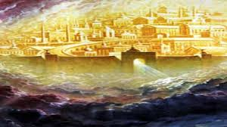
Dan Failed, but Refused to admit it!
The only sin God can not forgive is the one that is never acknowledged. If we persist in wrong and refuse to admit wrong, eventually, we think the transgression is no longer bad and begin to justify it and say it is all right to do wrong. Finally, the Holy Spirit, that convicts of sin, is silenced in the soul. The Third Person in the Godhead has been silenced. We can no longer hear His voice, In fact, we call His voice, the voice of wickedness! Scary, scary!!! Dan will be outside the New Jerusalem because of this sin!

