Slide 1
Final Scenes, pt.10
The Vine-Power

Slide 2
The Walk to Gethsemane
The upper room communion service was now finished. Judas was gone, having determined on betrayal of Christ. Jesus knew whither His footsteps were tending---separation from His Father, betrayal, forsaken by all, mockery, and then, crucifixion.
That which was uppermost in His mind were the disciples. Christ knew the trials that would assail them. He longed to guide them in straight paths. He told them, by an object lesson, the way to stay close to Him.

Slide 3
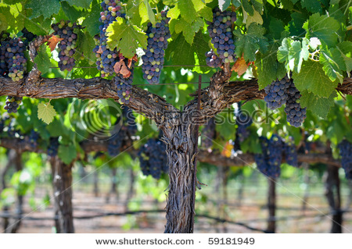
The True Vine
“I am the true vine, and my Father is the husbandman. Every branch in me that beareth not fruit he taketh away: and every branch that beareth fruit, he purgeth it, that it may bring forth more fruit.” Jn. 15:1,2

Slide 4
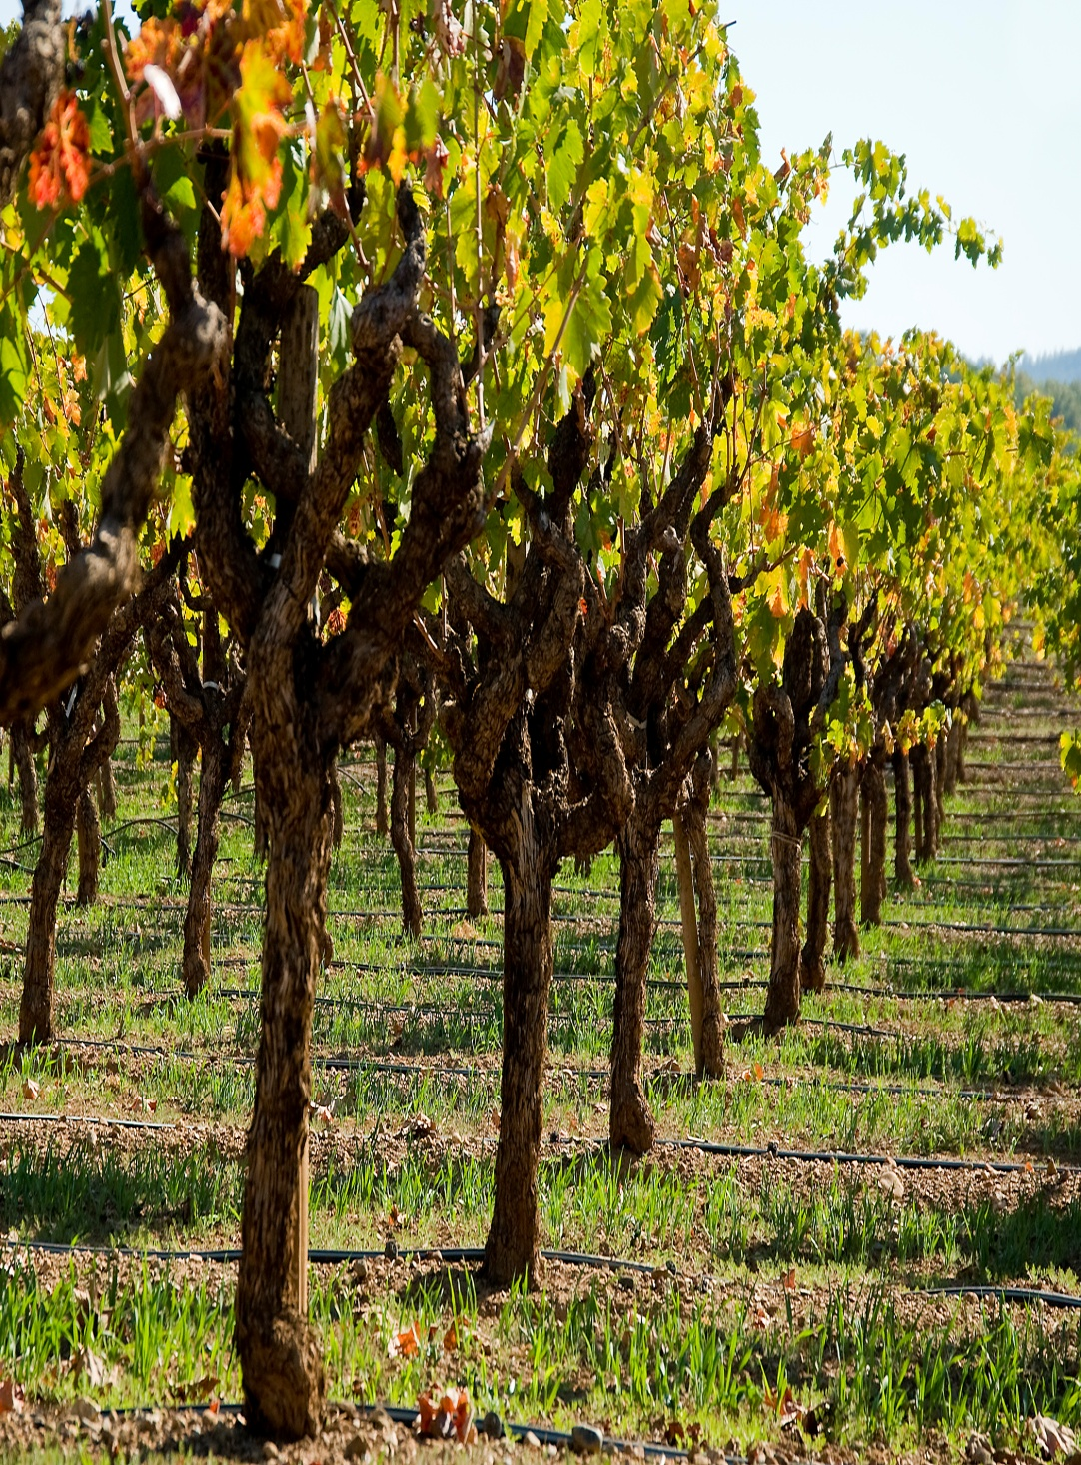
Only One
There is but one place in the universe where life is found.
“ All things were made by him; and without him was not any thing made that was made. In him was life; and the life was the light of men.” Jn. 1:3,4
“Jesus said unto her, I am the resurrection, and the life: he that believeth in me, though he were dead, yet shall he live:” Jn. 11:25

Slide 5
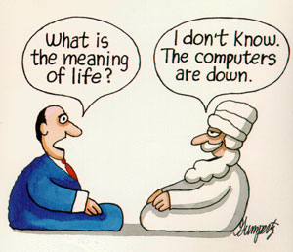
Life in Christ
There is no life in anything else. There is no life in going to church, being part of a church group, having our names on church books, claiming to believe in God, paying money to church, doing missionary work, or anything else!!

Slide 6
The Only Vine
"I am the true Vine," He says. Instead of choosing the graceful palm, the lofty cedar, or the strong oak, Jesus takes the vine with its clinging tendrils to represent Himself. The palm tree, the cedar, and the oak stand alone. They require no support. But the vine entwines about the trellis, and thus climbs heavenward. So Christ in His humanity was dependent upon divine power. "I can of Mine own self do nothing," He declared. John 5:30."I am the true Vine." The Jews had always regarded the vine as the most noble of plants, and a type of all that was powerful, excellent, and fruitful. Israel had been represented as a vine which God had planted in the Promised Land. The Jews based their hope of salvation on the fact of their connection with Israel. But Jesus says, I am the real Vine. Think not that through a connection with Israel you may become partakers of the life of God, and inheritors of His promise. Through Me alone is spiritual life received.” DA, pgs. 674,675

Slide 7
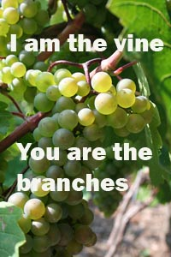
We are the Branches
The branches must maintain a connection to the vine moment by moment. This is the source of their power. Without that connection, the branches are lifeless. They can’t connect once a week. It is a daily affair.

Slide 8
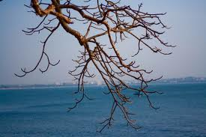
Dead Branches
Dead branches aren’t bad. Dead branches aren’t knowingly bad. Dead branches attend church will all the trimmings. Dead branches have a form of godliness; they don’t look horribly bad. They just aren’t connected to the VINE and forgot why they are here!!!

Slide 9
Connected to the Vine
“The connection of the branch with the vine, He said, represents the relation you are to sustain to Me. The scion is engrafted into the living vine, and fiber by fiber, vein by vein, it grows into the vine stock. The life of the vine becomes the life of the branch. So the soul dead in trespasses and sins receives life through connection with Christ. By faith in Him as a personal Saviour the union is formed. The sinner unites his weakness to Christ's strength, his emptiness to Christ's fullness, his frailty to Christ's enduring might. Then he has the mind of Christ. The humanity of Christ has touched our humanity, and our humanity has touched divinity. Thus through the agency of the Holy Spirit man becomes a partaker of the divine nature. He is accepted in the Beloved. This union with Christ, once formed, must be maintained.” DA, pgs. 675,676

Slide 10
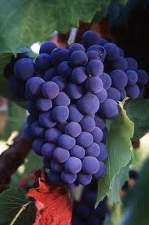
Bearing Fruit
“ Now the works of the flesh are manifest, which are these; Adultery, fornication, uncleanness, lasciviousness, Idolatry, witchcraft, hatred, variance, emulations, wrath, strife, seditions, heresies, Envyings, murders, drunkenness, revellings, and such like: of the which I tell you before, as I have also told you in time past, that they which do such things shall not inherit the kingdom of God. But the fruit of the Spirit is love, joy, peace, longsuffering, gentleness, goodness, faith, Meekness, temperance: against such there is no law. And they that are Christ's have crucified the flesh with the affections and lusts.” Galatians 5:19-24

Slide 11
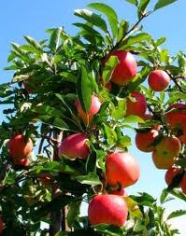
This is it!
“If ye abide in me, and my words abide in you, ye shall ask what ye will, and it shall be done unto you. Herein is my Father glorified, that ye bear much fruit; so shall ye be my disciples. As the Father hath loved me, so have I loved you: continue ye in my love.” Jn. 15:7-9

Slide 12
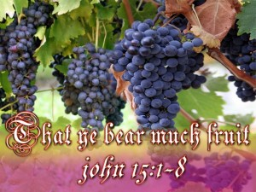
Part of 1st Angel’s Message
“And I saw another angel fly in the midst of heaven, having the everlasting gospel to preach unto them that dwell on the earth, and to every nation, and kindred, and tongue, and people, Saying with a loud voice, Fear God, and give glory to him; for the hour of his judgment is come: and worship him that made heaven, and earth, and the sea, and the fountains of waters.” Revelation 14:6,7

Slide 13
Fruit
"Herein is My Father glorified," said Jesus, "that ye bear much fruit." God desires to manifest through you the holiness, the benevolence, the compassion, of His own character. Yet the Saviour does not bid the disciples labor to bear fruit. He tells them to abide in Him. "If ye abide in Me," He says, "and My words abide in you, ye shall ask what ye will, and it shall be done unto you." It is through the word that Christ abides in His followers. This is the same vital union that is represented by eating His flesh and drinking His blood. The words of Christ are spirit and life. Receiving them, you receive the life of the Vine. You live "by every word that proceedeth out of the mouth of God." Matt. 4:4. The life of Christ in you produces the same fruits as in Him. Living in Christ, adhering to Christ, supported by Christ, drawing nourishment from Christ, you bear fruit after the similitude of Christ.” DA, pg. 677

Slide 14

Pain Brings Forth Fruit
”every branch that beareth fruit, he purgeth it, that it may bring forth more fruit.“
Verse 2
The school of hard knocks, learning that God’s way is the only way, usually can only be achieved by suffering.
“¹⁰ That I may know him, and the power of his resurrection, and the fellowship of his sufferings, being made conformable unto his death;” Phil. 3:10

Slide 15
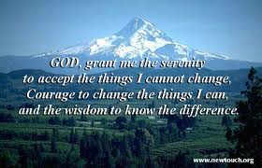
Serenity

Slide 16
Under the Knife
“Jesus, one as a withered branch was about to be taken away; the rest were to pass under the pruning knife of bitter trial. Jesus with solemn tenderness explained the purpose of the husbandman. The pruning will cause pain, but it is the Father who applies the knife. He works with no wanton hand or indifferent heart. There are branches trailing upon the ground; these must be cut loose from the earthly supports to which their tendrils are fastening. They are to reach heavenward, and find their support in God. The excessive foliage that draws away the life current from the fruit must be pruned off. The overgrowth must be cut out, to give room for the healing beams of the Sun of Righteousness. The husbandman prunes away the harmful growth, that the fruit may be richer and more abundant.” DA, pg. 677

Slide 17
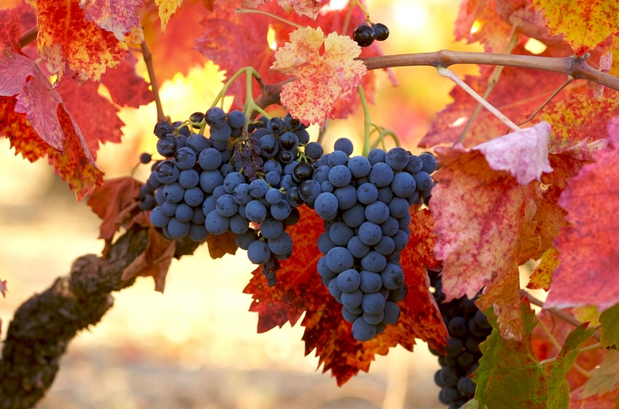
Fruit Thru Connection
“Abide in me, and I in you. As the branch cannot bear fruit of itself, except it abide in the vine; no more can ye, except ye abide in me.” Jn. 15:4

Slide 18
Our privilege
“While the graft is outwardly united with the vine, there may be no vital connection. Then there will be no growth or fruitfulness. So there may be an apparent connection with Christ without a real union with Him by faith. A profession of religion places men in the church, but the character and conduct show whether they are in connection with Christ. If they bear no fruit, they are false branches. Their separation from Christ involves a ruin as complete as that represented by the dead branch.” DA, pg. 676

