Slide 1
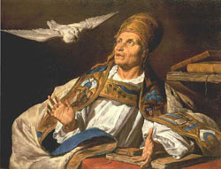
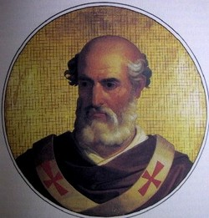
Baptized By Catholicism?
“Pope Gregory III moved All Saints’ Day from May to the beginning of November. One hundred years later. Pope Gregory IV decided that All Hallows’ Eve would be would be held on October 31. All Saints’ Day on November 2. The word ‘Halloween’ comes from ‘All Hallows’ Evening.’ This was gradually contracted to ‘All Hallows’ Even’,’ followed by ‘All Hallowe’en,’ and finally Halloween’.”—The Encyclopedia of Superstitions, p. 125
Deut. 18:9 “When thou art come into the land which the LORD thy God giveth thee, thou shalt not learn to do after the abominations of those nations.”

Slide 2
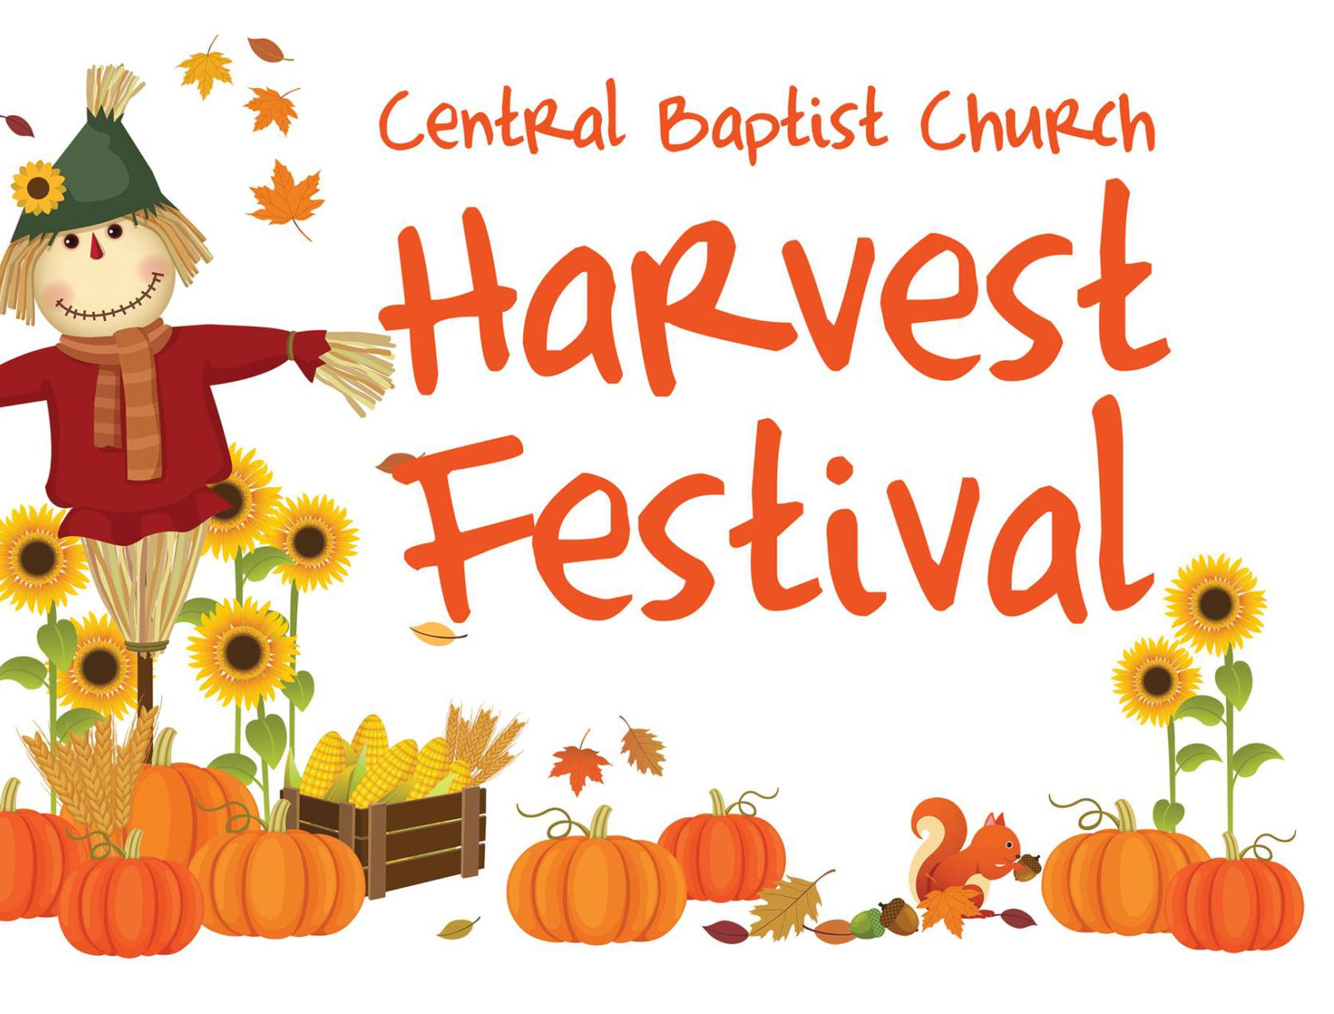
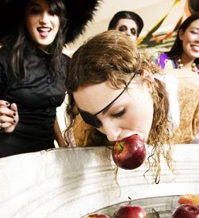
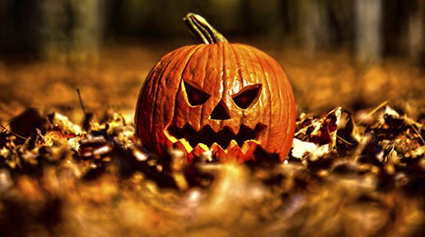
Deut. 12:30 “Take heed to thyself that thou be not snared by following them, after that they be destroyed from before thee; and that thou inquire not after their gods, saying, How did these nations serve their gods? even so will I do likewise.”

Slide 3
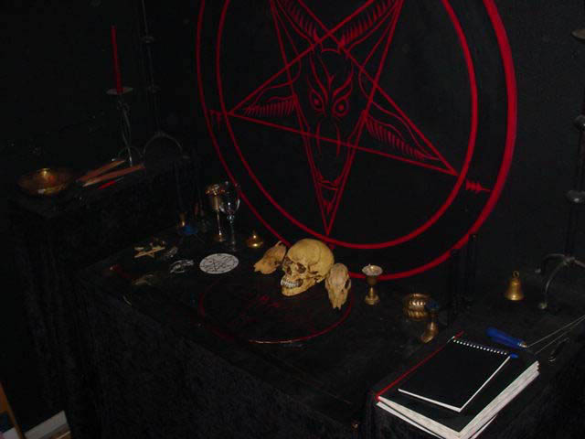
Human Sacrifices Still Happen Today…
As a child, Glenn Hobbs (a former Satanist) was deeply involved in the occult. He took part in Satanic sex worship with a young girl named Becky, having blood poured on him during the ritual, using drugs, summoning Lucifer, sacrificing different animals all occurring on Halloween. One Halloween night, Becky was tide to a Satanic altar and stabbed using Glenn’s hand by the high priest. According to Glenn, this is not an isolated event—this happens every year to innocent children throughout the world!—”Halloween: Day of Human Sacrificing”, youtube.com

Slide 4
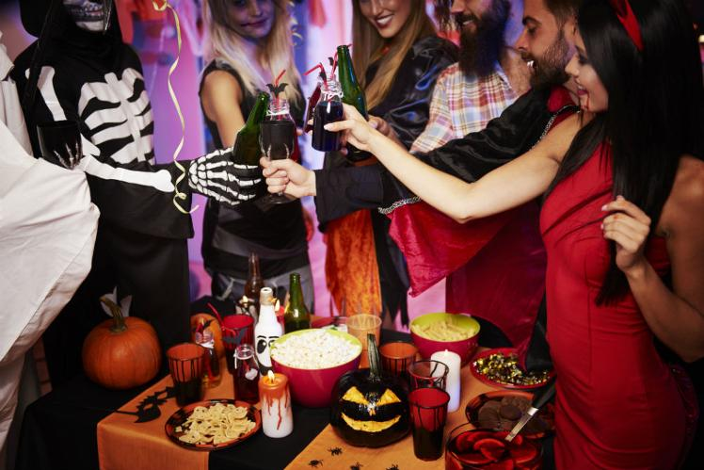
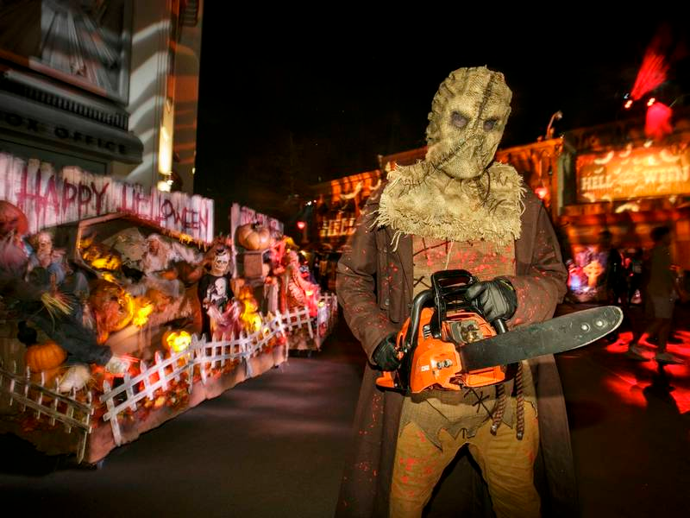
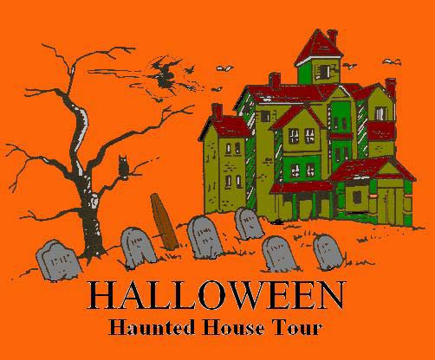
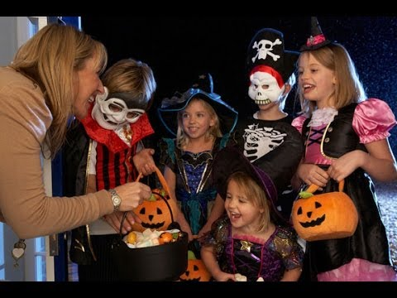

Slide 5
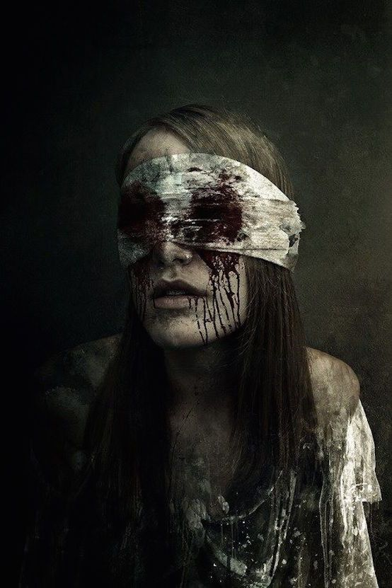
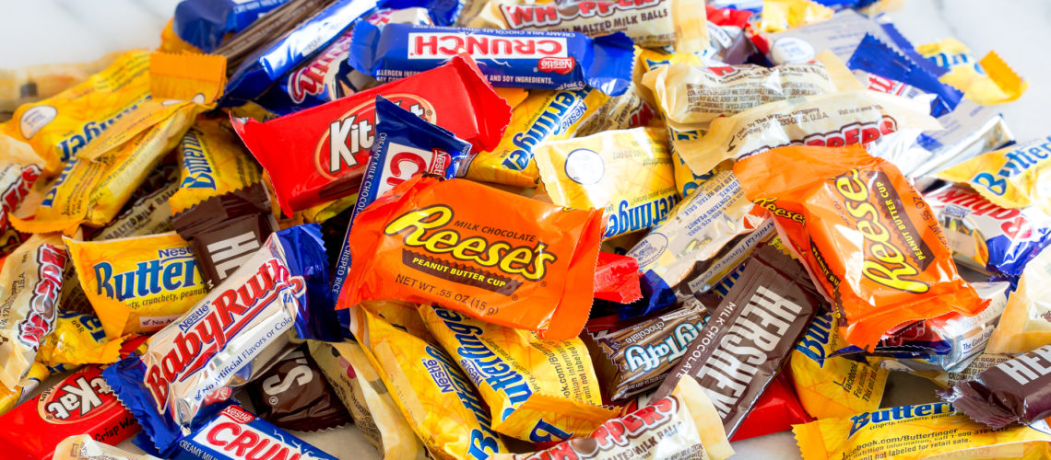
Glorification of Fear and Gluttony
Ask yourself, is this activity strengthening my spiritual walk? Am I feeling ennobled and closer to God? Is love and righteousness strengthened? Am I confident in His strength and mercy to overcome evil? Would I do this with Jesus? Or in heaven?
2 Tim. 1:7 “For God hath not given us the spirit of fear; but of power, and of love, and of a sound mind”

Slide 6
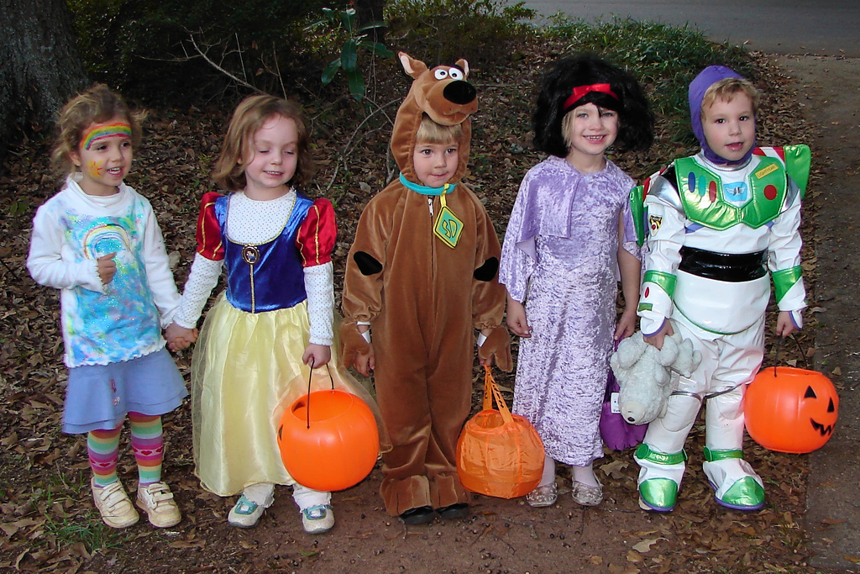
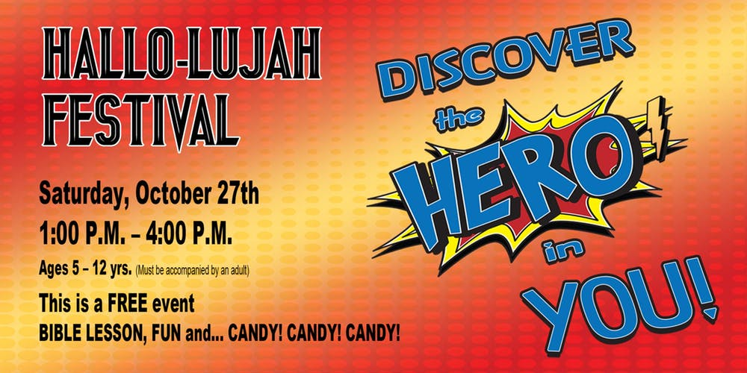
“Death, clad in the livery of heaven, lurks in the pathway of the young. Sin is gilded over by church sanctity. These various forms of amusement in the churches of our day have ruined thousands who, but for them, might have remained upright and become the followers of Christ. Wrecks of character have been made by these fashionable church festivals and theatrical performances, and thousands more will be destroyed; yet people will not be aware of the danger, nor of the fearful influences exerted. Many young men and women have lost their souls through these corrupting influences.”—The Review and Herald, November 21, 1878.

Slide 7
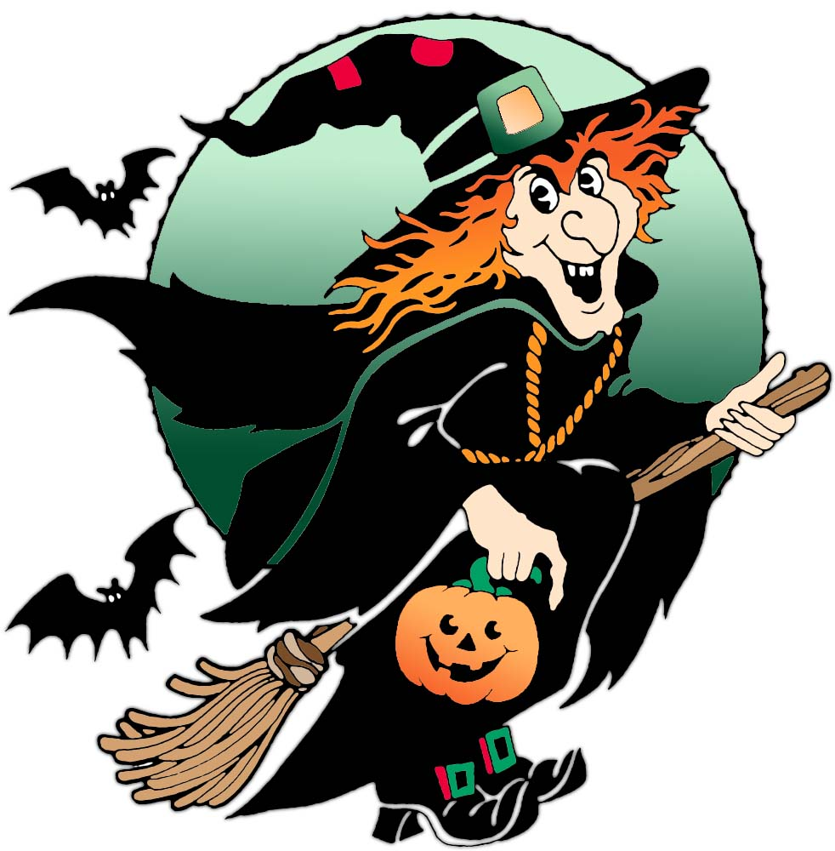
Holy with the Profane…
Ez. 44:23 “And they shall teach my people the difference between the holy and profane, and cause them to discern between the unclean and the clean.”
Rom. 12:9 “Abhor that which is evil; cleave to that which is good.”
Eph. 5:11 “And have no fellowship with the unfruitful works of darkness, but rather reprove them.”

Slide 8
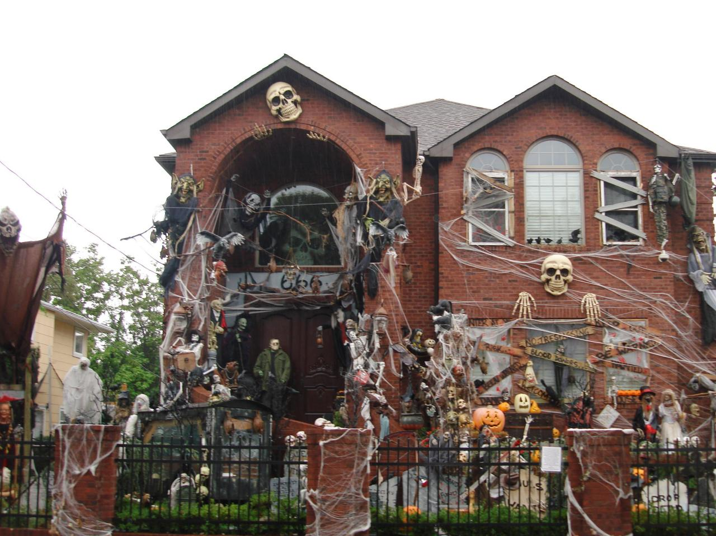
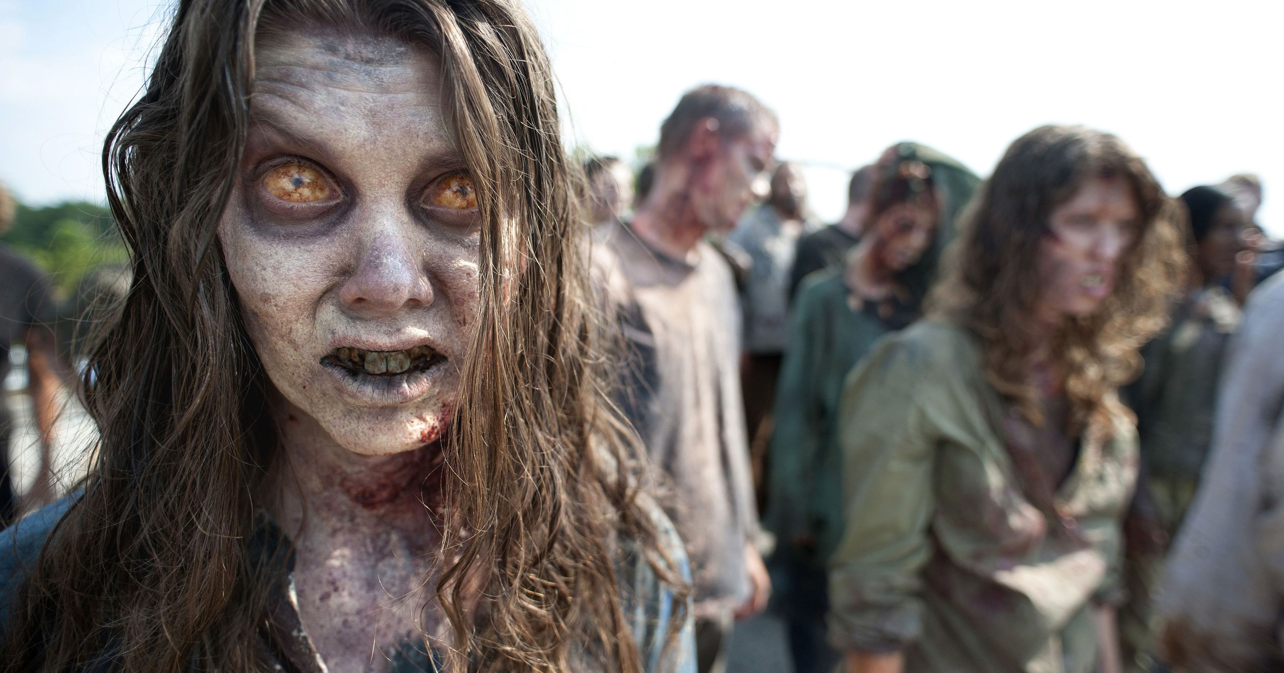
Glorification of Death and Evil….
1 Cor. 10:21 “But I say, that the things which the Gentiles sacrifice, they sacrifice to devils, and not to God: and I would not that ye should have fellowship with devils. Ye cannot drink the cup of the Lord, and the cup of devils: ye cannot be partakers of the Lord's table, and of the table of devils.”
Prov. 8:36 “all they that hate me love death.”

Slide 9
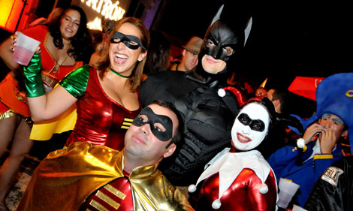
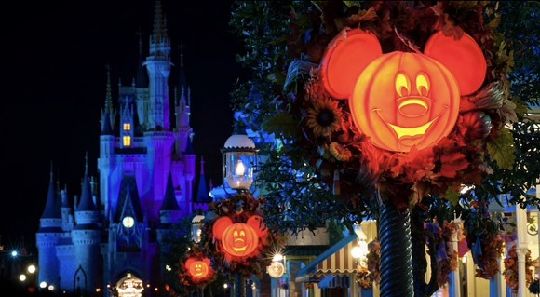
But Everyone is Doing It!?
Ex. 23:2 “Thou shalt not follow a multitude to do evil”
Matt. 7:13-14 “Enter ye in at the strait gate: for wide is the gate, and broad is the way, that leadeth to destruction, and many there be which go in thereat: Because strait is the gate, and narrow is the way, which leadeth unto life, and few there be that find it.

Slide 10
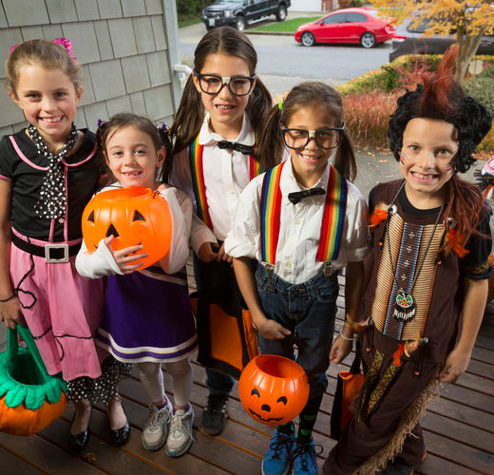
What if I dress up as a doctor, sailor, or soldier?
If you partake of this festival, by calling it another name, etc. you are still exposing your children to see and partake of death, fear, and evil. They will see the other children’s costumes. It teaches children that the war for good and evil is a joke or trivial matter. What’s worse however, is that this ritual day, acknowledged or not, is still used by the occult and pagans for the most criminal purposes. How does Jesus feel when we turn away from His counsel and participate in festivals which were inspired by demons…
Lev. 18:3 “After the doings of the land of Egypt, wherein ye dwelt, shall ye not do: and after the doings of the land of Canaan, whither I bring you, shall ye not do: neither shall ye walk in their ordinances.”

