Slide 1
Romans, pt. 24
Romans 14:1-23

Slide 2
Review of Romans 13
1. Romans 13 discusses the responsibility Christians have to their government.
2. Paul makes it clear that government is to be honored as long as they don’t seek to legislate the first table of the Decalogue.
3. Christ, Paul, and Peter said we are obligated to buy taxes, regardless of the corruption in government.
4. This obligation is part of honoring/loving our fellow man.

Slide 3
Be Gracious
“Him that is weak in the faith receive ye, [but] not to doubtful disputations. For one believeth that he may eat all things: another, who is weak, eateth herbs. Let not him that eateth despise him that eateth not; and let not him which eateth not judge him that eateth: for God hath received him. Who art thou that judgest another man's servant? to his own master he standeth or falleth. Yea, he shall be holden up: for God is able to make him stand.” Romans 14:1-4
Superficial readers of these verses would have Paul telling us that the people who eat vegetables are weak and that the strong folk are the ones who eating everything, clean and unclean meats! Is this what Paul is talking about? Is he re-writing all of the Old Testament health laws on diet?

Slide 4
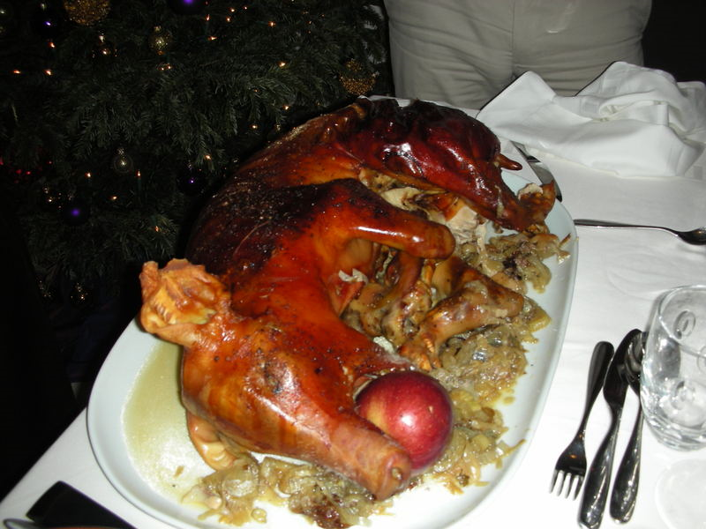
Yummy, Pig!?!?!
Acts 15 details a great council in Jerusalem and it looked at the great issues facing the early church and the Gentile converts. What things from Judaism would remain in the new church? What things would the Gentiles be encouraged to follow? What things would pass away? How quickly/stringently would they be enforced?

Slide 5
A Heated Meeting
Circumcision? Yes or No?
Feast days? Yes or No?
Health laws? Yes or No?
Sacrifices? Yes or No?
The ten commandments? Yes or No?
“This question was warmly discussed in the assembly. Intimately connected with the question of circumcision were several others demanding careful study. One was the problem as to what attitude should be taken toward the use of meats offered to idols. Many of the Gentile converts were living among ignorant and superstitious people who made frequent sacrifices and offerings to idols…The Holy Spirit saw good not to impose the ceremonial law on the Gentile converts, and the mind of the apostles regarding this matter was as the mind of the Spirit of God. James presided at the council, and his final decision was, "Wherefore my sentence is, that we trouble not them, which from among the Gentiles are turned to God." AA, pgs. 191,194

Slide 6
Paul and Circumcision/Feast Days
Paul said that circumcision was worthless. (1 Corinthians 7:19) He had Timothy circumcised. (Acts 16:3)
He said the feast days pointed to Christ and were beggarly elements. (Col. 2:14-17 and Galatians 4:9,10) However, he kept some of them. (Acts 18:21)
How can this be? Paul was dealing with Pharisaical Jews and heathen, Gentile converts from two extremes. He didn’t want to be a stumbling block toward anyone and didn’t want critical judgment to be manifest among the believers toward those strong in the faith and toward the weak in the faith. As people grew in their understanding of God’s will, Paul encouraged tolerance and patience toward one another; not intolerance, rudeness, and cruelty toward those who didn’t see it the way they did. Paul felt this way on non-salvational issues; not on issues relating to Christ and the 10 commandments

Slide 7
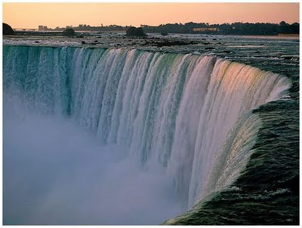
Paul’s Point
Those weak in faith should be received even though they may not see all ‘truth’. For a conscientious newcomer, something may be wrong for them to do, but for one more mature in the faith, the same thing may not be wrong. The mature one shouldn’t do what could be a stumbling block to the weaker soul and cause him to stumble nor should either person be judgmental of the other. If a weaker soul use to eat things sacrificed to idols, but now can’t because it would make him fall, Paul tells the more mature brethren not to eat things sacrificed to idols around them, lest it would cause them to stumble and lose their way.

Slide 8
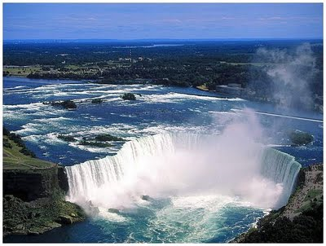
One Day Above Another
“One man esteemeth one day above another: another esteemeth every day [alike]. Let every man be fully persuaded in his own mind. He that regardeth the day, regardeth [it] unto the Lord; and he that regardeth not the day, to the Lord he doth not regard [it]. He that eateth, eateth to the Lord, for he giveth God thanks; and he that eateth not, to the Lord he eateth not, and giveth God thanks.” Romans 14:5,6

Slide 9
Paul’s Struggle and Counsel
Paul wasn’t talking about Sabbath and Sunday in these verses. The issue in Paul’s day centered around the keeping of the Jewish feast days. Many Jews still felt these days to be binding. Connected to each feast day was at least one ceremonial Sabbath. (See Leviticus 23) Paul knew these to be no longer binding, (Colossians 2:16,17), but admonished the brethren not to be judgmental of those who still kept them or didn’t keep them. Again, in something like this, Paul advised tolerance and tenderness and not harshness and cruelty. For those who made the feast days an issue of salvation, Paul came across stronger. “But now, after that ye have known God, or rather are known of God, how turn ye again to the weak and beggarly elements, whereunto ye desire again to be in bondage? Ye observe days, and months, and times, and years.” Galatians 4:9,10

Slide 10

Living for Whom?
“For none of us liveth to himself, and no man dieth to himself. For whether we live, we live unto the Lord; and whether we die, we die unto the Lord: whether we live therefore, or die, we are the Lord's. For to this end Christ both died, and rose, and revived, that he might be Lord both of the dead and living. But why dost thou judge thy brother? or why dost thou set at nought thy brother? for we shall all stand before the judgment seat of Christ.” Romans 14:7-10

Slide 11
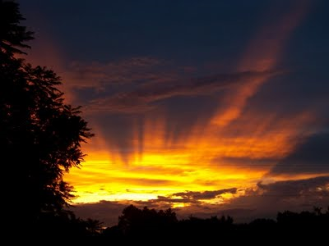
Responsibility
We are all responsible to someone; we all have a certain sphere of influence in others lives. We need to use our influence wisely and effectively toward the salvation of others. Just as Christ came “ not to be ministered unto, but to minister, and to give his life a ransom for many.” Matthew 20:28 Obviously, being judgmental was a grave problem in the lives of the Roman Christians and Paul nailed it. People were setting themselves up as the final word and using their influence to tear down others rather than to build them up in their walk. Brethren were being separated over the littleiest of things.

Slide 12

Judgment or Stumbling Block
“For it is written, As I live, saith the Lord, every knee shall bow to me, and every tongue shall confess to God. So then every one of us shall give account of himself to God. Let us not therefore judge one another any more: but judge this rather, that no man put a stumbling block or an occasion to fall in his brother's way.” Romans 14:11-13

Slide 13

My Influence
How am I using my influence? Am I constantly judging others and being critical of them? Am I tearing down others to make myself feel better? Does my influence win or repel? Paul was deeply concerned over the lack of kindness/tolerance in Rome and the horrible push to condemn and judge others instead!

Slide 14
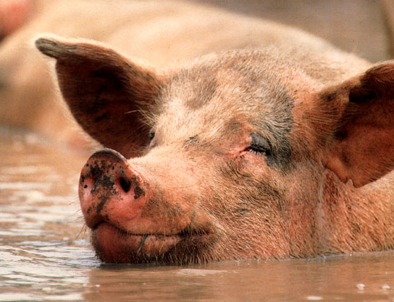
Food Was an Issue
“I know, and am persuaded by the Lord Jesus, that there is nothing unclean of itself: but to him that esteemeth any thing to be unclean, to him it is unclean. But if thy brother be grieved with thy meat, now walkest thou not charitably. Destroy not him with thy meat, for whom Christ died.” Romans 14:14,15 Is this guy now clean? Some would have us think so!!!

Slide 15
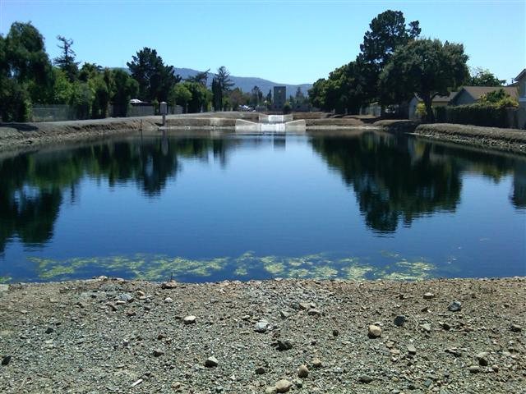
The Issue
Paul’s issue is not over clean and unclean meat; his issue is over how we treat others whose conscientious scruples disagree with ours!
1. The word for meat is broma which means food!
2. If your weaker brother is offended by you eating something and, for him, it is a conscientious issue, don’t do it in front of him and cause him/her to stumble. Be sensitive to others and how they feel.
3. How can we say that we love others when we intentionally offend weaker souls and cause them to stumble because we want to stand for the truth!

Slide 16
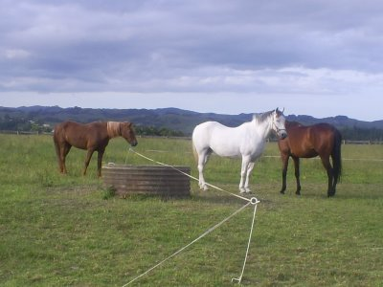
Edify One Another
“Let not then your good be evil spoken of: For the kingdom of God is not meat and drink; but righteousness, and peace, and joy in the Holy Ghost. For he that in these things serveth Christ is acceptable to God, and approved of men. Let us therefore follow after the things which make for peace, and things wherewith one may edify another.” Romans 14:16-19

Slide 17
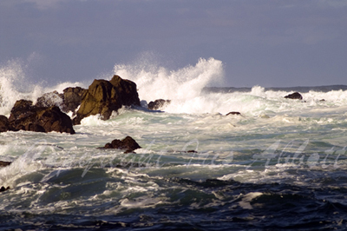
Mind /Body Connection
Paul’s comments are interesting. Food and drink are important only as they influence our mind and body to do certain things. Stimulating or tiring our mind and body leads to poor thinking and consequently, poor decisions. What is most important is that we are following what is right and living in peace with others by the power of the Holy Spirit! Proper health habits will put us in a position to hear the Spirit’s voice!

Slide 18
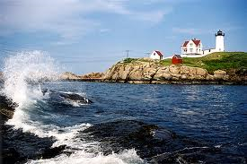
Be Careful!
“For meat destroy not the work of God. All things indeed are pure; but it is evil for that man who eateth with offence. It is good neither to eat flesh, nor to drink wine, nor any thing whereby thy brother stumbleth, or is offended, or is made weak. Hast thou faith? have it to thyself before God. Happy is he that condemneth not himself in that thing which he alloweth. And he that doubteth is damned if he eat, because he eateth not of faith: for whatsoever is not of faith is sin.” Romans 14: 20-23

Slide 19
Comment
Throughout the New Testament, it is important to understand that the word for meat is broma which means food. The word for flesh is kraes. This means animal flesh. Eat wisely, but don’t offend others in the process. Be careful not to cause another brother to stumble by what you are doing! This is Paul’s whole argument in Romans 14. What we choose to do, do it before God and not to display before others.

