Slide 1
Crisis in the Middle East

Slide 2
What does it mean? Many Angles!!!!
1. Crisis- forerunner to their Messiah.
2. Evangelibellies and a false Armageddon.
3. A 1,700 year dream come true.
4. American ‘dependence 'on oil.
5. Order from chaos spells Sunday!!

Slide 3
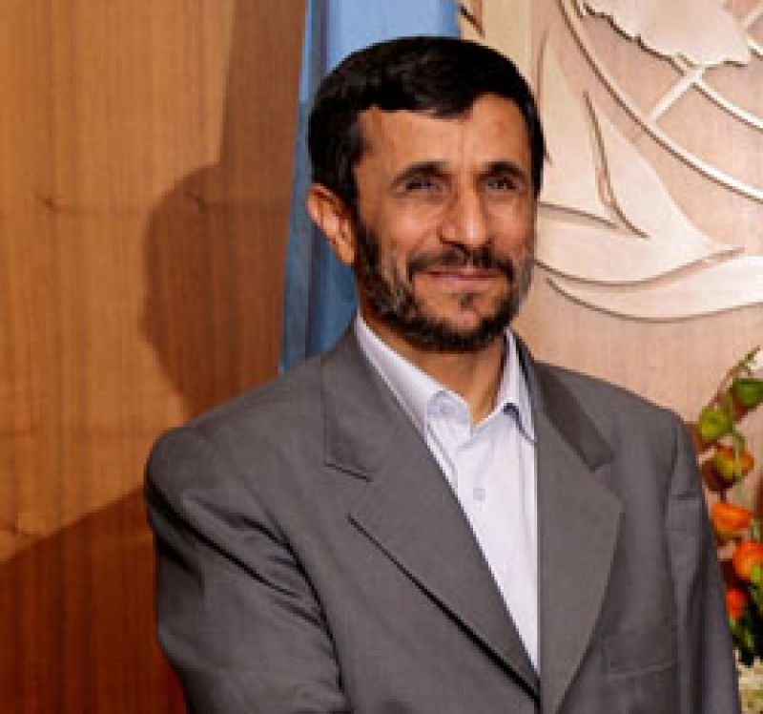
Crisis is necessary
“Iran's president believes Allah has chosen him to prepare the world for the coming of an Islamic 'savior' called the Mahdi.
But before the Mahdi's return, Mahmoud Ahmadinejad believes there must be global chaos - even if he has to create it himself.
Whether it's his belief that Israel should be wiped off the map, denials of the Holocaust, obsession with going nuclear, or support for radical Islamic terrorist groups, Mahmoud Ahmadinejad is a man on a divine mission.” http://www.cbn.com/cbnnews/411301.aspx

Slide 4
They Will Create it!!!
“Ahmadinejad is reportedly tied to a radical Islamic society in Iran that believes man can hasten the appearance of the Mahdi by creating chaos in the world.
"Ahmadinejad has stated that this chaos must take place before the Mahdi can come on the scene," Cantrell said.
Shiite eschatology says the Madhi's second coming will be marked by apocalyptic times. Wars, famines and floods will ravage the earth. Followed by judgment day and a battle between good and evil. "These will all come true under the rule of the perfect man, the last divine source on earth, the Mahdi, who will re-emerge, and Jesus Christ and other noble men will accompany him," Ahmadinejad once said. But until that day comes, Ahmadinejad, who sees himself as a kind of John the Baptist figure, is telling the world to prepare.” http://www.cbn.com/cbnnews/world/2008/October/Inside-Iran-Signs-of-the-Apocalypse-/

Slide 5
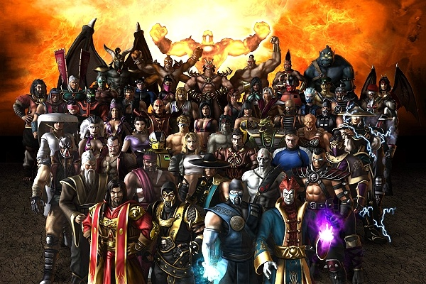
A False Armageddon Must Happen
All armies of the world, including the Tribulation Force, head for the Middle East to engage in one massive battle, as the world becomes even more dangerous to live in with death, mistrust, and treachery all around. Tim La Haye, considered one of the 25 most influential evangelicals, has been teaching this for decades.

Slide 6
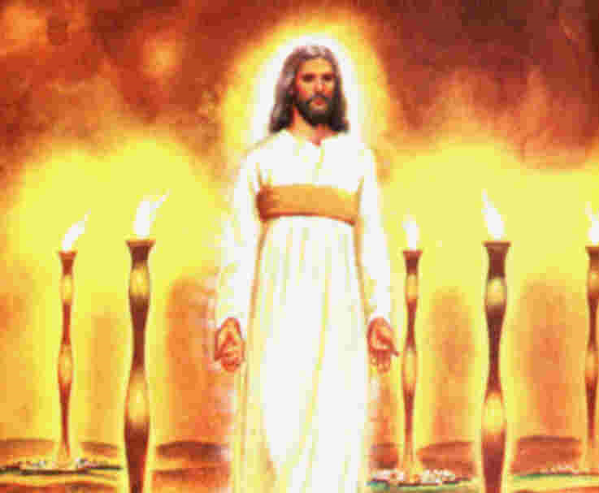
The Counterfeit
Before the mahdi (the Islamic messiah) can appear, chaos must come. This chaos will culminate in a false Armageddon where the powers of earth converge on the Middle East for battle. Only after this counterfeit battle takes place can the devil come, impersonating Christ.

Slide 7
All Religions Looking for Messiah
Islam-Mahdi
Buddhism-Maitreya: Meaning either 'The World Unifier' or simply 'The Friend’
The Aztec/Mayan Messiah: The return of Quetzalcoatl -- an olive-skinned man with a white beard and followers in red.
The Hindu Messiah: Kalki or Javada: The ninth and last Avatar of this yuga cycle. His final incarnation will appear from the West.
The Messiah of Central Asian nomads: The White Burkhan. He will come when the people of the steppes have abandoned their ancient gods (Communist Russia was atheist). He will come to offer them and the entire human race a spiritual rebirth.
The Christian Tradition-Jesus will come.
All religions await a Messiah figure. All whose names aren’t written in the Lamb’s book of life will see in the devil’s personating of Christ their messiah.

Slide 8
The Crowning Act
“As the crowning act in the great drama of deception, Satan himself will personate Christ. The church has long professed to look to the Saviour's advent as the consummation of her hopes. Now the great deceiver will make it appear that Christ has come. In different parts of the earth, Satan will manifest himself among men as a majestic being of dazzling brightness, resembling the description of the Son of God given by John in the Revelation. Revelation 1:13-15. The glory that surrounds him is unsurpassed by anything that mortal eyes have yet beheld. The shout of triumph rings out upon the air: "Christ has come! Christ has come!" The people prostrate themselves in adoration before him, while he lifts up his hands and pronounces a blessing upon them, as Christ blessed His disciples when He was upon the earth.” GC, pg. 624

Slide 9
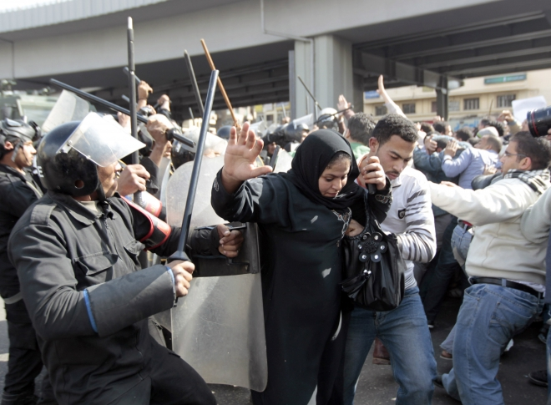
Havoc Breeds the Demand for a Peacemaker
As chaos possesses the Middle East, with each country seemingly following a similar pattern:
1. unrest
2. protests and riots
3. killing/armies called out
4. demand for leader’s removal
5. replaced with someone like him/ all under the Jesuits control
A cry will come for someone to bring peace!!

Slide 10
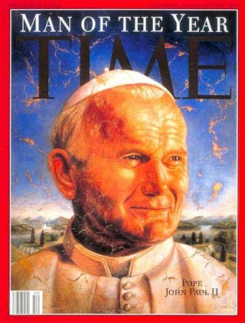
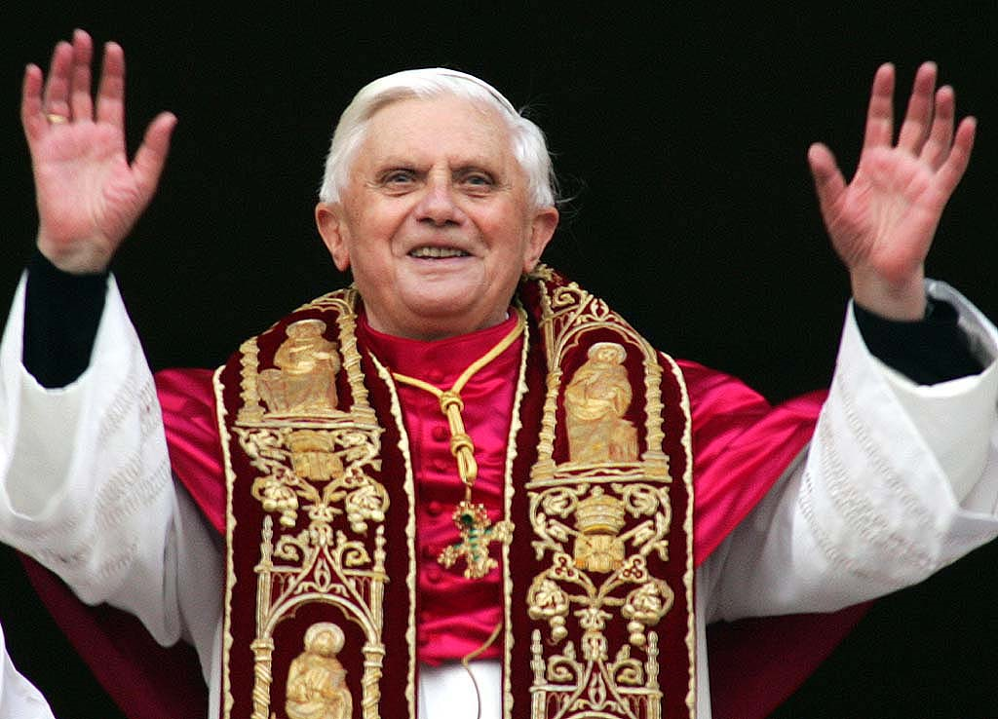
The Peacemaker

Slide 11
An Unfulfilled Dream
“In stark contrast to John Paul’s apology, the Vatican has now sponsored a conference that “portrays the Crusades as wars fought with the ‘noble aim’ of regaining the Holy Land for Christianity” (Times, London, March 20). One speaker at the mid-March symposium held at a pontifical university in Rome asserted that the crusaders were “inflamed by an ardor for charity and a love of God” (ansa, March 20).
It is important to understand the Vatican’s view of these Crusades for two reasons: 1) The Crusades showed the Catholic desire to control Christianity as a whole. 2) The Crusades showed this Catholic-branded form of Christianity’s desire to rule the world from Jerusalem.” http://www.thetrumpet.com/?q=2283.0.83.0

Slide 12
Coveting Jerusalem
“A Jesuit cardinal named Augustine Bea showed us how desperately the Roman Catholics wanted Jerusalem at the end of the third century.
Because of its religious history and its strategic location, the Holy City was considered a priceless treasure. A scheme had to be developed to make Jerusalem a Roman Catholic city…The Vatican desperately wanted Jerusalem because of its religious significance, but was blocked by the Jews.” Alberto Rivera’s ‘The Prophet’

Slide 13
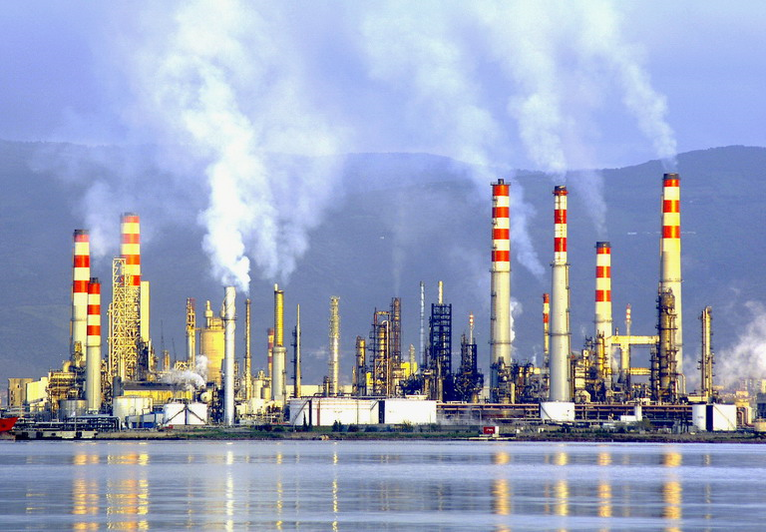
Dependence on Oil-Since 1973!!
“The 1973 oil crisis started in October 1973, when the members of Organization of Arab Petroleum Exporting Countries or the OAPEC (consisting of the Arab members of OPEC, plus Egypt, Syria and Tunisia) proclaimed an oil embargo "in response to the U.S. decision to re-supply the Israeli military" during the Yom Kippur war; it lasted until March 1974.^{[1]}With the US actions seen as initiating the oil embargo and the long term possibility of high oil prices, disrupted supply and recession, a strong rift was created within NATO.” Wikipedia

Slide 14
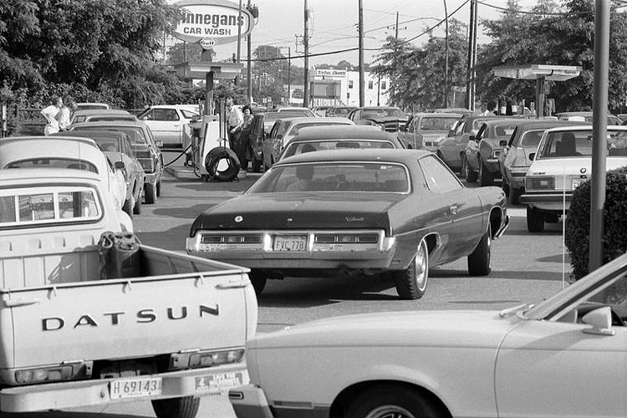
1973, 1979, 1990, and 2008
Long gas lines at the pump and skyrocketing of prices for a gallon of gas have characterized every oil crisis. With the rise of oil costs comes the inevitable rise in costs of every other commodity we buy. What will the rise in oil costs mean this time?

Slide 15
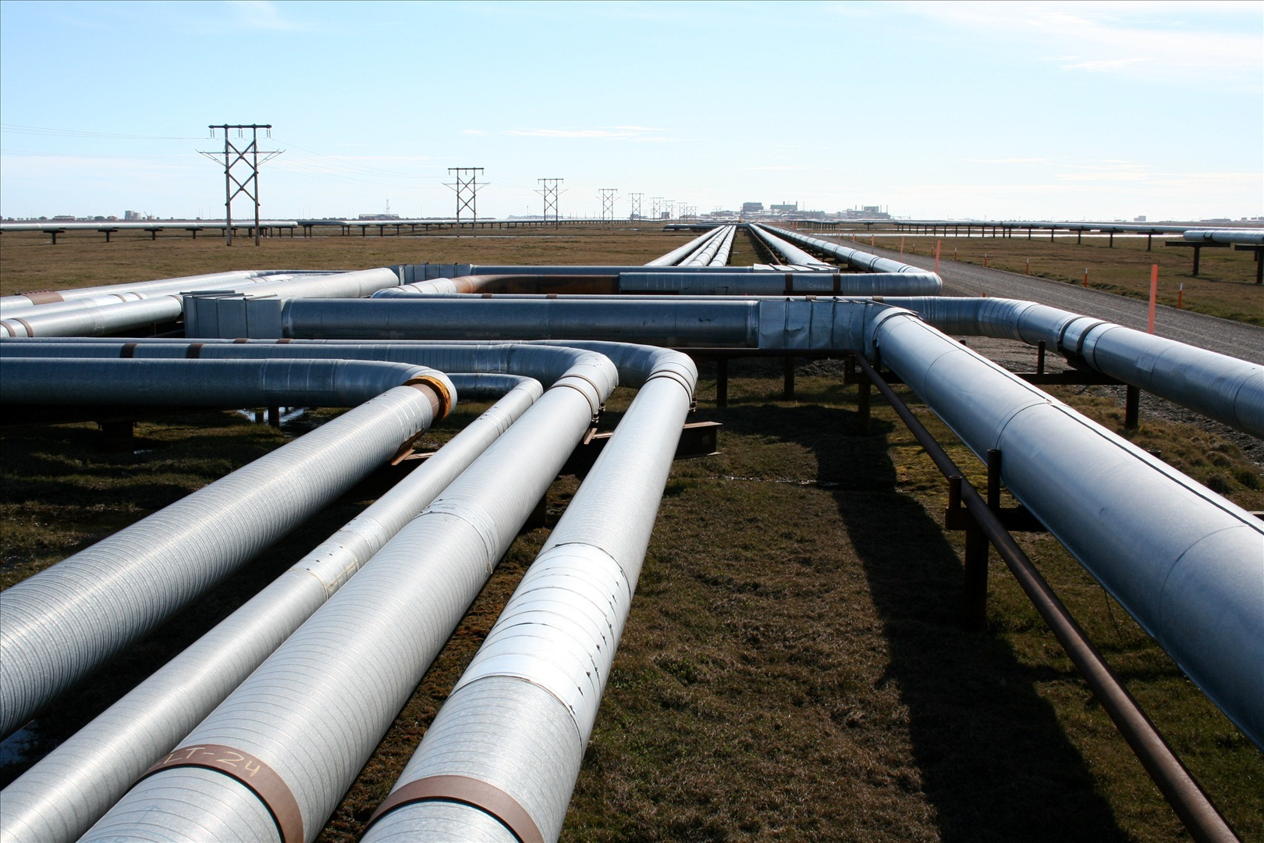
Doesn’t Have to Be!!
How much more pain must Americans endure before our masters in Washington let oil companies punch a few holes in the Alaskan tundra? Must we shiver pennilessly in the dark before we may extract new domestic petroleum deposits? Or shall we simply keep buying $111 barrels of oil from people who want us dead?... Approve new Alaskan oil drilling already. The Arctic National Wildlife Refuge’s pertinent parcel covers just 2,000 acres -- a veritable raindrop in the Olympic swimming pool that is Alaska’s 365-million-acre territory. ANWR’s estimated 10.4 billion barrels could match or replace for 19 years the 1.5 million barrels of Saudi oil that America imports daily.”http://www.humanevents.com/article.php?id=25964

Slide 16
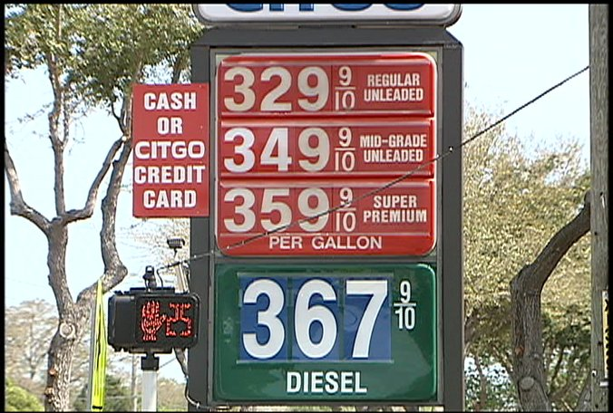
Prices Rising!
“Independent truckers have staged work stoppages to showcase their plight. Typical big-rig drivers who spent $837 to fill 250-gallon fuel tanks a year ago pay $1,189 today -- up 42 percent. As of Monday, automobile drivers paid a record average of $3.33 per gallon for self-serve gasoline, up 53 cents in 12 months, according to the federal Energy Information Administration.” http://www.humanevents.com/article.php?id=25964

Slide 17
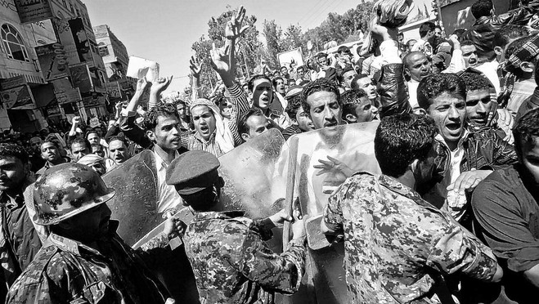
Coming Soon to a Town Near YOU!!
Chaos is being created throughout the world. We think it could never come to America. Think again!! It will come to America. People are getting totally fed up with corruption, greed, and injustice across this nation and world. Reminds me of a German philosopher; Hegel was his name!! The Hegelian dialectic it is called!!!

Slide 18
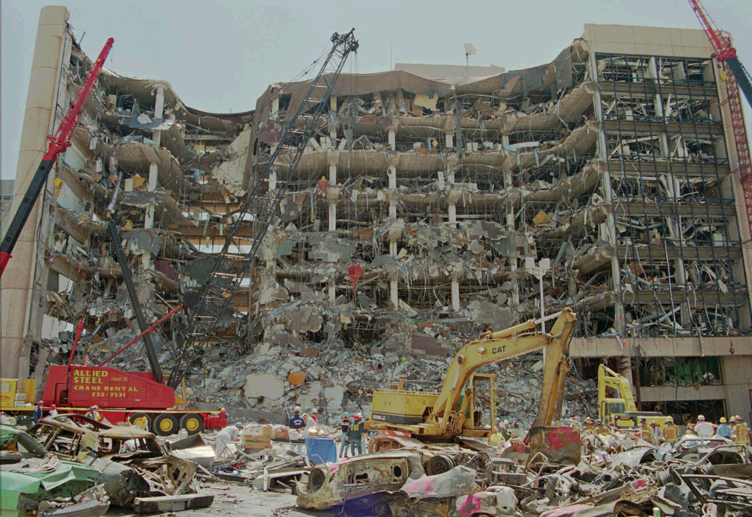
Hegelian Dialectic
Hegel’s ideas are very simple. You have an objective or something you want to accomplish. The way to achieve it is to create trouble bad enough so that people will start looking for a solution. When the troubles get bad enough, then you start offering the solution that you had in mind all along. Thus, you get what you want and the people have no idea that was what you wanted in the first place. The people are the pawns, moving exactly the way planned by the mastermind! We are Watching it work in the Middle East right now……………………..

Slide 19
The Solution in America-Back to God!!!
“Political corruption is destroying love of justice and regard for truth; and even in free America, rulers and legislators, in order to secure public favor, will yield to the popular demand for a law enforcing Sunday observance. Liberty of conscience, which has cost so great a sacrifice, will no longer be respected. In the soon-coming conflict we shall see exemplified the prophet's words: "The dragon was wroth with the woman, and went to make war with the remnant of her seed, which keep the commandments of God, and have the testimony of Jesus Christ." Revelation 12:17.”
GC, pg. 592

Slide 20
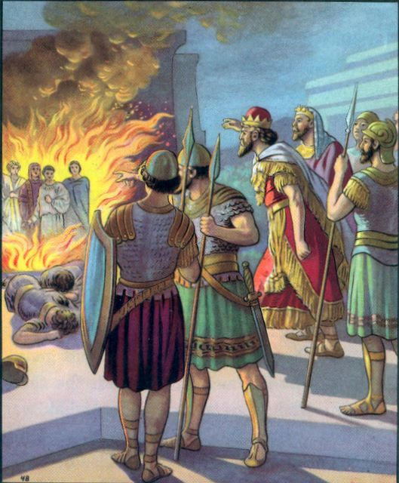
Christ Walks in Fire!!
If it be so, our God whom we serve is able to deliver us from the burning fiery furnace, and he will deliver us out of thine hand, O king. But if not, be it known unto thee, O king, that we will not serve thy gods, nor worship the golden image which thou hast set up…He answered and said, Lo, I see four men loose, walking in the midst of the fire, and they have no hurt; and the form of the fourth is like the Son of God.” Daniel 3:17, 18,25

