Slide 1
Jesus Life, pt. 16 “Rejected by Adventism”

Slide 2
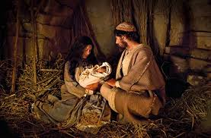
Every Opportunity Granted!
He gave Adventism every opportunity. Zacharias had been told the Messiah’s coming was imminent. They knew of His birth. The wisemen had asked them where the Messiah was born. They heard the testimony of Simeon and Anna. They heard Him in the temple at 12 and heard the preaching of John the Baptist. They heard John proclaim Jesus as Adventism’s Messiah! No stone was left unturned to try to win ancient Adventism. Strange infatuation; they knew not the time of their visitation!

Slide 3
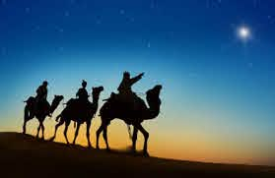
To accept the Messiah,
Adventism would have to
1. admit their interpretation of prophecy was wrong.
2. acknowledge their being separate from God because of their sins.
3. accept the fact that God bypassed them to reveal His plan to shepherds and wisemen; ignorant and heathen dogs!
This they would not do.

Slide 4
Broke His Heart!
“The Messiah's coming had been first announced in Judea. In the temple at Jerusalem the birth of the forerunner had been foretold to Zacharias as he ministered before the altar. On the hills of Bethlehem the angels had proclaimed the birth of Jesus. To Jerusalem the magi had come in search of Him. In the temple Simeon and Anna had testified to His divinity. “Jerusalem, and all Judea” had listened to the preaching of John the Baptist; and the deputation from the Sanhedrin, with the multitude, had heard his testimony concerning Jesus. In Judea, Christ had received His first disciples. Here much of His early ministry had been spent. The flashing forth of His divinity in the cleansing of the temple, His miracles of healing, and the lessons of divine truth that fell from His lips, all proclaimed that which after the healing at Bethesda He had declared before the Sanhedrin,—His Sonship to the Eternal.” DA, pg. 231

Slide 5
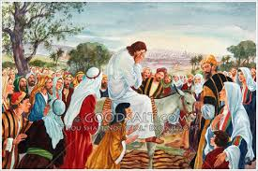
Today; No Different
“And when he was come near, he beheld the city, and wept over it, Saying, If thou hadst known, even thou, at least in this thy day, the things which belong unto thy peace! but now they are hid from thine eyes. For the days shall come upon thee, that thine enemies shall cast a trench about thee, and compass thee round, and keep thee in on every side, And shall lay thee even with the ground, and thy children within thee; and they shall not leave in thee one stone upon another; because thou knewest not the time of thy visitation.” Luke 19:41-44

Slide 6
Christ’s Response
“If the leaders in Israel had received Christ, He would have honored them as His messengers to carry the gospel to the world. To them first was given the opportunity to become heralds of the kingdom and grace of God. But Israel knew not the time of her visitation. The jealousy and distrust of the Jewish leaders had ripened into open hatred, and the hearts of the people were turned away from Jesus. The Sanhedrin had rejected Christ's message and was bent upon His death; therefore Jesus departed from Jerusalem, from the priests, the temple, the religious leaders, the people who had been instructed in the law, and turned to another class to proclaim His message, and to gather out those who should carry the gospel to all nations.” Desire of Ages, pg. 232

Slide 7
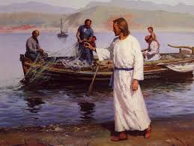
Called Whom Would Listen
Christ turned from the apostasy in Adventism and called for others to carry His messages to the world. He still found faithful in Adventism to do His work and to proclaim His truths to the world. Tragically, by their rejection of light, apostate Adventism was in a sorry state.

Slide 8
Whole System to be Swept Away!
“The people whom God had called to be the pillar and ground of the truth had become representatives of Satan. They were doing the work that he desired them to do, taking a course to misrepresent the character of God, and cause the world to look upon Him as a tyrant. The very priests who ministered in the temple had lost sight of the significance of the service they performed. They had ceased to look beyond the symbol to the thing signified. In presenting the sacrificial offerings they were as actors in a play. The ordinances which God Himself had appointed were made the means of blinding the mind and hardening the heart. God could do no more for man through these channels. The whole system must be swept away.” DA, pg. 36

Slide 9
“As the light and life of men was rejected by the ecclesiastical authorities in the days of Christ, so it has been rejected in every succeeding generation. Again and again the history of Christ's withdrawal from Judea has been repeated. When the Reformers preached the word of God, they had no thought of separating themselves from the established church; but the religious leaders would not tolerate the light, and those that bore it were forced to seek another class, who were longing for the truth. In our day few of the professed followers of the Reformers are actuated by their spirit. Few are listening for the voice of God, and ready to accept truth in whatever guise it may be presented. Often those who follow in the steps of the Reformers are forced to turn away from the churches they love, in order to declare the plain teaching of the word of God. And many times those who are seeking for light are by the same teaching obliged to leave the church of their fathers, that they may render obedience.” DA, pg. 232

Slide 10
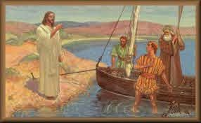
Christ wanted to use ancient Adventism, but their arrogance, pride, and self-righteousness left them out. Thus, Christ chose smelly fishermen to carry the torch to the world. Thus, it has been in every era of the Christian church.

Slide 11
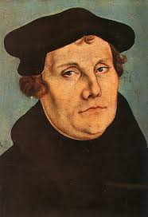
Luther
Luther was a dyed in the wool Catholic. He had no thought of leaving Catholicism. However, when he realized he could no longer remain a Catholic and preach the truth for his time, he left and started Lutheranism. Thus, it was with Calvin, Knox, Wesley, and many others!

Slide 12
Is it that way today?
Why are we in a self supporting church/ministry? Is it because this is what we started out to do? Or, is it because we can’t preach the truth for this time in mainstream Adventism? The answer is obvious. Just like the lady from Kenya who is being pushed out of Adventism because she dares to preach the 2nd and 3rd angel’s messages.

Slide 13
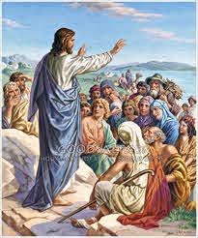
The message of Jesus
Now after that John was put in prison, Jesus came into Galilee, preaching the gospel of the kingdom of God, And saying, The time is fulfilled, and the kingdom of God is at hand: repent ye, and believe the gospel.” Mk. 1:14,15

Slide 14
Based on a Time Prophecy
“The burden of Christ's preaching was, “The time is fulfilled, and the kingdom of God is at hand; repent ye, and believe the gospel.” Thus the gospel message, as given by the Saviour Himself, was based on the prophecies. The “time” which He declared to be fulfilled was the period made known by the angel Gabriel to Daniel. “Seventy weeks,” said the angel, “are determined upon thy people and upon thy holy city, to finish the transgression, and to make an end of sins, and to make reconciliation for iniquity, and to bring in everlasting righteousness, and to seal up the vision and prophecy, and to anoint the most holy.” Daniel 9:24. A day in prophecy stands for a year. See Numbers 14:34; Ezekiel 4:6. The seventy weeks, or four hundred and ninety days, represent four hundred and ninety years. A starting point for this period is given: “Know therefore and understand, that from the going forth of the commandment to restore and to build Jerusalem unto the Messiah the Prince shall be seven weeks, and threescore and two weeks,” sixty-nine weeks, or four hundred and eighty-three years. Daniel 9:25. The commandment to restore and build Jerusalem, as completed by the decree of Artaxerxes Longimanus (see Ezra 6:14; 7:1, 9, margin), went into effect in the autumn of B. C. 457. From this time four hundred and eighty-three years extend to the autumn of A. D. 27. According to the prophecy, this period was to reach to the Messiah, the Anointed One. In A. D. 27, Jesus at His baptism received the anointing of the Holy Spirit, and soon afterward began His ministry. Then the message was proclaimed. “The time is fulfilled.” DA, pg. 233

Slide 15
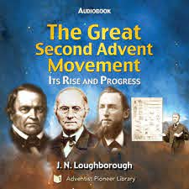
Only One Other Gospel Based on Time
“And I saw another angel fly in the midst of heaven, having the everlasting gospel to preach unto them that dwell on the earth, and to every nation, and kindred, and tongue, and people, Saying with a loud voice, Fear God, and give glory to him; for the hour of his judgment is come: and worship him that made heaven, and earth, and the sea, and the fountains of waters.” Revelation 14:6,7

Slide 16
Do Not Leave Your First Love!!!
“But after a time the zeal of the believers began to wane, and their love for God and for one another grew less. Coldness crept into the church. Some forgot the wonderful manner in which they had received the truth. One by one the old standard-bearers fell at their post. Some of the younger workers, who might have shared the burdens of these pioneers, and thus have been prepared for wise leadership, had become weary of oft-repeated truths. In their desire for something novel and startling they attempted to introduce new phases of doctrine, more pleasing to many minds, but not in harmony with the fundamental principles of the gospel. In their self-confidence and spiritual blindness they failed to discern that these sophistries would cause many to question the experiences of the past, and would thus lead to confusion and unbelief.
As these false doctrines were urged, differences sprang up, and the eyes of many were turned from beholding Jesus as the Author and Finisher of their faith. The discussion of unimportant points of doctrine, and the contemplation of pleasing fables of man's invention, occupied time that should have been spent in proclaiming the gospel. The masses that might have been convicted and converted by a faithful presentation of the truth were left unwarned.” AA, pg. 580

