Slide 1
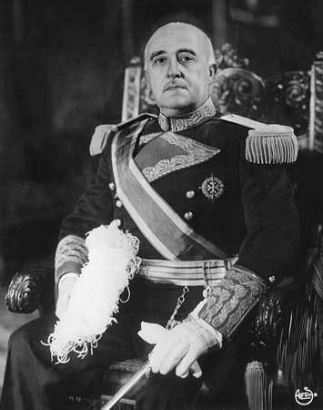
"Adolf Hitler, son of the Catholic Church, died while defending Christianity. It is therefore understandable that words cannot be found to lament over his death, when so many were found to exalt his life. Over his mortal remains stands his victorious moral figure. With the palm of the martyr, God gives Hitler the laurels of Victory". -Spanish dictator (Francisco Franco, Knight of the Order of Christ) published on the 3rd of May 1945, the day of Hitler's death. ("Reforme", 21st of July 1945.)

Slide 2
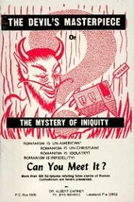
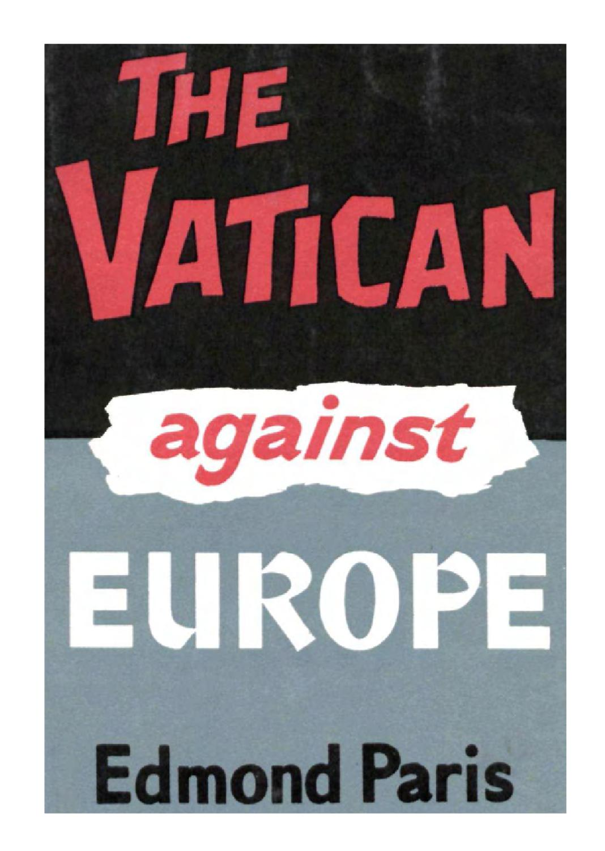

Slide 3
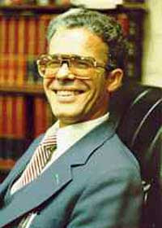
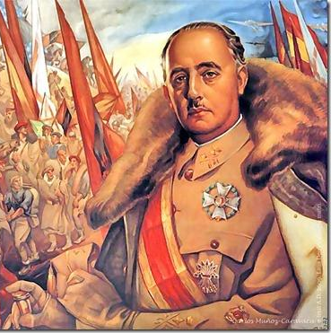
Activist Ex-Jesuit Alberto Rivera

Slide 4
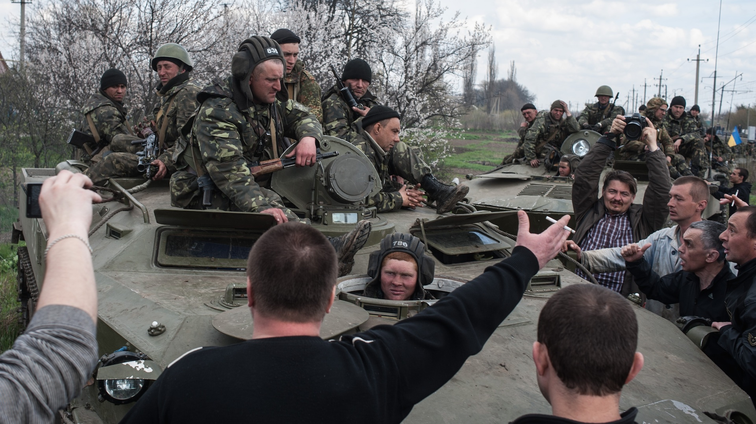
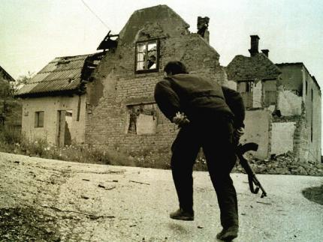
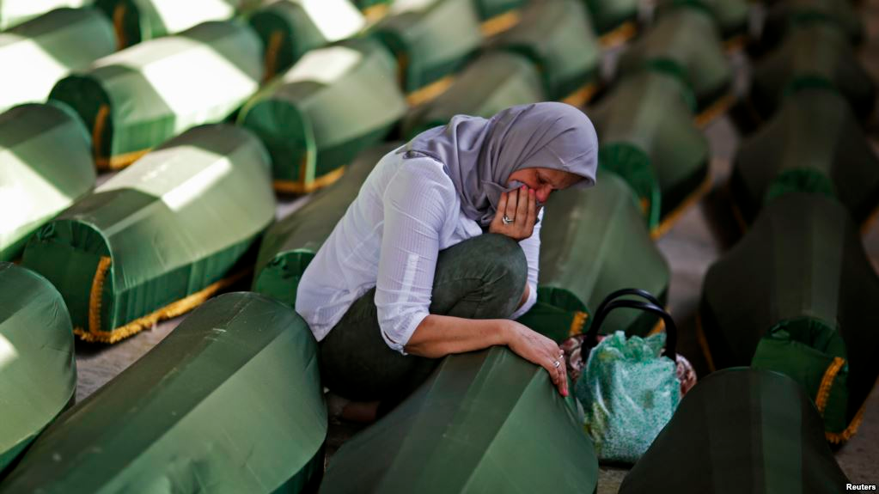
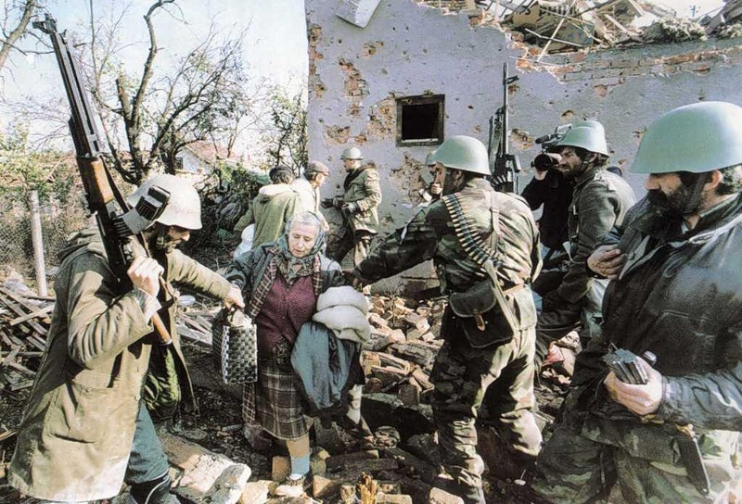

Slide 5
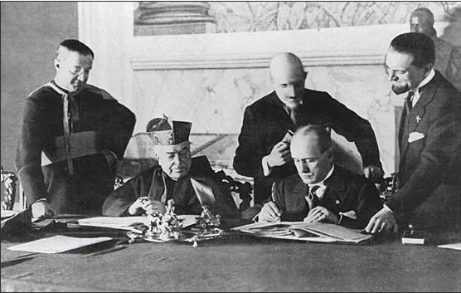
Cardinal Secretary of State Pietro Gaspari represents Pope Pius XI
Benito Mussolini
Benito Mussolini signs the Lateran Accord (Lateran Treaty) reinstating the Vatican as a Recognized Sovereignty

Slide 6
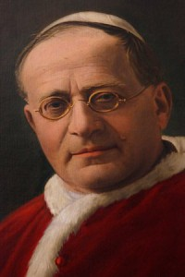
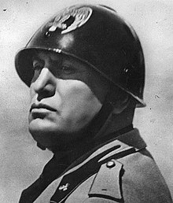
Mussolini is making rapid headway and will conquer all in his path. Mussolini is a wonderful man! Do you hear me? A wonderful man! The future is his.—Edmond Paris, The Vatican Against Rome, p. 69.
Pope Pius XI (1922-1939)

Slide 8
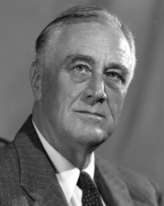
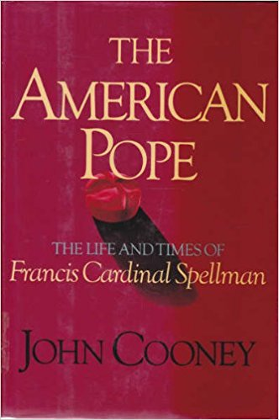
Franklin Delano Roosevelt (FDR)

Slide 9
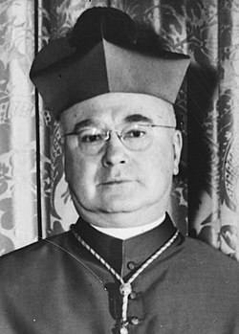
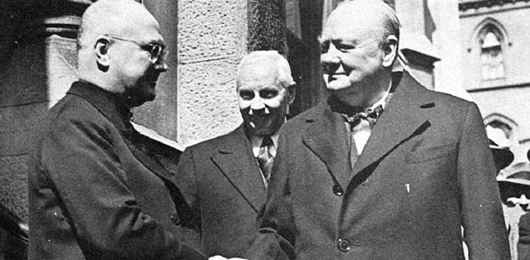
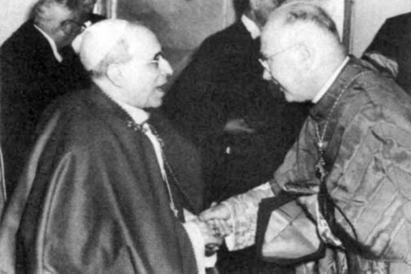
Francis Cardinal Spellman (1939-1967)

Slide 10
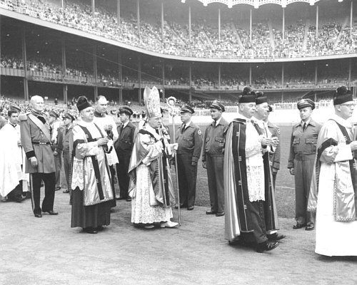
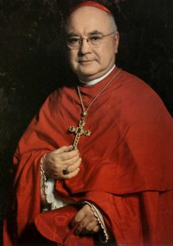

Slide 12
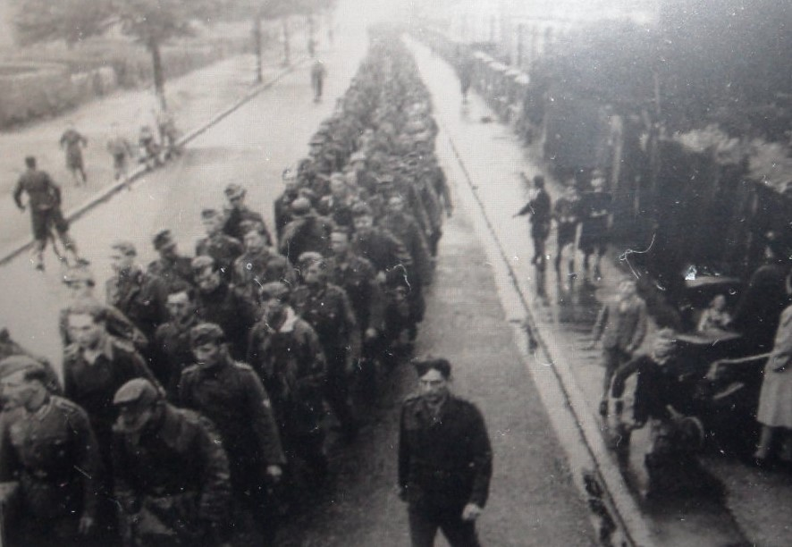
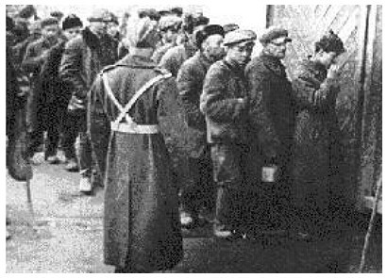
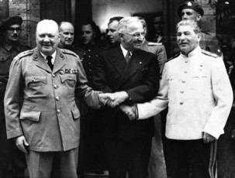
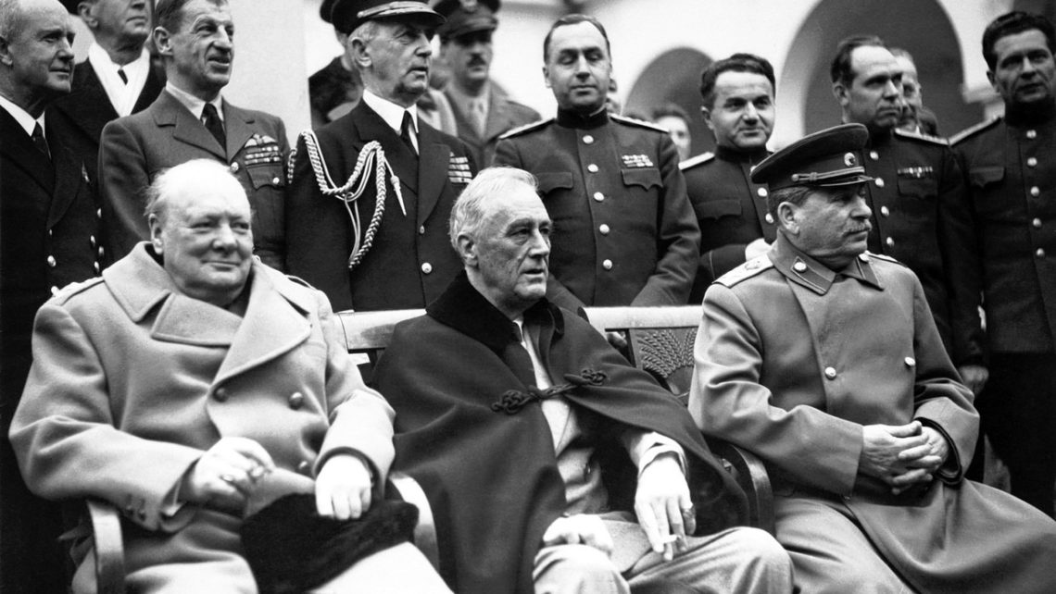

Slide 13
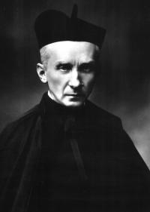
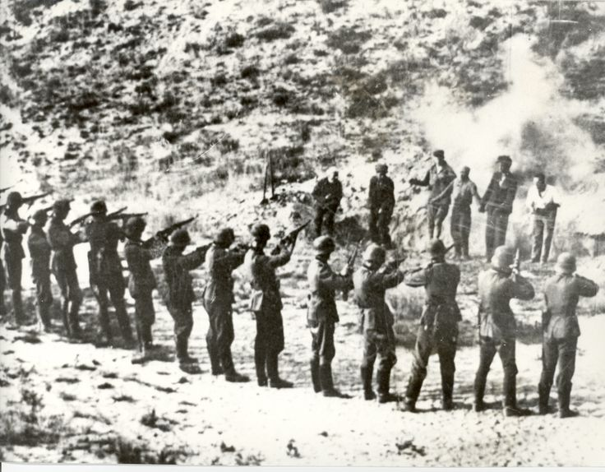
This is Jesuit “Evangelism”
Black Pope and Jesuit Superior
General during World War II,
Count Huk von Ledochowski

Slide 14
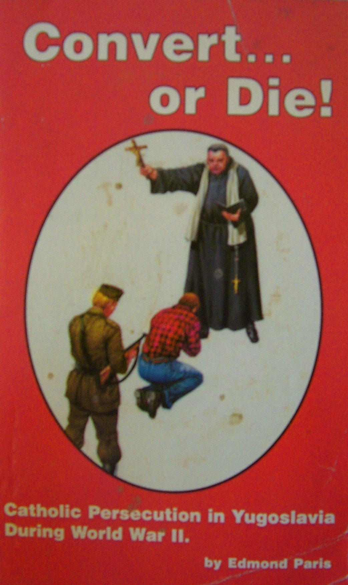
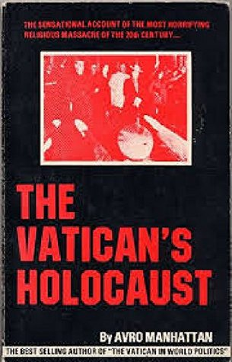

Slide 15
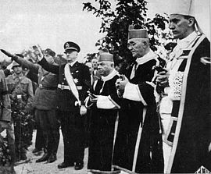
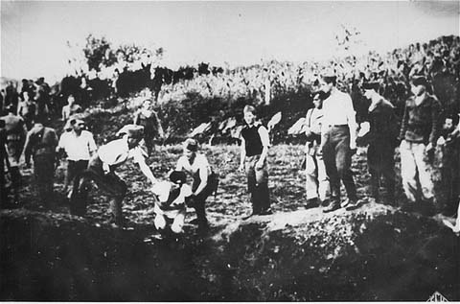
Ustase [Ustashi] (Yu-sta-she) committed genocide in Yugoslavia of the Orthodox Christians. This group was a Croatian Revolutionary Movement that was fascist, racist, ultranationalist and a terrorist organization, active, in its original form, between 1929 and 1945. Their ideology was a mix of facism—Roman Catholicism—and Croatian nationalism. Its members murdered hundreds of thousands of Serbs, Jews, non-Catholics, as well as political dissidents in Yugoslavia during World War II—essentially anyone they deemed as a “dissident”—sound familiar America?.

Slide 16
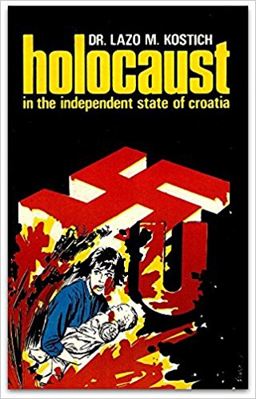
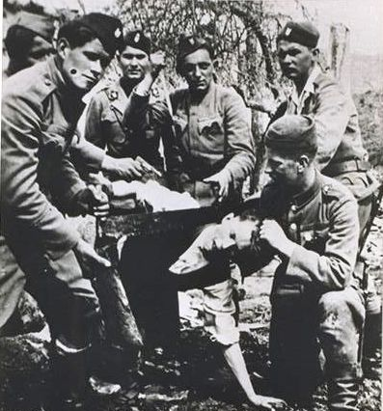
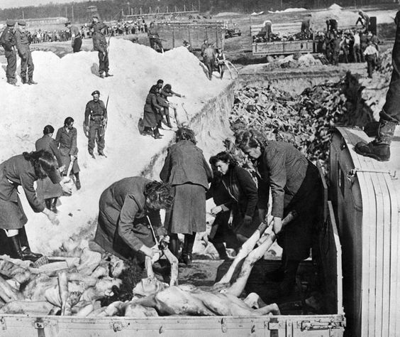
The mass expulsion or forced conversion of the Orthodox to Roman Catholicism was on the agenda. All measures aiming at the elimination of Serbdom in Croatia were carried out under the slogan annunciated by one of the Croatian ministers: “We shall massacre the first third of the Serbs, expel the second third from the country, and forced the final third to accept the Catholic faith whereby they will be absorbed by the Catholic element”-- Dr. Lazo Kostich, Holocaust in the Independent State of Croatia, p. 18

Slide 17
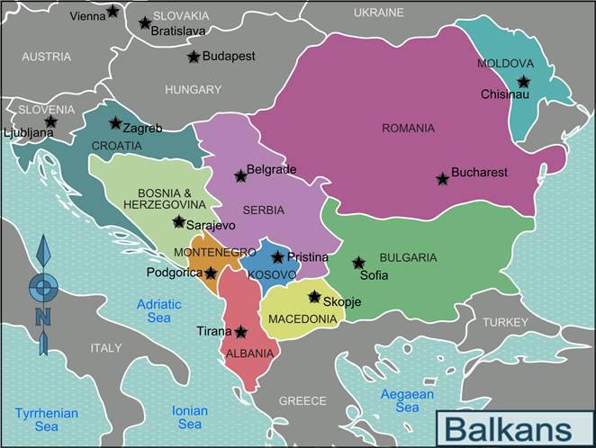
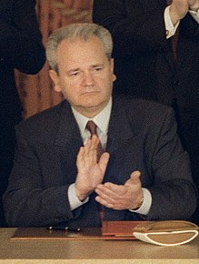
Sloboden Melossovich

Slide 18
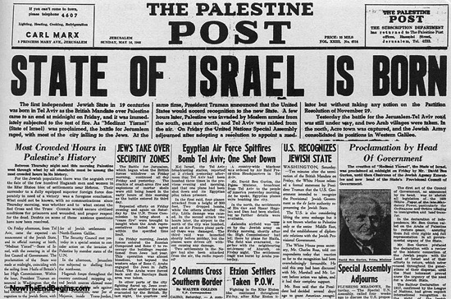

Slide 19
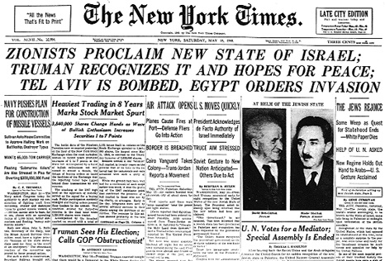

Slide 20
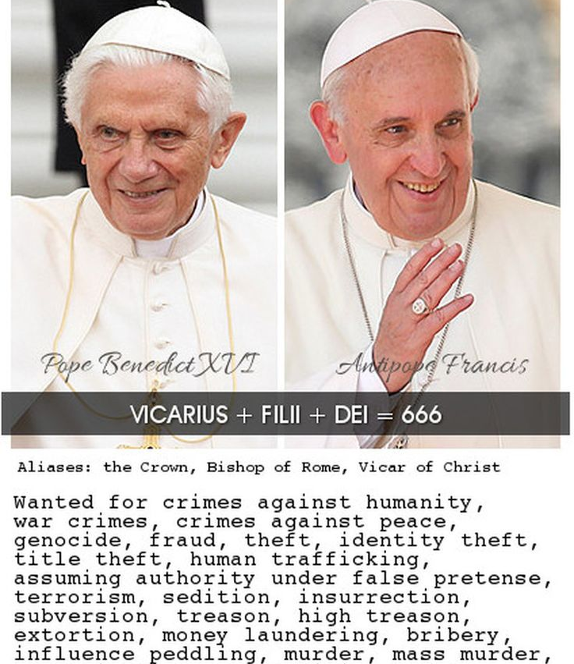
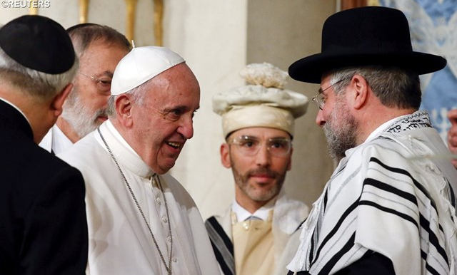
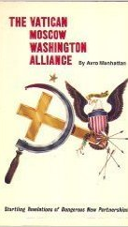
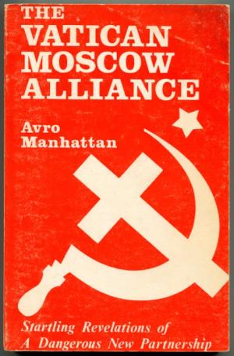

Slide 21
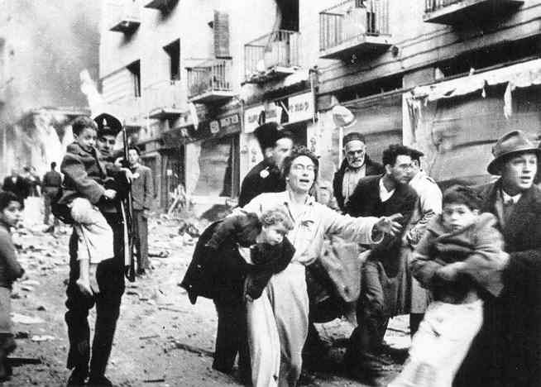
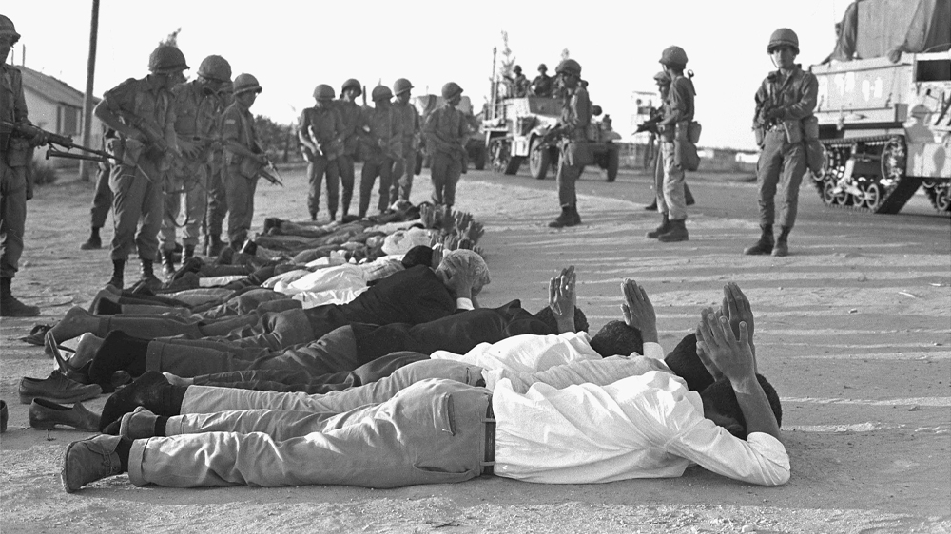
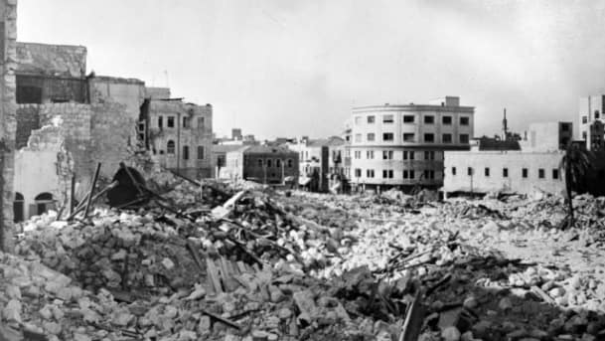
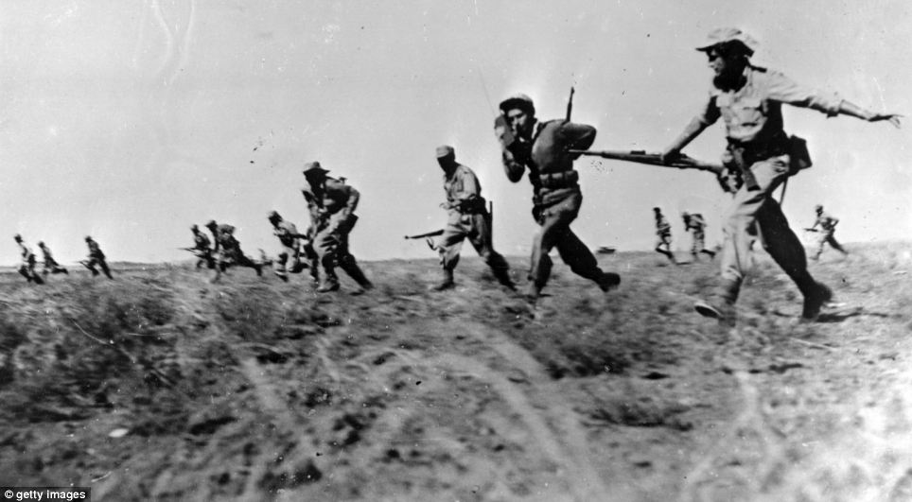
Since its inception, the story of Israel has been war after war, conflict after conflict, terrorist attack after terrorist attack, beginning in May 15, 1948 (1 day after Israel was declared an independent state), when 5 Arab countries simultaneously declared war on Israel—Jordan, Syria, Iraq, Egypt, and Lebanon

Slide 22
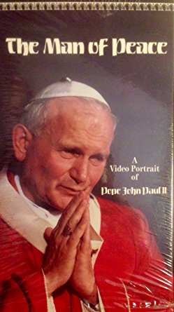
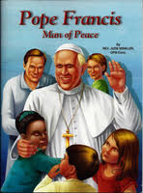
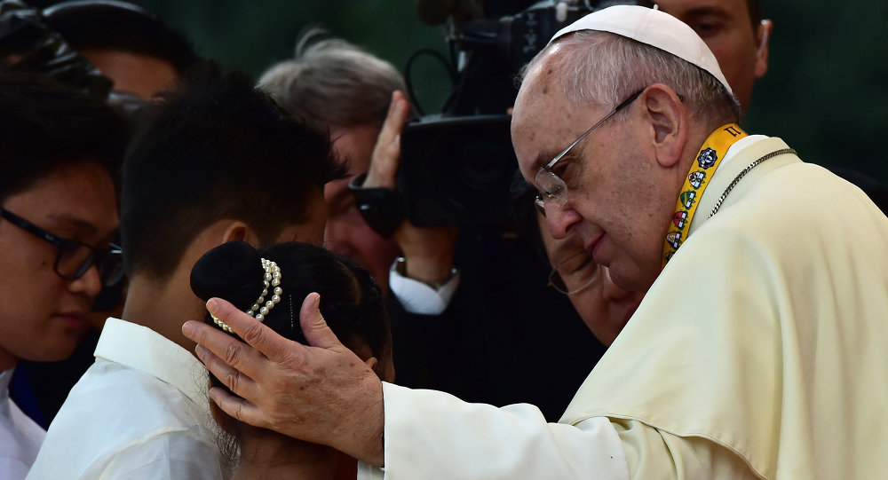
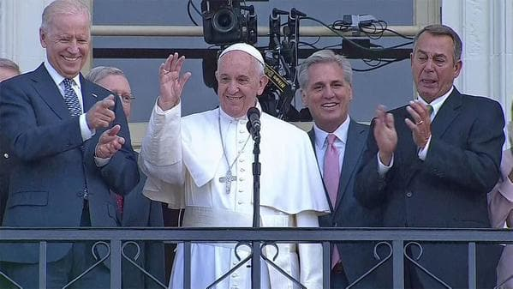

Slide 23
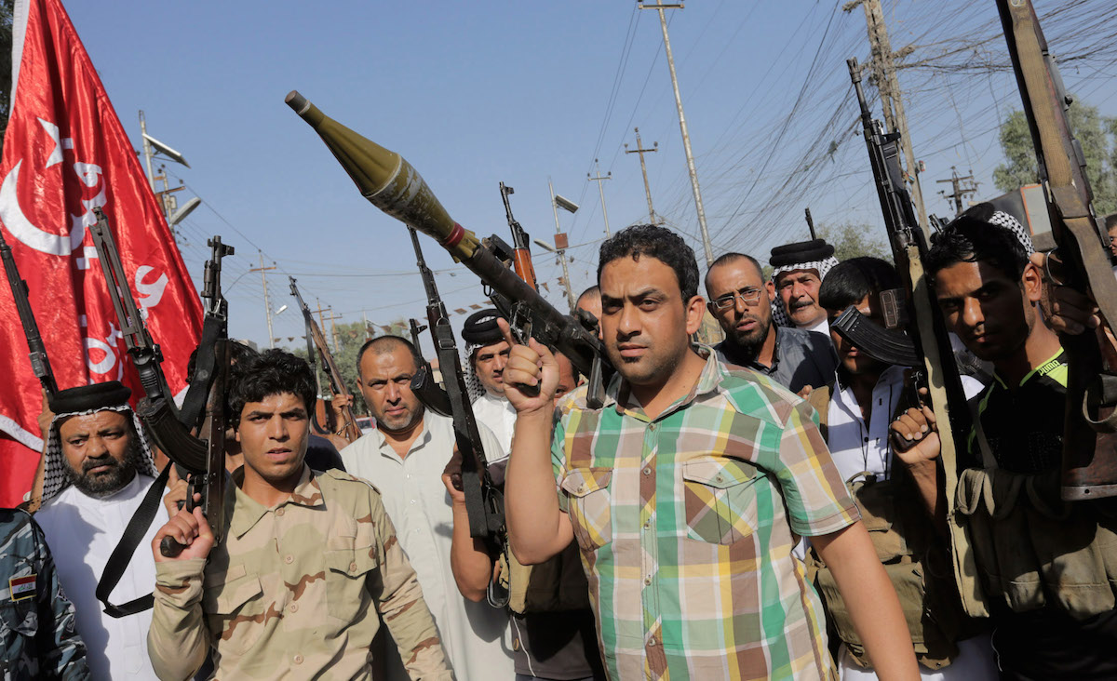
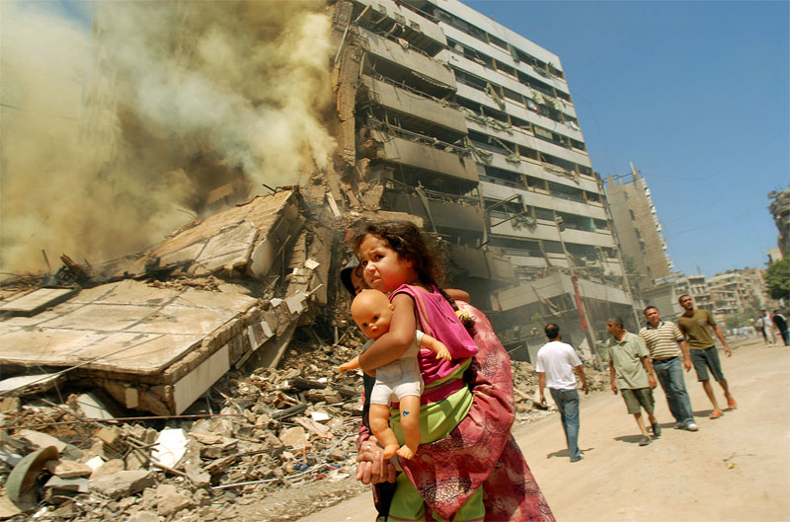

Slide 24
Steps toward the New World Order failed in the attempt of the League of Nations after World War I, but their plans were only postponed; more blood, plottings, seditions, fraud, corruption and deaths of the world’s sons and daughters would be required, so that by the end of World War II, the whole planet was begging for the creation of the United Nations—Hegelian Dialectic in action!

Slide 26
Interesting that the only area that remained open to non-Jesuit foreign merchants during Japan’s Edict of Exclusion of 1639, was the military target of an Atomic bomb in 1945. Coincidence? Or Payback!?

Slide 27
Atomic Bombs
Hiroshima: August 6, 1945
Nagasaki: August 9, 1945

Slide 28
All powers answer to Rome or they suffer the same fate as Japan. Don’t be fooled by who the media paints as the “Boogey Man”—the enemy is, as has always been since the Middle Ages, is the Pope of Rome.

