Slide 1
Lambs,Dragons,images
Revelation 13:11-18

Slide 2
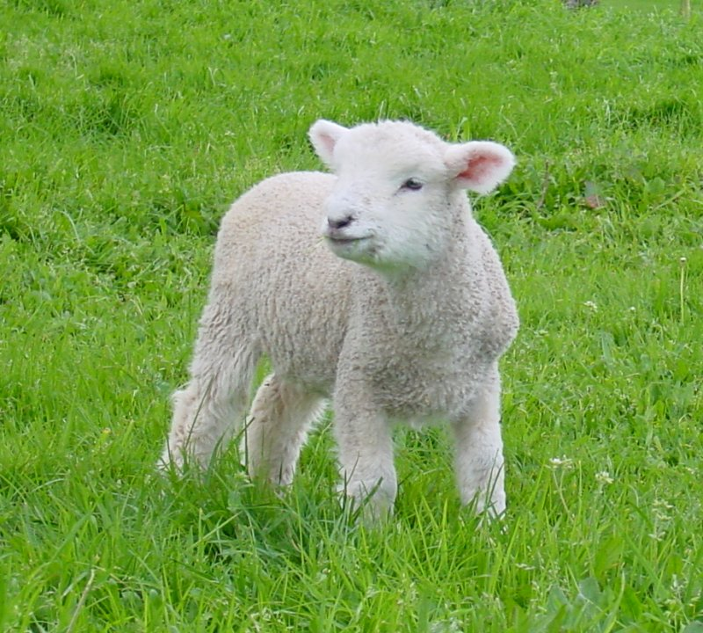
Strange Lamb
“And I beheld another beast coming up out of the earth; and he had two horns like a lamb, and he spake as a dragon. “ Revelation 13:11

Slide 3
Deciphering the Lamb
1. Beast- Daniel 7:17,23.
This world power rises out of the earth. The first power in Revelation 13:1 rose out of the sea. The sea represented ‘peoples, multitudes, and nations.’ Rev. 17:15 The earth must represent an area of the world where there are few inhabitants. The first power rose in the area of the Old World of Europe and the Mediterranean; this power must rise in the New World of the Western Hemisphere.
2. This world power of Revelation 13 starts off like a lamb.
The Lamb in the Bible-John 1:29 “The next day John seeth Jesus coming unto him, and saith, Behold the Lamb of God, which taketh away the sin of the world.”

Slide 4
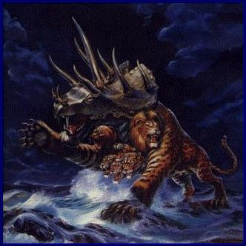
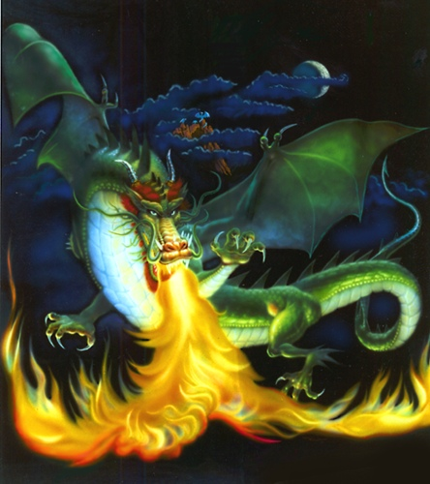
A Nation like Christ?

Slide 5
Christ’s Government vs. the Devil’s Government
Christ’s
1. freedoms for the people.
2. church and state separate.
3. government of the people, by the people, and for the people.
4. free to worship God as one chooses.
Devil’s
1. no freedoms for the people.
2. church and state together.
3. government where a few people control everything.
4. must worship God the way the state says.

Slide 6
Who is this Lamb-Like Nation?
1. It rises in the Western Hemisphere-the New World.
2. It gives the people freedoms; it keeps the church and state separate.
3. It is a government of the people; people are not persecuted for disagreeing with the nation.
This Lamb like power can only be America!

Slide 7
Why Would Anyone Want This?
“Rome saw at once that the very existence of the United States was a formidable menace to her own life. From the very beginning she perfidiously sowed the germs of division and hatred between the two great sections of this country and succeeded in dividing South from North on the burning question of slavery. That division was her golden opportunity to crush one by the other, and reign over the bloody ruins of both, a favored, long-standing policy.” Charles Chiniquy, Fifty Years in the Church of Rome, Chick Publications, p. 291, emphasis supplied

Slide 8
Confirmed
“At this point another symbol is introduced. Says the prophet: "I beheld another beast coming up out of the earth; and he had two horns like a lamb." Verse 11. Both the appearance of this beast and the manner of its rise indicate that the nation which it represents is unlike those presented under the preceding symbols. The great kingdoms that have ruled the world were presented to the prophet Daniel as beasts of prey, rising when "the four winds of the heaven strove upon the great sea." Daniel 7:2. In Revelation 17 an angel explained that waters represent "peoples, and multitudes, and nations, and tongues." Revelation 17:15. Winds are a symbol of strife. The four winds of heaven striving upon the great sea represent the terrible scenes of conquest and revolution by which kingdoms have attained to power.

Slide 9
“…But the beast with lamblike horns was seen "coming up out of the earth." Instead of overthrowing other powers to establish itself, the nation thus represented must arise in territory preciously unoccupied and grow up gradually and peacefully. It could not, then, arise among the crowded and struggling nationalities of the Old World--that turbulent sea of "peoples, and multitudes, and nations, and tongues." It must be sought in the Western Continent.
What nation of the New World was in 1798 rising into power, giving promise of strength and greatness, and attracting the attention of the world? The application of the symbol admits of no question. One nation, and only one, meets the specifications of this prophecy; it points unmistakably to the United States of America.” GC., 439,440

Slide 10
Speaking as a Dragon
While having the Christ like principles in its founding documents, America repudiates these ideals and turns despotic like Rome during the Dark Ages. “The lamblike horns and dragon voice of the symbol point to a striking contradiction between the professions and the practice of the nation thus represented. The "speaking" of the nation is the action of its legislative and judicial authorities. By such action it will give the lie to those liberal and peaceful principles which it has put forth as the foundation of its policy. The prediction that it will speak "as a dragon" and exercise "all the power of the first beast" plainly foretells a development of the spirit of intolerance and persecution that was manifested by the nations represented by the dragon and the leopard like beast.” GC., pg 442

Slide 11
America is Speaking Today
“The "wall of separation between church and State" is a metaphor based on bad history, a metaphor which has proved useless as a guide to judging. It should be frankly and explicitly abandoned. ” Wallace v. Jaffree, 472 U.S. 38, 106 (Rehnquist, J., dissenting)
The former Chief Justice of the Supreme Court spoke as a dragon!

Slide 12
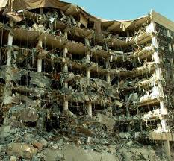
Create Fear
“The Omnibus Counter Terrorism Act of 1995 was on a slow track in Congress and the subject of a lively debate as to
whether it would violate some fundamental civil liberties,
including the right to confront one’s accuser. Now, after the Oklahoma City bombing, there are few surer legislative bets in Washington. Democrats and Republicans issued news releases Thursday calling for the bill’s quick passage. — Terror in the Heartland: Terrorism Bill Moves Very Fast, Orlando Sentinel, April 21st, 1995

Slide 13
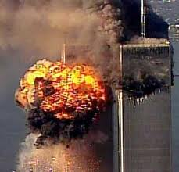
The Results
“The bill enhances the ability of federal authorities to tap
phones, share intelligence information, track Internet usage, e-mails and cell phones and protect U.S. borders. — Bush Signs Sweeping New Laws to Combat Terrorism, Reuters News Service, October 26, 2001.
“Lawmakers upset with some of the administrations antiterrorism actions will question Attorney General John Ashcroft on the matter. [Certain Congressmen] say the administration’s actions have
gone too far in infringing on civil liberties. — USA Today, November 26, 2001,.

Slide 14
The Issue is Worship
“And he exerciseth all the power of the first beast before him, and causeth the earth and them which dwell therein to worship the first beast, whose deadly wound was healed.” Rev. 13:12
America will use its worldwide authority to tell the world to worship the papacy. What will America tell the world to do to honor Rome?

Slide 15
True Worship vs. False Worship
“Why do thy disciples transgress the tradition of the elders? for they wash not their hands when they eat bread. But he answered and said unto them, Why do ye also transgress the commandment of God by your tradition? For God commanded, saying, Honour thy father and mother: and, He that curseth father or mother, let him die the death. But ye say, Whosoever shall say to his father or his mother, It is a gift, by whatsoever thou mightest be profited by me;
And honour not his father or his mother, he shall be free. Thus have ye made the commandment of God of none effect by your tradition. Ye hypocrites, well did Esaias prophesy of you, saying, This people draweth nigh unto me with their mouth, and honoureth me with their lips; but their heart is far from me. But in vain they do worship me, teaching for doctrines the commandments of men.” Matthew 15:2-9
Vain Worship- Following a man made tradition.
True Worship- Following God’s Commandments

Slide 16
A Roman Tradition
What tradition of the papacy, directly contrary to the ten commandments, will America exalt? “Protestants... accept Sunday rather than Saturday as the day for public worship after the Catholic Church made the change.... But the Protestant mind does not seem to realize that...in observing the Sunday, they are accepting the authority of the spokesman for the church, the Pope. “— Our Sunday Visitor, February 5, 1950.
“It is well to remind the Presbyterians, Baptists, Methodists, and all other Christians, that the Bible does not support them anywhere in their observance of Sunday. Sunday is an institution of the Roman Catholic Church, and those who observe the day observe a commandment of the Catholic Church. “— Priest Brady, in an address, reported in the Elizabeth, N.J. “News,” March 18, 1903.
The mark of Catholic Church authority in the world is Sunday observance. This is a tradition that has no place in the Bible. It originated in Rome, and when we honor the Sunday tradition, we are paying homage to the papacy. Sunday goes directly contrary to the plain teaching of the fourth commandment.

Slide 17
America Will Pass a National Sunday Law!
“And the statement that the beast with two horns "causeth the earth and them which dwell therein to worship the first beast" indicates that the authority of this nation is to be exercised in enforcing some observance which shall be an act of homage to the papacy.
Such action would be directly contrary to the principles of this government, to the genius of its free institutions, to the direct and solemn avowals of the Declaration of Independence, and to the Constitution. The founders of the nation wisely sought to guard against the employment of secular power on the part of the church, with its inevitable result--intolerance and persecution. The Constitution

Slide 18
provides that "Congress shall make no law respecting an establishment of religion, or prohibiting the free exercise thereof," and that "no religious test shall ever be required as a qualification to any office of public trust under the United States." Only in flagrant violation of these safeguards to the nation's liberty, can any religious observance be enforced by civil authority. But the inconsistency of such action is no greater than is represented in the symbol. It is the beast with lamblike horns--in profession pure, gentle, and harmless--that speaks as a dragon.” GC., pg 442

Slide 19

On Thursday, conservative radio host Laura Ingraham asked Hatch, "Do you think, if he had his druthers, President Obama would repeal the Second Amendment?"
"I don't think there's any question about it. Most liberal Democrats would," Hatch replied. "I don't know of any liberal Republicans that would, but most liberal Democrats would. They'll mouth that they wouldn't, but look, what are they doing? They want more and more controls."
Hatch has been adamantly against gun-control measures. He opposes bans on assault weapons and high-capacity magazines.

Slide 20
Deception/Miracles Used
“And he doeth great wonders, so that he maketh fire come down from heaven on the earth in the sight of men, And deceiveth them that dwell on the earth by the means of those miracles which he had power to do in the sight of the beast; saying to them that dwell on the earth, that they should make an image to the beast, which had the wound by a sword, and did live.” Rev. 13:13,14

Slide 21
Deception, Miracles
“Servants of God, with their faces lighted up and shining with holy consecration, will hasten from place to place to proclaim the message from heaven. By thousands of voices, all over the earth, the warning will be given. Miracles will be wrought, the sick will be healed, and signs and wonders will follow the believers. Satan also works, with lying wonders, even bringing down fire from heaven in the sight of men. Revelation 13:13. Thus the inhabitants of the earth will be brought to take their stand.
The message will be carried not so much by argument as by the deep conviction of the Spirit of God. The arguments have been presented. The seed has been sown, and now it will spring up and bear fruit.” GC., pg. 612

Slide 22
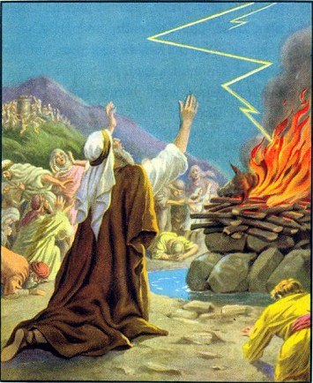
Fire From the Sky

Slide 23
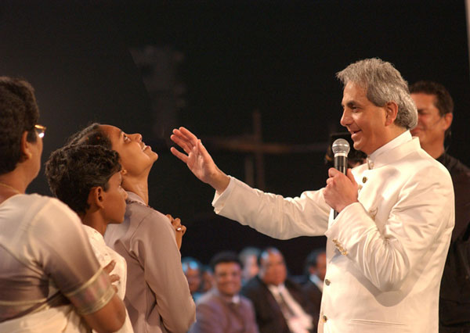
Benny Hinn

Slide 24
An Image of the Beast
“…saying to them that dwell on the earth, that they should make an image to the beast, which had the wound by a sword, and did live.
And he had power to give life unto the image of the beast, that the image of the beast should both speak, and cause that as many as would not worship the image of the beast should be killed.” Revelation 13:14,15

Slide 25
A Look-a-Like of the Papacy
1. A look-a-like of the Papacy will be set up in America.
2. This look-a-like of Rome will use the state to enforce Sunday keeping on America.
3. This image will persecute those who don’t follow their Sunday tradition.
Any idea who the image of the Papacy could be?

Slide 26
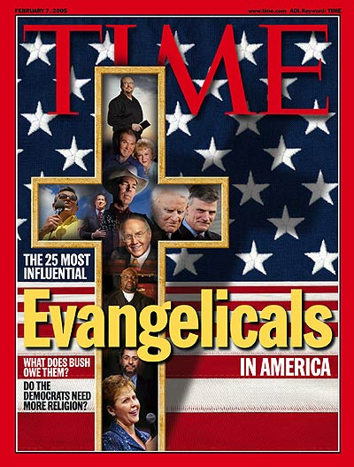
The Image is being Formed

Slide 27
Apostate Protestants
“In order for the United States to form an image of the beast, the religious power must so control the civil government that the authority of the state will also be employed by the church to accomplish her own ends.
Whenever the church has obtained secular power, she has employed it to punish dissent from her doctrines. Protestant churches that have followed in the steps of Rome by forming alliance with worldly powers have manifested a similar desire to restrict liberty of conscience.” GC. pg. 443

Slide 28
The image under development
“When the leading churches of the United States, uniting upon such points of doctrine as are held by them in common, shall influence the state to enforce their decrees and to sustain their institutions, then Protestant America will have formed an image of the Roman hierarchy, and the infliction of civil penalties upon dissenters will inevitably result.
The beast with two horns "causeth [commands] all, both small and great, rich and poor, free and bond, to receive a mark in their right hand, or in their foreheads: and that no man might buy or sell, save he that had the mark, or the name of the beast, or the number of his name." Revelation 13:16, 17. The third angel's warning is: "If any man worship the beast and his image, and receive his mark in his forehead, or in his hand, the same shall drink of the wine of the wrath of God." "The beast" mentioned in this message, whose worship is enforced by the two-horned beast, is the first, or leopard like beast of Revelation 13--the papacy. The "image to the beast" represents that form of apostate Protestantism which will be developed when the Protestant churches shall seek the aid of the civil power for the enforcement of their dogmas.” GC., pg. 445

Slide 29
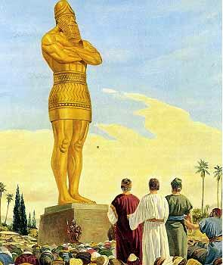
This Happened before
“If it be so, our God whom we serve is able to deliver us from the burning fiery furnace, and he will deliver us out of thine hand, O king.
But if not, be it known unto thee, O king, that we will not serve thy gods, nor worship the golden image which thou hast set up.” Daniel 3:17,18

Slide 30
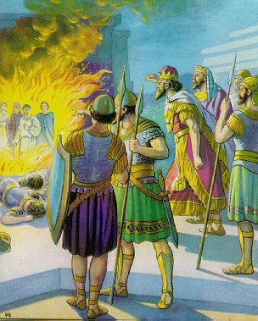
The Fiery Christ
“And he commanded the most mighty men that were in his army to bind Shadrach, Meshach, and Abed-nego, and to cast them into the burning fiery furnace…Lo, I see four men loose, walking in the midst of the fire, and they have no hurt; and the form of the fourth is like the Son of God.” Daniel 3:20,25

Slide 31
Very Serious
“And he causeth all, both small and great, rich and poor, free and bond, to receive a mark in their right hand, or in their foreheads: And that no man might buy or sell, save he that had the mark, or the name of the beast, or the number of his name. “ Revelation 13:16,17
The mark of papal authority in this world is Sunday. Economic sanctions will be brought to bear on those who refuse to bow to this sign of papal authority.
“Of course the Catholic Church claims that the change [from Saturday to Sunday] was her act. And the act is a MARK of her ecclesiastical power and authority in religious matters.” — C. F. Thomas, Chancellor of Cardinal Gibbons.
“Sunday is our MARK of authority.... The church is above the Bible, and this transference of Sabbath observance is proof of that fact.” — Catholic Record, September 1, 1923 (Ontario).

Slide 32
As in the Days of Shadrach…
“To the loyal heart the commands of sinful, finite men will sink into insignificance beside the word of the eternal God. Truth will be obeyed though the result be imprisonment or exile or death. As in the days of Shadrach, Meshach, and Abednego, so in the closing period of earth's history the Lord will work mightily in behalf of those who stand steadfastly for the right. He who walked with the Hebrew worthies in the fiery furnace will be with His followers wherever they are. His abiding presence will comfort and sustain. In the midst of the time of trouble--trouble such as has not been since there was a nation--His chosen ones will stand unmoved. Satan with all the hosts of evil cannot destroy the weakest of God's saints. Angels that excel in strength will protect them, and in their behalf Jehovah will reveal Himself as a "God of gods," able to save to the uttermost those who have put their trust in Him.” PK. Pg. 512,513

Slide 33
The number of the beast
“Here is wisdom. Let him that hath understanding count the number of the beast: for it is the number of a man; and his number is six hundred threescore and six.” Rev. 13:18
This number of 666 has everything to do with the papacy and nothing to do with anything else. It has nothing to do with a computer or a card or…or…. What does 666 and the papacy have in common?

Slide 34
Vicarius Filii Dei
VICARIUS FILII DEI = 666
VICARIUS FILII DEI = 666.
V = 5 I = 1 C = 100 A = 0 R = 0 I = 1 U = 5 S = 0
F = 0 I = 1 L = 50 I = 1 I = 1
D = 500 E = 0 I = 1
======= ======= =======
112_ 53_ 501
TOTAL 112 + 53 + 501 = 666

