Slide 1
The Oil Press/Gethsemane
Final Scenes, pt. 12

Slide 2
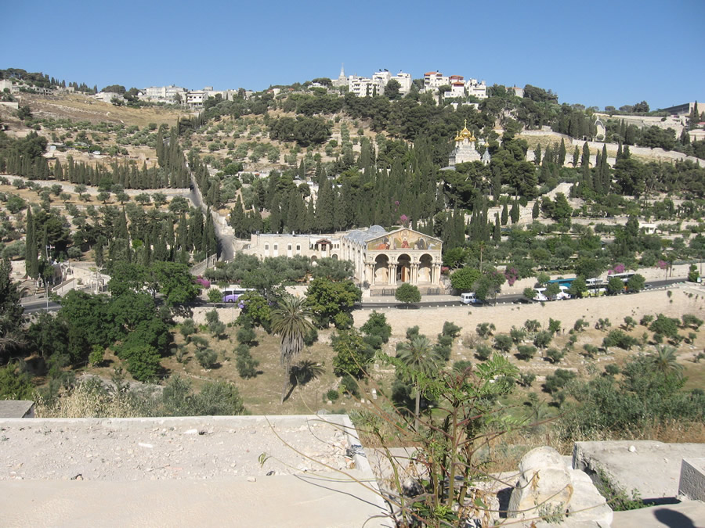
Only Christ has seen Gethsemane
Sometimes, I hear people say, “I’m going through my Gethsemane.” Friend, no human has ever gone thru Gethsemane, save Christ.
Typically, our sufferings are the consequences of our bad choices. Christ’s sufferings resulted from OUR bad choices, NOT His!!!

Slide 3
A Thoughtful Hour
“It would be well for us to spend a thoughtful hour each day in contemplation of the life of Christ. We should take it point by point, and let the imagination grasp each scene, especially the closing ones. As we thus dwell upon His great sacrifice for us, our confidence in Him will be more constant, our love will be quickened, and we shall be more deeply imbued with His spirit. If we would be saved at last, we must learn the lesson of penitence and humiliation at the foot of the cross.” Desire of Ages, pg. 83

Slide 4
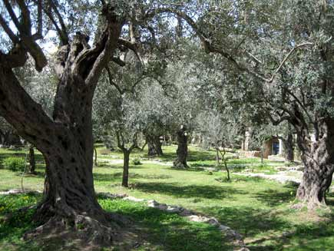
The Context
The Passover supper was complete; Judas was completing his work of betrayal; the disciples heard some of Christ’s final instructions. The dark part of the sixth day of the week had begun. The small band headed to Gethsemane ‘the oil press’.

Slide 5
A Place of Oil
Gethsemane today still has some very gnarled olive trees. Known for the olive oil it produced, this place has become famous for the blessings that have flowed from Christ’s experience there. For Christ, this was a time of deep suffering. For us, a place of great hope and strength.
“Then cometh Jesus with them unto a place called Gethsemane, and saith unto the disciples, Sit ye here, while I go and pray yonder. And he took with him Peter and the two sons of Zebedee, and began to be sorrowful and very heavy. Then saith he unto them, My soul is exceeding sorrowful, even unto death: tarry ye here, and watch.”
Matthew 26:36-38

Slide 6
Separation
“Jesus had been earnestly conversing with His disciples and instructing them; but as He neared Gethsemane, He became strangely silent. He had often visited this spot for meditation and prayer; but never with a heart so full of sorrow as upon this night of His last agony. Throughout His life on earth He had walked in the light of God's presence. When in conflict with men who were inspired by the very spirit of Satan, He could say, "He that sent Me is with Me: the Father hath not left Me alone; for I do always those things that please Him." John 8:29. But now He seemed to be shut out from the light of God's sustaining presence. Now He was numbered with the transgressors. The guilt of fallen humanity He must bear. Upon Him who knew no sin must be laid the iniquity of us all. So dreadful does sin appear to Him, so great is the weight of guilt which He must bear, that He is tempted to fear it will shut Him out forever from His Father's love. Feeling how terrible is the wrath of God against transgression, He exclaims, "My soul is exceeding sorrowful, even unto death."

Slide 7
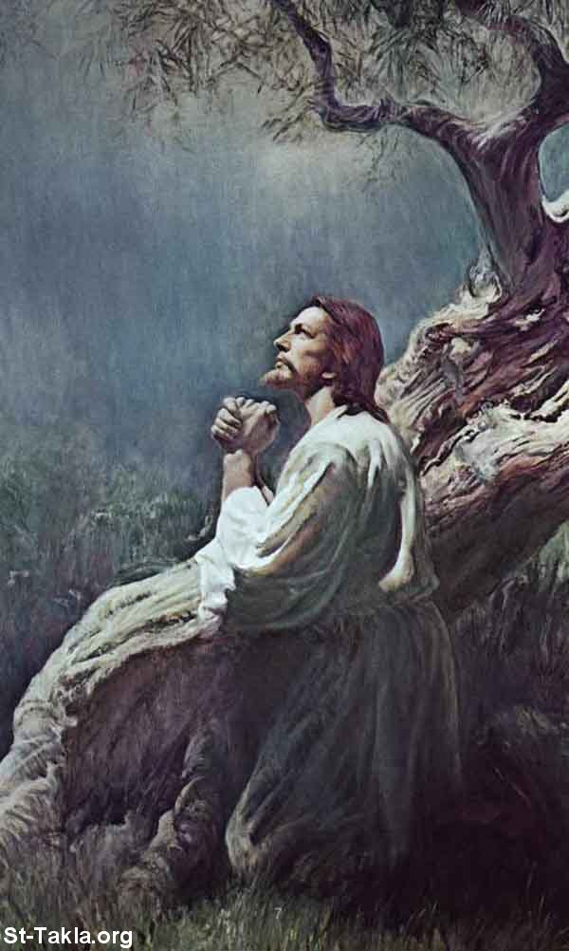
None Other
Death loomed over Christ in a way it never had up to this time. The presence of His Father was being withdrawn from Him. Our sins were being placed upon Him and they were beginning the process of crushing out His very life!

Slide 8
Surety for Man
“He went a little distance from them--not so far but that they could both see and hear Him--and fell prostrate upon the ground. He felt that by sin He was being separated from His Father. The gulf was so broad, so black, so deep, that His spirit shuddered before it. This agony He must not exert His divine power to escape. As man He must suffer the consequences of man's sin. As man He must endure the wrath of God against transgression.
Christ was now standing in a different attitude from that in which He had ever stood before. His suffering can best be described in the words of the prophet, "Awake, O sword, against My shepherd, and against the man that is My fellow, saith the Lord of hosts." Zech. 13:7. As the substitute and surety for sinful man, Christ was suffering under divine justice. He saw what justice meant. Hitherto He had been as an intercessor for others; now He longed to have an intercessor for Himself.
As Christ felt His unity with the Father broken up, He feared that in His human nature He would be unable to endure the coming conflict with the powers of darkness.” DA, pg. 686

Slide 9
The Thrice Repeated Prayer
Christ fully realized that He didn’t have to go through with this horrible ordeal. He could have simply wiped the sweat from His brow and gone back to heaven. He didn’t have to die. He was totally innocent!!
“And he went a little further, and fell on his face, and prayed, saying, O my Father, if it be possible, let this cup pass from me: nevertheless not as I will, but as thou wilt.” Matthew 26:39

Slide 10
What He Did!!
“Three times has He uttered that prayer. Three times has humanity shrunk from the last, crowning sacrifice. But now the history of the human race comes up before the world's Redeemer. He sees that the transgressors of the law, if left to themselves, must perish. He sees the helplessness of man. He sees the power of sin. The woes and lamentations of a doomed world rise before Him. He beholds its impending fate, and His decision is made. He will save man at any cost to Himself. He accepts His baptism of blood, that through Him perishing millions may gain everlasting life. He has left the courts of heaven, where all is purity, happiness, and glory, to save the one lost sheep, the one world that has fallen by transgression. And He will not turn from His mission. He will become the propitiation of a race that has willed to sin. His prayer now breathes only submission: "If this cup may not pass away from Me, except I drink it, Thy will be done."

Slide 11
Longed for Comfort
“When Jesus came to them, He found them still sleeping. Again He had felt a longing for companionship, for some words from His disciples which would bring relief, and break the spell of darkness that well-nigh overpowered Him. But their eyes were heavy; "neither wist they what to answer Him." His presence aroused them. They saw His face marked with the bloody sweat of agony, and they were filled with fear. His anguish of mind they could not understand. "His visage was so marred more than any man, and His form more than the sons of men." Isa. 52:14.” DA, pg. 690
“And he cometh unto the disciples, and findeth them asleep, and saith unto Peter, What, could ye not watch with me one hour? Watch and pray, that ye enter not into temptation: the spirit indeed is willing, but the flesh is weak. He went away again the second time, and prayed, saying, O my Father, if this cup may not pass away from me, except I drink it, thy will be done.”
Matt. 26:40-43

Slide 12
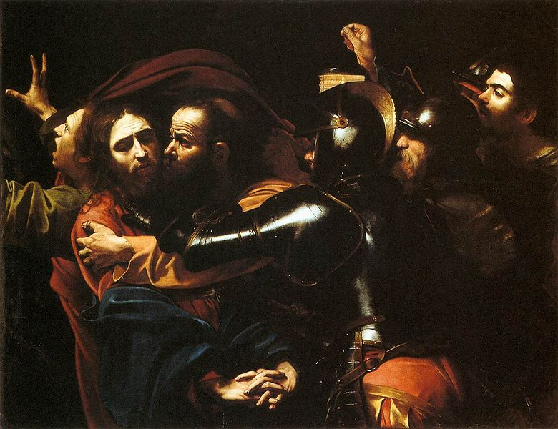
Christ and Judas
“Christ's agony did not cease, but His depression and discouragement left Him. The storm had in nowise abated, but He who was its object was strengthened to meet its fury. He came forth calm and serene. A heavenly peace rested upon His bloodstained face. He had borne that which no human being could ever bear; for He had tasted the sufferings of death for every man.” DA, pg. 694

Slide 13
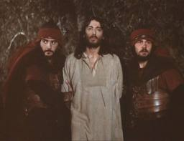
Arrested
“And while he yet spake, lo, Judas, one of the twelve, came, and with him a great multitude with swords and staves, from the chief priests and elders of the people. Now he that betrayed him gave them a sign, saying, Whomsoever I shall kiss, that same is he: hold him fast. And forthwith he came to Jesus, and said, Hail, master; and kissed him. And Jesus said unto him, Friend, wherefore art thou come? Then came they, and laid hands on Jesus, and took him.” Matthew 26:47-50

Slide 14
The Length of Iniquity
“Judas the betrayer did not forget the part he was to act. When the mob entered the garden, he had led the way, closely followed by the high priest. To the pursuers of Jesus he had given a sign, saying, "Whomsoever I shall kiss, that same is He: hold Him fast." Matt. 26:48. Now he pretends to have no part with them. Coming close to Jesus, he takes His hand as a familiar friend. With the words, "Hail, Master," he kisses Him repeatedly, and appears to weep as if in sympathy with Him in His peril. Jesus said to him, "Friend, wherefore art thou come?" His voice trembled with sorrow as He added, "Judas, betrayest thou the Son of man with a kiss?" This appeal should have aroused the conscience of the betrayer, and touched his stubborn heart; but honor, fidelity, and human tenderness had forsaken him. He stood bold and defiant, showing no disposition to relent. He had given himself up to Satan, and he had no power to resist him. Jesus did not refuse the traitor's kiss.
The mob grew bold as they saw Judas touch the person of Him who had so recently been glorified before their eyes. They now laid hold of Jesus, and proceeded to bind those precious hands that had ever been employed in doing good.” DA, pgs. 695,696

Slide 15
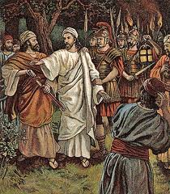
Peter and the Sword
⁵¹ ”And, behold, one of them which were with Jesus stretched out [his] hand, and drew his sword, and struck a servant of the high priest's, and smote off his ear. Then said Jesus unto him, Put up again thy sword into his place: for all they that take the sword shall perish with the sword. Thinkest thou that I cannot now pray to my Father, and he shall presently give me more than twelve legions of angels?” Matthew 26:51-53

Slide 16
Put it Away!
“The disciples had thought that their Master would not suffer Himself to be taken. For the same power that had caused the mob to fall as dead men could keep them helpless, until Jesus and His companions should escape. They were disappointed and indignant as they saw the cords brought forward to bind the hands of Him whom they loved. Peter in his anger rashly drew his sword and tried to defend his Master, but he only cut off an ear of the high priest's servant. When Jesus saw what was done, He released His hands, though held firmly by the Roman soldiers, and saying, "Suffer ye thus far," He touched the wounded ear, and it was instantly made whole. He then said to Peter, "Put up again thy sword into his place: for all they that take the sword shall perish with the sword. Thinkest thou that I cannot now pray to My Father, and He shall presently give Me more than twelve legions of angels?"--a legion in place of each one of the disciples. Oh, why, the disciples thought, does He not save Himself and us? Answering their unspoken thought, He added, "But how then shall the scriptures be fulfilled, that thus it must be?" "The cup which My Father hath given Me, shall I not drink it?“ DA, pg. 696

Slide 17
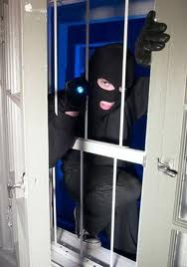
What About Us?
”And they took Lot, Abram's brother's son, who dwelt in Sodom, and his goods, and departed. And there came one that had escaped, and told Abram the Hebrew; for he dwelt in the plain of Mamre the Amorite, brother of Eshcol, and brother of Aner: and these [were] confederate with Abram. And when Abram heard that his brother was taken captive, he armed his trained [servants], born in his own house, three hundred and eighteen, and pursued [them] unto Dan. And he divided himself against them, he and his servants, by night, and smote them, and pursued them unto Hobah, which [is] on the left hand of Damascus.” Genesis 14:12-15

