Slide 1
The Greatest Sermon, pt. 1

Slide 2
The Mindset
“When the Saviour began His ministry, the popular conception of the Messiah and His work was such as wholly unfitted the people to receive Him. The spirit of true devotion had been lost in tradition and ceremonialism, and the prophecies were interpreted at the dictate of proud, world-loving hearts. The Jews looked for the coming One, not as a Saviour from sin, but as a great prince who should bring all nations under the supremacy of the Lion of the tribe of Judah. In vain had John the Baptist, with the heart-searching power of the ancient prophets, called them to repentance. In vain had he, beside the Jordan, pointed to Jesus as the Lamb of God, that taketh away the sin of the world. God was seeking to direct their minds to Isaiah's prophecy of the suffering Saviour, but they would not hear.
Had the teachers and leaders in Israel yielded to His transforming grace, Jesus would have made them His ambassadors among men. In Judea first the coming of the kingdom had been proclaimed, and the call to repentance had been given. In the act of driving out the desecrators from the temple at Jerusalem, Jesus had announced Himself as the Messiah--the One who should cleanse the soul from the defilement of sin and make His people a holy temple unto the Lord. But the Jewish leaders would not humble themselves to receive the lowly Teacher from Nazareth.” MB, pgs. 1,2

Slide 3
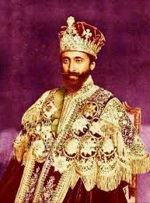
The Kingly Christ
The devil had prepared the Jews to reject Christ. He had prepared them to expect a conquering king rather than a humble man; the Jews wanted a deliver from the Romans rather than a Deliverer from sin. Jesus had to set the record straight; He had to lay bare the character of those who would make up His kingdom. Let the sermon begin……

Slide 4
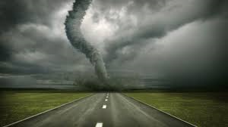
‘Blessed are the Poor…’
Christ’s words hit them with blinding force! What? Being poor in spirit? What about grandeur and palaces and kingdoms? This was the last thing the Adventists expected and not what they wanted to hear!

Slide 5
Shocking!
“As something strange and new, these words fall upon the ears of the wondering multitude. Such teaching is contrary to all they have ever heard from priest or rabbi. They see in it nothing to flatter their pride or to feed their ambitious hopes. But there is about this new Teacher a power that holds them spellbound. The sweetness of divine love flows from His very presence as the fragrance from a flower. His words fall like "rain upon the mown grass: as showers that water the earth." Psalm 72:6. All feel instinctively that here is One who reads the secrets of the soul, yet who comes near to them with tender compassion. Their hearts open to Him, and, as they listen, the Holy Spirit unfolds to them something of the meaning of that lesson which humanity in all ages so needs to learn.” MB, pg. 6

Slide 6
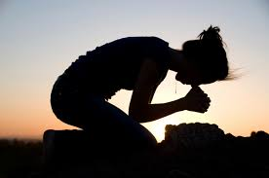
“And he opened his mouth, and taught them, saying, Blessed are the poor in spirit: for theirs is the kingdom of heaven.” Matthew 5:2,3

Slide 7

Heaven is for those with Spiritual Need!
“And when the scribes and Pharisees saw him eat with publicans and sinners, they said unto his disciples, How is it that he eateth and drinketh with publicans and sinners? When Jesus heard it, he saith unto them, They that are whole have no need of the physician, but they that are sick: I came not to call the righteous, but sinners to repentance.” Mk. 2:16,17

Slide 8
Pride Feels No Need!
“He who feels whole, who thinks that he is reasonably good, and is contented with his condition, does not seek to become a partaker of the grace and righteousness of Christ. Pride feels no need, and so it closes the heart against Christ and the infinite blessings He came to give. There is no room for Jesus in the heart of such a person. Those who are rich and honorable in their own eyes do not ask in faith, and receive the blessing of God. They feel that they are full, therefore they go away empty. Those who know that they cannot possibly save themselves, or of themselves do any righteous action, are the ones who appreciate the help that Christ can bestow. They are the poor in spirit, whom He declares to be blessed. Whom Christ pardons, He first makes penitent, and it is the office of the Holy Spirit to convince of sin. Those whose hearts have been moved by the convicting Spirit of God see that there is nothing good in themselves. They see that all they have ever done is mingled with self and sin. Like the poor publican, they stand afar off, not daring to lift up so much as their eyes to heaven, and cry, "God, be merciful to me the sinner." Luke 18:13, R.V., margin. And they are blessed. There is forgiveness for the penitent; for Christ is "the Lamb of God, which taketh away the sin of the world." John 1:29. “ MB, pgs. 7,8

Slide 9
1st Century Adventists
“And he spake this parable unto certain which trusted in themselves that they were righteous, and despised others: Two men went up into the temple to pray; the one a Pharisee, and the other a publican. The Pharisee stood and prayed thus with himself, God, I thank thee, that I am not as other men are, extortioners, unjust, adulterers, or even as this publican. I fast twice in the week, I give tithes of all that I possess. And the publican, standing afar off, would not lift up so much as his eyes unto heaven, but smote upon his breast, saying, God be merciful to me a sinner. I tell you, this man went down to his house justified rather than the other: for every one that exalteth himself shall be abased; and he that humbleth himself shall be exalted.” Luke 18:9-14

Slide 10

The Pharisee was too good to need help; too righteous to need the righteousness of Christ.
He had the sanctuary services, the spirit of prophecy, health laws, and a whole lot more. He lacked a humble heart and he closed it to Christ!

Slide 11
Peter’s Plea
“Humanity, with its weakness and sin, was brought in contrast with the perfection of divinity, and he felt altogether deficient and unholy. Thus it has been with all who have been granted a view of God's greatness and majesty.
Peter exclaimed, "Depart from me; for I am a sinful man;" yet he clung to the feet of Jesus, feeling that he could not be parted from Him. The Saviour answered, "Fear not; from henceforth thou shalt catch men." It was after Isaiah has beheld the holiness of God and his own unworthiness that he was entrusted with the divine message. It was after Peter had been led to self-renunciation and dependence upon divine power that he received the call to his work for Christ.” DA, pg. 246
“And Simon answering said unto him, Master, we have toiled all the night, and have taken nothing: nevertheless at thy word I will let down the net. And when they had this done, they inclosed a great multitude of fishes: and their net brake. And they beckoned unto their partners, which were in the other ship, that they should come and help them. And they came, and filled both the ships, so that they began to sink. When Simon Peter saw it, he fell down at Jesus' knees, saying, Depart from me; for I am a sinful man, O Lord.” Luke 5:4-8

Slide 12
Laodicea’s Biggest Problem
“Because thou sayest, I am rich, and increased with goods, and have need of nothing; and knowest not that thou art wretched, and miserable, and poor, and blind, and naked: I counsel thee to buy of me gold tried in the fire, that thou mayest be rich; and white raiment, that thou mayest be clothed, and that the shame of thy nakedness do not appear; and anoint thine eyes with eyesalve, that thou mayest see. As many as I love, I rebuke and chasten: be zealous therefore, and repent. Behold, I stand at the door, and knock: if any man hear my voice, and open the door, I will come in to him, and will sup with him, and he with me.” Rev. 3:17-20

Slide 13
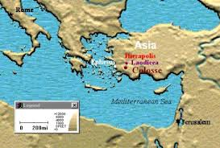
Laodicea, the Final Church
‘Towards the end of the Roman Republic and under the first emperors, Laodicea, benefiting from its advantageous position on a trade route, became one of the most important and flourishing commercial cities of Asia Minor, in which large money transactions and an extensive trade in black wool were carried on.’

Slide 14
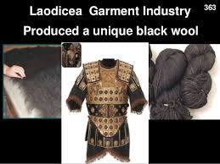
Very Prosperous, Wealthy Place
Laodicea had it all. Situated perfectly along the trade routes in Asia Minor, near to the Mediterranean, it flourished amid such opulence. Laodicea truly needed nothing and therein was her greatest problem; she was self sufficient!

Slide 15
No Room!
“Jesus had presented the cup of blessing to those who felt that they were "rich, and increased with goods" (Revelation 3:17), and had need of nothing, and they had turned with scorn from the gracious gift. He who feels whole, who thinks that he is reasonably good, and is contented with his condition, does not seek to become a partaker of the grace and righteousness of Christ. Pride feels no need, and so it closes the heart against Christ and the infinite blessings He came to give. There is no room for Jesus in the heart of such a person. Those who are rich and honorable in their own eyes do not ask in faith, and receive the blessing of God. They feel that they are full, therefore they go away empty. Those who know that they cannot possibly save themselves, or of themselves do any righteous action, are the ones who appreciate the help that Christ can bestow. They are the poor in spirit, whom He declares to be blessed.” Mount of Blessing, pg. 7

Slide 16
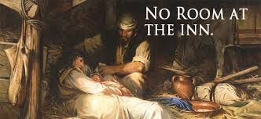
The Story of Christ’s Struggles with Humanity
“And so it was, that, while they were there, the days were accomplished that she should be delivered. And she brought forth her firstborn son, and wrapped him in swaddling clothes, and laid him in a manger; because there was no room for them in the inn.” Luke 2:6,7

Slide 17
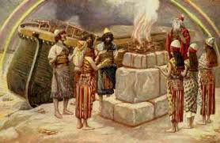
Not Many!
1. 8 in Noah’s day.
2. A handful in Moses’ day.
3. 11 and counting in Christ’s day.
4. 144,000 at the end of time.
Those who are poor in spirit recognize their spiritual deficiency and depend on the righteousness of Christ to do for them what they can not do for themselves, even obeying the commandments of God!!!

Slide 18
For All!
“All who have a sense of their deep soul poverty, who feel that they have nothing good in themselves, may find righteousness and strength by looking unto Jesus. He says, "Come unto Me, all ye that labor and are heavy-laden." Matthew 11:28. He bids you exchange your poverty for the riches of His grace. We are not worthy of God's love, but Christ , our surety, is worthy, and is abundantly able to save all who shall come unto Him. Whatever may have been your past experience, however discouraging your present circumstances, if you will come to Jesus just as you are, weak, helpless, and despairing, our compassionate Saviour will meet you a great way off, and will throw about you His arms of love and His robe of righteousness. He presents us to the Father clothed in the white raiment of His own character. He pleads before God in our behalf, saying: I have taken the sinner's place. Look not upon this wayward child, but look on Me. Does Satan plead loudly against our souls, accusing of sin, and claiming us as his prey, the blood of Christ pleads with greater power. "Surely, shall one say, in the Lord have I righteousness and strength. . . . In the Lord shall all the seed of Israel be justified, and shall glory." Isaiah 45:24, 25.” MB, pgs. 8,9

