Slide 1
ZebulUn ‘The Unknown’

Slide 2
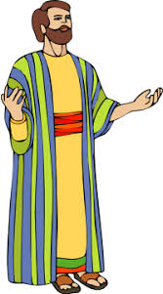
Who in the World?
Who in the world is Zebulun? From which wife of Jacob did he come? Where is his inheritance in Israel? Where does he fit into the family? What his he known for and did he do anything worthwhile? Lots of questions and, at this point, very few answers. We have 19 more slides to figure this guy out!

Slide 3
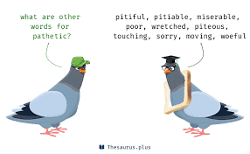
From Leah
“And Leah said, God hath given me my hire, because I have given my maiden to my husband: and she called his name Issachar. And Leah conceived again, and bare Jacob the sixth son. And Leah said, God hath endued me with a good dowry; now will my husband dwell with me, because I have born him six sons: and she called his name Zebulun.” Genesis 30:18-20

Slide 4
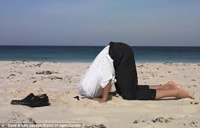
Leah had borne her husband 5 sons and he had failed to acknowledge her as his wife. Now, she names her 6th boy Zebulun believing this would finally do the trick. This is either utter desperation or the eternal optimist. Somewhere in this mix must come a little horse sense and a coming to grips with the situation!

Slide 5
Zebulun Was There!
Zebulun was part of the pathetic mob of brothers that cruelly sold Joseph into slavery. He lived with the guilt for 22 years. He watched his father’s pain because he chose to go along with the mob. He made some choices for right. “Joseph was satisfied. He had seen in his brothers the fruits of true repentance. Upon hearing Judah's noble offer he gave orders that all but these men should withdraw; then, weeping aloud, he cried, "I am Joseph; doth my father yet live?“ PP, pg. 230
Zebulun learned the bitter lesson that sin brings sorrow, pain, and separation. He truly repented and the Lord would do great things through this unknown son of Jacob!
“Zebulun shall dwell at the haven of the sea; and he shall be for an haven of ships; and his border shall be unto Zidon. Issachar is a strong ass couching down between two burdens: And he saw that rest was good, and the land that it was pleasant; and bowed his shoulder to bear, and became a servant unto tribute.” Genesis 49:13-15

Slide 6
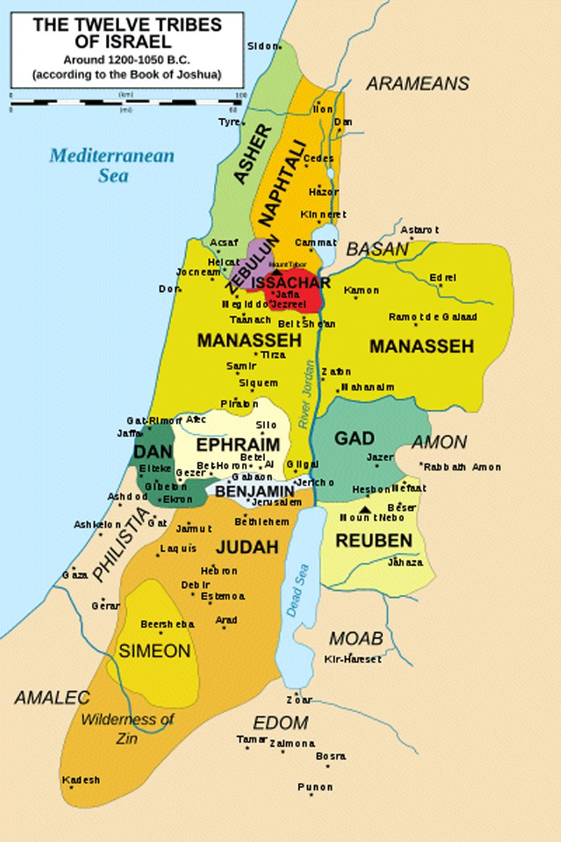
Even though Zebulun did not inherit the land directly on the coast, Jacob declared that Zebulun would be a sea going people. Dwelling near the sea and being a haven for ships. Zebulun would serve to aid those in need. The ship, tempest tossed and struggling would find comfort and protection with Zebulun. He would rise above the storm and be a strength to those about to give up hope! This would be Zebulun. “The LORD sitteth upon the flood; yea, the LORD sitteth King for ever. The LORD will give strength unto his people; the LORD will bless his people with peace.” Ps. 29:10,11

Slide 7
Moses Dying Benediction
“And of Zebulun he said, Rejoice, Zebulun, in thy going out; and, Issachar, in thy tents. They shall call the people unto the mountain; there they shall offer sacrifices of righteousness: for they shall suck of the abundance of the seas, and of treasures hid in the sand.” Deuteronomy 33:18,19
Because of their close proximity in age, Issachar and Zebulun are often discussed together. Both unknowns, they helped each other!

Slide 8
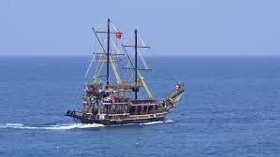
Being near the water and understanding the difficulties of being a seaman, Zebulun found joy in the journey. He was a traveler while Issachar stayed at home. Zebulun went out for several reasons.
1. They were involved in great missionary endeavors. They called people to worship the Lord at the mountain of God—Mt. Zion! ‘They shall call the people unto the mountain; there they shall offer sacrifices of righteousness.’
2. They loved the life of travel and adventure on the open seas. ‘Rejoice, Zebulun, in thy going out.’
3. They became wealthy in their travels, ‘they shall suck of the abundance of the seas, and of treasures hid in the sand.’

Slide 9
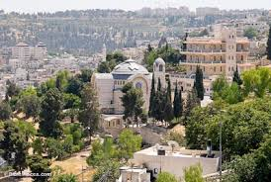
“That which selfish hearts would regard as humiliating service, ministering to those who are wretched and in every way inferior in character and rank, is the work of sinless angels. The spirit of Christ's self-sacrificing love is the spirit that pervades heaven and is the very essence of its bliss. This is the spirit that Christ's followers will possess, the work that they will do. When the love of Christ is enshrined in the heart, like sweet fragrance it cannot be hidden. Its holy influence will be felt by all with whom we come in contact. The spirit of Christ in the heart is like a spring in the desert, flowing to refresh all and making those who are ready to perish, eager to drink of the water of life. Love to Jesus will be manifested in a desire to work as He worked for the blessing and uplifting of humanity. It will lead to love, tenderness, and sympathy toward all the creatures of our heavenly Father's care.” Steps to Christ, pgs. 77,78

Slide 10
Battle at Megiddo
Fascinating story in this epic Old Testament clash. It takes place in Judges 4 and 5. Deborah, the prophetess of God’s people, just like Ellen White today; and Barak, a relative unknown from Kedesh-Naphtali, go out to square off with Jabin, king of Canaan and Sisera, his captain and leader of 900 chariots! It is a classic battle between the truth of God and His children versus those who claim Heaven’s blessings but do not bring forth obedience through faith in the power of Christ! The children of God prevail in the battle and triumph gloriously! One of the families in Israel that come to the aid of Deborah and Barak are the men of Zebulun.
“Go and draw toward mount Tabor, and take with thee ten thousand men of the children of Naphtali and of the children of Zebulun? And I will draw unto thee to the river Kishon Sisera, the captain of Jabin's army, with his chariots and his multitude; and I will deliver him into thine hand. And Barak said unto her, If thou wilt go with me, then I will go: but if thou wilt not go with me, then I will not go. And she said, I will surely go with thee: notwithstanding the journey that thou takest shall not be for thine honour; for the LORD shall sell Sisera into the hand of a woman. And Deborah arose, and went with Barak to Kedesh. And Barak called Zebulun and Naphtali to Kedesh; and he went up with ten thousand men at his feet: and Deborah went up with him.” Judges 4:6-10

Slide 11
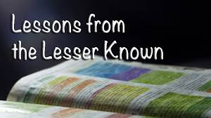
Zebulun-The Lesser Known Tribe
The tribes that got all the ink were Judah and Joseph; the Levites and Simeon, like all the other big boys, were not mentioned in this clash that decided the fate of God’s people for years to come. Even the first born, Rueben, was not sure what to do. “And the princes of Issachar were with Deborah; even Issachar, and also Barak: he was sent on foot into the valley. For the divisions of Reuben there were great thoughts of heart. Why abodest thou among the sheepfolds, to hear the bleatings of the flocks? For the divisions of Reuben there were great searchings of heart.” Judges 5:15,16

Slide 12
Who Met the Foe?
And the princes of Issachar were with Deborah; even Issachar, and also Barak: he was sent on foot into the valley. For the divisions of Reuben there were great thoughts of heart…. Zebulun and Naphtali were a people that jeoparded their lives unto the death in the high places of the field. The kings came and fought, then fought the kings of Canaan in Taanach by the waters of Megiddo; they took no gain of money.” Judges 5:15,18,19
Issachar, the donkey, Naphtali the hind let loose, and Zebulun the unknown were there in the valley, getting dirty with the kings of the earth!!! It was not about making big bucks, or about prestige, or being a big shot; it was about the truth of God and His honor that motivated these men! Do you think this is a history lesson?
“The time is not far distant when the test will come to every soul. The observance of the false sabbath will be urged upon us. The contest will be between the commandments of God and the commandments of men. Those who have yielded step by step to worldly demands and conformed to worldly customs will then yield to the powers that be, rather than subject themselves to derision, insult, threatened imprisonment, and death. At that time the gold will be separated from the dross. True godliness will be clearly distinguished from the appearance and tinsel of it. Many a star that we have admired for its brilliance will then go out in darkness. Those who have assumed the ornaments of the sanctuary, but are not clothed with Christ's righteousness, will then appear in the shame of their own nakedness.” PK, pg. 188

Slide 13
Big Boys Fall
“The Lord has a controversy with his professed people in these last days. In this controversy men in responsible positions will take a course directly opposite to that pursued by Nehemiah. They will not only ignore and despise the Sabbath themselves, but they will try to keep it from others by burying it beneath the rubbish of custom and tradition. In churches and in large gatherings in the open air, ministers will urge upon the people the necessity of keeping the first day of the week.” RH, March 18,1884
“Men of talent and pleasing address, who once rejoiced in the truth, employ their powers to deceive and mislead souls. They become the most bitter enemies of their former brethren. When Sabbath keepers are brought before the courts to answer for their faith, these apostates are the most efficient agents of Satan to misrepresent and accuse them, and by false reports and insinuations to stir up the rulers against them.” GC, pg. 608

Slide 14
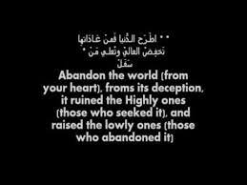
“As the time comes for it to be given with greatest power, the Lord will work through humble instruments, leading the minds of those who consecrate themselves to His service. The laborers will be qualified rather by the unction of His Spirit than by the training of literary institutions. Men of faith and prayer will be constrained to go forth with holy zeal, declaring the words which God gives them. The sins of Babylon will be laid open. The fearful results of enforcing the observances of the church by civil authority, the inroads of spiritualism, the stealthy but rapid progress of the papal power--all will be unmasked. By these solemn warnings the people will be stirred. Thousands upon thousands will listen who have never heard words like these.” GC, pg. 606
In other words, the Zebulun’s and Issachar's and Naphtali’s!!!

Slide 15
“Now these are they that came to David to Ziklag, while he yet kept himself close because of Saul the son of Kish: and they were among the mighty men, helpers of the war.” 1 Chronicles 12:1 “Of Zebulun, such as went forth to battle, expert in war, with all instruments of war, fifty thousand, which could keep rank: they were not of double heart.” 1 Chronicles 12:33

Slide 16
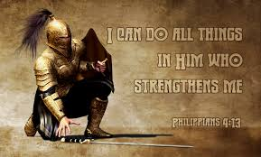
Courageous in battle, ready to fight for the long duration of the battle, the men of Zebulun were God’s warriors. They were ready to go froth in battle because they had already faced the greatest enemy of them all and won; they gained the victor over the carnal nature through faith in Jesus Christ! They could meet any foe as long as self was subdued!

Slide 17
Pre Eminent in Israel
“Men whom God favored, and to whom He entrusted great responsibilities, were sometimes overcome by temptation and committed sin, even as we at the present day strive, waver, and frequently fall into error. Their lives, with all their faults and follies, are open before us, both for our encouragement and warning. If they had been represented as without fault, we, with our sinful nature, might despair at our own mistakes and failures. But seeing where others struggled through discouragements like our own, where they fell under temptations as we have done, and yet took heart again and conquered through the grace of God, we are encouraged in our striving after righteousness. As they, though sometimes beaten back, recovered their ground, and were blessed of God, so we too may be overcomers in the strength of Jesus. On the other hand, the record of their lives may serve as a warning to us. It shows that God will by no means clear the guilty. He sees sin in His most favored ones, and He deals with it in them even more strictly than in those who have less light and responsibility. “ PP, pg. 238

Slide 18
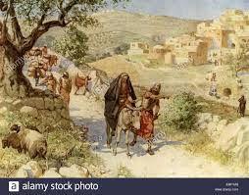
“So the posts passed from city to city through the country of Ephraim and Manasseh even unto Zebulun: but they laughed them to scorn, and mocked them. Nevertheless divers of Asher and Manasseh and of Zebulun humbled themselves, and came to Jerusalem. Also in Judah the hand of God was to give them one heart to do the commandment of the king and of the princes, by the word of the LORD. And there assembled at Jerusalem much people to keep the feast of unleavened bread in the second month, a very great congregation. And they arose and took away the altars that were in Jerusalem, and all the altars for incense took they away, and cast them into the brook Kidron. Then they killed the Passover on the fourteenth day of the second month: and the priests and the Levites were ashamed, and sanctified themselves, and brought in the burnt offerings into the house of the LORD.” 2 Chronicles 30:10-15

Slide 19
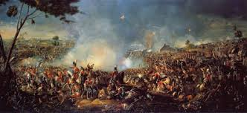
The tribe of Zebulun, hardly known in the annals of time, nevertheless, occupied a pre eminent position in Israel. Because they had learned to let God lead, they were now ready to lead people to Him! They were warriors in the Lord’s army, ready to do battle with the foes of the Lord. “ When the religion of Christ is most held in contempt, when His law is most despised, then should our zeal be the warmest and our courage and firmness the most unflinching. To stand in defense of truth and righteousness when the majority forsake us, to fight the battles of the Lord when champions are few—this will be our test. At this time we must gather warmth from the coldness of others, courage from their cowardice, and loyalty from their treason. The nation will be on the side of the great rebel leader.” 5Testimonies, pg. 136

