Slide 1
Jesus’ Life, pt.2 “Visitors from the East.”

Slide 2
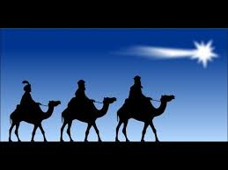
It Only Got Worse!
First, it was ignorant shepherds. Uneducated, unknown, certainly not anyone to be recognized or respected. Given the message of the Messiah’s birth and passing by the organized church! Impossible? This can not be true!
What? Who? Wise men from the east? Gentile heathen dogs are saying what? Want to know where the Messiah was born?
I think I'm going to be sick!

Slide 3
Where is He!?!
“Now when Jesus was born in Bethlehem of Judaea in the days of Herod the king, behold, there came wise men from the east to Jerusalem, Saying, Where is he that is born King of the Jews? for we have seen his star in the east, and are come to worship him. When Herod the king had heard these things, he was troubled, and all Jerusalem with him. And when he had gathered all the chief priests and scribes of the people together, he demanded of them where Christ should be born. And they said unto him, In Bethlehem of Judaea: for thus it is written by the prophet, And thou Bethlehem, in the land of Juda, art not the least among the princes of Juda: for out of thee shall come a Governor, that shall rule my people Israel.” Luke 2:1-6

Slide 4
Stand Higher than God’s People
“With eager steps they press onward, confidently expecting the Messiah's birth to be the joyful burden of every tongue. But their inquiries are in vain. Entering the holy city, they repair to the temple. To their amazement they find none who seem to have a knowledge of the newborn king. Their questions call forth no expressions of joy, but rather of surprise and fear, not unmingled with contempt.
The priests are rehearsing traditions. They extol their religion and their own piety, while they denounce the Greeks and Romans as heathen, and sinners above others. The wise men are not idolaters, and in the sight of God they stand far higher than do these, His professed worshipers; yet they are looked upon by the Jews as heathen. Even among the appointed guardians of the Holy Oracles their eager questionings touch no chord of sympathy.” DA, pgs. 60, 61

Slide 5
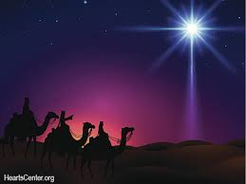
Who Were These Guys?
“The wise men from the East were philosophers. They belonged to a large and influential class that included men of noble birth, and comprised much of the wealth and learning of their nation. Among these were many who imposed on the credulity of the people. Others were upright men who studied the indications of Providence in nature, and who were honored for their integrity and wisdom. Of this character were the wise men who came to Jesus.” DA, pg. 59

Slide 6
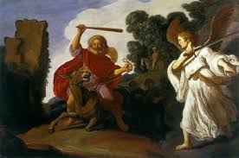
Balaam’s Prediction
“The light of God is ever shining amid the darkness of heathenism. As these magi studied the starry heavens, and sought to fathom the mystery hidden in their bright paths, they beheld the glory of the Creator. Seeking clearer knowledge, they turned to the Hebrew Scriptures. In their own land were treasured prophetic writings that predicted the coming of a divine teacher. Balaam belonged to the magicians, though at one time a prophet of God; by the Holy Spirit he had foretold the prosperity of Israel and the appearing of the Messiah; and his prophecies had been handed down by tradition from century to century. But in the Old Testament the Savior's advent was more clearly revealed. The magi learned with joy that His coming was near, and that the whole world was to be filled with a knowledge of the glory of the Lord.” DA, pg. 59

Slide 7
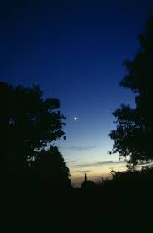
“The wise men had seen a mysterious light in the heavens upon that night when the glory of God flooded the hills of Bethlehem. As the light faded, a luminous star appeared, and lingered in the sky. It was not a fixed star nor a planet, and the phenomenon excited the keenest interest. That star was a distant company of shining angels, but of this the wise men were ignorant. Yet they were impressed that the star was of special import to them. They consulted priests and philosophers, and searched the scrolls of the ancient records. The prophecy of Balaam had declared, “There shall come a Star out of Jacob, and a Scepter shall rise out of Israel.” Numbers 24:17. Could this strange star have been sent as a harbinger of the Promised One? The magi had welcomed the light of heaven-sent truth; now it was shed upon them in brighter rays. Through dreams they were instructed to go in search of the newborn Prince. “ DA. Pg. 60

Slide 8
The Wisemen Biographies
1. They were wealthy.
2. They were of noble birth.
3. They were searching for the truth.
4. They studied the heaven’s and the movement of celestial bodies.
5. A star they had never seen before appeared in the western sky.
6. They heeded the Spirit of Prophecy thru their prophet, Balaam!
7. They followed the mysterious star-Angels!!
8. They were initially snubbed by God’s professed people.
9. The arrival of the wisemen reached all the way to the place.
10. When men follow the Spirit of Prophecy and the light of angel’s, they will be brought before kings!

Slide 9
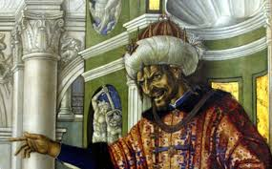
Troubled!
“When Herod the king had heard these things, he was troubled, and all Jerusalem with him.” Matthew 2:3
For Herod, it is obvious. He saw in the Messianic king a rival, one who he thought would eventually take over his throne. If the Jews had given him a correct view of prophecy, there would have been no concern. Are we giving the world a wrong view today, espousing the role of Islam, leading people from the truth of God!

Slide 10
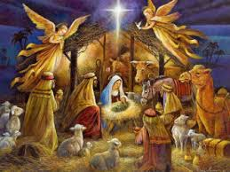
God’s People Troubled
1. They had rejected the angel’s message to the shepherds.
2. In their greed for riches and worldly honor, they had been unprepared for the Messiah’s coming.
3. They turned the glad tidings of Messiah’s coming into hatred for Him!
4. When inquiry was made by the Magi, they were totally unprepared to help them.

Slide 11
Too Proud!
“The priests and elders of Jerusalem were not as ignorant concerning the birth of Christ as they pretended. The report of the angels’ visit to the shepherds had been brought to Jerusalem, but the rabbis had treated it as unworthy of their notice. They themselves might have found Jesus, and might have been ready to lead the magi to His birthplace; but instead of this, the wise men came to call their attention to the birth of the Messiah. “Where is He that is born King of the Jews?” they said; “for we have seen His star in the East, and are come to worship Him.” Now pride and envy closed the door against the light. If the reports brought by the shepherds and the wise men were credited, they would place the priests and rabbis in a most unenviable position, disproving their claim to be the exponents of the truth of God.” DA, pg. 62

Slide 12
“….These learned teachers would not stoop to be instructed by those whom they termed heathen. It could not be, they said, that God had passed them by, to communicate with ignorant shepherds or uncircumcised Gentiles. They determined to show their contempt for the reports that were exciting King Herod and all Jerusalem. They would not even go to Bethlehem to see whether these things were so. And they led the people to regard the interest in Jesus as a fanatical excitement. Here began the rejection of Christ by the priests and rabbis. From this point their pride and stubbornness grew into a settled hatred of the Savior. While God was opening the door to the Gentiles, the Jewish leaders were closing the door to themselves.” DA, pg. 62

Slide 13
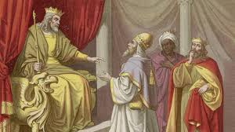
Herod Wants an Answer!
“And when he had gathered all the chief priests and scribes of the people together, he demanded of them where Christ should be born. And they said unto him, In Bethlehem of Judaea: for thus it is written by the prophet, And thou Bethlehem, in the land of Juda, art not the least among the princes of Juda: for out of thee shall come a Governor, that shall rule my people Israel.” Matthew 2:4-6

Slide 14
Higher Criticism/Scholarship or Stupidity??
“Similar hermeneutical connections that would not be exegetically acceptable, but theologically legitimate and useful, occur in the New Testament. In spite of the popular proof-text opinion, it is not a sound contextual exegesis to quote Is 7:14 as a direct prophecy of the Messiah’s birth (Mt 1:23). The same may be said about Jr 31:15, as a prophecy fulfilled in the slaughter of Bethlehem children, or Hos 11:1 pointing to Jesus’ exodus from Egypt (Mt 2:15,18), though exegetically they had a different intention and fulfillment. Similarly, Paul’s reading in Is 54:1 the Gentile Church (Ga 4:27), or in Jr 31:31 the Christian covenant (Heb. 8:8) is not sound exegesis, but they are justified or legitimized on broad hermeneutic principles, as theological applications.” Florin G. Lăiu, MThOT (UNISA), Bible teacher, The Romanian Adventist Theological Institute, Cernica-Bucharest

Slide 15
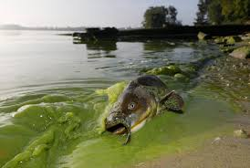
What Did He Just Say????
To quote Micah 5:2 relating to the Messiah’s birthplace OR quoting Isaiah 7:14 “Therefore the Lord himself shall give you a sign; Behold, a virgin shall conceive, and bear a son, and shall call his name Immanuel”, and saying that is referring to the Messiah, is WRONG! Because the passage had application in Micah’s day and Isaiah’s day AND IT IS INCORRECT TO USE IT TO PROVE SOMETHING IN THE FUTURE. We must use the historical, critical method of study and NOT the proof text method! That man is crazy!!!! And, he is a scholar!!!

Slide 16
Could Have Been Different!
“The wise men departed alone from Jerusalem. The shadows of night were falling as they left the gates, but to their great joy they again saw the star, and were directed to Bethlehem. They had received no such intimation of the lowly estate of Jesus as was given to the shepherds. After the long journey they had been disappointed by the indifference of the Jewish leaders, and had left Jerusalem less confident than when they entered the city. At Bethlehem they found no royal guard stationed to protect the newborn King. None of the world's honored men were in attendance. Jesus was cradled in a manger. His parents, uneducated peasants, were His only guardians. Could this be He of whom it was written, that He should “raise up the tribes of Jacob,” and “restore the preserved of Israel;” that He should be “a light to the Gentiles,” and for “salvation unto the end of the earth”? Isaiah 49:6.

Slide 17
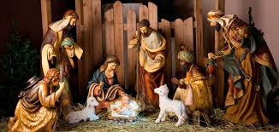
“When they were come into the house, they saw the young child with Mary His mother, and fell down, and worshiped Him.” Beneath the lowly guise of Jesus, they recognized the presence of Divinity. They gave their hearts to Him as their Savior, and then poured out their gifts,—“gold, and frankincense, and myrrh.” What a faith was theirs! It might have been said of the wise men from the East, as afterward of the Roman centurion, “I have not found so great faith, no, not in Israel.” Matthew 8:10.

Slide 18
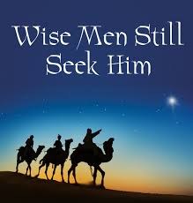
Wise Men Still Seek Him
1. They followed the prophet.
2. They followed the angel star.
3. They found their Savior.
4. They gave Him rich gifts!
5. May we do the same!

