Slide 1
Romans, pt. 23
The Christian and the Government

Slide 2
Review of Romans 12
1. Paul gives practical admonition in this chapter.
2. He challenges all believers to holiness.
3. He demands thrift and faithfulness in business.
4. He encourages all to be compassionate toward other people.

Slide 3

Subjection
“Let every soul be subject unto the higher powers. For there is no power but of God: the powers that be are ordained of God. Whosoever therefore resisteth the power, resisteth the ordinance of God: and they that resist shall receive to themselves damnation.” Romans 13:1,2

Slide 4
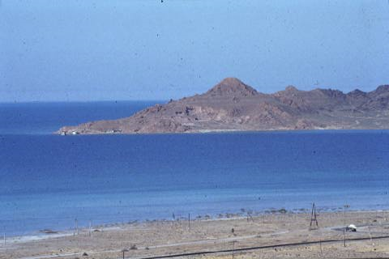
The Historical Backdrop
Throughout Paul’s discussion of the Christian’s relationship to government, he uses the word power or powers. Here, the word does not mean strength, as in Romans 1:16, but rather authority or position of authority. Thus, Paul’s calling Christians to honor authority within its rightful sphere is outlined. In the light of the history of the first century, this counsel is paramount. Many Jews considered it lawful and their duty to foment and push insurrection against the Romans. In fact, Jews engaged in these plots against government were called zealots. Paul drew the lines very clearly, making it very clear that Christians respect governmental authority as ordained by God.

Slide 5
Our standing before government
1. Paul is talking about Christians and how they should relate to government. “Know ye not, brethren, (for I speak to them that know the law,)” Rom. 7:1
2. Every ruler rules as God appointed leader. “And he changeth the times and the seasons: he removeth kings, and setteth up kings:” Daniel 2:21 “until thou know that the most High ruleth in the kingdom of men, and giveth it to whomsoever he will.” Daniel 4:32
3. To try and dispose or rebel against a ruler isn’t from God. “And he said unto his men, The LORD forbid that I should do this thing unto my master, the LORD'S anointed, to stretch forth mine hand against him, seeing he [is] the anointed of the LORD.” 1Samuel 24:6

Slide 6

Honor government in its Sphere
Since we are admonished not to resist the government, then we obviously should honor and obey the government as long as it doesn’t supersede the authority of God and His honor. Only when government seeks to take authority that alone belongs to God is it right for a Christian to disobey.

Slide 7
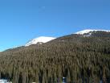
Honor Government in its Sphere
“Submit yourselves to every ordinance of man for the Lord's sake: whether it be to the king, as supreme; Or unto governors, as unto them that are sent by him for the punishment of evildoers, and for the praise of them that do well. For so is the will of God, that with well doing ye may put to silence the ignorance of foolish men: As free, and not using [your] liberty for a cloke of maliciousness, but as the servants of God. Honour all [men]. Love the brotherhood. Fear God. Honour the king.” 1 Peter 2:13-17

Slide 8
Peter Applies the Principle
“But the angel of the Lord by night opened the prison doors, and brought them forth, and said, Go, stand and speak in the temple to the people all the words of this life. And when they heard [that], they entered into the temple early in the morning, and taught. But the high priest came, and they that were with him, and called the council together, and all the senate of the children of Israel, and sent to the prison to have them brought. But when the officers came, and found them not in the prison, they returned, and told, Saying, The prison truly found we shut with all safety, and the keepers standing without before the doors: but when we had opened, we found no man within. Now when the high priest and the captain of the temple and the chief priests heard these things, they doubted of them whereunto this would grow. Then came one and told them, saying, Behold, the men whom ye put in prison are standing in the temple, and teaching the people. Then went the captain with the officers, and brought them without violence: for they feared the people, lest they should have been stoned. And when they had brought them, they set [them] before the council: and the high priest asked them, Saying, Did not we straitly command you that ye should not teach in this name? and, behold, ye have filled Jerusalem with your doctrine, and intend to bring this man's blood upon us. Then Peter and the [other] apostles answered and said, We ought to obey God rather than men.” Acts 5:19-29

Slide 9
Applying the Principle
While Barack Obama:
1. is working for Rome
2. is following the agenda that will ultimately lead to Sunday laws
Nevertheless, God allowed him to be placed in power at this time and he is to be honored as long as he doesn’t usurp authority that belongs to God alone!

Slide 10
Wagoner on Romans 13:1,2
“The Roman power, even in the days of the infamous and brutal Nero, was as much derived from God as was the Jewish power in the days of David. When Pilate told Christ that he had power to crucify him or to let him go, Christ replied, “Thou could have no power at all against me, except it were given thee from above.” John 19:11. This fact does not, however, prove that the acts of that power were right, or that God sanctioned them…. This is a warning against rebellion and insurrection. It is God who removes kings as well as sets them up. Therefore whoever presumes to remove a king is assuming God’s prerogative. It is as though he knew better than God when the government should be altered. Unless those who rise up against any earthly government can show a direct revelation to them from heaven appointing them to that work, they are setting themselves against God, by seeking to overthrow his order. They are putting themselves ahead of God…It is worth while to remember that Christ was condemned on a political charge, and for political reasons, yet he made no resistance, although He showed that He had power to do so…It is the height of folly for us to argue from this chapter that it is the duty of Christians to obey human laws when they conflict with the law of God. God does not grant indulgence to sin; much less does he command us to sin.”

Slide 11
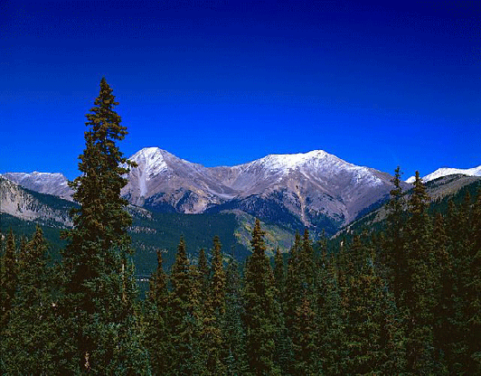
Romans 13:3,4
“For rulers are not a terror to good works, but to the evil. Wilt thou then not be afraid of the power? do that which is good, and thou shalt have praise of the same: For he is the minister of God to thee for good. But if thou do that which is evil, be afraid; for he beareth not the sword in vain: for he is the minister of God, a revenger to execute wrath upon him that doeth evil.”

Slide 12

Paul’s Argument
1. Typically, leaders are selfish and corrupt and out solely for themselves.
2. Our responsibility is to follow the laws as long as they don’t tell us how to worship God.
3. If we refuse to honor the rightful laws of government, we deserve punishment.

Slide 13
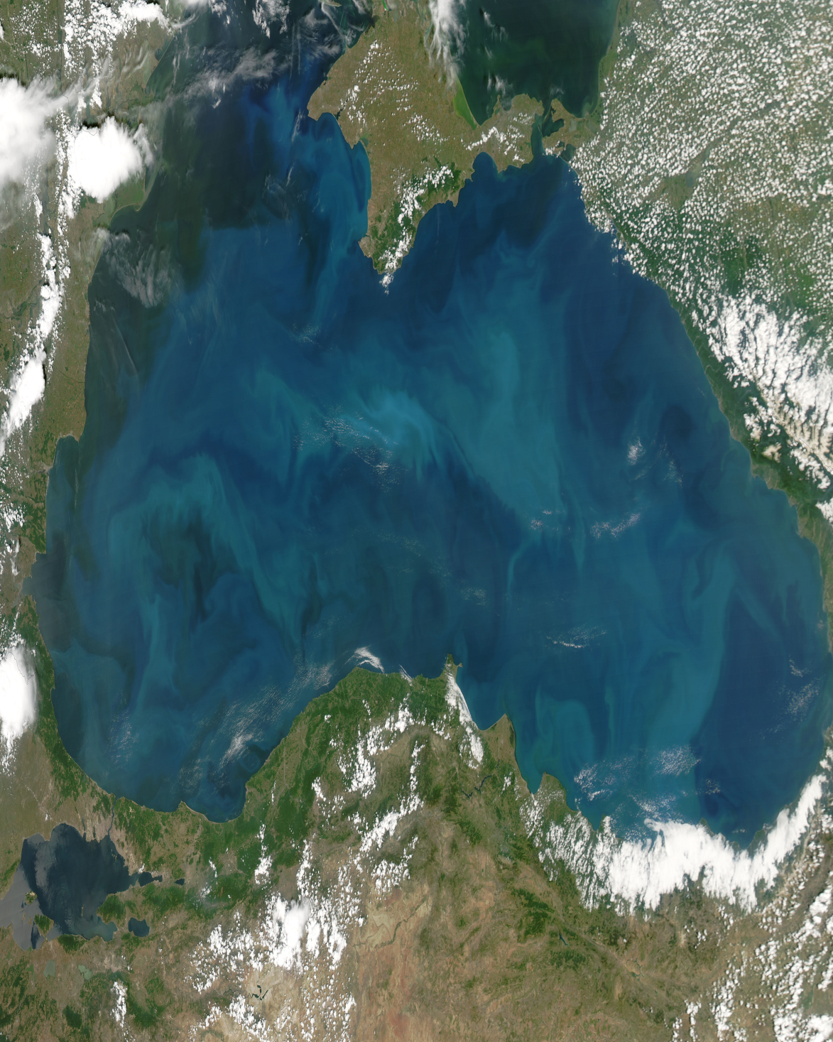
Paying of Taxes
“Wherefore ye must needs be subject, not only for wrath, but also for conscience sake. For for this cause pay ye tribute also: for they are God's ministers, attending continually upon this very thing. Render therefore to all their dues: tribute to whom tribute is due; custom to whom custom; fear to whom fear; honour to whom honour.” Romans 13:5-7

Slide 14
Christ Lays it Down
Christ’s statement along this same line is all that Paul is setting forth here. “And he said unto them, Render therefore unto Caesar the things which be Caesar's, and unto God the things which be God's.” Luke 20:25 “The spies had expected Jesus to answer their question directly, in one way or the other. If He should say, It is unlawful to give tribute to Caesar, He would be reported to the Roman authorities and arrested for inciting rebellion. But in case He should pronounce it lawful to pay the tribute, they designed to accuse Him to the people as opposing the law of God. Now they felt themselves baffled and defeated. Their plans were disarranged. The summary manner in which their question had been settled left them nothing further to say. Christ's reply was no evasion, but a candid answer to the question. Holding in His hand the Roman coin, upon which were stamped the name and image of Caesar, He declared that since they were living under the protection of the Roman power, they should render to that power the support it claimed, so long as this did not conflict with a higher duty. But while peaceably subject to the laws of the land, they should at all times give their first allegiance to God.” DA, pg. 602
No more wicked empire ever ruled the world than the Roman empire. No one understood how evil it was as did Christ! Nevertheless, Christ declared that Christians should render to Rome the support it claimed so long as it did not conflict with a higher duty. This is the message of Paul and Peter!

Slide 15

Love at its Pinnacle
“Owe no man any thing, but to love one another: for he that loveth another hath fulfilled the law. For this, Thou shalt not commit adultery, Thou shalt not kill, Thou shalt not steal, Thou shalt not bear false witness, Thou shalt not covet; and if there be any other commandment, it is briefly comprehended in this saying, namely, Thou shalt love thy neighbour as thyself. Love worketh no ill to his neighbour: therefore love is the fulfilling of the law.” Romans 13:8-10

Slide 16
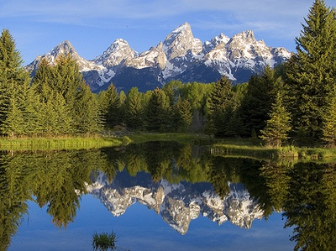
The One Absolute
Only in the ten commandments do we find an absolute that tells us what love does and what love does not do. The commandments that Paul mentioned were those that relate to our duty to our fellow man. True love follows these laws and doesn’t hold grudges when others have broken them against us!

Slide 17

Love in Action
“Let all bitterness, and wrath, and anger, and clamour, and evil speaking, be put away from you, with all malice: And be ye kind one to another, tenderhearted, forgiving one another, even as God for Christ's sake hath forgiven you.” Ephesians 4:31,32

Slide 18
A Must
“Therefore is the kingdom of heaven likened unto a certain king, which would take account of his servants. And when he had begun to reckon, one was brought unto him, which owed him ten thousand talents. But forasmuch as he had not to pay, his lord commanded him to be sold, and his wife, and children, and all that he had, and payment to be made. The servant therefore fell down, and worshipped him, saying, Lord, have patience with me, and I will pay thee all. Then the lord of that servant was moved with compassion, and loosed him, and forgave him the debt. But the same servant went out, and found one of his fellowservants, which owed him an hundred pence: and he laid hands on him, and took [him] by the throat, saying, Pay me that thou owest. And his fellowservant fell down at his feet, and besought him, saying, Have patience with me, and I will pay thee all. And he would not: but went and cast him into prison, till he should pay the debt. So when his fellowservants saw what was done, they were very sorry, and came and told unto their lord all that was done. Then his lord, after that he had called him, said unto him, O thou wicked servant, I forgave thee all that debt, because thou desiredst me: Shouldest not thou also have had compassion on thy fellowservant, even as I had pity on thee? And his lord was wroth, and delivered him to the tormentors, till he should pay all that was due unto him. So likewise shall my heavenly Father do also unto you, if ye from your hearts forgive not every one his brother their trespasses.” Matthew 18:23-35

Slide 19
How Near Now?!?
“Finally, brethren, whatsoever things are true, whatsoever things are honest, whatsoever things are just, whatsoever things are pure, whatsoever things are lovely, whatsoever things are of good report; if there be any virtue, and if there be any praise, think on these things.” Philippians 4:8 Our Filter!
“And that, knowing the time, that now it is high time to awake out of sleep: for now is our salvation nearer than when we believed. The night is far spent, the day is at hand: let us therefore cast off the works of darkness, and let us put on the armour of light. Let us walk honestly, as in the day; not in rioting and drunkenness, not in chambering and wantonness, not in strife and envying. But put ye on the Lord Jesus Christ, and make not provision for the flesh, to fulfil the lusts thereof.” Romans 13:11-14

