Slide 1
The Plan
Long Time Coming

Slide 2
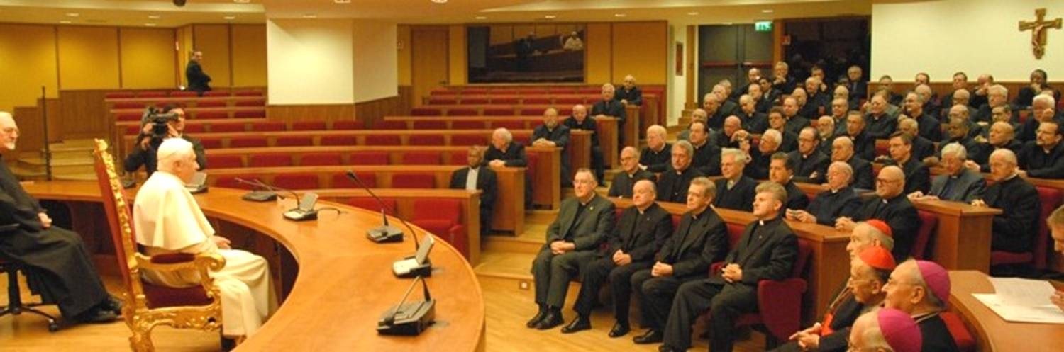
The Meeting

Slide 3
The Discussion
Pope asks Jesuits to make Their Service a Priority
Strategies and tactics are being implemented in order to create a church and state, authoritarian government. On November 3, 2006 Pope Benedict XVI met with his Jesuits at the Pontifical Gregorian Jesuit University in Rome. In this meeting he challenged the Jesuits to continue making their work a
“priority in the service of the church,” according La Gregoriana No. 27, December 2006, the University’s news magazine. The Pope first held a general meeting addressing hundreds of Jesuit scholars, professors, priests, missionaries, and students, and then met privately with 89 of the top Jesuit hierarchy from around the world. Pope Benedict told Peter-Hans Kolvenbach, the Jesuit superior general, and other top Jesuits leaders that they have “one of the greatest services to perform for the Catholic Church throughout the world.” Pope Benedict said he hoped their education and training would help them become the people who “know how to perform services and fulfill offices competently in the church and, especially, to be leaven for the kingdom of God in the temporal sphere for the salvation of all humanity.”

Slide 4
The Purpose
“Throughout Christendom, Protestantism was menaced by formidable foes. The first triumphs of the Reformation past, Rome summoned new forces, hoping to accomplish its destruction. At this time the order of the Jesuits was created, the most cruel, unscrupulous, and powerful of all the champions of popery. Cut off from earthly ties and human interests, dead to the claims of natural affection, reason and conscience wholly silenced, they knew no rule, no tie, but that of their order, and no duty but to extend its power. The gospel of Christ had enabled its adherents to meet danger and endure suffering, undismayed by cold, hunger, toil, and poverty, to uphold the banner of truth in face of the rack, the dungeon, and the stake. To combat these forces, Jesuitism inspired its followers with a fanaticism that enabled them to endure like dangers, and to oppose to the power of truth all the weapons of deception. There was no crime too great for them to commit, no deception too base for them to practice, no disguise too difficult for them to assume. Vowed to perpetual poverty and humility, it was their studied aim to secure wealth and power, to be devoted to the overthrow of Protestantism, and the re-establishment of the papal supremacy. “

Slide 5
Continued
“When appearing as members of their order, they wore a garb of sanctity, visiting prisons and hospitals, ministering to the sick and the poor, professing to have renounced the world, and bearing the sacred name of Jesus, who went about doing good. But under this blameless exterior the most criminal and deadly purposes were often concealed. It was a fundamental principle of the order that the end justifies the means. By this code, lying, theft, perjury, assassination, were not only pardonable but commendable, when they served the interests of the church. Under various disguises the Jesuits worked their way into offices of state, climbing up to be the counselors of kings, and shaping the policy of nations. They became servants to act as spies upon their masters. They established colleges for the sons of princes and nobles, and schools for the common people; and the children of Protestant parents were drawn into an observance of popish rites. All the outward pomp and display of the Romish worship was brought to bear to confuse the mind and dazzle and captivate the imagination, and thus the liberty for which the fathers had toiled and bled was betrayed by the sons. The Jesuits rapidly spread themselves over Europe, and wherever they went, there followed a revival of popery.” GC, pgs. 234,235

Slide 6
The Meaning
When Benedict tells the Jesuits to make their work a priority in the World to bring about the salvation of all humanity, he means for them to do whatever it takes to bring all the world back to obeisance to the papacy. Benedict is telling the Jesuits to destroy, maim, wipe out anything that stands in the way. Especially, anything that smells of Protestantism and bring the world to accept our mark of authority in the earth, which is………………..

Slide 7
The Control Mechanism
“And the merchants of the earth shall weep and mourn over her; for no man buyeth their merchandise any more: The merchandise of gold, and silver, and precious stones, and of pearls, and fine linen, and purple, and silk, and scarlet, and all thyine wood, and all manner vessels of ivory, and all manner vessels of most precious wood, and of brass, and iron, and marble, And cinnamon, and odours, and ointments, and frankincense, and wine, and oil, and fine flour, and wheat, and beasts, and sheep, and horses, and chariots, and slaves, and souls of men. And the fruits that thy soul lusted after are departed from thee, and all things which were dainty and goodly are departed from thee, and thou shalt find them no more at all. The merchants of these things, which were made rich by her, shall stand afar off for the fear of her torment, weeping and wailing, And saying, Alas, alas, that great city, that was clothed in fine linen, and purple, and scarlet, and decked with gold, and precious stones, and pearls!
For in one hour so great riches is come to nought.” Revelation 18:11-17

Slide 8
The Wealthiest of them All
Aware that the Rothschilds are an important Jewish family, I looked them up in Encyclopedia Judaica and discovered that they bear the title ‘Guardians of the Vatican Treasury’…. The appointment of Rothschild gave the black papacy absolute financial privacy and secrecy. Who would ever search a family of orthodox Jews for the key to the wealth of the Roman Catholic Church? — F. Tupper Saussy, Rulers of Evil, Harper Collins, page 160, 161

Slide 9
The Scope
1. The Central Banks/Federal Reserve
2. The International Banks/ IMF
3. The World Bank
4. The Commodities
5. The Stock Markets

Slide 10
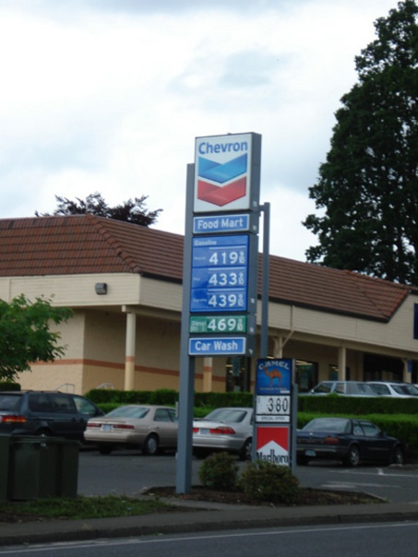
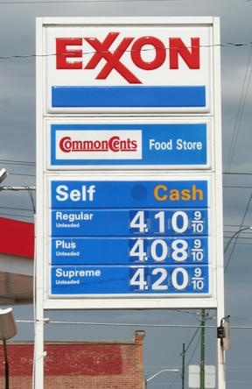
The Process

Slide 11
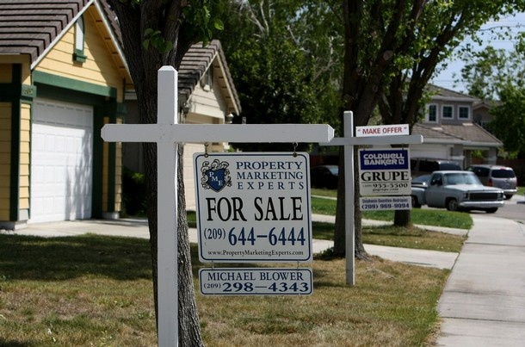

The Fallout

Slide 12
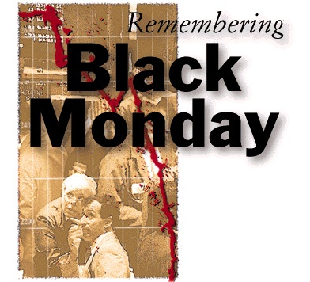
The ‘Anything Goes’ Principle

Slide 13
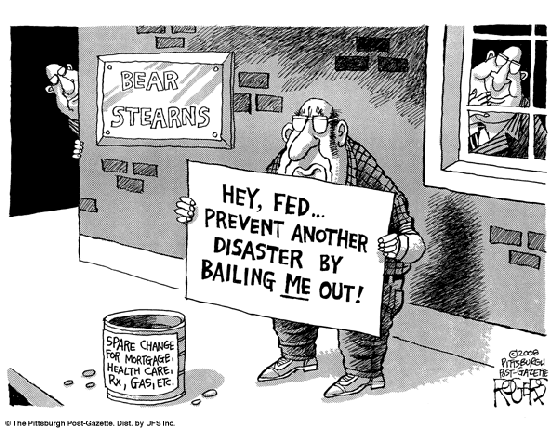
The Bail Out

Slide 14
The Crunch
Orlando Sentinel, May 25,2008 ‘Middle Class Losing its Grip’—”The story of how the Thompson’s tumbled to the brink of homelessness is not just about one family. To social service workers, who see an increasing number of once-middle-class families losing their grasp on the American dream, it is the story of our times.”
The middle class is a direct result of the Protestant Reformation. The Jesuit Order was raised up to destroy every vestige of the Reformation. They had a meeting in Nov. 2006. God is allowing them to do this that people might turn to Him!

Slide 15
The Original Plan
Strategies and tactics are being implemented in order to create a church and state, authoritarian government. On November 3, 2006 Pope Benedict XVI met with his Jesuits at the Pontifical Gregorian Jesuit University in Rome. In this meeting he challenged the Jesuits to continue making their work a
“priority in the service of the church,” according La Gregoriana No. 27, December 2006, the University’s news magazine. The Pope first held a general meeting addressing hundreds of Jesuit scholars, professors, priests, missionaries, and students, and then met privately with 89 of the top Jesuit hierarchy from around the world. Pope Benedict told Peter-Hans Kolvenbach, the Jesuit superior general, and other top Jesuits leaders that they have “one of the greatest services to perform for the Catholic Church throughout the world.” Pope Benedict said he hoped their education and training would help them become the people who “know how to perform services and fulfill offices competently in the church and, especially, to be leaven for the kingdom of God in the temporal sphere for the salvation of all humanity.”

Slide 16

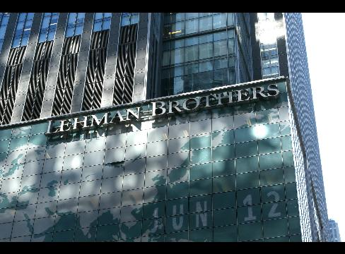
The Chaos

Slide 17
The Goal
“Even now he is at work. In accidents and calamities by sea and by land, in great conflagrations, in fierce tornadoes and terrific hailstorms, in tempests, floods, cyclones, tidal waves, and earthquakes, in every place and in a thousand forms, Satan is exercising his power. He sweeps away the ripening harvest, and famine and distress follow. He imparts to the air a deadly taint, and thousands perish by the pestilence. These visitations are to become more and more frequent and disastrous. Destruction will be upon both man and beast. "The earth mourneth and fadeth away," "the haughty people . . . do languish. The earth also is defiled under the inhabitants thereof; because they have transgressed the laws, changed the ordinance, broken the everlasting covenant." Isaiah 24:4, 5.
And then the great deceiver will persuade men that those who serve God are causing these evils. The class that have provoked the displeasure of Heaven will charge all their troubles upon those whose obedience to God's commandments is a perpetual reproof to transgressors..………..

Slide 18
The Goal cont.
It will be declared that men are offending God by the violation of the Sunday sabbath; that this sin has brought calamities which will not cease until Sunday observance shall be strictly enforced; and that those who present the claims of the fourth commandment, thus destroying reverence for Sunday, are troublers of the people, preventing their restoration to divine favor and temporal prosperity.” GC, 589,590

Slide 19
The President Elect
Barry Goldwater, With No Apologies , “When a new President comes on board, there is a great turnover in personnel, but no change in policy. Example: During the Nixon[a Republican] years Henry Kissinger, CFR member and Nelson Rockefeller’s protégé, was in charge of foreign policy. When Jimmy Carter [a Democrat] was elected, Kissinger was replaced by Zbigniew Brzezinski, CFR member and David Rockefeller’s protégé.” pg. 279

Slide 20
The ‘No Difference’ Principle
Revelation 17:1,2,17 “…I will shew unto thee the judgments of the great whore that sitteth upon many waters. With whom the kings of the earth have committed fornication…And the woman, which thou sawest, is that great city, which reigneth over the kings of the earth .” The President elect, like the man he ran against, and the man who is leaving the White House, are all kings/leaders in the earth. They are all controlled by Babylon the Great. They do Rome’s bidding. There is no difference between them……………………………………………..

Slide 21
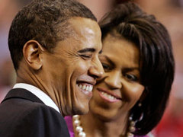
The Same Agenda

Slide 22
The Change
Yes, President Barack Obama is absolutely right—change is coming! Especially when we consider that many of his appointees are Jesuit-trained. For example, Obama's Chief Speechwriter, Jon Favreau, was Jesuit-trained; Obama's Senior Military and Foreign Policy Advisor, Major General J. Scott Gration, was Jesuit-trained; Obama's Deputy Communications Director, Dan Pfeiffer, was

Slide 23
Same Old Same Old
Jesuit-trained; Obama’s Chicago mentor is Gregory Galluzzo, a “former” Jesuit priest and National Director and co-founder of the Gamaliel Foundation—a community organizing network representing more than a million multi-faith, church-going people who work on campaigns for social justice guided by an extreme, anti-American ideology;

Slide 24
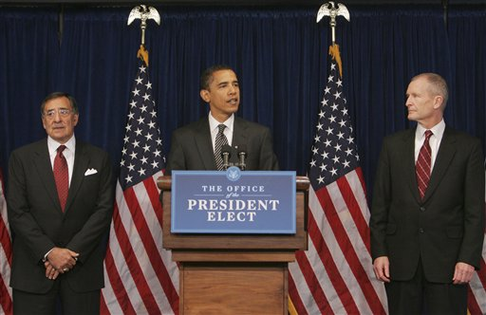
Wake Up
and former congressman Leon Panetta, who graduated from Santa Clara University—a comprehensive Jesuit, Catholic university, as head of the Central Intelligence Agency (CIA). Fasten your seatbelts!” D. Vierra’s, The Final Inquisition, pg. 27

Slide 25
Obama’s Famous Berlin Speech - July 24,2008
“Yes, there have been differences between America and Europe. No doubt, there will be differences in the future. But the burdens of global citizenship continue to bind us together.”
“That is why the greatest danger of all is to allow new walls to divide us from one another. The walls between old allies on either side of the Atlantic cannot stand. The walls between the countries with the most and those with the least cannot stand. The walls between races and tribes; natives and immigrants; Christian and Muslim and Jew cannot stand. These now are the walls we must tear down.”
“Not only have walls come down in Berlin, but they have come down in Belfast, where Protestant and Catholic found a way to live together…”

Slide 26
The Chart
-Sunday-/Closing Probation-/-Loud Cry--/C of P- Seal of God/Mark Latter Rain

Slide 27
The Promise
“And after these things I saw another angel come down from heaven, having great power; and the earth was lightened with his glory.“ Revelation 18:1
“And it shall come to pass afterward, that I will pour out my spirit upon all flesh; and your sons and your daughters shall prophesy, your old men shall dream dreams, your young men shall see visions: And also upon the servants and upon the handmaids in those days will I pour out my spirit.” Joel 2:28,29

Slide 28
The Power
“I saw the latter rain is coming suddenly, as the midnight cry and with ten times the power.” Ellen White letter, Spalding-Megan Collection, pages 3,4
How powerful was the midnight cry?
“In the parable of Matthew 25 the time of waiting and slumber is followed by the coming of the bridegroom. This was in accordance with the arguments just presented, both from prophecy and from the types. They carried strong conviction of their truthfulness; and the "midnight cry" was heralded by thousands of believers.
Like a tidal wave the movement swept over the land. From city to city, from village to village, and into remote country places it went, until the waiting people of God were fully aroused.

Slide 29
The Time Is NOW
“We need not worry about the Latter Rain; all we have to do is to keep the vessel clean and prepared for the reception of the heavenly rain and keep praying, ‘Let the Latter Rain come into my vessel; let the light of the glorious angel, which unites with the third angel, shine upon me. Give me a part in the work; let me sound the proclamation; let me be a co-laborer with Jesus Christ’. Thus, let me tell you, He is fitting you up all the time, giving you His grace. You need not be worried. You need not be thinking that there is a special time coming when you are to be crucified, the time to be crucified is just NOW. Every day, every hour, self is to be crucified, and then, when the time comes that the test shall come to God’s people in earnest, the everlasting arms are around you. The angels of God make

Slide 30
The time continued
a wall of fire around about and deliver you. All your self-crucifixion will not do any good then. It must come before the destiny of souls is decided. It is now that self is to be crucified, when there is work to do, when there is some use to be made of every entrusted capability. It is now that we are to be empty and thoroughly cleanse the vessel of its impurity. It is now that we are to be made holy unto God. This is our work, this very moment. You are not to wait for any special period for a wonderful work to be done: it is today, I give myself to God TODAY”. MS 35, 1891

