Slide 1
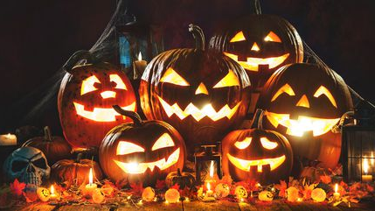
What is Hallow about Halloween?

Slide 2
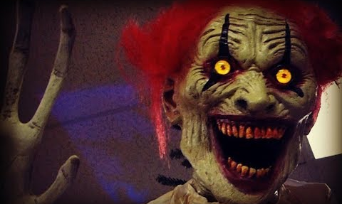
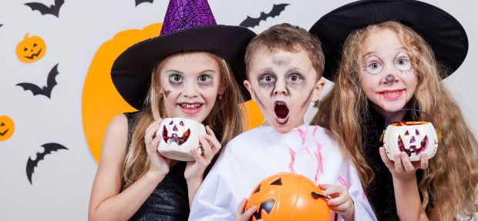
A Few Bible Principles Before We Begin…
2 Cor. 6:14 “Be ye not unequally yoked together with unbelievers: for what fellowship hath righteousness with unrighteousness? and what communion hath light with darkness?”
3 John 1:11 “Beloved, follow not that which is evil, but that which is good. He that doeth good is of God: but he that doeth evil hath not seen God.”
1 Thess. 5:21-22 “Prove all things; hold fast that which is good. Abstain from all appearance of evil.

Slide 3
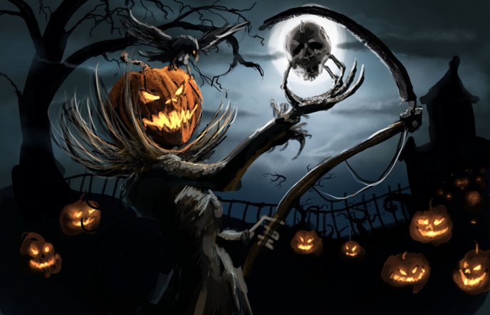
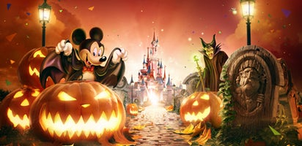
What Does Hallow-Een Mean???
1828 Dictionary : Hallow
1. To make holy; to consecrate; to set apart for holy or religious use. Exodus 28:38; Exodus 29:1; 1 Kings 8:64.
2. To devote to holy or religious exercises; to treat as sacred.
Hallow the sabbath day, to do no work therein. Jeremiah 17:24.
Een
contracted from even (even, evening, eve), which see.

Slide 4
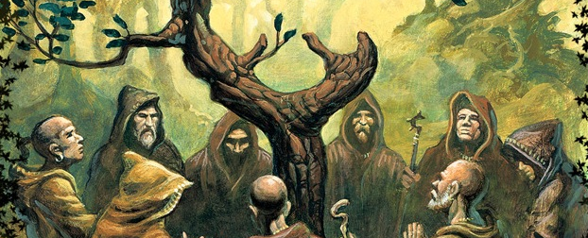
Roots in Druid Religion…
“Halloween’s origins date back to the ancient Celtic festival of Samhain (pronounced sow-in). The Celts, who lived 2,000 years ago in the area that is now Ireland, the United Kingdom and northern France, celebrated their new year on November 1. This day marked the end of summer and the harvest and the beginning of the dark, cold winter, a time of year that was often associated with human death. Celts believed that on the night before the year, the boundary between the worlds of the living and the dead became blurred. On the night of October 31 they celebrated Samhain, when it was believed that the ghosts of the dead returned to earth. “—History.com, “History of Halloween”

Slide 5
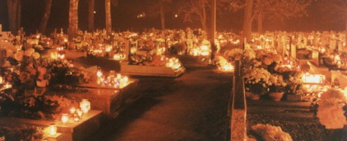
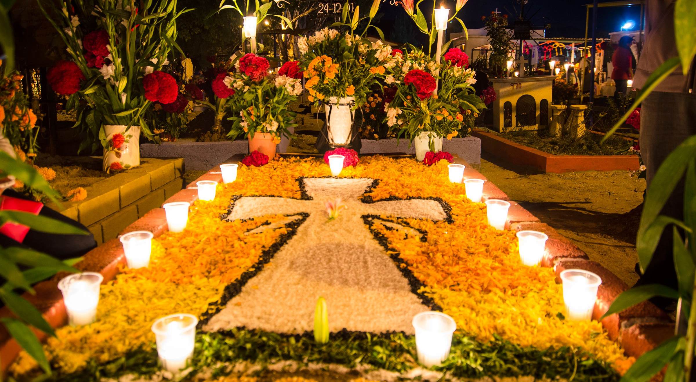
What is the Spirit of Inspiration?
“By 43 A.D., the Roman Empire had conquered the majority of Celtic territory. In the course of the four hundred years that they ruled the Celtic lands, two festivals of Roman origin were combined with the traditional Celtic celebration of Samhain. The first was Feralia, a day in late October when the Romans traditionally commemorated the passing of the dead. The second was a day to honor Pomona, the Roman goddess of fruit and trees.”—Ibid.

Slide 6
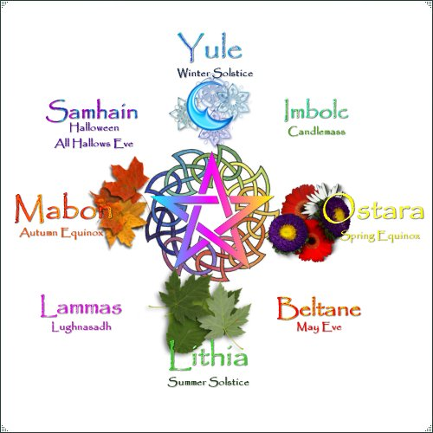

Slide 7
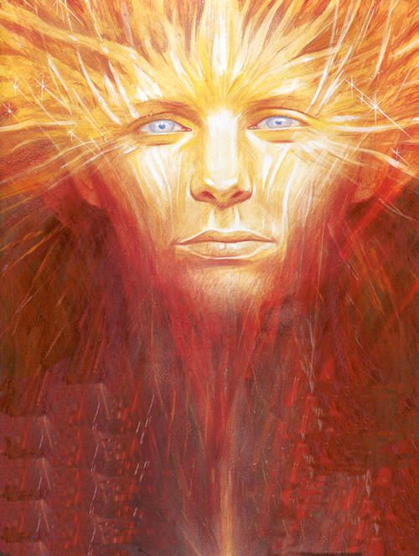
What is Samhain “celebrating”?
“Samhain represented the death of the summer sun god, Lugh. This festival celebrates Nature's cycle of death and renewal, a time when the Celts acknowledged the beginning and ending of all things in life and nature. Samhain marked the end of harvest and the beginning of the New Celtic Year. The first month of the Celtic year was Samonios. . . Samhain heralds the beginning of Winter when the world starts to darken and the days are getting shorter - the 'dark half' of the year and the demise of the power of the sun”—www.new-age.co.uk/Samhain-festival
Lugh—god of light

Slide 8
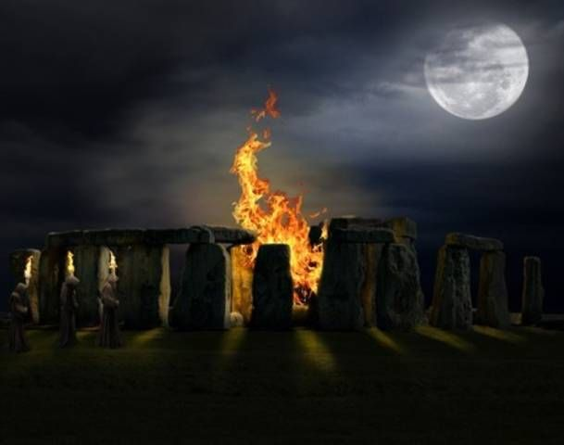
How was it celebrated/What are the rites?
“Samhain was also a festival of the dead; their ghosts were fed at this time. As winter came on the powers of growth were suffering eclipse, and men sought by magical means to aid them. This they did by means of a bonfire. . . people jumped through the fire. There was a sacrifice at Samhain and there is some reason to believe that in early times it was a human sacrifice. Caesar bears witness that in his time human sacrifices were offered by Druids to avert sickness and to secure victory in battle”—Barton, The Religions of the World, p. 297

Slide 9
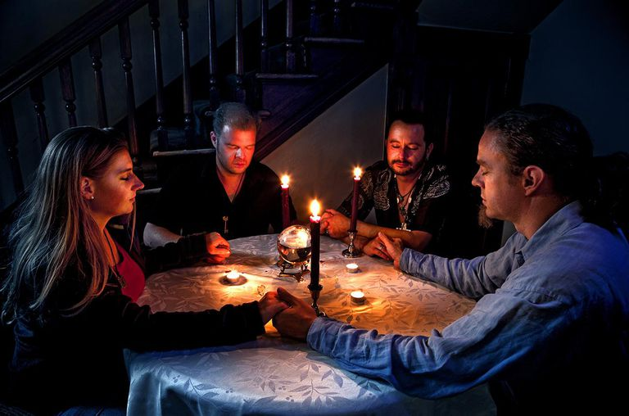
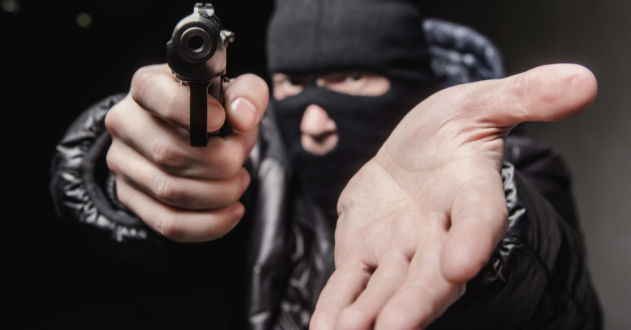
“In order to protect themselves from any roaming evil spirits the Celts would appease them by offering them treats. The custom of wearing costumes on Halloween is thought to derive from the Celts disguising themselves at Samhain, so the spirits would think that they belonged to their own company. They could then communicate with the spirit world, known as 'souling’. . . Samhain was a time for divination and magic, the Druids would foretell the future on this powerful night . . . Ducking or bobbing for apples was a marriage divination. The first person to bite an apple would be the first to marry in the coming year.”—www.new-age.co.uk/Samhain-festival.htm

Slide 10
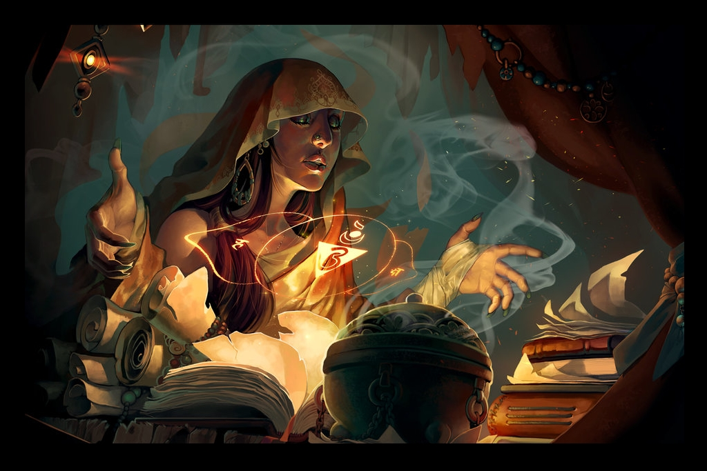
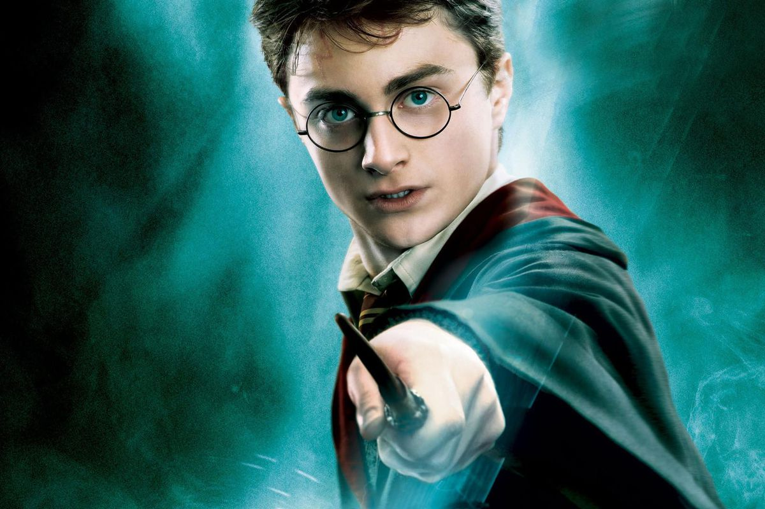
Deut. 18:10-13 “There shall not be found among you any one that maketh his son or his daughter to pass through the fire, or that useth divination, or an observer of times, or an enchanter, or a witch. Or a charmer, or a consulter with familiar spirits, or a wizard, or a necromancer. For all that do these things are an abomination unto the Lord: and because of these abominations the Lord thy God doth drive them out from before thee. Thou shalt be perfect with the Lord thy God.”
Jer. 10:2 “Thus saith the Lord, Learn not the way of the heathen, and be not dismayed at the signs of heaven; for the heathen are dismayed at them.”

