Slide 1
The Great Controversy
Past and Future

Slide 2
Brief Recap of Revelation
Revelation chapter 1- Pictures of Jesus Christ
Revelation chapters 2-3- Jesus Christ and His Church
Revelation chapters 4-8:1- Jesus Christ’s Efforts to Save Humanity.
Revelation chapters 8:2-9- Jesus Christ’s Strange Acts of Judgment
Revelation chapter 10- Jesus Christ’s Judgment in 1844.
Revelation chapter 11-Jesus Christ’s Rejection by France.

Slide 3
Revelation 12
“And there appeared a great wonder in heaven; a woman clothed with the sun, and the moon under her feet, and upon her head a crown of twelve stars:
And she being with child cried, travailing in birth, and pained to be delivered.
And there appeared another wonder in heaven; and behold a great red dragon, having seven heads and ten horns, and seven crowns upon his heads.
And his tail drew the third part of the stars of heaven, and did cast them to the earth: and the dragon stood before the woman which was ready to be delivered, for to devour her child as soon as it was born.
And she brought forth a man child, who was to rule all nations with a rod of iron: and her child was caught up unto God, and to his throne.” Revelation 12:1-5

Slide 4
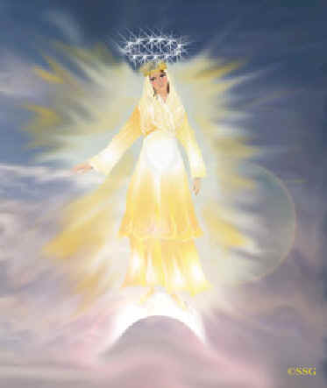
The Pure Woman
A woman in Scripture is likened to the church. A pure woman represents the true church and an impure woman an apostate church. “ For I am jealous over you with godly jealousy: for I have espoused you to one husband, that I may present you as a chaste virgin to Christ.” 2 Corinthians 11:2

Slide 5
Confirmation
In Revelation 17 Babylon is represented as a woman --a figure which is used in the Bible as the symbol of a church, a virtuous woman representing a pure church, a vile woman an apostate church. In the Bible the sacred and enduring character of the relation that exists between Christ and His church is represented by the union of marriage. The Lord has joined His people to Himself by a solemn covenant, He promising to be their God, and they pledging themselves to be His and His alone. He declares: "I will betroth thee unto Me forever; yea, I will betroth thee unto Me in righteousness, and in judgment, and in loving-kindness, and in mercies." Hosea 2:19. And, again: "I am married unto you." Jeremiah 3:14. And Paul employs the same figure in the New Testament when he says: "I have espoused you to one husband, that I may present you as a chaste virgin to Christ." 2 Corinthians 11:2.” Great Controversy, pages 381,382

Slide 6
Continued
The unfaithfulness of the church to Christ in permitting her confidence and affection to be turned from Him, and allowing the love of worldly things to occupy the soul, is likened to the violation of the marriage vow. The sin of Israel in departing from the Lord is presented under this figure; and the wonderful love of God which they thus despised is touchingly portrayed: "I sware unto thee, and entered into a covenant with thee, saith the Lord God, and thou becamest Mine." "And thou wast exceeding beautiful and thou didst prosper into a kingdom. And thy renown went forth among the heathen for thy beauty: for it was perfect through My comeliness, which I had put upon thee. . . . But thou didst trust in thine own beauty, and playedst the harlot because of thy renown." "As a wife treacherously departeth from her husband, so have ye dealt treacherously with Me, O house of Israel, saith the Lord;" "as a wife that committeth adultery, which taketh strangers instead of her husband!" Ezekiel 16:8, 13-15, 32; Jeremiah 3:20. GC. , page 382

Slide 7
Giving Birth
“And she being with child cried, travailing in birth…And she brought forth a man child, who was to rule all nations with a rod of iron: and her child was caught up unto God, and to his throne and pained to be delivered…“ Revelation 12:2,5
“The line of prophecy in which these symbols are found begins with Revelation 12, with the dragon that sought to destroy Christ at His birth. The dragon is said to be Satan (Revelation 12:9); he it was that moved upon Herod to put the Saviour to death. But the chief agent of Satan in making war upon Christ and His people during the first centuries of the Christian Era was the Roman Empire, in which paganism was the prevailing religion. Thus while the dragon, primarily, represents Satan, it is, in a secondary sense, a symbol of pagan Rome.” GC, page 438

Slide 8

Efforts to Destroy
“Then Herod, when he saw that he was mocked of the wise men, was exceeding wroth, and sent forth, and slew all the children that were in Bethlehem, and in all the coasts thereof, from two years old and under, according to the time which he had diligently inquired of the wise men.” Matthew 2:16

Slide 9
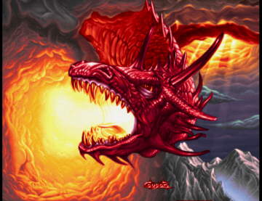
the War Rages
“And there appeared another wonder in heaven; and behold a great red dragon, having seven heads and ten horns, and seven crowns upon his heads.
And his tail drew the third part of the stars of heaven, and did cast them to the earth: and the dragon stood before the woman which was ready to be delivered, for to devour her child as soon as it was born.” Revelation 12:3,4

Slide 10
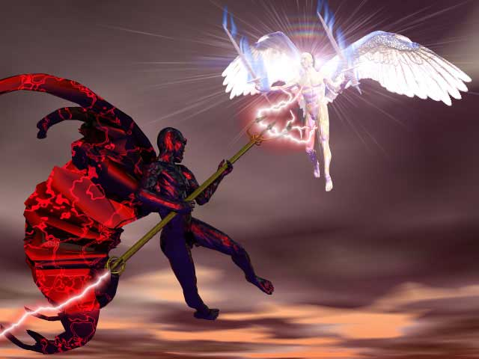
The Battle’s Beginning
“And there was war in heaven: Michael and his angels fought against the dragon; and the dragon fought and his angels,
And prevailed not; neither was their place found any more in heaven.
And the great dragon was cast out, that old serpent, called the Devil, and Satan, which deceiveth the whole world: he was cast out into the earth, and his angels were cast out with him.” Revelation 12:7-9

Slide 11
Selfishness
“Lucifer's disposition to serve himself instead of his Creator aroused a feeling of apprehension when observed by those who considered that the glory of God should be supreme. In heavenly council the angels pleaded with Lucifer. The Son of God presented before him the greatness, the goodness, and the justice of the Creator, and the sacred, unchanging nature of His law. God Himself had established the order of heaven; and in departing from it, Lucifer would dishonor his Maker and bring ruin upon himself. But the warning, given in infinite love and mercy, only aroused a spirit of resistance. Lucifer allowed his jealousy of Christ to prevail, and became the more determined. To dispute the supremacy of the Son of God, thus impeaching the wisdom and love of the Creator, had become the purpose of this prince of angels. To this object he was about to bend the energies of that master mind, which, next to Christ's, was first among the hosts of God. But He who would have the will of all His creatures free, left none unguarded to the bewildering sophistry by which rebellion would seek to justify itself. Before the great contest should open, all were to have a clear presentation of His will, whose wisdom and goodness were the spring of all their joy.” PP, pages 35,36

Slide 12
An ‘I’ Problem
“Son of man, take up a lamentation upon the king of Tyrus, and say unto him, Thus saith the Lord GOD; Thou sealest up the sum, full of wisdom, and perfect in beauty. Thou hast been in Eden the garden of God; every precious stone was thy covering, the sardius, topaz, and the diamond, the beryl, the onyx, and the jasper, the sapphire, the emerald, and the carbuncle, and gold: the workmanship of thy tabrets and of thy pipes was prepared in thee in the day that thou wast created.
Thou art the anointed cherub that covereth; and I have set thee so: thou wast upon the holy mountain of God; thou hast walked up and down in the midst of the stones of fire. Thou wast perfect in thy ways from the day that thou wast created, till iniquity was found in thee. By the multitude of thy merchandise they have filled the midst of thee with violence, and thou hast sinned: therefore I will cast thee as profane out of the mountain of God: and I will destroy thee, O covering cherub, from the midst of the stones of fire. Thine heart was lifted up because of thy beauty, thou hast corrupted thy wisdom by reason of thy brightness: I will cast thee to the ground, I will lay thee before kings, that they may behold thee.” Ezekiel 28:12-17

Slide 13
Christ Wept at Satan’s Woe
“Satan trembled as he viewed his work. He was alone in meditation upon the past, the present, and his future plans. His mighty frame shook as with a tempest. An angel from heaven was passing. He called him and entreated an interview with Christ. This was granted him. He then related to the Son of God that he repented of his rebellion and wished again the favor of God. He was willing to take the place God had previously assigned him, and be under His wise command. Christ wept at Satan's woe but told him, as the mind of God, that he could never be received into heaven. Heaven must not be placed in jeopardy. All heaven would be marred should he be received back, for sin and rebellion originated with him. The seeds of rebellion were still within him. He had, in his rebellion, no occasion for his course, and he had hopelessly ruined not only himself but the host of angels also, who would then have been happy in heaven had he remained steadfast. The law of God could condemn but could not pardon.”SR 26

Slide 14
Continued
“He repented not of his rebellion because he saw the goodness of God which he had abused. It was not possible that his love for God had so increased since his fall that it would lead to cheerful submission and happy obedience to His law which had been despised. The wretchedness he realized in losing the sweet light of heaven, and the sense of guilt which forced itself upon him, and the disappointment he experienced himself in not finding his expectation realized, were the cause of his grief.” SR, page 26,27

Slide 15
Victory Assured
“I heard a loud voice saying in heaven, Now is come salvation, and strength, and the kingdom of our God, and the power of his Christ: for the accuser of our brethren is cast down, which accused them before our God day and night.” Revelation 12:10

Slide 16
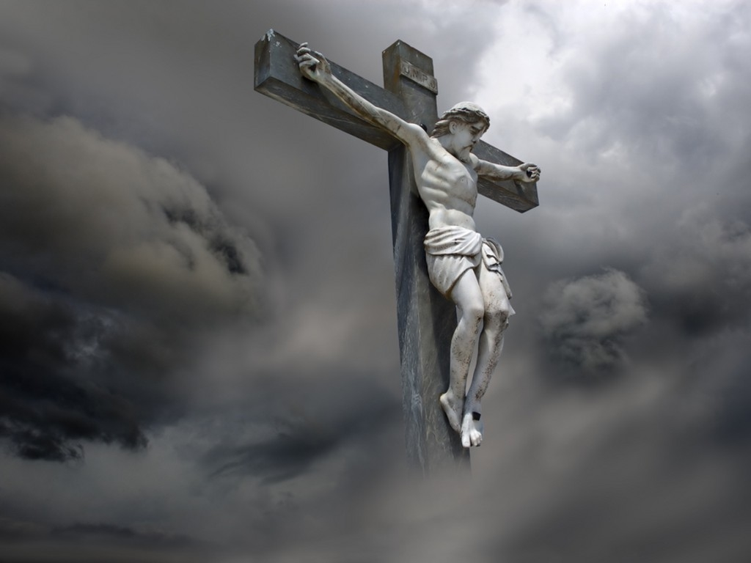
At The Cross
“The battle had been won. His right hand and His holy arm had gotten Him the victory. As a Conqueror He planted His banner on the eternal heights. Was there not joy among the angels? All heaven triumphed in the Saviour's victory. Satan was defeated, and knew that his kingdom was lost. To the angels and the unfallen worlds the cry, "It is finished," had a deep significance. It was for them as well as for us that the great work of redemption had been accomplished. They with us share the fruits of Christ's victory. Not until the death of Christ was the character of Satan clearly revealed to the angels or to the unfallen worlds. The arch apostate had so clothed himself with deception that even holy beings had not understood his principles. They had not clearly seen the nature of his rebellion. “ DA, page 758

Slide 17
The War Continues
“And they overcame him by the blood of the Lamb, and by the word of their testimony; and they loved not their lives unto the death. Therefore rejoice, ye heavens, and ye that dwell in them. Woe to the inhabiters of the earth and of the sea! for the devil is come down unto you, having great wrath, because he knoweth that he hath but a short time.” Revelation 12:11,12

Slide 18
Note……………………………………
“Whenever, through faith in the Lamb of God, a soul renounces the service of sin, Satan's wrath is kindled. The holy life of Abel testified against Satan's claim that it is impossible for man to keep God's law. When Cain, moved by the spirit of the wicked one, saw that he could not control Abel, he was so enraged that he destroyed his life. And wherever there are any who will stand in vindication of the righteousness of the law of God, the same spirit will be manifested against them. It is the spirit that through all the ages has set up the stake and kindled the burning pile for the disciples of Christ. But the cruelties heaped upon the follower of Jesus are instigated by Satan and his hosts because they cannot force him to submit to their control. It is the rage of a vanquished foe. Every martyr of Jesus has died a conqueror. Says the prophet, "They overcame him ["that old serpent, called the devil, and Satan"] by the blood of the Lamb, and by the word of their testimony; and they loved not their lives unto the death." Revelation 12:11, 9 PP, page 77

Slide 19
Time is Almost Over
“Through the agency of evil spirits strange gods were introduced; and because of transgression, the chosen people were finally scattered from the Land of Promise. This history Satan is striving to repeat in our day. God is leading His people out from the abominations of the world, that they may keep His law; and because of this, the rage of "the accuser of our brethren" knows no bounds. "The devil is come down unto you, having great wrath, because he knoweth that he hath but a short time." Revelation 12:10, 12. The antitypical land of promise is just before us, and Satan is determined to destroy the people of God and cut them off from their inheritance. The admonition, "Watch ye and pray, lest ye enter into temptation" (Mark 14:38), was never more needed than now.” P.P., page 689

Slide 20
The Devil Assaults the Church
“And the woman fled into the wilderness, where she hath a place prepared of God, that they should feed her there a thousand two hundred and threescore days….
And to the woman were given two wings of a great eagle, that she might fly into the wilderness, into her place, where she is nourished for a time, and times, and half a time, from the face of the serpent. “ Revelation 12:6,14

Slide 21
Comment
“In the sixth century the papacy had become firmly established. Its seat of power was fixed in the imperial city, and the bishop of Rome was declared to be the head over the entire church. Paganism had given place to the papacy. The dragon had given to the beast "his power, and his seat, and great authority." Revelation 13:2. And now began the 1260 years of papal oppression foretold in the prophecies of Daniel and the Revelation. Daniel 7:25; Revelation 13:5-7. (See Appendix.) Christians were forced to choose either to yield their integrity and accept the papal ceremonies and worship, or to wear away their lives in dungeons or suffer death by the rack, the fagot, or the headsman's ax. Now were fulfilled the words of Jesus: "Ye shall be betrayed both by parents, and brethren, and kinsfolks, and friends; and some of you shall they cause to be put to death. And ye shall be hated of all men for My name's sake." Luke 21:16, 17. Persecution opened upon the faithful with greater fury than ever before, and the world became a vast battlefield. For hundreds of years the church of Christ found refuge in seclusion and obscurity. Thus says the prophet: "The woman fled into the wilderness, where she hath a place prepared of God, that they should feed her there a thousand two hundred and three-score days." Revelation 12:6. GC., pages 54,55

Slide 22
Bacchiochi’s Babble
“Historically, our Adventist church has interpreted this prophetic period as representing the 1260 years of Papal domination from 538 to 1798. Supposedly the prophetic period of the Antichrist began in 538 when Justinian's general, Belisarius, defeated the Ostrogoths, thus enabling the Pope to regain some of his power. The period terminated in 1798 when Napoleon's general, Bethier, entered Rome with a French army, proclaiming the end to the political rule of the papacy, and taking with him the pope prisoner to France.
This interpretation poses two major problems, which thinking Adventists have long recognized. In fact during the past few months I have received several email messages and calls from pastors who have asked me to help them understand more fully what really happened in 538.
The first problem is the questionable significance of 538. We noted earlier that Justinian's triumph over the Ostrogoths in 538 was short lived, because under their new leader, Totila, the Ostrogoths quickly recaptured most of their lost territories. In other words, this event did not significant boost the power of the Papacy, which still faced constant harassments from various rulers for centuries to come.”
"Islam and TheEndtime Issues No. 86
6 July 2002
Papacy in Prophecy"

Slide 23
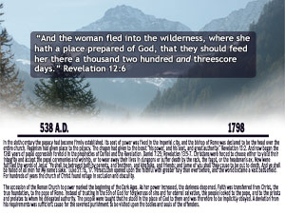
The Truth

Slide 24
A Comment
“The First Siege of Rome during the Gothic War lasted for a year and nine days, from ca. March 537 to March 538. It was fought between the defending East Romans, under general Belisarius, and the Ostrogothic army under king Witigis. The siege was the first major encounter between the forces of the two opponents, and played a decisive role in the subsequent development of the war.” Wikipedia on Belisarius.

Slide 25
The Final Assault
“And the serpent cast out of his mouth water as a flood after the woman, that he might cause her to be carried away of the flood. And the earth helped the woman, and the earth opened her mouth, and swallowed up the flood which the dragon cast out of his mouth. And the dragon was wroth with the woman, and went to make war with the remnant of her seed, which keep the commandments of God, and have the testimony of Jesus Christ.” Revelation 12:15-17

Slide 26
The Remnant
The last battle would be between the devil and Heaven’s leftovers. The two identifying marks of God’s final people would be:
1. They follow all of God’s ten commandments.
2. They have the testimony of Jesus Christ.

Slide 27
All Ten Commandments
“Thou shalt have no other gods before me. Thou shalt not make unto thee any graven image, or any likeness of any thing that is in heaven above, or that is in the earth beneath, or that is in the water under the earth: Thou shalt not bow down thyself to them, nor serve them:… Thou shalt not take the name of the LORD thy God in vain; for the LORD will not hold him guiltless that taketh his name in vain. Remember the sabbath day, to keep it holy. Six days shalt thou labour, and do all thy work: But the seventh day is the sabbath of the LORD thy God: in it thou shalt not do any work, thou, nor thy son, nor thy daughter, thy manservant, nor thy maidservant, nor thy cattle, nor thy stranger that is within thy gates: For in six days the LORD made heaven and earth, the sea, and all that in them is, and rested the seventh day: wherefore the LORD blessed the sabbath day, and hallowed it.” Exodus 20:3-11
“Honour thy father and thy mother: that thy days may be long upon the land which the LORD thy God giveth thee. Thou shalt not kill. Thou shalt not commit adultery. Thou shalt not steal. Thou shalt not bear false witness against thy neighbour. Thou shalt not covet thy neighbour's house, thou shalt not covet thy neighbour's wife, nor his manservant, nor his maidservant, nor his ox, nor his ass, nor any thing that is thy neighbour's. “ Exodus 20:12-17

Slide 28
The Biggie that Divides
“Remember the sabbath day, to keep it holy. Six days shalt thou labour, and do all thy work: But the seventh day is the sabbath of the LORD thy God: in it thou shalt not do any work, thou, nor thy son, nor thy daughter, thy manservant, nor thy maidservant, nor thy cattle, nor thy stranger that is within thy gates: For in six days the LORD made heaven and earth, the sea, and all that in them is, and rested the seventh day: wherefore the LORD blessed the sabbath day, and hallowed it.” Exodus 20:8-11
The fourth commandment is the commandment that separates so many churches from being the last remnant. God’s final people will keep this day, as Christ kept it, and not as the Jews kept it.

Slide 29
The Other Identifying mark
“And the dragon was wroth with the woman, and went to make war with the remnant of her seed, which keep the commandments of God, and have the testimony of Jesus Christ.” Revelation 12:17
“And I fell at his feet to worship him. And he said unto me, See thou do it not: I am thy fellow servant, and of thy brethren that have the testimony of Jesus: worship God: for the testimony of Jesus is the spirit of prophecy.” Revelation 19:10

Slide 30
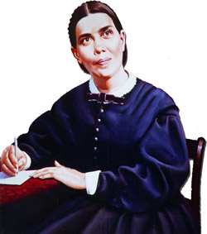
The Spirit of Prophecy
God’s final people would have the gift of prophecy-a prophet/messenger in their midst. This person would be treated like all other prophets have been treated- with disdain and contempt. God help us!! This prophet would exalt all ten of God’s commandments!!

Slide 32
The Beast out of the Sea
Revelation 13:1-10

Slide 33
Sure Word
“We have also a more sure word of prophecy; whereunto ye do well that ye take heed, as unto a light that shineth in a dark place, until the day dawn, and the day star arise in your hearts:” 2 Peter 1:19

Slide 34
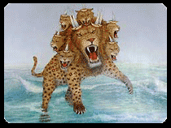
The Beast out of the Sea
“And I stood upon the sand of the sea, and saw a beast rise up out of the sea, having seven heads and ten horns, and upon his horns ten crowns, and upon his heads the name of blasphemy. And the beast which I saw was like unto a leopard, and his feet were as the feet of a bear, and his mouth as the mouth of a lion: and the dragon gave him his power, and his seat, and great authority.” Revelation 13:1,2

Slide 35
Symbols, Symbols, Symbols
1. A Beast-Daniel 7:17,23-”These great beasts, which are four, are four kings, which shall arise out of the earth….The fourth beast shall be the fourth kingdom upon earth.”
2. the Sea-Revelation 17:15 “ The waters which thou sawest, where the whore sitteth, are peoples, and multitudes, and nations, and tongues.”

Slide 36
More Symbols
Blasphemy-John 10:30,33 “I and my Father are one…“ The Jews answered him, saying, For a good work we stone thee not; but for blasphemy; and because that thou, being a man, makest thyself God.”
Mark 2:5-7 “When Jesus saw their faith, he said unto the sick of the palsy, Son, thy sins be forgiven thee. But there were certain of the scribes sitting there, and reasoning in their hearts, Why doth this man thus speak blasphemies? who can forgive sins but God only?

Slide 37
Summary
A beast/world power rises up out of the sea/Old World of masses of people. This political power is also a religious power because it claims to be God on earth and claims that it can forgive people of their sins. Can you think of a religious/political power that rose up in the Mediterranean World that thinks its God and claims it can forgive sins?

Slide 38
More Clues
“And the beast which I saw was like unto a leopard, and his feet were as the feet of a bear, and his mouth as the mouth of a lion: and the dragon gave him his power, and his seat, and great authority.” Revelation 13:1,2
It has characteristics of the leopard/Greece-Daniel 7:5. Greece gave us the idea of the immortal soul. It is like
a bear/Medo-Persia-Daniel 7:5. Medo-Persian leaders believed they were gods that deserved reverence! (Daniel Chapter 6)

Slide 39
More…………
The beast that comes out of the sea has the mouth of a lion/Babylon-Daniel 7:4. Babylon felt they could tell people how to worship God. (Daniel 3)
Finally, the beast is given power by the dragon/devil-Revelation 12:9
Who could this horrible beast power represent?

Slide 40
Ummmmmmm……………………………
1. It is a political/religious power.
2. It rises in the Mediterranean World.
3. It claims to be God/ claims to forgive sin.
4. It teaches the immortal soul.
5. It demands reverence because it is god.
6. It forces people to worship God the way it thinks.
7. It gets its power from the devil.

Slide 41
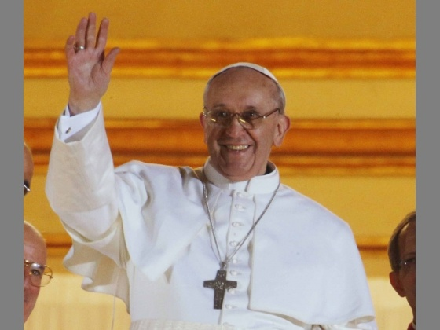
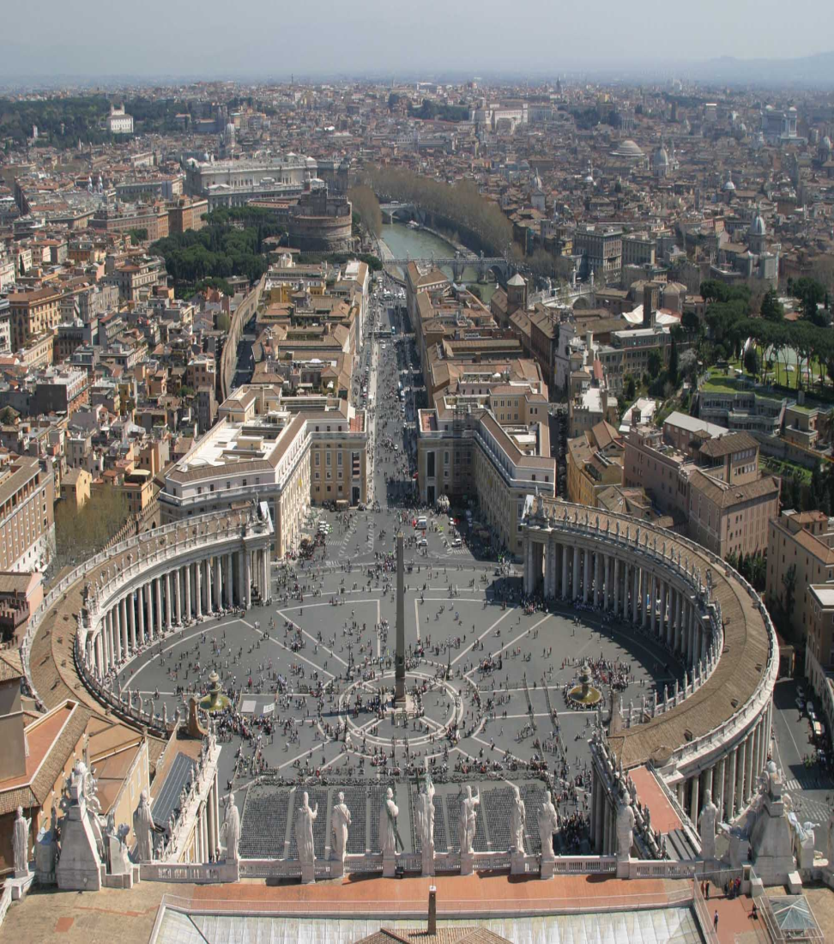
Who could it Be?

Slide 42
Listen
Pope Innocent III (1198-1216) wrote: "We may according to the fullness of our power, dispose of the law and dispense above the law. Those whom the Pope of Rome doth separate, it is not a man that separates them but God. For the Pope holdeth place on earth, not simply of a man but of the true God." (1 Book of Gregory 9 Decret. c.3)
3) The Lateran Council addressing Pope Julius II in an oration delivered by Marcellus said: "Take care that we lose not that salvation, that life and breath which thou hast given us, for thou art our shepherd, thou art our physician, thou art our governor, thou art our husbandman, thou art finally another God on earth." (Council Edition. Colm. Agrip. 1618)

Slide 43
4) Pope Nicholas said of himself: "I am in all and above all, so that God Himself and I, the vicar of God, hath both one consistory, and I am able to do almost all that God can do…wherefore, if those things that I do be said not to be done of man, but of God, what do you make of me but God? Again, if prelates of the Church be called of Constantine for gods, I then being above all prelates, seem by this reason to be above all gods. Wherefore, no marvel, if it be in my power to dispense with all things, yea with the precepts of Christ." (Decret. par. Distinct 96 ch. 7 edit. Lugo 1661)

Slide 44
5) The RC New York catechism states: "The Pope takes the place of Jesus Christ on earth…by divine right the Pope has supreme and full power in faith, in morals over each and every pastor and his flock. He is the true vicar, the head of the entire church, the father and teacher of all Christians. He is the infallible ruler, the founder of dogmas, the author of and the judge of councils; the universal ruler of truth, the arbiter of the world, the supreme judge of heaven and earth, the judge of all, being judged by no one, God himself on earth."

Slide 45
Are you Listening?
(2) Does the pope claim the ability to forgive sin? "This judicial authority will even include the power to forgive sin." -The Catholic Encyclopedia Vol 12, -article "Pope" pg. 265 Can you think of a power, rising up in the area of Europe that claims it can forgive sins and claims to be God? The confessional box of the Catholic Church is known throughout the world as the place where people go to have their sins forgiven by a priest. The most heinous crimes and the most awful deeds have resulted from one individual bearing his or her innermost thoughts to another human being. The Bible says, “For there is one God, and one mediator between God and men, the man Christ Jesus;” (1 Timothy 2:5.) A Catholic priest has no more ability to forgive sins than your pet dog! ‘Secret Terrorists

Slide 46
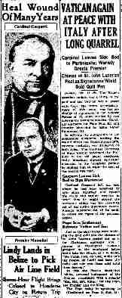
The Deadly Wound
“And I saw one of his heads as it were wounded to death; and his deadly wound was healed: and all the world wondered after the beast.” Rev.13:3 The papacy was wounded in 1798 and restored in 1929.

Slide 47
"Power was given unto him to continue forty and two months." And, says the prophet, "I saw one of his heads as it were wounded to death." And again, "He that leadeth into captivity shall go into captivity; he that killeth with the sword must be killed with the sword." The forty and two months are the same as the "time and times and the dividing of time," three years and a half, or 1260 days, of Daniel 7,--the time during which the papal power was to oppress God's people. This period, as stated in preceding chapters, began with the establishment of the papacy, A. D. 538, and terminated in 1798. At that time, when the papacy was abolished and the pope made captive by the French army, the papal power received its deadly wound, and the prediction was fulfilled,…” GC 438

Slide 48
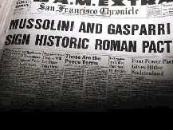
Healing the Deadly Wound

Slide 49
There is More
“And they worshipped the dragon which gave power unto the beast: and they worshipped the beast, saying, Who is like unto the beast? who is able to make war with him? And there was given unto him a mouth speaking great things and blasphemies; and power was given unto him to continue forty and two months. And he opened his mouth in blasphemy against God, to blaspheme his name, and his tabernacle, and them that dwell in heaven. And it was given unto him to make war with the saints, and to overcome them: and power was given him over all kindreds, and tongues, and nations.’ Revelation 13:4-7

Slide 50
False Worship
“Why do thy disciples transgress the tradition of the elders? for they wash not their hands when they eat bread. But he answered and said unto them, Why do ye also transgress the commandment of God by your tradition? For God commanded, saying, Honor thy father and mother: and, He that curseth father or mother, let him die the death. But ye say, Whosoever shall say to his father or his mother, It is a gift, by whatsoever thou mightest be profited by me;
And honor not his father or his mother, he shall be free. Thus have ye made the commandment of God of none effect by your tradition. Ye hypocrites, well did Esaias prophesy of you, saying, This people draweth nigh unto me with their mouth, and honoureth me with their lips; but their heart is far from me. But in vain they do worship me, teaching for doctrines the commandments of men.” Matthew 15:2-9
Vain Worship- Following a man made tradition.
True Worship- Following God’s Commandments

Slide 51
Has the Papacy Changed Any of the Commandments?
“Prove to me from the Bible alone that I am bound to keep Sunday holy. There is no such law in the Bible. It is a law of the holy Catholic Church alone. The Bible says ‘Remember the Sabbath day to keep it holy.’ The Catholic Church says, No. By my divine power I abolish the Sabbath day and command you to keep holy the first day of the week. And lo! The entire civilized world bows down in reverent obedience to the command of the Holy Catholic Church. — Thomas Enright, CSSR, President, Redemptorist College (Roman Catholic), Kansas City, MO., February 18, 1884.
“The observance of Sunday by the Protestants is an homage they pay, in spite of themselves, to the authority of the [Catholic] church. — Monsignor Louis Segur, Plain Talk About the Protestantism of Today (1868), p. 213.

Slide 52
Listen!!!
“If Protestants would follow the Bible, they should worship God on the Sabbath Day [Saturday]. In keeping the Sunday they are following a law of the Catholic church. — Albert Smith, Chancellor of the Archdiocese of Baltimore, replying for the Cardinal in a letter of February 10, 1920.
“The State, in passing laws for the due sanctification of Sunday, is unwittingly acknowledging the authority of the Catholic Church, and carrying out more or less faithfully its prescriptions.
“The Sunday, as a day of the week set apart for the obligatory public worship of Almighty God, to be sanctified by a suspension of all servile labor, trade, and worldly avocations and by exercises of devotion, is purely a creation of the Catholic Church. — The American Catholic Quarterly Review, January, 1883, pp. 152, 139.

Slide 53
They Freely Admit it!
Protestants... accept Sunday rather than Saturday as the day for public worship after the Catholic Church made the change.... But the Protestant mind does not seem to realize that...in observing the Sunday, they are accepting the authority of the spokesman for the church, the Pope. — Our Sunday Visitor, February 5, 1950.
It is well to remind the Presbyterians, Baptists, Methodists, and all other Christians, that the Bible does not support them anywhere in their observance of Sunday. Sunday is an institution of the Roman Catholic Church, and those who observe the day observe a commandment of the Catholic Church. — Priest Brady, in an address, reported in the Elizabeth, N.J. “News,” March 18, 1903.
The mark of Catholic Church authority in the world is Sunday observance. This is a tradition that has no place in the Bible. It originated in Rome, and when we honor the Sunday tradition, we are paying homage to the papacy. Sunday goes directly contrary to the plain teaching of the fourth commandment,…

Slide 54
Oh My!!
The Bible declares that Rome is responsible for persecuting God’s people killing over 150,000,000 died. They Ruled the world from 538-1798. This is the 1,260 year period of Rev. 13:5;11:2,3; and Rev.12:6,14. They attack the heavenly temple by setting up a false priest system “For there is one God, and one mediator between God and men, the man Christ Jesus” 1 Timothy 2:5

Slide 55
Hold Fast
“And all that dwell upon the earth shall worship him, whose names are not written in the book of life of the Lamb slain from the foundation of the world.” Revelation 13:8 Those who bow before the throne of Rome have chosen their master. Those who refuse have their name in the Lamb’s book of life. “Is my name written there, on the page white and fair, in the book of Thy kingdom, is my name written there?”

Slide 56
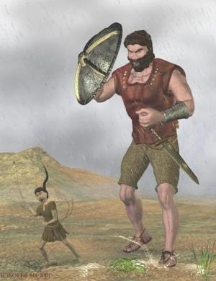
David and Goliath

Slide 57
A Strange, New Twist
"Although it is true that there was a period in the life of the Seventh-day Adventist Church when the denomination took a distinctly anti-Roman Catholic viewpoint...that attitude on the church's part was nothing more than a manifestation of widespread anti-popery among conservative Protestant denominations in the early part of this century and the latter part of the last, and which has now been consigned to the historical trash heap so far as the Seventh-day Adventist Church is concerned." (Neal C. Wilson, past president of the Seventh-day Adventist General Conference, Court Transcript of United States vs the Seventh-day Adventist Church, Equal Employment Opportunity Commission vs the Pacific Press Publishing Association and the General Conference, Reply Brief for Defendants, p 4, Civil Case #74-2025 CBR, presided over by Judge Charles B. Renfrew, U.S. District Court, San Francisco, California, 1974-1975.)

Slide 58
Continued
William Johnson-Editor-Adventist Review-1994,1995 ‘Saints Victory in the End-time’ “To interpret the sea monster of Revelation 13 as the papacy seems somewhat out of keeping with the spirit of the times. In an age when Christianity in general faces the onslaughts of secularism and when among Christians ecumenism has become popular, the interpretation smacks of narrowness and bigotry.” Shocking………………………………………

Slide 59
There is More!!
George Vandeman “These were dark ages for the church. How could Christians be so intolerant of their brothers and sisters in Christ? Jesus had predicted that those who killed His followers would sincerely think they were serving God…It is not for us to question our medieval ancestors…Nor must we overlook the good done by the church. Throughout the world, monasteries provided care for orphans, widows, and the sick. And all of us owe appreciation to the church of the Middle Ages for preserving the Scriptures.” Vandeman, The Rise and Fall of Christ, pages 54,55

Slide 60
Dumb Dogs that will not Bark
Associate Editor of the Review, Myron Widmer “I was surprised and delighted to learn that the Bible is the sole textbook during the pope’s visit and the World Youth Day activities. What a wonderful opportunity fro so many young people to hear the gospel message straight from God’s Word…Or might a better understanding be that God is working through this pope to open doors for Catholics to the great truths of Scripture concerning salvation by faith in Christ?”…I can only wonder if in these last days He is using some very unexpected sources to encourage many individuals (especially Catholics) in search for truth.” Review and Herald, September 9,23,and 30, 1993

Slide 61
Why we are where we are
Ranko Stefanovic, professor, Andrews University, writes a book entitled ‘Revelation of Jesus Christ’. It is over 600 pages. It is endorsed by Andrews and Notre Dame Universities. When commenting on the beast who comes up from the sea, he gets tongue tied, never once mentioning the papacy. Shocking!

