Slide 1
What is the Difference Between Mormons, Jehovah’s Witnesses, and Seventh-day Adventists? pt 8

Slide 2
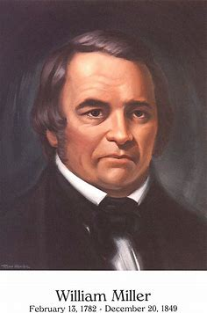
A Few More Thoughts on the 2300 Days/Years
Many Christians (previously myself included) reject the SDA faith and Millerism as false, fanatical, and a hoax because the prophecy failed. These are the facts in the case: William Miller predicted that Jesus would Return to Earth a Second Time at the close of the 2300 day/years AFTER the start of the date 457BC was ascertained. Simply put, that did not happen. So, case closed right? William Miller was a false messenger, and God did not lead the Millerite Movement—their experiences, renewed interest in Bible Study and Berean mentality, their repentance, reformation of life and character were all figments of their imaginations—not provoked by God, but by their own thinking, and/or by the enemy of souls. But let’s take a closer look!

Slide 3
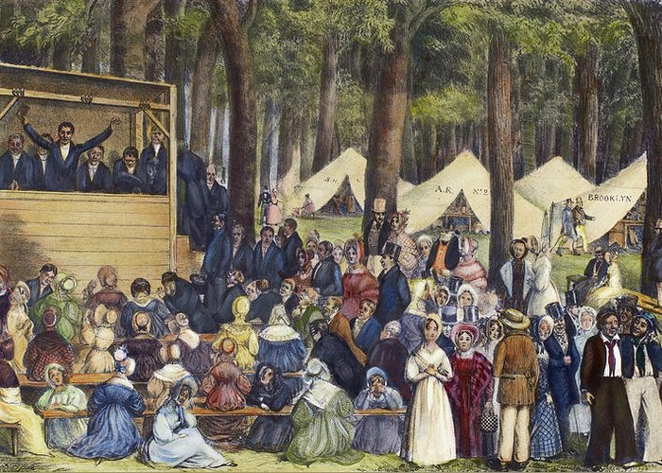
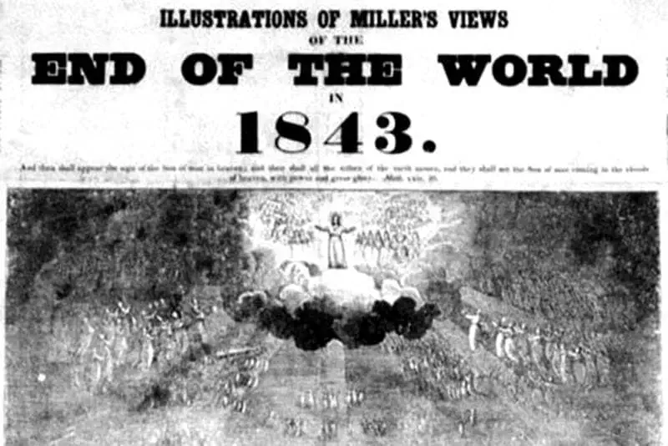
Evidence that the Millerite Movement Was God-Inspired:
The Millerite Movement took place during the Second Great Awakening—if God had not been at work in the Millerites experiences of confession, repentance, revival and reformation?—then what was God true movement in that era, we’ve already seen glaring errors in the origins of Mormonism and Jehovah’s Witnesses—what was the real movement of that time?
The Millerite Movement had the exact same experience that the Disciples had—Both the Disciples and the Millerites made the same error in misinterpreting the event that was to take place, and both experience a “Great Disappointment”

Slide 4
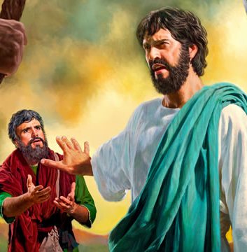
Peter Did NOT Understand!
Matt. 16:20-23 “Then charged he his disciples that they should tell no man that he was Jesus the Christ. From that time forth began Jesus to shew unto his disciples, how that he must go unto Jerusalem, and suffer many things of the elders and chief priests and scribes, and be killed, and be raised again the third day. Then Peter took him, and began to rebuke him, saying, Be it far from thee, Lord: this shall not be unto thee. But he turned, and said unto Peter, Get thee behind me, Satan: thou art an offence unto me: for thou savourest not the things that be of God, but those that be of men.”

Slide 5
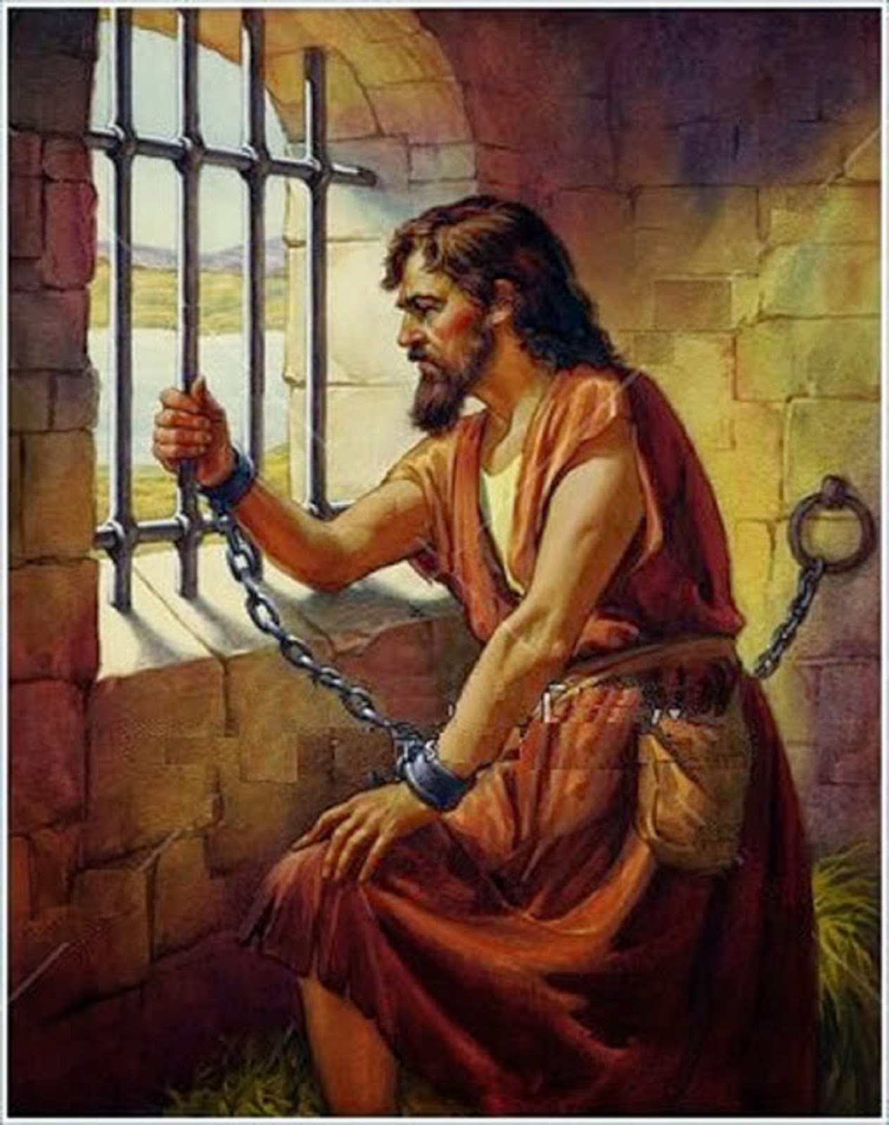
John the Baptist Did NOT get it!
Matt. 11:2-10 “Now when John had heard in the prison the works of Christ, he sent two of his disciples, And said unto him, Art thou he that should come, or do we look for another? Jesus answered and said unto them, Go and shew John again those things which ye do hear and see: The blind receive their sight, and the lame walk, the lepers are cleansed, and the deaf hear, the dead are raised up, and the poor have the gospel preached to them. And blessed is he, whosoever shall not be offended in me. And as they departed, Jesus began to say unto the multitudes concerning John, What went ye out into the wilderness to see? A reed shaken with the wind? But what went ye out for to see? A man clothed in soft raiment? behold, they that wear soft clothing are in kings' houses. But what went ye out for to see? A prophet? yea, I say unto you, and more than a prophet. For this is he, of whom it is written, Behold, I send my messenger before thy face, which shall prepare thy way before thee.”

Slide 6
Experience Millerites Disciples__
Misunderstood a prophetic event Second Coming Sacrifice/Kingship
Misunderstood Christ’s Work High Priest Sacrifice
Both have to Do with the Sanctuary Entering the Most Holy Fulfilling the Lamb
Both fulfill Prophetic Feast Days Day of Atonement Passover
Both had their Major Prophet/Teacher
Misunderstand the Event too William Miller John the Baptist
6. Both experiences are based on the
Same prophetic time prophecy close of 2300 years 490/2300 years
7. Both misunderstandings surround
Christ’s Coming Second Coming First Coming
8. Both experienced a Great
Disappointment Jesus did NOT Return Jesus NOT King
9. Both gave themselves to the
Proclamation of their messages
Better because they did not understand Excited to See Christ Excited to Rule Earth

Slide 7
Experience Millerites Disciples__
10. Both only understood the event
Properly AFTER the event passed Edson/Crosier Sanctuary Road to Emmaus
11. A Proper understanding of the
Sanctuary was key to understanding
The event Jesus is High Priest Jesus is Sacrifice
12. Both events led to deep heart-
Searching 50K-50 Many thousands-120
13. Both had other groups testifying
The same message without contact
To each other Sweden kids/scholars Elizabeth, Anna,
Wisemen
14. Both were hated by mainstream
Churches Protestants Jews
15. Both restored the true religion
Causing them to be forced to separate
(which was not their intention) Sabbath, State of Dead, Righteousness By Faith,
Sanctuary in heaven Faith & Works

Slide 8
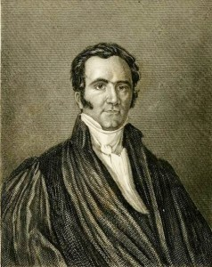
How is this all possible?
“Germany did not communicate the truth to Switzerland, nor Switzerland to France, nor France to England. All these countries received it from God, just as one part of the world does not transmit the light to another part; but the same shining globe communicates it directly to all the earth. Christ, the day spring from on high, infinitely exalted above all mankind, was, at the period of the Reformation, as at the establishment of Christianity, the divine fire which gave life to the world. In the sixteenth century, one and the same doctrine was at once established in the homes and churches of the most distant and diversified nations. The reason is, that the same Spirit was everywhere at work producing the same faith. “The Reformation of Germany and that of Switzerland demonstrate this truth. Zwingle had no intercourse with Luther. There was, no doubt, a link between these two men; but we must search for it above the earth. He who from heaven gave the truth to Luther, gave it to Zwingle. God was the medium of communication between them. ‘I began to preach the gospel,’ says Zwingle, ‘in the year of grace 1516, in other words, at a time when the name of Luther had never been heard of in our country. I did not learn the doctrine of Christ from Luther, but from the word of God. If Luther preaches Christ, he does what I do; that is all.’”—Merle D’Aubigne, History of the Reformation, Book viii, chap. i, pars. ii, iii.

Slide 9
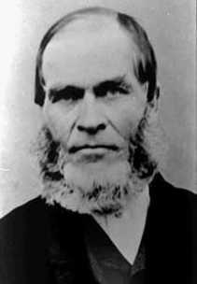
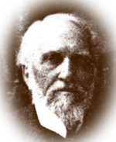
Hiram Edson and ORL Crosier Restore Sanctuary
“We started, and while passing through a large field I was stopped about midway of the field. Heaven seemed opened to my view, and I saw distinctly and clearly that instead of our High Priest coming out of the Most Holy of the heavenly sanctuary to come to this earth on the tenth day of the seventh month, at the end of the 2300 days [calculated to be October 22, 1844], He for the first time entered on that day the second apartment of that sanctuary; and that He had a work to perform in the Most Holy before coming to the earth.” F.D. Nichol, The Midnight Cry, 458

Slide 10
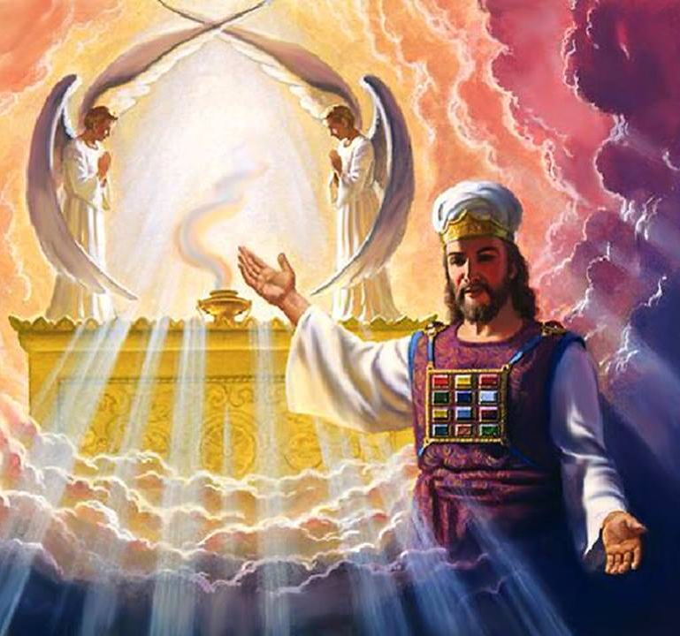
Christ in the Heavenly Sanctuary!
“Edson shared his experience with many of the local Adventists who were greatly encouraged by his account. As a result, he began studying the bible with two of the other believers in the area, O.R.L. Crosier and Franklin B. Hahn, who published their findings in a paper called Day-Dawn. This paper explored the biblical parable of the Ten Virgins and attempted to explain why the bridegroom had tarried. The article also explored the concept of the day of atonement and what the authors called "our chronology of events". The findings published by Crosier, Hahn and Edson led to a new understanding about the sanctuary in heaven. Their paper explained how there was a sanctuary in heaven, that Christ, the High Priest, was to cleanse. The believers understood this cleansing to be what the 2300 days in Daniel was referring to.” Wikipedia, The History of the Seventh-day Adventist Church

Slide 11
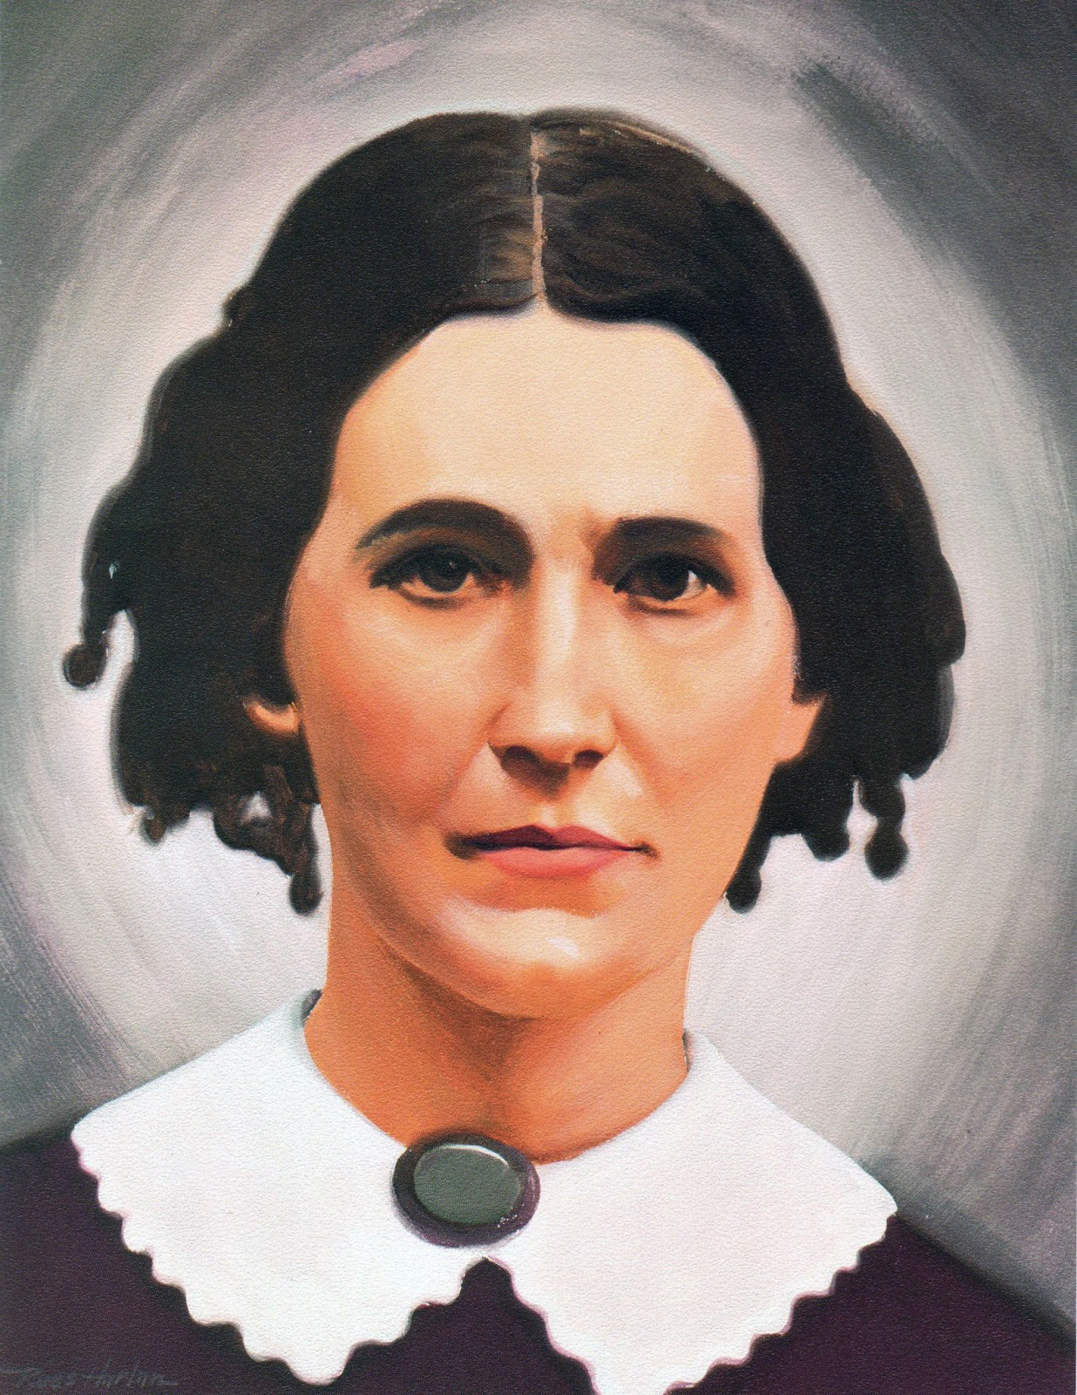
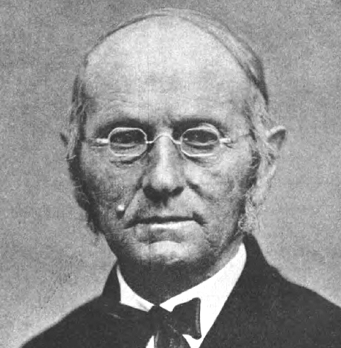
Different Sources of Truth: The Sabbath & Rachel Oaks
“A young Seventh Day Baptist layperson named Rachel Oakes Preston living in New Hampshire was responsible for introducing Sabbath to the Millerite Adventists. Due to her influence, Frederick Wheeler, a local Methodist-Adventist preacher, began keeping the seventh day as Sabbath, probably in the early spring of 1844. Several members of the Washington, New Hampshire church he occasionally ministered to also followed his decision. These included William and Cyrus Farnsworth. T. M. Preble soon accepted it either from Wheeler or directly from Oakes. These events were shortly followed by the Great Disappointment. Preble promoted Sabbath through the February 28, 1845 issue of the Hope of Israel. In March he published his Sabbath views in tract form. Although he returned to observing Sunday in the next few years, his writing convinced Joseph Bates and J. N. Andrews. These men in turn convinced James and Ellen White [in 1846 with Bates’ pamphlet “The Seventh Day Sabbath, A Perpetual Sign”], as well as Hiram Edson and hundreds of others.” Wikipedia, History of the Seventh-day Adventist Church

Slide 12
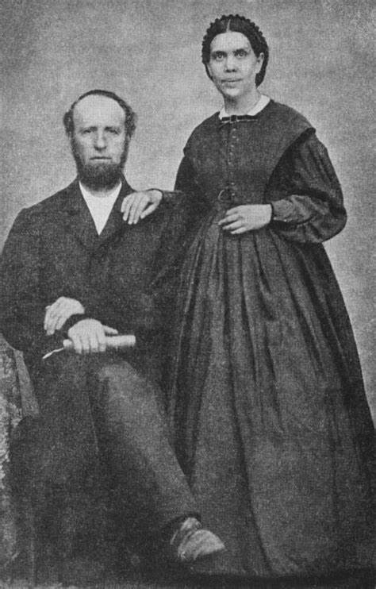
NOT 1 Arbiter of Truth! They Studied Themselves!
“Bates proposed that a meeting should be organised between the believers in New Hampshire and Port Gibson. At this meeting, which occurred sometime in 1846 at Edson's farm, Edson and other Port Gibson believers readily accepted Sabbath and at the same time forged an alliance with Bates and [the Whites] . . . Between April 1848, and December 1850 twenty-two "Sabbath conferences" were held in New York and New England. These meetings were often seen as opportunities for leaders such as James White, Joseph Bates, Stephen Pierce and Hiram Edson to discuss and reach conclusions about doctrinal issues” Ibid.

Slide 13
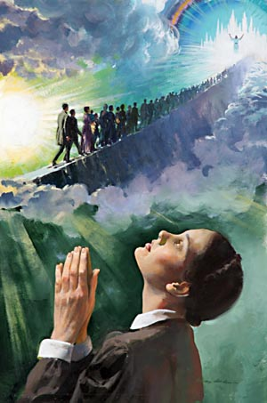
The First Vision of Ellen White: To Women?
“In December 1844, White experienced her first vision during a prayer meeting at the home of Mrs. Haines at 60 Ocean Street in South Portland, Maine, which later became the Griffin Club. The building was torn down in 2018. “At this time I visited one of our Advent sisters, and in the morning we bowed around the family altar. It was not an exciting occasion, and there were but five of us present, all females. While praying, the power of God came upon me as I never had felt it before, and I was wrapt up in a vision of God's glory, and seemed to be rising higher and higher from the earth and was shown something of the travels of the Advent people to the Holy City ...”—Wikipedia, Ellen G. White

Slide 14
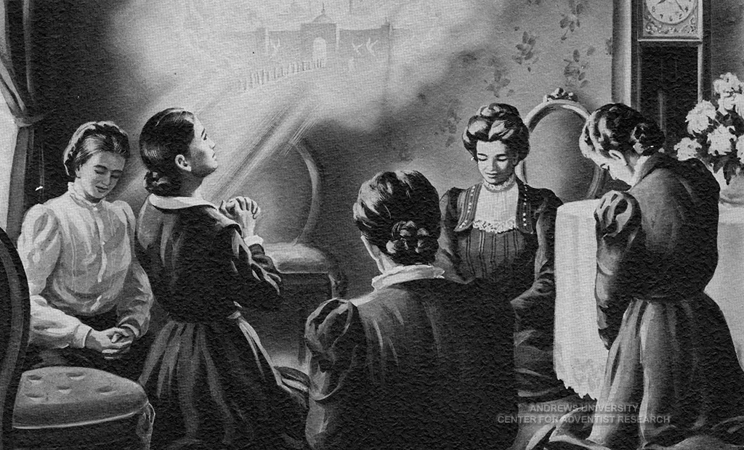
About the Second Coming!
“In this vision the "Advent people" were traveling a high and dangerous path towards the city of New Jerusalem [heaven]. Their path was lit from behind by "a bright (light) which an angel told me was the midnight cry." Some of the travelers grew weary and were encouraged by Jesus; others denied the light, the light behind them went out, and they fell "off the path into the dark and wicked world below." The vision continued with a portrayal of Christ's second coming, following which the Advent people entered the New Jerusalem; and ended with her returning to earth feeling lonely, desolate and longing for that "better world.“—Ibid.

Slide 15
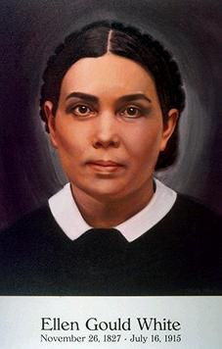
Ellen White as a Prophet
Ellen White’s visions helped guide the early church on to greater truths and encourage them in the truth of their experience. She was tested as a prophet by the Bible’s outline of physical signs, which was done publicly among skeptics. Her writings were also found to be inspired when tested by the Bible and read as guides to doctrine, history, and truth—again, always tested by the Bible. She wrote the conflict of the ages series, many books, letters, manuscripts, pamphlets and articles. Her prophetic insights have proven to be true thus far, and she has always seemed to end up on the right side of history—she was a prominent figure in the temperance movement, health reform, proper education, evangelism—even her enemies testified that she was a sincere Christian.

Slide 16
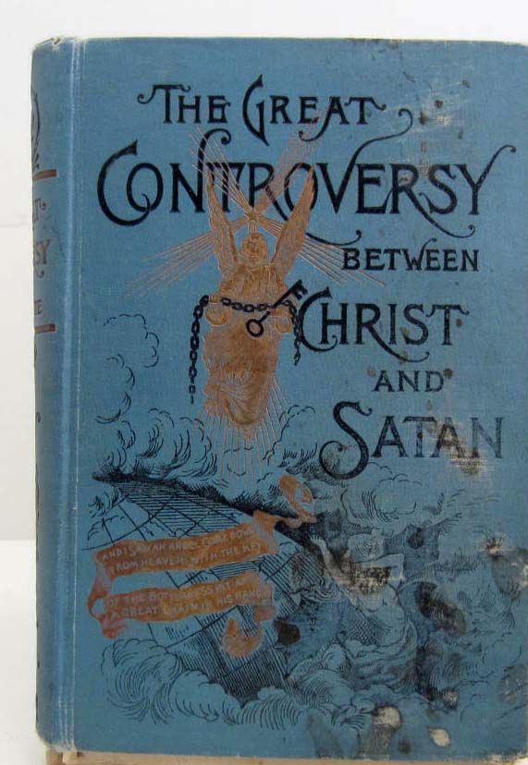
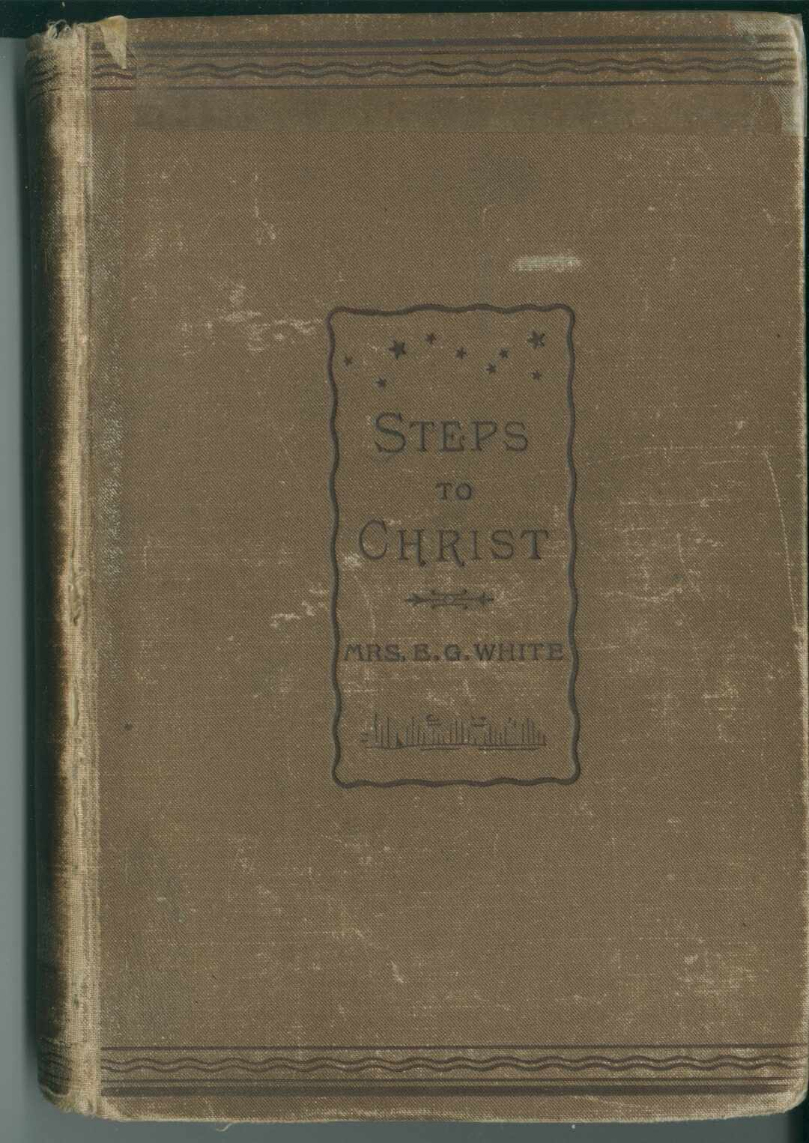
Blessed by God? Or Satanic Deception?
“Ellen G. White is the most translated female non-fiction author in the history of literature, as well as the most translated American non-fiction author of either gender. Her writings covered a broad range of subjects, including religion, social relationships, prophecy, publishing, nutrition, creationism, agriculture, theology, evangelism, Christian lifestyle, education, and health. She advocated vegetarianism . . . During her lifetime she wrote more than 5,000 periodical articles and 40 books. As of 2019 more than 200 White titles are available in English, including compilations from her 100,000 pages of manuscript published by the Ellen G. White Estate, which are accessible at the Adventist Book Center. Her most notable books are Steps to Christ, The Desire of Ages and The Great Controversy.” Wikipedia, Ellen G. White

Slide 17
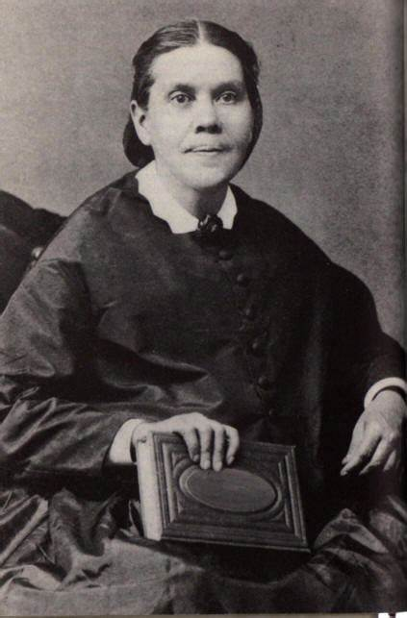
The Movement Grows
“In 1860, the fledgling movement finally settled on the name, Seventh-day Adventist, representative of the church's distinguishing beliefs. Three years later, on May 21, 1863, the General Conference of Seventh-day Adventists was formed and the movement became an official organization. . . Ellen G. White (1827–1915), while holding no official role, was a dominant personality. She, along with her husband, James White, and Joseph Bates, moved the denomination to a concentration on missionary and medical work. Mission and medical work continues to play a central role in the 21st century. Under White's guidance the denomination in the 1870s turned to missionary work and revivals, tripling its membership to 16,000 by 1880; rapid growth continued, with 75,000 members in 1901. By this time operated two colleges, a medical school, a dozen academies, 27 hospitals, and 13 publishing houses.” Wikipedia, History of the Seventh-day Adventist Church

Slide 18
Time-setting Again! 1975
"Choosing the Best Way of Life". The Watchtower. March 15, 1980. pp. 17–18. With the appearance of the book Life Everlasting—in Freedom of the Sons of God, ... considerable expectation was aroused regarding the year 1975. ... there were other statements published that implied that such realization of hopes by that year was more of a probability than a mere possibility. It is to be regretted that these latter statements apparently overshadowed the cautionary ones and contributed to a buildup of the expectation already initiated. ... persons having to do with the publication of the information ... contributed to the buildup of hopes centered on that date.
"What will the 1970's Bring?". Awake!. Watch Tower Society. October 8, 1968. p. 14. Does this mean that the above evidence positively points to 1975 as the complete end of this system of things? Since the Bible does not specifically state this, no man can say... If the 1970s should see intervention by Jehovah God to bring an end to a corrupt world drifting toward ultimate disintegration, that should surely not surprise us.
"How Are You Using Your Life?". Our Kingdom Ministry. May 1, 1974. p. 63. Reports are heard of brothers selling their homes and property and planning to finish out the rest of their days in this old system in the pioneer service. Certainly, this is a fine way to spend the short time remaining before the wicked world's end.

Slide 19
Decline of the Watch Tower After Death
Chicago Daily Tribune October 30, 1949 pg 18: "Pastor Russell died in 1916. In the 33 years since, the methods of this sect have deviated completely from those of Pastor Russell and his manner of teaching."

Slide 20
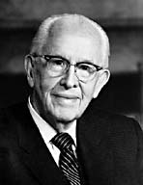
An Important Statement From an LDS Prophet
Prophet Ezra Taft: “the Book of Mormon is the keystone of our religion. This was the Prophet Joseph Smith’s statement. He testified that “the Book of Mormon was the most correct of any book on earth, and the keystone of our religion” (Introduction to the Book of Mormon). A keystone is the central stone in an arch. It holds all the other stones in place, and if removed, the arch crumbles.” (October 1986 General Conference)

