Slide 1
Revelation 20
Triumph and Tragedy

Slide 2
Summary
Revelation 19 ended with the 2nd Coming of Jesus Christ. The children of God, clothed in the righteousness of Christ, are being taken to heaven. The children of perpetual rebellion have been slain by the brightness of Christ’s coming.
“And to you who are troubled rest with us, when the Lord Jesus shall be revealed from heaven with his mighty angels, In flaming fire taking vengeance on them that know not God, and that obey not the gospel of our Lord Jesus Christ: Who shall be punished with everlasting destruction from the presence of the Lord, and from the glory of his power; When he shall come to be glorified in his saints, and to be admired in all them that believe (because our testimony among you was believed) in that day.” 2Thess. 1:7-10

Slide 3
What happens to the Devil?
“And I saw an angel come down from heaven, having the key of the bottomless pit and a great chain in his hand. And he laid hold on the dragon, that old serpent, which is the Devil, and Satan, and bound him a thousand years, And cast him into the bottomless pit, and shut him up, and set a seal upon him, that he should deceive the nations no more, till the thousand years should be fulfilled: and after that he must be loosed a little season.” Revelation 20:1-3

Slide 4
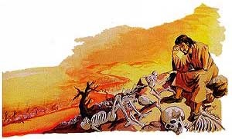
The Devil Chained
“The revelator foretells the banishment of Satan and the condition of chaos and desolation to which the earth is to be reduced, and he declares that this condition will exist for a thousand years. After presenting the scenes of the Lord's second coming and the destruction of the wicked, the prophecy continues:”…That the expression "bottomless pit" represents the earth in a state of confusion and darkness is evident from other scriptures. Concerning the condition of the earth "in the beginning," the Bible record says that it "was without form, and void; and darkness was upon the face of the deep." [THE HEBREW WORD HERE TRANSLATED "DEEP" IS RENDERED IN THE SEPTUAGINT (GREEK) TRANSLATION OF THE HEBREW OLD TESTAMENT BY THE SAME WORD RENDERED "BOTTOMLESS PIT" IN REVELATION 20:1-3.] GC, pg. 658

Slide 5
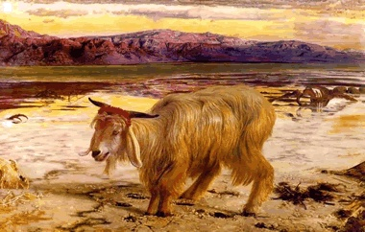
The Scapegoat Gets his Reward
“Now the event takes place foreshadowed in the last solemn service of the Day of Atonement. When the ministration in the holy of holies had been completed, and the sins of Israel had been removed from the sanctuary by virtue of the blood of the sin offering, then the scapegoat was presented alive before the Lord; and in the presence of the congregation the high priest confessed over him "all the iniquities of the children of Israel, and all their transgressions in all their sins, putting them upon the head of the goat." Leviticus 16:21. In like manner, when the work of atonement in the heavenly sanctuary has been completed, then in the presence of God and heavenly angels and the hosts of the redeemed the sins of God's people will be placed upon Satan; he will be declared guilty of all the evil which he has caused them to commit. And as the scapegoat was sent away into a land not inhabited, so Satan will be banished to the desolate earth, an uninhabited and dreary wilderness.” GC., pg. 658

Slide 6
The Redeemed
“And I saw thrones, and they sat upon them, and judgment was given unto them: and I saw the souls of them that were beheaded for the witness of Jesus, and for the word of God, and which had not worshipped the beast, neither his image, neither had received his mark upon their foreheads, or in their hands; and they lived and reigned with Christ a thousand years. But the rest of the dead lived not again until the thousand years were finished. This is the first resurrection.
Blessed and holy is he that hath part in the first resurrection: on such the second death hath no power, but they shall be priests of God and of Christ, and shall reign with him a thousand years.” Revelation 20:4-6

Slide 7
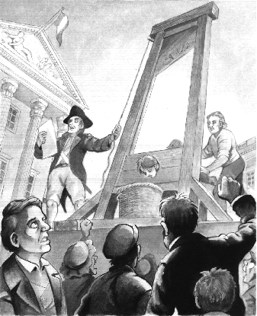
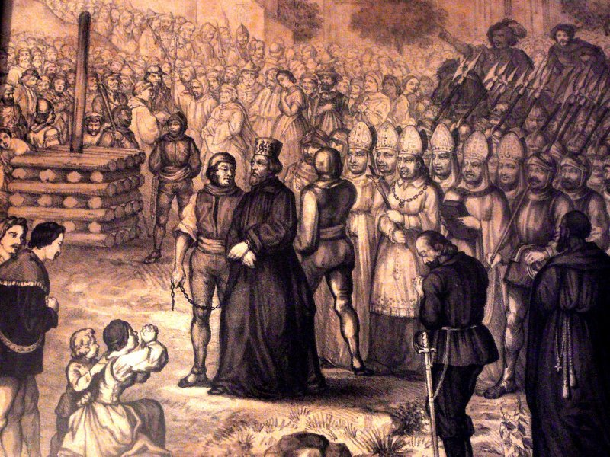
Martyrs for Christ

Slide 8
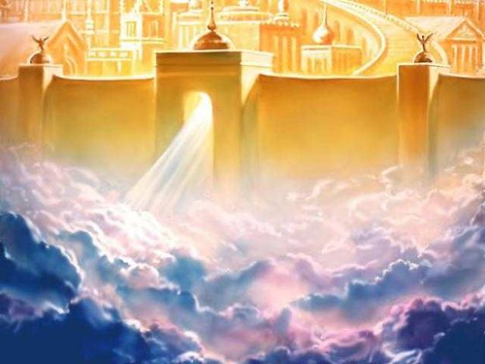
We will Judge
“Do ye not know that the saints shall judge the world? and if the world shall be judged by you, are ye unworthy to judge the smallest matters? Know ye not that we shall judge angels? how much more things that pertain to this life?” 1Corinthians 6:2,3

Slide 9
1,000 YEARS ARE OVER
“When the thousand years are expired, Satan shall be loosed out of his prison, And shall go out to deceive the nations which are in the four quarters of the earth, Gog and Magog, to gather them together to battle: the number of whom is as the sand of the sea.” Revelation 20:7,8
“But the rest of the dead lived not again until the thousand years were finished.” Revelation 20:5

Slide 10
The Scene
“Now Satan prepares for a last mighty struggle for the supremacy. While deprived of his power and cut off from his work of deception, the prince of evil was miserable and dejected; but as the wicked dead are raised and he sees the vast multitudes upon his side, his hopes revive, and he determines not to yield the great controversy. He will marshal all the armies of the lost under his banner and through them endeavor to execute his plans. The wicked are Satan's captives. In rejecting Christ they have accepted the rule of the rebel leader. They are ready to receive his suggestions and to do his bidding. Yet, true to his early cunning, he does not acknowledge himself to be Satan. He claims to be the prince who is the rightful owner of the world and whose inheritance has been unlawfully wrested from him. He represents himself to his deluded subjects as a redeemer, assuring them that his power has brought them forth from their graves and that he is about to rescue them from the most cruel tyranny. The presence of Christ having been removed, Satan works wonders to support his claims.” GC, pg. 663

Slide 11
The City
“And they went up on the breadth of the earth, and compassed the camp of the saints about, and the beloved city:” Revelation 20:9
“As the New Jerusalem, in its dazzling splendor, comes down out of heaven, it rests upon the place purified and made ready to receive it, and Christ, with His people and the angels, enters the Holy City.” GC, pg. 663

Slide 12
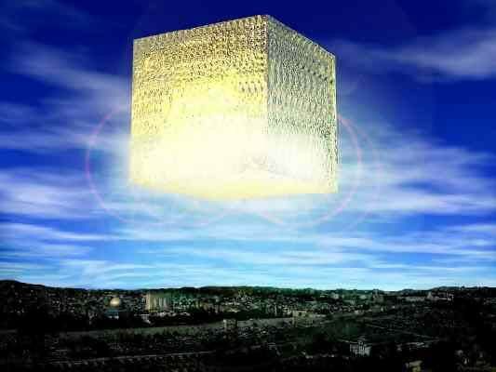
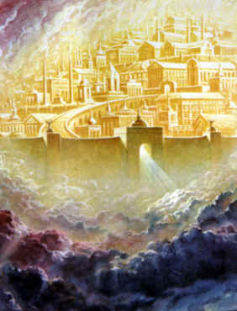
The Holy City

Slide 13
The Encounter
GC, pg. 664 “Satan consults with his angels, and then with these kings and conquerors and mighty men. They look upon the strength and numbers on their side, and declare that the army within the city is small in comparison with theirs, and that it can be overcome. They lay their plans to take possession of the riches and glory of the New Jerusalem. All immediately begin to prepare for battle. Skillful artisans construct implements of war. Military leaders, famed for their success, marshal the throngs of warlike men into companies and divisions.
At last the order to advance is given, and the countless host moves on--an army such as was never summoned by earthly conquerors, such as the combined forces of all ages since war began on earth could never equal. Satan, the mightiest of warriors, leads the van, and his angels unite their forces for this final struggle. Kings and warriors are in his train, and the multitudes follow in vast companies, each under its appointed leader. With military precision the serried ranks advance over the earth's broken and uneven surface to the City of God. By command of Jesus, the gates of the New Jerusalem are closed, and the armies of Satan surround the city and make ready for the onset.”

Slide 14
The Scene
“Now Christ again appears to the view of His enemies. Far above the city, upon a foundation of burnished gold, is a throne, high and lifted up. Upon this throne sits the Son of God, and around Him are the subjects of His kingdom. The power and majesty of Christ no language can describe, no pen portray. The glory of the Eternal Father is enshrouding His Son. The brightness of His presence fills the City of God, and flows out beyond the gates, flooding the whole earth with its radiance.
Nearest the throne are those who were once zealous in the cause of Satan, but who, plucked as brands from the burning, have followed their Saviour with deep, intense devotion. Next are those who perfected Christian characters in the midst of falsehood and infidelity, those who honored the law of God when the Christian world declared it void, and the millions, of all ages, who were martyred for their faith. And beyond is the "great multitude, which no man could number, of all nations, and kindreds, and people, and tongues, . . . before the throne, and before the Lamb, clothed with white robes, and palms in their hands." Revelation 7:9. Their warfare is ended, their victory won. They have run the race and reached the prize. The palm branch in their hands is a symbol of their triumph, the white robe an emblem of the spotless righteousness of Christ which now is theirs.
The redeemed raise a song of praise that echoes and re-echoes through the vaults of heaven: "Salvation to our God which sitteth upon the throne, and unto the Lamb." Verse 10. And angel and seraph unite their voices in adoration…” GC, pg. 665

Slide 15
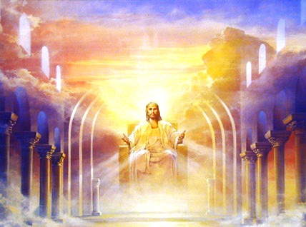
It is Over
“In the presence of the assembled inhabitants of earth and heaven the final coronation of the Son of God takes place. And now, invested with supreme majesty and power, the King of kings pronounces sentence upon the rebels against His government and executes justice upon those who have transgressed His law and oppressed His people.” GC, pg. 666

Slide 16
Jesus Above All
“Above the throne is revealed the cross; and like a panoramic view appear the scenes of Adam's temptation and fall, and the successive steps in the great plan of redemption. The Saviour's lowly birth; His early life of simplicity and obedience; His baptism in Jordan; the fast and temptation in the wilderness; His public ministry, unfolding to men heaven's most precious blessings; the days crowded with deeds of love and mercy, the nights of prayer and watching in the solitude of the mountains; the plottings of envy, hate, and malice which repaid His benefits; the awful, mysterious agony in Gethsemane beneath the crushing weight of the sins of the whole world; His betrayal into the hands of the murderous mob; the fearful events of that night of horror--the unresisting prisoner, forsaken by His best-loved disciples, rudely hurried through the streets of Jerusalem; the Son of God exultingly displayed before Annas, arraigned in the high priest's palace, in the judgment hall of Pilate, before the cowardly and cruel Herod, mocked, insulted, tortured, and condemned to die--all are vividly portrayed. And now before the swaying multitude are revealed the final scenes--the patient Sufferer treading the path to Calvary; the Prince of heaven hanging upon the cross; the haughty priests and the jeering rabble deriding His expiring agony; the supernatural darkness; the heaving earth, the rent rocks, the open graves, marking the moment when the world's Redeemer yielded up His life. The awful spectacle appears just as it was. Satan, his angels, and his subjects have no power to turn from the picture of their own work.” GC. Pg. 666,667

Slide 17
Executive Judgment
“And I saw a great white throne, and him that sat on it, from whose face the earth and the heaven fled away; and there was found no place for them. And I saw the dead, small and great, stand before God; and the books were opened: and another book was opened, which is the book of life: and the dead were judged out of those things which were written in the books, according to their works. And the sea gave up the dead which were in it; and death and hell delivered up the dead which were in them: and they were judged every man according to their works.” Rev. 20: 11-13

Slide 18
Two Courtroom Scenes
Daniel 7:9,10 “I beheld till the thrones were cast down, and the Ancient of days did sit, whose garment was white as snow, and the hair of his head like the pure wool: his throne was like the fiery flame, and his wheels as burning fire. A fiery stream issued and came forth from before him: thousand thousands ministered unto him, and ten thousand times ten thousand stood before him: the judgment was set, and the books were opened.” From 1844-close of probation
The one in Revelation 20 takes place at the end of the 1,000 years. This is the execution of the judgment. All the universe sees that God was in no way responsible for sin and rebellion. The guilt rests solely on the devil.

Slide 19
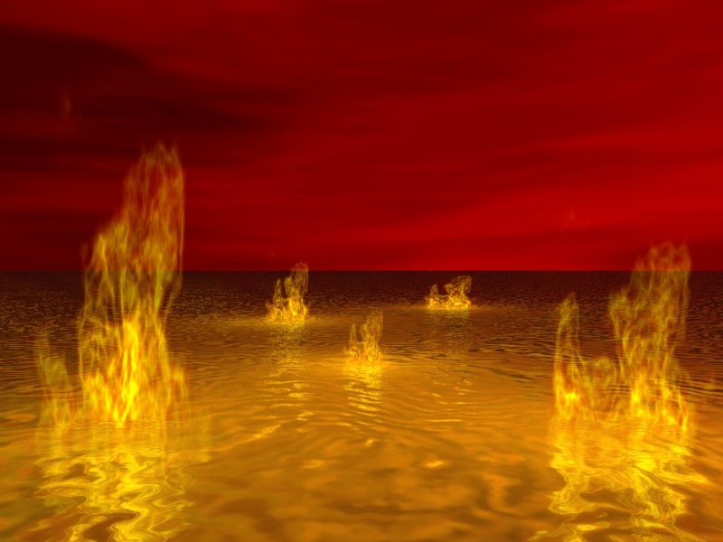
The Lake of Fire
“and fire came down from God out of heaven, and devoured them. And the devil that deceived them was cast into the lake of fire and brimstone, where the beast and the false prophet are, and shall be tormented day and night for ever and ever.”
Revelation 20:9,10

Slide 20
No Second Chance
“Fire comes down from God out of heaven. The earth is broken up. The weapons concealed in its depths are drawn forth. Devouring flames burst from every yawning chasm. The very rocks are on fire. The day has come that shall burn as an oven. The elements melt with fervent heat, the earth also, and the works that are therein are burned up. Malachi 4:1; 2 Peter 3:10. The earth's surface seems one molten mass--a vast, seething lake of fire. It is the time of the judgment and perdition of ungodly men--"the day of the Lord's vengeance, and the year of recompenses for the controversy of Zion." Isaiah 34:8. The wicked receive their recompense in the earth. Proverbs 11:31. They "shall be stubble: and the day that cometh shall burn them up, saith the Lord of hosts." Malachi 4:1. Some are destroyed as in a moment, while others suffer many days. All are punished "according to their deeds." The sins of the righteous having been transferred to Satan, he is made to suffer not only for his own rebellion, but for all the sins which he has caused God's people to commit. His punishment is to be far greater than that of those whom he has deceived. After all have perished who fell by his deceptions, he is still to live and suffer on. In the cleansing flames the wicked are at last destroyed, root and branch--Satan the root, his followers the branches.” GC, pg. 672,673

Slide 21
Forever and ever/ How Long is Forever?
“And if the servant shall plainly say, I love my master, my wife, and my children; I will not go out free: Then his master shall bring him unto the judges; he shall also bring him to the door, or unto the door post; and his master shall bore his ear through with an aul; and he shall serve him for ever.” Exodus 21:5,6
“But Hannah went not up; for she said unto her husband, I will not go up until the child be weaned, and then I will bring him, that he may appear before the LORD, and there abide for ever.” 1 Samuel 1:22… “Therefore also I have lent him to the LORD; as long as he liveth he shall be lent to the LORD. And he worshipped the LORD there.” verse 28

Slide 22
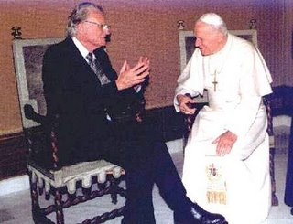
A Bad Future for the beast and his image
Revelation 14:9,10- the wrath of God.
Rev. 16:2- the first plague.
Rev. 19:20- the lake of fire.
Rev. 20:10- the lake of fire.

Slide 23
Rebellion Dies
“And death and hell were cast into the lake of fire. This is the second death. And whosoever was not found written in the book of life was cast into the lake of fire.” Rev. 20:14,15

Slide 24
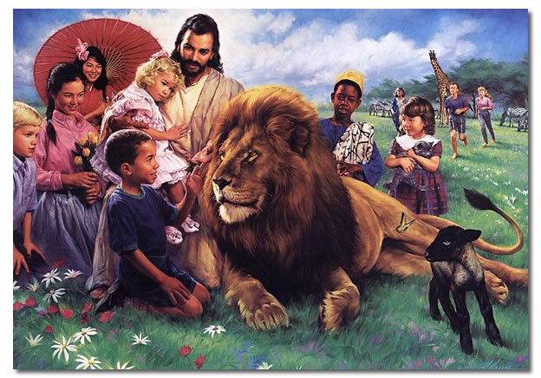
The Over comers
Revelation 3:5 “He that overcometh, the same shall be clothed in white raiment; and I will not blot out his name out of the book of life, but I will confess his name before my Father, and before his angels.”

