Slide 1
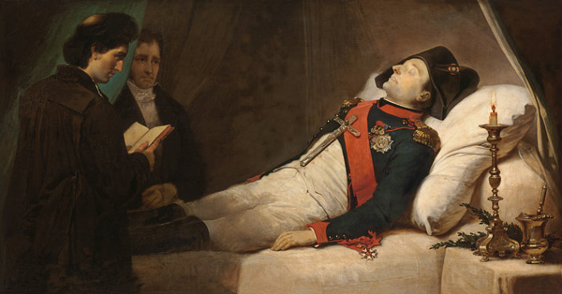
Famous Last Words…

Slide 2
No Middle Ground—Accept or Reject!
Matt. 12:30 He that is not with me is against me; and he that gathereth not with me scattereth abroad.
God will save no man while he continues in transgression after the light has come. The great sacrifice of the Son of God was made that it might be possible for man to become obedient through faith. “For God so loved the world, that He gave His only begotten Son, that whosoever believeth in Him should not perish, but have everlasting life.” The atonement in the offering of Christ for the sin of the world is the great argument that the law of God is binding upon every human being. “I came not,” said Christ, “to destroy the law or the prophets, but to fulfil. For verily I say unto you, Till heaven and earth pass, one jot or one tittle shall in no wise pass from the law, till all be fulfilled.” . . . The everlasting inheritance is purchased only for the elect.—Bible Echo, November 20, 1899

Slide 3
Choices in Life Echo in Eternity….
“While God has given ample evidence for faith, He will never remove all excuse for unbelief. All who look for hooks to hang their doubts upon will find them. And those who refuse to accept and obey God's Word until every objection has been removed, and there is no longer an opportunity for doubt, will never come to the light“--The Great Controversy, p. 527

Slide 4
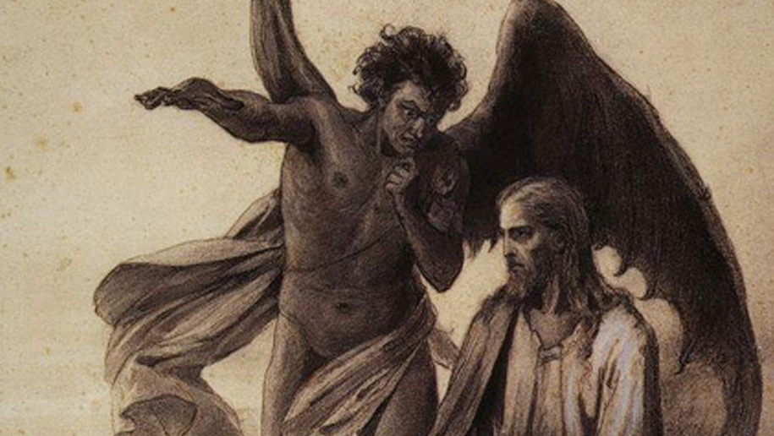

Slide 5
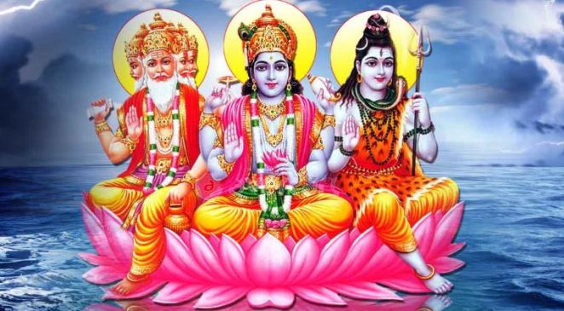
Hinduism’s Gandhi
“I love Hinduism more dearly than life itself. I must tell you in all humility that Hinduism, as I know it, entirely satisfies my soul, fills my whole being, and I find a solace in the Bhagavad Gita and Upanishads that I miss even in the Sermon on the Mount. Not that I do not prize the ideal presented therein, not that some of the precious teachings in the Sermon on the Mount have not left a deep impression upon me, but I must confess to you that when doubt haunts me, when disappointments stare me in the face, and when I see not one ray of light in the horizon I turn to the Bhagavad Gita and a verse to comfort me . . . My life has been full of external tragedies and, if they have not left any visible and delible effect on me, I owe it the teaching of the Bhagavad Gita”—Mohandes Gandhi, The Wit and Wisdom of Gandhi, p. 186

Slide 6
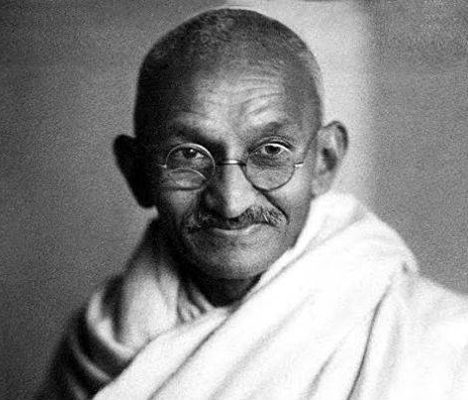
Not and Ever-Lasting Peace…
“My days are numbered. I am not likely to live very long, perhaps a yearr or a little more. For the first time in 50 years I find myself in a slough of despond. All about me is darkness; I am praying for light”—Gandhi quoted in Give Me an Answer, Cliffe Knechtle, p. 20

Slide 7
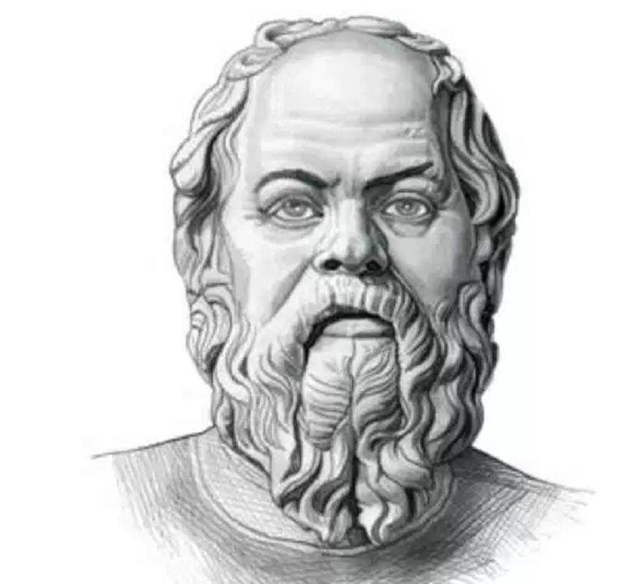
Philosophy’s Socrates
“All of the wisdom of this world is but a tiny raft upon which we must set sail when we leave this earth. If only there was a firmer foundation upon which to sail, perhaps some divine word.”—Socrates quoted in Kenneth Boa, Rewriting Your Broken Story: The Power of an Eternal perspective, Ch. 5 Conclusion

Slide 8
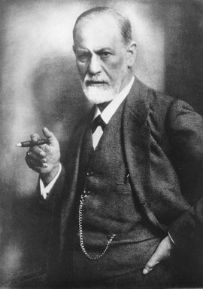
Psychology’s Sigmund Freud
“The meager satisfaction that man can extract from reality leaves him starving.”—Sigmund Freud quoted in, The Man in the Mirror: Solving the 24 Problems Men Face, Patrick Morley, Ch. 24 “Famous Last Words”

Slide 9
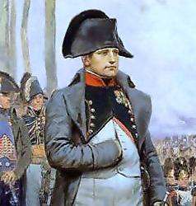
The Conqueror Napoleon Bonaparte
“I die before my time and body shall be given back to the earth and devoured by worms. What an abysmal gulf between my deep miseries and the eternal kingdom of Christ. I marvel that whereas the ambitious dreams of myself and of Alexander and of Caesar should have vanished into thin air, a Judean peasant—Jesus—should be able to stretch his hands across the centuries, and control the destinies of men and nations”—Napoleon, quoted in Ibid.

Slide 10
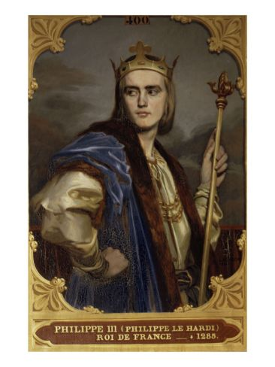
An Obedient King at the Height of Papal Supremacy
King Phillip III of France reigned from 1270-1285. He was obedient to the Roman Catholic Church’s will, coronated by Pope Innocent IV. He generally followed the consciences of his counselors and participated in the 8th Crusade, said this on his deathbed: “What an account I shall have to give to God! How I should like to live otherwise than I have lived.”—quoted in The Evidence Bible: Irrefutable Evidence for the Thinking Mind, p. 582

Slide 11
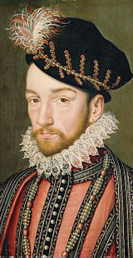
St Bartholomew’s Day Massacre
“Charles IX (1550-1574). King of France. Under an oath of safety, a group of French Protestants was allowed into Paris to attend the wedding of the King of Navarre. Charles’ mother, Catherine de Medici, urged him to order the slaughter of thousands of these Protestants—the St. Bartholomew’s Day massacre. Apparently this act greatly troubled the dying monarch, because he lamented to his medical attendants: ‘Asleep or awake, I see the mangled forms of the Huguenots passing before me. They drip with blood. They point at their open wounds. Oh! That I had spared at least the little infants at the breast! What blood! I know not where I am. How will all of this end? What shall I do? I am lost forever! I know it. Oh, I have done wrong. God pardon me!’”

Slide 12
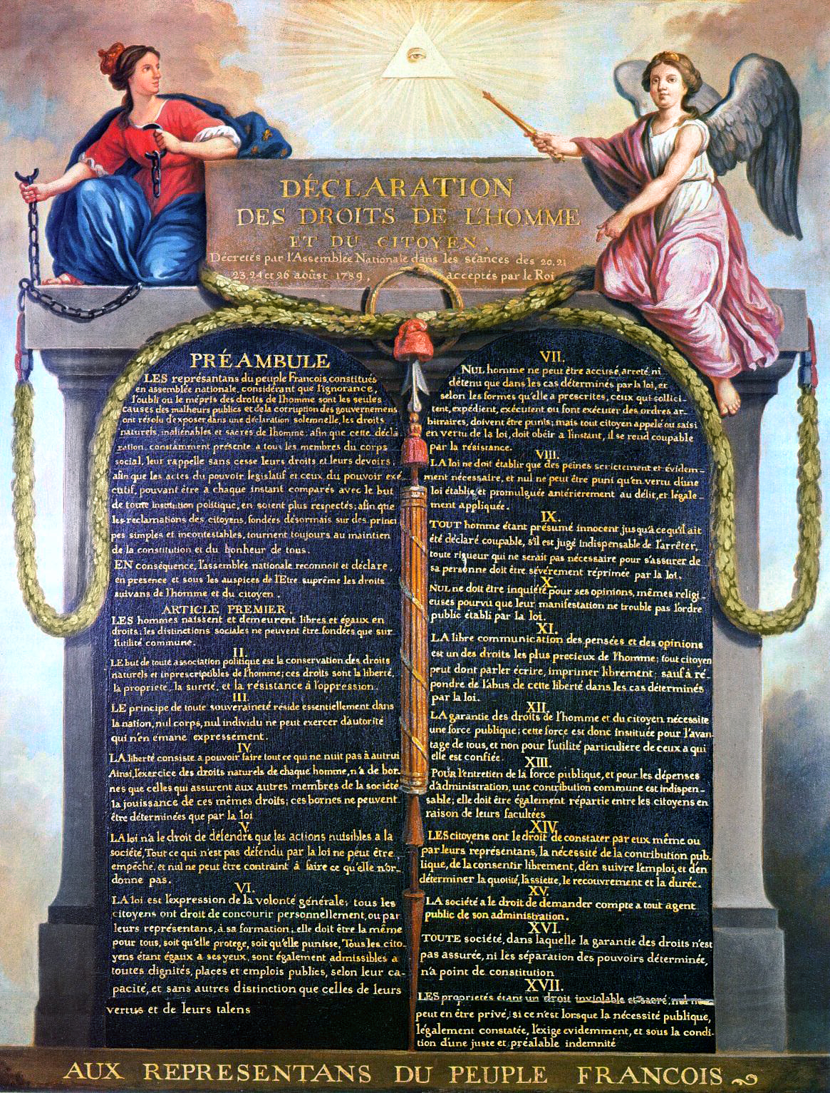
Humanism’s Voltaire
“In twenty years Christianity will be no more. My single hand shall destroy the edifice it took twelve apostles to rear.”—Voltaire quoted in The Pacific vol. 51, p. 22
The historian Peter Gar, himself and admirer of Votaire, described Voltaire’s ‘distaste’ for Christianity as ‘almost an obsession.’ Repeated and passionately, Voltaire returned to the theme: ‘Every sensible man, every honorable man, must hold the Christian sect in horror’”—quoted in The Roads to Modernity, Gertrude Himmelfarb, p. 154

Slide 13
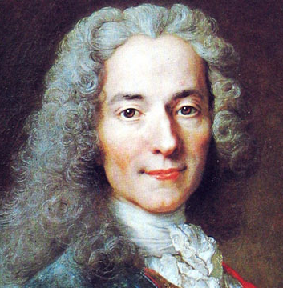
A Change of Tune…
“’I am abandoned by God and Man! . . . Doctor, I will give you half of what I am worth, if you will give me Six month’s Life.’ The Doctor answered, ‘Sir, you cannot live Six weeks.’ Voltaire replied, ‘ Then I shall go to Hell, and you will go with me!”—quoted in A Collection of One Hundred Pieces of English Literature, BS Nayler, p. 181

Slide 14
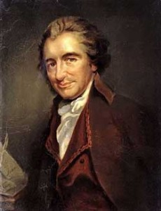
Enlightenment Pioneer, Atheist, and Age of Reason Publisher!!
“I would give worlds if I had them, The Age of Reason had never been published. O Lord, help me! Christ, help me! O God, what have I done to suffer so much? But there is no God! But if there should be, what will become hereafter? Stay with me, for God’s sake! Send even a child to stay with me, for it is hell to be alone. If ever the Devil had agent, I have been that one.”—quoted in Make Disciples!, Terry Bowland, p. 221

Slide 15
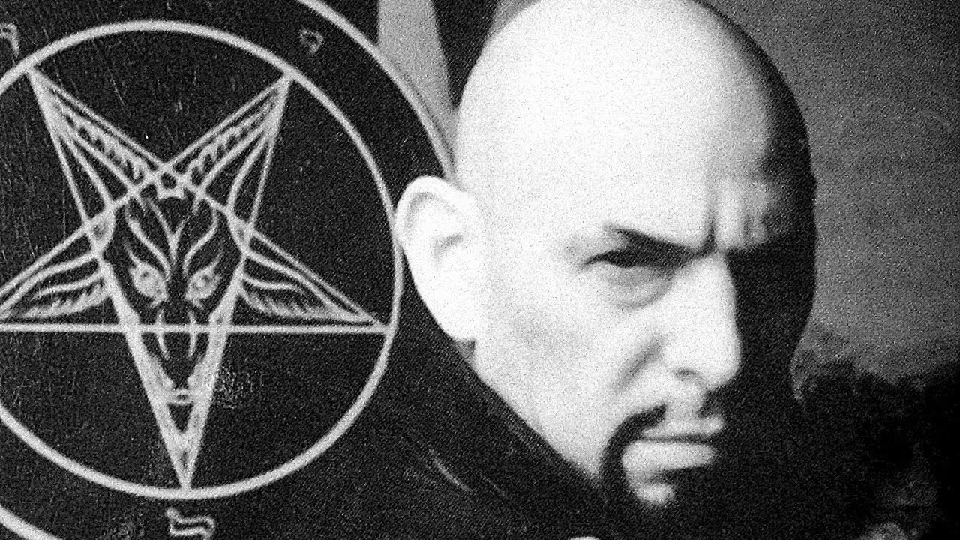
Satanism’s Anton Lavey
“I dip my forefinger in the watery blood of your impotent mad redeemer, and write over his thorn-torn brow: The TRUE prince of evil-the king of slaves!”—Lavey, The Satanic Bible, 1:6

Slide 16
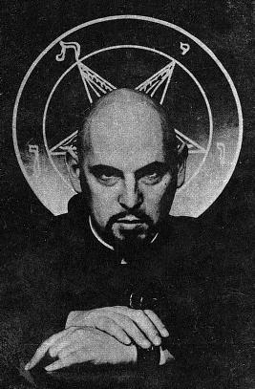
Peaceful Death???
On his death bed, Anton LaVey has a revelation of the spiritual world just as he is about to die, and hettered his last words ‘What have I done? There’s something very wrong here... This is all wrong’”—quoted in The Only Solution, David Hackathorn, p. 63
Is. 48:22 “There is no peace, saith the LORD, unto the wicked.”

Slide 17
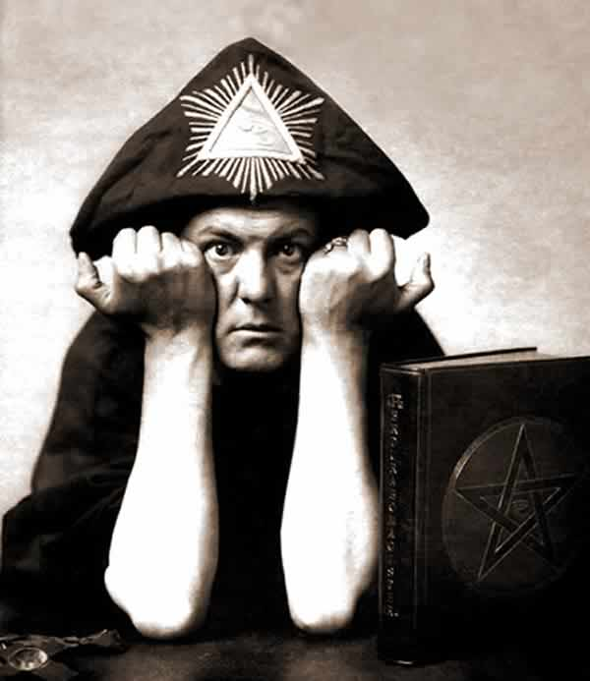
The Occult and New Age’s Patron Saint: Aleister Crowley
“I do not wish to argue that the doctrines of Jesus, they and they alone, have degraded the world to its present condition. I take it that Christianity is not only the cause but the symptom of slavery”--Crowley, The World’s Tragedy, p. 39

Slide 18
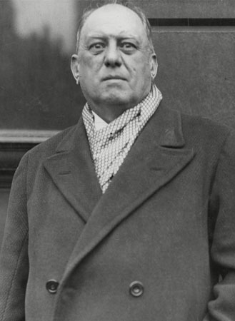
Last Words of a Do What Thou Wilt philosophy?
“On December 1, 1947 Aliester Crowley died. ‘I am perplexed’ were reported as his dying words.
Prov. 29:18 “Where there is no vision, the people perish: but he that keepeth the law, happy is he.”

Slide 19
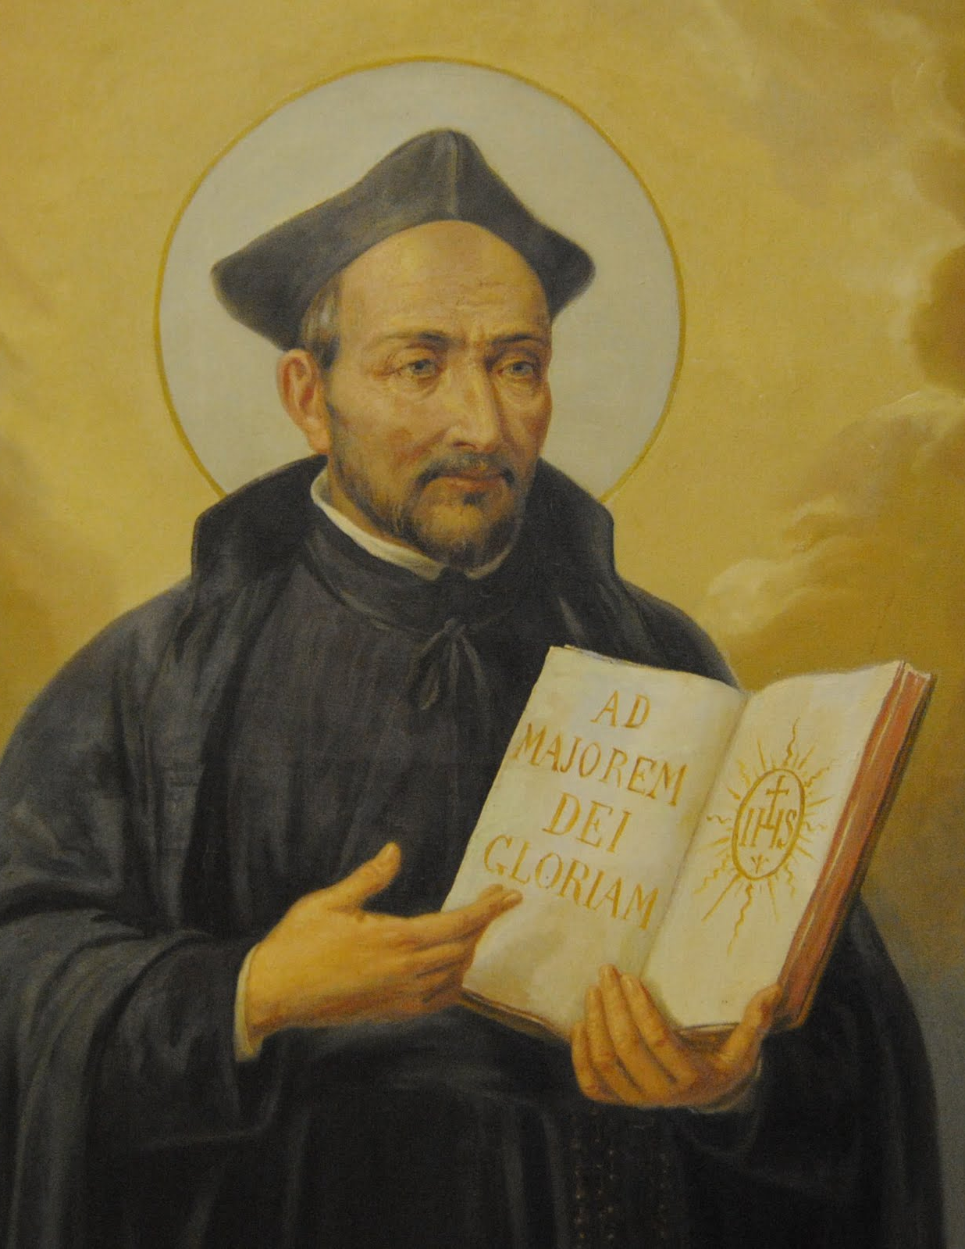
Catholicism’s Greatest Champion…
“’I have done much good to the church of Rome. I have seen many provinces of our men, many colleges, houses, residents and wealth belonging to our society. But all these things desert me now and I don’t know where to turn.’ At length, he expired in a fit of trembling and his face turned black, according to an eyewitness, a Jesuit, Tyrannus”--History of the Jesuits, vol. 1, p. 292

Slide 20
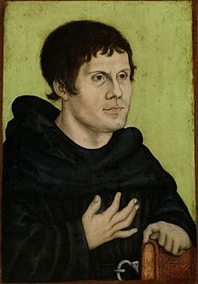
On the Other Hand… The Protestor
“’Oh my Father, God of our Lord Jesus Christ, the Father of all consolation. I thank thee for having revealed to me thy well-beloved Son in whom I believe. Whom I have preached and acknowledged, loved and celebrated, and whom the Pope and the impious persecute. I commend to thee my soul. Jesus my Lord, I am quitting this earthly body; I am leaving this life, but I know I shall abide with thee for eternity.’ He then repeated three times the words of the Psalm, ‘Into thy hands I commit my spirit; God of truth, thou hast redeemed me’”—quoted in The Autobiography of Martin Luther, John Parker Lawson, p. 362-363

Slide 21
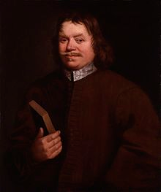
The Author: John Bunyan…
“Weep not for me, but for yourselves. I go to the Father of our Lord Jesus Christ, who will, through the mediation of His blessed Son, receive me, though a sinner, where I hope we shall meet tot sing the new song, and remain everlastingly happy, world without end.”—Make Disciples!, Terry Bowland, p. 221

Slide 22
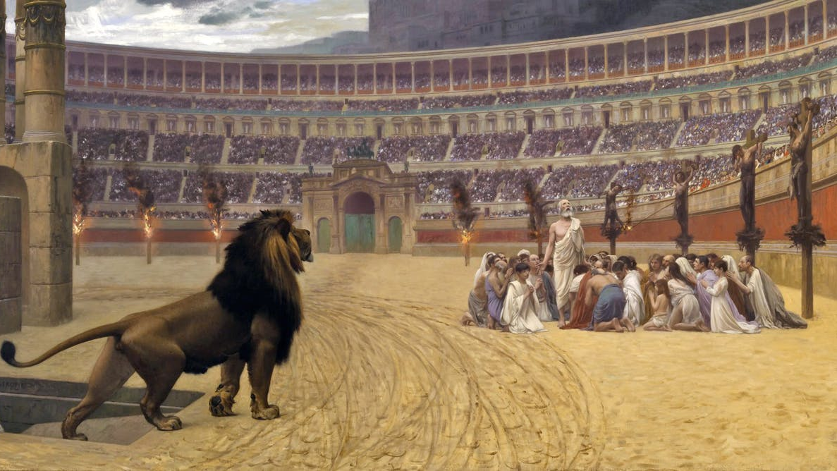

Slide 23
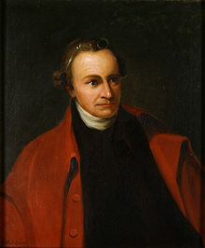
The Founding Patriot: Patrick Henry
“Doctor, I wish you to observe how real and beneficial the religion of Christ is to a man about to die”
In his will he stated: “This is all the inheritance I give to my dear family. The religion of Christ will give them one which will make them rich indeed.”—quoted in America’s God and Country: Encyclopedia of Quotations, p. 290

Slide 24
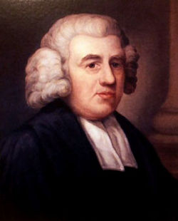
The Singer: Amazing Grace
“I am still in the land of the dying; I shall be in the land of the living soon”—The Christian Advocate vol. 80(16), March 2, 1905, p. 336

Slide 26
English Reformer, John Wesley
“On Tuesday 1 March, he called for pen and ink, but could not write. His devoted bandleader Betsy Ritchie said: ‘Let me write for you, sir; tell me what you would say.’
‘Nothing,’ answered Wesley, ‘but that God is with us.’ He then astonished his attendants by bursting out with the last hymn he had led at the City Road a week before:
‘I’ll praise my Maker while I’ve breath, And when my voice is lost in death, Praise shall employ my nobler pow’rs; My days of praise shall ne’er be past, While life and thought and being last, Or immortality endures.’
He urged that his sermon on the love of God be printed and given away for free, but then his mumbling became incomprehensible, so he merely repeated at intervals ‘The best of all is God is with us!’ Throughout the night he tried to sing the same hymn, but could only get out ‘I’ll praise… I’ll praise…’ After a last ‘Farewell’, he died on Wednesday morning.”—John Wesley, A Biography, Stephen Tomkins, p. 193-194

Slide 27
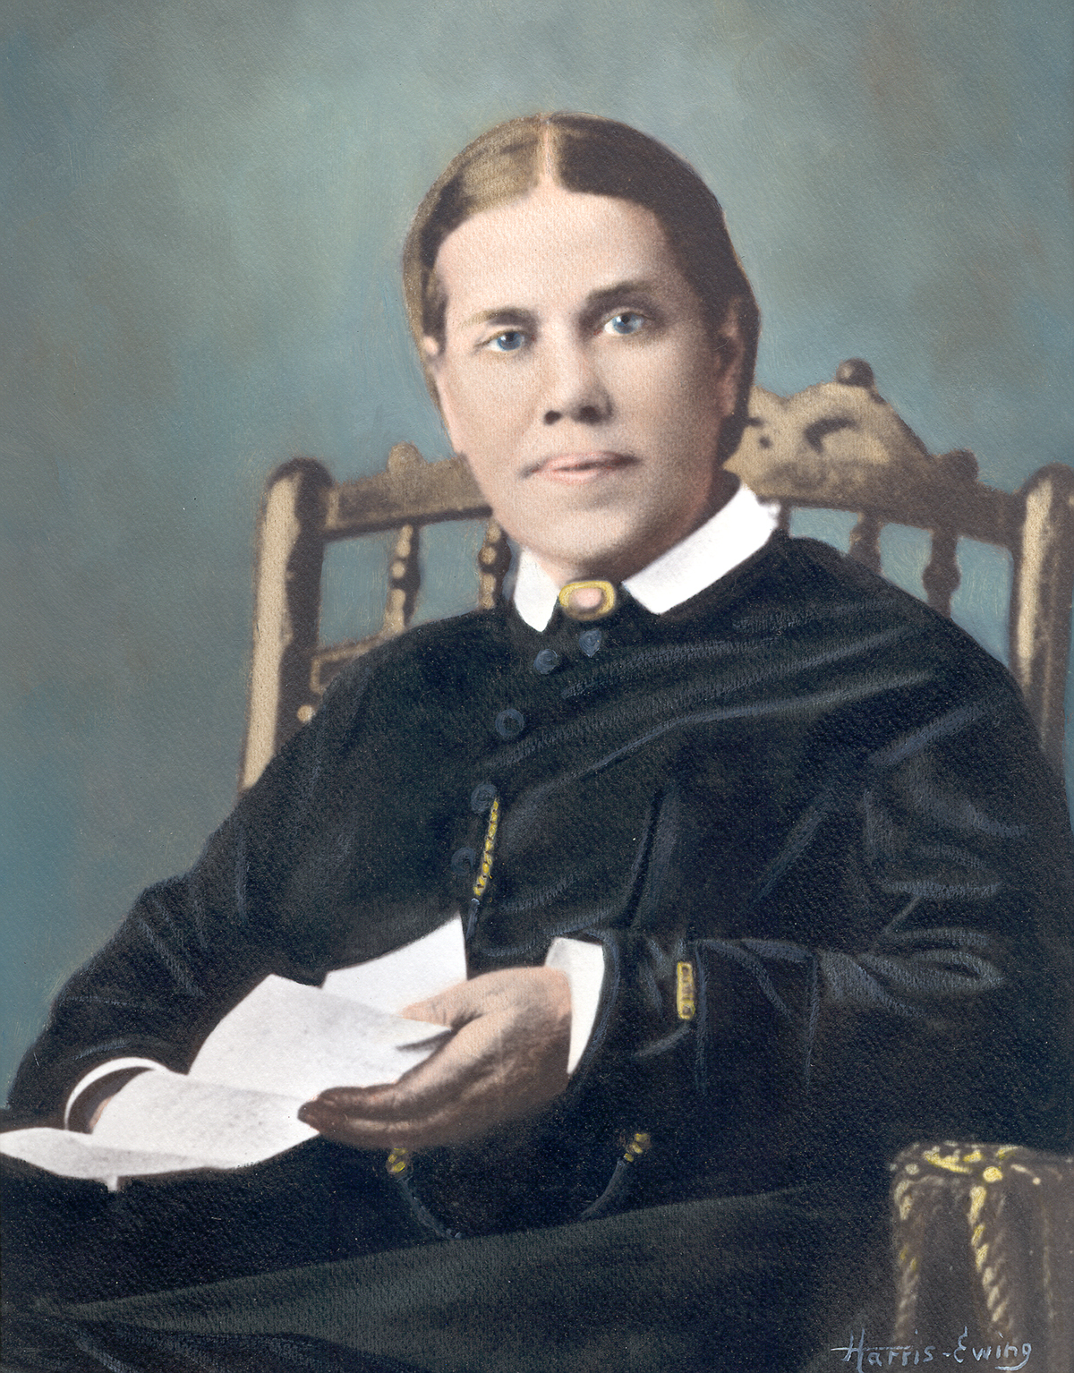
The Prophet: Ellen White
“I know in whom I have believed. God is love. He giveth His beloved sleep.”—Life Sketches of Ellen G. White, p. 449
The final words of individuals many times reveals a summary of their past, present and future condition! Their remarks are highly telling of their experiences here on earth. May our final condition be of solemn rest and peace with our Maker also!!!

