Slide 1
Final Scenes, pt. 8
The Man Who Knew Too Much

Slide 2
A Thoughtful Hour
“It would be well for us to spend a thoughtful hour each day in contemplation of the life of Christ. We should take it point by point, and let the imagination grasp each scene, especially the closing ones. As we thus dwell upon His great sacrifice for us, our confidence in Him will be more constant, our love will be quickened, and we shall be more deeply imbued with His spirit. If we would be saved at last, we must learn the lesson of penitence and humiliation at the foot of the cross.” Desire of Ages, pg. 83

Slide 3
Wednesday is Over
The fourth day of Christ’s final week was done and it had been a busy one. He had delivered His final message in the synagogue, the woes on the Pharisees, found in Matthew 23. He then, upon leaving, was met by the Greeks who wanted to talk to Him. Then, as He left Jerusalem for the trek up to the Mt. of Olives, and sought for rest, the disciples came to Him, wondering about the future of the temple and the Second Coming, found in Matthew 24, Mark 13, and Luke 21. It had been a very eventful day.

Slide 4
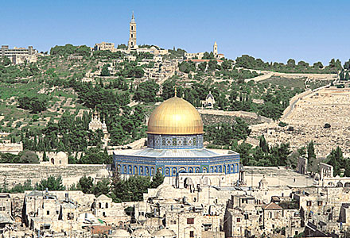
Christ’s final full Day
The fifth day of the week, or Thursday, was Jesus’ last full day on earth before His death. This day was spent in preparing for the Passover feast that would take place that evening. The hustle and bustle of this season, Springtime, would bring nearly 2-3 million Jews to Jerusalem. A very festive season would ensue. But, there was death on the wind!

Slide 5
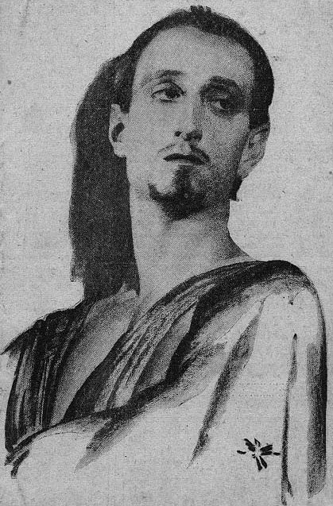
One Not Preparing for Passover
“A little before the Passover, Judas had renewed his contract with the priests to deliver Jesus into their hands. Then it was arranged that the Saviour should be taken at one of His resorts for meditation and prayer. Since the feast at the house of Simon, Judas had had opportunity to reflect upon the deed which he had covenanted to perform, but his purpose was unchanged. For thirty pieces of silver--the price of a slave--he sold the Lord of glory to ignominy and death.” DA, pg. 716

Slide 6
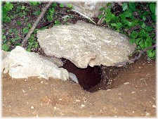
Foxes Have Holes
“Now when Jesus saw great multitudes about him, he gave commandment to depart unto the other side. And a certain scribe came, and said unto him, Master, I will follow thee whithersoever thou goest. And Jesus saith unto him, The foxes have holes, and the birds of the air have nests; but the Son of man hath not where to lay his head.” Matthew 8:18-20

Slide 7
Judas
“While Jesus was preparing the disciples for their ordination, one who had not been summoned urged his presence among them. It was Judas Iscariot, a man who professed to be a follower of Christ. He now came forward, soliciting a place in this inner circle of disciples. With great earnestness and apparent sincerity he declared, "Master, I will follow Thee whithersoever Thou goest." Jesus neither repulsed nor welcomed him, but uttered only the mournful words: "The foxes have holes, and the birds of the air have nests; but the Son of man hath not where to lay His head." Matt. 8:19, 20. Judas believed Jesus to be the Messiah; and by joining the apostles, he hoped to secure a high position in the new kingdom. This hope Jesus designed to cut off by the statement of His poverty.” DA, pgs. 293,294

Slide 8
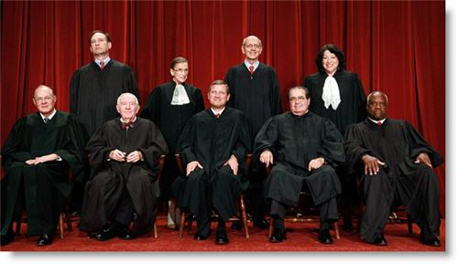
Judas was a Scribe
Their functions were to copy, read amend, explain, and protect the law. The scribe keeps record of work done and goods paid, of prices and costs, of profits and loss; he counts the cattle as they move to the slaughter, or corn as it is measured out in sale, he draws up contracts and wills, and makes out his master's income tax. The Scribes (Hakamin, learned) were not a sect but a profession; they were scholars learned in the law, who lectured on it in synagogues, taught it in schools, debated it in public and private, and applied it in judgment on specific cases.

Slide 9
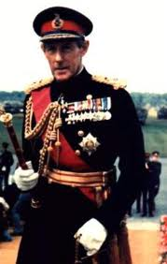
A Big Shot
“The disciples were anxious that Judas should become one of their number. He was of commanding appearance, a man of keen discernment and executive ability, and they commended him to Jesus as one who would greatly assist Him in His work. They were surprised that Jesus received him so coolly.” DA, pg. 294

Slide 10
Big Time
Judas was a high official in Ancient Adventism. He was an executive official of the General Conference. He commanded and demanded attention. People listened when he spoke. He was highly educated.
“Judas was highly regarded by the disciples, and had great influence over them. He himself had a high opinion of his own qualifications, and looked upon his brethren as greatly inferior to him in judgment and ability. They did not see their opportunities, he thought, and take advantage of circumstances. The church would never prosper with such shortsighted men as leaders.” DA, pg. 717

Slide 11
Wanted Something More
Judas saw the apostasy in Adventism. He knew there was more and knew that the independent Preacher from Galilee had the truth.
“Judas saw the sick, the lame, the blind, flock to Jesus from the towns and cities. He saw the dying laid at His feet. He witnessed the Saviour's mighty works in healing the sick, casting out devils, and raising the dead. He felt in his own person the evidence of Christ's power. He recognized the teaching of Christ as superior to all that he had ever heard. He loved the Great Teacher, and desired to be with Him. He felt a desire to be changed in character and life, and he hoped to experience this through connecting himself with Jesus. The Saviour did not repulse Judas. He gave him a place among the twelve. He trusted him to do the work of an evangelist. He endowed him with power to heal the sick and to cast out devils. But Judas did not come to the point of surrendering himself fully to Christ.” DA, pg. 717

Slide 12
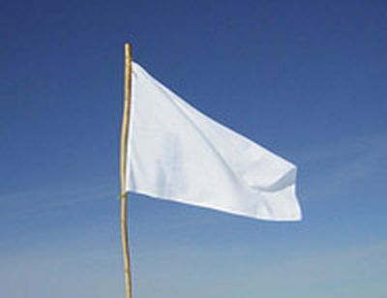
I Surrender All…??? Or Some??
“He did not give up his worldly ambition or his love of money. While he accepted the position of a minister of Christ, he did not bring himself under the divine molding. He felt that he could retain his own judgment and opinions, and he cultivated a disposition to criticize and accuse…Judas was blinded to his own weakness of character, and Christ placed him where he would have an opportunity to see and correct this. As treasurer for the disciples, he was called upon to provide for the needs of the little company, and to relieve the necessities of the poor.” DA, pg. 717

Slide 13
Love of Money
Judas had naturally a strong love for money; but he had not always been corrupt enough to do such a deed as this. He had fostered the evil spirit of avarice until it had become the ruling motive of his life. The love of mammon overbalanced his love for Christ. Through becoming the slave of one vice he gave himself to Satan, to be driven to any lengths in sin…Judas indulged his covetous disposition. The small sums that came into his hands were a continual temptation. Often when he did a little service for Christ, or devoted time to religious purposes, he paid himself out of this meager fund. In his own eyes these pretexts served to excuse his action; but in God's sight he was a thief.” DA, pgs. 716,718

Slide 14
Disagreed With Christ
“Christ's oft-repeated statement that His kingdom was not of this world offended Judas. He had marked out a line upon which he expected Christ to work. He had planned that John the Baptist should be delivered from prison. But lo, John was left to be beheaded. And Jesus, instead of asserting His royal right and avenging the death of John, retired with His disciples into a country place. Judas wanted more aggressive warfare…Notwithstanding the Saviour's own teaching, Judas was continually advancing the idea that Christ would reign as king in Jerusalem. At the feeding of the five thousand he tried to bring this about…” DA, pg. 718

Slide 15
The Turning Points
“Christ's discourse in the synagogue concerning the bread of life was the turning point in the history of Judas. He heard the words, "Except ye eat the flesh of the Son of man, and drink His blood, ye have no life in you." John 6:53. He saw that Christ was offering spiritual rather than worldly good. He regarded himself as farsighted, and thought he could see that Jesus would have no honor, and that He could bestow no high position upon His followers. He determined not to unite himself so closely to Christ but that he could draw away. He would watch. And he did watch.” DA, pg. 719
“When Mary anointed the Saviour's feet, Judas manifested his covetous disposition. At the reproof from Jesus his very spirit seemed turned to gall. Wounded pride and desire for revenge broke down the barriers, and the greed so long indulged held him in control. This will be the experience of everyone who persists in tampering with sin. The elements of depravity that are not resisted and overcome, respond to Satan's temptation, and the soul is led captive at his will.” DA. Pg. 720

Slide 16
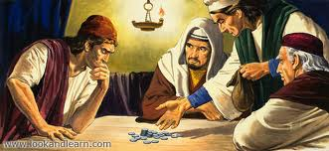
Where it Led!!!
“Verily I say unto you, Wheresoever this gospel shall be preached in the whole world, there shall also this, that this woman hath done, be told for a memorial of her. Then one of the twelve, called Judas Iscariot, went unto the chief priests, And said unto them, What will ye give me, and I will deliver him unto you? And they covenanted with him for thirty pieces of silver.
And from that time he sought opportunity to betray him.” Matthew 26:13-16

Slide 17
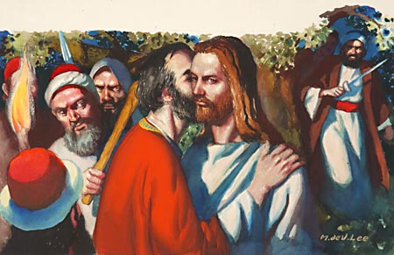
Where it Led!!!
“And while he yet spake, lo, Judas, one of the twelve, came, and with him a great multitude with swords and staves, from the chief priests and elders of the people. Now he that betrayed him gave them a sign, saying, Whomsoever I shall kiss, that same is he: hold him fast. And forthwith he came to Jesus, and said, Hail, master; and kissed him.” Matthew 26:47-49

Slide 18
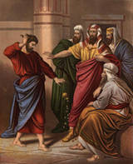
Where it Led!!!!!
“As the trial drew to a close, Judas could endure the torture of his guilty conscience no longer. Suddenly a hoarse voice rang through the hall, sending a thrill of terror to all hearts: He is innocent; spare Him, O Caiaphas! The tall form of Judas was now seen pressing through the startled throng. His face was pale and haggard, and great drops of sweat stood on his forehead. Rushing to the throne of judgment, he threw down before the high priest the pieces of silver that had been the price of his Lord's betrayal. Eagerly grasping the robe of Caiaphas, he implored him to release Jesus, declaring that He had done nothing worthy of death. Caiaphas angrily shook him off, but was confused, and knew not what to say. ” DA, pgs. 721,722

Slide 19
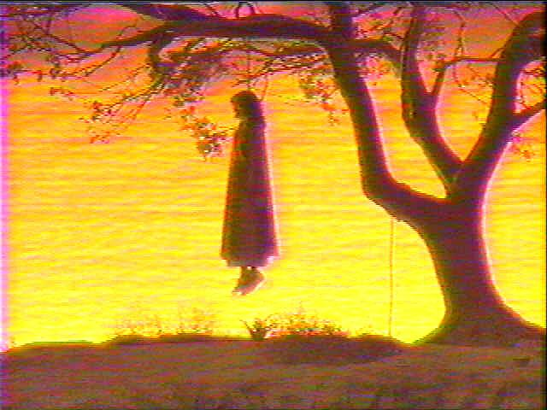
Where it Led!!!!
“Judas saw that his entreaties were in vain, and he rushed from the hall exclaiming, It is too late! It is too late! He felt that he could not live to see Jesus crucified, and in despair went out and hanged himself. Later that same day, on the road from Pilate's hall to Calvary, there came an interruption to the shouts and jeers of the wicked throng who were leading Jesus to the place of crucifixion. As they passed a retired spot, they saw at the foot of a lifeless tree, the body of Judas.” DA, pg. 722

Slide 20
Sad Ending!
“The history of Judas presents the sad ending of a life that might have been honored of God. Had Judas died before his last journey to Jerusalem he would have been regarded as a man worthy of a place among the twelve, and one who would be greatly missed. The abhorrence which has followed him through the centuries would not have existed but for the attributes revealed at the close of his history. But it was for a purpose that his character was laid open to the world. It was to be a warning to all who, like him, should betray sacred trusts.” DA, pg. 716

