Slide 1
The Circus
The Jesuits CFR

Slide 2
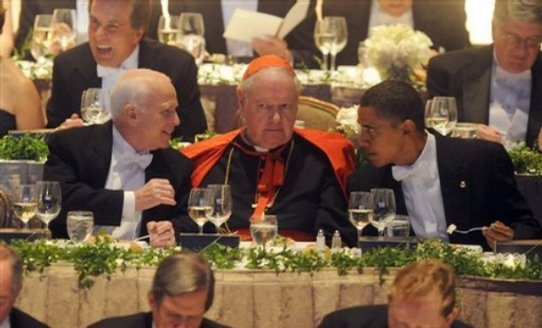
Welcome to the Party: 2008

Slide 3
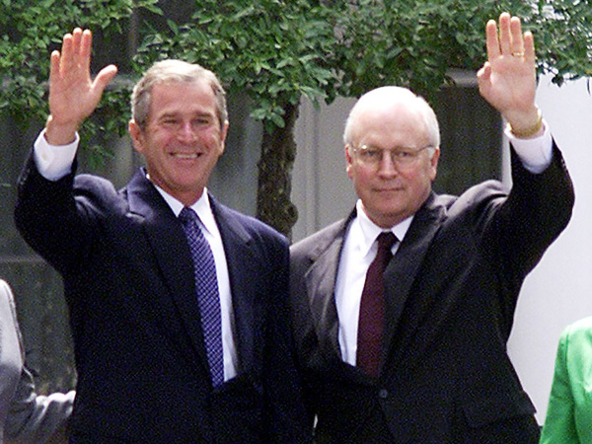
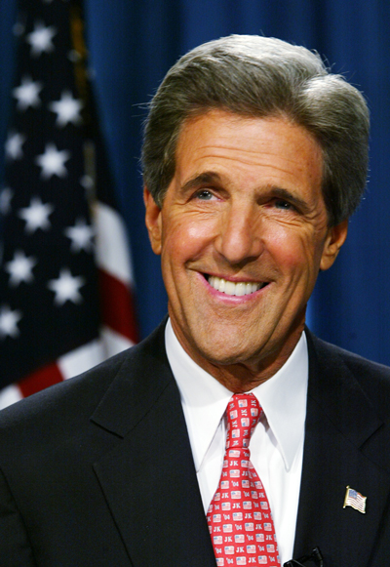
Who Do You Choose? 2004

Slide 4
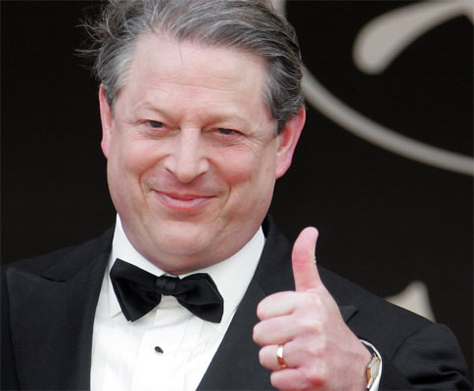
How About? 2000

Slide 5
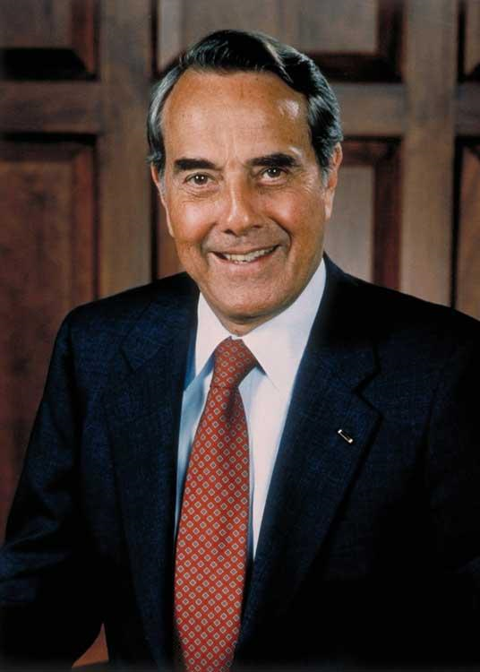
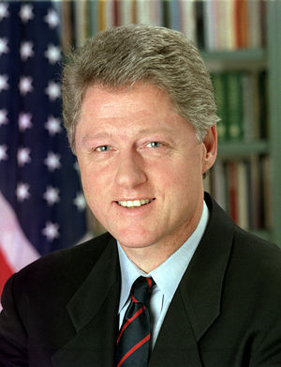
Do you remember? 1996

Slide 6
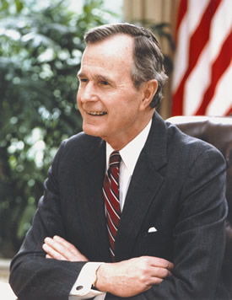
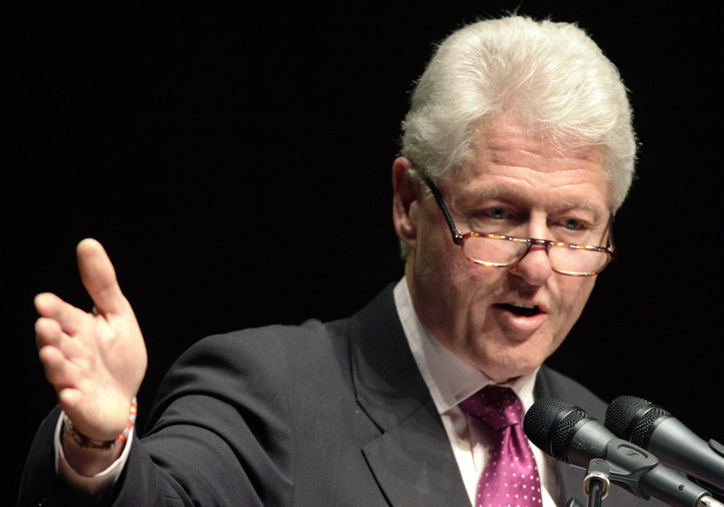
1992?

Slide 7
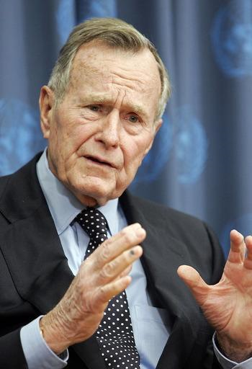
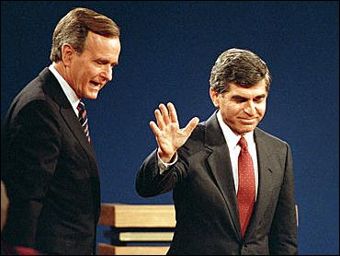
1988 Anyone?

Slide 8
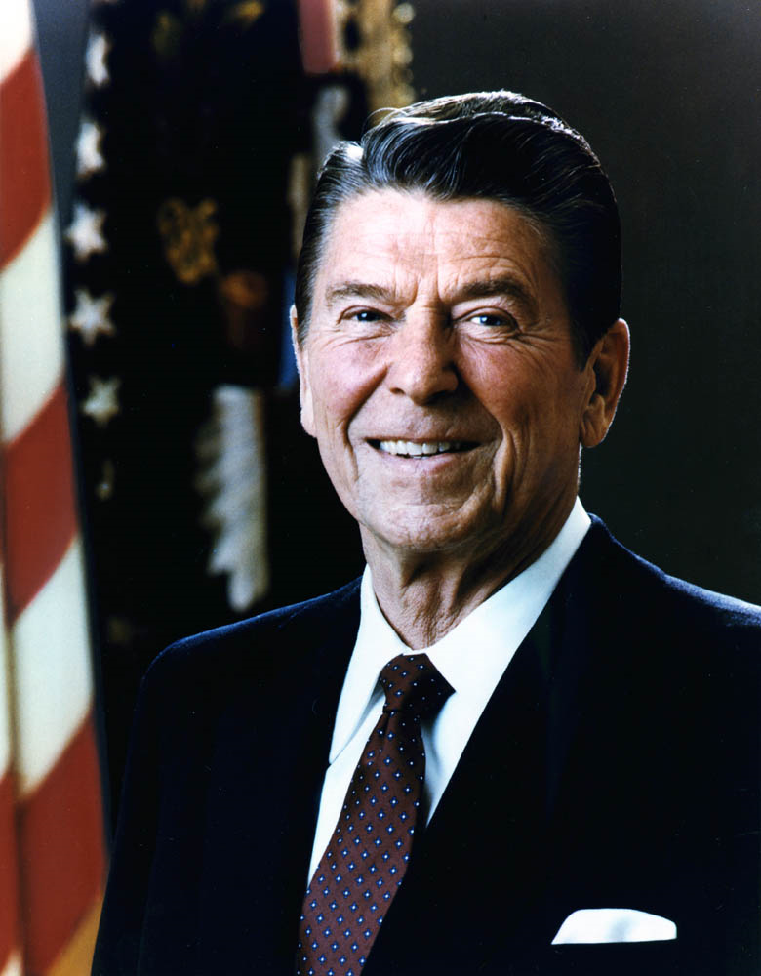
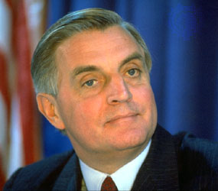
1984? 313 helpers!

Slide 9
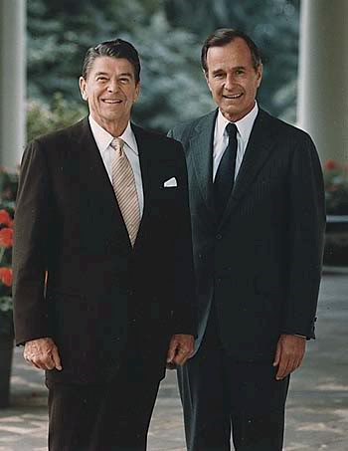
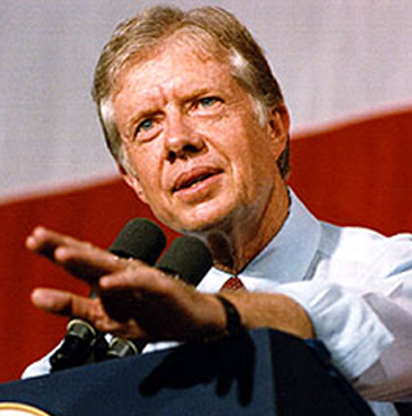
Long Ago-1980

Slide 10
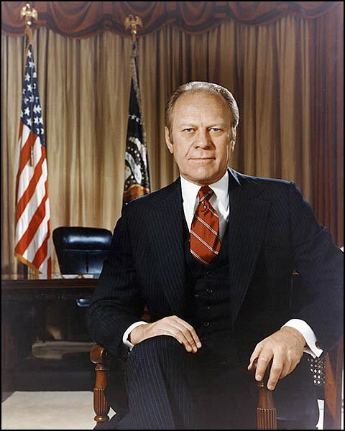
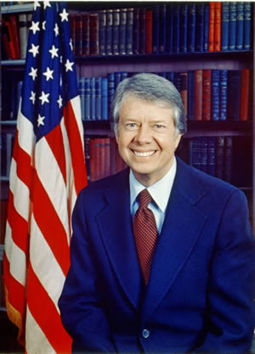
Can You Imagine? 1976

Slide 11
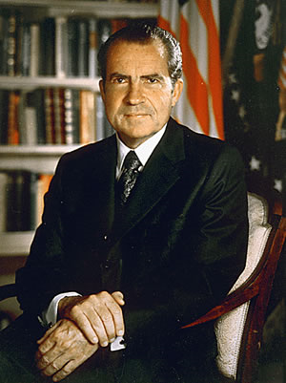
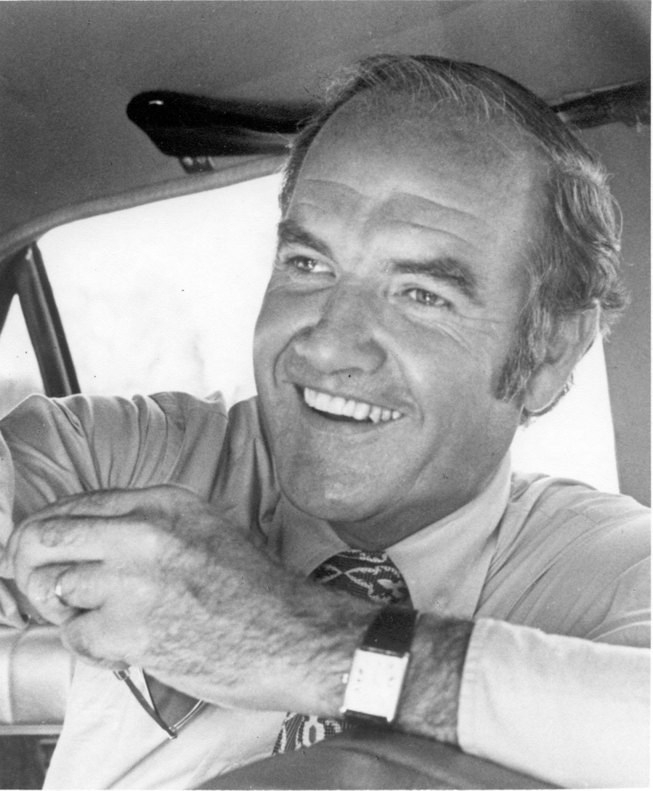
1972?

Slide 12
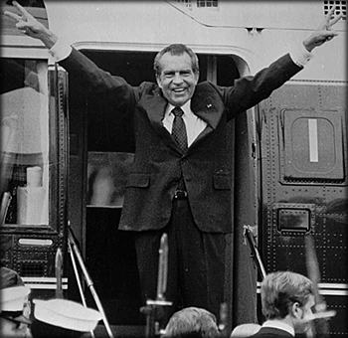
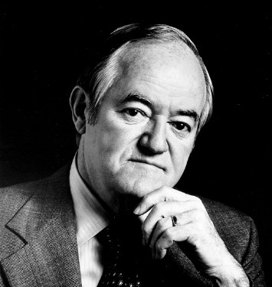
1968?

Slide 13
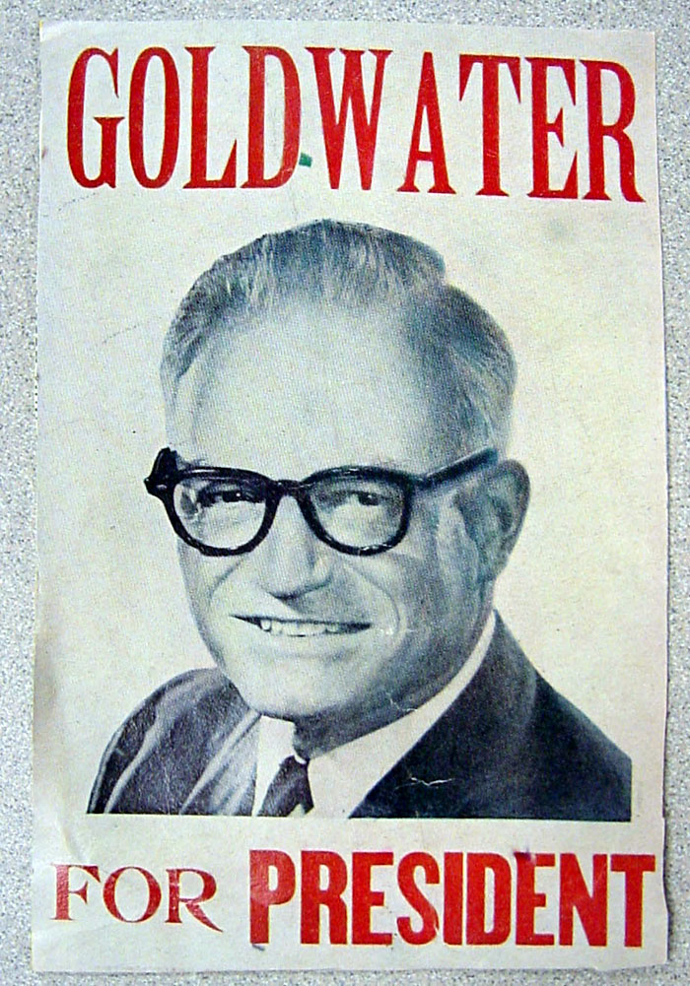
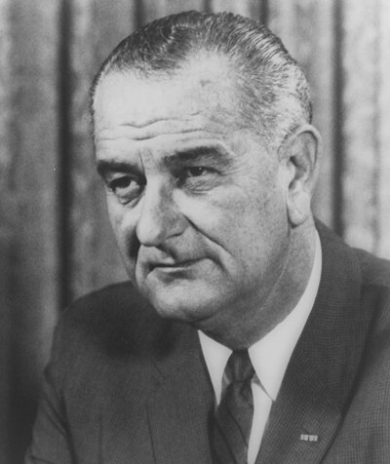
Do You See a Pattern Yet?

Slide 14
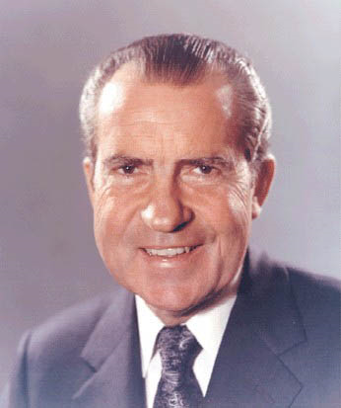
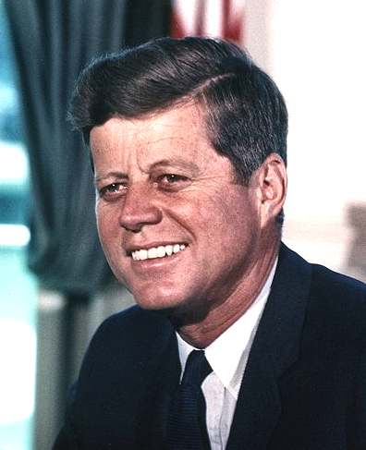
What do you know?

Slide 15
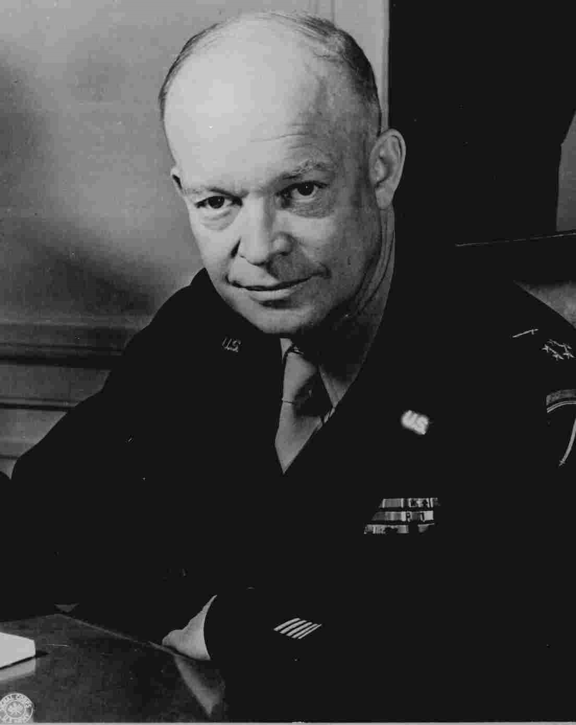
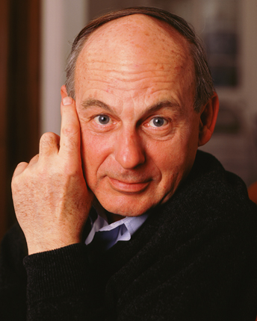
Oh,my! Eisenhower and Stevenson 1952 and 1956

Slide 16
Counsel on Foreign Relations
WASHINGTON – It started in 1952.
Nearly every person elected as president of the United States since then – and nearly every opponent – has belonged to a secretive, globalism-oriented organization known as the Council on Foreign Relations.
Some presidents and their challengers have belonged to additional clubs of internationalists – the Bilderberg Group and the Trilateral Commission. Running mates, too, more often than not have had ties to the groups.
That the groups exert enormous influence on public policy is indisputable. What is disputed is whether such groups are, as adherents and members argue, just discussion forums for movers and shakers, or, as critics have long alleged, secret societies shaping a new world order from behind the scenes. On that last point at least, no one could challenge the critics: All these groups operate in considerable secrecy, away from the scrutiny of the American public.

Slide 17
CFR Members
Regardless of how one characterizes them, the fact that virtually all presidents belong to the same secret clubs prompts the author of a new book to wonder if the 2008 election will also be a contest between globalist insiders. Judging from the list of frontrunners of each party, Daniel Estulin, author of "The True Story of the Bilderberg Group," may be on to something.
According to a variety of sources, the following presidential candidates are either members of one of the groups or have strong ties: Hillary Rodham Clinton, Rudy Giuliani, Mitt Romney, Barack Obama, John McCain, John Edwards, Fred Thompson, Joe Biden, Chris Dodd and Bill Richardson.
Mike Huckabee, though not a member, spoke to the CFR in September. Since then, his political star has risen to the point that he has become a top-tier candidate.
So often throughout recent history it has been the case.
Ever since Democrat Adlai Stevenson challenged Republican Dwight D. Eisenhower in 1952 and 1956, the odds have significantly favored those with membership in the elite groups.

Slide 18
Where Does it Stop?
In 1960, both John F. Kennedy and Richard M. Nixon were members. In 1964, President Lyndon B. Johnson was not a member. Neither was his opponent, Barry Goldwater. But Johnson had already staffed his administration with plenty of insiders. In 1968, it was Nixon versus club member Hubert H. Humphrey. In 1972, it was Nixon again against Democratic Party CFR member George McGovern.
In 1976, it was CFR Republican Gerald Ford losing to CFR Democrat Jimmy Carter.
In 1980, Ronald Reagan was not a member, but his running mate, George H.W. Bush, was. So were both of his opponents – Carter and independent John Anderson. Assuming office, however, Reagan quickly named 313 CFR members to his team.

Slide 19
Amazing!
In 1984, another CFR member, Walter Mondale, was nominated by the Democratic Party to challenge Reagan. In 1988, CFR member Bush took on CFR member Michael Dukakis.
In 1992, Bush was challenged by an obscure governor from Arkansas, Bill Clinton, who won the "trifecta" by being a member of the CFR, Trlateral Commission and Bilderberg Group. He was also a Rhodes scholar – another favored credential of the worldwide elite.
In 1996, Clinton was challenged by CFR member Bob Dole. In 2000, CFR member Al Gore ran against non-member George W. Bush, but his running mate, Dick Cheney, was.
In 2004, Bush was challenged by CFR member John Kerry.
"David Rockefeller, whose family financed the CFR, is a common denominator among these parallel groups," writes Estulin. "Not only is he the CFR chairman emeritus, but he also continues to provide financial and personal support to the TC, CFR and Bilderberg Group."

Slide 20
There is More!
“To guard against exposure, and to mold public opinion, as far back as 1915 the powerful men in America working in world government set out to control the news media. They accomplished this by employing 12 leading men in the newspaper field to find out what was necessary to control the general policy of the daily press throughout the country. It was decided that this could be accomplished by purchasing control of 25 of the greatest papers. Thus, while the Council on Foreign Relations was working to remake the world, for the first 35 years of its existence, no feature article about it appeared in the news media. It was not until the 1960s that this near total control of the media began to be circumvented. For decades many top officials of the United States Government have been members of the Council on Foreign Relations. This includes many presidents, fourteen secretaries of state, fourteen treasury secretaries, eleven defense secretaries, and scores of other federal department heads. – Dee Zahner, The Secret Side of History, LTAA Communications Publishers, p. 91.

Slide 21
Where did this monster begin?
The earliest origin of the Council stemmed from a working fellowship of about 150 scholars, called "The Inquiry," tasked to brief President Woodrow Wilson about options for the postwar world when Germany was defeated. Through 1917–1918, this academic band, including Wilson's closest adviser and long-time friend "Colonel" Edward M. House, as well as Walter Lippmann, gathered at 155th Street and Broadway at the Harold Pratt House in New York City, to assemble the strategy for the postwar world. The team produced more than 2,000 documents detailing and analyzing the political, economic, and social facts globally that would be helpful for Wilson in the peace talks. Their reports formed the basis for the Fourteen Points, which outlined Wilson's strategy for peace after war's end.^{[6]}
"The money to found the CFR came in part from J.P. Morgan, John D. Rockefeller, Bernard Baruch, Otto Kahn, Jacob Schiff and Paul Warburg".
This article was found at: www.biblebelievers.org.au/ and expands on the CFR's beginnings as excerpted from Quigley's book Tragedy and Hope .
- Jackie - February 8th, 2001
The CFR began toward the end of World War 1. The key movers were Edward Mandel House, J.P. Morgan, and the Rockefeller’s.

Slide 22
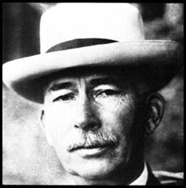
Edward Mandel House
House was also intimate with the power centers of money and power in Europe.
“House had close contacts with both J.P. Morgan and the old banking families of Europe.” — G. Edward Griffin, The Creature from Jekyll Island, American Opinion Publishing, p. 239. The old banking families of Europe were the Rothschild's.
“Aware that the Rothschild's are an important Jewish family, I looked them up in Encyclopedia Judaica and discovered that they bear the title ‘Guardians of the Vatican Treasury’…. The appointment of Rothschild gave the black papacy absolute financial privacy and secrecy. Who would ever search a family of orthodox Jews for the key to the wealth of the Roman Catholic Church?” — F. Tupper Saussy, Rulers of Evil, Harper Collins, page 160, 161

Slide 23
House/Rothschild/Jesuit Consortium
House used Jesuit/Rothschild/Morgan/ Rockefeller money to create the Counsel on Foreign Relations.
“And it was Edward M. House, under the watchful eye of Jacob Schiff, who was under the watchful eye of the HEAD of this international conspiracy {the House of Rothschild of London and Paris}, that established in 1921 what their earlier comrades established, to overthrow the governments of France and Russia. Called the Jacobin Clubs in France in the 18th century, this aristocratic revolutionary movement today in America is called THE COUNCIL ON FOREIGN RELATIONS, INC. and its offshoot is the TRILATERAL COMMISSION. The Council on Foreign Relations, Inc. is the political side of the Illuminati today. They have produced Congressmen, Senators and even Presidents, that they have used Senators and even Presidents, that they have used to pass laws that have little by little led America into becoming a Socialist country.” Enemy Unmasked, pgs. 80,81
The agents of the Jesuits created the Council on Foreign Relations. The locations would be in the two most powerful Roman Catholic Dioceses in the American Empire, New York and Chicago. The CFR would control the Empire’s finance, government, industry, religion, education, and press. No one could be elected to the Presidency of the United States without the Council’s consent, as the office would be a tool for the Archbishop of New York subject to ‘the Vicar of Christ’ [the pope] in Rome. (One of the founders of the CFR also aided in the creation of the Federal Reserve Bank. He was the ‘holy monk’, a Shriner Freemason and agent of the Jesuit General. Edward M. House.)– Eric Phelps, VA, p. 464, 465.

Slide 24
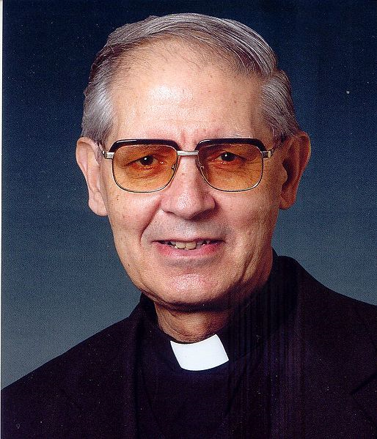
Pick Presidents/Control Press
The top political leader of the world would come under the control of the Jesuit general and would do his bidding! Not only presidents, but all of the major media outlets would be controlled by Rome as well! And we are just tapping the surface! Justices, Congressmen, business leaders are all in this octopus of wickedness!

