Slide 1
Day of Atonement, pt. 3
A Legal Base

Slide 2
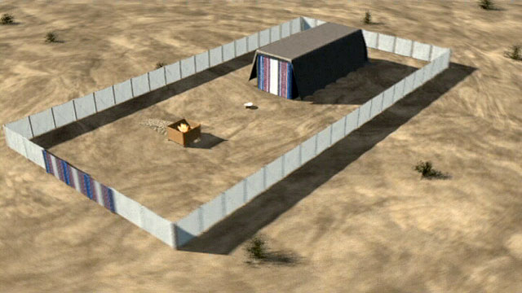
The Gospel in Pictures
As a loving Father would try to make things so simple for his children, illustrating with clarity exactly what he wanted his children to understand, so has the God of heaven tried to make plain to us the great truths of redemption. Because of idolatry and blindness in Egypt, God brought the Israelites to Mt. Sinai that they may understand the great truths of redemption.
“Wherefore then serveth the law? It was added because of transgressions, till the seed should come to whom the promise was made; and it was ordained by angels in the hand of a mediator.” Galatians 3:19

Slide 3
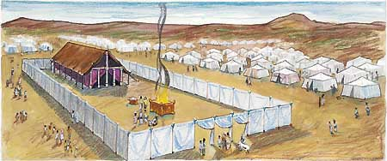
For Understanding
To grasp the plan of redemption, God illustrated it through the sanctuary and placed His awesome plan on a perfectly legal base that anyone could recognize in practical law. The center pieces of His plan were built around His unchanging law, sacrifice, and mediation.

Slide 4
The Service
“And if any one of the common people sin through ignorance, while he doeth somewhat against any of the commandments of the LORD concerning things which ought not to be done, and be guilty; Or if his sin, which he hath sinned, come to his knowledge: then he shall bring his offering, a kid of the goats, a female without blemish, for his sin which he hath sinned. And he shall lay his hand upon the head of the sin offering, and slay the sin offering in the place of the burnt offering. And the priest shall take of the blood thereof with his finger, and put it upon the horns of the altar of burnt offering, and shall pour out all the blood thereof at the bottom of the altar. And he shall take away all the fat thereof, as the fat is taken away from off the sacrifice of peace offerings; and the priest shall burn it upon the altar for a sweet savour unto the LORD; and the priest shall make an atonement for him, and it shall be forgiven him.” Leviticus 4:27-31

Slide 5
The Keys
1. The law
2. sacrifice
3. mediation
The law reveals sin. It doesn’t save; it points to the remedy for sin. “Wherefore the law was our schoolmaster to bring us unto Christ, that we might be justified by faith.” Galatians 3:24
The sacrifice made forgiveness possible, BUT DID NOT complete the plan of salvation.
The high priest mediated the blood AND THEN forgiveness and atonement was complete!
“The intercession of Christ in man's behalf in the sanctuary above is as essential to the plan of salvation as was His death upon the cross. By His death He began that work which after His resurrection He ascended to complete in heaven. We must by faith enter within the veil, "whither the forerunner is for us entered." Hebrews 6:20. There the light from the cross of Calvary is reflected. There we may gain a clearer insight into the mysteries of redemption. The salvation of man is accomplished at an infinite expense to heaven; the sacrifice made is equal to the broadest demands of the broken law of God. Jesus has opened the way to the Father's throne, and through His mediation the sincere desire of all who come to Him in faith may be presented before God.” GC. Pg. 489

Slide 6
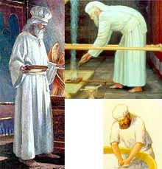
Christ Offers Himself
The plan of redemption was not finished at the cross. As awesome as was the death of Christ for man’s sins, this didn’t complete the redemption story just as the sacrifice of the lamb in the Hebrew sanctuary didn’t complete the plan either! The sacrifice complete; the priest must now apply the blood! Everything must be done legally and in order! The plan of redemption must be placed on solid, legal footing!

Slide 7
The Devil Attacked it!
“By His life and His death, Christ proved that God's justice did not destroy His mercy, but that sin could be forgiven, and that the law is righteous, and can be perfectly obeyed. Satan's charges were refuted. God had given man unmistakable evidence of His love.
Another deception was now to be brought forward. Satan declared that mercy destroyed justice, that the death of Christ abrogated the Father's law. Had it been possible for the law to be changed or abrogated, then Christ need not have died. But to abrogate the law would be to immortalize transgression, and place the world under Satan's control. It was because the law was changeless, because man could be saved only through obedience to its precepts, that Jesus was lifted up on the cross. Yet the very means by which Christ established the law Satan represented as destroying it. Here will come the last conflict of the great controversy between Christ and Satan.” DA, pgs. 762,763

Slide 8
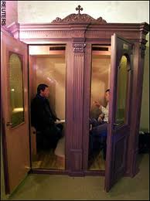
Someone Would Try to Stop it!
Christ paid the full penalty for man’s sin and the law was shown to be unchangeable. Christ would now apply His blood on man’s behalf. This had to be perverted and confused. “Yea, he magnified himself even to the prince of the host, and by him the daily sacrifice was taken away, and the place of his sanctuary was cast down.” Daniel 8:11

Slide 9
Confuse the Sanctuary Service
“And arms shall stand on his part, and they shall pollute the sanctuary of strength, and shall take away the daily sacrifice, and they shall place the abomination that maketh desolate.” Daniel 11:31
“Let no man deceive you by any means: for that day shall not come, except there come a falling away first, and that man of sin be revealed, the son of perdition; Who opposeth and exalteth himself above all that is called God, or that is worshipped; so that he as God sitteth in the temple of God, shewing himself that he is God.” 2 Thessalonians 2:3,4
“And he opened his mouth in blasphemy against God, to blaspheme his name, and his tabernacle, and them that dwell in heaven.” Revelation 13:6

Slide 10
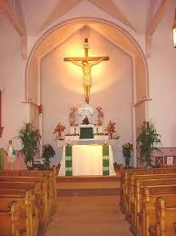
The List goes on and on and on….
1. pilgrimages, works bring salvation.
2. the law has been changed because it was faulty.
3. the priest forgives in the confessional.
4. exalt the cross and don’t have a clue what Christ is doing now.
The beauty of the sanctuary is eroded and people have no idea how to be saved; how to find peace with God.

Slide 11
The Beauty of it All
When we come to God and confess our sins, asking for forgiveness in the name of Jesus Christ, the throne of the universe is built on this awesome truth that God will willingly and absolutely forgive. A human being, loaded with guilt and pain is forgiven. “And this is the record, that God hath given to us eternal life, and this life is in his Son. He that hath the Son hath life; and he that hath not the Son of God hath not life.” 1 John 5:11,12
Now, the confusion begins!!

Slide 12
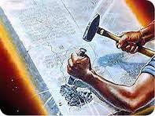
The Options
1. Once we accept Christ, we are saved-eternal security.
2. Because we accept Christ, it shows that we are predestined to be saved-predestination.
3. Because God gave so much, He won’t allow anyone to be lost-universalism.
4. Everything was done at the cross, accept it, and you are saved-the New Theology.
5. The law of God has been done away with it, nothing to worry about-antinomianism

Slide 13
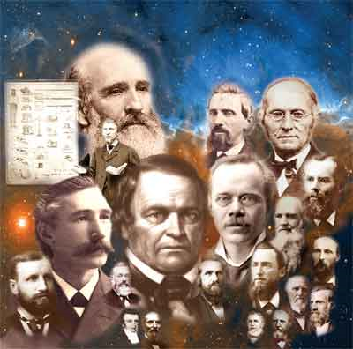
An Alternative
The brilliant and great minds have struggled with what happens after a person has accepted Christ. Luther and Calvin gave us predestination; the Baptists gave us once saved always saved, the evangelicals say atonement was finished at the cross, and the new theology says ‘just accept what Christ did 2,000 years ago and you are saved.’ And some farmers from the northeastern part of America gave us the only logical and legal plan by which God could save mankind: the Investigative Judgment!

Slide 14
Discovery of Long Buried Truth!
The investigative judgment is the only logical, legal, and lawful answer to the plan of salvation. God grants legal forgiveness for anyone who comes to Him. However, God also realizes that people can change their mind after accepting Him as their Savior. He therefore enters, as Western law defines it, an interlocutory judgment on behalf of those who have accepted Him. When we accept Christ as our Savior, this ices the fact that we will come up in the judgment. “For the time [is come] that judgment must begin at the house of God: and if [it] first [begin] at us, what shall the end [be] of them that obey not the gospel of God?” 1 Peter 4:17
This entitles a person everything God has promised, but also takes note of one’s free choice. For those at the end of their probationary time, who are still choosing Christ as their Savior and Lord, they will be granted everything to which the plan of salvation entitles them; even eternal life!

Slide 15

The Devil Hoped against Hope!
Desperately, the devil had hoped that no one would be aware of the judgment and its beginnings. However, this small group of farmers studied and saw the application of the words of John to the church of Philadelphia, “These things saith he that is holy, he that is true, he that hath the key of David, he that openeth, and no man shutteth; and shutteth, and no man openeth. I know thy works: behold, I have set before thee an open door, and no man can shut it: for thou hast a little strength, and hast kept my word, and hast not denied my name.” Revelation 3:7,8

Slide 16
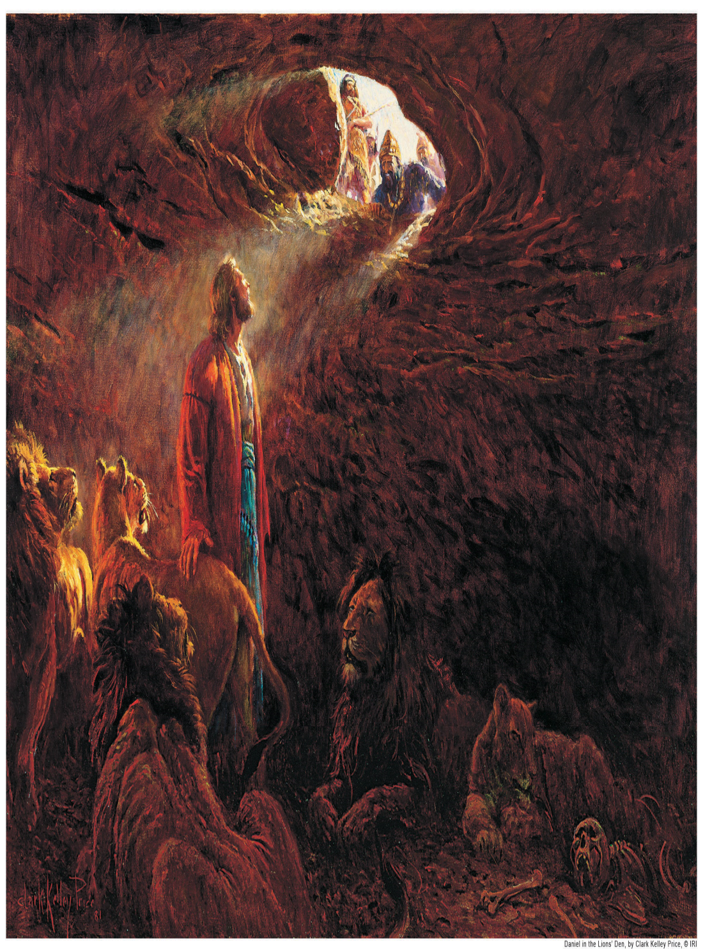
Restored Right on Time!
Everything the devil had hoped would be forever destroyed, as far as the great truths of the sanctuary and the investigative judgment, were restored and proclaimed by these farmers just as Daniel had been told in Daniel 8!

Slide 17
In 2,300 Years
“And out of one of them came forth a little horn, which waxed exceeding great, toward the south, and toward the east, and toward the pleasant land. And it waxed great, even to the host of heaven; and it cast down some of the host and of the stars to the ground, and stamped upon them. Yea, he magnified himself even to the prince of the host, and by him the daily sacrifice was taken away, and the place of his sanctuary was cast down. And a host was given him against the daily sacrifice by reason of transgression, and it cast down the truth to the ground; and it practiced, and prospered. Then I heard one saint speaking, and another saint said unto that certain saint which spake, How long shall be the vision concerning the daily sacrifice, and the transgression of desolation, to give both the sanctuary and the host to be trodden under foot? And he said unto me, Unto two thousand and three hundred days; then shall the sanctuary be cleansed.” Daniel 8:14

Slide 18
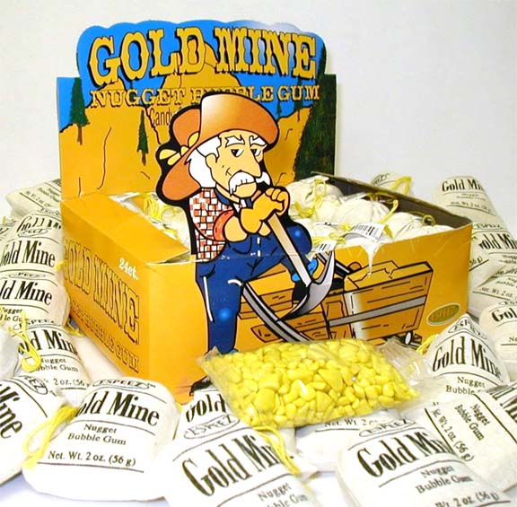
The Temple was Opened in Heaven!
The likes of James White, Hiram Edson, J.N. Andrews, Brother Pierce, Joseph Bates, O. R. L. Crozier, to name a few, were the ones used of heaven to place the plan of salvation on a perfectly logical and legal base and to make so much clearer the story of redemption. Where so many others had failed and faltered in their understanding, these men succeeded! “And the temple of God was opened in heaven, and there was seen in his temple the ark of his testament: and there were lightnings, and voices, and thunderings, and an earthquake, and great hail.“ Revelation 11:19

Slide 19
Confirmed by a ‘Voice Among Us’
“But clearer light came with the investigation of the sanctuary question. They now saw that they were correct in believing that the end of the 2300 days in 1844 marked an important crisis. But while it was true that that door of hope and mercy by which men had for eighteen hundred years found access to God, was closed, another door was opened, and forgiveness of sins was offered to men through the intercession of Christ in the most holy. One part of His ministration had closed, only to give place to another. There was still an "open door" to the heavenly sanctuary, where Christ was ministering in the sinner's behalf.
Now was seen the application of those words of Christ in the Revelation, addressed to the church at this very time: "These things saith He that is holy, He that is true, He that hath the key of David, He that openeth, and no man shutteth; and shutteth, and no man openeth; I know thy works: behold, I have set before thee an open door, and no man can shut it." Revelation 3:7, 8.
It is those who by faith follow Jesus in the great work of the atonement who receive the benefits of His mediation in their behalf, while those who reject the light which brings to view this work of ministration are not benefited thereby.” GC., pgs. 429,430

