Slide 1
Jesus Life, pt. 8 ‘Temptation’

Slide 2
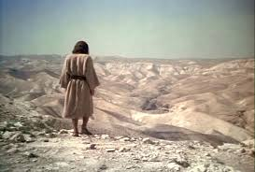
Following the baptism, the Bible says “Then was Jesus led up of the Spirit into the wilderness to be tempted of the devil.” Matthew 4:1
Jesus was led to be tempted; we just walk right into temptation. We invite it; we covet it!!!

Slide 3
Mighty Issues at Stake!!
“Mighty issues for the world were at stake in the conflict between the Prince of light and the leader of the kingdom of darkness. After tempting man to sin, Satan claimed the earth as his, and styled himself the prince of this world. Having conformed to his own nature the father and mother of our race, he thought to establish here his empire. He declared that men had chosen him as their sovereign. Through his control of men, he held dominion over the world. Christ had come to disprove Satan's claim. As the Son of man, Christ would stand loyal to God. Thus it would be shown that Satan had not gained complete control of the human race, and that his claim to the world was false. All who desired deliverance from his power would be set free. The dominion that Adam had lost through sin would be recovered.” DA, pg. 114

Slide 4
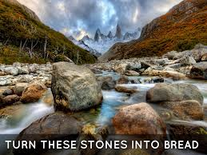
Temptation #1
“And when the tempter came to him, he said, If thou be the Son of God, command that these stones be made bread. But he answered and said, It is written, Man shall not live by bread alone, but by every word that proceedeth out of the mouth of God.” Matthew 4:3,4

Slide 5
If Thou Be the Son of God!
“The words from heaven, “This is My beloved Son, in whom I am well pleased” (Matthew 3:17), were still sounding in the ears of Satan. But he was determined to make Christ disbelieve this testimony. The word of God was Christ's assurance of His divine mission. He had come to live as a man among men, and it was the word that declared His connection with heaven. It was Satan's purpose to cause Him to doubt that word. If Christ's confidence in God could be shaken, Satan knew that the victory in the whole controversy would be his. He could overcome Jesus. He hoped that under the force of despondency and extreme hunger, Christ would lose faith in His Father, and work a miracle in His own behalf. Had He done this, the plan of salvation would have been broken. When Satan and the Son of God first met in conflict, Christ was the commander of the heavenly hosts; and Satan, the leader of revolt in heaven, was cast out. Now their condition is apparently reversed, and Satan makes the most of his supposed advantage. One of the most powerful of the angels, he says, has been banished from heaven. The appearance of Jesus indicates that He is that fallen angel, forsaken by God, and deserted by man. A divine being would be able to sustain his claim by working a miracle; “if Thou be the Son of God, command this stone that it be made bread.” Such an act of creative power, urges the tempter, would be conclusive evidence of divinity. It would bring the controversy to an end.” Da, pg. 119

Slide 6
“Satan saw that he must either conquer or be conquered. The issues of the conflict involved too much to be entrusted to his confederate angels. He must personally conduct the warfare. All the energies of apostasy were rallied against the Son of God. Christ was made the mark of every weapon of hell. Many look on this conflict between Christ and Satan as having no special bearing on their own life; and for them it has little interest. But within the domain of every human heart this controversy is repeated. Never does one leave the ranks of evil for the service of God without encountering the assaults of Satan. The enticements which Christ resisted were those that we find it so difficult to withstand. They were urged upon Him in as much greater degree as His character is superior to ours.” DA, pg. 116

Slide 7
He Could have Failed!!!
“Satan had pointed to Adam's sin as proof that God's law was unjust, and could not be obeyed. In our humanity, Christ was to redeem Adam's failure. But when Adam was assailed by the tempter, none of the effects of sin were upon him. He stood in the strength of perfect manhood, possessing the full vigor of mind and body. He was surrounded with the glories of Eden, and was in daily communion with heavenly beings. It was not thus with Jesus when He entered the wilderness to cope with Satan. For four thousand years the race had been decreasing in physical strength, in mental power, and in moral worth; and Christ took upon Him the infirmities of degenerate humanity. Only thus could He rescue man from the lowest depths of his degradation. Many claim that it was impossible for Christ to be overcome by temptation. Then He could not have been placed in Adam's position; He could not have gained the victory that Adam failed to gain. If we have in any sense a more trying conflict than had Christ, then He would not be able to succor us. But our Saviour took humanity, with all its liabilities.” DA, pg. 117

Slide 8
Christ took upon Himself our nature and went to war with the devil in our flesh! “For verily he took not on him the nature of angels; but he took on him the seed of Abraham. Wherefore in all things it behoved him to be made like unto his brethren, that he might be a merciful and faithful high priest in things pertaining to God, to make reconciliation for the sins of the people.” Hebrews 2:16,17

Slide 9
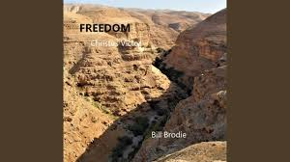
Christ could have failed in the wilderness. The plan of salvation hung in the balances. Christ was victorious! So can we be!!!
“ It is not His will that we should be placed at a disadvantage in the conflict with Satan. He would not have us intimidated and discouraged by the assaults of the serpent. “Be of good cheer,” He says; “I have overcome the world.” DA, pg. 122

Slide 10
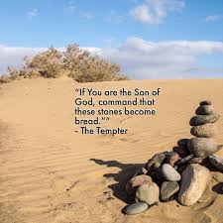
Much More Difficult
Jesus’ temptations were so much more difficult than others. We could never turn stones in to bread. But, Jesus could. He could have used His divine power for His benefit and destroyed the plan of salvation! Jesus relied solely on that which we must rely- It is written!

Slide 11
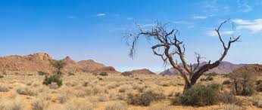
Wilderness
“Many claim that it was impossible for Christ to be overcome by temptation. Then He could not have been placed in Adam's position; He could not have gained the victory that Adam failed to gain. If we have in any sense a more trying conflict than had Christ, then He would not be able to succor us. But our Savior took humanity, with all its liabilities. He took the nature of man, with the possibility of yielding to temptation. We have nothing to bear which He has not endured.” DA, pg. 117

Slide 12
It is Written!
“Jesus met Satan with the words of Scripture. “It is written,” He said. In every temptation the weapon of His warfare was the word of God. Satan demanded of Christ a miracle as a sign of His divinity. But that which is greater than all miracles, a firm reliance upon a “Thus saith the Lord,” was a sign that could not be controverted. So long as Christ held to this position, the tempter could gain no advantage.” DA, pg. 120

Slide 13
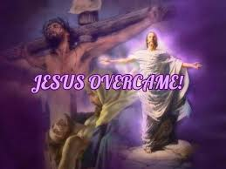
“From the time of Adam to that of Christ, self-indulgence had increased the power of the appetites and passions, until they had almost unlimited control. Thus men had become debased and diseased, and of themselves it was impossible for them to overcome. In man's behalf, Christ conquered by enduring the severest test. For our sake He exercised a self-control stronger than hunger or death. And in this first victory were involved other issues that enter into all our conflicts with the powers of darkness.” DA, pg. 117

Slide 14
“The prince of this world cometh,” said Jesus, “and hath nothing in Me.” John 14:30. There was in Him nothing that responded to Satan's sophistry. He did not consent to sin. Not even by a thought did He yield to temptation. So it may be with us. Christ's humanity was united with divinity; He was fitted for the conflict by the indwelling of the Holy Spirit. And He came to make us partakers of the divine nature. So long as we are united to Him by faith, sin has no more dominion over us. God reaches for the hand of faith in us to direct it to lay fast hold upon the divinity of Christ, that we may attain to perfection of character. And how this is accomplished, Christ has shown us. By what means did He overcome in the conflict with Satan? By the word of God. Only by the word could He resist temptation. “It is written,” He said. And unto us are given “exceeding great and precious promises: that by these ye might be partakers of the divine nature, having escaped the corruption that is in the world through lust.” 2 Peter 1:4. Every promise in God's word is ours. “By every word that proceedeth out of the mouth of God” are we to live.

Slide 15
We Can Overcome!
When assailed by temptation, look not to circumstances or to the weakness of self, but to the power of the word. All its strength is yours. “Thy word,” says the psalmist, “have I hid in mine heart, that I might not sin against Thee.” “By the word of Thy lips I have kept me from the paths of the destroyer.” Psalm 119:11; 17:4.” DA, pg. 123

Slide 16
Presumption
“Then the devil taketh him up into the holy city, and setteth him on a pinnacle of the temple, And saith unto him, If thou be the Son of God, cast thyself down: for it is written, He shall give his angels charge concerning thee: and in their hands they shall bear thee up, lest at any time thou dash thy foot against a stone. Jesus said unto him, It is written again, Thou shalt not tempt the Lord thy God.” Matthew 4:5-7

Slide 17
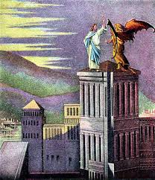
Taking God for Granted!
“The tempter thought to take advantage of Christ's humanity, and urge Him to presumption.” DA, pg. 125
Presumption is claiming God’s favor and protection while living in known sin. “Keep back thy servant also from presumptuous sins; let them not have dominion over me: then shall I be upright, and I shall be innocent from the great transgression.” Ps. 19:13

Slide 18
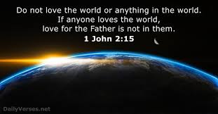
Love of the World!

