Slide 1
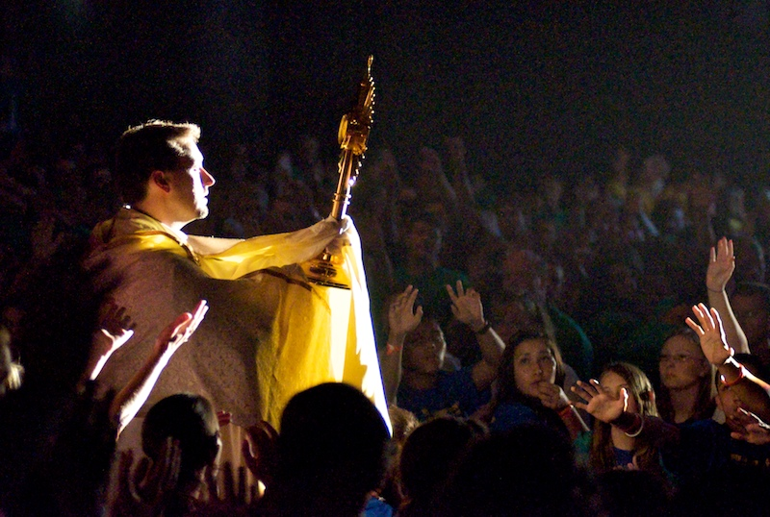
Catholics are to treat the Eucharist as Christ after it is blessed by the Priest…
“If any one shall deny that the body and blood, together with the soul and divinity of our Lord Jesus Christ, and therefore entire Christ, are truly, really and substantially contained in the sacrament of the most Holy Eucharist; and say that He is only in it as a sign, or in a figure—let him be accursed!”—Canon 1, Council of Trent 1563, Confirmed in Vatican II, 1963

Slide 2
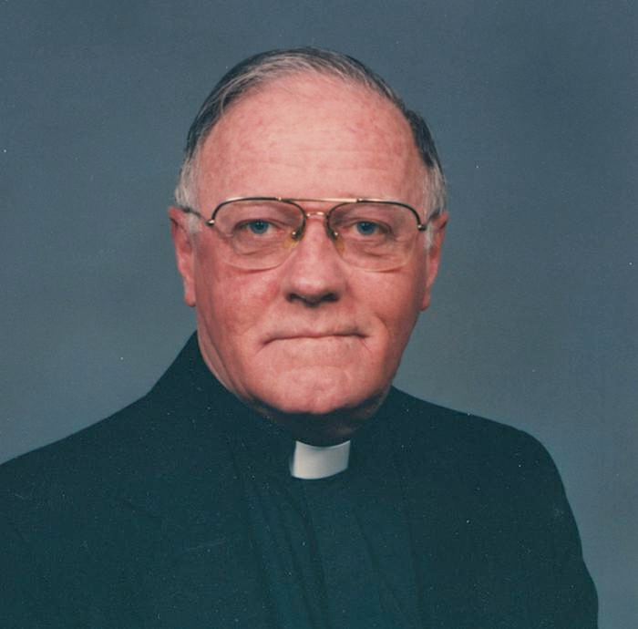
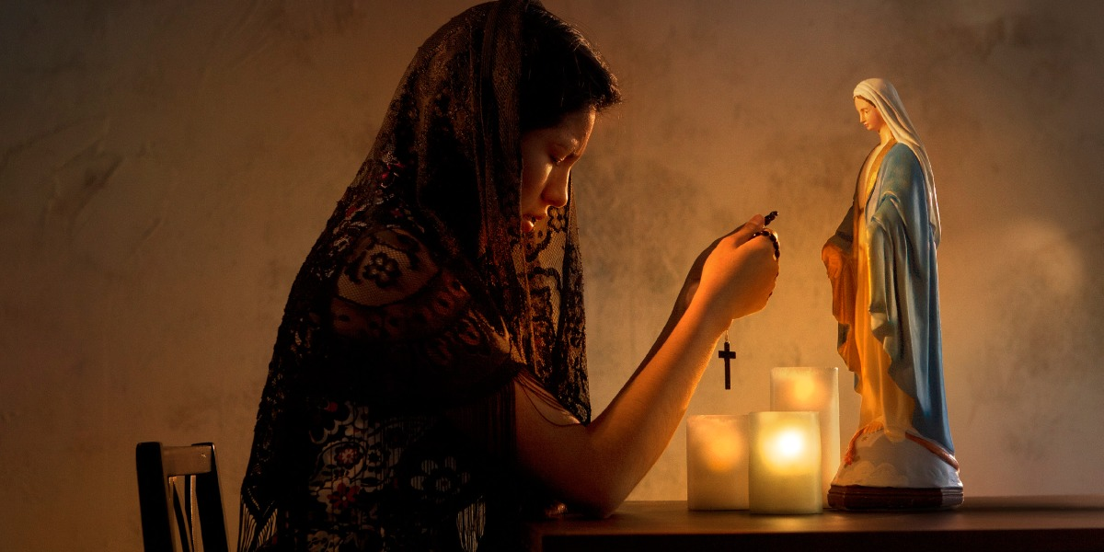
Contradiction to Scriptures
Catholic Church Scripture
Call priest “Father” “And call no man your father upon the earth: for one is your Father, which is in heaven.”— Matt 23:9
Prayers to saints “And when they shall say unto you, Seek unto them that have familiar spirits, and unto wizards that peep and that mutter: should not a people seek unto their God? for the living to the dead?”—Is. 8:19

Slide 3
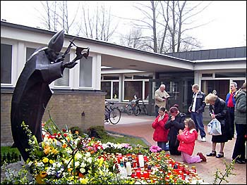
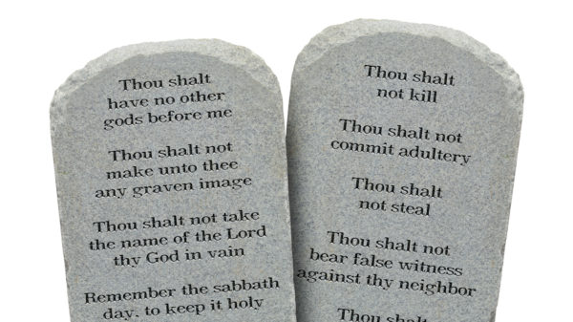

Slide 4
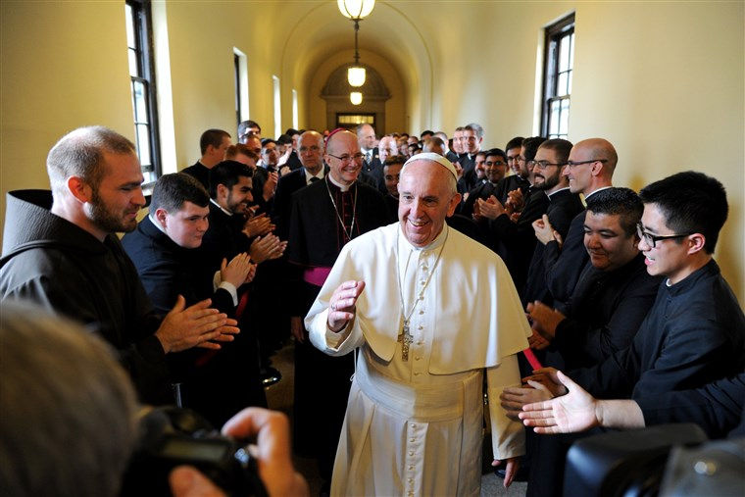
Why the Priesthood????

Slide 5
The Bible Says No More Priesthood….
Heb. 8:4-13 “For if he were on earth, he should not be a priest, seeing that there are priests that offer gifts according to the law: Who serve unto the example and shadow of heavenly things, as Moses was admonished of God when he was about to make the tabernacle: for, See, saith he, that thou make all things according to the pattern shewed to thee in the mount. But now hath he obtained a more excellent ministry, by how much also he is the mediator of a better covenant, which was established upon better promises. For if that first covenant had been faultless, then should no place have been sought for the second. For finding fault with them, he saith, Behold, the days come, saith the Lord, when I will make a new covenant with the house of Israel and with the house of Judah: Not according to the covenant that I made with their fathers in the day when I took them by the hand to lead them out of the land of Egypt; because they continued not in my covenant, and I regarded them not, saith the Lord. For this is the covenant that I will make with the house of Israel after those days, saith the Lord; I will put my laws into their mind, and write them in their hearts: and I will be to them a God, and they shall be to me a people: And they shall not teach every man his neighbour, and every man his brother, saying, Know the Lord: for all shall know me, from the least to the greatest. For I will be merciful to their unrighteousness, and their sins and their iniquities will I remember no more. In that he saith, A new covenant, he hath made the first old. Now that which decayeth and waxeth old is ready to vanish away.”

Slide 6
Catholicism insists on the Priesthood…
“Jesus has died to institute the priesthood. It was not necessary for the Redeemer to die in order to save the world; a drop of his blood, a single tear, or prayer, was sufficient to procure salvation for all; for such a prayer, being of infinite value, should be sufficient to save not one but a thousand worlds. But to institute the priesthood, the death of Jesus Christ has been necessary. Had he not died, where should we find the victim that the priests of the New Law now offer? a victim altogether holy and immaculate, capable of giving to God an honor worthy of God. As has been already said, all the lives of men and angels are not capable of giving to God an infinite honor like that which a priest offers to him by a single Mass... The priest has the power of the keys, or the power of delivering sinners from Hell, of making them worthy of Paradise, and of changing them from the slaves of Satan into the children of God. And God Himself is obliged to abide by the judgment of His priests, and either not to pardon or to pardon.... Were the Redeemer to descend into a church, and sit in a confessional to administer the sacrament of penance, and a priest to sit in another confessional, Jesus would say over each penitent, "Ego te absolve," the priest would likewise say over each of his penitents, "Ego te absolve," and the penitents of each would be equally absolved... Thus the priest may, in a certain manner, be called the creator of his Creator, since by saying the words of consecration, he creates, as it were, Jesus in the sacrament, by giving him a sacramental existence, and produces him as a victim to be offered to the eternal Father... Let the priest," says St. Laurence Justinian, "approach the altar as another Christ.”--St. Alphonsus Liguori, The Dignities and Duties of the Priest (1927).

Slide 7
Herein is love, not that we loved God, but that he loved us, and sent his Son to be the propitiation for our sins.—1 John 4:10
Christ hath redeemed us from the curse of the law, being made a curse for us—Gal. 3:13
And almost all things are by the law purged with blood; and without shedding of blood is no remission.—Heb. 9:22

Slide 8
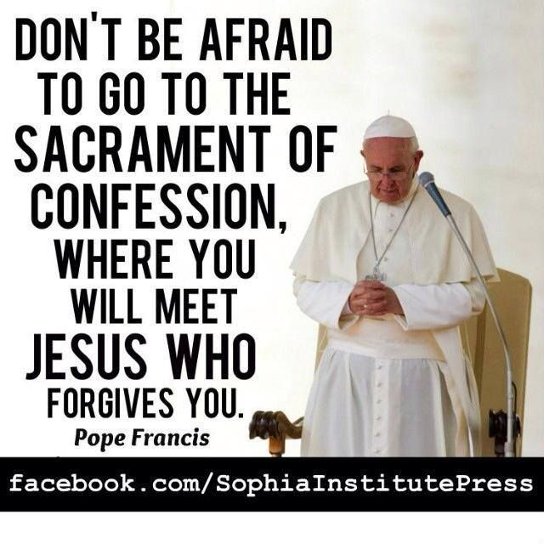
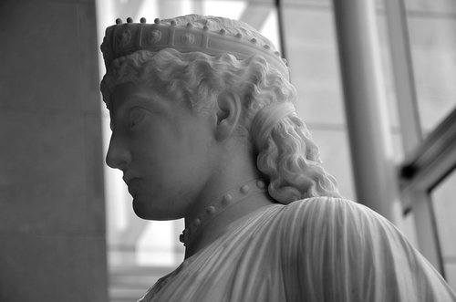
Anyone Have an Answer as to Why the Priesthood is SOOOOO Important???
“For I do not exaggerate when I say, that for many noble-hearted, well-educated, high-minded women, to be forced to unveil their hearts before the eyes of a man, to open to him all the most secret recesses of their souls, all the most sacred mysteries of their single or married life, to allow him to put to them questions which the most depraved woman would never consent to hear from her vilest seducer, is often more horrible and intolerable than to be tied to burning coals.”—The Priest, the Woman, and the Confessional, Charles Chiniquy, p. 13
“She [Semaramis] designed the confessional to pry into the secrets of her followers. The people feared their priests. They were afraid of being blackmailed. Satan loved this idea. In the future, he would use the confessionals to destroy nations”—Jack Chick, Alberto Series, The Force, p. 10

Slide 10
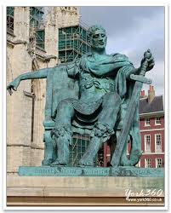
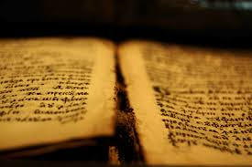
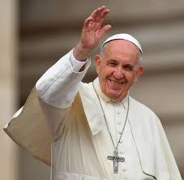
Who’s Your Authority???
Or…

