Slide 1
The Seven Last Plagues
Heaven’s Strange Act

Slide 2
Plague #1
“And I heard a great voice out of the temple saying to the seven angels, Go your ways, and pour out the vials of the wrath of God upon the earth. And the first went, and poured out his vial upon the earth; and there fell a noisome and grievous sore upon the men which had the mark of the beast, and upon them which worshipped his image.” Rev. 16:1,2

Slide 3
The Papacy’s Mark of Authority
What tradition of the papacy, directly contrary to the ten commandments, will America exalt? “Protestants... accept Sunday rather than Saturday as the day for public worship after the Catholic Church made the change.... But the Protestant mind does not seem to realize that...in observing the Sunday, they are accepting the authority of the spokesman for the church, the Pope. “— Our Sunday Visitor, February 5, 1950.
“It is well to remind the Presbyterians, Baptists, Methodists, and all other Christians, that the Bible does not support them anywhere in their observance of Sunday. Sunday is an institution of the Roman Catholic Church, and those who observe the day observe a commandment of the Catholic Church. “— Priest Brady, in an address, reported in the Elizabeth, N.J. “News,” March 18, 1903.
The mark of Catholic Church authority in the world is Sunday observance. This is a tradition that has no place in the Bible. It originated in Rome, and when we honor the Sunday tradition, we are paying homage to the papacy. Sunday goes directly contrary to the plain teaching of the fourth commandment.

Slide 4
It is Important/ Life or Death
The first plague falls on those who continue in rebellion by keeping Sunday. Divine retribution falls on those who are rebelling against God. So many feel that a day is not important. The first plague says otherwise. Rebellion against heaven is treated with great concern, great entreaty, and if rejected, great retribution. Mark it well…………………………………
But wait just a minute…………………………………….

Slide 5
Paul Says………………
“One man esteemeth one day above another: another esteemeth every day alike. Let every man be fully persuaded in his own mind. He that regardeth the day, regardeth it unto the Lord; and he that regardeth not the day, to the Lord he doth not regard it.” Romans 14:5,6 Paul says that we need to let everyone worship when they want.?.?

Slide 6
Stop Judging?!?!
“Blotting out the handwriting of ordinances that was against us, which was contrary to us, and took it out of the way, nailing it to his cross; And having spoiled principalities and powers, he made a shew of them openly, triumphing over them in it. Let no man therefore judge you in meat, or in drink, or in respect of an holyday, or of the new moon, or of the sabbath days: Which are a shadow of things to come; but the body is of Christ.” Colossians 2:14-17 When will we stop judging?

Slide 7
What was Paul Talking About?
“And in the beginnings of your months (New Moons)ye shall offer a burnt offering unto the LORD; two young bullocks, and one ram, seven lambs of the first year without spot; And three tenth deals of flour for a meat offering, (Meat)mingled with oil, for one bullock; and two tenth deals of flour for a meat offering, mingled with oil, for one ram; And a several tenth deal of flour mingled with oil for a meat offering unto one lamb; for a burnt offering of a sweet savour, a sacrifice made by fire unto the LORD. And their drink offerings (Drink)shall be half an hin of wine unto a bullock, and the third part of an hin unto a ram, and a fourth part of an hin unto a lamb: this is the burnt offering of every month throughout the months of the year. And one kid of the goats for a sin offering unto the LORD shall be offered, beside the continual burnt offering, and his drink offering. And in the fourteenth day of the first month is the passover of the LORD. And in the fifteenth day of this month is the feast: seven days shall unleavened bread be eaten.; In the first day shall be an holy convocation (: Holyday)ye shall do no manner of servile work therein:(sabbath day).” Numbers 28:11-17 All five pieces that Paul was talking about were found in the feast days. Paul said they were no longer binding; they pointed forward to Christ and some work He would do on behalf of man.

Slide 8
Feast Day Sabbaths
Paul had to deal with Jews who were continually pushing the merits of keeping the Jewish ceremonies/ordinances. “And certain men which came down from Judaea taught the brethren, and said, Except ye be circumcised after the manner of Moses, ye cannot be saved. When therefore Paul and Barnabas had no small dissension and disputation with them, they determined that Paul and Barnabas, and certain other of them, should go up to Jerusalem unto the apostles and elders about this question.” Acts 15:1,2 Paul told them that the ceremonies all pointed forward to Christ and that since Christ came, they should no longer be observed. Paul’s comments had nothing to do with the 7th day Sabbath, but everything to do with the ceremonial, Sabbath feast days.

Slide 9
Plague #2 and #3
“And the second angel poured out his vial upon the sea; and it became as the blood of a dead man: and every living soul died in the sea. And the third angel poured out his vial upon the rivers and fountains of waters; and they became blood. And I heard the angel of the waters say, Thou art righteous, O Lord, which art, and wast, and shalt be, because thou hast judged thus. For they have shed the blood of saints and prophets, and thou hast given them blood to drink; for they are worthy. And I heard another out of the altar say, Even so, Lord God Almighty, true and righteous are thy judgments.” Revelation 16:3-7

Slide 10
Just Like in Egypt
“And Moses and Aaron did so, as the LORD commanded; and he lifted up the rod, and smote the waters that were in the river, in the sight of Pharaoh, and in the sight of his servants; and all the waters that were in the river were turned to blood. And the fish that was in the river died; and the river stank, and the Egyptians could not drink of the water of the river; and there was blood throughout all the land of Egypt.” Exodus 7:20,21
“Moses and Aaron were directed to visit the riverside next morning, where the king was accustomed to repair. The overflowing of the Nile being the source of food and wealth for all Egypt, the river was worshiped as a god, and the monarch came thither daily to pay his devotions. Here the two brothers again repeated the message to him, and then they stretched out the rod and smote upon the water. The sacred stream ran blood, the fish died, and the river became offensive to the smell. The water in the houses, the supply preserved in cisterns, was likewise changed to blood. But "the magicians of Egypt did so with their enchantments," and "Pharaoh turned and went into his house, neither did he set his heart to this also." For seven days the plague continued, but without effect.” PP, pg. 265

Slide 11
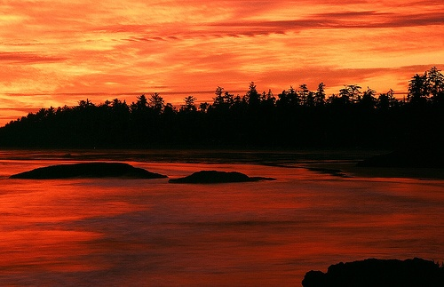
Waters to Blood
“His wonderful works in their deliverance from bondage and His dealings with them in their travels through the wilderness were not for their benefit alone. These were to be as an object lesson to the surrounding nations. The Lord revealed Himself as a God above all human authority and greatness. The signs and wonders He wrought in behalf of His people showed His power over nature and over the greatest of those who worshiped nature. God went through the proud land of Egypt as He will go through the earth in the last days. With fire and tempest, earthquake and death, the great I AM redeemed His people. He took them out of the land of bondage.” CC, pg. 90

Slide 12
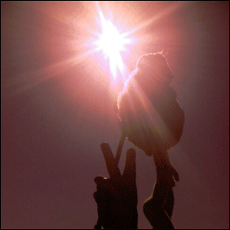
Plague #4
“And the fourth angel poured out his vial upon the sun; and power was given unto him to scorch men with fire. And men were scorched with great heat, and blasphemed the name of God, which hath power over these plagues: and they repented not to give him glory.” Revelation 16:8,9

Slide 13
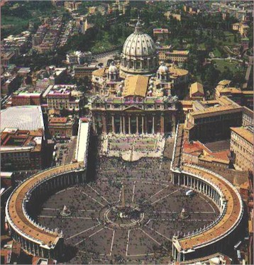
The Beast Gets it
“And the fifth angel poured out his vial upon the seat of the beast; and his kingdom was full of darkness; and they gnawed their tongues for pain, And blasphemed the God of heaven because of their pains and their sores, and repented not of their deeds.” Revelation 16:10,11

Slide 14
Plague #6
“And the sixth angel poured out his vial upon the great river Euphrates; and the water thereof was dried up, that the way of the kings of the east might be prepared. And I saw three unclean spirits like frogs come out of the mouth of the dragon, and out of the mouth of the beast, and out of the mouth of the false prophet. For they are the spirits of devils, working miracles, which go forth unto the kings of the earth and of the whole world, to gather them to the battle of that great day of God Almighty. Behold, I come as a thief. Blessed is he that watcheth, and keepeth his garments, lest he walk naked, and they see his shame. And he gathered them together into a place called in the Hebrew tongue Armageddon.” Revelation 16:13-16

Slide 15
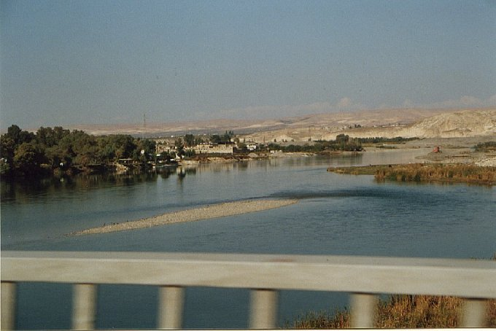
Drying of the river Euphrates
When Medo-Persia overthrew Babylon in the days of Daniel, the Persian army diverted the waters of the Euphrates, drying up the river. The troops took the city by marching in on the dry river bed, after the priests betrayed the city by opening the iron gates that spanned the river. This established a historical precedent, and so Revelation 16 speaks of the overthrow of modern Mystery Babylon in the same terms. It is symbolic this time, of course, but one must look at the original historic event as a pattern for the overthrow of modern Babylon. The River Euphrates was the life blood of Babylon. It was Babylon's "fruitfulness." Modern Babylon is no longer a mere city, nor even a regional empire. It is now a global system; the system of the Papacy.

Slide 16
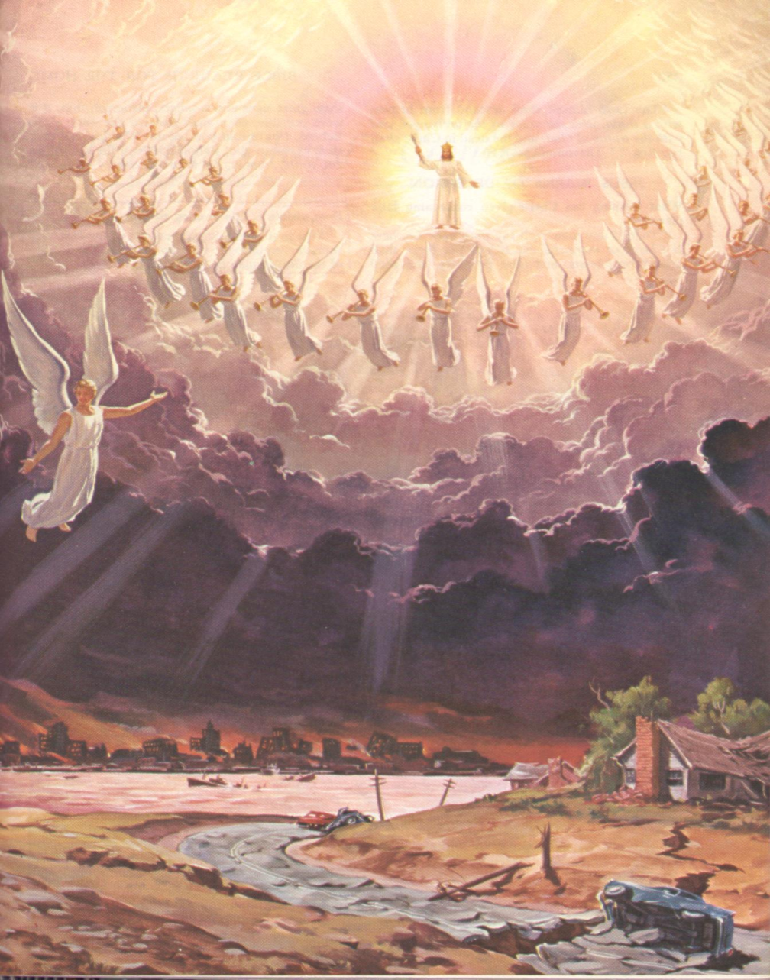
The Kings of the East Come
“For as the lightning cometh out of the east, and shineth even unto the west; so shall also the coming of the Son of man be.”
Matthew 24:27 “Soon there appears in the east a small black cloud, about half the size of a man's hand. It is the cloud which surrounds the Saviour and which seems in the distance to be shrouded in darkness. The people of God know this to be the sign of the Son of man.” GC, 640

Slide 17
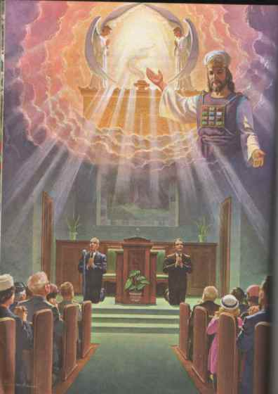
The ‘Other King’
“As the crowning act in the great drama of deception, Satan himself will personate Christ. The church has long professed to look to the Saviour's advent as the consummation of her hopes. Now the great deceiver will make it appear that Christ has come. In different parts of the earth, Satan will manifest himself among men as a majestic being of dazzling brightness, resembling the description of the Son of God given by John in the Revelation. Revelation 1:13-15. The glory that surrounds him is unsurpassed by anything that mortal eyes have yet beheld. The shout of triumph rings out upon the air: "Christ has come! Christ has come!" The people prostrate themselves in adoration before him, while he lifts up his hands and pronounces a blessing upon them, as Christ blessed His disciples when He was upon the earth. His voice is soft and subdued, yet full of melody. In gentle, compassionate tones he presents some of the same gracious, heavenly truths which the Saviour uttered; he heals the diseases of the people, and then, in his assumed character of Christ, he claims to have changed the Sabbath to Sunday, and commands all to hallow the day which he has blessed. He declares that those who persist in keeping holy the seventh day are blaspheming his name by refusing to listen to his angels sent to them with light and truth. This is the strong, almost overmastering delusion.” GC, pg. 624

Slide 18
The three unclean spirits
A frog's tongue is attached in front. It also flicks out at great speed, curls around the prey, then flicks back into the mouth with the doomed dinner.
“By the decree enforcing the institution of the papacy in violation of the law of God, our nation [the United States] will disconnect herself fully from righteousness. When Protestantism shall stretch her hand across the gulf to grasp the hand of the Roman power, when she shall reach over the abyss to clasp hands with spiritualism, when, under the influence of this threefold union, our country shall repudiate every principle of its Constitution as a Protestant and republican government, and shall make provision for the propagation of papal falsehoods and delusions, then we may know that the time has come for the marvelous working of Satan and that the end is near.
Through the two great errors, the immortality of the soul and Sunday sacredness, Satan will bring the people under his deceptions. While the former lays the foundation of spiritualism, the latter creates a bond of sympathy with Rome. The Protestants of the United States will be foremost in stretching their hands across the gulf to grasp the hand of spiritualism; they will reach over the abyss to clasp hands with the Roman power; and under the influence of this threefold union, this country will follow in the steps of Rome in trampling on the rights of conscience.” Maranatha, 190

Slide 19
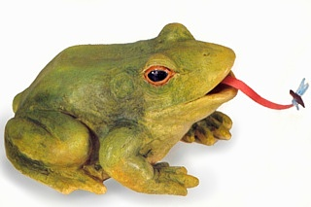
The Frogs
1. the beast-papacy
2. the false prophet-apostate Protestantism
3. the dragon-spiritualism
These three powers unite together to deceive the world into accepting a false rest day. Miracles will be wrought to back up the false claims.

Slide 20
Summary
During the time of this sixth plague, with everything in shambles, the devil will impersonate Christ. By this time, the threefold powers of the papacy, spiritualism, and apostate protestants will have reached the ultimate in deception. They have been working all along to reach this point and pave the way for the devil. Christ pronounces a blessing on those clothed in His righteousness.

Slide 21
Christ’s Righteousness
“Well may our hearts turn to our Redeemer with the most perfect trust when we think of what He has done for us, even when we were sinners. Through faith we may rest in His love. "Him that cometh to me," He says, "I will in no wise cast out" (John 6:37). It would be a terrible thing to stand before God clothed in sinful garments, with His eye reading every secret of our lives. But through the efficacy of Christ's sacrifice we may stand before God pure and spotless, our sins atoned for and pardoned. "If we confess our sins, he is faithful and just to forgive us our sins, and to cleanse us from all unrighteousness" (1 John 1:9). The redeemed sinner, clothed in the robes of Christ's righteousness, may stand in the presence of a sin-hating God, made perfect by the merits of the Saviour. Only through faith in Christ's name can the sinner be saved. . . . Faith in Christ is not the work of nature, but the work of God on human minds, wrought in the very soul by the Holy Spirit, who reveals Christ, as Christ revealed the Father. Faith is the substance of things hoped for, the evidence of things not seen. With its justifying, sanctifying power, it is above what men call science. It is the science of eternal realities. Human science is often deceptive and misleading, but this heavenly science never misleads. It is so simple that a child may understand it, and yet the most learned men cannot explain it. It is inexplainable and immeasurable, beyond all human expression.
What inexpressible love has the Saviour manifested toward the children of men! Not only does He take off the brand of sin, but He cleanses and purifies the soul, clothing it in the robe of His own righteousness, which is without spot, woven in the loom of heaven. He not only lifts the curse from the sinner, but brings him into oneness with Himself, reflecting upon him the bright beams of His righteousness. He is welcomed by the heavenly universe, accepted in the beloved Son of God. What glory can fallen man, through repentance and faith, bring back to God!” Heavenly Places, 51

Slide 22
Armageddon
Armageddon = "the hill or city of Megiddo"
In Rev. 16:16 the scene of a the struggle of good and evil is suggested by that battle plain of Esdraelon, which was famous for two great victories, of Barak over the Canaanites, and of Gideon over the Midianites; and for two great disasters, the deaths of Saul and Josiah. Hence in Revelation a place of great slaughter, the scene of a terrible retribution upon the wicked. The RSV translates the name as Har-Magedon, i.e. the hill (as Ar is the city) of Megiddo.
hill, mountain, hill country, mount
Megiddo or Megiddon = "place of crowds"
ancient city of Canaan assigned to Manasseh and located on the southern rim of the plain of Esdraelon 6 miles (10 km) from Mount Carmel and 11 miles (18 km) from Nazareth
to penetrate, cut, attack, invade
a) (Qal) to penetrate, cut into
b) (Hithpoel)
1) to cut oneself
2) to gather in troops or crowds

Slide 23
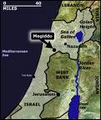
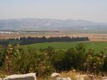
The Physical Place

Slide 24
The Final Battle
Armageddon will be the culmination of a battle that has raged for 6,000 years between the children of God and the children of the devil. Those who have arrayed themselves under the papacy, apostate Protestantism, and spiritualism will oppose those who are clothed in the garments of Prince Immanuel. The devil will lead his forces of deception and then Christ will come to end their party and take His children home to their heavenly paradise.

Slide 25
Christ Comes ‘Secretly’?
Rev. 16:15 “Behold, I come as a thief. Blessed is he that watcheth, and keepeth his garments…”
2 Peter 3:10 “But the day of the Lord will come as a thief in the night; in the which the heavens shall pass away with a great noise, and the elements shall melt with fervent heat, the earth also and the works that are therein shall be burned up.”
Thieves don’t come secretly ‘with a great noise’ and with everything burning up. However, they do come when people least expect them to come. Christ coming as a thief means when people least expect it, He will appear. It doesn’t mean He will come secretly or quietly.

Slide 26

The Second Coming
“And the seventh angel poured out his vial into the air; and there came a great voice out of the temple of heaven, from the throne, saying, It is done. And there were voices, and thunders, and lightnings; and there was a great earthquake, such as was not since men were upon the earth, so mighty an earthquake, and so great. And the great city was divided into three parts, and the cities of the nations fell: and great Babylon came in remembrance before God, to give unto her the cup of the wine of the fierceness of his wrath. And every island fled away, and the mountains were not found. And there fell upon men a great hail out of heaven, every stone about the weight of a talent: and men blasphemed God because of the plague of the hail; for the plague thereof was exceeding great.” Rev. 16:17-21

Slide 27
Glorious Victory
“It is at midnight that God manifests His power for the deliverance of His people. The sun appears, shining in its strength. Signs and wonders follow in quick succession. The wicked look with terror and amazement upon the scene, while the righteous behold with solemn joy the tokens of their deliverance. Everything in nature seems turned out of its course. The streams cease to flow. Dark, heavy clouds come up and clash against each other. In the midst of the angry heavens is one clear space of indescribable glory, whence comes the voice of God like the sound of many waters, saying: "It is done." Revelation 16:17. That voice shakes the heavens and the earth. There is a mighty earthquake, "such as was not since men were upon the earth, so mighty an earthquake, and so great." Verses 17, 18. The firmament appears to open and shut. The glory from the throne of God seems flashing through. The mountains shake like a reed in the wind, and ragged rocks are scattered on every side. There is a roar as of a coming tempest. The sea is lashed into fury. There is heard the shriek of a hurricane like the voice of demons upon a mission of destruction. The whole earth heaves and swells like the waves of the sea. Its surface is breaking up. Its very foundations seem to be giving way. Mountain chains are sinking. Inhabited islands disappear. The seaports that have become like Sodom for wickedness are swallowed up by the angry waters. Babylon the great has come in remembrance before God, "to give unto her the cup of the wine of the fierceness of His wrath." Great hailstones, every one "about the weight of a talent," are doing their work of destruction. Verses 19, 21. The proudest cities of the earth are laid low. The lordly palaces, upon which the world's great men have lavished their wealth in order to glorify themselves, are crumbling to ruin before their eyes. Prison walls are rent asunder, and God's people, who have been held in bondage for their faith, are set free. Graves are opened, and "many of them that sleep in the dust of the earth. . . awake, some to everlasting life, and some to shame and everlasting contempt." Daniel 12:2. All who have died in the faith of the third angel's message come forth from the tomb glorified, to hear God's covenant of peace with those who have kept His law. “ GC, 636,637

