Slide 1
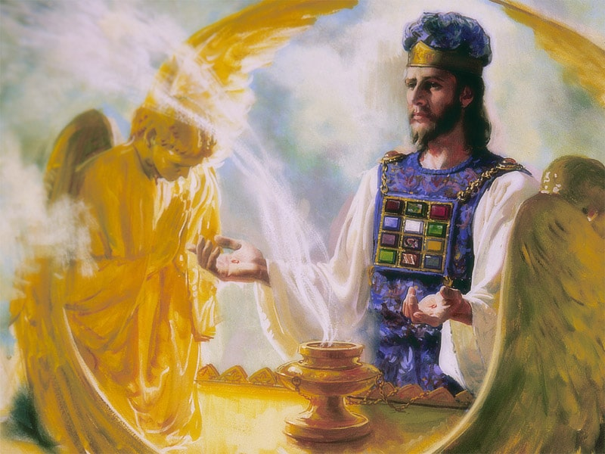
The Sanctuary pt 64: The Day of Atonement 11: The Pre-Advent Judgment

Slide 2
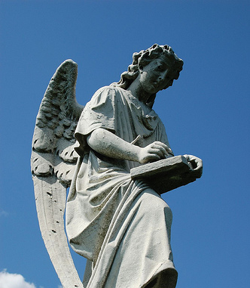
Review of the Books…
“The righteous dead will not be raised until after the Judgment at which they are accounted worthy of ‘the resurrection of life.’ Hence they will not be present in person at the tribunal when their records are examined, and their cases decided.”—GC, 482
“As the artist takes on the polished glass a true picture of the human face, so the angels of God daily place upon the books of heaven an exact representation of the character of every human being”—ST Feb. 11, 1903

Slide 3
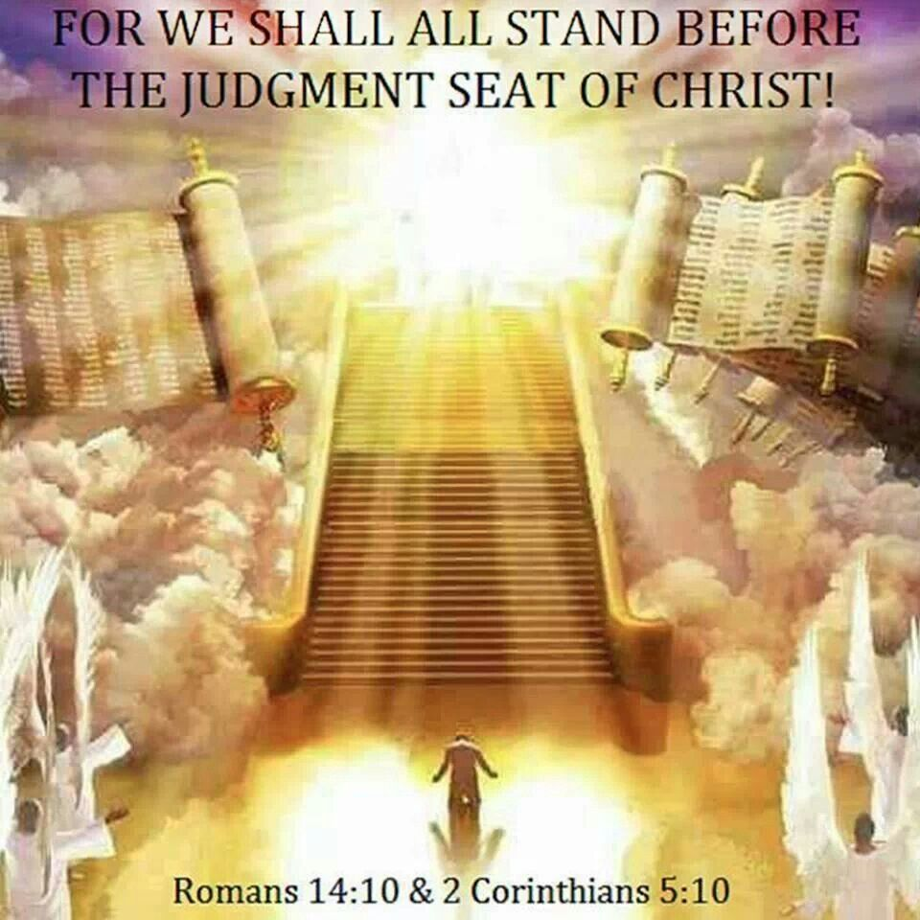
Righteous Dead then Righteous Living
“Every case had been decided for life or death. While Jesus had been ministering in the sanctuary, the judgment had been going on for the righteous dead, and then for the righteous living. Christ had received His kingdom, having made the atonement for His people and blotted out their sins. The subjects of the kingdom were made up. The marriage of the Lamb was consummated. And the kingdom, and the greatness of the kingdom under the whole heaven, was given to Jesus and the heirs of salvation, and Jesus was to reign as King of kings and Lord of lords.” {EW 280.1}

Slide 4
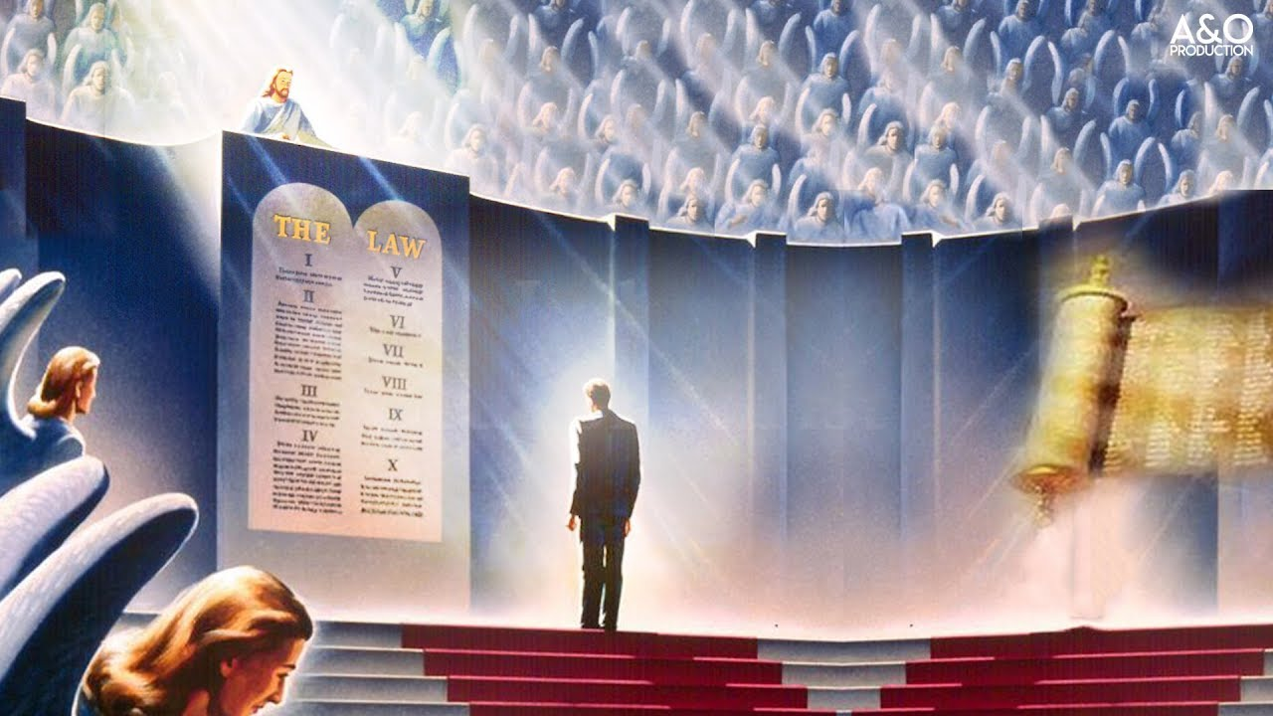
Judgment of the Living Begins At the House of God
1 Pet. 4:17-18 “For the time is come that judgment must begin at the house of God: and if it first begin at us, what shall the end be of them that obey not the gospel of God? And if the righteous scarcely be saved, where shall the ungodly and the sinner appear?”

Slide 5
Begin at My Sanctuary
Ez. 9:4-6 “And the Lord said unto him, Go through the midst of the city, through the midst of Jerusalem, and set a mark upon the foreheads of the men that sigh and that cry for all the abominations that be done in the midst thereof. And to the others he said in mine hearing, Go ye after him through the city, and smite: let not your eye spare, neither have ye pity: Slay utterly old and young, both maids, and little children, and women: but come not near any man upon whom is the mark; and begin at my sanctuary. Then they began at the ancient men which were before the house.”

Slide 6
Ellen White Commentary on this Verse…
“I have been shown that God here illustrates how He regards sin among those who profess to be His commandment-keeping people. Those whom He has specially honored with witnessing the remarkable exhibitions of His power, as did ancient Israel, and who will even then venture to disregard His express directions, will be subjects of His wrath. He would teach His people that disobedience and sin are exceedingly offensive to Him and are not to be lightly regarded. He shows us that when His people are found in sin they should at once take decided measures to put that sin from them, that His frown may not rest upon them all. But if the sins of the people are passed over by those in responsible positions, His frown will be upon them, and the people of God, as a body, will be held responsible for those sins. In His dealings with His people in the past the Lord shows the necessity of purifying the church from wrongs. One sinner may diffuse darkness that will exclude the light of God from the entire congregation. When the people realize that darkness is settling upon them, and they do not know the cause, they should seek God earnestly, in great humility and self-abasement, until the wrongs which grieve His Spirit are searched out and put away.”—3T, p. 265

Slide 7
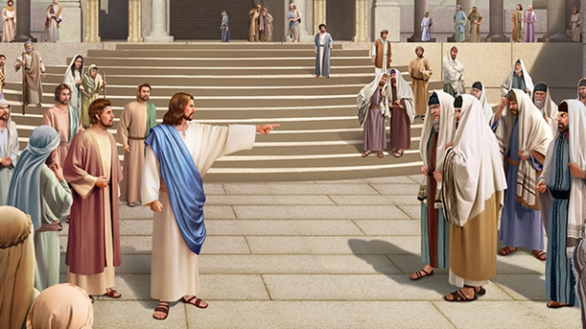
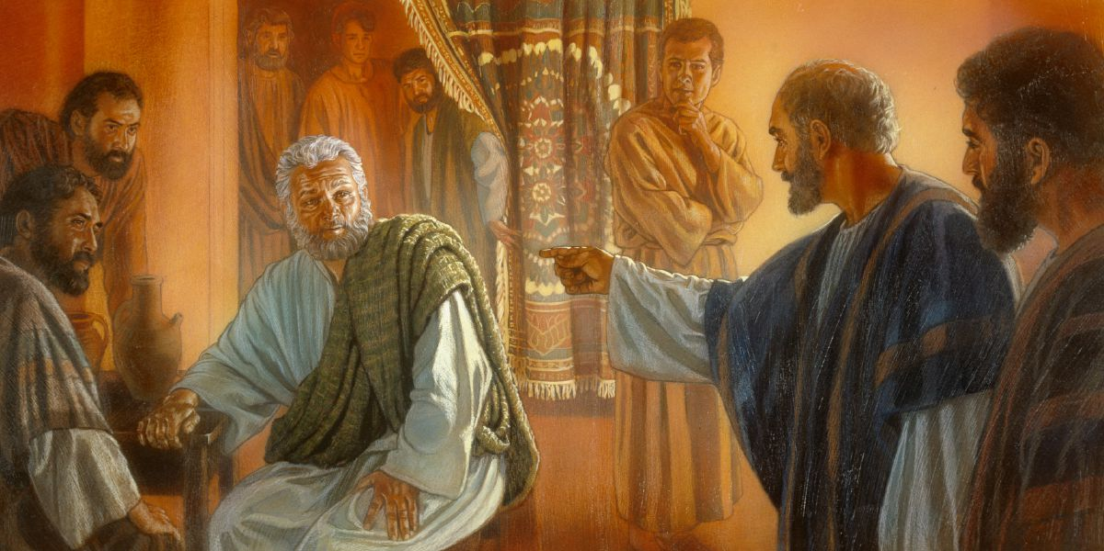
Who’s Duty???
“The prejudice which has arisen against us because we have reproved the wrongs that God has shown me existed, and the cry that has been raised of harshness and severity, are unjust. God bids us speak, and we will not be silent. If wrongs are apparent among His people, and if the servants of God pass on indifferent to them, they virtually sustain and justify the sinner, and are alike guilty and will just as surely receive the displeasure of God; for they will be made responsible for the sins of the guilty”—Ibid.

Slide 8
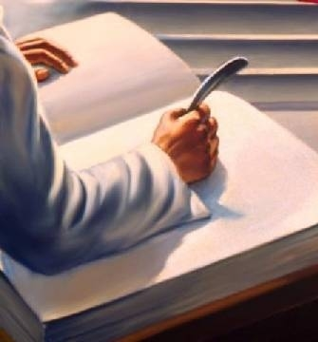
Mrs. White Puts it This Way
“Every man's work passes in review before God, and is registered for faithfulness or unfaithfulness. Opposite each name in the books of heaven is entered, with terrible exactness, every wrong word, every selfish act, every unfulfilled duty, and every secret sin, with every artful dissembling. Heaven-sent warnings or reproofs neglected, wasted moments, unimproved opportunities, the influence exerted for good or for evil, with its far-reaching results, all are chronicled by the recording angel. The law of God is the standard by which the characters and the lives of men will be tested in the judgment.” GC, 482

Slide 9
There is NO UNITY in ERROR!
“The true people of God, who have the spirit of the work of the Lord and the salvation of souls at heart, will ever view sin in its real, sinful character. They will always be on the side of faithful and plain dealing with sins which easily beset the people of God. Especially in the closing work for the church, in the sealing time of the one hundred and forty-four thousand who are to stand without fault before the throne of God, will they feel most deeply the wrongs of God's professed people. This is forcibly set forth by the prophet's illustration of the last work under the figure of the men each having a slaughter weapon in his hand. One man among them was clothed with linen, with a writer's inkhorn by his side. "And the Lord said unto him, Go through the midst of the city, through the midst of Jerusalem, and set a mark upon the foreheads of the men that sigh and that cry for all the abominations that be done in the midst thereof.“”—3T, 266

Slide 10
What About those who Oppose the Straight Testimony?
“Who are standing in the counsel of God at this time? Is it those who virtually excuse wrongs among the professed people of God and who murmur in their hearts, if not openly, against those who would reprove sin? Is it those who take their stand against them and sympathize with those who commit wrong? No, indeed! Unless they repent, and leave the work of Satan in oppressing those who have the burden of the work and in holding up the hands of sinners in Zion, they will never receive the mark of God's sealing approval. They will fall in the general destruction of the wicked, represented by the work of the five men bearing slaughter weapons”—Ibid.

Slide 11
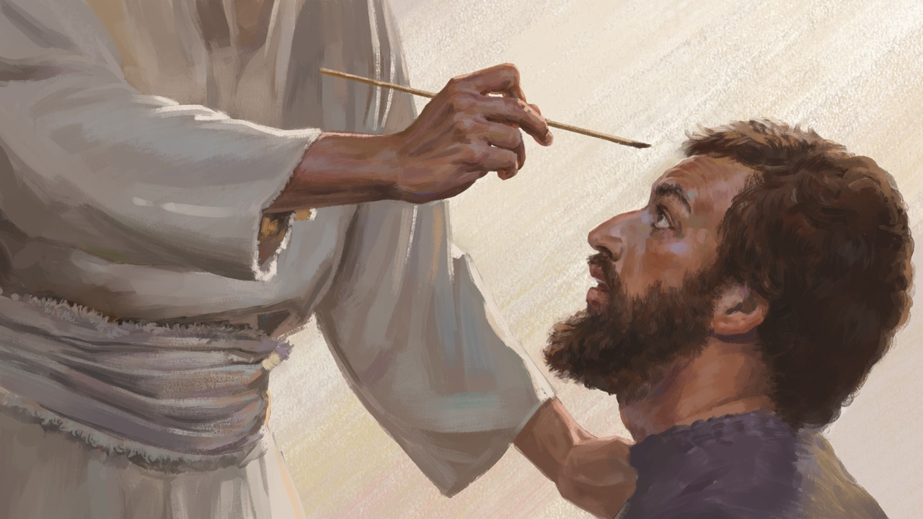
Do you Want the Seal?
“Mark this point with care: Those who receive the pure mark of truth, wrought in them by the power of the Holy Ghost, represented by a mark by the man in linen, are those "that sigh and that cry for all the abominations that be done" in the church. Their love for purity and the honor and glory of God is such, and they have so clear a view of the exceeding sinfulness of sin, that they are represented as being in agony, even sighing and crying. Read the ninth chapter of Ezekiel.”—Ibid.

Slide 12
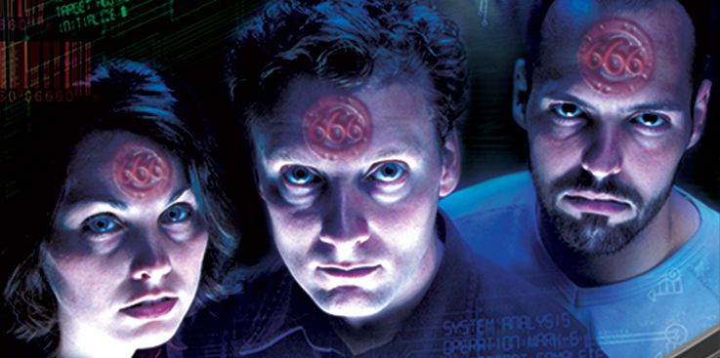
What Happens to the Rest???
“But the general slaughter of all those who do not thus see the wide contrast between sin and righteousness, and do not feel as those do who stand in the counsel of God and receive the mark, is described in the order to the five men with slaughter weapons: "Go ye after him through the city, and smite: let not your eye spare, neither have ye pity: slay utterly old and young, both maids, and little children, and women: but come not near any man upon whom is the mark; and begin at My sanctuary.“” Ibid., p. 267

Slide 13
Are You Sighing and Crying for…
1. The implementation of “Spiritual Formation” (Catholic spiritual exercises of Loyola) into the Pastoral training (see Handbook of Seventh-Day Adventist Ministerial and Theological Education, p. 37 & p. 57)
2. In 2010-11, Ted Wilson spearheaded an evangelistic campaign called “The Great Controversy Project” where he reduced the 800+ pages of the Great Controversy book to a 92 page devotional, which says nothing about the Papacy, or last days events—the great hope
3. Ted Wilson going to Moscow to represent the SDA Church at the 500th Anniversary of the Reformation, ecumenical charters signed in January 2021, Bert Beach’s (GC Rep) gold medal to the Pope?
4. Ganoune Diop’s interfaith meetings with the Antichrist, as a representative of the GC—good use of tithe?
5. The General Conference accepted over 72 million taxpayer dollars (pastors and teachers are to be paid with tithe only), closing churches during lockdowns, and refusing to assist their flocks who were seeking religious exemptions—who’s defending liberty of conscience?
6. Leaders who REFUSE to talk about the apostasies of the SDA church? Such as watered-down messages, love gospel only, misusing funds, wrong music and dress, preaching false doctrines like: time-setting, saved in sin, ‘get glue’ and stay in the church because those who left ‘went out from us?’

Slide 14
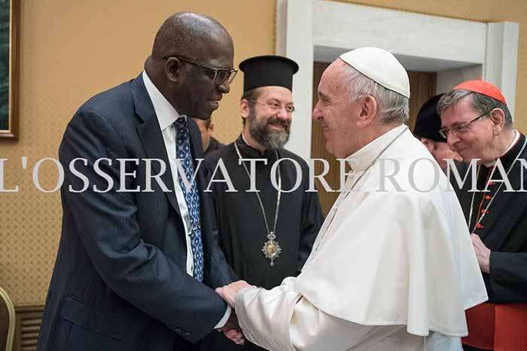
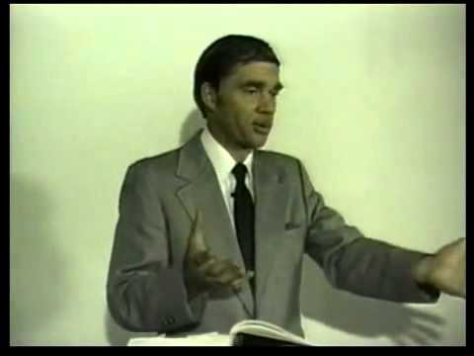
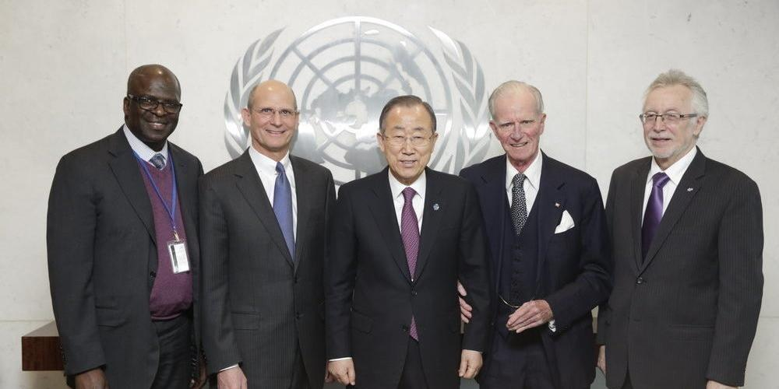
Who Went Out???

Slide 15
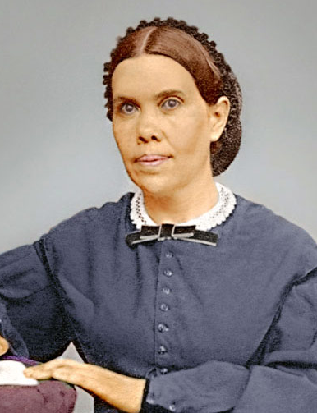
Back to the Judgment Hour Scene
“Solemn are the scenes connected with the closing work of the atonement. Momentous are the interests involved therein. The judgment is now passing in the sanctuary above. For many years this work has been in progress. Soon--none know how soon--it will pass to the cases of the living. In the awful presence of God our lives are to come up in review. At this time above all others it behooves every soul to heed the Saviour's admonition: "Watch and pray: for ye know not when the time is." Mark 13:33. "If therefore thou shalt not watch, I will come on thee as a thief, and thou shalt not know what hour I will come upon thee." Revelation 3:3.” {GC 490.1}

Slide 16
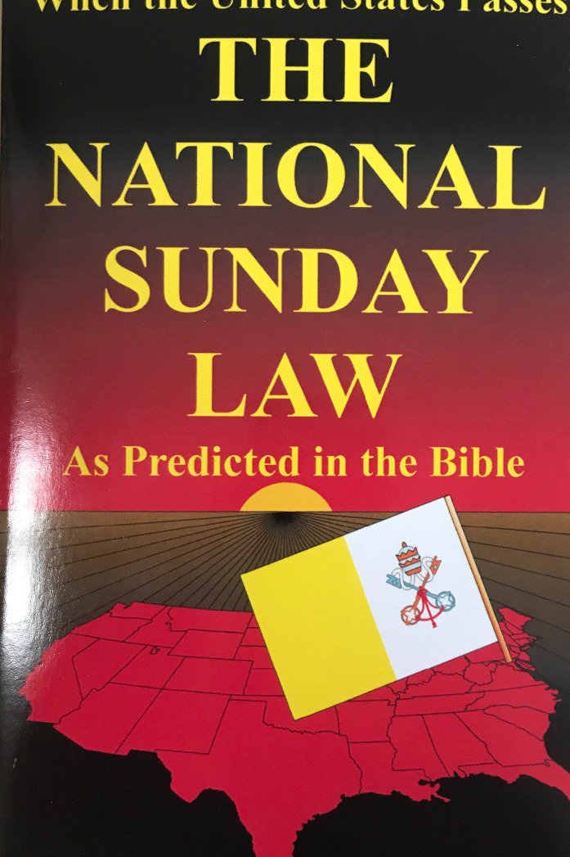
When Does Judgment of the Living Begin???
“The image of the beast will be formed before probation closes; for it is to be the great test for the people of God, by which their eternal destiny will be decided.... This is the test that the people of God must have before they are sealed. All who prove their loyalty to God by observing His law, and refusing to accept a spurious sabbath, will rank under the banner of the Lord God Jehovah, and will receive the seal of the living God. Those who yield the truth of heavenly origin, and accept the Sunday sabbath, will receive the mark of the beast.”—Maranatha p. 164

Slide 17
When is Probation Closed?
“The same angel who visited Sodom is sounding the note of warning, "Escape for thy life." The bottles of God's wrath cannot be poured out to destroy the wicked and their works until all the people of God have been judged, and the cases of the living as well as the dead are decided. And even after the saints are sealed with the seal of the living God, His elect will have trials individually. Personal afflictions will come; but the furnace is closely watched by an eye that will not suffer the gold to be consumed. The indelible mark of God is upon them. God can plead that His own name is written there. The Lord has shut them in. Their destination is inscribed--"God, New Jerusalem." They are God's property, His possession. Will this seal be put upon the impure in mind, the fornicator, the adulterer, the man who covets his neighbor's wife? Let your souls answer the question, Does my character correspond to the qualifications essential that I may receive a passport to the mansions Christ has prepared for those who are fitted for them? Holiness must be inwrought in our character.” {TM 446.2}

Slide 18
Another Quote
“As Jesus moved out of the most holy place, I heard the tinkling of the bells upon His garment; and as He left, a cloud of darkness covered the inhabitants of the earth. There was then no mediator between guilty man and an offended God. While Jesus had been standing between God and guilty man, a restraint was upon the people; but when He stepped out from between man and the Father, the restraint was removed and Satan had entire control of the finally impenitent. It was impossible for the plagues to be poured out while Jesus officiated in the sanctuary; but as His work there is finished, and His intercession closes, there is nothing to stay the wrath of God, and it breaks with fury upon the shelterless head of the guilty sinner, who has slighted salvation and hated reproof. In that fearful time, after the close of Jesus' mediation, the saints were living in the sight of a holy God without an intercessor. Every case was decided, every jewel numbered. Jesus tarried a moment in the outer apartment of the heavenly sanctuary, and the sins which had been confessed while He was in the most holy place were placed upon Satan, the originator of sin, who must suffer their punishment” EW, 280-281

Slide 19
Probation Closes Unnoticed
“When the work of the investigative judgment closes, the destiny of all will have been decided for life or death. Probation is ended a short time before the appearing of the Lord in the clouds of heaven. Christ in the Revelation, looking forward to that time, declares: "He that is unjust, let him be unjust still: and he which is filthy, let him be filthy still: and he that is righteous let him be righteous still: and he that is holy, let him be holy still. And, behold, I come quickly; and My reward is with Me, to give every man according as his work shall be." Revelation 22:11, 12. The righteous and the wicked will still be living upon the earth in their mortal state--men will be planting and building, eating and drinking, all unconscious that the final, irrevocable decision has been pronounced in the sanctuary above. Before the Flood, after Noah entered the ark, God shut him in and shut the ungodly out; but for seven days the people, knowing not that their doom was fixed, continued their careless, pleasure-loving life and mocked the warnings of impending judgment. "So," says the Saviour, "shall also the coming of the Son of man be." Matthew 24:39. Silently, unnoticed as the midnight thief, will come the decisive hour which marks the fixing of every man's destiny, the final withdrawal of mercy's offer to guilty men.”—GC, 490-491

Slide 20
