Slide 1
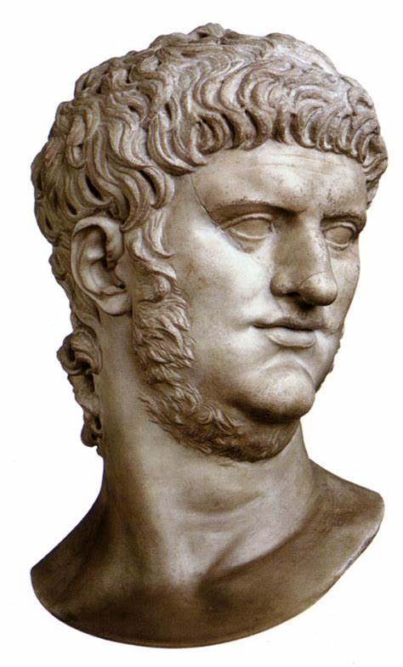
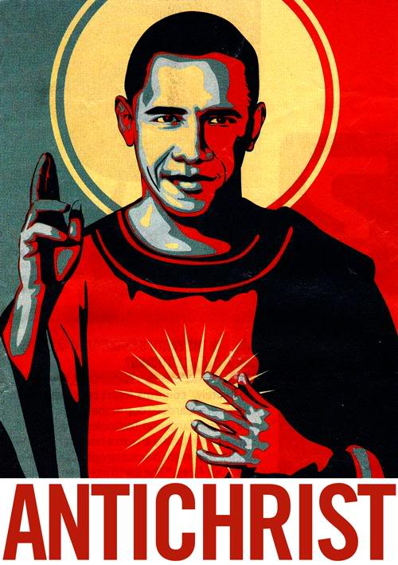
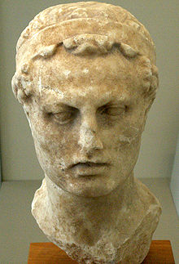
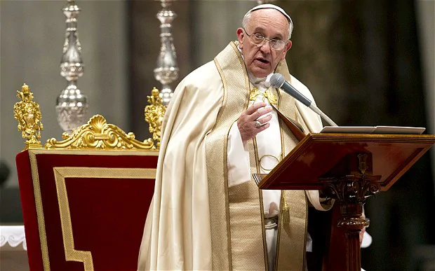
The Antichrist Showdown! pt 19: The Gospel Marches On!

Slide 2
Daniel Continues the Pagan/Papal History
Daniel 11:33-34 “And they that understand among the people shall instruct many: yet they shall fall by the sword, and by flame, by captivity, and by spoil, many days. Now when they shall fall, they shall be holpen with a little help: but many shall cleave to them with flatteries.”

Slide 3
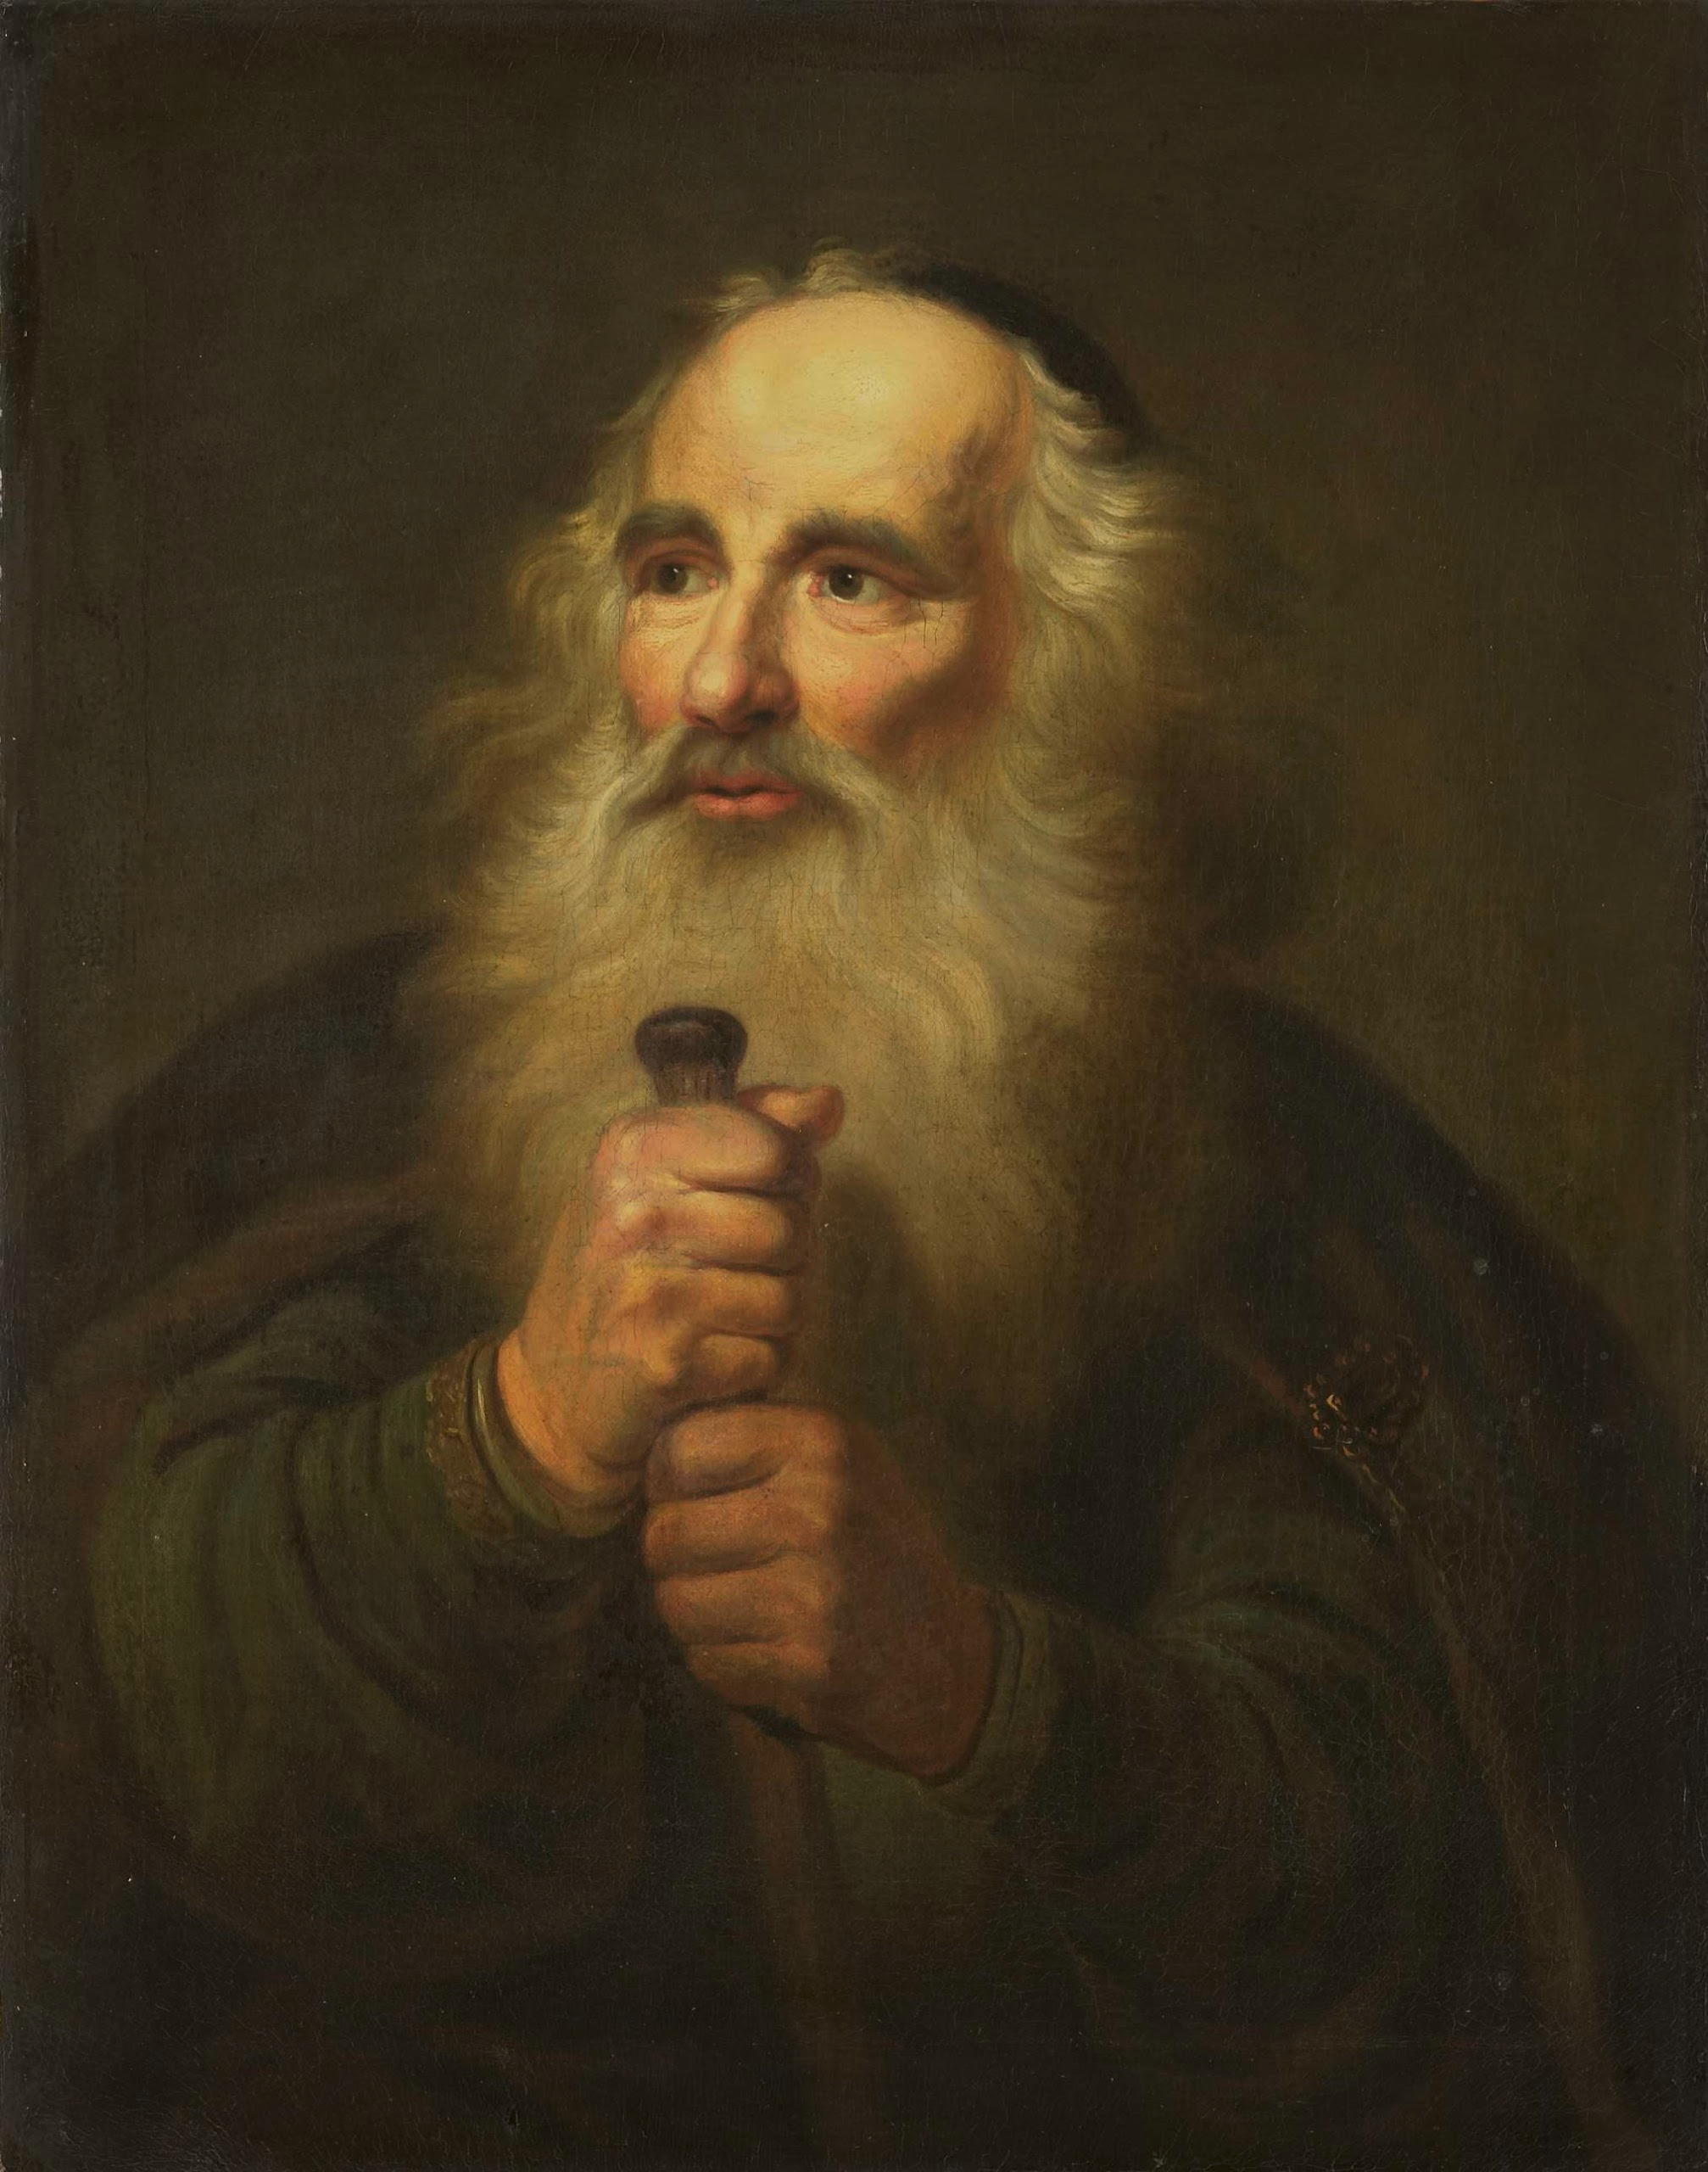
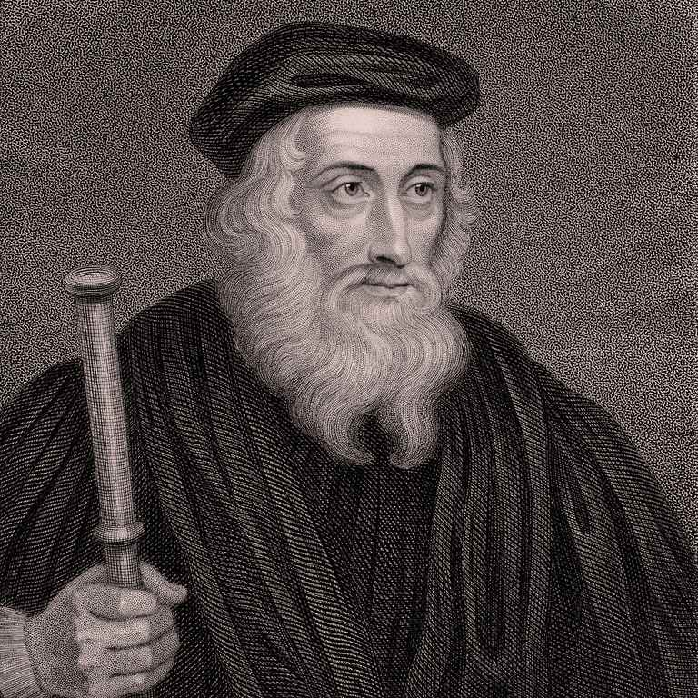
They That Understand Shall Instruct Many…
They that understand and shall instruct many are the great Christian leaders throughout the Pagan then Papal Empires. People like the Apostle Paul, who sacrificed every pleasure and every commodity to share the Gospel with the Gentiles. People like James, John, Peter, and the other disciples who lived for Christ and died as martyrs, and after them during the great persecutions. Other great heroes of the faith later on are John Wycliffe, John Huss, Jerome of Prague, General Ziska, Martin Luther, William Tyndale, John Wesley, Gaspard de Coligny, Oliver Cromwell, Roger Williams, and much more. Yet, many of the these fell by the sword (Apostle Paul was beheaded, Coligny was killed by the sword in the St. Bartholomew’s Day Massacre), by flame (Christians at Nero’s parties, in the Colosseum, John Huss), and by spoil (all Christians during Pagan Rome persecutions, the Albigenses and Waldenses later)

Slide 4
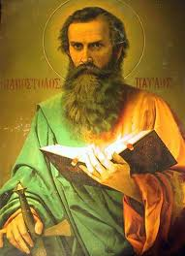
In Paul’s Day…
2 Cor. 11:24-28 “Of the Jews five times received I forty stripes save one. Thrice was I beaten with rods, once was I stoned, thrice I suffered shipwreck, a night and a day I have been in the deep; In journeyings often, in perils of waters, in perils of robbers, in perils by mine own countrymen, in perils by the heathen, in perils in the city, in perils in the wilderness, in perils in the sea, in perils among false brethren; In weariness and painfulness, in watchings often, in hunger and thirst, in fastings often, in cold and nakedness. Beside those things that are without, that which cometh upon me daily, the care of all the churches.”

Slide 5
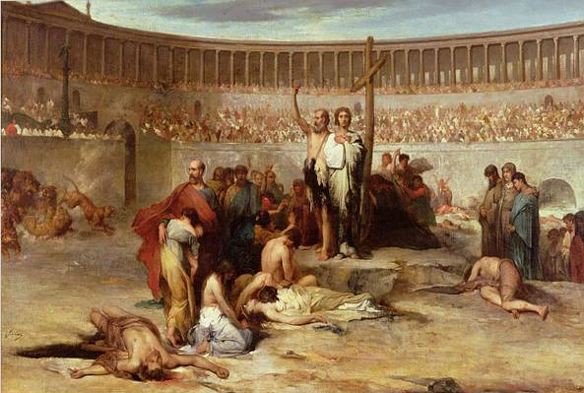
They Shall be Holpen With a Little Help… But many shall cleave unto them with flatteries…
Even though both Pagan and Papal Rome tried to stomp out true Christianity, they were unable to do so. The true Christians were always helped by God and the message ALWAYS went forth! However, there were also another class. Wolves in sheep’s clothing, who clave unto Christianity by flatteries, the false conversions of men like King Clovis, Constantine, Augustine, Eusebius, Origen, Jerome, all the false and wicked men who have helped to degrade and destroy true Christianity throughout the centuries are here displayed.

Slide 6
Ellen White Explains Pagan Rome…
“In vain were Satan's efforts to destroy the church of Christ by violence. The great controversy in which the disciples of Jesus yielded up their lives did not cease when these faithful standard-bearers fell at their post. By defeat they conquered. God's workmen were slain, but His work went steadily forward. The gospel continued to spread and the number of its adherents to increase. It penetrated into regions that were inaccessible even to the eagles of Rome. Said a Christian, expostulating with the heathen rulers who were urging forward the persecution: You may "kill us, torture us, condemn us. . . . Your injustice is the proof that we are innocent . . . . Nor does your cruelty . . . avail you." It was but a stronger invitation to bring others to their persuasion. ‘The oftener we are mown down by you, the more in number we grow; the blood of Christians is seed.’—Tertullian, Apology, paragraph 50. Thousands were imprisoned and slain, but others sprang up to fill their places. And those who were martyred for their faith were secured to Christ and accounted of Him as conquerors. They had fought the good fight, and they were to receive the crown of glory when Christ should come. The sufferings which they endured brought Christians nearer to one another and to their Redeemer. Their living example and dying testimony were a constant witness for the truth; and where least expected, the subjects of Satan were leaving his service and enlisting under the banner of Christ.”—GC, 41-42

Slide 7
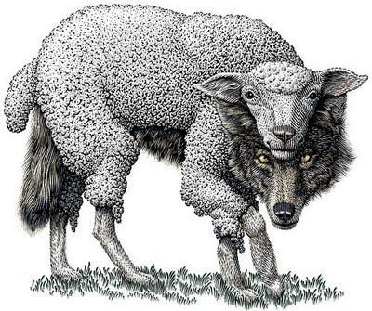
And the Wolves Came Marching In…
Acts 20:28-31 “Take heed therefore unto yourselves, and to all the flock, over the which the Holy Ghost hath made you overseers, to feed the church of God, which he hath purchased with his own blood. For I know this, that after my departing shall grievous wolves enter in among you, not sparing the flock. Also of your own selves shall men arise, speaking perverse things, to draw away disciples after them. Therefore watch, and remember, that by the space of three years I ceased not to warn every one night and day with tears.”

Slide 8
Another Warning…
Gal. 3:1 “O foolish Galatians, who hath bewitched you, that ye should not obey the truth, before whose eyes Jesus Christ hath been evidently set forth, crucified among you?”
2 Tim. 3:12-15 “Yea, and all that will live godly in Christ Jesus shall suffer persecution. But evil men and seducers shall wax worse and worse, deceiving, and being deceived. But continue thou in the things which thou hast learned and hast been assured of, knowing of whom thou hast learned them; And that from a child thou hast known the holy scriptures, which are able to make thee wise unto salvation through faith which is in Christ Jesus.”

Slide 9
An Ancient Problem
Jer. 6:13-17 “For from the least of them even unto the greatest of them every one is given to covetousness; and from the prophet even unto the priest every one dealeth falsely. They have healed also the hurt of the daughter of my people slightly, saying, Peace, peace; when there is no peace. Were they ashamed when they had committed abomination? nay, they were not at all ashamed, neither could they blush: therefore they shall fall among them that fall: at the time that I visit them they shall be cast down, saith the Lord. Thus saith the Lord, Stand ye in the ways, and see, and ask for the old paths, where is the good way, and walk therein, and ye shall find rest for your souls. But they said, We will not walk therein. Also I set watchmen over you, saying, Hearken to the sound of the trumpet. But they said, We will not hearken.”

Slide 10
Warning after Warning!
Col. 2:4, 8 “And this I say, lest any man should beguile you with enticing words. . . . Beware lest any man spoil you through philosophy and vain deceit, after the tradition of men, after the rudiments of the world, and not after Christ.
Matt. 15:13 “ But he answered and said, Every plant, which my heavenly Father hath not planted, shall be rooted up.”

Slide 11
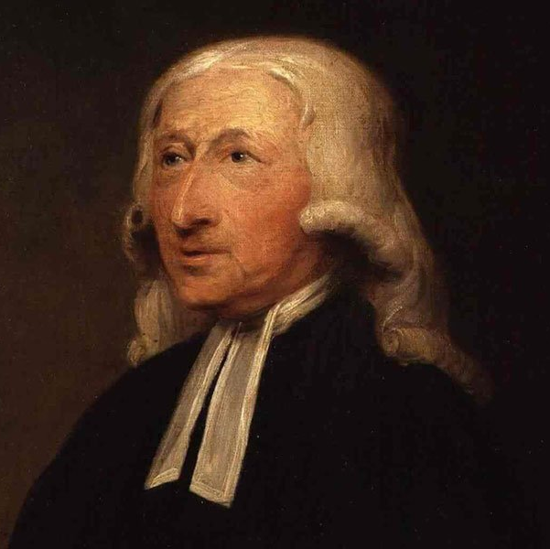
Augustine… One Example
“Augustine himself. (A wonderful saint! As full of pride, passion, bitterness, censoriousness, and as foul-mouthed to all that contradicted him…) When Augustine’s passions were heated, his word is not worth a rush. And here is the secret: St. Augustine was angry at Pelagius: Hence he slandered and abused him, (as his manner was,) without either fear or shame. And St. Augustine was then in the Christian world, what Aristotle was afterwards: There needed no other proof of any assertion, than Ipse dixit: ‘St. Augustine said it.’”– John Wesley, The Works of the Late Reverend John Wesley (1835 Edition), volume 2, p. 110
Augustine is also famous for promoting the primacy of the Bishop of Rome, and is commonly referenced as saying: ‘Rome has spoken; the case is closed.’

Slide 12
Holpen with a Little Help (Papal Rome)
“Weakened by divisions among its supporters, and assailed by powerful foes, Protestantism seemed destined to be utterly destroyed. Thousands sealed their testimony with their blood. Civil war broke out; the Protestant cause was betrayed by one of its leading adherents; the noblest of the reformed princes fell into the hands of the emperor and were dragged as captives from town to town. But in the moment of his apparent triumph, the emperor was smitten with defeat. He saw the prey wrested from his grasp, and he was forced at last to grant toleration to the doctrines which it had been the ambition of his life to destroy. He had staked his kingdom, his treasures, and life itself upon the crushing out of the heresy. Now he saw his armies wasted by battle, his treasuries drained, his many kingdoms threatened by revolt, while everywhere the faith which he had vainly endeavored to suppress, was extending. Charles V had been battling against omnipotent power. God had said, "Let there be light," but the emperor had sought to keep the darkness unbroken. His purposes had failed; and in premature old age, worn out with the long struggle, he abdicated the throne and buried himself in a cloister.”—GC, 211

Slide 13
Daniel Continues…
Daniel 11:35-36 “And some of them of understanding shall fall, to try them, and to purge, and to make them white, even to the time of the end: because it is yet for a time appointed. And the king shall do according to his will; and he shall exalt himself, and magnify himself above every god, and shall speak marvellous things against the God of gods, and shall prosper till the indignation be accomplished: for that that is determined shall be done.”

Slide 14
The Victims Were Victors
“Thousands were imprisoned and slain, but others sprang up to fill their places. And those who were martyred for their faith were secured to Christ and accounted of Him as conquerors. They had fought the good fight, and they were to receive the crown of glory when Christ should come. The sufferings which they endured brought Christians nearer to one another and to their Redeemer. Their living example and dying testimony were a constant witness for the truth”—GC, 42

Slide 15
Don’t Be a Tare, Who Will Say:
Prov. 5:11-14 “And thou mourn at the last, when thy flesh and thy body are consumed, And say, How have I hated instruction, and my heart despised reproof; And have not obeyed the voice of my teachers, nor inclined mine ear to them that instructed me! I was almost in all evil in the midst of the congregation and assembly.”

Slide 16
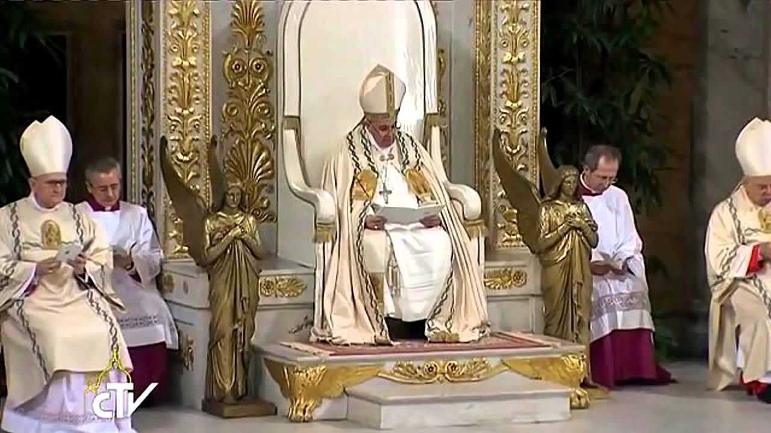
Marvelous Words Against God!
As we remember from Daniel 7, the “great” and “marvelous” words the Antichrist speaks against God are considered Blasphemy. As we saw from Mark 2:7 and Matthew 26:63-65 that Blasphemy is defined as when a man says he can forgive sins and when a man claims to be God. Both claims are an absolute insult to the entire government of God.
As we’ve seen the Papacy claims the power to forgive sins even to this day! Indulgences for sins, Crusades absolved, Torture permitted and forgiven—and this ‘power’ was also instilled in the priests. Moreover, the Papacy still claims to be God on earth today, which was much more open in the past.—Sunday Worship being a perfect example of Rome’s claims of divine authority.

Slide 17
Both blasphemies shown in the priesthood
“Jesus has died to institute the priesthood. It was not necessary for the Redeemer to die in order to save the world; a drop of his blood, a single tear, or prayer, was sufficient to procure salvation for all; for such a prayer, being of infinite value, should be sufficient to save not one but a thousand worlds. But to institute the priesthood, the death of Jesus Christ has been necessary. Had he not died, where should we find the victim that the priests of the New Law now offer? a victim altogether holy and immaculate, capable of giving to God an honor worthy of God. As has been already said, all the lives of men and angels are not capable of giving to God an infinite honor like that which a priest offers to him by a single Mass... The priest has the power of the keys, or the power of delivering sinners from Hell, of making them worthy of Paradise, and of changing them from the slaves of Satan into the children of God. And God Himself is obliged to abide by the judgment of His priests, and either not to pardon or to pardon.... Were the Redeemer to descend into a church, and sit in a confessional to administer the sacrament of penance, and a priest to sit in another confessional, Jesus would say over each penitent, "Ego te absolve," the priest would likewise say over each of his penitents, "Ego te absolve," and the penitents of each would be equally absolved... Thus the priest may, in a certain manner, be called the creator of his Creator, since by saying the words of consecration, he creates, as it were, Jesus in the sacrament, by giving him a sacramental existence, and produces him as a victim to be offered to the eternal Father... Let the priest," says St. Laurence Justinian, "approach the altar as another Christ.”—St. Alphonsus Liguori, The Dignities and Duties of the Priest (1927).

Slide 18
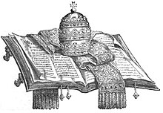
The Pope Seeks to Correct God
“Through the pope of Rome the same work has been carried on here on earth as was carried on in the courts of heaven before the expulsion of the prince of darkness. Satan sought to correct the law of God in heaven, and to supply an amendment of his own. He exalted his own judgment above that of his Creator, and placed his will above the will of Jehovah, and in this way virtually declared God to be fallible. The pope also takes the same course and, claiming infallibility for himself, seeks to adjust the law of God to meet his own ideas, thinking himself able to correct the mistakes he thinks he sees in the statutes and commands of the Lord of heaven and earth. He virtually says to the world, I will give you better laws than those of Jehovah. What an insult is this to the God of heaven!”—ST, Nov. 19, 1894

Slide 19
Nero/Antiochus Islam Papacy
1. Came from Rome
x x
2. Arises After 10 division of Rome
x
3. Plucks up 3 “Horns” of Rome
x
4. Rome Rules Until Judgment is Declared and Christ Returns
x
5. Becomes a greater horn than all other 10 kings
x x x
6. Commits Blasphemy
x x X!!!
7. Wears out the Saints
x x X!!!
8. Changes Times and Laws
x X!!!
9. Reigns for 1260 Years with Clear start and end times
X
10. Rome and Little Horn are “Different” (fierce and religio-political) than other historical powers before them
X

Slide 20
Nero/Antiochus Islam Papacy
11. Comes out of Apostatized Christianity
x
12. Son of Perdition is like Judas, appears as friend of Christ
X
13. Exalts himself against God, His Government, His Law, etc.
x X
14. Comes From, and is within the Church
x
15. Destroyed personally by the spirit of Christ’s mouth
x x
16. Performs Miracles to Deceive People
X
17. Represents a king (office, not a specific person) and a kingdom
X
18. Comes from 4 Divisions of Greece
x X
19. Took Away Daily
X

Slide 21
Nero/Antiochus Islam Papacy
20. Fierce
x x x
22. Uses others to inflict persecutions
X
23. Destroys wonderfully
x x X
24. Magnifies himself
x x X
25. Destroys by peaceful means through his false doctrines
X
26. Stands up against Jesus
x x X

Slide 22
King Clovis (466-511): Rome’s Champion!
Clovis became by his conversion the object of hope and attachment to such a party [Catholic] in almost every country on the continent of Europe. He had the powerful support of the whole body of the Catholic clergy, in whose hearts the interests of their church far out-weighed all other considerations. . . . He had, indeed, without the slightest provocation, deprived a noble and peaceable neighbour of his power and life. He had treacherously murdered his royal kindred, and deprived their children of their birthright. He had on all occasions shown himself the heartless ruffian, the greedy conqueror, the blood-thirsty tyrant; but by his conversion he had led the way to the triumph of Catholicism ; he had saved the Roman Catholic Church from the Scylla and Charybdis of heresy and PAGANISM, planted it on a rock in the very centre of Europe, and fixed its doctrines and traditions in the hearts of the conquerors of the West.”—Historian’s History of the World, Vol. VII, p. 471, 477

Slide 23
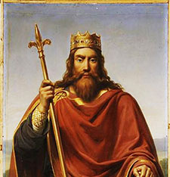
By 508 Clovis Accomplished…
United the Franks, Establishing Paris, and acknowledged as the ruler of Gaul (modern France) by the Byzantine Emperor Anastasius—Clovis then received 100 warships from Emperor Anastasius
Fought and won the decisive Battle of Poiters, defeating Alarac—King of the Goths
Sent the treaty gifts offered by Emperor Anastasius, including a golden crown, to the Papal treasury
Greatly favored and enriched the Roman Catholic religion
Solidified the Papacy as a legitimate power in the west, and gaining the ascendency over Arianism
Modeled the role of the subservient temporal king (Clovis) towards his superior and spiritual lord (the Pope)—This model was followed by almost every monarch thereafter until the fall of the Papacy in 1798
“Clovis eventually converted to Catholicism following the Battle of Tolbiac on Christmas Day 508”—Wikipedia, King Clovis I

