Slide 1
Trouble in Galatia
A Perverted Gospel

Slide 2
Paul’s Challenge
“I marvel that ye are so soon removed from him that called you into the grace of Christ unto another gospel:
Which is not another; but there be some that trouble you, and would pervert the gospel of Christ.
But though we, or an angel from heaven, preach any other gospel unto you than that which we have preached unto you, let him be accursed. As we said before, so say I now again, If any man preach any other gospel unto you than that ye have received, let him be accursed.” Galatians 1:7-9

Slide 3

The Struggle
Paul preached the gospel of Jesus Christ. “For I am not ashamed of the gospel of Christ: for it is the power of God unto salvation to every one that believeth; to the Jew first, and also to the Greek. For therein is the righteousness of God revealed from faith to faith: as it is written, The just shall live by faith.” Romans 1:16,17

Slide 4

Perverts in Galatia
After Paul preached the gospel, others came in preaching another gospel. They said that salvation came through some other means other than faith in Jesus Christ which leads to obedience to all of God’s commandments. They made salvation dependent on some other issue.

Slide 5
Salvation in……………………..
But contrariwise, when they saw that the gospel of the uncircumcision was committed unto me, as the gospel of the circumcision was unto Peter; (For he that wrought effectually in Peter to the apostleship of the circumcision, the same was mighty in me toward the Gentiles:) And when James, Cephas, and John, who seemed to be pillars, perceived the grace that was given unto me, they gave to me and Barnabas the right hands of fellowship; that we should go unto the heathen, and they unto the circumcision.” Galatians 2:6-9
“But now, after that ye have known God, or rather are known of God, how turn ye again to the weak and beggarly elements, whereunto ye desire again to be in bondage? Ye observe days, and months, and times, and years.” Galatians 4:9,10

Slide 6

Circumcision and the Feast Days
If you want to be saved, then you must be circumcised and keep the feast days. These were salvational issues. This was what the perverted ones were saying in Galatia. Do we have this same thing among us today? Right here in Australia? In Adventism? “And certain men which came down from Judaea taught the brethren, and said, Except ye be circumcised after the manner of Moses, ye cannot be saved.” Acts 15:1
If you want to be saved, then you have to………………………WHAT?

Slide 7
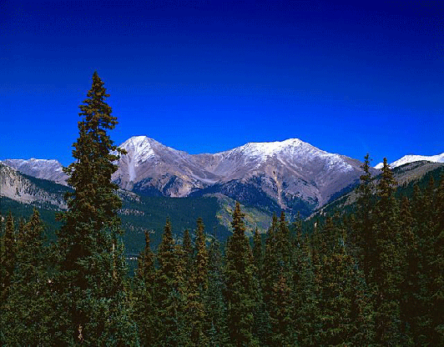
Scary Stuff
“O foolish Galatians, who hath bewitched you, that ye should not obey the truth, before whose eyes Jesus Christ hath been evidently set forth, crucified among you? This only would I learn of you, Received ye the Spirit by the works of the law, or by the hearing of faith? Are ye so foolish? having begun in the Spirit, are ye now made perfect by the flesh?” Galatians 3:1-3

Slide 8
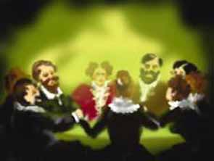
Bewitched!?!
The Galatians were charmed into believing a lie. Bewitching, sorcery, spiritualism; all go together. Because these ones in Galatia had rejected Christ, they were holding communion with someone who should be dead- even the old man of sin! When we embrace an idea and say salvation depends on one accepting it, like circumcision or the feast days, or………….then we are under the control of an evil spirit as well because we too have rejected Christ. It is happening today in Adventism!

Slide 9
the Masterpiece
“Many will be confronted by the spirits of devils personating beloved relatives or friends and declaring the most dangerous heresies. These visitants will appeal to our tenderest sympathies and will work miracles to sustain their pretensions. We must be prepared to withstand them with the Bible truth that the dead know not anything and that they who thus appear are the spirits of devils.
Just before us is "the hour of temptation, which shall come upon all the world, to try them that dwell upon the earth." Revelation 3:10. All whose faith is not firmly established upon the word of God will be deceived and overcome. Satan "works with all deceivableness of unrighteousness" to gain control of the children of men, and his deceptions will continually increase. But he can gain his object only as men voluntarily yield to his temptations. Those who are earnestly seeking a knowledge of the truth and are striving to purify their souls through obedience, thus doing what they can to prepare for the conflict, will find, in the God of truth, a sure defense. "Because thou hast kept the word of My patience, I also will keep thee" (verse 10), is the Saviour's promise. He would sooner send every angel out of heaven to protect His people than leave one soul that trusts in Him to be overcome by Satan.” GC, pg. 560

Slide 10
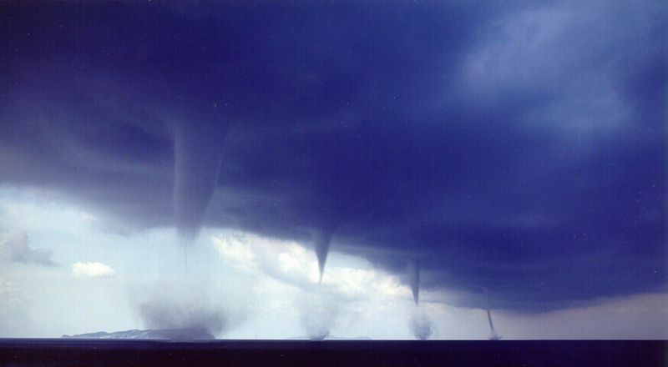
The Other Side of Spiritualism
“It is true that spiritualism is now changing its form and, veiling some of its more objectionable features, is assuming a Christian guise….While it formerly denounced Christ and the Bible, it now professes to accept both... Love is dwelt upon as the chief attribute of God, but it is degraded to a weak sentimentalism, making little distinction between good and evil. God's justice, His denunciations of sin, the requirements of His holy law, are all kept out of sight. ” GC. Pg. 557,558

Slide 11

Oh Jerusalem, Jerusalem!!!
The people of Galatia and Jerusalem had embraced an idea to save them; they had rejected Christ! They were under the charms of Satan and were under the old covenant. How many of us today are in the same position; without Christ, and as lost as the heathen!

Slide 12
Rejection of the Gospel …………… Religiously
“The apostle urged the Galatians to leave the false guides by whom they had been misled, and to return to the faith that had been accompanied by unmistakable evidences of divine approval. The men who had attempted to lead them from their belief in the gospel were hypocrites, unholy in heart and corrupt in life. Their religion was made up of a round of ceremonies, through the performance of which they expected to gain the favor of God. They had no desire for a gospel that called for obedience to the word, "Except a man be born again, he cannot see the kingdom of God." John 3:3. They felt that a religion based on such a doctrine, required too great a sacrifice, and they clung to their errors, deceiving themselves and others. To substitute external forms of religion for holiness of heart and life is still as pleasing to the unrenewed nature as it was in the days of these Jewish teachers. Today, as then, there are false spiritual guides, to whose doctrines many listen eagerly. It is Satan's studied effort to divert minds from the hope of salvation through faith in Christ and obedience to the law of God. In every age the archenemy adapts his temptations to the prejudices or inclinations of those whom he is seeking to deceive.” AA, pg. 386,387

Slide 13
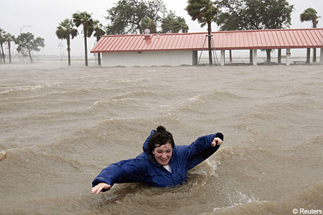
The Old Covenant Too
Adventism of old was being overwhelmed by Spiritualism as WE are TODAY and was under the old covenant! When we turn from submission to Christ and embrace an issue as salvational, we have fallen under Satan’s spell and are as verily lost as were the Jews!

Slide 14
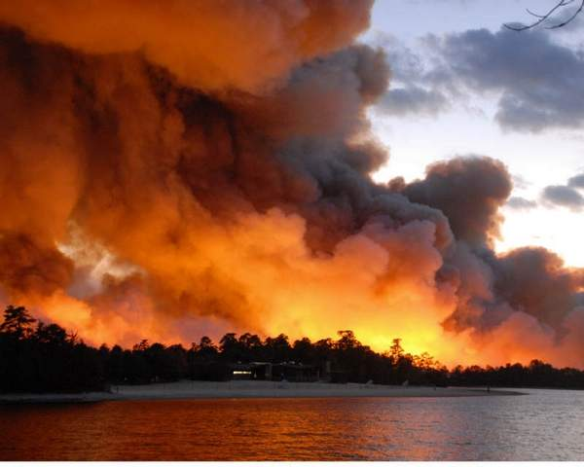
Salvational Issues and Love, Love, Love
We’ve all heard the sentimental love gospel that puts us in heaven without surrendering our lives to Christ. What about the salvational issues that are proposed without which, we are told, we will be lost?
How about:
1. salvation in the feast days?
2. salvation in the sacred name of God?

Slide 15
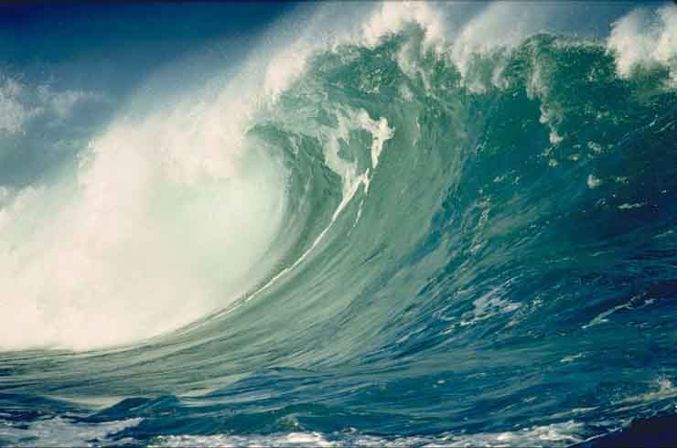
One String on the Violin!
3. salvation in the rejection of the Godhead: Christ was created/the Holy Spirit a presence.
4. salvation in the Wednesday crucifixion
5. salvation in the doctrine ‘God doesn’t kill’.
6. salvation in extremes in diet or dress reform.
7. salvation in only the original writings of E.G. White.
8. salvation in the church is Babylon.
9. salvation only outside the church.
10. salvation in the 2520.

Slide 16
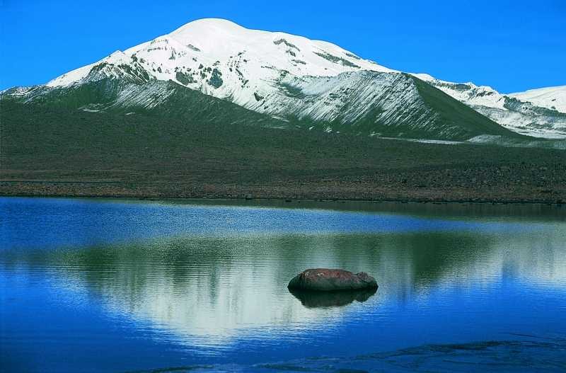
Christ or Issues?
“For we through the Spirit wait for the hope of righteousness by faith.”Galatians 5:6
“This I say then, Walk in the Spirit, and ye shall not fulfill the lust of the flesh.” Galatians 5:16
“And they that are Christ's have crucified the flesh with the affections and lusts.” Galatians 5:24
“I am crucified with Christ: nevertheless I live; yet not I, but Christ liveth in me: and the life which I now live in the flesh I live by the faith of the Son of God, who loved me, and gave himself for me. I do not frustrate the grace of God: for if righteousness come by the law, then Christ is dead in vain.” Galatians 2:20,21

Slide 17

Peace with God
“Therefore being justified by faith, we have peace with God through our Lord Jesus Christ: By whom also we have access by faith into this grace wherein we stand, and rejoice in hope of the glory of God. And not only so, but we glory in tribulations also: knowing that tribulation worketh patience; And patience, experience; and experience, hope: And hope maketh not ashamed; because the love of God is shed abroad in our hearts by the Holy Ghost which is given unto us.” Rom. 5:1-4 “Howbeit when he, the Spirit of truth, is come, he will guide you into all truth: for he shall not speak of himself; but whatsoever he shall hear, that shall he speak: and he will shew you things to come. He shall glorify me: for he shall receive of mine, and shall shew it unto you.” John 16:13,14

