Slide 2
Behind the Door pt 16:
The Edict of Nantes

Slide 3
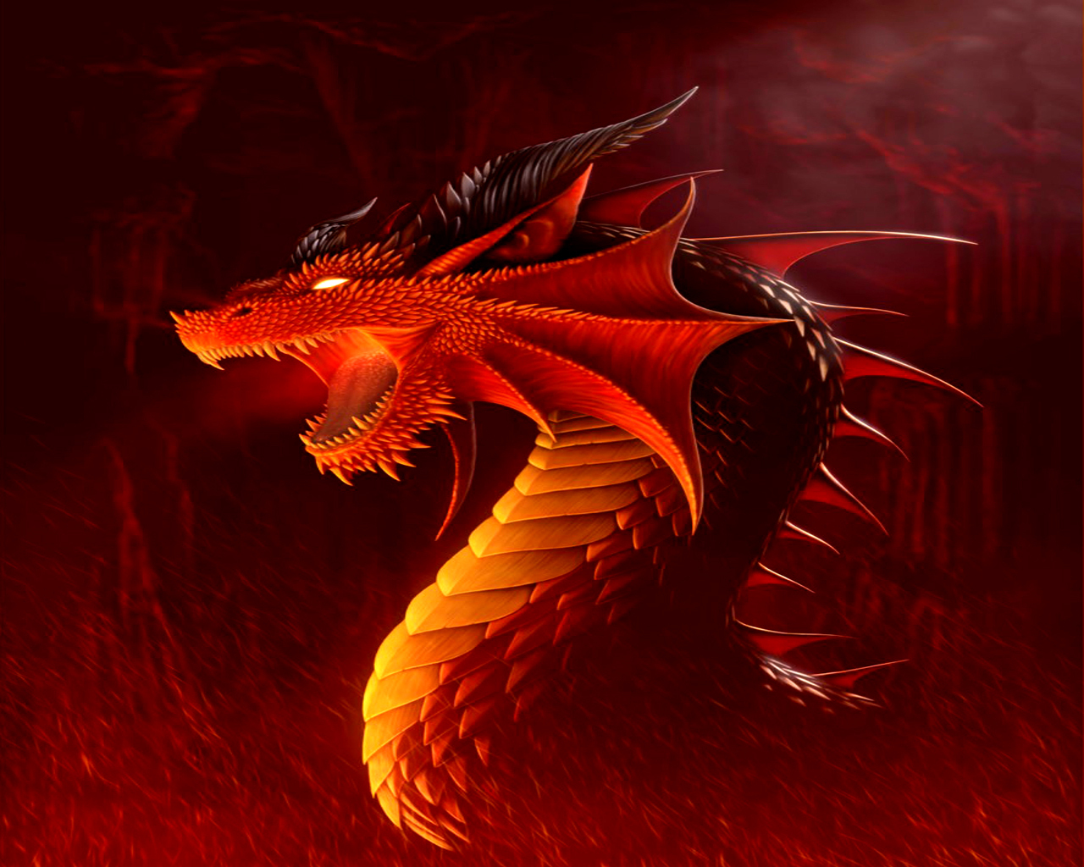
Rev. 13:11 “And I beheld another beast coming up out of the earth; and he had two horns like a lamb, and he spake as a dragon.”

Slide 4
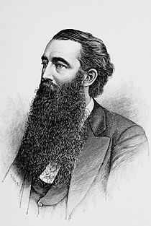
John Clark Ridpath wrote a 9 Volume “History of the World” set in 1894 (originally 8 volumes). The Statement made by Bill Hughes is in the section entitled: NEW WORLD AND REFORMATION —LAST HALF OF CENTURY XVL 239, possibly Volume IV or V depending on the edition

Slide 5
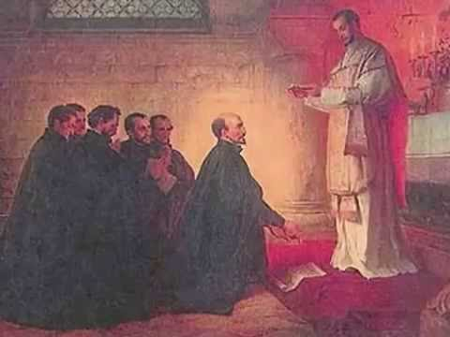
Established Sept. 27, 1540 by Pope Paul III via a Papal Bull, with the first Jesuit Leaders of Ignatius de Loyola, Francis Xavier, and Peter Faber

Slide 6
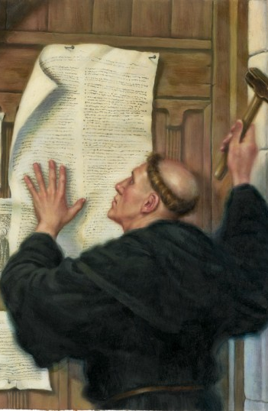
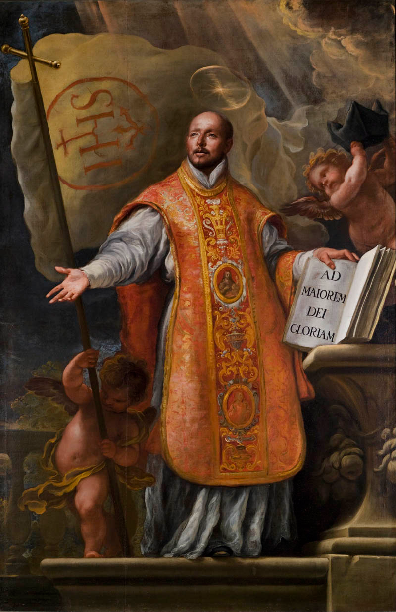
Luther began Reformation in 1517 when he nailed his 95 Theses (a rebuke to Rome about the unbiblical practice of indulgences) to the door of the Wittenberg Chapel.
VS
In response the Pope launched a Counter-Reformation creating the Jesuit Order for the specific purpose of destroying Protestantism. The Order became the official military arm of the Roman Catholic Church in the Council of Trent in 1546, led by Ignatius Loyola

Slide 7
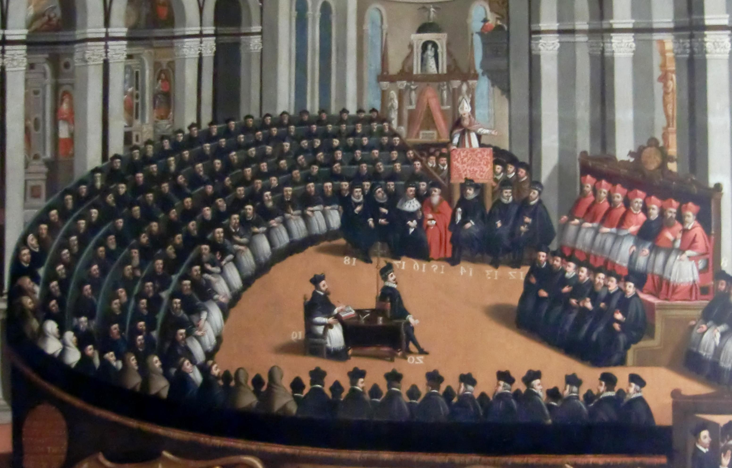
The Council of Trent occurred from 1545-1563, where the Church convened in discussing how to stop the spread of truth via the Reformation and Protestantism. During this time, false teachings were reaffirmed, uninspired writings were put on the level of Scripture (Vulgate), and the destruction of Protestantism commenced with wars, inquisitions, and Crusades.

Slide 10
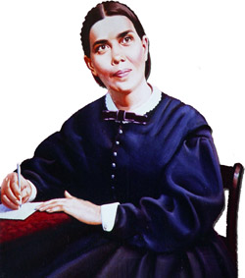
Throughout Christendom, Protestantism was menaced by formidable foes. The first triumphs of the Reformation past, Rome summoned new forces, hoping to accomplish its destruction. At this time the order of the Jesuits was created, the most cruel, unscrupulous, and powerful of all the champions of popery. Cut off from earthly ties and human interests, dead to the claims of natural affection, reason and conscience wholly silenced, they knew no rule, no tie, but that of their order, and no duty but to extend its power.—The Great Controversy, Ellen White, 1911, p. 234

Slide 11
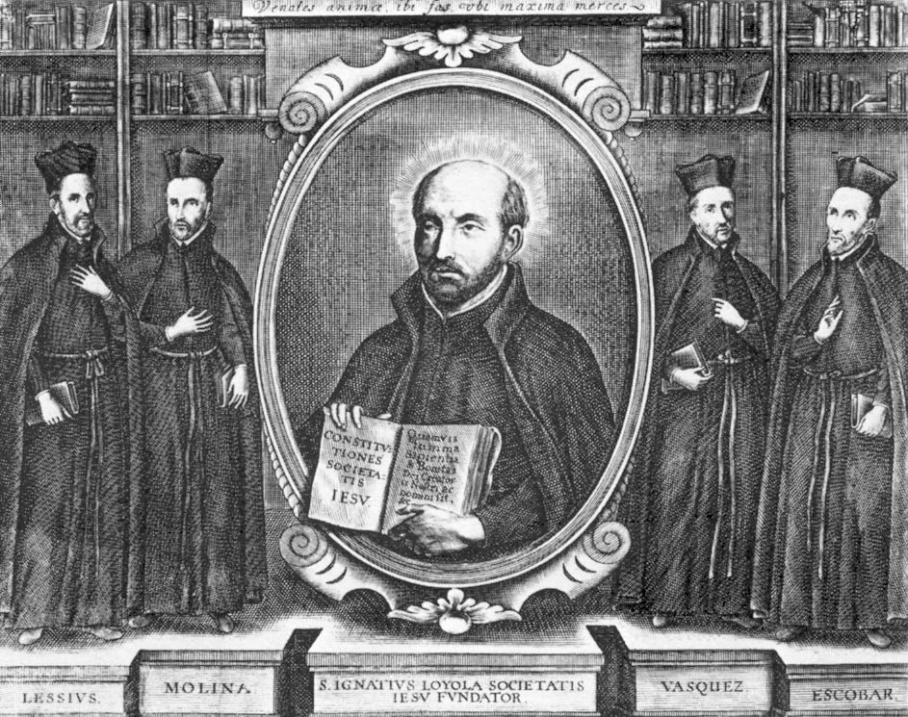
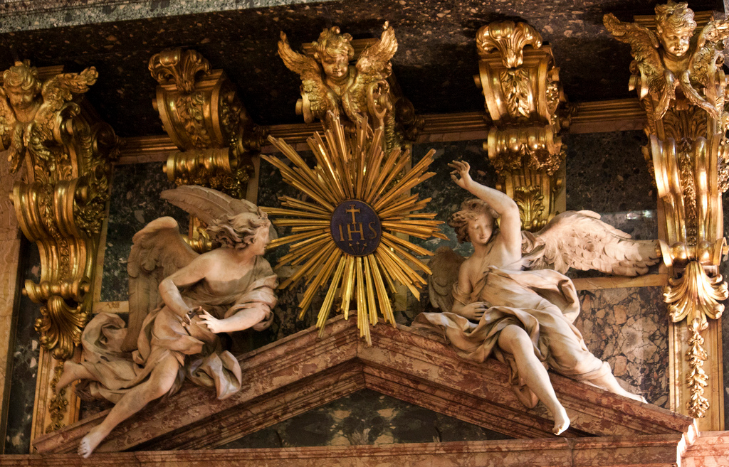
The gospel of Christ had enabled its adherents to meet danger and endure suffering, undismayed by cold, hunger, toil, and poverty, to uphold the banner of truth in face of the rack, the dungeon, and the stake. To combat these forces, Jesuitism inspired its followers with a fanaticism that enabled them to endure like dangers, and to oppose to the power of truth all the weapons of deception. There was no crime too great for them to commit, no deception too base for them to practice, no disguise too difficult for them to assume. Vowed to perpetual poverty and humility, it was their studied aim to secure wealth and power, to be devoted to the overthrow of Protestantism, and the re-establishment of the papal supremacy.—ibid., 234

Slide 12
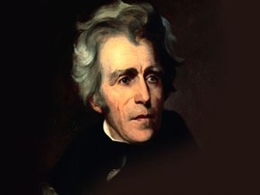
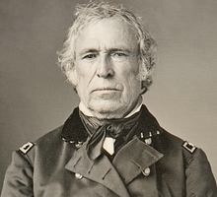
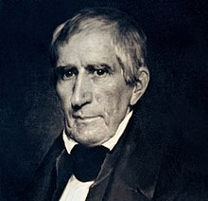
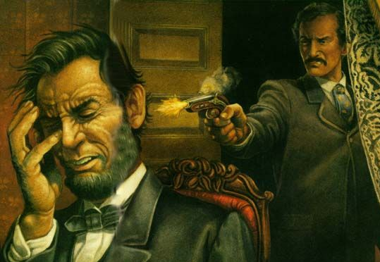
Zachary Taylor 1850
Andrew Jackson Attempted in 1835
Multiple Attempts were made on Andrew Jackson for his opposition to the Federal Reserve, Attempts were made on James Buchanan, Franklin Pierce, and successful against John F. Kennedy. The price for defiance against Rome and their plans. Jesuits have been busy serving their masters, Who are we serving?
William Henry Harrison 1841
Abraham Lincoln 1865

Slide 14
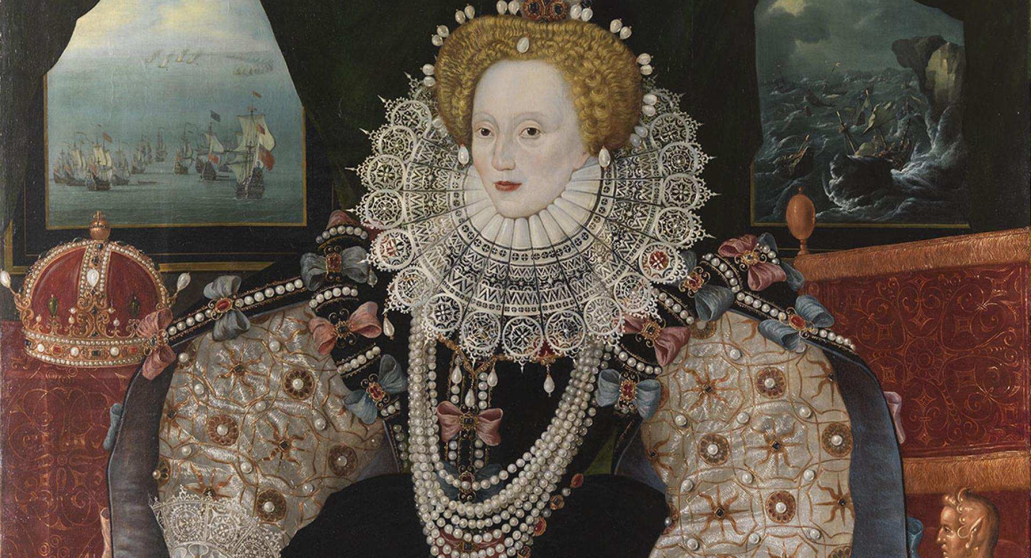
Queen Elizabeth I of England: Reigned from 1558-1603
The Deal: Serve the Roman Pontiff (the Papacy) Pope Sixtus unconditionally or…..
Die via the Roman Catholic Agency of the Jesuit Order
For the Next 30 years starting in 1558, multiple assassination attempts were made on her life throughout her reign ending in 1603

Slide 15
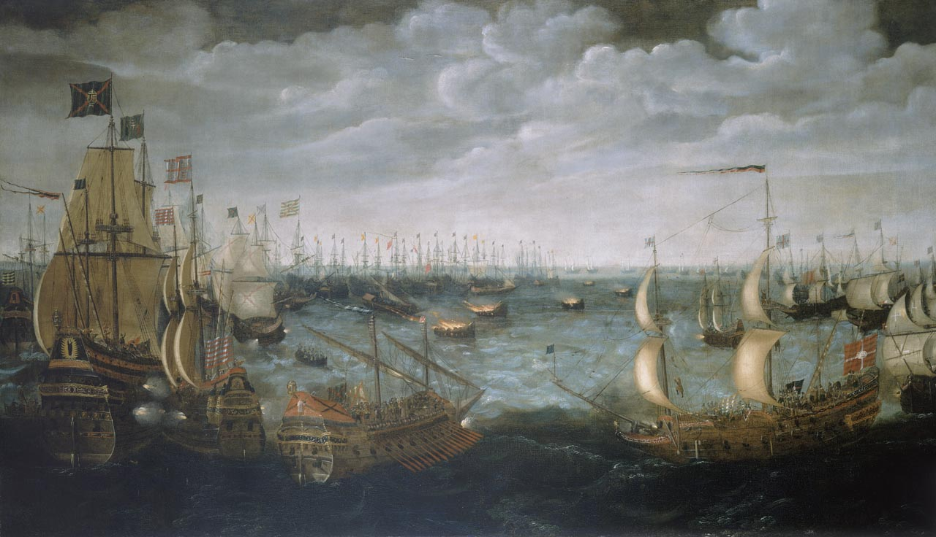
Catholic Spain sent its unrivaled Spanish Armada to England to Destroy the Island Country and depose its Protestant leader

Slide 16
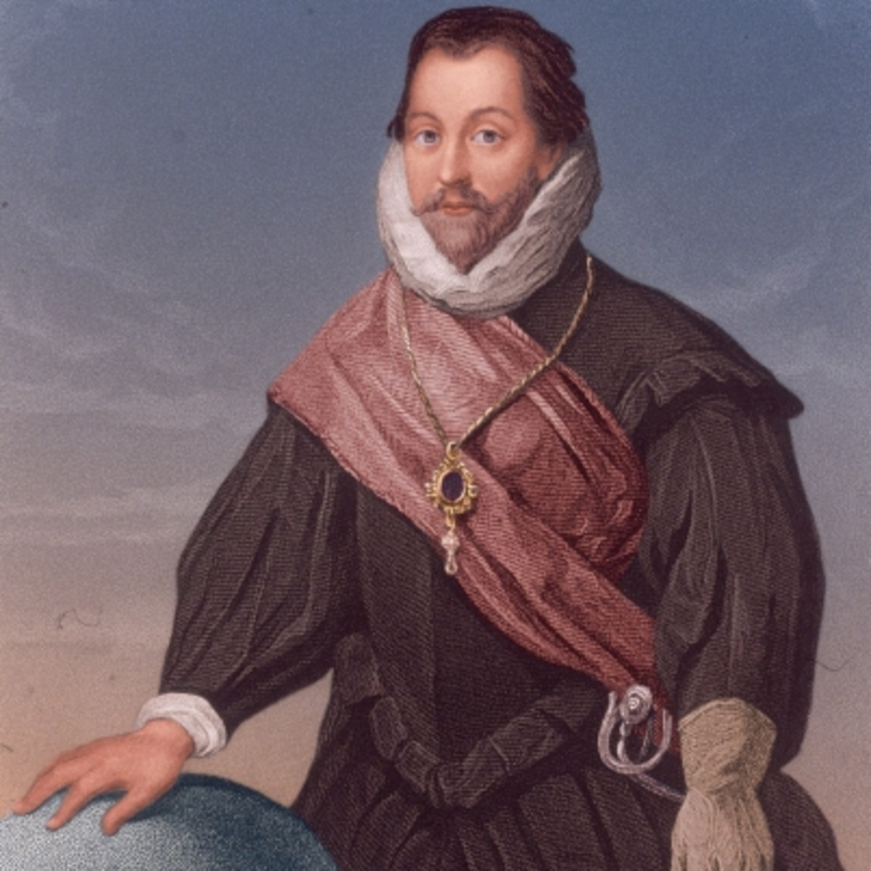
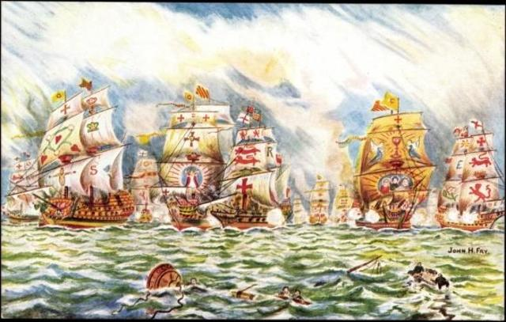
The Spanish Armada was defeated due to a providential storm which massacred most of the fleet of Spain, while Sir Francis Drake utilized a technique that gave his smaller, more maneuverable ships the advantage
Sir Francis Drake (Active: 1563-1596)

Slide 17
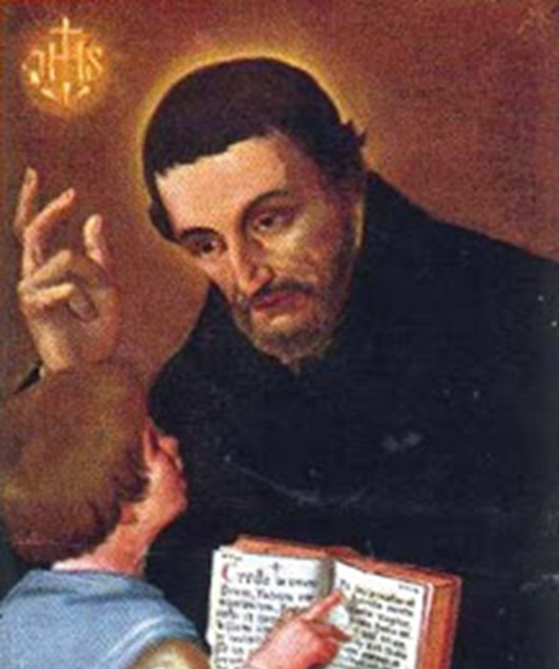
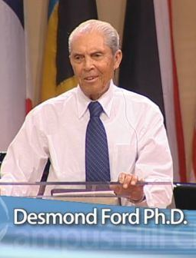
Preterism
Luis de Alcasar (1554-1613) was a Jesuit scholar who also studied and reinterpreted the historical prophecies of Daniel and Revelation, putting them in the past prior to the decline of the Roman Empire. In this scenario, “Nero” was the Antichrist and the Catholic Church was the triumphant “New Jerusalem” which vanquished both spiritual and temporal enemies. This has been expanded to include Antiochus IV Epiphanes
(Vestigatio arcani sensus in Apocalypsi (1614))
This Catholic-Jesuit-originating belief was later propagated by SDA Desmond Ford in the 1970s until dismissed becoming nondenominational evangelical in 1980. Think there might be a Jesuit infiltration in the churches today? SDA or otherwise?

Slide 18
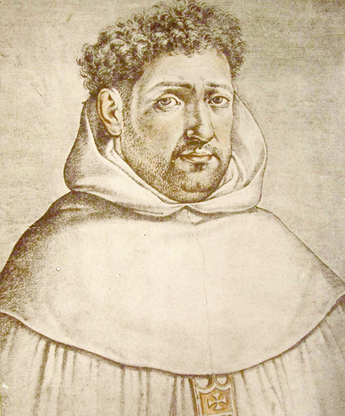
Futurism
Francisco Ribera (1537-1591), a Jesuit priest and doctor of theology from Spain, reinterpreted the prophecies to look for a future figure at the end of times as the true Antichrist and one that would originate from outside the church.
(George Eldon Ladd, The Blessed Hope. A Biblical Study of the Second Advent and Rapture (Grand Rapids, Michigan: Eerdmans, 1956): 37-38.)
These are the Prophetic Beliefs of every mainstream Protestant (Evangelical) Church Today!!! Originating from Catholic Sources, Protestantism is truly wondering after the Beast! What Happened to the doctrines of every single Protestant founding father, which unanimously declared that the Pope was the Antichrist???

Slide 19
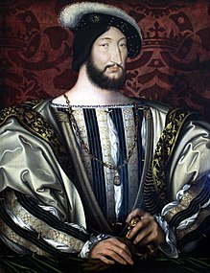
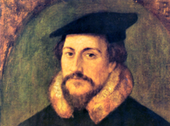
Louis De Berquin (All writings were burned then he was Burned at the Stake in 1529 by a Roman Catholic-French tribunal)
John Calvin (Born in Noyon, Picardy, France in 1509, broke from the Catholic Church in 1530 and fled France on pain of death to Switzerland, where he eventually joined the Reformation in Geneva
Francis I, King of France (1515-1547

Slide 20
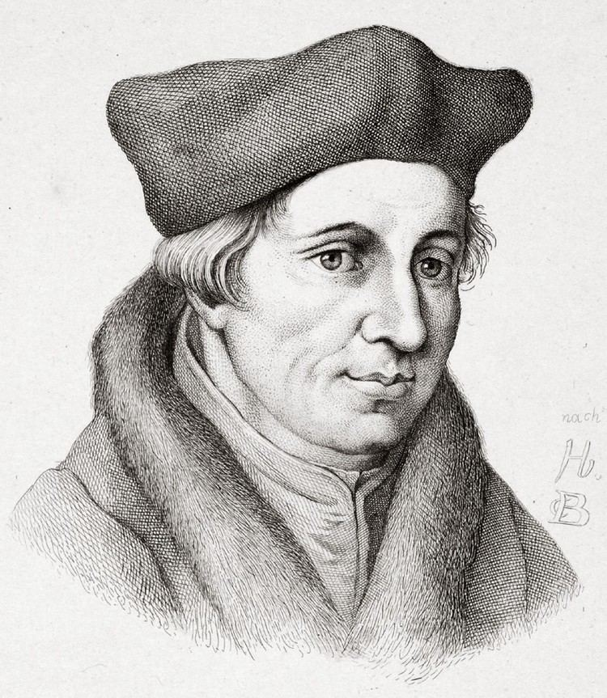
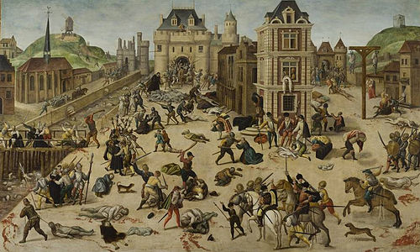
St Bartholomew’s Day Massacre (1572)-A Deceptive peace proposal by Rome led to the slaughter of 10,000-30,000 Protestant Christians
Jacques Lefevre d’Etaples (1455 – 1536)

Slide 21
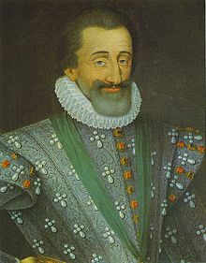
Henry of Navarre or Henry IV was raised Protestant and was thus a Huguenot. He narrowly escaped the slaughter of the St Bartholomew’s Day Massacre. He would be later assassinated by a Catholic Francois Ravaillac in 1610.
Henry IV of France (Reign: 1589-1610)

Slide 22
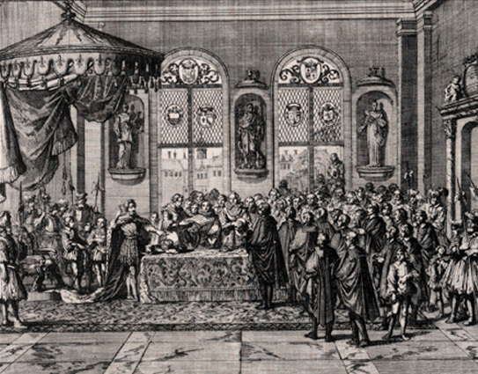
The Edict of Nantes was passed in 1598, granting religious tolerance to Protestants and effectively ending the bloody “French Wars of Religion”

Slide 23
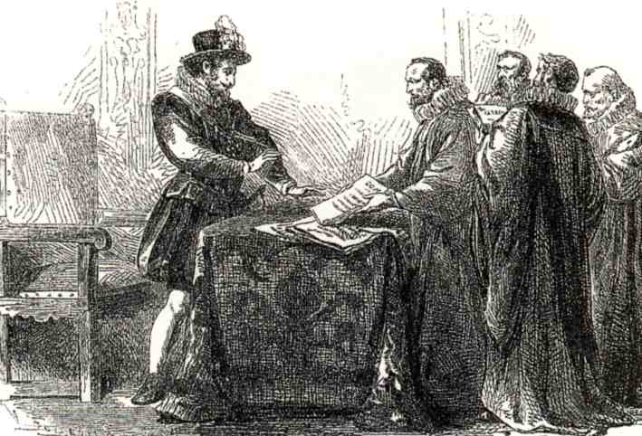

Slide 24
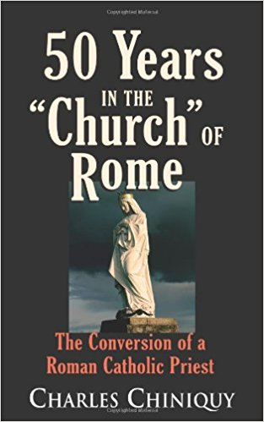
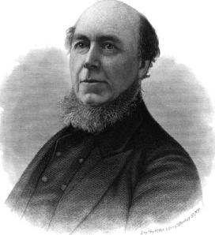
Charles Chiniquy

Slide 25
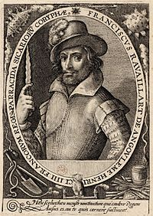
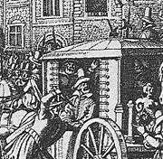
In 1610, Revaillac waited for King Henry IV’s carriage in Paris. When Henry IV’s carriage was paused due to a road block, Revaillac suddenly sprung on Henry IV and stabbed him to death
Jesuit Assassin and Known Catholic Zealot Fanatic Francois Revaillac (1578-1610)

Slide 26
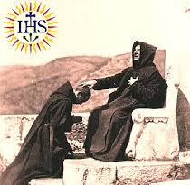

Slide 27
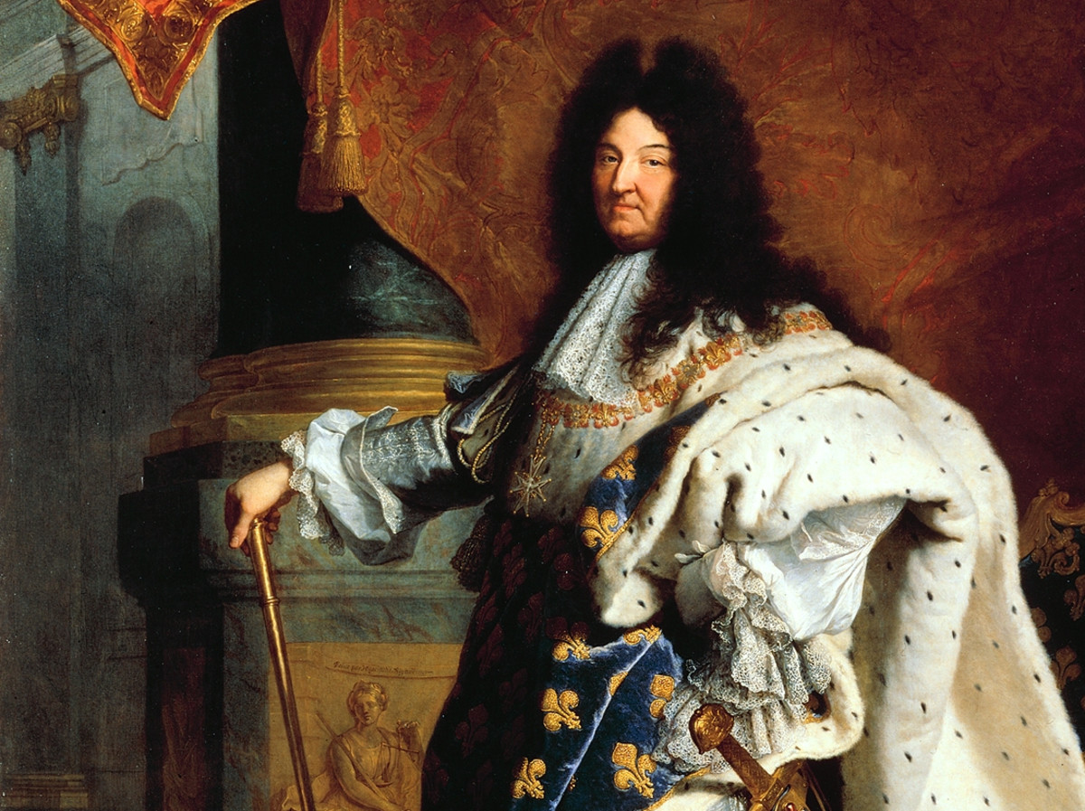
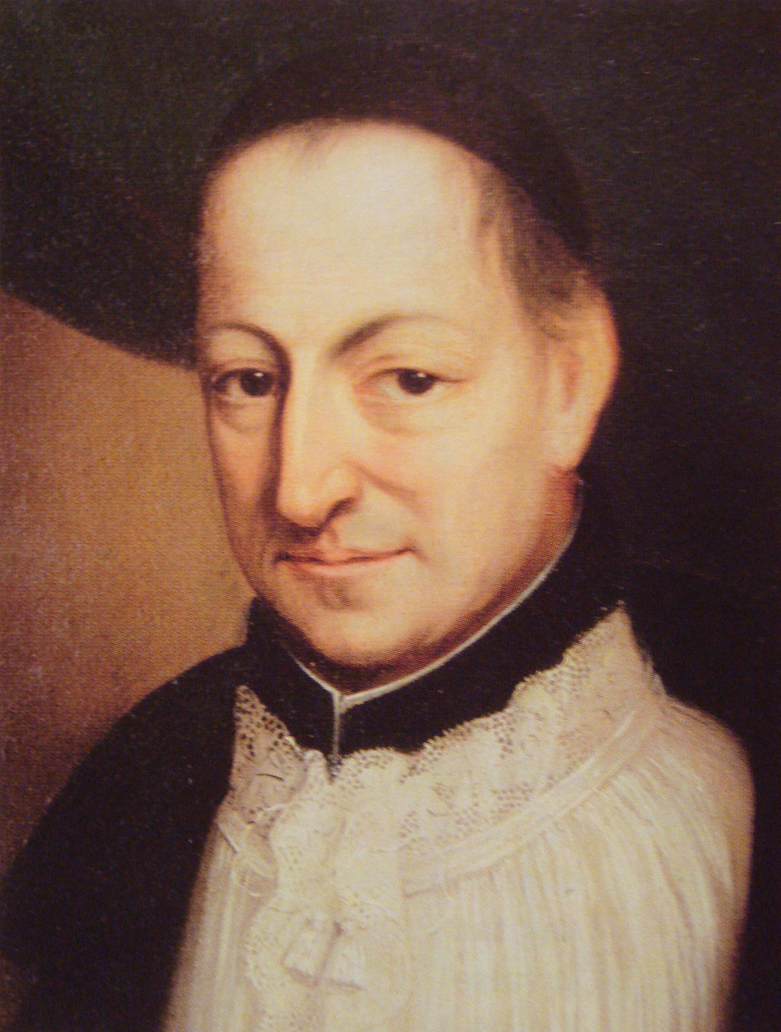
King Louis XIV aka the “Sun King” (Reign 1643-1654)
Jesuit Confessor La Chaise

Slide 28
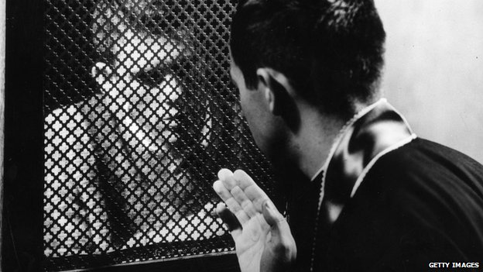
BLACKMAILED!!!

Slide 29
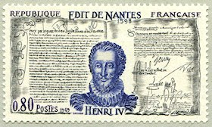

Slide 30
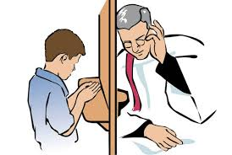

Slide 31
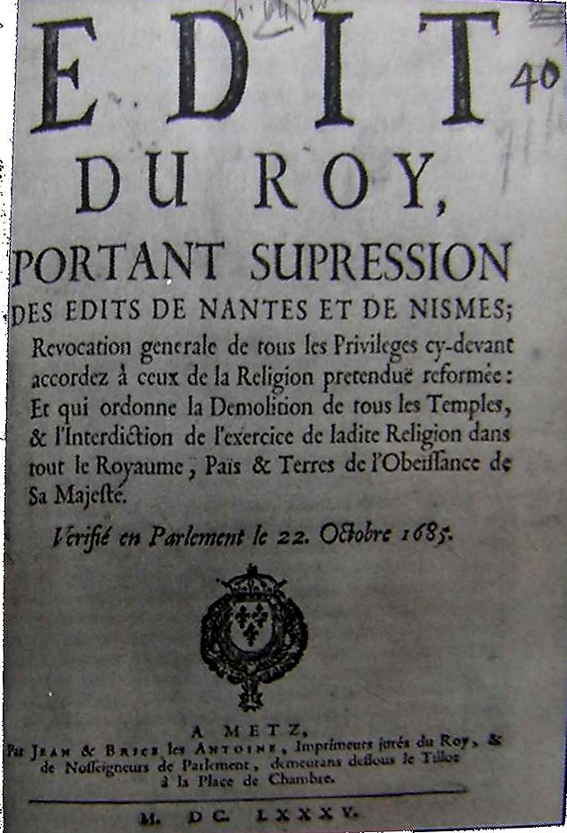
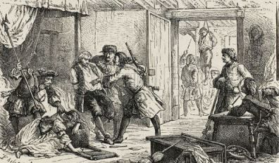
Persecution of the Huguenots and Protestants return after the revocation of the Edict of Nantes in 1685, making Protestantism illegal with the Edict of Fontainebleau

Slide 32
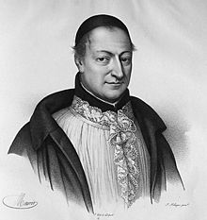
King Louis XIV’s Confessor La Chaise

Slide 33
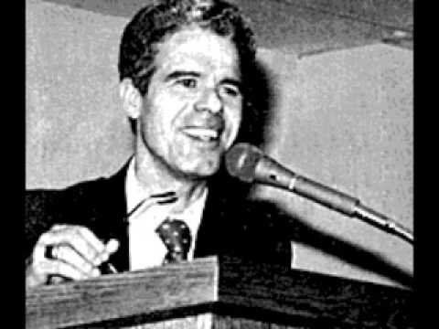
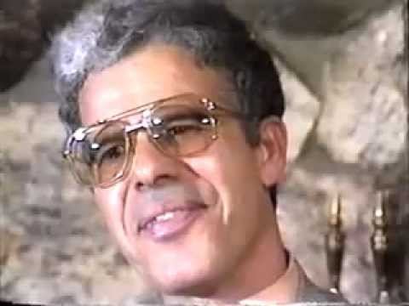
Former Jesuit, Alberto Rivera was a priest in Spain, before leaving Catholicism to embrace Christ. Books about him include: “Is Alberto for Real?-Sidney Hunter, Alberto Rivera series by Jack Chick, and interviewed by Seventh-day Adventist Jim Arabito

