Slide 1
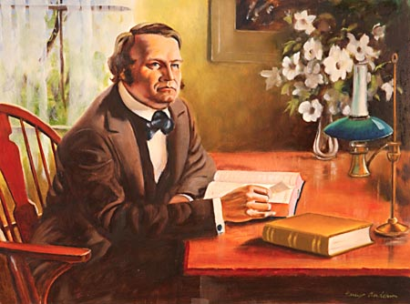
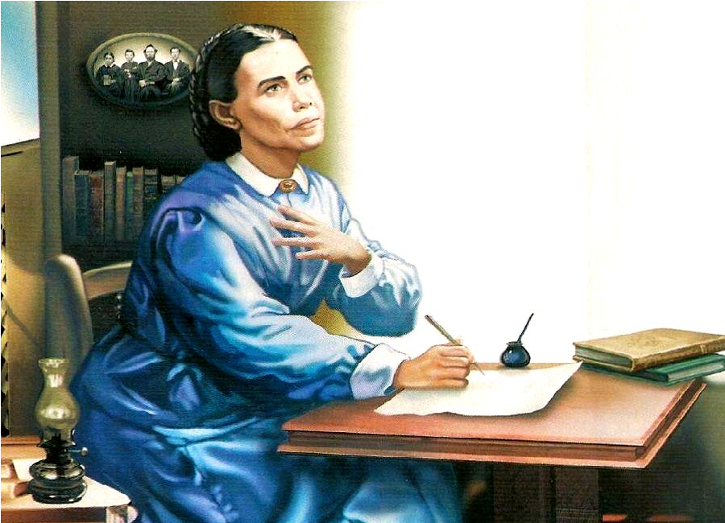
The Sanctuary pt 53: The Antitypical Trumpet Call 3

Slide 2
Recap, the 1st Angel’s Message Includes:
The Everlasting Gospel: The teachings of the Old and New Testaments
Fear God: Keeping the Commandments and hating evil
Give Glory to Him: Keeping Good Health Principles, Consecrated to God, Bearing Fruits
For the Hour of His Judgment is come: Pointing to the Judgment work of Christ in the Heavenly Sanctuary since 1844
Worship Him that made: revival of the lost worship-related commandment of the Sabbath

Slide 3
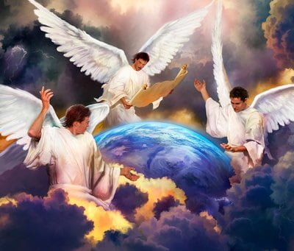
Recap, The 2nd Angel’s Message Includes:
Babylon is fallen: Those Churches who have rejected the warning message given in the 1st Angel’s Message are now in a fallen state, they have become Babylon
Made all nations drink of the wine of the wrath of her fornication: They have used their power and influence to exert their false doctrine upon governments and world leaders, which leads to the 3rd Angel’s Message

Slide 4
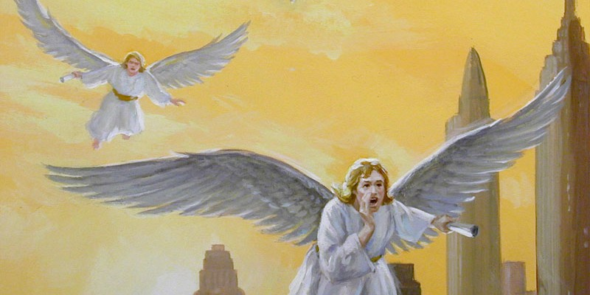
Importance of the Third Angel’s Message
“It has been revealed to me that there is among our people a great lack of knowledge in regard to the rise and progress of the third angel's message. There is great need to search the book of Daniel and the book of Revelation, and learn the texts thoroughly, that we may know what is written.”—Evangelism, p. 363

Slide 5
How Do We Spread the Message!???
“The question then arises, How can these people be reached? How can the great work of the third angel’s message be accomplished? It must be largely accomplished by persevering, individual effort; by visiting the people at their homes.” Evangelism, p. 410

Slide 6
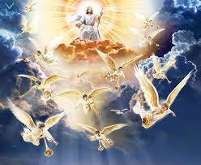
The Power of the Holy Spirit
“This message embraces the two preceding messages. It is represented as being given with a loud voice; that is, with the power of the Holy Spirit. Everything is now at stake. The third angel’s message is to be regarded as of the highest importance. It is a life and death question. The impression made by this message will be proportionate to the earnestness and solemnity with which it is proclaimed.” Manuscript 16, 1900

Slide 7
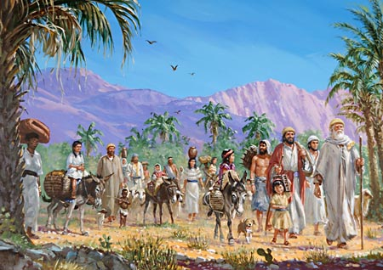
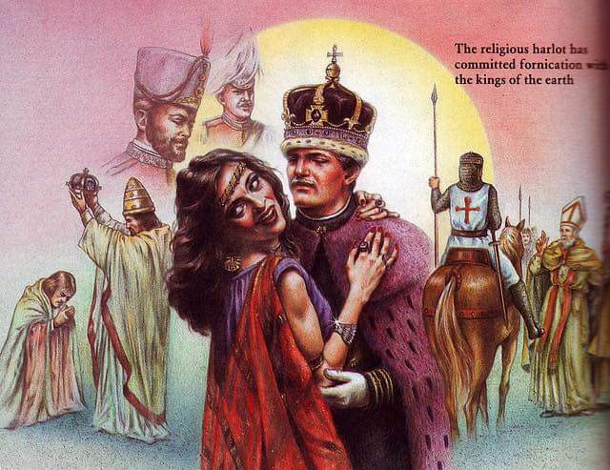
The Last Warning…
Rev. 14:9-12 “And the third angel followed them, saying with a loud voice, If any man worship the beast and his image, and receive his mark in his forehead, or in his hand, The same shall drink of the wine of the wrath of God, which is poured out without mixture into the cup of his indignation; and he shall be tormented with fire and brimstone in the presence of the holy angels, and in the presence of the Lamb: And the smoke of their torment ascendeth up for ever and ever: and they have no rest day nor night, who worship the beast and his image, and whosoever receiveth the mark of his name. Here is the patience of the saints: here are they that keep the commandments of God, and the faith of Jesus.”

Slide 8
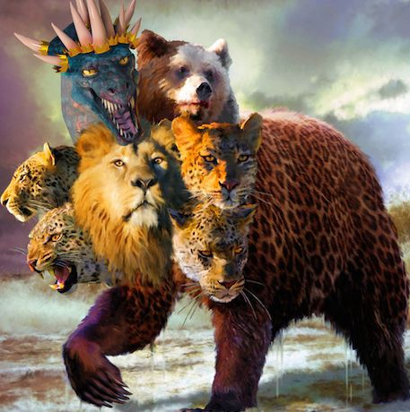
Who’s The Beast? And What is Her Mark?
“Of course the Catholic Church claims that the change was her act. And the act is a mark of her ecclesiastical power and authority in religious matters.” (C.F. Thomas, Chancellor of Cardinal Gibbons, in answer to a letter regarding the change of the Sabbath, November 11, 1895)
“Sunday is our mark of authority . . . The church is above the Bible, and this transference of Sabbath observance is proof of that fact.” (Catholic Record, Sept. 1, 1923, Ontario)

Slide 9
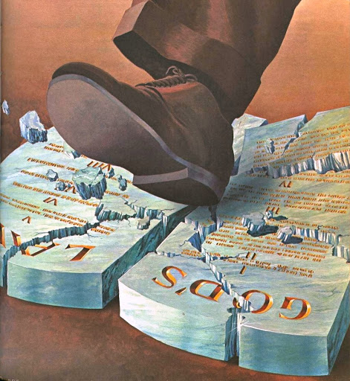
A Couple More Powerful Quotes…
“Perhaps the boldest thing, the most revolutionary change the Church ever did, happened in the first century. The holy day, the Sabbath, was changed from Saturday to Sunday. ‘The day of the Lord’ was chosen, not from any direction noted in the Scriptures, but from the Church’s sense of its power . . . People who think that the Scriptures should be the sole authority, should logically become 7th Day Adventists, and keep Saturday holy” (St. Catherine Church Sentinel, Algonac, Michigan, May 21, 1995)
"It is not yet too late for Protestants to redeem themselves. Will they do it?... will they indeed take the written word only, the Scripture alone, as their sole authority and their sole standard? Or will they still hold the indefensible, self contradictory, and suicidal doctrine and practice of following the authority of the Catholic church and wear the sign of her authority? Will they keep the Sabbath of the Lord, the seventh day, according to Scripture? Or will they keep the Sunday according to the tradition of the Catholic church." (Canon and Tradition, page 31)

Slide 10
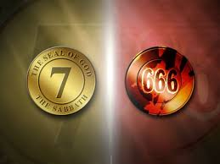

Slide 11
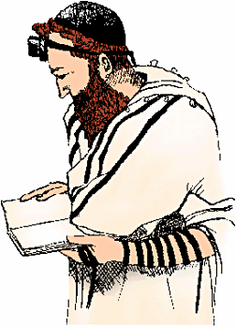
In the Forehead or in the Hand
Deut. 6:1-8 “Now these are the commandments, the statutes, and the judgments, which the Lord your God commanded to teach you, that ye might do them in the land whither ye go to possess it: That thou mightest fear the Lord thy God, to keep all his statutes and his commandments, which I command thee, thou, and thy son, and thy son's son, all the days of thy life; and that thy days may be prolonged. Hear therefore, O Israel, and observe to do it; that it may be well with thee, and that ye may increase mightily, as the Lord God of thy fathers hath promised thee, in the land that floweth with milk and honey. Hear, O Israel: The Lord our God is one Lord: And thou shalt love the Lord thy God with all thine heart, and with all thy soul, and with all thy might. And these words, which I command thee this day, shall be in thine heart: And thou shalt teach them diligently unto thy children, and shalt talk of them when thou sittest in thine house, and when thou walkest by the way, and when thou liest down, and when thou risest up. And thou shalt bind them for a sign upon thine hand, and they shall be as frontlets between thine eyes.”

Slide 12
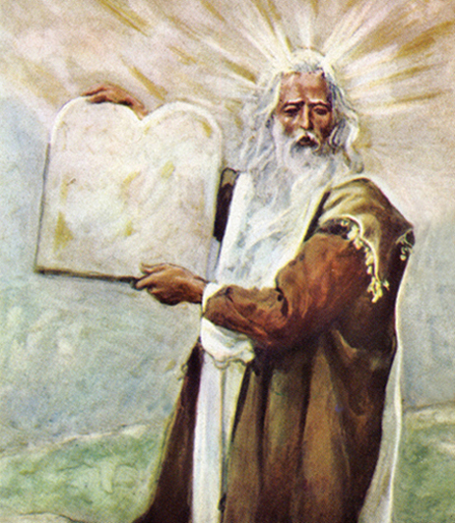
The Patience of the Saints
Rev. 14:12 “Here is the patience of the saints: here are they that keep the commandments of God, and the faith of Jesus”
Is. 58:12 “And they that shall be of thee shall build the old waste places: thou shalt raise up the foundations of many generations; and thou shalt be called, The repairer of the breach, The restorer of paths to dwell in.”
Jer. 6:16 “Thus saith the Lord, Stand ye in the ways, and see, and ask for the old paths, where is the good way, and walk therein, and ye shall find rest for your souls. But they said, We will not walk therein.”

Slide 13
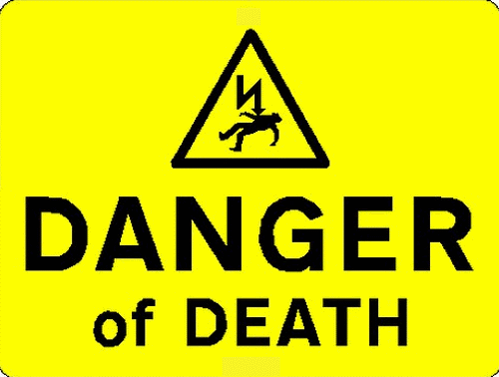
It’s The Final Message of Warning!
“Will the churches heed the Laodicean message? Will they repent, or will they, notwithstanding that the most solemn message of truth--the third angel's message--is being proclaimed to the world, go on in sin? This is the last message of mercy, the last warning to a fallen world. If the church of God becomes lukewarm, it does not stand in favor with God any more than do the churches that are represented as having fallen and become the habitation of devils, and the hold of every foul spirit, and the cage of every unclean and hateful bird.” Manuscript Releases, Vol. 19, p. 176

Slide 14
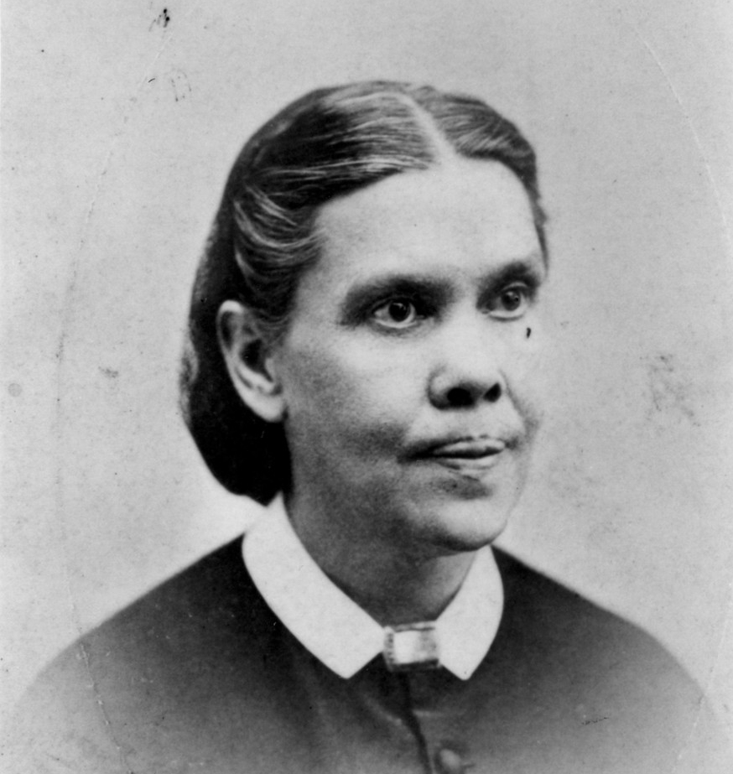
Faith of Jesus=Righteousness By Faith!
“The third angel’s message is the proclamation of the commandments of God and the faith of Jesus Christ. The commandments of God have been proclaimed, but the faith of Jesus Christ has not been proclaimed by Seventh-day Adventists as of equal importance, the law and the gospel going hand in hand. I cannot find language to express this subject in its fullness. ‘The faith of Jesus.’ It is talked of, but not understood. What constitutes the faith of Jesus, that belongs to the third angel’s message? Jesus becoming our sin-bearer that He might become our sin-pardoning Saviour. He was treated as we deserve to be treated. He came to our world and took our sins that we might take His righteousness. And faith in the ability of Christ to save us amply and fully and entirely is the faith of Jesus.” (3 Selected Messages, p. 172)

Slide 15
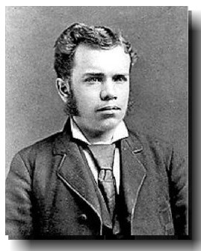
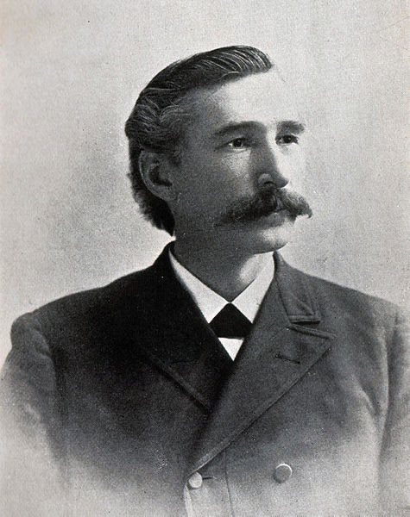
AT Jones and EJ Waggoner: The Faith of Jesus!
“The Lord in His great mercy sent a most precious message to His people through Elders Waggoner and Jones. This message was to bring more prominently before the world the uplifted Saviour, the sacrifice for the sins of the whole world. It presented justification through faith in the Surety; it invited the people to receive the righteousness of Christ, which is made manifest in obedience to all the commandments of God. Many had lost sight of Jesus. They needed to have their eyes directed to His divine person, His merits, and His changeless love for the human family. All power is given into His hands, that He may dispense rich gifts unto men, imparting the priceless gift of His own righteousness to the helpless human agent. This is the message that God commanded to be given to the world. It is the third angel’s message, which is to be proclaimed with a loud voice, and attended with the outpouring of His Spirit in a large measure.” TM, p. 91-92

Slide 16
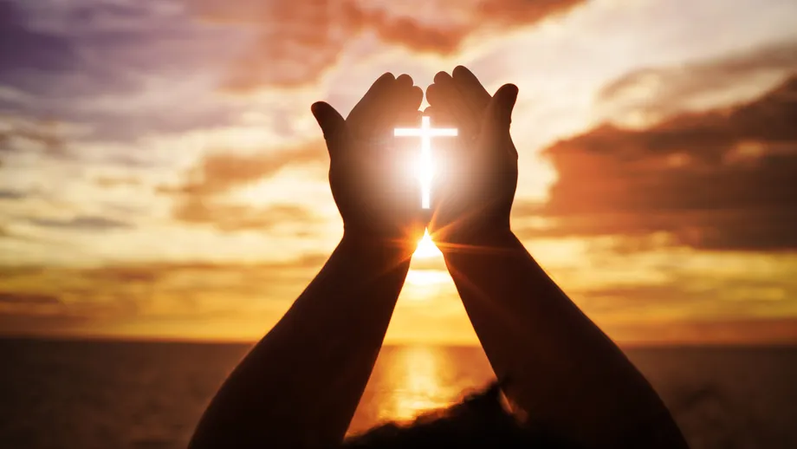
Can’t Be Clearer!
“Several have written to me, inquiring if the message of justification by faith is the third angel’s message, and I have answered, ‘It is the third angel’s message, in verity’”—R&H, Aug. 1, 1890
“The message of Christ’s righteousness is to sound from one end of the earth to the other to prepare the way of the Lord. This is the glory of God, which closes the work of the third angel.”—6T, p. 19

Slide 17
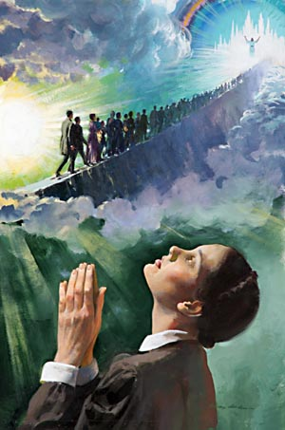
That Means Perfection is the Goal We Must Attain!
“Those who are living upon the earth when the intercession of Christ shall cease in the sanctuary above are to stand in the sight of a holy God without a mediator. Their robes must be spotless, their characters must be purified from sin by the blood of sprinkling. Through the grace of God and their own diligent efforts, they must be conquerors in the battle with evil. While the investigative judgment is going forward in heaven, while the sins of penitent believers are being removed from the sanctuary, there is to be a special work of purification, of putting away sin, among God's people on earth.” {RH, January 17, 1907 par. 4}

Slide 18
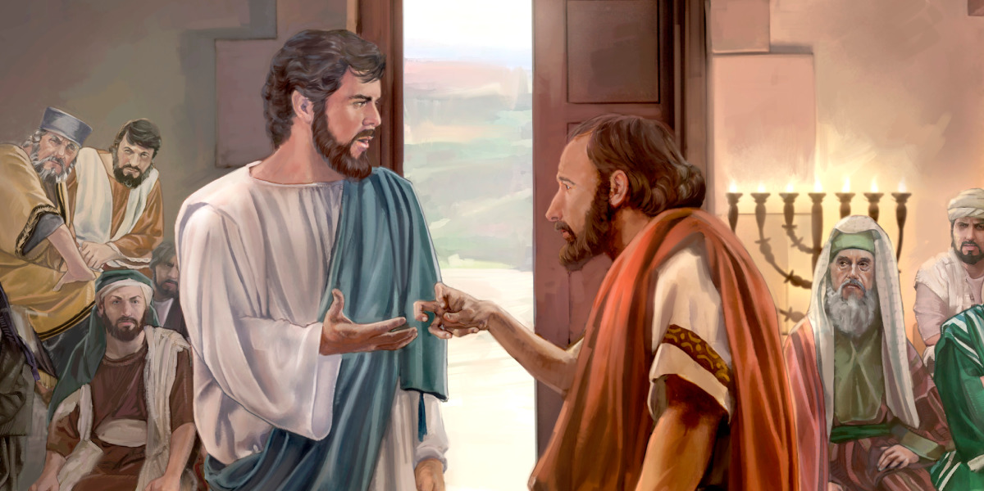
The Right Arm!
“When properly conducted, the health work is an entering wedge, making a way for other truths to reach the heart. When the third angel’s message is received in its fullness, health reform will be given its place in the councils of the conference, in the work of the church, in the home, at the table, and in all the household arrangements. Then the right arm will serve and protect the body. But while the health work has its place in the promulgation of the third angel’s message, its advocates must not in any way strive to make it take the place of the message”—Counsels on Diet and Foods, p. 62

Slide 19
The Vision of 1863.
“Pure air, sunlight, abstemiousness, rest, exercise, proper diet, the use of water, trust in divine power—these are the true remedies. Every person should have a knowledge of nature's remedial agencies and how to apply them. It is essential both to understand the principles involved in the treatment of the sick and to have a practical training that will enable one rightly to use this knowledge.”—Ministry of Healing, p. 127

Slide 20
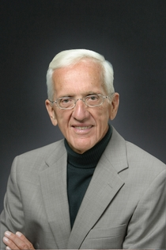
The Science catches up: Whole Foods Plant-based Diet
“The speed at which most nutritional benefits appear when switching to a WFPB diet is jaw-dropping. Diabetics must be monitored from the very first day they adopt the diet, so their meds can be reduced as the diet takes effect. Otherwise, they’re in real danger of having their blood sugar drop low enough to send them into hypoglycemic shock. . . . Caldwell Esselstyn, Jr., MD, used a mostly WFPB diet to reverse advanced heart disease in a study that began in 1985, he found that chronic chest pain (also known as angina) typically disappeared within one to two weeks. . . . The WFPB diet deals with so many diseases and conditions that you begin to wonder if there isn’t just one basic disease cause—poor nutrition—that manifests through thousands of different symptoms. Rather than focus on the underlying cause, Western medicine has decided to focus on the individual symptoms and call each of them a disease. And admittedly, it’s good business to identify thousands of different diseases, then make and sell treatments for each of them, rather than to look at the big picture and prescribe one simple intervention that helps them all.” Dr. T. Colin Campbell, Whole, p. 17, 18, 19

Slide 21
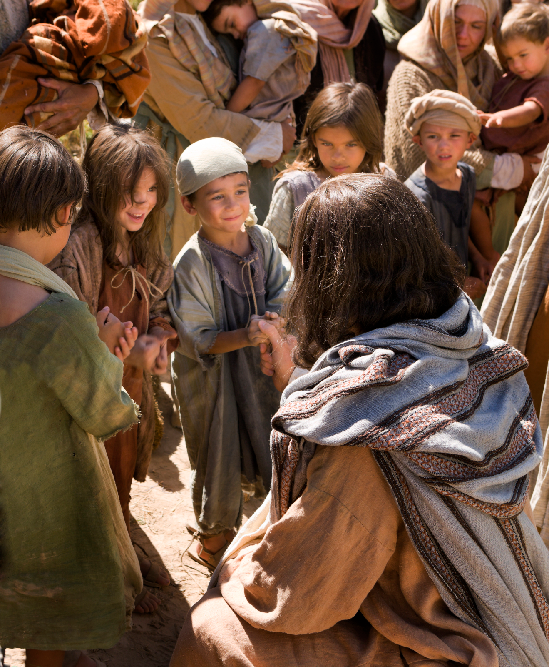
The Perfect Combination!
“Combine the medical missionary work with the proclamation of the third angel’s message. Make regular, organized effort to lift the churches out of the dead level into which they have fallen and have remained for years. Send into the churches workers who will set the principles of health reform in their connection with the third angel’s message before every family and individual. Encourage all to take a part in work for their fellowmen, and see if the breath of life will not quickly return to these churches” TM, p. 416

