Slide 1
Prophecy Update!

Slide 2
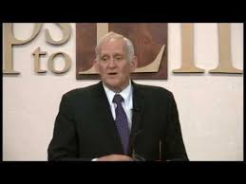
It Is Not the Jews
Evan Sadler. New Zealander. Evangelist. Has done much good work handing out SOP at big events. Will back down to no one. Holds camp meetings in New Zealand; nice guy!
Has, for some reason gone off and teaches that the Jews rule the world today!! You have got to be kidding and SDA’s listen to that nonsense! How prophetic and pathetic!
Come on Evan!!

Slide 3
Beast of Revelation 13:1-10
1. claims to be god on earth.
2. claims power to forgive sins.
3. receives power from the devil.
4. received a deadly wound in 1798.
5. exalts the Sunday tradition above the 7th day Sabbath.
6. reigned through the Dark Ages for 1260 years.
7. claims their priests can forgive sins.
8. persecutes God’s people.
The beast of Revelation 14:9 can only be the papal system. Now, what are we going to do?
1. not proclaim this because someone might be offended?
2. proclaim this precious message and let the chips fall?

Slide 4
The Whore of Revelation of Revelation 17
1. unites with government leaders.
2. claims they are god.
3. claims power to forgive sins.
4. extremely wealthy church.
5. leaders of the apostate protestant churches.
6. persecutes God’s people.
7. locked in the name of this church is the name of a great city in the world.

Slide 5
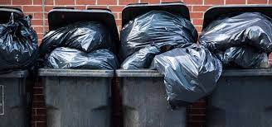
Why Do We Tolerate Garbage?
Don’t we get it? If one domino falls in Adventism, then many other dominoes fall too! If we are confused on the beast, then what is his mark, and who is his image? If we do not know who the whore is, then who are her harlot daughters? Who are the kings united with her? Revelation 17 makes no sense!! Evan, you are wrong!!!

Slide 6
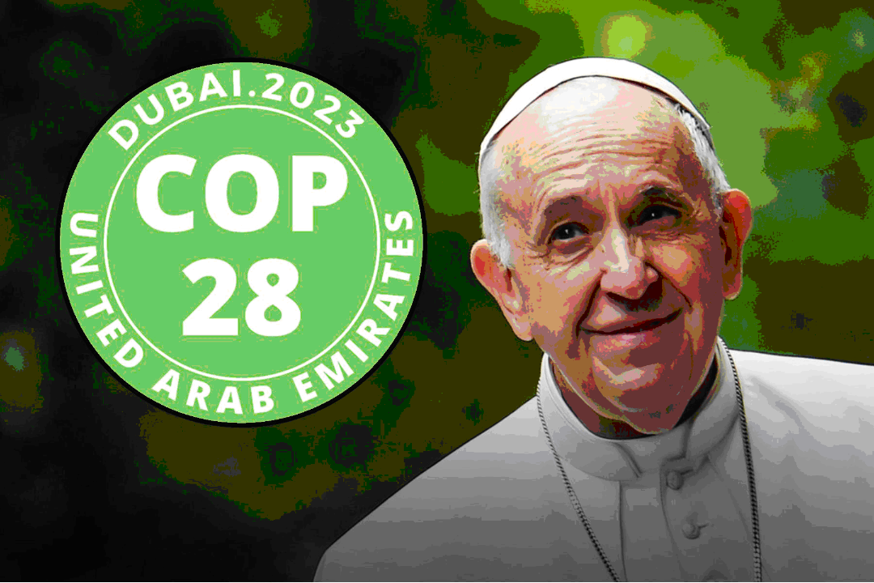
Prophecy Unfolding!
The United Nations 2023 Climate Change Conference (COP 28) is scheduled to take place in Dubai, United Arab Emirates, from November 30 to December 12. Already, Pope Francis is pushing his climate encyclical as the model and solution for the world’s largest international climate change summit. Pope Francis said on July 3, 2023, during an interview with Al-Ittihad, an Arabic-language newspaper published daily in the United Arab Emirates:

Slide 7
Laudato Si!
“In my encyclical ‘Laudato Si’ on the care of our common home, I tried to ask what kind of world we want to leave for those who come after us, for the children who grow up. COP27 in Egypt and COP28 in the United Arab Emirates are essential occasions for the urgent appeal to be heard and to provide answers to the environmental crisis and to the cry of the earth and the cry of the poor who can no longer wait. Let us take care of creation, the gift of our good God. I encourage the United Arab Emirates in its efforts, and I wish it great success for the benefit of our planet, which is our ‘common home’. The only effective way to face this crisis is to find realistic solutions to the real problems of the ecological crisis. We must turn statements into action before it’s too late.” Thanks to Advent Messenger

Slide 8

Laudato Si Emphasis
“On Sunday, our participation in the Eucharist has special importance. Sunday, like the Jewish Sabbath, is meant to be a day which heals our relationships with God, with ourselves, with others and with the world. Sunday is the day of the Resurrection, the ‘first day’ of the new creation, whose first fruits are the Lord’s risen humanity, the pledge of the final transfiguration of all created reality. It also proclaims ‘man’s eternal rest in God’.” (Laudato Si’ #237)

Slide 9
Francis Promotes this in Lisbon!
“Upon his arrival in Lisbon, on Wednesday, Pope Francis made an impassioned plea for Europe to revive the ideals of its founders and seek to build bridges of peace, fraternity and inclusion.”
“World Youth Day therefore represents an opportunity ‘to build together‘, said the Pope, as it ‘revives our desire to accomplish something new and different‘ and ‘to set sail together towards the future.’
“The first is the protection of creation, our common home facing the threats of climate change and of shameless pollution also affecting the oceans. ‘How can we claim to believe in young people, if we do not give them healthy spaces in which to build the future?’ he asked.”
“In a globalized world ‘that brings us closer but fails to create fraternal closeness,’ he said, ‘all of us are challenged to cultivate a sense of community, a sense of closeness and solidarity‘.”

Slide 10
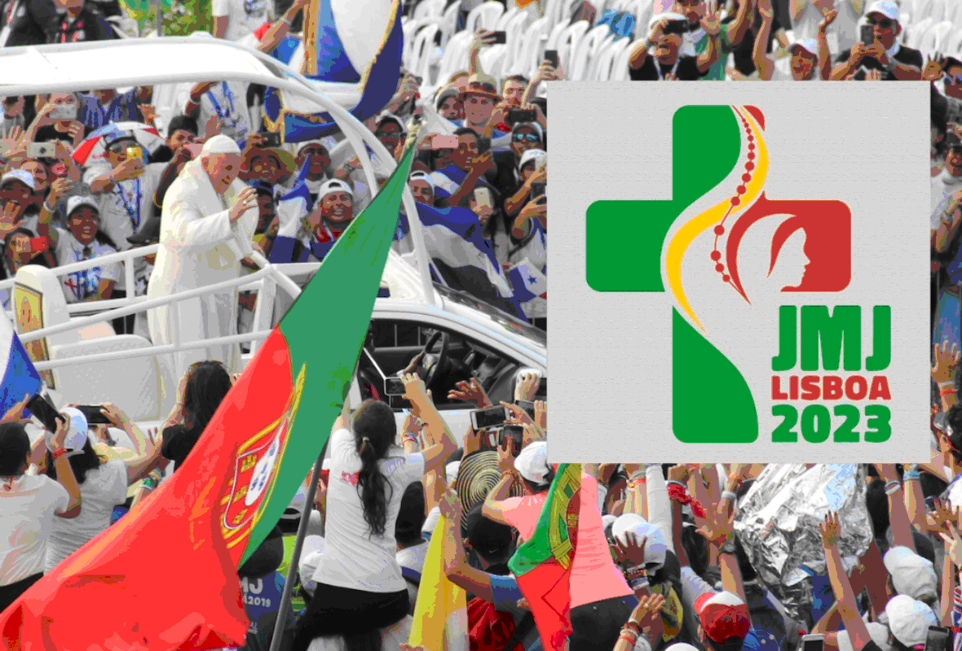
Francis Unites Climate, Sunday, and fraternity- Ecumenism
“The different religions, based on their respect for each human person as a creature called to be a child of God, contribute significantly to building fraternity and defending justice in society” (Fratelli Tutti, 271).
“The Church esteems the ways in which God works in other religions, and “rejects nothing of what is true and holy in these religions” (Fratelli Tutti, 277).
“Once more we realized that no one is saved alone; we can only be saved together” (Fratelli Tutti, 32).

Slide 11
Climate Issues, Sunday, Unity!
“In every place and in a thousand forms, Satan is exercising his power. He sweeps away the ripening harvest, and famine and distress follow. He imparts to the air a deadly taint, and thousands perish by the pestilence. These visitations are to become more and more frequent and disastrous. Destruction will be upon both man and beast. “The earth mourneth and fadeth away,” “the haughty people ... do languish. The earth also is defiled under the inhabitants thereof; because they have transgressed the laws, changed the ordinance, broken the everlasting covenant.” Isaiah 24:4, 5. And then the great deceiver will persuade men that those who serve God are causing these evils. The class that have provoked the displeasure of Heaven will charge all their troubles upon those whose obedience to God's commandments is a perpetual reproof to transgressors. It will be declared that men are offending God by the violation of the Sunday sabbath; that this sin has brought calamities which will not cease until Sunday observance shall be strictly enforced; and that those who present the claims of the fourth commandment, thus destroying reverence for Sunday, are troublers of the people, preventing their restoration to divine favor and temporal prosperity.” GC, pgs. 589,590

Slide 12
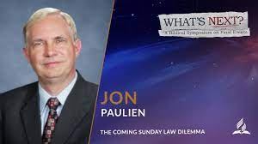
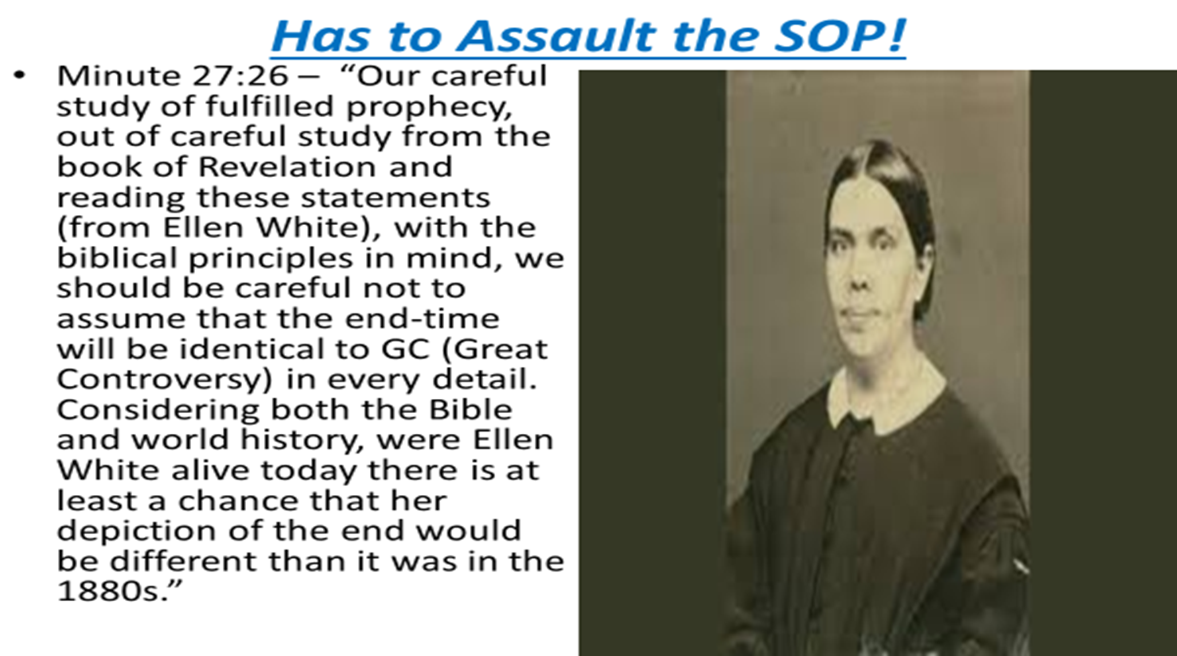
Adventists Respond

Slide 13
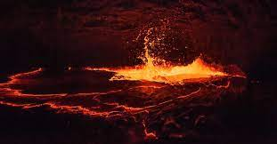
Fraternity with Rome!!
After years of ecumenical dialogue with Rome, interfaith cooperation, and mutual trust, Seventh-day Adventists in Brazil are now working in partnership with Roman Catholics to give “solidarity baths” and vaccinations to the homeless. These “solidarity baths” are designed to bring the participating church into unity as well as the homeless community. Solidarity with Rome will lead to reconciliation and bring an end to religious divisions. This is Vatican II, and it’s bringing the separated brethren back together.
UNICO Portal is a journalistic publication located in the city of Manaus, Brazil. On June 15, 2023, UNICO Portal reported the following regarding the partnership between Seventh-day Adventists and Roman Catholics:

Slide 14
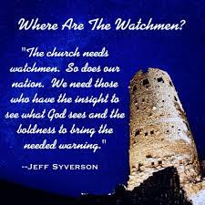
Insane!!
• “The Seventh-day Adventist Church, in partnership with the Catholic Church and the Manaus City Hall, is organizing another edition of the ‘Solidarity Bath‘ for homeless people in Manaus, who circulate through Praça da Matriz, next Saturday, at 5 p.m. “More than 200 volunteers will organize – from bath cabins and showers installed in Praça da Matriz – baths and other hygienic procedures for 150 people on the streets.” They will have clothes to change, hygiene kits, consultation, exams and vaccination. In addition to haircut, nail cut, and for women, eyebrows. A social action will deliver 500 meals at the end. What? Solidarity bath. Where? Matriz Square. When? 6/17/2023 from 3 p.m. to 8 p.m.” There is absolutely nothing wrong with feeding the homeless and providing for the needy, but to exploit this good work and use it as a ruse to inject the wine of Babylon by bringing all the churches together. ://portalunico.com/evangelicos-e-catolicos-oferecem-banho-solidario-a-moradores-de-rua/
Thanks to Advent messenger

Slide 15
Praise the Lord!
“In the closing work of God in the earth, the standard of His law will be again exalted. False religion may prevail, iniquity may abound, the love of many may wax cold, the cross of Calvary may be lost sight of, and darkness, like the pall of death, may spread over the world; the whole force of the popular current may be turned against the truth; plot after plot may be formed to overthrow the people of God; but in the hour of greatest peril the God of Elijah will raise up human instrumentalities to bear a message that will not be silenced. In the populous cities of the land, and in the places where men have gone to the greatest lengths in speaking against the Most High, the voice of stern rebuke will be heard. Boldly will men of God's appointment denounce the union of the church with the world. Earnestly will they call upon men and women to turn from the observance of a man-made institution to the observance of the true Sabbath. “Fear God, and give glory to Him,” they will proclaim to every nation; “for the hour of His judgment is come: and worship Him that made heaven, and earth, and the sea, and the fountains of waters.... If any man worship the beast and his image, and receive his mark in his forehead, or in his hand, the same shall drink of the wine of the wrath of God, which is poured out without mixture into the cup of His indignation.” Revelation 14:7-10.

