Slide 1
The Third Angel’s Message
Revelation 14:9-11

Slide 2
In a Nutshell
“And the third angel followed them, saying with a loud voice, If any man worship the beast and his image, and receive his mark in his forehead, or in his hand,
The same shall drink of the wine of the wrath of God, which is poured out without mixture into the cup of his indignation; and he shall be tormented with fire and brimstone in the presence of the holy angels, and in the presence of the Lamb:
And the smoke of their torment ascendeth up for ever and ever: and they have no rest day nor night, who worship the beast and his image, and whosoever receiveth the mark of his name.” Revelation 14:9-11

Slide 3
Worship is the issue
“If any man worship………..” Revelation 14:9
“Why do thy disciples transgress the tradition of the elders? for they wash not their hands when they eat bread.
But he answered and said unto them, Why do ye also transgress the commandment of God by your tradition? For God commanded, saying, Honour thy father and mother: and, He that curseth father or mother, let him die the death. But ye say, Whosoever shall say to his father or his mother, It is a gift, by whatsoever thou mightest be profited by me; And honour not his father or his mother, he shall be free. Thus have ye made the commandment of God of none effect by your tradition. Ye hypocrites, well did Esaias prophesy of you, saying, This people draweth nigh unto me with their mouth, and honoureth me with their lips; but their heart is far from me. But in vain they do worship me, teaching for doctrines the commandments of men.” Matthew 15:2-9

Slide 4
The True and the False
True worship is honoring God’s commandments thru faith in Jesus Christ.
False worship is honoring a man made tradition that is in open rebellion against God’s commandments.

Slide 5
The Contrast and the Warning
““Fear God, and give glory to him; for the hour of his judgment is come: and worship him that made heaven, and earth, and the sea, and the fountains of waters.” We are called upon to worship the Creator. As we have seen, worship is tied to the 10 commandments. True worship is honoring God’s commands and false worship is honoring man made traditions.
“If any man worship the beast and his image, and receive his mark in his forehead, or in his hand,
The same shall drink of the wine of the wrath of God, which is poured out without mixture into the cup of his indignation;” Rev. 14:9,10

Slide 6
Exodus 20:8-11
“Remember the sabbath day, to keep it holy. Six days shalt thou labour, and do all thy work: But the seventh day is the sabbath of the LORD thy God: in it thou shalt not do any work, thou, nor thy son, nor thy daughter, thy manservant, nor thy maidservant, nor thy cattle, nor thy stranger that is within thy gates: For in six days the LORD made heaven and earth, the sea, and all that in them is, and rested the seventh day: wherefore the LORD blessed the sabbath day, and hallowed it.”

Slide 7

Honoring the Commandment that reveals the Creator: The Sabbath

Slide 8
The Results
“And I heard a great voice out of the temple saying to the seven angels, Go your ways, and pour out the vials of the wrath of God upon the earth. And the first went, and poured out his vial upon the earth; and there fell a noisome and grievous sore upon the men which had the mark of the beast, and upon them which worshipped his image.” Rev. 16:1,2
“Revelation 19:20,21 “And the beast was taken, and with him the false prophet that wrought miracles before him, with which he deceived them that had received the mark of the beast, and them that worshipped his image. These both were cast alive into a lake of fire burning with brimstone.”

Slide 9
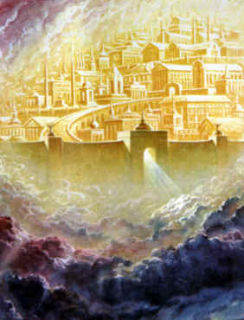
The Victory of the Redeemed
“And I saw thrones, and they sat upon them, and judgment was given unto them: and I saw the souls of them that were beheaded for the witness of Jesus, and for the word of God, and which had not worshipped the beast, neither his image, neither had received his mark upon their foreheads, or in their hands; and they lived and reigned with Christ a thousand years.“ Revelation 20:4,5

Slide 10
The Beast Did It!
This is the first beast in Revelation 13 who has these characteristics.
1. It is a political/religious power. (Rev.13:1)
2. It rises in the Mediterranean World. (Rev.13:1)
3. It claims to be God/ claims to forgive sin. (ver.1)
4. It teaches the immortal soul.
5. It demands reverence because it thinks that it is god. (ver.1)
6. It forces people to worship God the way it thinks.(ver. 3,4)
7. It gets its power from the devil. (Rev.13:2)

Slide 11
There is More
8. It ruled the world for 1,260 years. (Rev.13:5)
9. It sought to usurp Christ’s work on man’s behalf in the heavenly sanctuary. (Rev. 13:6)
10. It killed people in the name of God. (Rev. 13:7)
11. Those who reject her authority have their name written in the Lamb’s Book of Life. (Rev. 13:8)

Slide 12
And More………………
12. It received a deadly wound in 1798. (Rev. 13:3)
13. It unites with America to enforce worship. (Rev. 13:12)
14. Its number is 666- Vicarius Filii Dei.
Who can this power be that seeks to enforce worship?
Notes:
12)

Slide 13
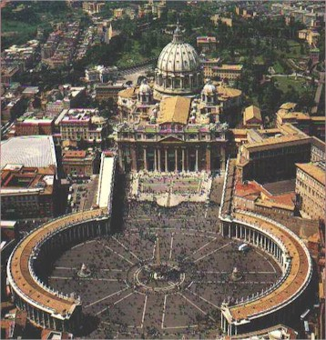
The Home of the Beast

Slide 14
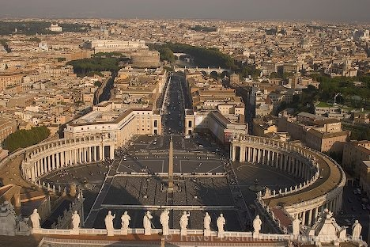
Will we Honor the Beast?

Slide 15
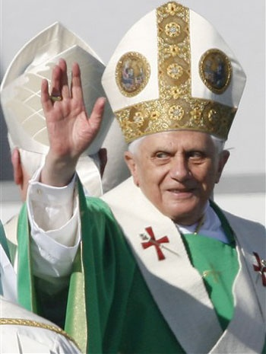
The Dire Warning
This system is setting up a false religious plan to assist people to save themselves in their sins.
To comply with them is to be lost… “The same shall drink of the wine of the wrath of God, which is poured out without mixture into the cup of his indignation…”

Slide 16
Their Worship Plan
Prove to me from the Bible alone that I am bound to keep Sunday holy. There is no such law in the Bible. It is a law of the holy Catholic Church alone. The Bible says ‘Remember the Sabbath day to keep it holy.’ The Catholic Church says, No. By my divine power I abolish the Sabbath day and command you to keep holy the first day of the week. And lo! The entire civilized world bows down in reverent obedience to the command of the Holy Catholic Church. — Thomas Enright, CSSR, President, Redemptorist College (Roman Catholic), Kansas City, MO., February 18, 1884.
The observance of Sunday by the Protestants is an homage they pay, in spite of themselves, to the authority of the [Catholic] church. — Monsignor Louis Segur, Plain Talk About the Protestantism of Today (1868), p. 213.

Slide 17
Continued….
If Protestants would follow the Bible, they should worship God on the Sabbath Day [Saturday]. In keeping the Sunday they are following a law of the Catholic church. — Albert Smith, Chancellor of the Archdiocese of Baltimore, replying for the Cardinal in a letter of February 10, 1920.
The State, in passing laws for the due sanctification of Sunday, is unwittingly acknowledging the authority of the Catholic Church, and carrying out more or less faithfully its prescriptions.
The Sunday, as a day of the week set apart for the obligatory public worship of Almighty God, to be sanctified by a suspension of all servile labor, trade, and worldly avocations and by exercises of devotion, is purely a creation of the Catholic Church. — The American Catholic Quarterly Review, January, 1883, pp. 152, 139.

Slide 18
Dies Domini 7-5-1998
APOSTOLIC LETTER
DIES DOMINI
OF THE HOLY FATHER
JOHN PAUL II
TO THE BISHOPS, CLERGY AND FAITHFUL
OF THE CATHOLIC CHURCH
ON KEEPING THE LORD'S DAY HOLY
My esteemed Brothers in the Episcopate
and the Priesthood,
Dear Brothers and Sisters!
1. The Lord's Day — as Sunday was called from Apostolic times(1) — has always been accorded special attention in the history of the Church because of its close connection with the very core of the Christian mystery. In fact, in the weekly reckoning of time Sunday recalls the day of Christ's Resurrection. It is Easter which returns week by week, celebrating Christ's victory over sin and death, the fulfillment in him of the first creation and the dawn of "the new creation" (cf. 2 Cor 5:17). It is the day which recalls in grateful adoration the world's first day and looks forward in active hope to "the last day", when Christ will come in glory (cf. Acts 1:11; 1 Th 4:13-17) and all things will be made new (cf. Rev 21:5).

Slide 19
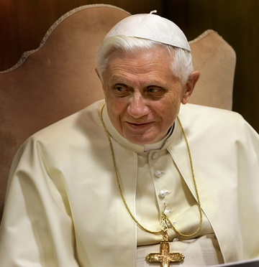
The man who wrote Dies Domini
As the head of the Congregation for the Doctrine of the Faith, (known before as the Holy Office of the Inquisition) it was Joseph Ratzinger’s job to write encyclicals and be the defender of Catholic teaching and to punish all dissenters. Anyone who didn’t agree with ‘God’s Rottweiler’ was to suffer his wrath.

Slide 20
Benedict’s Push
Pope: Sunday Worship a “Necessity” For All
September 17, 2007 | From theTrumpet.com
Pope Benedict XVI says your life depends upon worshiping on Sunday.
“Sine dominico non possumus!” “Without Sunday [worship] we cannot live!” Pope Benedict xvi declared during a mass on September 9 at St. Stephen’s Cathedral in Vienna.
Speaking on the final day of his three-day visit to Austria, the German pope voiced a strong call for Christians to revive Sunday keeping as an all-important religious practice.
“Give the soul its Sunday, give Sunday its soul,” he chanted before a rain-soaked crowd of 40,000.
Benedict said that Sunday, which he stated has its origin as “the day of the dawning of creation,” was “also the church’s weekly feast of creation.”
Warning against the evils of allowing Sunday to become just a part of the weekend, the pope said people needed to have a spiritual focus during the first day of the week, or else leisure time would just become wasted time.

Slide 21
The Image Concurs
1. A look-a-like of the Papacy will be set up in America.
2. This look-a-like of Rome will use the state to enforce Sunday keeping on America.
3. This image will persecute those who don’t follow their Sunday tradition.
Any idea who the image of the Papacy could be?

Slide 22
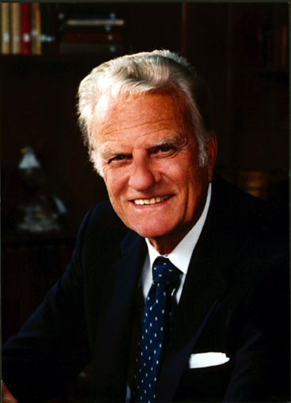
The Image
Apostate Protestant churches embrace the beast-the papacy-when they honor Sunday. By this act, they are honoring a man made tradition and will suffer the horrific consequences.

Slide 23
The Victors
“And I saw as it were a sea of glass mingled with fire: and them that had gotten the victory over the beast, and over his image, and over his mark, and over the number of his name, stand on the sea of glass, having the harps of God.
And they sing the song of Moses the servant of God, and the song of the Lamb, saying, Great and marvellous are thy works, Lord God Almighty; just and true are thy ways, thou King of saints.
Who shall not fear thee, O Lord, and glorify thy name? for thou only art holy: for all nations shall come and worship before thee; for thy judgments are made manifest.” Rev. 15:2-4

Slide 24
The Messages
“The proclamation of the first, second, and third angels' messages has been located by the Word of Inspiration. Not a peg or pin is to be removed. No human authority has any more right to change the location of these messages than to substitute the New Testament for the Old. The Old Testament is the gospel in figures and symbols. The New Testament is the substance. One is as essential as the other.” Ms 32, 1896, p. 1

Slide 25
Life and Death
Third Angel's Message a Life-and-Death Question.-We know that now everything is at stake. The third angel's message is to be at this time regarded as of the highest importance. It is a life-and-death question. {9MR 290.1}
The eighteenth chapter of Revelation reveals the importance of presenting the truth in no measured terms, but with boldness and power. There must be no toning down of the truth, no muffling of the message for this time. Satan has devised a state of things whereby the proclamation of the third angel's message shall be bound about. We must beware of his plans and methods. The third angel's message is to be strengthened and confirmed. . . . {9MR 290.2}
Satan will so mingle his deceptions with truth that side issues will be created to turn the attention of the people from the great issue, the test to be brought upon the people of God in these last days.--Letter 28, 1900, pp. 2-4.

Slide 26
Justification by Faith
“Several have written to me, inquiring if the message of justification by faith is the third angel's message, and I have answered, "It is the third angel's message, in verity."-- The Review and Herald, April 1, 1890. {1SM 372.2}

Slide 27
Let them tell you.
William Johnson-Editor-Adventist Review-1994,1995 ‘Saints Victory in the End-time’ “To interpret the sea monster of Revelation 13 as the papacy seems somewhat out of keeping with the spirit of the times. In an age when Christianity in general faces the onslaughts of secularism and when among Christians ecumenism has become popular, the interpretation smacks of narrowness and bigotry.” Shocking………………………………………

Slide 28
George Vandemann
George Vandeman “These were dark ages for the church. How could Christians be so intolerant of their brothers and sisters in Christ? Jesus had predicted that those who killed His followers would sincerely think they were serving God…It is not for us to question our medieval ancestors…Nor must we overlook the good done by the church. Throughout the world, monasteries provided care for orphans, widows, and the sick. And all of us owe appreciation to the church of the Middle Ages for preserving the Scriptures.” Vandeman, The Rise and Fall of Christ, pages 54,55

Slide 29
Associate Editor of Review
Associate Editor of the Review, Myron Widmer “I was surprised and delighted to learn that the Bible is the sole textbook during the pope’s visit and the World Youth Day activities. What a wonderful opportunity fro so many young people to hear the gospel message straight from God’s Word…Or might a better understanding be that God is working through this pope to open doors for Catholics to the great truths of Scripture concerning salvation by faith in Christ?”…I can only wonder if in these last days He is using some very unexpected sources to encourage many individuals (especially Catholics) in search for truth.” Review and Herald, September 9,23,and 30, 1993

Slide 30
Professor of Andrews
Ranko Stefanovic, professor, Andrews University, writes a book entitled ‘Revelation of Jesus Christ’. It is over 600 pages. It is endorsed by Andrews and Notre Dame Universities. When commenting on the beast who comes up from the sea, he gets tongue tied, never once mentioning the papacy. Shocking!

Slide 31
Samuel Bacchiochi
“In the light of this symbolic interpretation of the three and half year as the time of the domination and persecution of the Antichrist during which God's people will be protected, this identifying mark of the Little Horn applies equally well to the Papacy and Islam. Both powers have attempted to wear out the saints of the Most High, but during the times of persecution many believers have been empowered and protected by God.
The preceding analysis of the identifying marks of the prophetic Antichrist, represented in Daniel 7 by the imagery of the Little Horn and in Revelation 13 by the symbol of a Beast, has shown that both the Papacy and Islam fulfill the qualifying marks of this prophetic power.” End time Issues, #86 Disgusting!

Slide 32
The Spirit of God
Ellen White, over 90 times identifies the papacy as the beast in Revelation 13:1-10.
“In chapter 13 (verses 1-10) is described another beast, "like unto a leopard," to which the dragon gave "his power, and his seat, and great authority." This symbol, as most Protestants have believed, represents the papacy, which succeeded to the power and seat and authority once held by the ancient Roman empire. Of the leopard like beast it is declared: "There was given unto him a mouth speaking great things and blasphemies. . . . And he opened his mouth in blasphemy against God, to blaspheme His name, and His tabernacle, and them that dwell in heaven. And it was given unto him to make war with the saints, and to overcome them: and power was given him over all kindreds, and tongues, and nations." This prophecy, which is nearly identical with the description of the little horn of Daniel 7, unquestionably points to the papacy.” GC. Page 439

