Slide 1
Election Fiasco
Smell the Roses, honey!

Slide 2
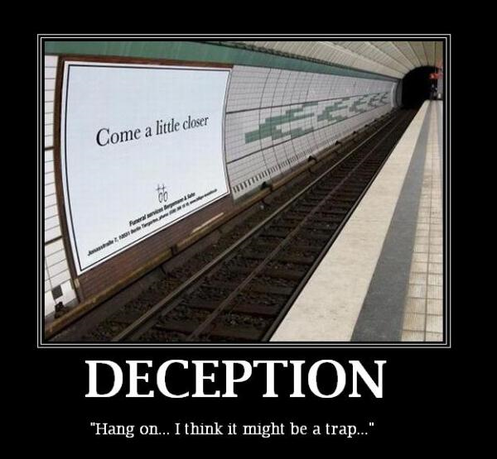
Take Heed That….
“And Jesus answered and said unto them, Take heed that no man deceive you.” “For many shall come in my name, saying, I am Christ; and shall deceive many.” “And many false prophets shall rise, and shall deceive many.” “For there shall arise false Christ's, and false prophets, and shall shew great signs and wonders; insomuch that, if it were possible, they shall deceive the very elect.” Matthew 24:4,5.11, and 24

Slide 3
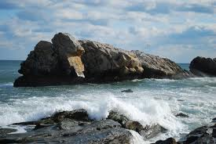
Listen!
“We have also a more sure word of prophecy; whereunto ye do well that ye take heed, as unto a light that shineth in a dark place, until the day dawn, and the day star arise in your hearts:” 2 Peter 1:19

Slide 4
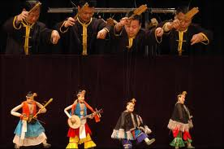
The Puppets
”And there came one of the seven angels which had the seven vials, and talked with me, saying unto me, Come hither; I will shew unto thee the judgment of the great whore that sitteth upon many waters: With whom the kings of the earth have committed fornication, and the inhabitants of the earth have been made drunk with the wine of her fornication…And the woman which thou sawest is that great city, which reigneth over the kings of the earth.” Rev. 17:1,2,18

Slide 5
By Implication, Rev. 17:18 says…
1. The leaders of the world do as the papacy tells them!
2. The leaders of the world do what is in the papacy’s best interest, not that of their country!
3. The leaders of the world are traitors to their own country, willing to destroy THEIR country if the papacy says so!
4. The leaders of the world are committing treason against their nation, their people, and are committing rank treason!

Slide 6
Never Changes
“The Roman Catholic Church, with all its ramifications throughout the world, forms one vast organization under the control, and designed to serve the interests, of the papal see. Its millions of communicants, in every country on the globe, are instructed to hold themselves as bound in allegiance to the pope. Whatever their nationality or their government, they are to regard the authority of the church as above all other. Though they may take the oath pledging their loyalty to the state, yet back of this lies the vow of obedience to Rome, absolving them from every pledge inimical to her interests.
History testifies of her artful and persistent efforts to insinuate herself into the affairs of nations; and having gained a foothold, to further her own aims, even at the ruin of princes and people. In the year 1204, Pope Innocent III extracted from Peter II, king of Arragon, the following extraordinary oath: "I, Peter, king of Arragonians, profess and promise to be ever faithful and obedient to my lord, Pope Innocent, to his Catholic successors, and the Roman Church, and faithfully to preserve my kingdom in his obedience, defending the Catholic faith, and persecuting heretical depravity." --John Dowling, The History of Romanism, b. 5, ch. 6, sec. This is in harmony with the claims regarding the power of the Roman pontiff "that it is lawful for him to depose emperors" and "that he can absolve subjects from their allegiance to unrighteous rulers."--Mosheim, b. 3, cent. 11, pt. 2, ch. 2, sec. 9, note 17. (See also Appendix note for page 447.)
And let it be remembered, it is the boast of Rome that she never changes.” GC, pgs. 580,581

Slide 7
Warring from Within!
“A nation can survive its fools, and even the ambitious. But it cannot survive treason from within. An enemy at the gates is less formidable, for he is known and carries his banners openly against the city. But the traitor moves among those within the gates freely, his sly whispers rustling through all the alleys, heard in the very halls of government itself. For the traitor appears no traitor; he speaks in the accents familiar to his victims, and he wears their face and their garments, and he appeals to the baseness that lies deep in the hearts of all men. He rots the soul of a nation; he works secretly and unknown in the night to undermine the pillars of a city; he infects the body politic so that it can no longer resist.” — Marcus Cicero, speaking to Caesar, Crassus, Pompey and the Roman Senate.

Slide 8
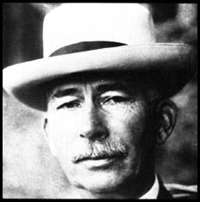
In America/The CFR
The CFR would control the Empire’s finance, government, industry, religion, education, and press. No one could be elected to the Presidency of the United States without the Council’s consent, as the office would be a tool for the Archbishop of New York subject to ‘the Vicar of Christ’ [the pope] in Rome. (One of the founders of the CFR also aided in the creation of the Federal Reserve Bank. He was the ‘holy monk’, a Shriner Freemason and agent of the Jesuit General. Edward M. House.)– Eric Phelps, VA, p. 464, 465.

Slide 9
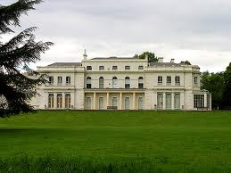
House Created it
House was also intimate with the power centers of money and power in Europe.
“House had close contacts with both J.P. Morgan and the old banking families of Europe.” — G. Edward Griffin, The Creature from Jekyll Island, American Opinion Publishing, p. 239. The old banking families of Europe were the Rothschild's.
"The money to found the CFR came in part from J.P. Morgan, John D. Rockefeller, Bernard Baruch, Otto Kahn, Jacob Schiff and Paul Warburg".
This article was found at: www.biblebelievers.org.au/ and expands on the CFR's beginnings as excerpted from Quigley's book Tragedy and Hope .
“Aware that the Rothschild's are an important Jewish family, I looked them up in Encyclopedia Judaica and discovered that they bear the title ‘Guardians of the Vatican Treasury’…. The appointment of Rothschild gave the black papacy absolute financial privacy and secrecy. Who would ever search a family of orthodox Jews for the key to the wealth of the Roman Catholic Church?” — F. Tupper Saussy, Rulers of Evil, Harper Collins, page 160, 161

Slide 10
The Pyramid
The Jesuits/Papacy
Rothschild’s/Rockefeller’s/Morgan’s
Edward M. House
Politicians/Media/Destroy Sovereignty

Slide 11
Media Dominance
“There is no such thing, at this date of the world’s history, in America, as an independent press. You know it, and I know it. There is not one of you who dares to write your honest opinions, and if you did, you know beforehand that it would never appear in print. I am paid weekly for keeping my honest opinion out of the paper I am connected with. Others of you are paid similar salaries for similar things, and any of you who would be so foolish as to write honest opinions would be out on the streets looking for another job. If I allowed my honest opinions to appear in one issue of my newspaper, before twenty-four hours my occupation would be gone. The business of the journalists is to destroy the truth; to lie outright; to pervert; to vilify; to fawn at the feet of mammon, and to sell his country and his race for his daily bread. You know it, and I know it and what folly is this toasting an independent press? We are the tools and vassals of rich men behind the scenes. We are the jumping jacks, they pull the strings and we dance. Our talents, our possibilities and our lives are all the property of other men. We are intellectual prostitutes. — Multiple contributors, A U.S. Police Action: Operation Vampire Killer, The American Citizens and Laumen Association, pp. 18,19, (emphasis supplied).

Slide 12
Since 1952!
The Jesuits have always hated America and everything this country stands for, and they work tirelessly to destroy this country.
The great objective of the CFR was the destruction of American sovereignty and constitutional liberties. To accomplish this, both political parties would have to be controlled.
“When a new President comes on board, there is a great turnover in personnel, but no change in policy. Example: During the Nixon [a Republican] years Henry Kissinger, CFR member and Nelson Rockefeller’s protégé, was in charge of foreign policy. When Jimmy Carter [a Democrat] was elected, Kissinger was replaced by Zbigniew Brzezinski, CFR member and David Rockefeller’s protégé. “
Barry Goldwater, With No Apologies, William Morrow and Company, page 278.
Every politician since 1952 has either been a member of the Council on Foreign Relations, the Trilateral Commission, Skull and Bones, or a Roman Catholic! Every one of these groups is subservient to Rome. Have you ever wondered why nothing changes, even when a new party comes on board!

Slide 13
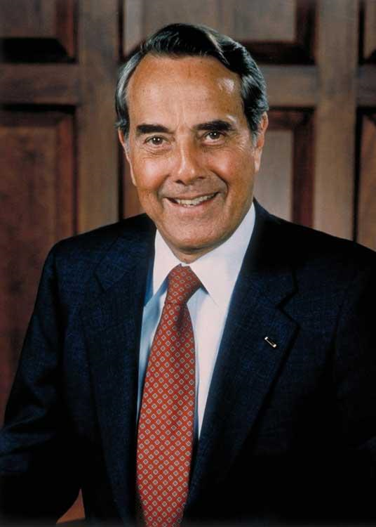
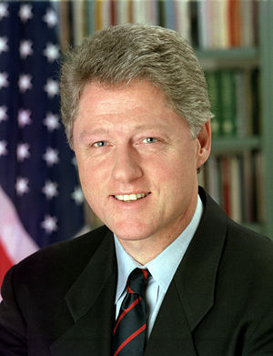
Do you remember? 1996

Slide 14
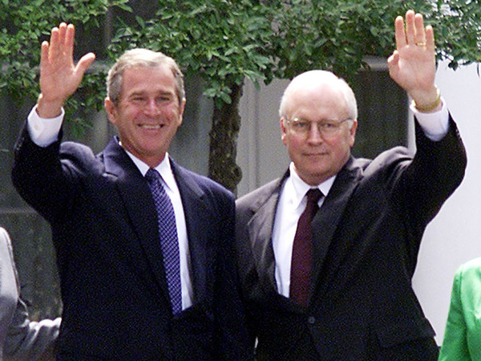
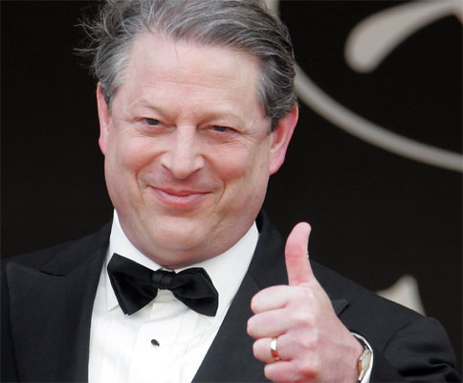
How About? 2000

Slide 15
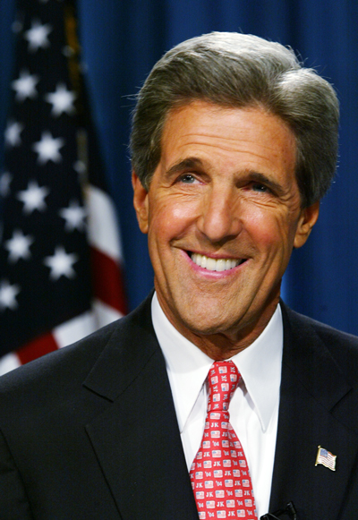
Who Do You Choose? 2004

Slide 16
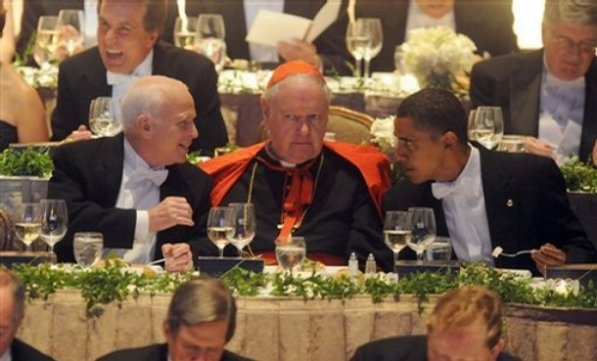
Welcome to the Party: 2008

Slide 17
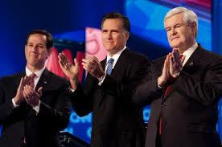
The big Dance
In this picture, we have two Roman Catholics; Santorum and Gingrich. What do you know? Romney is a CFR member; so is Gingrich. No matter who is nominated from the Republican side, they are a puppet of Rome!

Slide 18
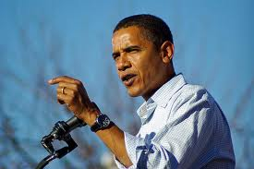
Obama is CFR Too!
Democrat Barack Obama is a member of the CFR. He is doing exactly what his master in Rome wants him to do. He, like the presidents of the last 70 years, are doing whatever Rome wants them to do. Republican and Democratic CFR members can agree on one thing.

Slide 19
Even Americans!
…This pernicious law poses one of the greatest threats to civil liberties in our nation’s history. Under Section 1021 of the NDAA, foreign nationals who are alleged to have committed or merely “suspected” of sympathizing with or providing any level of support to groups the U.S. designates as terrorist organization or an affiliate or associated force may be imprisoned without charge or trial “until the end of hostilities.” The law affirms the executive branch’s authority granted under the 2001 Authorization for Use of Military Force (AUMF) and broadens the definition and scope of “covered persons.” But because the “war on terror” is a war on a tactic, not on a state, it has no parameters or timetable. Consequently, this law can be used by authorities to detain (forever) anyone the government considers a threat to national security and stability – potentially even demonstrators and protesters exercising their First Amendment rights.” http://www.counterpunch.org/2012/01/18/why-the-ndaa-is-unconstitutional/
Proposed by McCain, passed by Obama. CFR members unite!

Slide 20
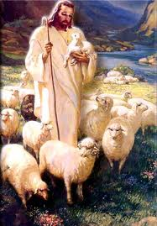
There is an Alternative

