Slide 1
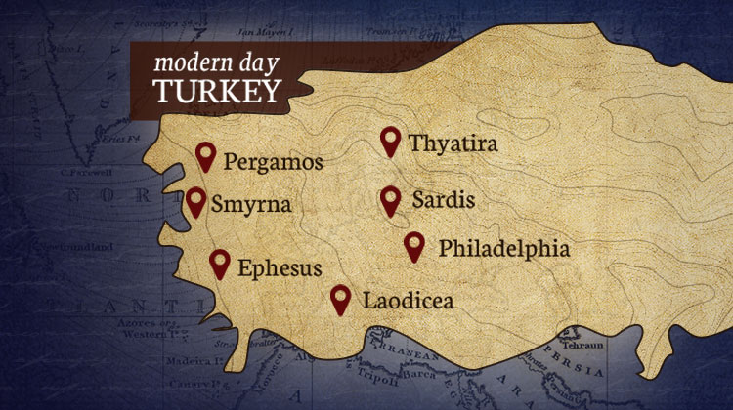
The Seven Churches pt 6: Sardis

Slide 2
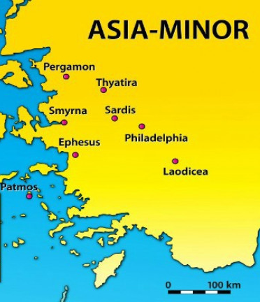
What We Will Study and How….
The Seven Churches in the Context of the Literal Seven Churches—How the messages relate to that specific Church
The Seven Churches in the Context of a time Prophecy—How the messages relate prophetically to chronological periods of Church history
The Seven Churches in the Context of Personal counsel—How the messages relate to all Christians in all periods of earth’s history

Slide 3
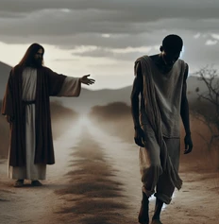
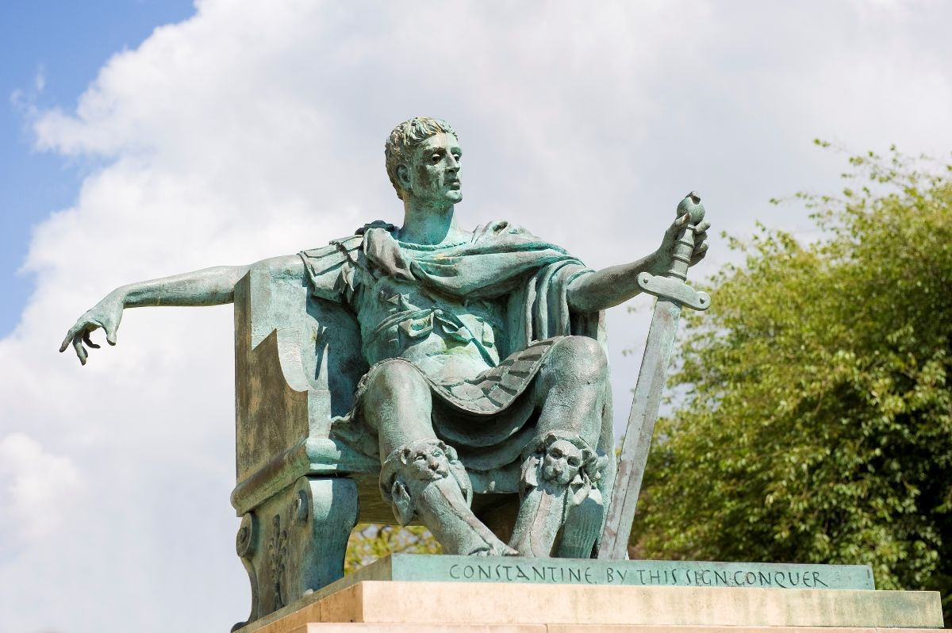
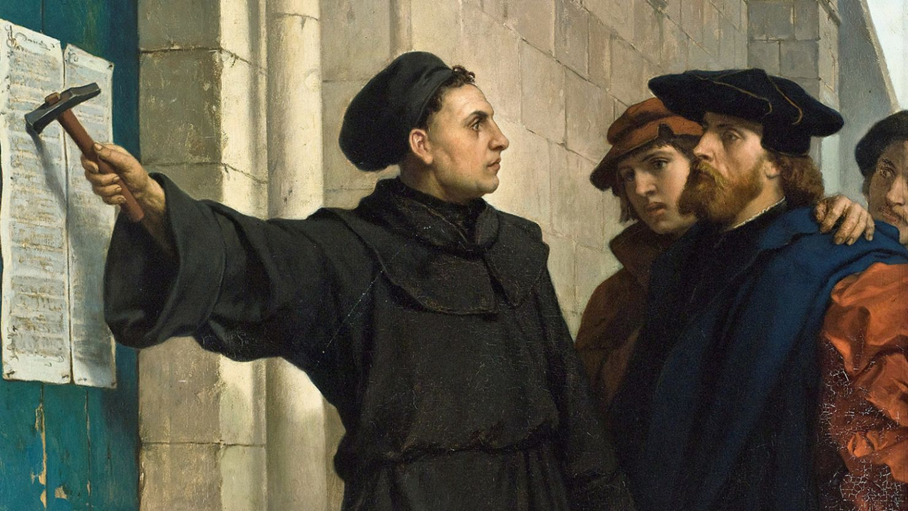
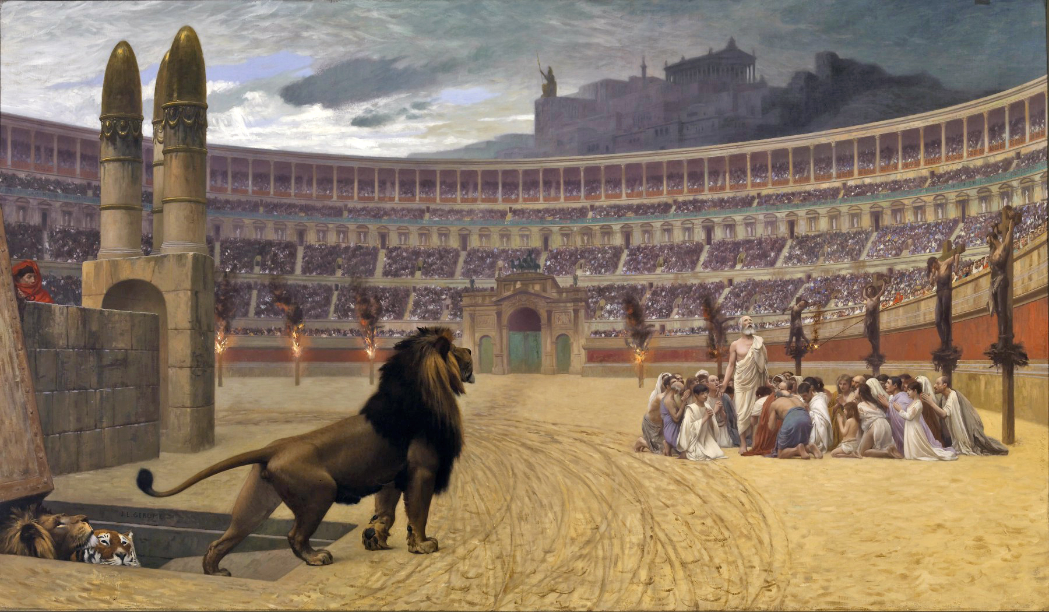
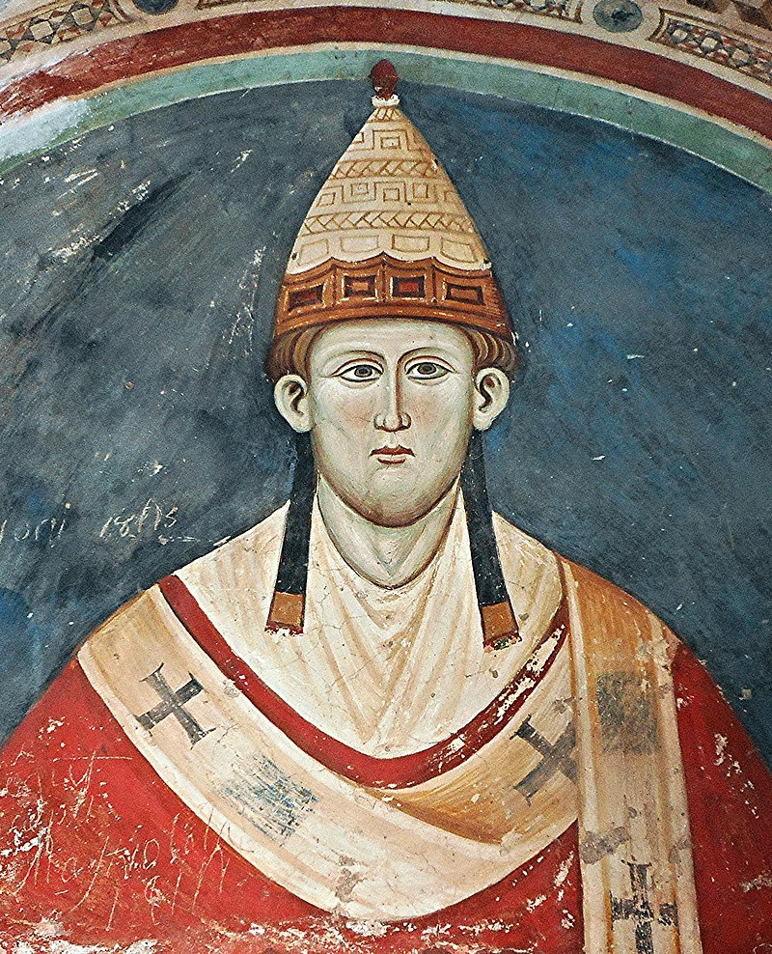
Recap
Ephesus
Pergamos
34AD-100AD
Laodicea
Sardis
313AD-538AD
Thyatira
Philadelphia
Smyrna
100AD-313AD
538AD-

Slide 4
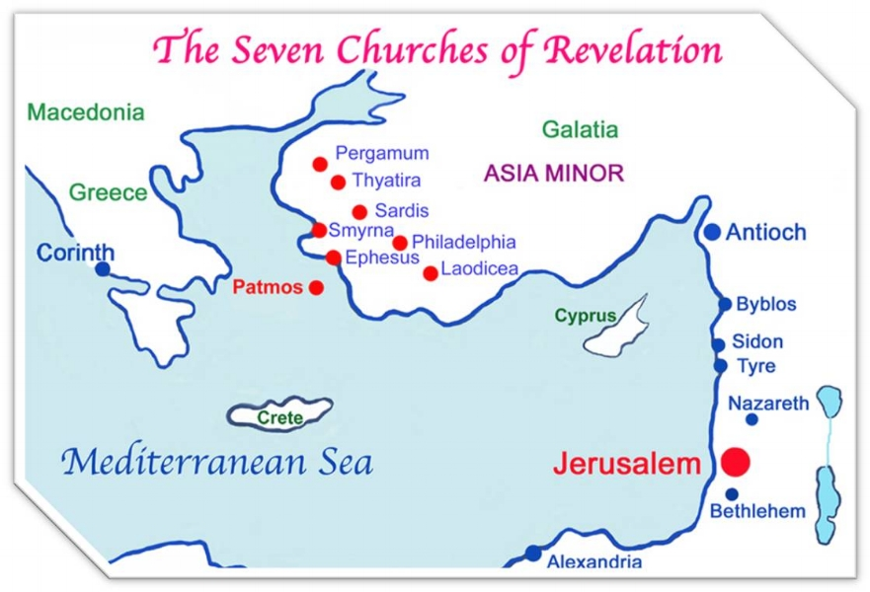
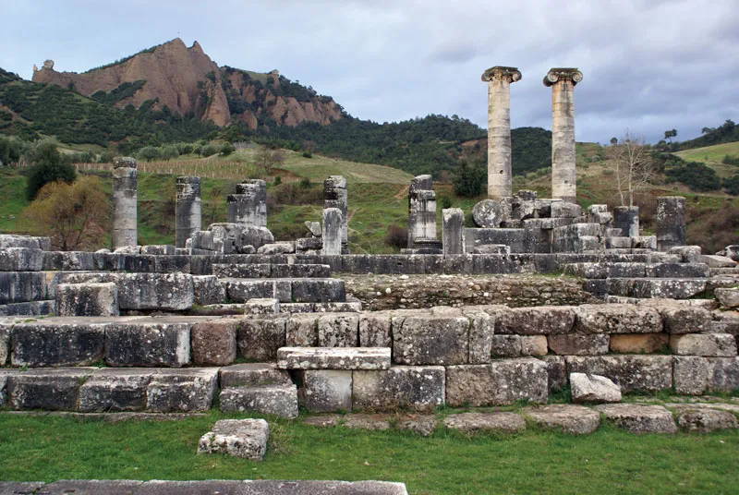
A Few Facts About Sardis…
The Name Sardis means “prince of joy” and/or “That which remains” – its ancient name is Sepharad (Obadiah v. 20)
Like Pergamos, Sardis was the seat of government – but not of the Roman or Greek, but of the Ancient Lydian Empire – think of America’s Philadelphia—extremely wealthy
Sardis’ patron gods were Artemis (like Ephesus) and “Mother Earth” – Cybele (Sibilee)
Sardis’ culture was obsessed with death, resurrection, cycle of renewal-death-renewal in the seasons of the Mother Earth cycle. They 2 mountains highlighting this fact—the Acropolis and the Necropolis (Tmolus Mountains)
Founded sometime between 1200BC-1000BC, the upper city (acropolis) was home to the wealthy, while the valley area (polis) was home to everyone else. The Pactolus river flowed from the mountains through the city and contained “electrum”—archeologists have unearthed remains of gold refineries and Sardis is thought to have minted coins

Slide 5
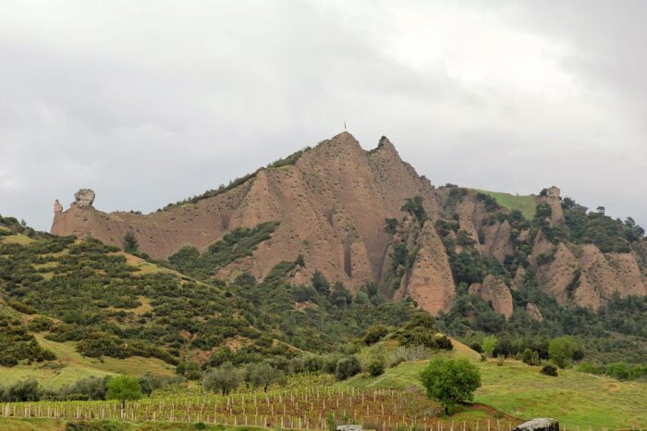
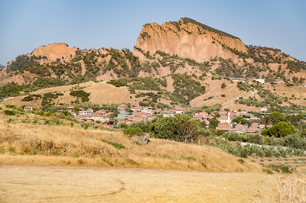
Acropolis and Necropolis

Slide 6
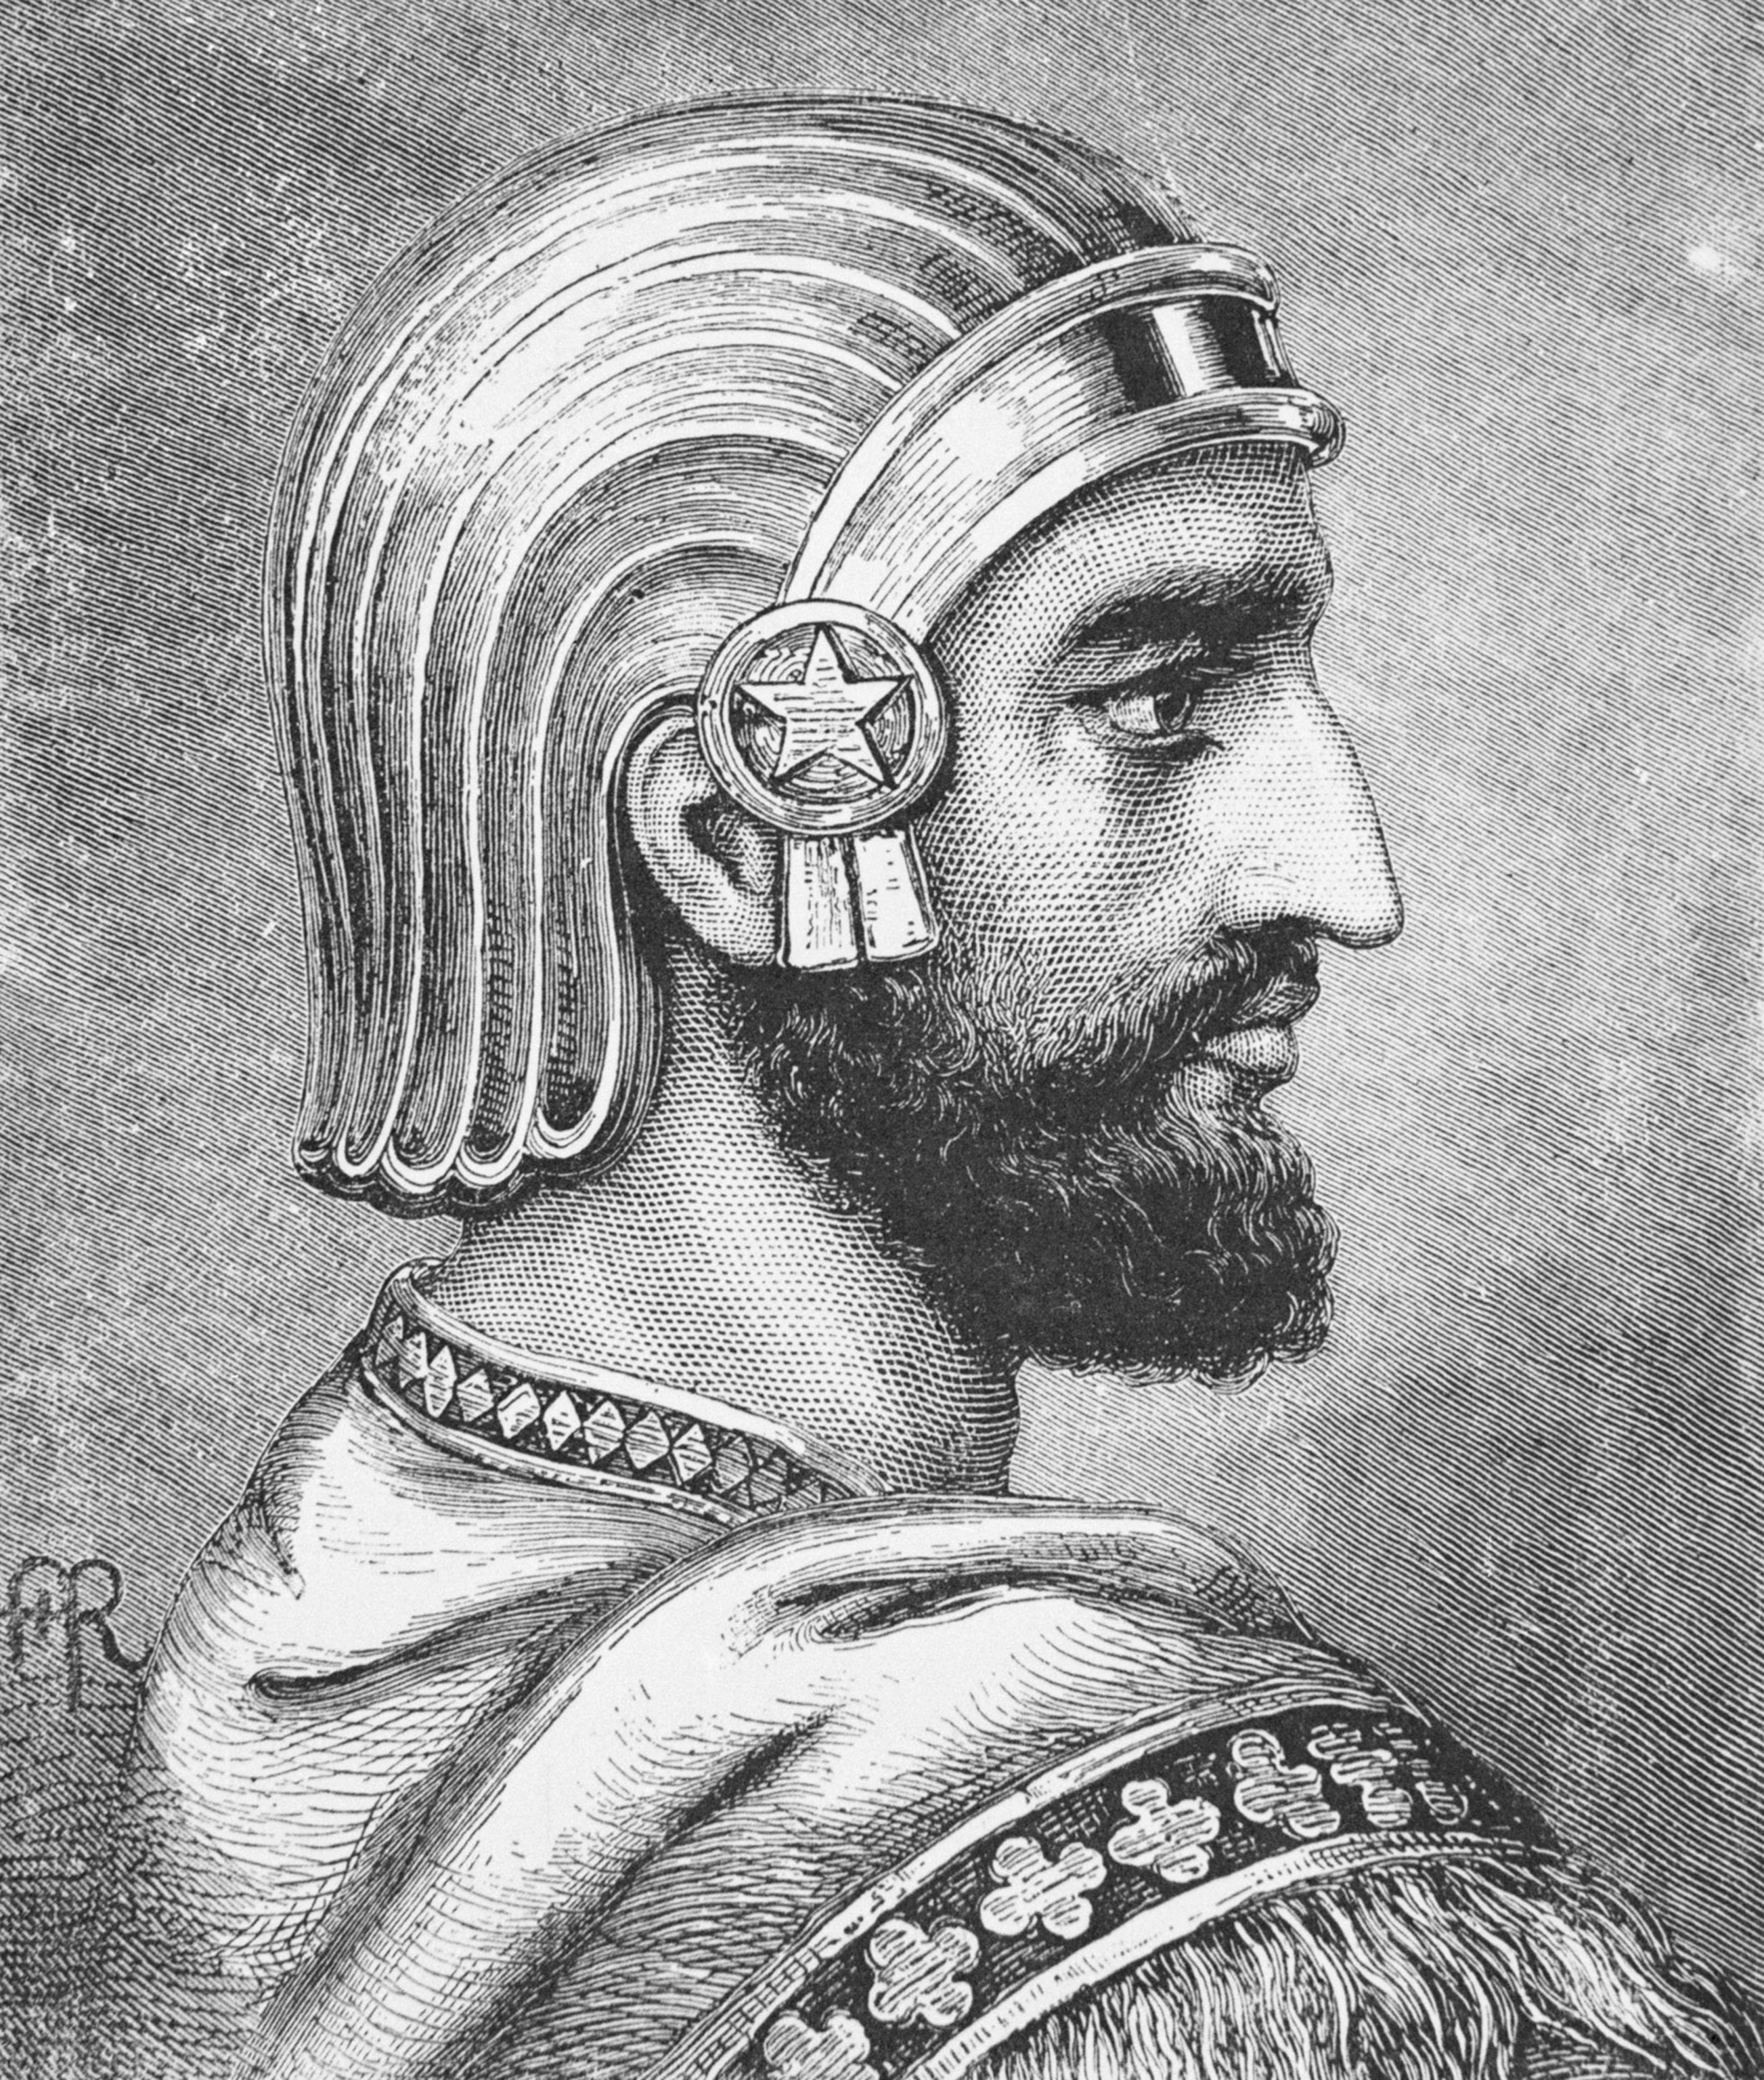
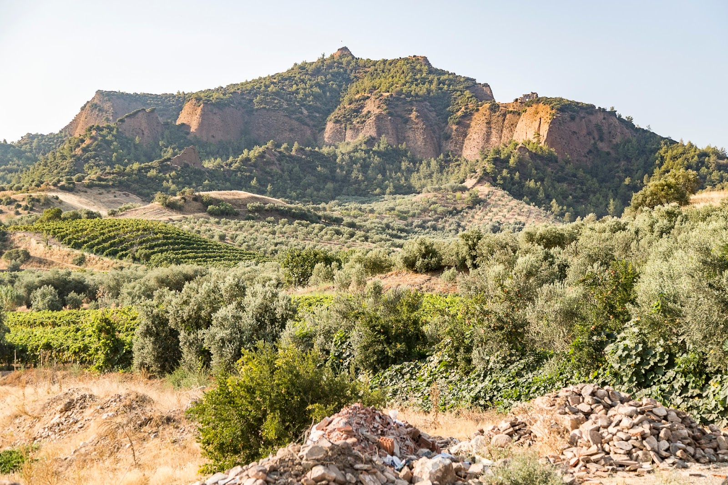
Sardis Continued…
6. Sardis suffered 3 major, abrupt catastrophes in similar fashion: 1) The Siege of Sardis in 547BC, King Croesus was overthrown by Cyrus the Great due to an unguarded, hidden gate found by Hyroeades. 2) The Siege of Sardis in 213BC between Antiochus III the Seluecid King and Achaeus, a separatist general and cousin to the king. This time Lagorus notices vultures perched on a wall signifying that it was unguarded—both captures of the city occurred in a single night once the hidden path was found! 3) The Earthquake of 17AD, recorded by Pliny the Elder as “the greatest earthquake in human memory” (Natural History 2:86) destroyed the acropolis going from 30 acres to 5 acres in a moment along with 11 other cities. Tiberius Caesar waived taxes for 5 years for Sardis, causing them to erect a statue in his honor.
7. Sardis venerated the cycle of death-life like the Egyptians, Acropolis-Necropolis, Mother Earth goddess Cybele, plus they had major ancient burial mounds (pyramids) called a “tumulus”

Slide 7
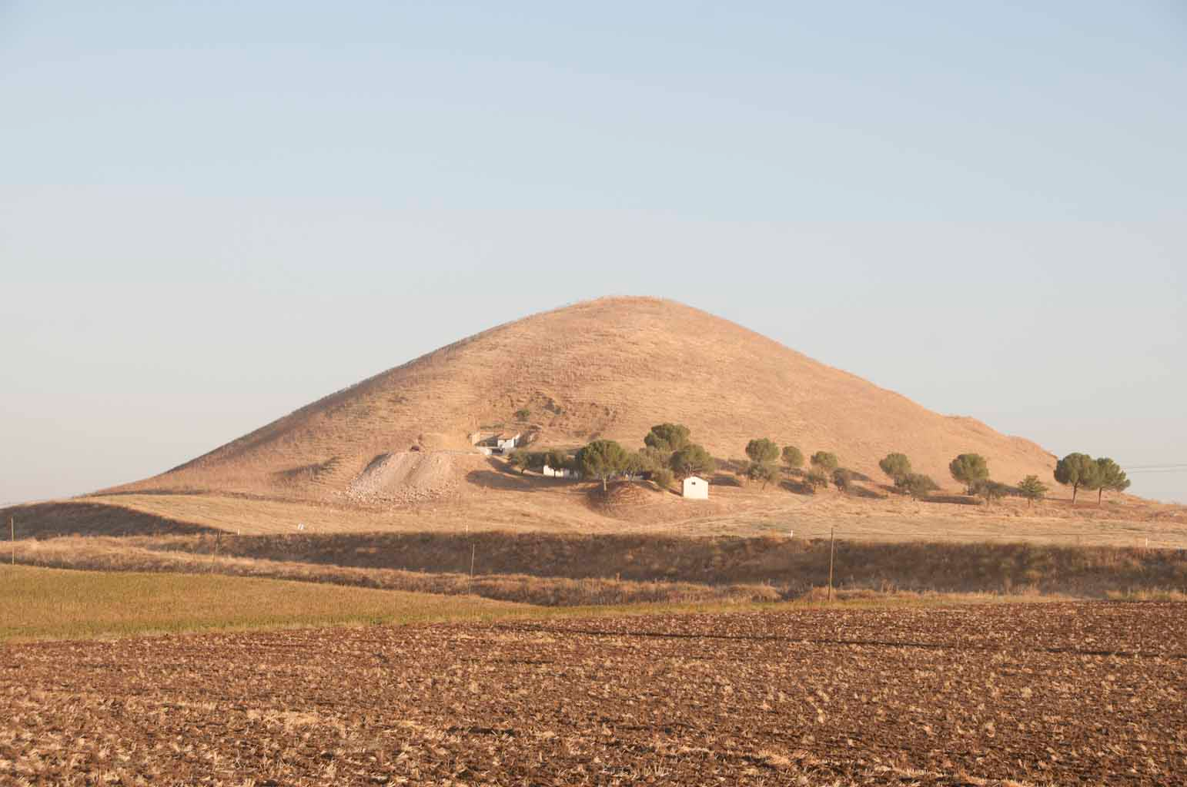
Tumulus of Attalus

Slide 8
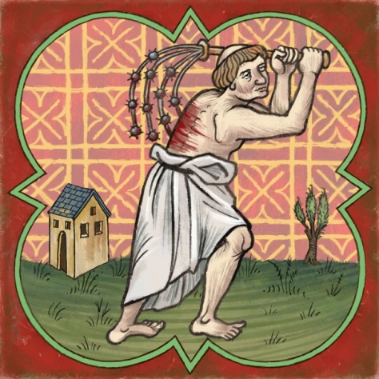
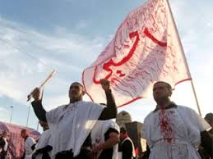
The Cult of Cybele-Artemis…
The mythology goes that Cybele’s grandson Attis wanted to make a name for himself in Cybele’s eyes, so eventually he castrates himself but dies of the wound. Cybele is touched and resurrects him.
Galli priests would follow Attis’ example and castrate themselves creating a celibate priesthood.
The end of March and early April there was a major festival to Cybele called Megalesia which was 6 days of games, feasting, and theater—much like Mardi Gras or Spring Break
During the festival women would seek sexual partners to honor Cybele in fertility rites, while men would wear white garments and cut themselves in honor of Attis – like doing penance
The closest modern day equivalent to what the men practiced is the Muslim holiday of Ashura

Slide 9
The Letter to Sardis…
Rev. 3:1-6 “And unto the angel of the church in Sardis write; These things saith he that hath the seven Spirits of God, and the seven stars; I know thy works, that thou hast a name that thou livest, and art dead. Be watchful, and strengthen the things which remain, that are ready to die: for I have not found thy works perfect before God. Remember therefore how thou hast received and heard, and hold fast, and repent. If therefore thou shalt not watch, I will come on thee as a thief, and thou shalt not know what hour I will come upon thee. Thou hast a few names even in Sardis which have not defiled their garments; and they shall walk with me in white: for they are worthy. He that overcometh, the same shall be clothed in white raiment; and I will not blot out his name out of the book of life, but I will confess his name before my Father, and before his angels. He that hath an ear, let him hear what the Spirit saith unto the churches.”

Slide 10
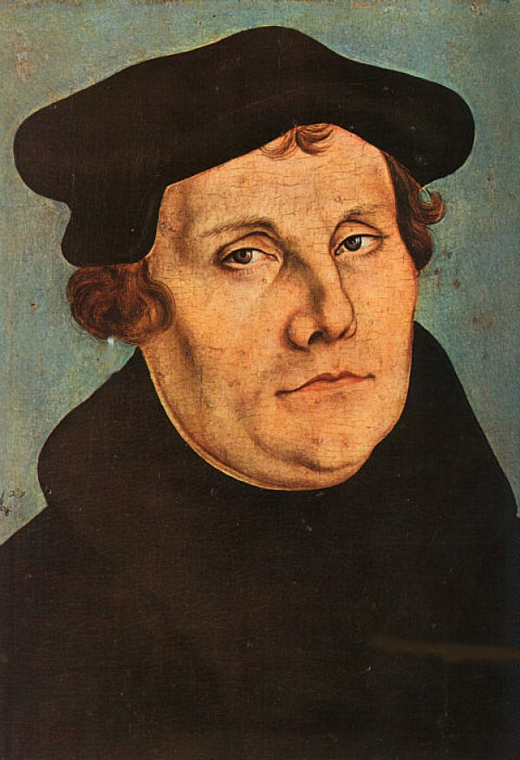
Prophetic Sardis…
Matt. 24:21-22 “For then shall be great tribulation, such as was not since the beginning of the world to this time, no, nor ever shall be. And except those days should be shortened, there should no flesh be saved: but for the elect's sake those days shall be shortened”

Slide 11
Return to the “Old Paths”!
Jer. 6:13-17 “For from the least of them even unto the greatest of them every one is given to covetousness; and from the prophet even unto the priest every one dealeth falsely. They have healed also the hurt of the daughter of my people slightly, saying, Peace, peace; when there is no peace. Were they ashamed when they had committed abomination? nay, they were not at all ashamed, neither could they blush: therefore they shall fall among them that fall: at the time that I visit them they shall be cast down, saith the Lord. Thus saith the Lord, Stand ye in the ways, and see, and ask for the old paths, where is the good way, and walk therein, and ye shall find rest for your souls. But they said, We will not walk therein. Also I set watchmen over you, saying, Hearken to the sound of the trumpet. But they said, We will not hearken.”

Slide 12
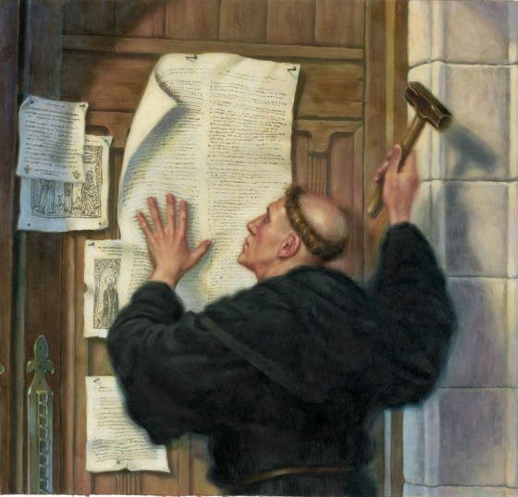
In Response to Indulgences
“On the preceding day, Luther, joining the crowds that were already making their way to the church, posted on its door a paper containing ninety-five propositions against the doctrine of indulgences. He declared his willingness to defend these theses next day at the university, against all who should see fit to attack them. His propositions attracted universal attention. They were read and reread, and repeated in every direction. Great excitement was created in the university and in the whole city. By these theses it was shown that the power to grant the pardon of sin, and to remit its penalty, had never been committed to the pope or to any other man. The whole scheme was a farce,—an artifice to extort money by playing upon the superstitions of the people,—a device of Satan to destroy the souls of all who should trust to its lying pretensions” GC, p. 129-130

Slide 13
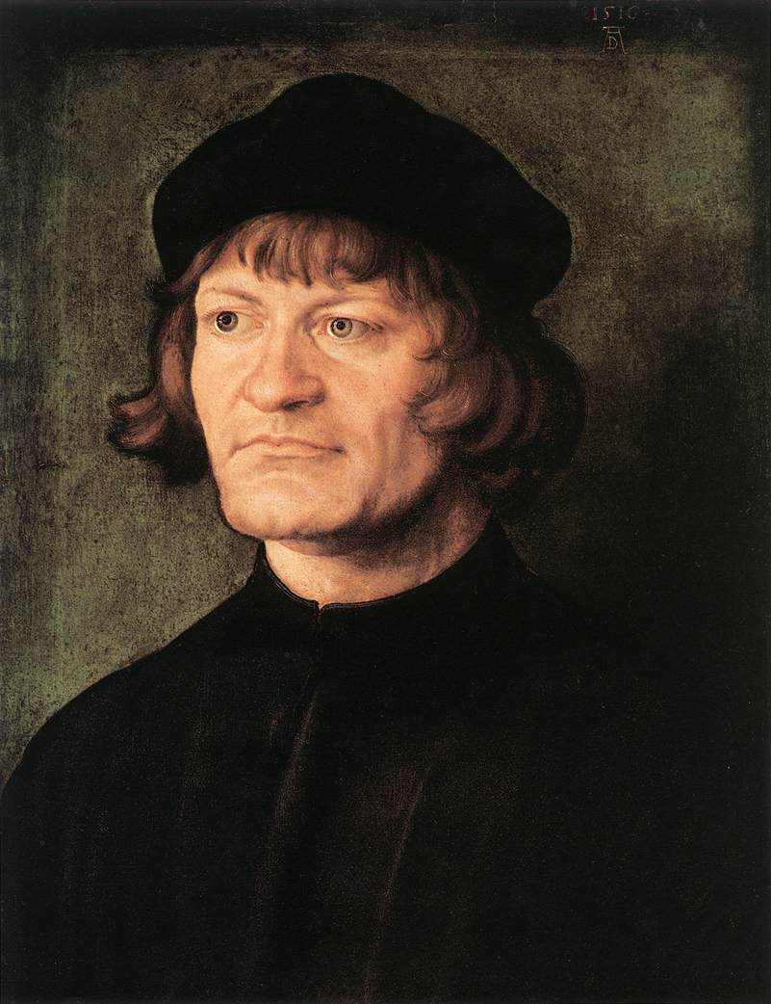
A Torch in the Darkness!
“There suddenly burst upon the darkness a multitude of lights. In Germany there was but one pre-eminent center, and one pre-eminently great leader. Luther towered up like some majestic Alp. Alone over all that land was seen his colossal figure. But in Switzerland one, and another, and a third stood up, and like Alpine peaks, catching the first rays, they shed a bright and pure effulgence not only upon their own cities and cantons, but over all Christendom.” JA Wylie, History of Protestantism B.8. Ch 4.

Slide 14
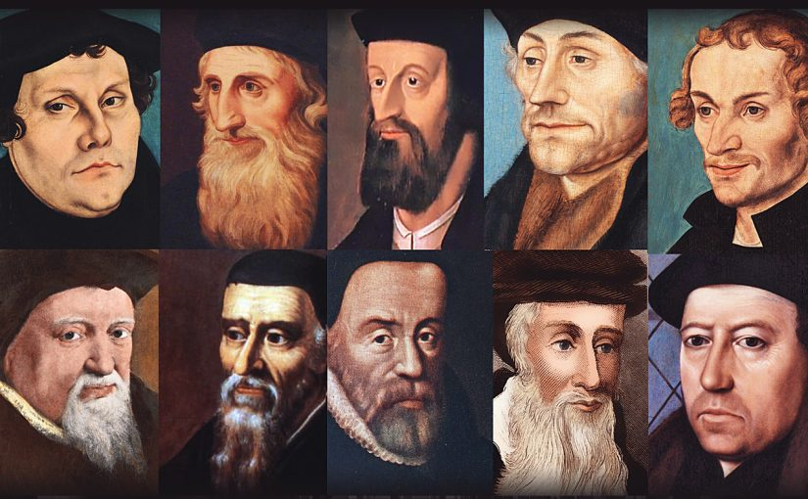
The Reformer Army…
The Reformation was supernatural in origin. Luther led in Germany, Huss and Jerome in Bohemia before which led to the Bohemian wars, Ulrich Zwingli in Switzerland, Calvin in France and Geneva, John Knox in Scottland, William Tyndale in England and before him John Wycliffe, Thomas Cranmer, John Wesley, George Whitefield, Jonathan Edwards and many many more!

Slide 15
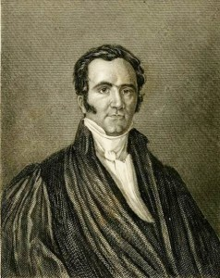
God was the Author
“Germany did not communicate the truth to Switzerland, nor Switzerland to France, nor France to England. All these countries received it from God, just as one part of the world does not transmit the light to another part; but the same shining globe communicates it directly to all the earth. Christ, the day spring from on high, infinitely exalted above all mankind, was, at the period of the Reformation, as at the establishment of Christianity, the divine fire which gave life to the world. In the sixteenth century, one and the same doctrine was at once established in the homes and churches of the most distant and diversified nations. The reason is, that the same Spirit was everywhere at work producing the same faith. “The Reformation of Germany and that of Switzerland demonstrate this truth. Zwingle had no intercourse with Luther. There was, no doubt, a link between these two men; but we must search for it above the earth. He who from heaven gave the truth to Luther, gave it to Zwingle. God was the medium of communication between them. ‘I began to preach the gospel,’ says Zwingle, ‘in the year of grace 1516, in other words, at a time when the name of Luther had never been heard of in our country. I did not learn the doctrine of Christ from Luther, but from the word of God. If Luther preaches Christ, he does what I do; that is all.’”—Merle D’Aubigne, History of the Reformation, Book viii, chap. i, pars. ii, iii.

Slide 16
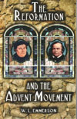
But Problems Persisted…
The Reformation eventually sank into formalism and stopped seeking the light. W.L. Emmerson’s book “The Reformation and the Advent Movement” identifies some of the Reformers and their followers as “halfway men”. In the midst of the light from the word of God, doctrines like these still persisted:
Church and State together
Enforcing rigid creeds
No liberty of conscience
Traditions, prayer books, sacramentalism, predestination, consubstantiation
Rise of Deism
Formalism and Ritualism
Sunday

Slide 17
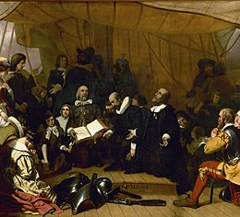
The Reformation Stopped Reforming!
John Robinson in his farewell address to the pilgrims: “Brethren, we are now erelong to part asunder, and the Lord knoweth whether I shall live ever to see your faces more. But whether the Lord hath appointed it or not, I charge you before God and His blessed angels to follow me no farther than I have followed Christ. If God should reveal anything to you by any other instrument of His, be as ready to receive it as ever you were to receive any truth of my ministry; for I am very confident the Lord hath more truth and light yet to break forth out of His holy word.”—Martyn 5:70. “For my part, I cannot sufficiently bewail the condition of the reformed churches, who are come to a period in religion, and will go at present no farther than the instruments of their reformation. The Lutherans cannot be drawn to go beyond what Luther saw; ... and the Calvinists, you see, stick fast where they were left by that great man of God, who yet saw not all things. This is a misery much to be lamented; for though they were burning and shining lights in their time, yet they penetrated not into the whole counsel of God, but were they now living, would be as willing to embrace further light as that which they first received.”—D. Neal, History of the Puritans 1:269” GC 291-292

Slide 18
Ellen White Explains Perfectly….
“But as the spirit of humility and devotion in the church had given place to pride and formalism, love for Christ and faith in His coming had grown cold. Absorbed in worldliness and pleasure seeking, the professed people of God were blinded to the Saviour's instructions concerning the signs of His appearing. The doctrine of the second advent had been neglected; the scriptures relating to it were obscured by misinterpretation, until it was, to a great extent, ignored and forgotten. Especially was this the case in the churches of America. The freedom and comfort enjoyed by all classes of society, the ambitious desire for wealth and luxury, begetting an absorbing devotion to money-making, the eager rush for popularity and power, which seemed to be within the reach of all, led men to center their interests and hopes on the things of this life, and to put far in the future that solemn day when the present order of things should pass away.” GC, 309

Slide 19
Wake Up!!!
The condition of the church at this time is pointed out in the Saviour's words in the Revelation: "Thou hast a name [310] that thou livest, and art dead." And to those who refuse to arouse from their careless security, the solemn warning is addressed: "If therefore thou shalt not watch, I will come on thee as a thief, and thou shalt not know what hour I will come upon thee." Revelation 3:1, 3. It was needful that men should be awakened to their danger; that they should be roused to prepare for the solemn events connected with the close of probation. . . . To prepare a people to stand in the day of God, a great work of reform was to be accomplished. God saw that many of His professed people were not building for eternity, and in His mercy He was about to send a message of warning to arouse them from their stupor and lead them to make ready for the coming of the Lord. ” GC 309-310, 311

Slide 20
The Personal Counsel… Make it Right!
“And unto the angel of the church in Sardis write; These things saith He that hath the seven Spirits of God, and the seven stars; I know thy works, that thou hast a name that thou livest, and art dead. Be watchful, and strengthen the things which remain, that are ready to die: for I have not found thy works perfect before God.” Here the problem is solved. The persons here described have had light that would have prompted them to altogether different works, if they had followed the light and had strengthened the things that remained that were ready to die. The light which was glowing in their own hearts when Jesus spoke to their souls, “Thy sins be forgiven thee,” they might have kept alive by helping those who needed help. The work to be done is plainly specified: “Be watchful, and strengthen the things which remain, that are ready to die: for I have not found thy works perfect before God. Remember therefore how thou hast received and heard, and hold fast, and repent. If therefore thou shalt not watch, I will come on thee as a thief, and thou shalt not know what hour I will come upon thee.” Many have heard and received the word of life, and have been strongly moved by the truth, but have allowed their souls to become cold, their faith dim, through self-righteousness, self-importance, and pride in the possession of a knowledge of truth which they fail to practice. The truth which is not put in practice, loses its power. The heart is closed to its divine influence, and those who should be workers for Christ are idle, and souls whom they might help are left in discouragement and darkness and despair.” TM, 352-353

