Slide 1
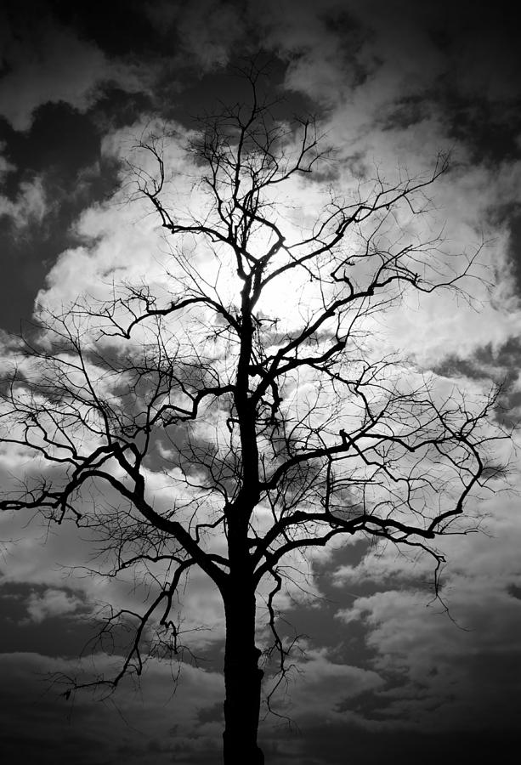
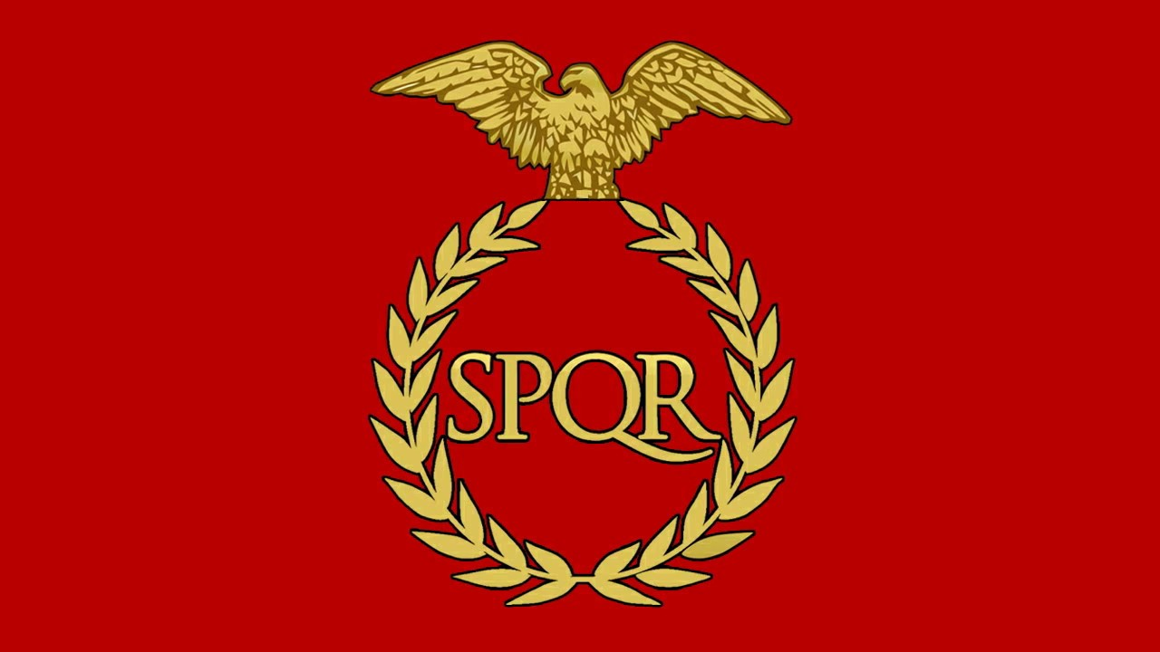
Fruits of the Same Tree

Slide 2
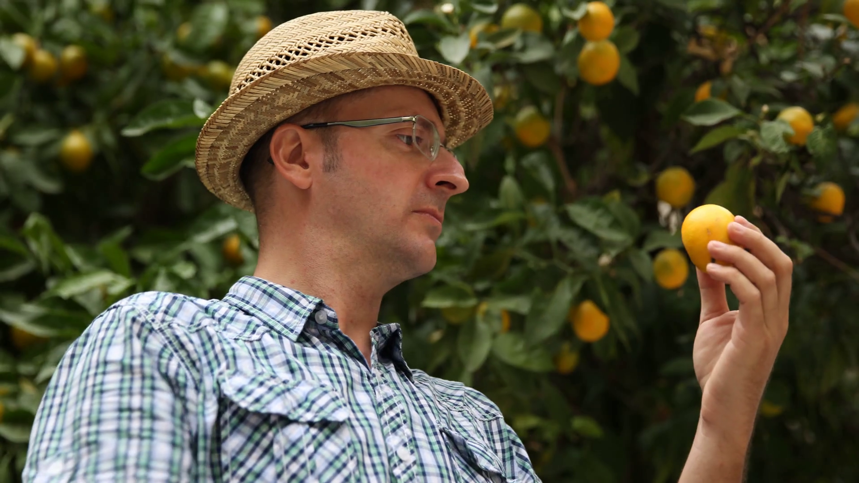
What Can We Learn by examining the fruits?
Matt. 7:15-24 “Beware of false prophets, which come to you in sheep's clothing, but inwardly they are ravening wolves. Ye shall know them by their fruits. Do men gather grapes of thorns, or figs of thistles? Even so every good tree bringeth forth good fruit; but a corrupt tree bringeth forth evil fruit. A good tree cannot bring forth evil fruit, neither can a corrupt tree bring forth good fruit. Every tree that bringeth not forth good fruit is hewn down, and cast into the fire. Wherefore by their fruits ye shall know them. Not every one that saith unto me, Lord, Lord, shall enter into the kingdom of heaven; but he that doeth the will of my Father which is in heaven. Many will say to me in that day, Lord, Lord, have we not prophesied in thy name? and in thy name have cast out devils? and in thy name done many wonderful works? And then will I profess unto them, I never knew you: depart from me, ye that work iniquity. Therefore whosoever heareth these sayings of mine, and doeth them, I will liken him unto a wise man, which built his house upon a rock”

Slide 3
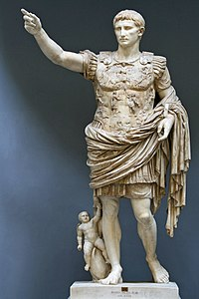
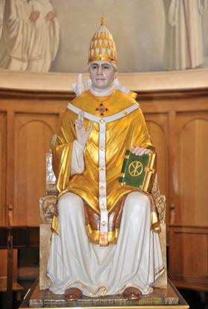
Are Pagan Rome and Papal Rome the Same???

Slide 4
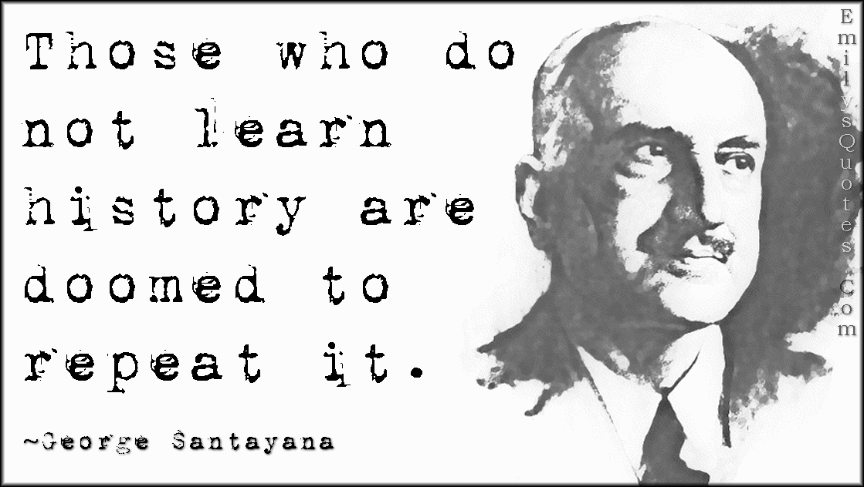
Why Compare Histories???
Ecc. 1:9-11 “ The thing that hath been, it is that which shall be; and that which is done is that which shall be done: and there is no new thing under the sun. Is there any thing whereof it may be said, See, this is new? it hath been already of old time, which was before us. There is no remembrance of former things; neither shall there be any remembrance of things that are to come with those that shall come after.

Slide 5
Another Why?
Dan. 7:7-11 “After this I saw in the night visions, and behold a fourth beast, dreadful and terrible, and strong exceedingly; and it had great iron teeth: it devoured and brake in pieces, and stamped the residue with the feet of it: and it was diverse from all the beasts that were before it; and it had ten horns. I considered the horns, and, behold, there came up among them another little horn, before whom there were three of the first horns plucked up by the roots: and, behold, in this horn were eyes like the eyes of man, and a mouth speaking great things. I beheld till the thrones were cast down, and the Ancient of days did sit, whose garment was white as snow, and the hair of his head like the pure wool: his throne was like the fiery flame, and his wheels as burning fire. A fiery stream issued and came forth from before him: thousand thousands ministered unto him, and ten thousand times ten thousand stood before him: the judgment was set, and the books were opened. I beheld then because of the voice of the great words which the horn spake: I beheld even till the beast was slain, and his body destroyed, and given to the burning flame.”
Rev. 20:4 “And I saw thrones, and they sat upon them, and judgment was given unto them: and I saw the souls of them that were beheaded for the witness of Jesus, and for the word of God, and which had not worshipped the beast, neither his image, neither had received his mark upon their foreheads, or in their hands”

Slide 7
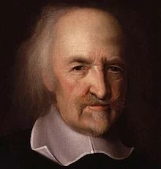
Thomas Hobbes Once Said…
“For though they were first invested in the right of being supreme teachers of Christian doctrine, by and under Christian emperors within the limits of the Roman Empire (as is acknowledged by themselves), by the title of Pontifex Maximus, who was an officer subject to the civil state; yet after the Empire was divided and dissolved, it was not hard to obtrude upon the people already subject to them, another title, namely, the right of St. Peter; not only to save entire their pretended power, but also to extend the same over the same Christian provinces, though no more united in the Empire of Rome”—Thomas Hobbes, Leviathan, ch. 47

Slide 8
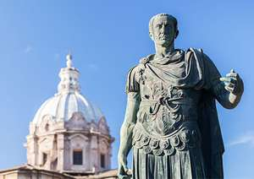
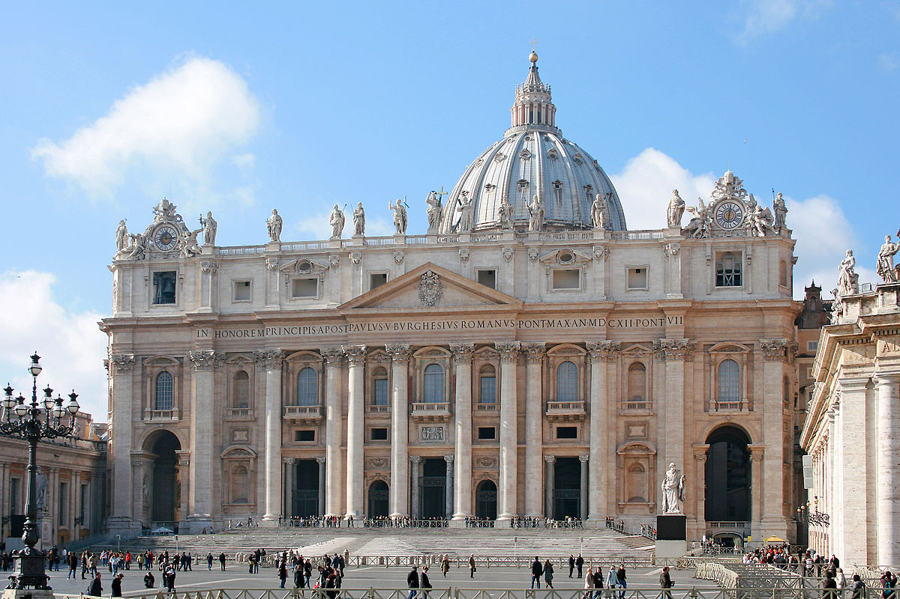
Same Title
“Julius Caesar was elected pontifex maximus in 63 BCE and kept the office until his death. The house where he spent the night before he was killed, was the domus publica. After his death, Marcus Aemilius Lepidus became pontifex maximus (44-12 BCE); when he died, the emperor Augustus became responsible for the state cult. He also put an end to the election of the pontifices. From then on, a position in the college of pontifices was a sign of special imperial favor, comparable to a decoration in our age. . . . The pope still calls himself pontifex maximus.”—livius.org, “Pontifex Maximus”

Slide 9
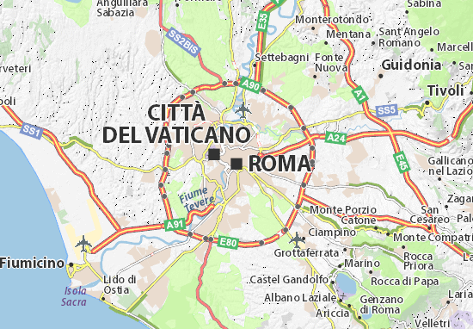
Where did/do the Emperor and the Pope Reign???

Slide 10
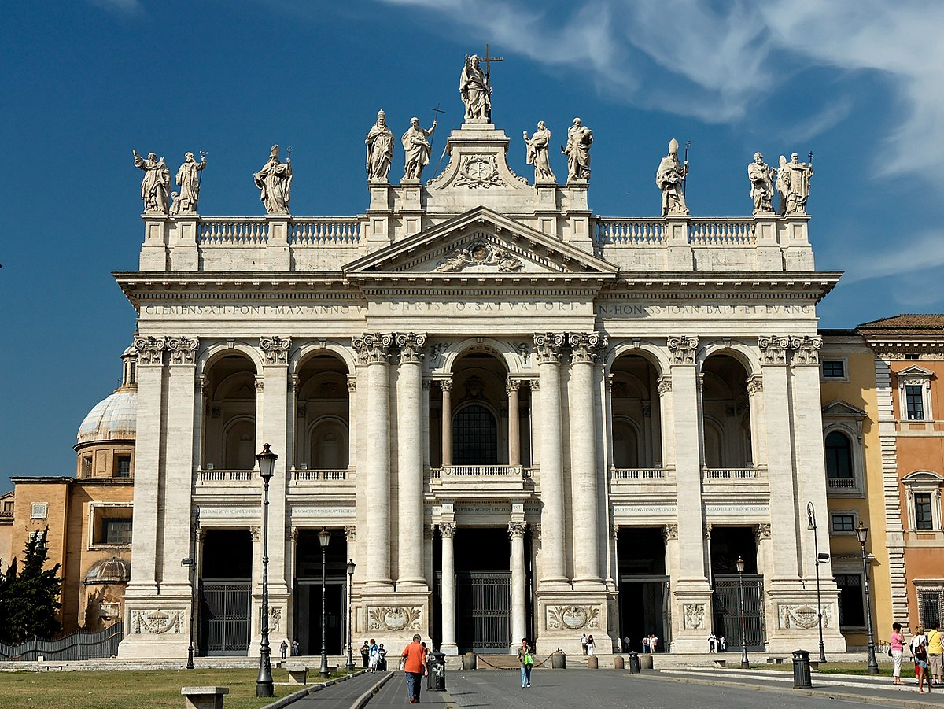
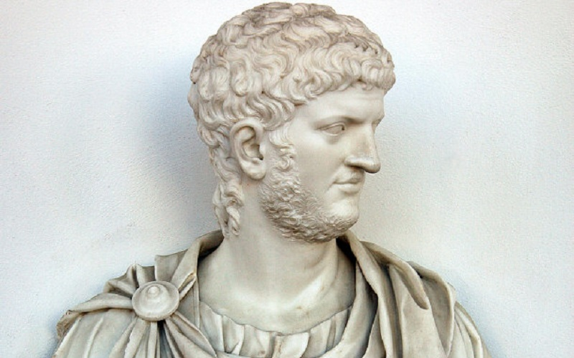
The Lateran Palace…
“The Lateran Palace is an ancient palace of the Roman Empire and later the main papal residence in southeast Rome.”—Wikipedia, “Lateran Palace” (see also: Barnes, Arthur. “Saint John Lateran.” The Catholic Encyclopedia. Vol 9. New York: Robert Appleton Company, 1910.)

