Slide 1
Ezekiel, pt. 4, The Remnant
Never Fails

Slide 2
Mountains, Hills, Rivers, Valley’s
“ Son of man, set thy face toward the mountains of Israel, and prophesy against them, And say, Ye mountains of Israel, hear the word of the Lord GOD; Thus saith the Lord GOD to the mountains, and to the hills, to the rivers, and to the valleys; Behold, I, even I, will bring a sword upon you, and I will destroy your high places. And your altars shall be desolate, and your images shall be broken: and I will cast down your slain men before your idols. And I will lay the dead carcases of the children of Israel before their idols; and I will scatter your bones round about your altars. In all your dwelling places the cities shall be laid waste, and the high places shall be desolate; that your altars may be laid waste and made desolate, and your idols may be broken and cease, and your images may be cut down, and your works may be abolished. And the slain shall fall in the midst of you, and ye shall know that I am the LORD.” Ezek. 6:2-7

Slide 3
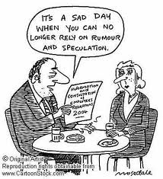
Human Characteristics
The inanimate things of nature receive of God’s judgments. Clearly, the mountains, hills, valley’s, and rivers represent the people of Israel. Which groups in Israel represented aren’t clear. When something in Scripture isn’t clear, it is best to leave it alone!! Speculation can get us in a lot of trouble!!! Amalgamation?

Slide 4
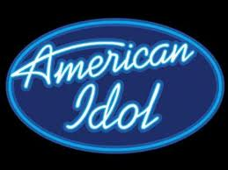
Idols Destroyed
No speculating here. Five times in this chapter, we are told that our idols will be destroyed. (verses 4,6,9, and 13) Idols can be made of anything. Rock stars, movie stars, sports stars, women, money, food. The Bible says, “Wherefore, my dearly beloved, flee from idolatry.” 1 Corinthians 10:14
“Idolatry, witchcraft, hatred, variance, emulations, wrath, strife, seditions, heresies,” Gal. 5:20
Destroy or be destroyed!!??!!

Slide 5
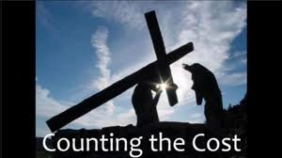
Ezekiel’s Great Popularity
For his plain speaking, Ezekiel wasn’t popular. He was following in other’s footsteps.
Jeremiah-thrown into a pit. (Jer. 38:6)
Isaiah-sawn in pieces. (Hebrews. 11:37)
John the Baptist-beheaded. (Mark 6:27,28)

Slide 6
Four Times in this Chapter
“And the slain shall fall in the midst of you, and ye shall know that I am the LORD.’ verse 7
“And they shall know that I am the LORD, and that I have not said in vain that I would do this evil unto them.” verse 10
“Then shall ye know that I am the LORD, when their slain men shall be among their idols round about their altars.” verse 13
“So will I stretch out my hand upon them, and make the land desolate, yea, more desolate than the wilderness toward Diblath, in all their habitations: and they shall know that I am the LORD.” verse 14

Slide 7
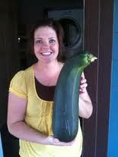
Righteous Retribution
There will be cost. Results always spring from actions. Punishment, though long deferred, is always the sure result of a life of wrong. “ Be not deceived; God is not mocked: for whatsoever a man soweth, that shall he also reap. For he that soweth to his flesh shall of the flesh reap corruption; but he that soweth to the Spirit shall of the Spirit reap life everlasting.” Galatians. 6:7,8

Slide 8
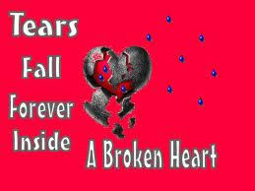
God’s Breaking Heart
In the midst of slain bodies, devastated cities, crushed dreams, toppled idols, God cries. “And they that escape of you shall remember me among the nations whither they shall be carried captives, because I am broken with their whorish heart, which hath departed from me, and with their eyes, which go a whoring after their idols: and they shall loathe themselves for the evils which they have committed in all their abominations.” Ezek. 6:9

Slide 9
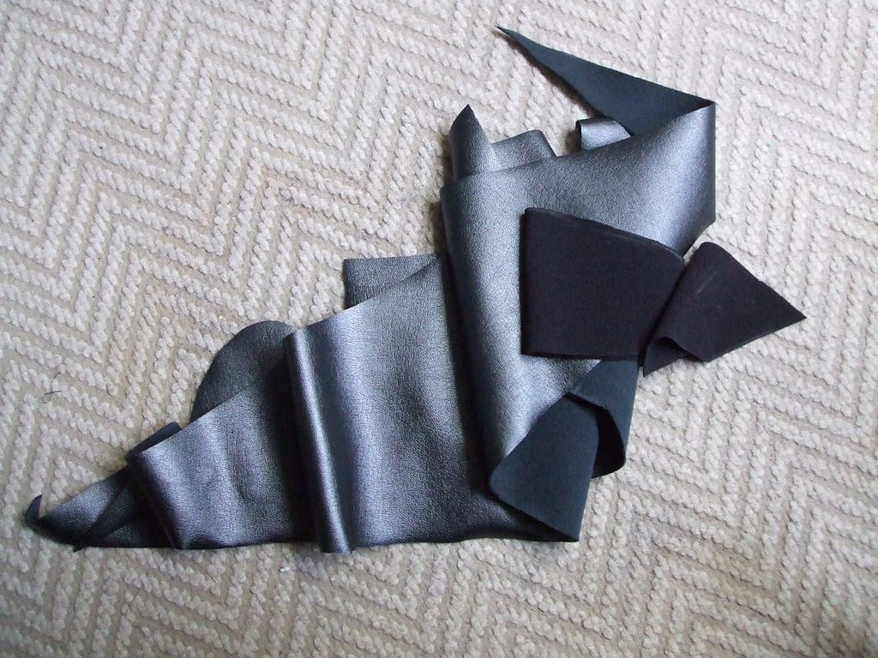
Always a Remnant
“Yet will I leave a remnant, that ye may have some that shall escape the sword among the nations, when ye shall be scattered through the countries.” Ezek. 6:8
“And the dragon was wroth with the woman, and went to make war with the remnant of her seed, which keep the commandments of God, and have the testimony of Jesus Christ.” Rev. 12:17

Slide 10
JERUSALEM/The world
“Moreover the word of the LORD came unto me, saying, Also, thou son of man, thus saith the Lord GOD unto the land of Israel; An end, the end is come upon the four corners of the land. Now is the end come upon thee, and I will send mine anger upon thee, and will judge thee according to thy ways, and will recompense upon thee all thine abominations. And mine eye shall not spare thee, neither will I have pity: but I will recompense thy ways upon thee, and thine abominations shall be in the midst of thee: and ye shall know that I am the LORD. Thus saith the Lord GOD; An evil, an only evil, behold, is come. An end is come, the end is come: it watcheth for thee; behold, it is come.” Ezek. 7:1-6

Slide 11
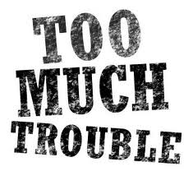
No Peace and Safety
There was no peace and safety in Ezekiel’s or Jeremiah’s message. They prophesied trouble/desolation for Israel. They didn’t say, “Apostasy is going through to the kingdom. Our leaders are bringing revival and reformation.” God’s prophets told the truth and let the chips fall.

Slide 12
No Turning Back
“Severer and yet more severe chastisements were to be inflicted upon the rebellious nation, until at last the entire land was to become a desolation, Jerusalem was to be laid waste and burned with fire, the temple that Solomon had built was to be destroyed, and the kingdom of Judah was to fall, never again to occupy its former position among the nations of earth. Those times of change, so fraught with peril to the Israelitish nation, were marked with many messages from Heaven through Jeremiah. Thus the Lord gave the children of Judah ample opportunity of freeing themselves from entangling alliances with Egypt, and of avoiding controversy with the rulers of Babylon. As the threatened danger came closer, he taught the people by means of a series of acted parables, hoping thus to arouse them to a sense of their obligation to God, and also to encourage them to maintain friendly relations with the Babylonian government.” PK, pg. 423

Slide 13
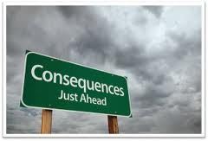
Consequences
”Now will I shortly pour out my fury upon thee, and accomplish mine anger upon thee: and I will judge thee according to thy ways, and will recompense thee for all thine abominations. And mine eye shall not spare, neither will I have pity: I will recompense thee according to thy ways and thine abominations that are in the midst of thee; and ye shall know that I am the LORD that smiteth. Behold the day, behold, it is come: the morning is gone forth; the rod hath blossomed, pride hath budded.” Ezek. 7:7-10

Slide 14
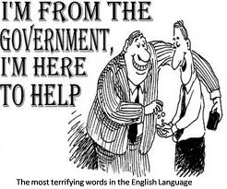
1. Abortion
2. Human trafficking
3. Bullying the World
4. Greed
5. Lies, Murder
6. Homosexuality
America, the world, and Israel of old were ripe for destruction for their wickedness against God and His Law.

Slide 15
In The Midst of Judgment
“Yet will I leave a remnant, that ye may have some that shall escape the sword among the nations, when ye shall be scattered through the countries.” Ezek. 6:8
“The remnant of Israel shall not do iniquity, nor speak lies; neither shall a deceitful tongue be found in their mouth: for they shall feed and lie down, and none shall make them afraid.” Zeph. 3:13

Slide 16
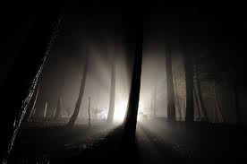
The Remnant Has Light
In the midst of darkness and deception, the remnant has light. “We have also a more sure word of prophecy; whereunto ye do well that ye take heed, as unto a light that shineth in a dark place, until the day dawn, and the day star arise in your hearts:” 2 Peter 1:19

Slide 17
Protection in Christ Alone!
” But they that escape of them shall escape, and shall be on the mountains like doves of the valleys, all of them mourning, every one for his iniquity. All hands shall be feeble, and all knees shall be weak as water. They shall also gird themselves with sackcloth, and horror shall cover them; and shame shall be upon all faces, and baldness upon all their heads. They shall cast their silver in the streets, and their gold shall be removed: their silver and their gold shall not be able to deliver them in the day of the wrath of the LORD: they shall not satisfy their souls, neither fill their bowels: because it is the stumbling block of their iniquity.” Ezek. 7:16-19

Slide 18
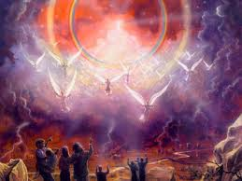
Lo, This is Our God…
“He will swallow up death in victory; and the Lord GOD will wipe away tears from off all faces; and the rebuke of his people shall he take away from off all the earth: for the LORD hath spoken it. And it shall be said in that day, Lo, this is our God; we have waited for him, and he will save us: this is the LORD; we have waited for him, we will be glad and rejoice in his salvation.” Isaiah 25:8,9

