Slide 1
Ezekiel, pt. 13
‘Till He Come’

Slide 2
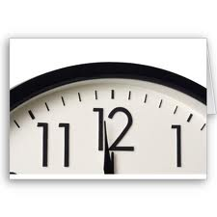
The Day and Time
“And it came to pass in the seventh year, in the fifth month, the tenth day of the month, that certain of the elders of Israel came to enquire of the LORD, and sat before me.” Ezekiel 20:1 Ezekiel was writing chapters 20-22 around 590 BC. Jerusalem would be plowed like a field and Solomon’s temple would be destroyed in 4 years. What did he have to say?

Slide 3
Through Ezekiel 21 and 22
“Seeing then that I will cut off from thee the righteous and the wicked, therefore shall my sword go forth out of his sheath against all flesh from the south to the north:” verse 4
“It is sharpened to make a sore slaughter; it is furbished that it may glitter: should we then make mirth? …” verse 10
“Cry and howl, son of man: for it shall be upon my people, it shall be upon all the princes of Israel: terrors by reason of the sword shall be upon my people: smite therefore upon thy thigh.” verse 12

Slide 4
Continued
“Therefore thus saith the Lord GOD; Because ye have made your iniquity to be remembered, in that your transgressions are discovered, so that in all your doings your sins do appear; because, I say, that ye are come to remembrance, ye shall be taken with the hand.” verse 24
“And I will pour out mine indignation upon thee, I will blow against thee in the fire of my wrath, and deliver thee into the hand of brutish men, and skilful to destroy.” verse 31

Slide 5
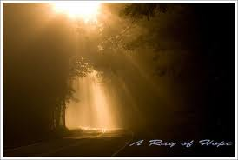
A Ray of Hope
“I will overturn, overturn, overturn, it: and it shall be no more, until he come whose right it is; and I will give it him.” Ezekiel 21:27

Slide 6
Christ is Coming
“To the "profane wicked prince" had come the day of final reckoning. "Remove the diadem," the Lord decreed, "and take off the crown." Not until Christ Himself should set up His kingdom was Judah again to be permitted to have a king. "I will overturn, overturn, overturn, it," was the divine edict concerning the throne of the house of David; "and it shall be no more, until He come whose right it is; and I will give it Him." Ezekiel 21:25-27.

Slide 7
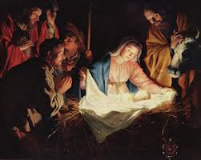
Desire of Ages
With the fall of Babylon, Medo-Persia, and Greece, Ezekiel foretold that during the next empire, the Messiah would come. The only hope for mankind, the DESIRE OF AGES, would come and He would establish His kingdom of grace!!

Slide 8
Flood of Grace
“And when the fullness of the time had come, the Deity was glorified by pouring upon the world a flood of healing grace that was never to be obstructed or withdrawn till the plan of salvation should be fulfilled.
Satan was exulting that he had succeeded in debasing the image of God in humanity. Then Jesus came to restore in man the image of his Maker. None but Christ can fashion anew the character that has been ruined by sin. He came to expel the demons that had controlled the will. He came to lift us up from the dust, to reshape the marred character after the pattern of His divine character, and to make it beautiful with His own glory.” DA, pgs. 37,38

Slide 9
Ezekiel 22
Ezekiel 22 is not a pretty picture either. Judgments on sin and rebellion; warnings that iniquity will be punished, continued to pour forth from Ezekiel’s mouth. The Lord was relentless in trying to turn Ancient Adventism from rebelliousness before the Lord would have no choice but to allow their destruction!

Slide 10
Behold!
“Thou art become guilty in thy blood that thou hast shed; and hast defiled thyself in thine idols which thou hast made; and thou hast caused thy days to draw near, and art come even unto thy years: therefore have I made thee a reproach unto the heathen, and a mocking to all countries.” verse 4
“Thou hast despised mine holy things, and hast profaned my sabbaths. In thee are men that carry tales to shed blood: and in thee they eat upon the mountains: in the midst of thee they commit lewdness.” verses 8,9
“And I will scatter thee among the heathen, and disperse thee in the countries, and will consume thy filthiness out of thee.” verse 15

Slide 11
Conspiracy
“ There is a conspiracy of her prophets in the midst thereof, like a roaring lion ravening the prey; they have devoured souls; they have taken the treasure and precious things; they have made her many widows in the midst thereof. Her priests have violated my law, and have profaned mine holy things: they have put no difference between the holy and profane, neither have they shewed difference between the unclean and the clean, and have hid their eyes from my sabbaths, and I am profaned among them. Her princes in the midst thereof are like wolves ravening the prey, to shed blood, and to destroy souls, to get dishonest gain.” Verse 25-27

Slide 12
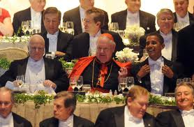
A Conspiracy
“…I will shew unto thee the judgment of the great whore that sitteth upon many waters: With whom the kings of the earth have committed fornication...” Rev. 17:1,2
“MYSTERY, BABYLON THE GREAT, THE MOTHER OF HARLOTS.” Rev. 17:5
“The merchants of these things, which were made rich by her, shall stand afar off for the fear of her torment, weeping and wailing,” Rev. 18:15

Slide 13
George Bush, 9-11, Conspiracy
United Nations on November 10, 2001, United States President George W. Bush denounced the emergence of "outrageous conspiracy theories ... that attempt to shift the blame away from the terrorists, themselves, away from the guilty." Later, as media exposure of conspiracy theories of the events of 9/11 increased, U.S. Government agencies and the Bush Administration issued responses to the theories, including a formal analysis by the National Institute of Standards and Technology (NIST) about the collapse of the World Trade Center,^{[11]} a revised 2006 State Department webpage to debunk the theories,^{[12]} and a strategy paper referred to by President Bush in an August 2006 speech, which declared that terrorism springs from "subcultures of conspiracy and misinformation," and that "terrorists recruit more effectively from populations whose information about the world is contaminated by falsehoods and corrupted by conspiracy theories.”

Slide 14
A Conspiracy
“‘The Enemy Unmasked’, however, goes far beyond that to link many groups and individuals into a world-wide conspiracy that we do not believe is correct, and in fact, is very inflammatory and damaging to the efforts of Christian brotherhood and goodwill. I enjoy very much my fellowship with all Christian pastors and believers in my community, and I deeply regret that this book was printed and distributed anywhere. I believe it is harmful to the cause of Christ.

Slide 15
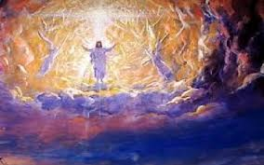
Any Hope
“When Protestant churches shall unite with the secular power in sustaining a false religion, for opposing which
their ancestors endured the fiercest persecution, then will the papal Sabbath be enforced by the combined authority of church and State. There will be a national apostasy , which will end in national ruin.” 1. E.G. White, The Signs of the Times, Pacific Press, {ST, November 8, 1899 par.
6}

Slide 16
Ellen White Applies Ezekiel 21 to NOW!!!
All that prophecy has foretold as coming to pass, until the present time, has been traced on the pages of history, and we may be assured that all which is yet to come will be fulfilled in its order. The final overthrow of all earthly dominions is plainly foretold in the word of truth. In the prophecy uttered when sentence from God was pronounced upon the last king of Israel is given the message: "Thus saith the Lord God; Remove the diadem, and take off the crown: . . . exalt him that is low, and abase him that is high. I will overturn, overturn, overturn, it: and it shall be no more, until He come whose right it is; and I will give it Him." Ezekiel 21:26, 27.

Slide 17
…The crown removed from Israel passed successively to the kingdoms of Babylon, Medo-Persia, Greece, and Rome. God says, "It shall be no more, until He come whose right it is; and I will give it Him.“ That time is at hand. Today the signs of the times declare that we are standing on the threshold of great and solemn events. Everything in our world is in agitation. Before our eyes is fulfilling the Saviour's prophecy of the events to precede His coming: "Ye shall hear of wars and rumors of wars. . . . Nation shall rise against nation, and kingdom against kingdom: and there shall be famines, and pestilences, and earthquakes, in divers places." Matthew 24:6, 7.” Ed. Pgs. 178,179

Slide 18
Christ Will Come!!!
…The present is a time of overwhelming interest to all living. Rulers and statesmen, men who occupy positions of trust and authority, thinking men and women of all classes, have their attention fixed upon the events taking place about us. They are watching the strained, restless relations that exist among the nations. They observe the intensity that is taking possession of every earthly element, and they recognize that something great and decisive is about to take place--that the world is on the verge of a stupendous crisis. Angels are now restraining the winds of strife, that they may not blow until the world shall be warned of its coming doom; but a storm is gathering, ready to burst upon the earth; and when God shall bid His angels loose the winds, there will be such a scene of strife as no pen can picture.” Education, pgs. 179, 180

