Slide 1
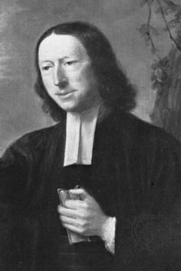
The man of sin, the son of perdition– …in many respects, the Pope has an indisputable claim to those titles. He is, in an emphatical sense, the man of sin, as he increases all manner of sin above measure. And he is, too, properly styled, the son of perdition, as he has caused the death of numberless multitudes, both of his opposers and followers, destroyed innumerable souls, and will himself perish everlastingly.—Explanatory Notes Upon the New Testament, p. 216
John Wesley (1703-1791)

Slide 3
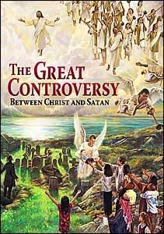

Slide 4
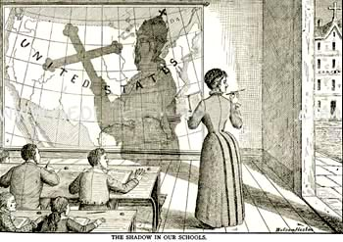

Slide 5
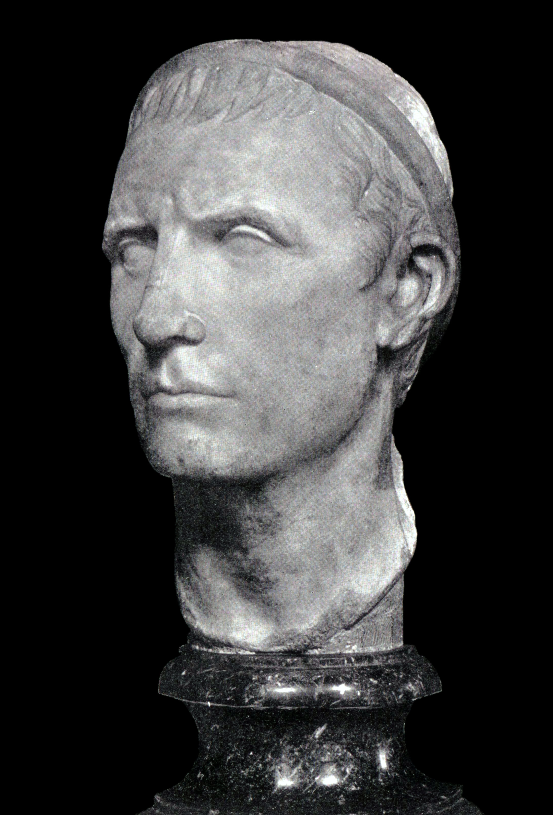
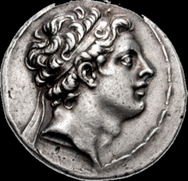
Seleucid King: Antiochus IV Epiphanes (Reigned 175-164 BC)

Slide 6
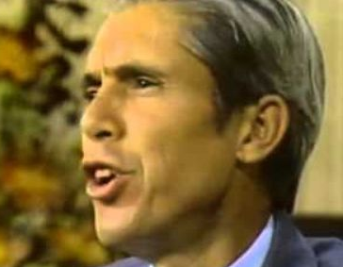
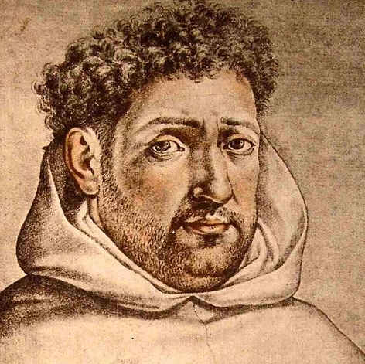
Covering Rome’s Tracks!!! The Jesuits
What does that tell you about this man? Desmond Ford, former Seventh-day Adventist, who rejected the Protestant Reformer belief about the Antichrist and instead accepted a Jesuit theology. What does it tell you about his relationship to Christ? His education? Character? And Goals? To proclaim truth? Or Betray it?
Francisco Ribera-Created the Theory of Futurism, looking to the future for the Antichrist, taking the eyes off the Pope
Luis De Alcazar-Created the Theory of Preterism, looking to the past for the Antichrist, taking the eyes off the Pope

Slide 8
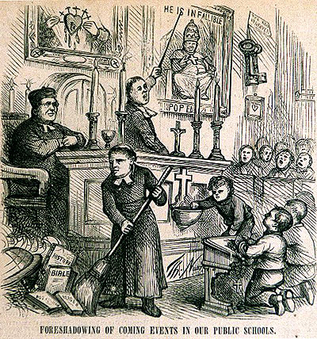
Protestant Denominations have utterly forgotten their hallmark doctrinal truths about the Antichrist. The biblical principle of “By their Fruits Ye Shall Know them” tells us that obviously there is an infiltration in the education systems—why else would professed Protestants adopt a wholly Catholic theology, created by Jesuits during the early years of the Counter-Reformation?

Slide 9
Pacific Union College-Affiliated with the Adventists, established in 1882, located in Angwin, CA in the Napa Valley

Slide 10
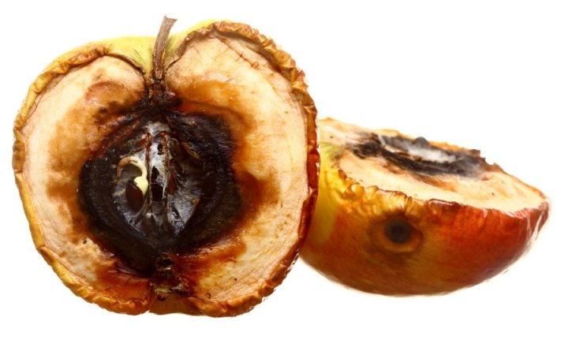
BY THEIR FRUITS YE SHALL KNOW THEM—Mattew 7:20

Slide 11
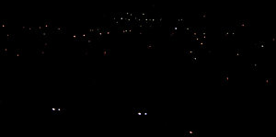

Slide 12
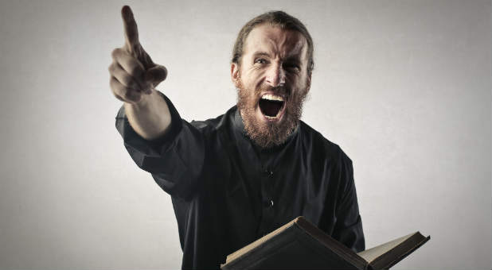
The SDA Church is Babylon!!!!

Slide 13
The Message for any SDA Church that is not proclaiming the 3 Angel’s Messages in word and deed is…
They are NOT Babylon

Slide 14
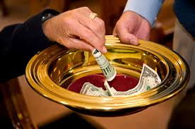
Church Policy: Pay your money and keep your mouth shut!! You must submit to my spiritual authority! You cannot think for yourself, but do what the Church tells you!

Slide 16
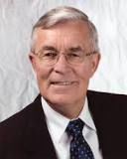
What do these Fruits tell you???
To interpret the sea monster of Revelation 13 as the papacy seems somewhat out of keeping with the spirit of the times. In an age when Christianity in general faces the onslaughts of secularism and when among Christians ecumenism has become popular, the interpretation smacks of narrowness and bigotry—William Johnsson, “The Saints’ Victory in the End-Time”, Adventist Review, November 1994, 171
William G. Johnsson (Seventh-day Adventist author and was editor of the Adventist Review, the church's flagship weekly magazine, from 1982 to 2006)

Slide 17
These photos are taken from the Adventist Review, (Entitled: “The Bridegroom’s Coming: Does Anybody Care?”) September 8 1994, p. 16 (top) and p. 3 (bottom)

Slide 18
Rome’s Heresies are now part of the last day message???
Photos taken from the Adventist Review (Entitled: “For a Brighter Future in Pakistan”), May 2, 1991, p. 10 (all photos)

Slide 19
Myron Widmer: Adventist Review (Entitled: “Indochina: A rare glimpse of Adventists in Laos, Vietnam, Cambodia, and Myanmar”), September 9, 1993, p. 4
Or might a better understanding
be that God is working through this pope to open doors for Catholics to the great truths of Scripture concerning salvation by faith in Christ?—Myron Widmer, Adventist Review, September 23, 1993, p. 5

Slide 21
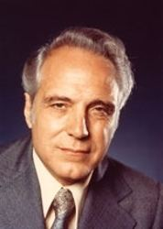
More Rotten Fruits
It is not for us to question the motives of our medieval ancestors. . . Nor must we overlook the good done by the church. Throughout the world monasteries provided care for orphans, widows, and the sick. And all of us owe appreciation to the church of the Middle Ages for preserving the Scriptures.—George Vandeman, 1986, The Rise and Fall of Anti-Christ, p. 54-55
Television Evangelist: George Vandeman (1916-2000)

Slide 22
Which is Truth??? What decision will you make???
OR

Slide 23
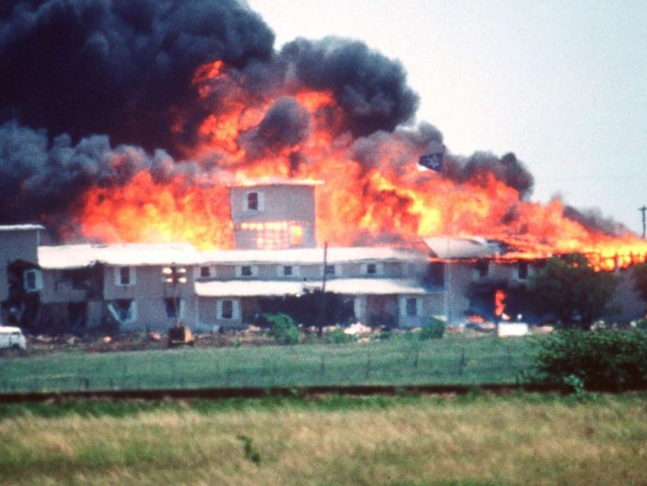
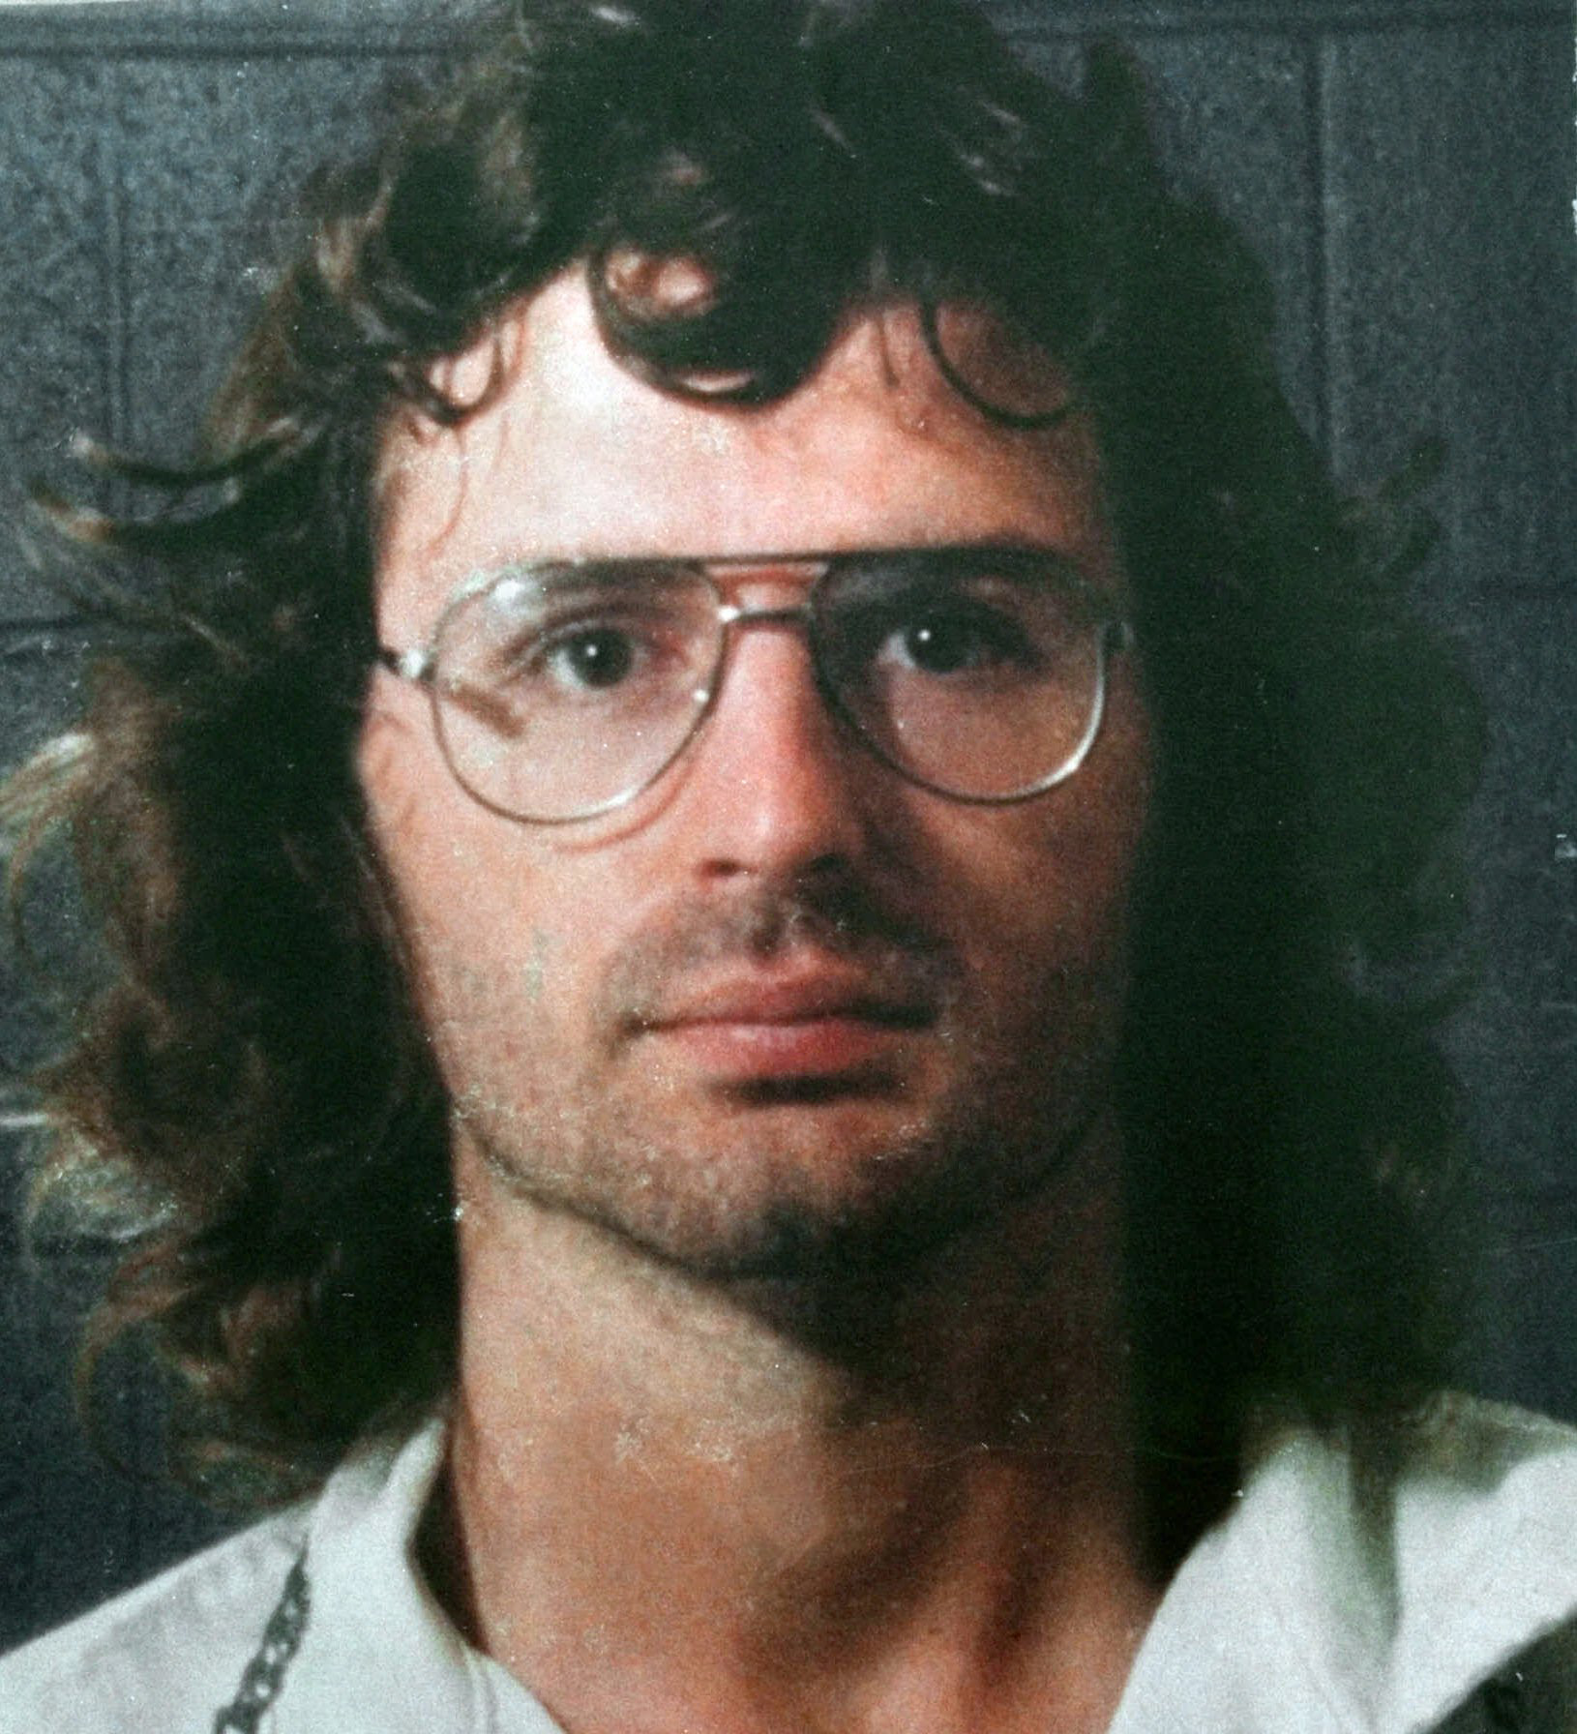

Slide 24
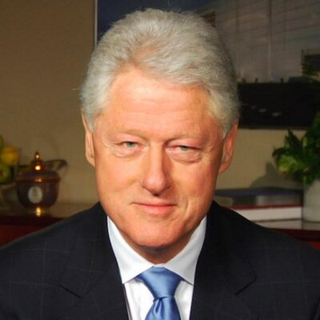
“Again I want to say as I did yesterday, I’m very sorry for the loss of life which occurred at the beginning and at the end of this tragedy in Waco. I hope very much that others who will be tempted to join cults and to become involved with people like David Koresh, will be deterred by the horrible scenes they have seen over the last seven weeks. And I hope very much that the difficult situations which federal agents confronted there, and which they will be doubtless required to confront in other contexts in the future, will be somewhat better handled and better understood because of what has been learned now”—Bill Clinton, White House Press Release, April 20, 1993
Bill Clinton (President of the United States from 1993-2001

Slide 25
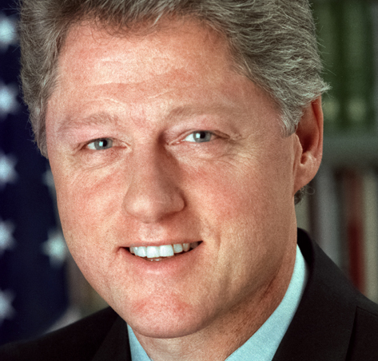
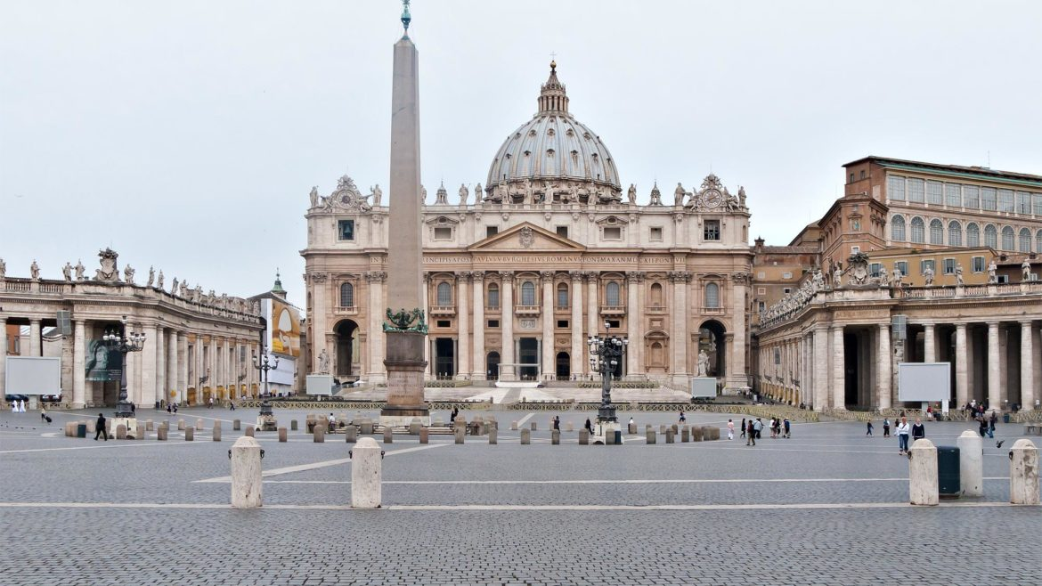
Who is Clinton working for????
?
?
?
?
?
?
?
?
?
?
?
?
?
?
OR
Capitol Hill?
St. Peter’s Basilica

Slide 26
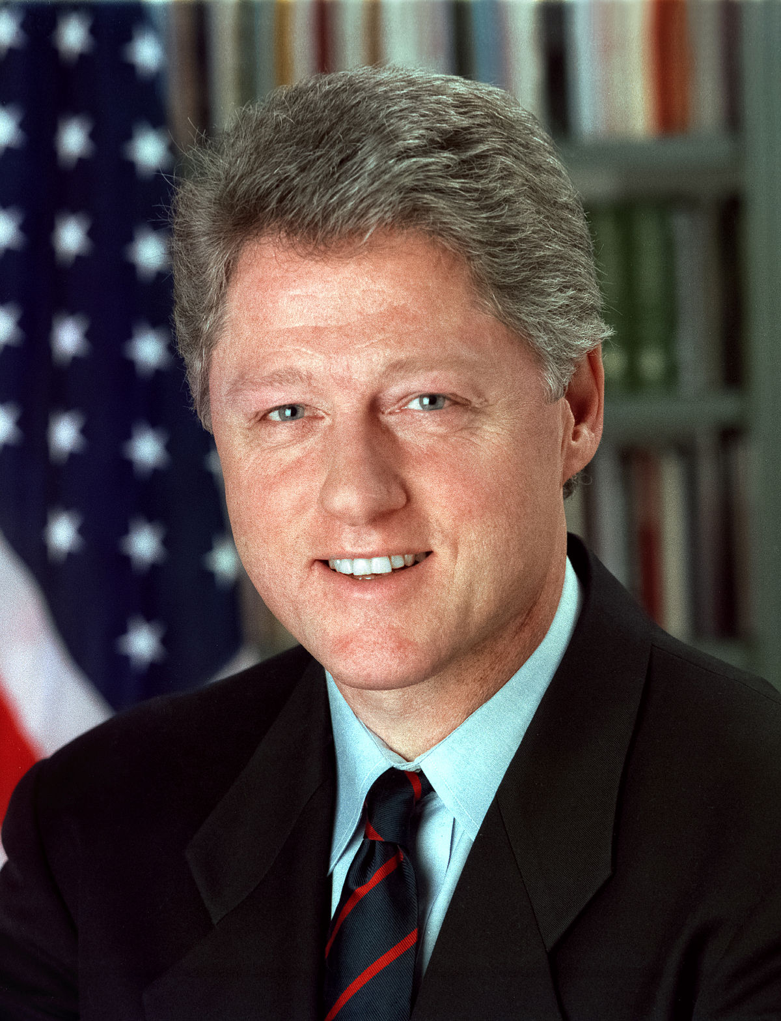
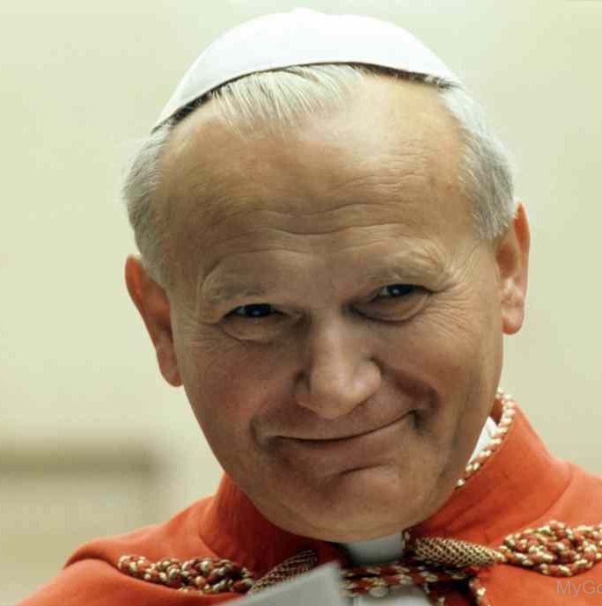
Bill Clinton’s Message and Meaning….
DO NOT JOIN independent ministries, but stay in all mainstream, Jesuit-Controlled Denominations, or you will share the same fate as the Davidians of Waco!
Well Said!!!
Who’s will was Clinton serving???

Slide 27
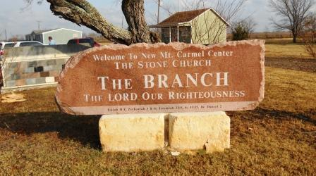
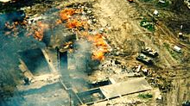
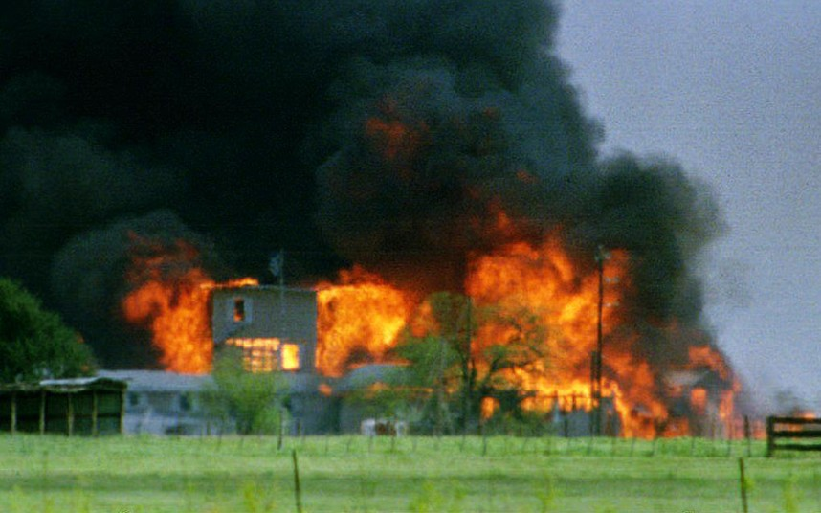
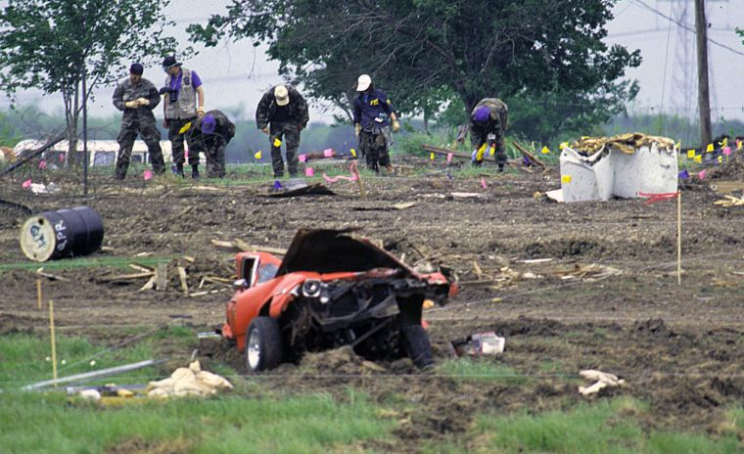

Slide 28
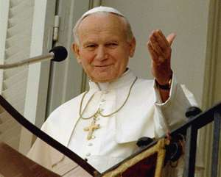
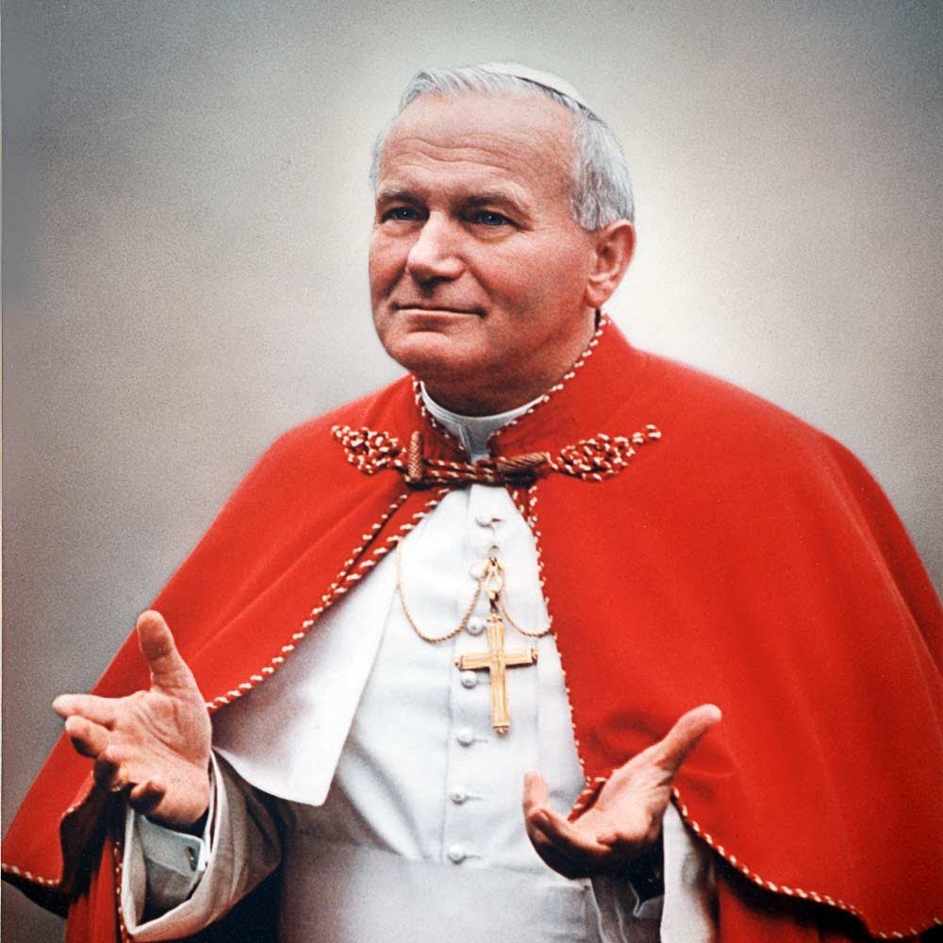
John Paul II (Papacy: 1978-2005): “The proselytizing activity of the sects and new religious groups of America is a grave hindrance to the work of evangelization. The success of proselytism by the sects and new religious groups in America cannot be ignored”—John Paul II, “The Challenge of the Sects”, Exhortation, Article 73

Slide 29
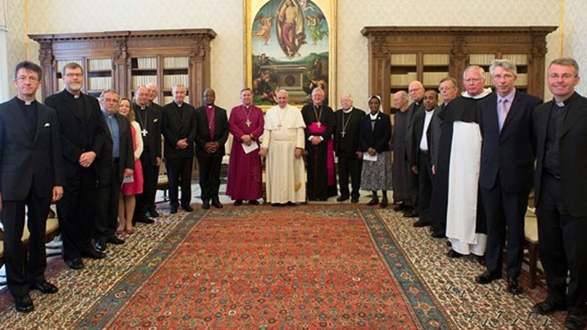
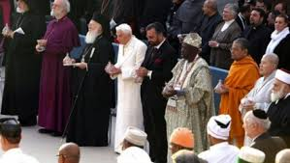
God Will Raise Up a People to Finish the Work of Spreading the Three Angel’s Messages; will you and I answer the call? Please Join Christ in this Final Work for Mankind—Let’s All Take Hold of Christ, and take ownership of this great work!! Each of us doing what we can in our spheres—mass mailings, websites, YouTube Channels, passing out pamphlets, books, doing Bible Studies, Anything we can! Take heart, God is with us and He will be the Victor!!
The Forces of Darkness are on the move…. Are we?

Slide 30
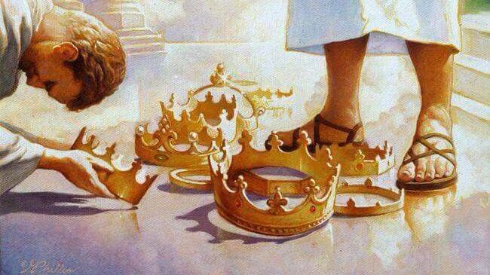

Slide 31
