Slide 1
The Golden Rule, pt. 1 “Robert Morris”

Slide 2
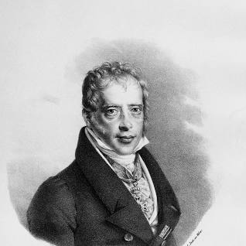
Mayer A. Rothschild
The founder of the money power of the Rothschild’s was this man, Mayer Amchel Rothschild. He once made an interesting comment, ““GIVE me control of a nation’s money supply, and I care not who makes its laws.” Rothschild understood that money was the ultimate source of power in this world and if he could control a nation’s money flow, then he could eventually destroy all the laws of that nation!

Slide 3
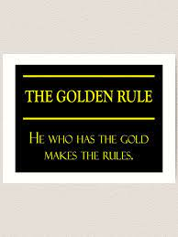
The Golden Rule!
In other words, Rothschild believed in the Golden Rule; the one who has the gold makes the rules. The one with the gold would eventually be able to so guide earth’s events that he could ultimately dictate policy and behavior to the world!
This is exactly what Rev. 13 says, “And he causeth all, both small and great, rich and poor, free and bond, to receive a mark in their right hand, or in their foreheads: And that no man might buy or sell, save he that had the mark, or the name of the beast, or the number of his name.” verses 16,17

Slide 4
Are We Treading Near this Ground Today?
“On March 9, the Biden administration issued a sweeping executive order directing a laundry list of government agencies to develop plans to regulate cryptocurrencies like Bitcoin, as well as to produce a detailed plan to study the potential creation of a central bank digital currency (CBDC) for the United States. If the federal government and Federal Reserve were to ultimately issue a CBDC, it would be the first time in a century that America has released an entirely new currency…. Digital dollars could easily be tracked by banks, federal agencies and the Federal Reserve. They could also be programmed to control the kinds of things people can buy, how much could be purchased at a single time or any number of other variables. In short, the development of a digital currency could present the most dramatic expansion of federal power in history, depending on its design. In the coming weeks and months, advocates of a digital dollar might allege that all of these concerns are highly speculative, or perhaps even "conspiracy theories." But there are good reasons to think a digital dollar like the one the White House is considering would be used to micromanage the U.S. economy—and, by extension, the whole of society.” JUSTIN HASKINS , EDITORIAL DIRECTOR, THE HEARTLAND INSTITUTE
3/18/22 AT 6:30 AM EDT

Slide 5
A New Trend?? Timeless Pursuit?
Is the Biden administration starting a new trend whereby money could be used to control and dictate policy to an entire nation and world? Or, is this current effort something that has been in the works from the beginning of America?
We have mentioned the Rothschilds AS A FAMILY THAT HAS USED MONEY FOR HUNDREDS OF YEARS TO CONTORL NATIONS! Are they still involved and are they working for someone else who has similar aspirations? Is the final goal still dictating policy to this planet via money? Or, is Rev. 13:17 a relic of the past? “And that no man might buy or sell, save he that had the mark, or the name of the beast, or the number of his name.”

Slide 6
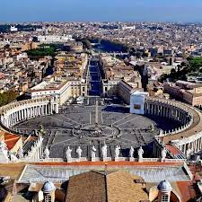
Rothschild/Vatican Connect!
“Aware that the Rothschilds are an important Jewish family, I looked them up in Encyclopedia Judaica and discovered that they bear the title 'Guardians of the Vatican Treasury.'... The appointment of Rothschild gave the black papacy absolute financial privacy and secrecy. Who would ever search a family of orthodox Jews for the key to the wealth of the Roman Catholic Church? -- F. Tupper Saussy, Rulers of Evil, Harper-Collins, pp. 160,161.

Slide 7
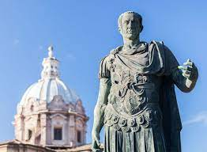
More Powerful than Caesar!!
Biographer Frederick Morton concluded that ‘through the effective use of money the Rothschilds had successfully conquered the world more thoroughly, more cunningly, and much more lastingly than all the Caesar's before or all the Hitler’s after them. -- Frederic Morton, The Rothschilds: A Family Portrait, Atheneum, p. 14.

Slide 8
The Bible Agrees!
“And the merchants of the earth shall weep and mourn over her; for no man buyeth their merchandise any more: The merchandise of gold, and silver, and precious stones, and of pearls, and fine linen, and purple, and silk, and scarlet, and all thyine wood, and all manner vessels of ivory, and all manner vessels of most precious wood, and of brass, and iron, and marble, And cinnamon, and odours, and ointments, and frankincense, and wine, and oil, and fine flour, and wheat, and beasts, and sheep, and horses, and chariots, and slaves, and souls of men. And the fruits that thy soul lusted after are departed from thee, and all things which were dainty and goodly are departed from thee, and thou shalt find them no more at all. The merchants of these things, which were made rich by her, shall stand afar off for the fear of her torment, weeping and wailing,….” Revelation 18:11-15

Slide 9
Would the Rothschild’s Come to America?
The way to gain control of a nation’s wealth would be to create a central bank. Through the central bank, local banks are tied to them, and then on to the people. With a central, organized banking system, the flow of money could be controlled and money could be easily manipulated to create depressions/boom-bust cycles. With people in your hands financially, one could then influence public policy and through money could control politicians!

Slide 10
Terribly Dangerous
Andrew Jackson understood the dangers of the central bank and vetoed the bill to renew the bank’s charter. Jackson’s argument was simple. “Is there no danger to our liberty and independence in a bank that in its nature has so little to bind it to our country?...[Is there not] cause to tremble for the purity of our elections in peace and for the independence of our country in war?...Of the course which would be pursued by a bank almost wholly owned by the subjects of a foreign power, and managed by those whose interests, if not affections, would run in the same direction there can be no doubt...Controlling our currency, receiving our public monies, and holding thousands of our citizens in dependence, it would be more formidable and dangerous than a naval and military power of the enemy. -- Herman E. Kross, Documentary History of Banking and Currency in the United States, Chelsea House, pp. 26, 27.

Slide 11
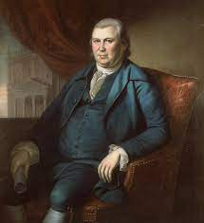
Attempt Number 1
As the new nation of America began to spread its wings, it would need a sound financial base from which to operate. It needed a bank, all right, but the bank used America instead of America using the bank. Financial genius and opportunist, Robert Morris organized the first bank. He and his associates believed that the bank should be modeled after the Bank of England. While the first bank in North America was not as ruthless as the central banks of today, it performed many of the operations of a modern central bank. ‘Secret’ investors put up $400,000 to start this bank. This attempt failed after two short years.

Slide 12
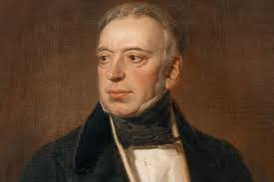
Secret Investors and Robert Morris
“Under the surface, the Rothschilds long had a powerful influence in dictating American financial laws. The law records show that they were the power in the old Bank of the United States. -- Gustavus Myers History of the Great American Fortunes, Random House, p. 556 [emphasis added].
“Over the years since N.M. [Nathan Rothschild], the Manchester textile manufacturer, had bought cotton from the Southern states, Rothschilds had developed heavy American commitments Nathan... had made loans to various states of the Union, had been, for a time, the official European banker for US government and was a pledged supporter of the Bank of the United States. --
Derek Wilson, Rothschild: The Wealth and Power of a Dynasty, Charles Scribner’s Sons, p. 178.

Slide 13
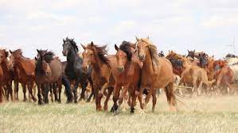
Rothschild/ Papacy/Central Bank
In 1782, the Bank of North America was opened in America during the infancy of the United States. It was modelled after Rothschild’s Bank of England. It operated as a central bank and, as it was organized by Congressman Robert Morris, it was intended from the start to serve both its directors and the politicians of the day. The bank did indeed serve the bankers and politicians - at the expense of the depositors.” ‘The Bank Was Saved, and the People Were Ruined.’ Jeff Thomas

Slide 14
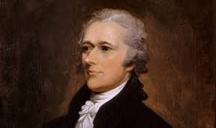
Next Up: Alex Hamilton
Hamilton is an interesting study. He served under Robert Morris/Rothschild’s first attempt at a central bank. When he saw how it worked, he shifted to sound money and no central bank by 1787 and then 3 years later shifted back to wanting a central bank in America. The Rothschilds/papacy wanted to control American banking so they bribed Hamilton to try it again and got a 20 year central bank charter in 1791. ‘“For the love of money is the root of all evil: which while some coveted after, they have erred from the faith, and pierced themselves through with many sorrows.” 1 Tim. 6:10

Slide 15
Quantum Shift
“Secretary of the Treasury, Alexander Hamilton, submitted a proposal to Congress in 1790 for a central bank. Interestingly enough, Hamilton had been an aide of Robert Morris in the initial experience of central banking in North America. Surprisingly, during the Constitutional convention of 1787, Hamilton had been a strong supporter of sound money. That Hamilton completely shifted within three years and proposed a central bank, which could generate money as the Federal Reserve Bank does, shows that Hamilton’s loyalty was compromised by the Jesuits. This is hard to reconcile, and one must suspect that, even the most well intentioned of men can become corrupted by the temptations of wealth and power. -- G. Edward Griffin, The Creature from Jekyll Island, American Opinion,
p. 328.
Note carefully Griffin’s conclusion. For Alexander Hamilton to have shifted so
drastically within a few short years would lead us to believe that he had been
bribed or blackmailed by the ‘secret investors’; either that , or joined them.

Slide 16
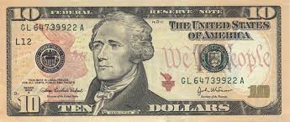
20 Year Charter
The central bank was almost completely controlled by the Rothschilds/papacy! They wielded great power over the other banks in America and regulated banking to a frightening degree. As the bank charter was nearing expiration in 1811, attempts to renew the charter were made, but it failed to be renewed! And guess what happened? The Rothschild/papal consortium were furious. In order to show their anger, guess what happened in 1812? The British invaded America and a war was fought! No one was to stand in the way of the central bank!!!

Slide 17
A Plan Was in Place!
“And he causeth all, both small and great, rich and poor, free and bond, to receive a mark in their right hand, or in their foreheads: And that no man might buy or sell, save he that had the mark, or the name of the beast, or the number of his name.” Rev. 13:16,17
“Behold, I come as a thief. Blessed is he that watcheth, and keepeth his garments, lest he walk naked, and they see his shame.” Rev. 16:15

