Slide 1
Ezekiel, pt. 21
“The Tale of Two Sticks”

Slide 2
Context
The first half of Ezekiel 37 looks at the outpouring of the Holy Spirit in the Latter Rain. This runs parallel to Revelation 18:1. At that time, the rest of Ezekiel 37 tells us what will happen among God’s people. Quite amazing!!!

Slide 3
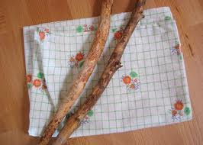
Two Sticks
“Moreover, thou son of man, take thee one stick, and write upon it, For Judah, and for the children of Israel his companions: then take another stick, and write upon it, For Joseph, the stick of Ephraim, and for all the house of Israel his companions:” Ezekiel 37:16

Slide 4
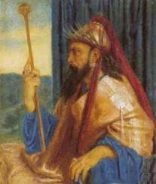
From the Days of Solomon
Following the death of Solomon, the 10 northern tribes, known as the tribes of Israel, came to Solomon’s son, Rehoboam, requesting for mercy and tenderness. When Rehoboam refused, the ten northern tribes went with Jeroboam and their was a split among God’s people.

Slide 5
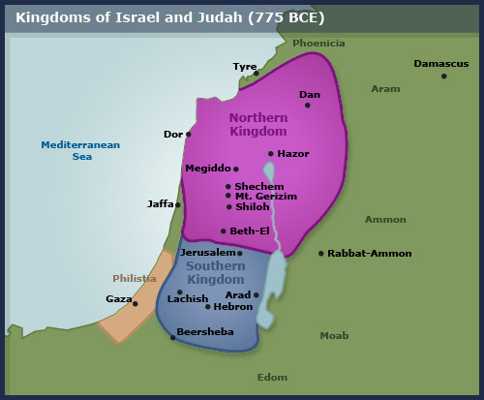
Division Among God’s Professed People

Slide 6
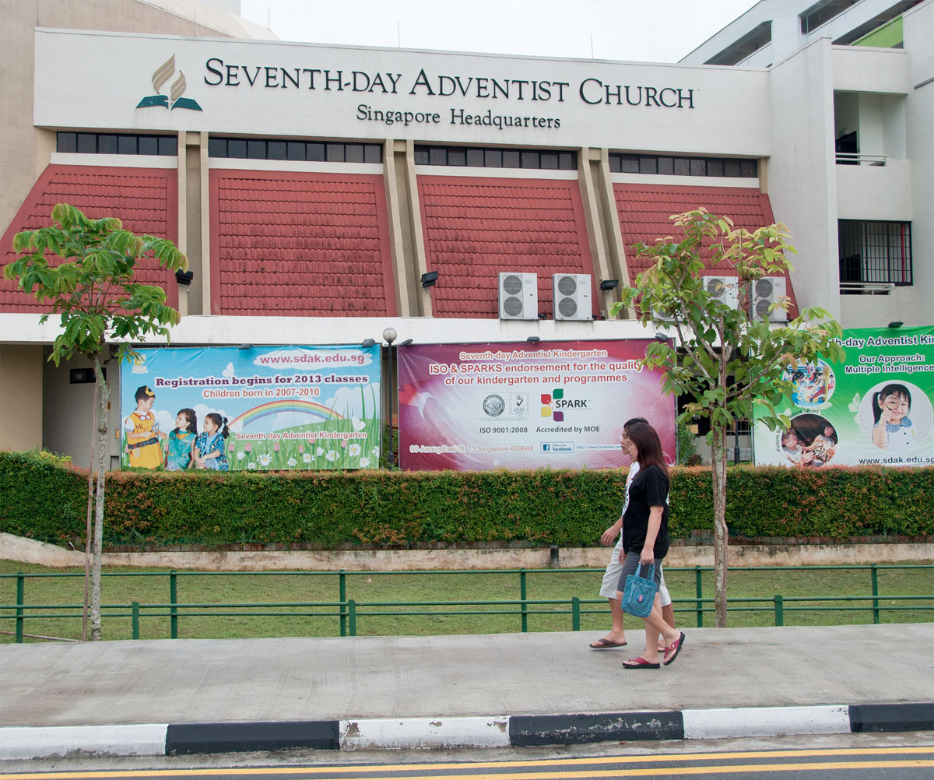
Division Today
Amongst us as a people, there is so much division today. Conference Adventism and self-supporting groups are two very distinct divisions today. In the midst of those 2 broad groups, there are many divides over a 1,000 things!!

Slide 7
Ezekiel Speaks!
“And join them one to another into one stick; and they shall become one in thine hand. And when the children of thy people shall speak unto thee, saying, Wilt thou not shew us what thou meanest by these? Say unto them, Thus saith the Lord GOD; Behold, I will take the stick of Joseph, which is in the hand of Ephraim, and the tribes of Israel his fellows, and will put them with him, even with the stick of Judah, and make them one stick, and they shall be one in mine hand. And the sticks whereon thou writest shall be in thine hand before their eyes.” Ezekiel 37:17-20

Slide 8
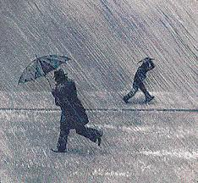
The Latter Rain and Sunday Law
The context of Ezekiel 37 is the Latter Rain. At the time of the Latter Rain and NSL, those of God’s professed people in the denomination that are clinging to Christ and His truth will unite with those in self supporting work who are doing the same and THEY , united together, will become “an exceeding great army.” v. 10 Those clinging to sin and resisting the truth of the 3 Angels of Rev. 14 will unite with the world to persecute the faithful!

Slide 9
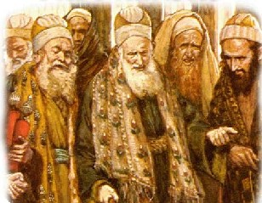
An Illustration of This!
Among the highest ranking officials in Ancient Adventism were Nicodemus and Joseph of Arimathea. They remained separate from the self supporting ministry of Christ. At the time of crisis, when Christ died, they united with the faithful ones in self-supporting work and supported the truth with all they had!

Slide 10
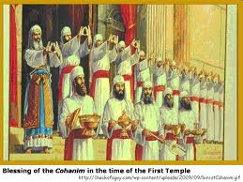
Pastors too
“And the word of God increased; and the number of the disciples multiplied in Jerusalem greatly; and a great company of the priests were obedient to the faith.” Acts 6:7

Slide 11
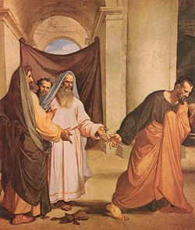
Apostates Unite Too
The apostates in Ancient, denominational Adventism ; like Caiaphas and the rabble, united with the apostates in self-supporting Adventism; names Judas, and together they persecuted Christ and the faithful!

Slide 12
Which Way?
“As the storm approaches, a large class who have professed faith in the third angel's message, but have not been sanctified through obedience to the truth, abandon their position and join the ranks of the opposition. By uniting with the world and partaking of its spirit, they have come to view matters in nearly the same light; and when the test is brought, they are prepared to choose the easy, popular side. Men of talent and pleasing address, who once rejoiced in the truth, employ their powers to deceive and mislead souls. They become the most bitter enemies of their former brethren. When Sabbath keepers are brought before the courts to answer for their faith, these apostates are the most efficient agents of Satan to misrepresent and accuse them, and by false reports and insinuations to stir up the rulers against them. “ GC, pg. 608

Slide 13
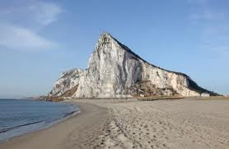
Faithful Souls
“The church is God's fortress. His city of refuge, which He holds in a revolted world. Any betrayal of the church is treachery to Him who has bought mankind with the blood of His only-begotten Son. From the beginning, faithful souls have constituted the church on earth. In every age the Lord has had His watchmen, who have borne a faithful testimony to the generation in which they lived. These sentinels gave the message of warning; and when they were called to lay off their armor, others took up the work.” AA, pg. 11

Slide 14
Who is the Church?
“God Has a Church. It is not the great cathedral; neither is it the national establishment, neither is it the various denominations. It is the people who love God and keep his commandments. “Where two or three are gathered in my name,
There I am in the midst of them.” Upward Look, pg. 315

Slide 15
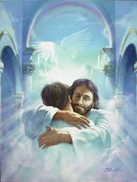
Promised Land
“And say unto them, Thus saith the Lord GOD; Behold, I will take the children of Israel from among the heathen, whither they be gone, and will gather them on every side, and bring them into their own land: And I will make them one nation in the land upon the mountains of Israel; and one king shall be king to them all: and they shall be no more two nations, neither shall they be divided into two kingdoms any more at all: Neither shall they defile themselves any more with their idols, nor with their detestable things, nor with any of their transgressions: but I will save them out of all their dwelling places, wherein they have sinned, and will cleanse them: so shall they be my people, and I will be their God.” Ezekiel 37:21-23

Slide 16
Home At Last
“Human language is inadequate to describe the reward of the righteous. It will be known only to those who behold it. No finite mind can comprehend the glory of the Paradise of God.
In the Bible the inheritance of the saved is called "a country." Hebrews 11:14-16. There the heavenly Shepherd leads His flock to fountains of living waters. The tree of life yields its fruit every month, and the leaves of the tree are for the service of the nations. There are ever-flowing streams, clear as crystal, and beside them waving trees cast their shadows upon the paths prepared for the ransomed of the Lord. There the wide-spreading plains swell into hills of beauty, and the mountains of God rear their lofty summits. On those peaceful plains, beside those living streams, God's people, so long pilgrims and wanderers, shall find a home.
"My people shall dwell in a peaceable habitation, and in sure dwellings, and in quiet resting places." "Violence shall no more be heard in thy land, wasting nor destruction within thy borders; but thou shalt call thy walls Salvation, and thy gates Praise." "They shall build houses, and inhabit them; and they shall plant vineyards, and eat the fruit of them. " Isaiah 32:18; 60:18; 65:21, 22. GC, pg. 677

Slide 17
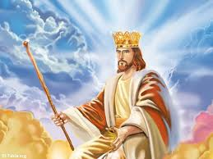
One King
“And David my servant shall be king over them; and they all shall have one shepherd: they shall also walk in my judgments, and observe my statutes, and do them. And they shall dwell in the land that I have given unto Jacob my servant, wherein your fathers have dwelt; and they shall dwell therein, even they, and their children, and their children's children for ever: and my servant David shall be their prince for ever.” Ezekiel 37:24,25

Slide 18
Christ the King
All the promises made to God’s children will be recognized. The land of Canaan will now be theirs. Christ, whose domain over man, was given up by Adam, will now be enshrined as King of Kings and Lord of Lords over ALL His creation!!

Slide 19
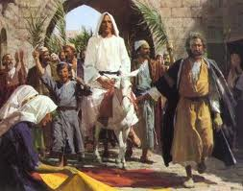
Because of Him
Because Christ was willing to step down from the throne of the universe, and to then die, you and I can one day walk on streets of gold and be restored to our lost Eden home. Because of Him!

