Slide 1
Naphtali “Hind Let loose”

Slide 2
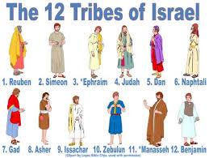
Almost Nothing About Him
Naphtali was the 2nd son of Rachel via her handmaid, Bilhah! Rachel, watching Leah pop out children like popcorn, became desperate. She wasn’t having a single child and her frustration knew no bounds. In this struggle, she devised a plan whereby she might have a child, even vicariously. It made little difference to her. Now, the number of competing wives would be three and soon four as Leah would give her maid to Jacob as well. What a mess and the 144,000 would emerge from this family in the end!!!!!

Slide 3

Battle Royal!!
“And she gave him Bilhah her handmaid to wife: and Jacob went in unto her. And Bilhah conceived, and bare Jacob a son. And Rachel said, God hath judged me, and hath also heard my voice, and hath given me a son: therefore called she his name Dan. And Bilhah Rachel's maid conceived again, and bare Jacob a second son. And Rachel said, With great wrestlings have I wrestled with my sister, and I have prevailed: and she called his name Naphtali.” Gen. 30:4-8

Slide 4
Silence
Nothing more is said specifically about Naphtali until Jacob’s benediction in genesis 49. However, we know that Naphtali was part of the wicked fiasco when Joseph was sold as a slave. We know too that Naphtali simply did as he was told by the older, more influential brothers; Rueben, Simeon, and Judah! They said ‘jump’ and Naphtali’s response would be, “How high?” Just like his servant mother, Bilhah, he/she did as they were told; regardless of right, principle, or conviction! We know too, that Naphtali came to Egypt and Joseph saw that he, along with the other brothers, had changed.
“Joseph was satisfied. He had seen in his brothers the fruits of true repentance. Upon hearing Judah's noble offer he gave orders that all but these men should withdraw; then, weeping aloud, he cried, "I am Joseph; doth my father yet live?“ PP, pg.230
In Jacob’s final benediction, he mentioned very little about Naphtali. What he did say, was quite positive and illustrative of a fine man!

Slide 5
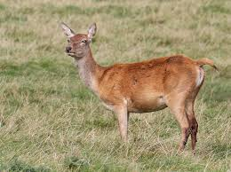
A Hind Let Loose!
“Naphtali is a hind let loose: he giveth goodly words.” Genesis 49:21
A hind is a female deer, especially a red deer, over three years old. Her counterpart, the mature male, is called a stag. In other species of deer the hind may be referred to as a doe and the male as a hart or a buck. References to the hind are popular in both literature and science.

Slide 6
Special Characteristics of a Hind
One of the noted characteristics of the hind (but not the hart) is its family loyalty. Mother red deer and their children form a family group that lasts until the children mate for themselves. Even then, young males often have territories that overlap those of their mothers. Biblical writers also noted this loyalty. “Rejoice with the wife of thy youth. Let her be as the loving hind and pleasant roe; let her breasts satisfy thee at all times; and be thou ravished always with her love.” (Proverbs 5:18-19) Jeremiah considered this loyalty so amazing that a violation of it would be as remarkable as God’s destruction of Jerusalem. “Yea, the hind also calved in the field, and forsook it, because there was no grass.” (Jeremiah 14:5) He goes on to talk about the sins of Jerusalem that would bring this marvel about.

Slide 7
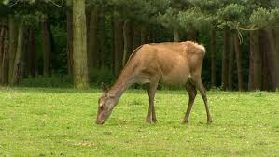
Red deer are also noted for finding whatever they need for sustenance. Harts have come down from the hills to eat from farm crops when food was scarce. This persistence in finding what they need was noted by a psalmist. “As the hart panteth after the water brooks, so my soul panteth after thee, O God.” (Ps 42:1)

Slide 8
Agility
“The one characteristic of the red deer most noted by biblical writers, however, is their agility. “Then shall the lame man leap as an hart, and the tongue of the dumb sing: for in the wilderness shall waters break out, and streams in the desert.” (Isa 35:6) Beyond noticing their mere leaping, many writers make reference specifically to the unerring hinds’ feet. (Yes, that would include their hind feet.) In 2 Samuel 22, David makes a psalm upon his deliverance from his enemies. This is also Psalm 18. In verse 34 (verse 33 in the Psalm) David says, “He maketh my feet like hinds' feet: and setteth me upon my high places.” He praises God for keeping him from falling. After Habakkuk had a vision of God in all his glory, he concludes by asserting God’s faithful support. “The LORD God is my strength, and he will make my feet like hinds' feet, and he will make me to walk upon mine high places.” (Hab 3:19)
The hart and the hind don’t worry about food, or falling. As we go through our days, we should be like they. Let us pant for God, who will plant our feet on the heights. Then we will be as pleasant in aspect as the hart or the hind.” As the Deer, Tim O’ Hearn

Slide 9
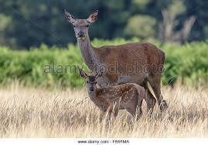
Hind’s Noble Characteristics
1. very loyal.
2. very protective.
3. takes care of their family.
4. Serves as a lookout for unwanted foes.
5. agile; able to conquer towering difficulties with ease!
These were characteristics that marked and blessed the tribe of Naphtali and, through them, many others!

Slide 10
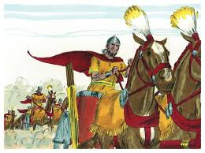
Naphtali’s Mightiest Warrior
God’s people had been oppressed by Sisera for 20 years. With his iron chariots, the Israelites quaked before him and his army.
The time had come for Israel to be delivered. The first battler in the vale of Megiddo was soon to be fought. The Lord called a woman, a prophetess and a man from Naphtali to lead the armies of the Lord. The woman’s name was………………………………………………………………………………………………………………………………………………..Deborah……………….and the man from Naphtali was…

Slide 11
Barak
“And Deborah, a prophetess, the wife of Lapidoth, she judged Israel at that time. And she dwelt under the palm tree of Deborah between Ramah and Bethel in mount Ephraim: and the children of Israel came up to her for judgment. And she sent and called Barak the son of Abinoam out of Kedeshnaphtali, and said unto him, Hath not the LORD God of Israel commanded, saying, Go and draw toward mount Tabor, and take with thee ten thousand men of the children of Naphtali and of the children of Zebulun? And I will draw unto thee to the river Kishon Sisera, the captain of Jabin's army, with his chariots and his multitude; and I will deliver him into thine hand. And Barak said unto her, If thou wilt go with me, then I will go: but if thou wilt not go with me, then I will not go. And she said, I will surely go with thee: notwithstanding the journey that thou takest shall not be for thine honour; for the LORD shall sell Sisera into the hand of a woman. And Deborah arose, and went with Barak to Kedesh.” Judges 4:4-9

Slide 12
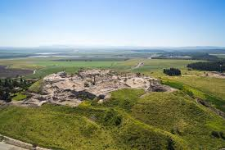
The Protective, Loyal Hind
When the Lord needed a loyal man to lead His army, He turned to Naphtali. He would, by the grace of the Lord, protect and defend Heaven’s little ones!! Barak would be a hind let loose; going to battle to protect God’s children! Not only would Barak stand, but so did the rest of the tribe of Naphtali!
“Zebulun and Naphtali were a people that jeoparded their lives unto the death in the high places of the field. The kings came and fought, then fought the kings of Canaan in Taanach by the waters of Megiddo; they took no gain of money. They fought from heaven; the stars in their courses fought against Sisera.“ Judges 5:18-20

Slide 13
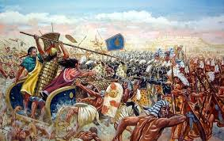
Naphtali Would fight
In mortal combat, God’s people stared down the enemy. Rueben wasn’t there; he wasn’t sure if it was time to engage the enemy! Dan was out on the Mediterranean having a good time. Battle, you say? Dan was having too much fun to get into a battle! Asher remained on the shore, counting his riches and worldly advantages; he was too busy making money to engage in the Lord’s work! The hind, Naphtali, was giving his life that God’s people could be saved. Naphtali’s loyalty to the cause of God was unrivaled!!

Slide 14
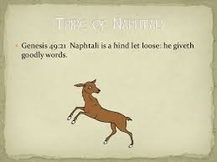
Goodly Words
Naphtali is a hind let loose: he giveth goodly words.” Gen. 49:21 Naphtali was on the lookout as one of the Lord’s sentinels. Not only was he vigilant in defense of the Lord’s heritage, Naphtali knew when to speak and what to say as the Lord’s mouthpiece. Like his Master, Naphtali spoke the truth but it was done in a thoughtful and tactful way.

Slide 15
Tact and Thoughtful
“Jesus did not suppress one word of truth, but He uttered it always in love. He exercised the greatest tact and thoughtful, kind attention in His intercourse with the people. He was never rude, never needlessly spoke a severe word, never gave needless pain to a sensitive soul. He did not censure human weakness. He spoke the truth, but always in love. He denounced hypocrisy, unbelief, and iniquity; but tears were in His voice as He uttered His scathing rebukes. He wept over Jerusalem, the city He loved, which refused to receive Him, the way, the truth, and the life. They had rejected Him, the Saviour, but He regarded them with pitying tenderness. His life was one of self-denial and thoughtful care for others. Every soul was precious in His eyes. While He ever bore Himself with divine dignity, He bowed with the tenderest regard to every member of the family of God. In all men He saw fallen souls whom it was His mission to save.” Steps to Christ, pg. 12

Slide 16
Words Spoken
“And moreover, because the preacher was wise, he still taught the people knowledge; yea, he gave good heed, and sought out, and set in order many proverbs. The preacher sought to find out acceptable words: and that which was written was upright, even words of truth. The words of the wise are as goads, and as nails fastened by the masters of assemblies, which are given from one shepherd.” Eccl. 12:9-11
“The wise in heart shall be called prudent: and the sweetness of the lips increaseth learning. Understanding is a wellspring of life unto him that hath it: but the instruction of fools is folly. The heart of the wise teacheth his mouth, and addeth learning to his lips. Pleasant words are as an honeycomb, sweet to the soul, and health to the bones. There is a way that seemeth right unto a man, but the end thereof are the ways of death. He that laboureth for himself; for his mouth craveth it of him. An ungodly man diggeth up evil: and in his lips there is as a burning fire.” Proverbs 16:21-27

Slide 17
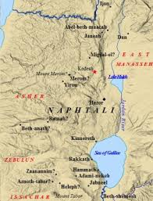
The land of Naphtali was to see more of Christ’s miracles than all the other places in Israel. It was in Naphtali that Christ did more healing and preaching.
Because of all the blessings the Lord poured upon Naphtali, it would be easy to become complacent and sometimes complacency breeds indolence and ease! Christ knew the dangers that would come against Naphtali and He sought to shield her in her trials. Naphtali was one of the first tribes to feel the stings of heathen conquests

Slide 18
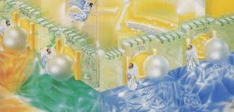
Learned his Lessons
The hind let loose finally learned that the only way to scale the difficult paths in life was through submission to the Lord!
Naphtali, the protector, finally realized that his only defense was in the Lord.
“The name of the LORD is a strong tower: the righteous runneth into it, and is safe.” Proverbs 18:10
For these reasons, a gate in the New Jerusalem will carry the name of Naphtali!

