Slide 1
The Book of Romans pt. 4
Romans 2:17-29

Slide 2
Contact Information for Bill Hughes
Address E-mail
P.O. Box 1417 N3232@cs.com
Eustis, FL 32727
U.S.A.
Mobile phone
1-863-412-0522

Slide 3
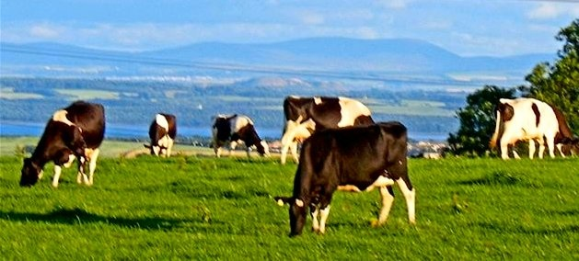
Summary of Romans 2:1-16
1. No one is without excuse for knowing God.
2. All will be judged on the light they have received.
3. The goodness of God leads us to repent.
4. The fact that so few repent tells us of the stubbornness of man.
5. God is no respecter of persons.
6. Sin and righteousness will be rewarded regardless of the profession.

Slide 4
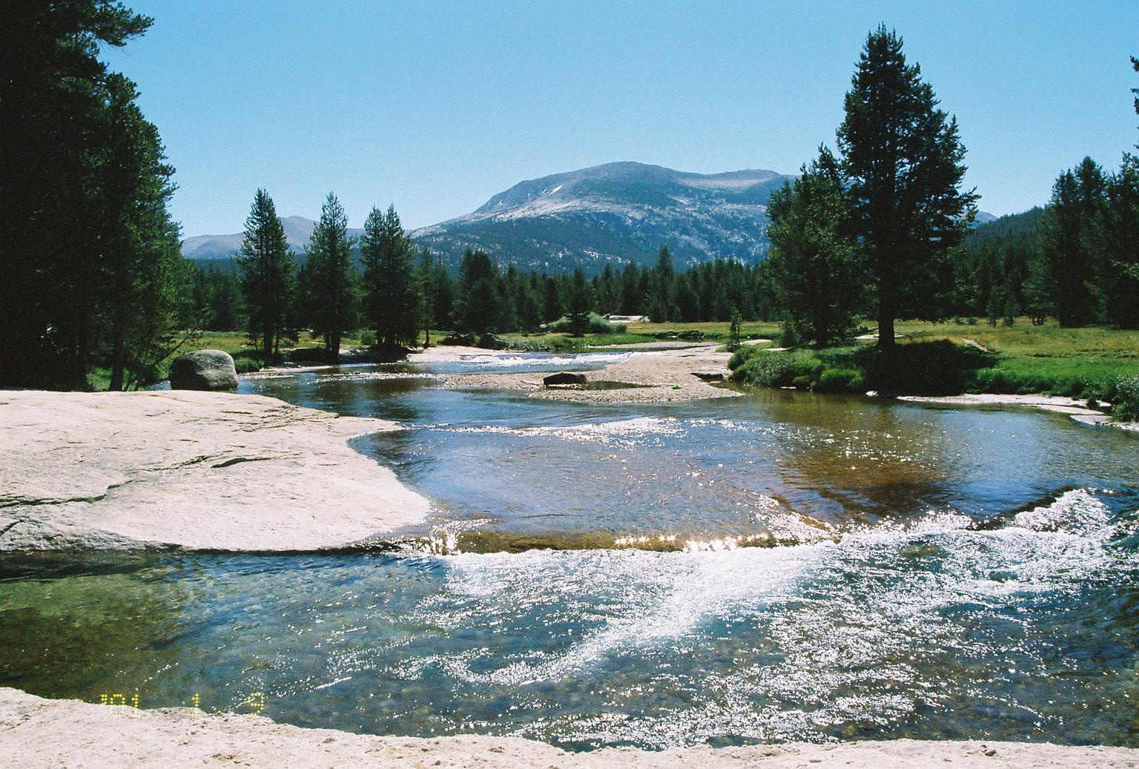
Romans 2:17-20
“Behold, thou art called a Jew, and restest in the law, and makest thy boast of God, And knowest his will, and approvest the things that are more excellent, being instructed out of the law; And art confident that thou thyself art a guide of the blind, a light of them which are in darkness,
An instructor of the foolish, a teacher of babes, which hast the form of knowledge and of the truth in the law.”

Slide 5
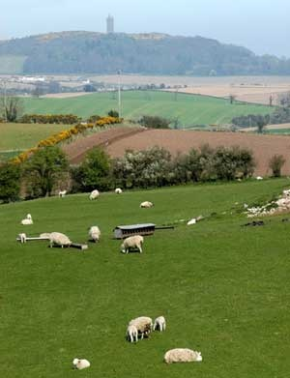
Professor’s of Christ
“And if ye be Christ's, then are ye Abraham's seed, and heirs according to the promise.” Galatians 3:29
“I know thy works, and tribulation, and poverty, (but thou art rich) and I know the blasphemy of them which say they are Jews, and are not, but are the synagogue of Satan.” Rev. 2:9
“Behold, I will make them of the synagogue of Satan, which say they are Jews, and are not, but do lie...” Rev. 3:9

Slide 6
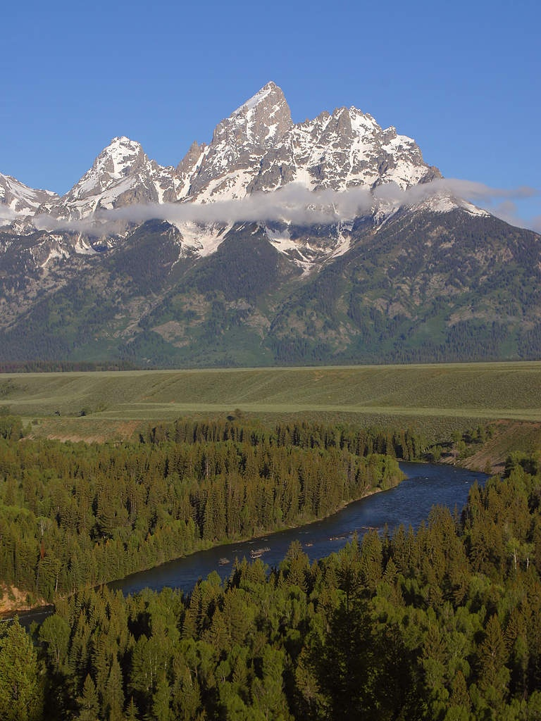
Paul’s Challenge
Paul was dealing with those who professed to be Christ’s followers. While it certainly has application to the Jews, it is not exclusive. It focuses on professed Christians at large.

Slide 7
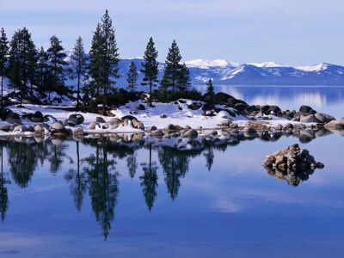
Resting in the Law or in the Lord?
Paul saw a horrible arrogance that said, “The Pharisee stood and prayed thus with himself, God, I thank thee, that I am not as other men are, extortioners, unjust, adulterers, or even as this publican.” Luke 18:11 Confident in themselves, in their good deeds, and yet, refusing to minister to their fellow man, this was/is the plight of most professed Christians. Heavenly privilege's demand corresponding ministry to others.

Slide 8

What Worth Without Christ?
Professing Christ, confident in outward acts of obedience, looking good for the multitudes, and yet, not possessing Christ within, is dung, garbage, and nothingness.
“But what things were gain to me, those I counted loss for Christ. Yea doubtless, and I count all things but loss for the excellency of the knowledge of Christ Jesus my Lord: for whom I have suffered the loss of all things, and do count them but dung, that I may win Christ,..” Philippians 3:7,8

Slide 9
Christ Alone Possesses Righteousness!
“The only defense against evil is the indwelling of Christ in the heart through faith in His righteousness.” DA, pg. 324
“Surely, shall one say, in the LORD have I righteousness and strength: even to him shall men come; and all that are incensed against him shall be ashamed.” Isa. 45:24
“I will go in the strength of the Lord GOD: I will make mention of thy righteousness, even of thine only.” Ps. 71:16
“this is his name whereby he shall be called, THE LORD OUR RIGHTEOUSNESS.’ Jer. 23:6

Slide 10
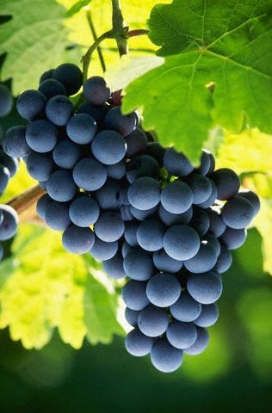
Romans 2:21-24
“Thou therefore which teachest another, teachest thou not thyself? thou that preachest a man should not steal, dost thou steal? Thou that sayest a man should not commit adultery, dost thou commit adultery? thou that abhorrest idols, dost thou commit sacrilege? Thou that makest thy boast of the law, through breaking the law dishonourest thou God? For the name of God is blasphemed among the Gentiles through you, as it is written.”

Slide 11
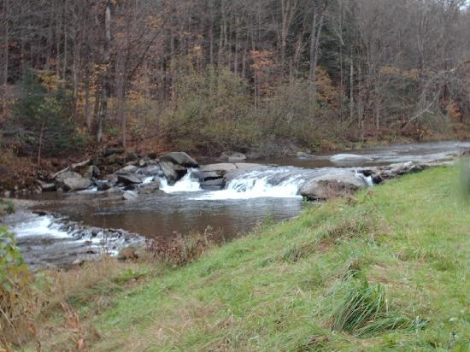
How Far do we go?
Paul is concerned that our commit to God is only skin deep; meaning, we only apply the law to our outward life. This is the ‘letter’ of the law. This is Pharisaical righteousness. While we may appear outwardly righteous to others, what is on the inside where it matters most? “For I say unto you, That except your righteousness shall exceed the righteousness of the scribes and Pharisees, ye shall in no case enter into the kingdom of heaven.” Matthew 5:20

Slide 12
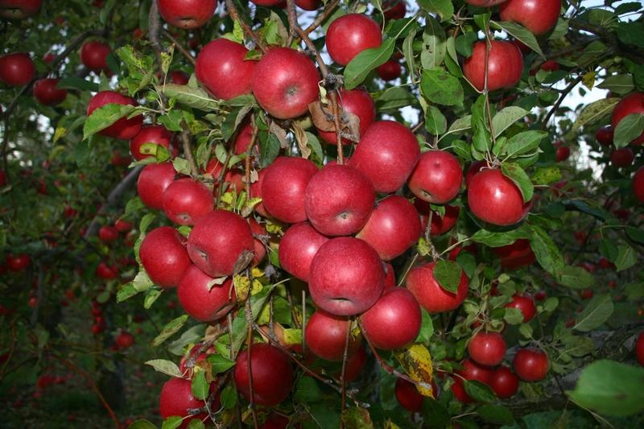
Well?
“Woe unto you, scribes and Pharisees, hypocrites! for ye are like unto whited sepulchres, which indeed appear beautiful outward, but are within full of dead men's bones, and of all uncleanness. Even so ye also outwardly appear righteous unto men, but within ye are full of hypocrisy and iniquity.” Matthew 23:27,28

Slide 13
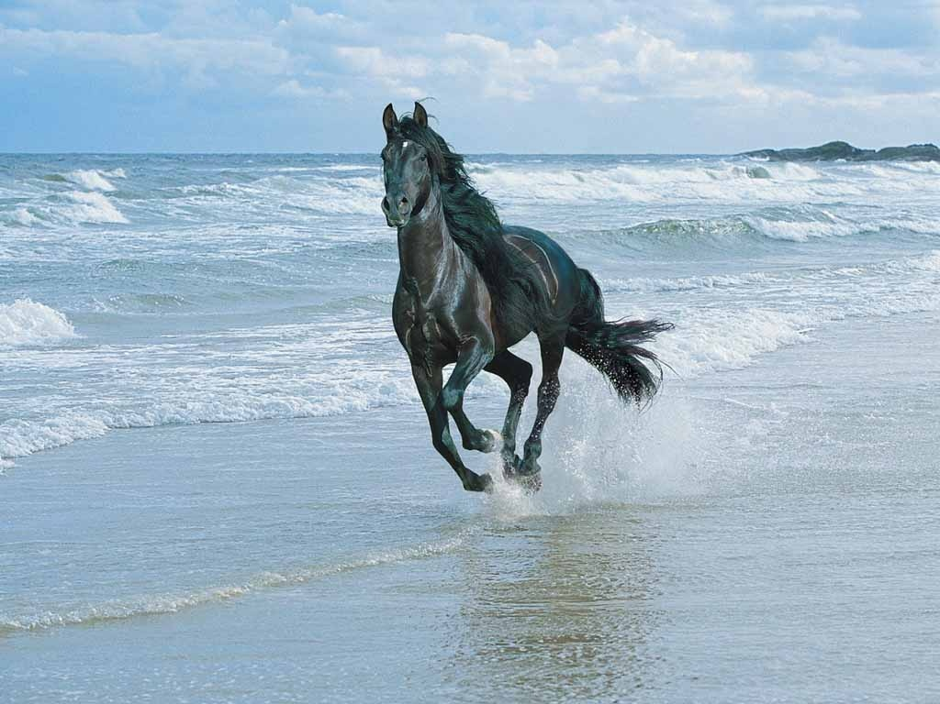
How is it with Us?
“Behold, thou desirest truth in the inward parts: and in the hidden part thou shalt make me to know wisdom. Purge me with hyssop, and I shall be clean: wash me, and I shall be whiter than snow. Make me to hear joy and gladness; that the bones which thou hast broken may rejoice. Hide thy face from my sins, and blot out all mine iniquities. Create in me a clean heart, O God; and renew a right spirit within me.” Psalm 51:6-10 God wants to reign within; He wants to be Master of our minds! How we have dishonored Him within while our outward appearance seems so righteous!

Slide 14
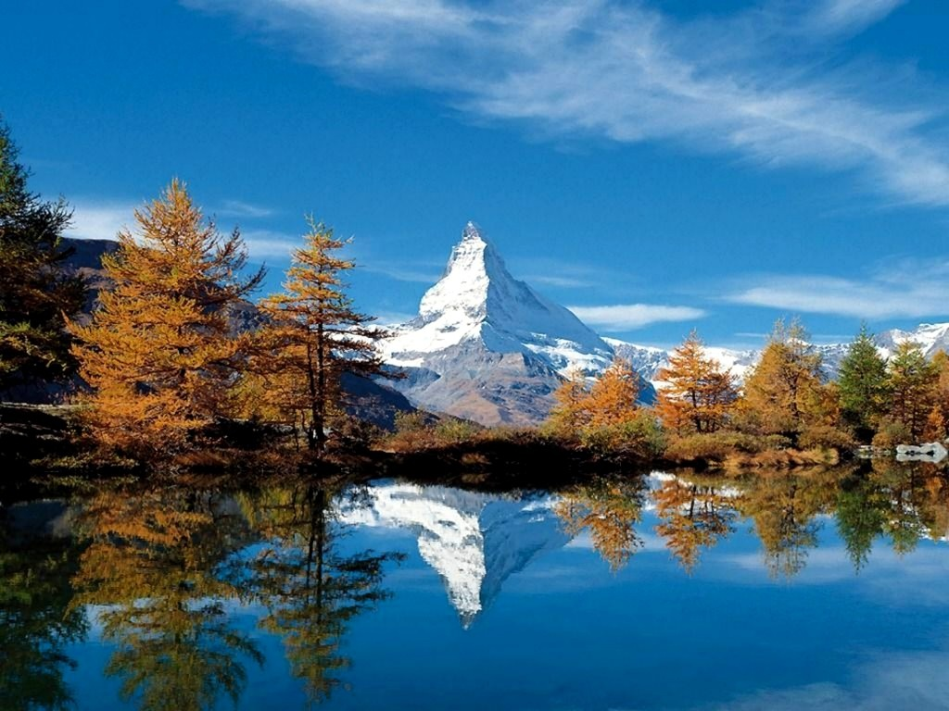
Not a One
All of us have brought dishonor to God by our disobedience, by our outward conformity to the letter of the law, but by our breaking the law within. When we break God’s law within, we will eventually break it by action! We have all brought pain and grief to God. “All we like sheep have gone astray; we have turned every one to his own way;” Isaiah 53:6

Slide 15
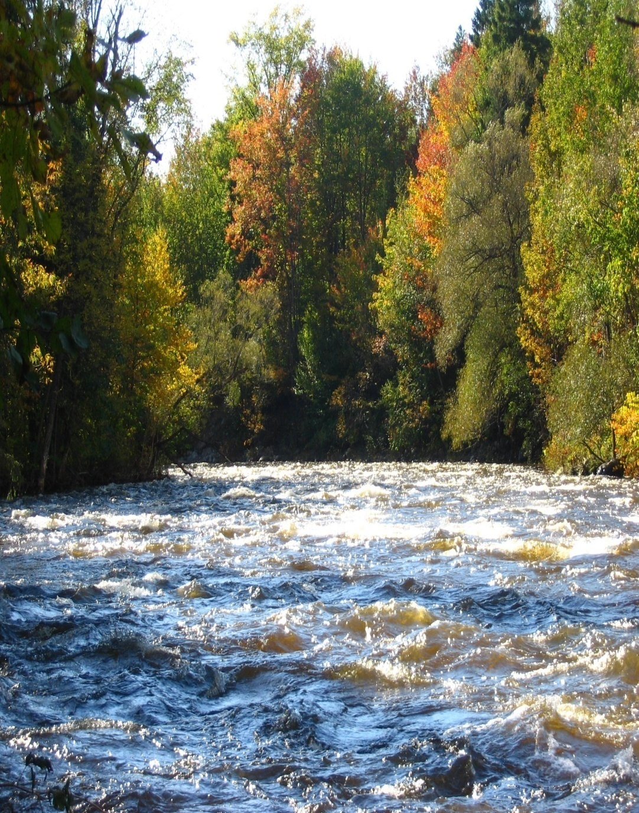
Romans 2:25-29
“For circumcision verily profiteth, if thou keep the law: but if thou be a breaker of the law, thy circumcision is made uncircumcision.
Therefore if the uncircumcision keep the righteousness of the law, shall not his uncircumcision be counted for circumcision? And shall not uncircumcision which is by nature, if it fulfill the law, judge thee, who by the letter and circumcision dost transgress the law? For he is not a Jew, which is one outwardly; neither is that circumcision, which is outward in the flesh: But he is a Jew, which is one inwardly; and circumcision is that of the heart, in the spirit, and not in the letter; whose praise is not of men, but of God.”
The Jews had their sign. What is ours?

Slide 16
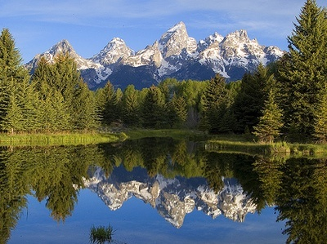
Outward Sign
Outward acts of piety are good, but never as a replacement for inward purity and submission. Circumcision was good, in itself, but never as anything but a sign.
“And the LORD thy God will circumcise thine heart, and the heart of thy seed, to love the LORD thy God with all thine heart, and with all thy soul, that thou mayest live.” Deut. 30:6

Slide 17
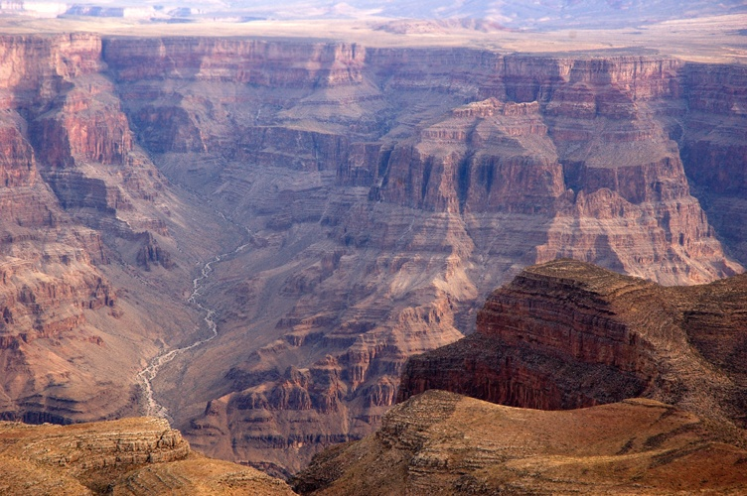
Can’t Produce Righteousness
An outward act of conformity to God’s requirements can never produce right doing. Some hope that a religious rite performed somehow makes one righteous; it never can. It never produces anything; it simply represents what is being professed in the life inside.

Slide 18

What Signs Do
Signs declare what is happening on the inside. A sign that says, “Shoes For Sale” tells us that inside the store are shoes for purchase. What if we went inside and there were no shoes? The sign on the store front would be a sham and joke. Same with circumcision and the Sabbath.

Slide 19
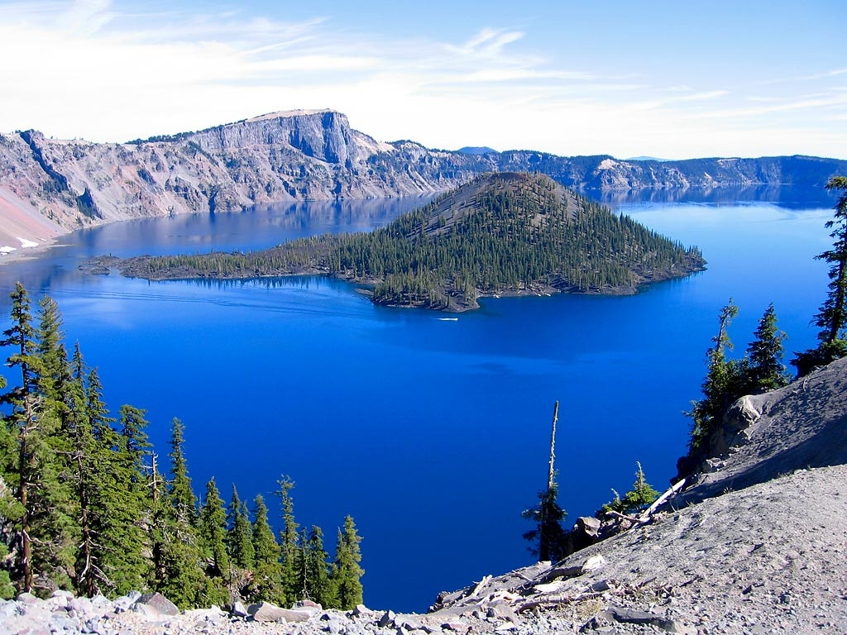
Anything that is Really Real
What is real is revealed solely by what is within. The outward acts simply affirm what is inside. But if the outward acts are there, but what is inside is lacking, the outward acts eventually die away.
“Wherewith shall I come before the LORD, and bow myself before the high God? shall I come before him with burnt offerings, with calves of a year old? Will the LORD be pleased with thousands of rams, or with ten thousands of rivers of oil? shall I give my firstborn for my transgression, the fruit of my body for the sin of my soul? He hath shewed thee, O man, what is good; and what doth the LORD require of thee, but to do justly, and to love mercy, and to walk humbly with thy God?” Micah 6:6-8

Slide 20
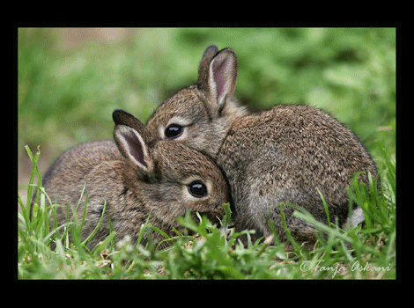
A Real Jew
“But he is a Jew, which is one inwardly; and circumcision is that of the heart, in the spirit, and not in the letter; whose praise is not of men, but of God.” Rom. 2:29

Slide 21
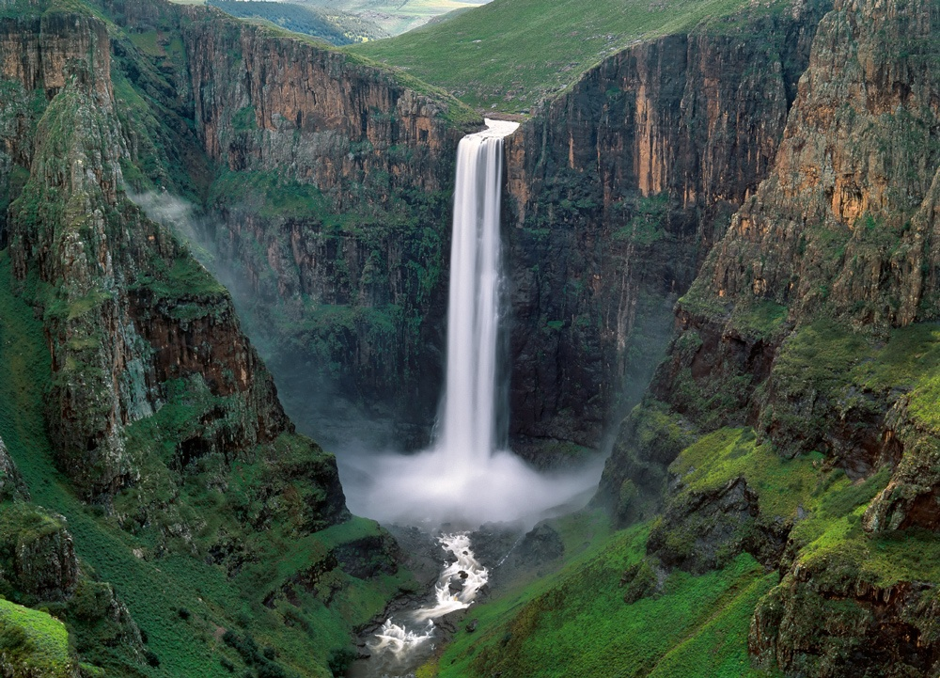
A Sign
“And he received the sign of circumcision, a seal of the righteousness of the faith which he had yet being uncircumcised: that he might be the father of all them that believe, though they be not circumcised; that righteousness might be imputed unto them also:” Romans 4:11

Slide 22
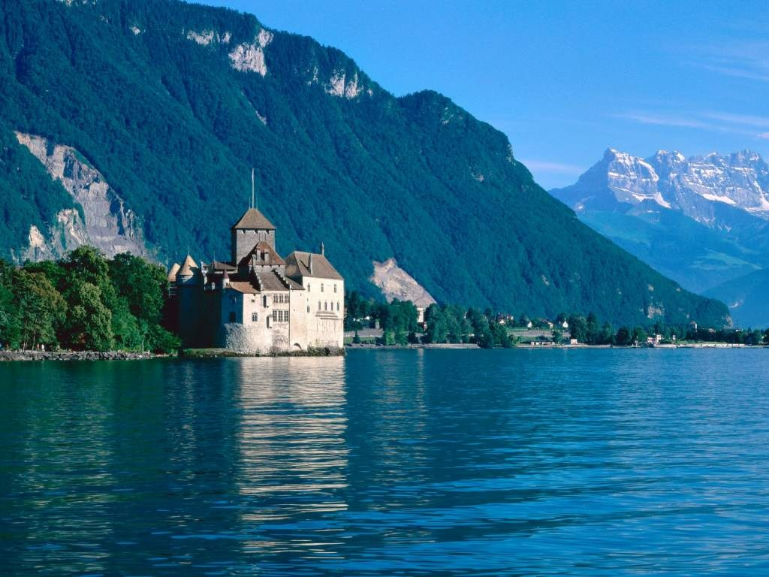
The Sign Today
“Moreover also I gave them my sabbaths, to be a sign between me and them, that they might know that I am the LORD that sanctify them.” Ezekiel 20:12
“Speak thou also unto the children of Israel, saying, Verily my sabbaths ye shall keep: for it is a sign between me and you throughout your generations; that ye may know that I am the LORD that doth sanctify you.” Exodus 31:13

Slide 23
Christ Within
“To whom God would make known what is the riches of the glory of this mystery among the Gentiles; which is Christ in you, the hope of glory.” Colossians 1:27
“That He would grant you, according to the riches of His glory, to be strengthened with might by His Spirit in the inner man; that Christ may dwell in your heart by faith….” Ephesians 3:16,17

